Slide 1
Class 21: Thurs 10 Apr 2025
Copyright Spring 2025
Moral Rights; Droite de Suite
Randal C. Picker
James Parker Hall Distinguished Service Professor of Law
The Law School
The University of Chicago

Slide 2
Berne Convention
WIPO

Slide 3
Article 6^{bis}
Berne Convention

Slide 4
1990 Statute
Pub. L. 101-650 (1 Dec 1990)

Slide 5
Visual Artists Rights Act of 1990
Pub. L. 101-650 (1 Dec 1990)

Slide 6
VARA Legis History
H.R. 101-514 (1 June 1990)

Slide 7
Implementing Berne?
H.R. 101-514 (1 June 1990)

Slide 8
To Be(rne) or Not To Be(rne)
H.R. 101-514 (1 June 1990)

Slide 9
Not Berne, But Our Own Version
H.R. 101-514 (1 June 1990)

Slide 10
Visual Artists? Movie Directors?
H.R. 101-514 (1 June 1990)

Slide 11
Different Business Models
H.R. 101-514 (1 June 1990)

Slide 12
Multiple Copies v. Single (or Limited) Copies
H.R. 101-514 (1 June 1990)

Slide 13
Rights of Attribution and Integrity
“(a) Rights of Attribution and Integrity. Subject to section 107 and independent of the exclusive rights provided in section 106, the author of a work of visual art—(1) shall have the right—”
17 USC 106A

Slide 14
Sec. 101: “Work of Visual Art”
17 USC 101

Slide 15
Sec. 101: “Work of Visual Art”
17 USC 101

Slide 16
Sec. 106A(a)(1): Attribution
“(a) Rights of Attribution and Integrity. Subject to section 107 and independent of the exclusive rights provided in section 106, the author of a work of visual art—(1) shall have the right—(A) to claim authorship of that work, and (B) to prevent the use of his or her name as the author of any work of visual art which he or she did not create;”
17 USC 106A

Slide 17
Sec. 106A(a)(2): Prevent Use of Name
“(2) shall have the right to prevent the use of his or her name as the author of the work of visual art in the event of a distortion, mutilation, or other modification of the work which would be prejudicial to his or her honor or reputation; and”
17 USC 106A

Slide 18
Sec. 106A(a)(3)(A): Preserve Integrity of the Work
“(3) subject to the limitations set forth in section 113(d), shall have the right—(A) to prevent any intentional distortion, mutilation, or other modification of that work which would be prejudicial to his or her honor or reputation, and any intentional distortion, mutilation, or modification of that work is a violation of that right, and”
17 USC 106A

Slide 19
Sec. 106A(a)(3)(B): Prevent Destruction
“(B) to prevent any destruction of a work of recognized stature, and any intentional or grossly negligent destruction of that work is a violation of that right.”
17 USC 106A

Slide 20
Sec. 106A(b): Author Holds Right
“(b) Scope and Exercise of Rights. Only the author of a work of visual art has the rights conferred by subsection (a) in that work, whether or not the author is the copyright owner. The authors of a joint work of visual art are coowners of the rights conferred by subsection (a) in that work.”
17 USC 106A

Slide 21
Sec. 106A(c)(1): Natural Changes Aren’t Covered
“(c) Exceptions. (1) The modification of a work of visual art which is a result of the passage of time or the inherent nature of the materials is not a distortion, mutilation, or other modification described in subsection (a)(3)(A).”
17 USC 106A

Slide 22
Sec. 106A(c)(2): Conservation; Presentation
“(c) Exceptions. (2) The modification of a work of visual art which is the result of conservation, or of the public presentation, including lighting and placement, of the work is not a destruction, distortion, mutilation, or other modification described in subsection (a)(3) unless the modification is caused by gross negligence.”
17 USC 106A

Slide 23
Sec. 106A(e): Transfer and Waiver
“(e) Transfer and Waiver. (1) The rights conferred by subsection (a) may not be transferred, but those rights may be waived if the author expressly agrees to such waiver in a written instrument signed by the author. Such instrument shall specifically identify the work, and uses of that work, to which the waiver applies, and the waiver shall apply only to the work and uses so identified. … ”
17 USC 106A

Slide 24
VARA Sec. 608
Pub. L. 101-650 (1 Dec 1990)

Slide 25
VARA Sec. 609
Pub. L. 101-650 (1 Dec 1990)

Slide 26
Beneath Sec. 101
17 USC 101

Slide 27
Pollock
TTYN (1 of 4)
Hypo 1
  Jackson Pollock takes a blank canvas and paint and creates the object on the next slide
What is the copyright status of the new object? Do you need to know anything about Pollock’s work process to answer that question?

Slide 28
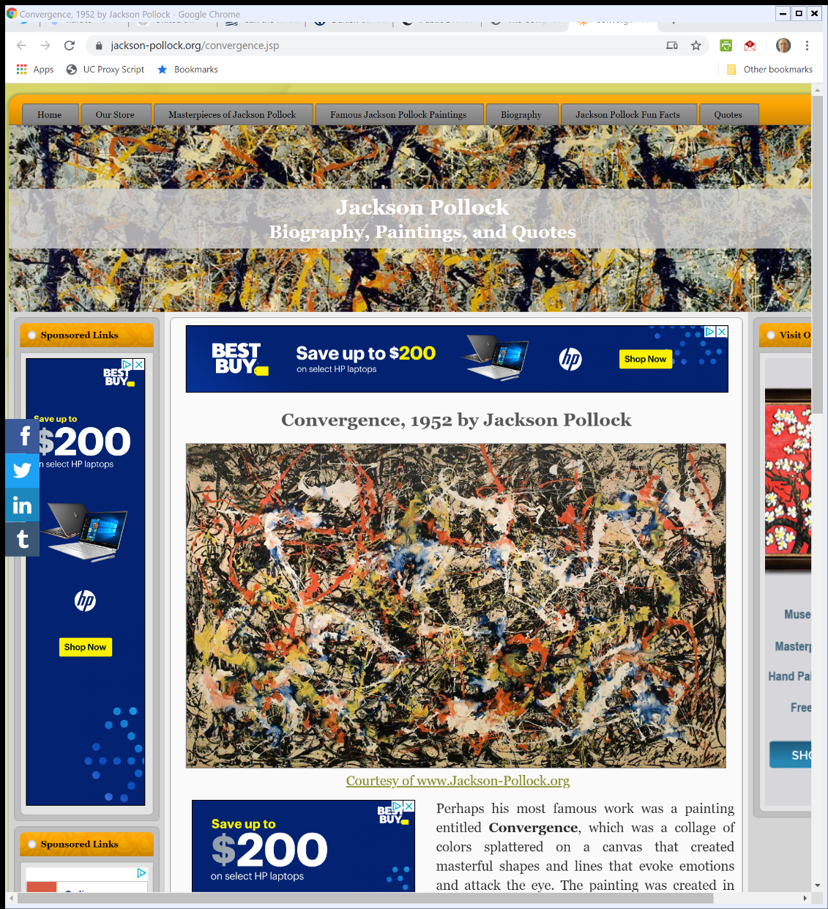

Convergence, 1952 (TTYN (2 of 4))
Jackson-Pollock.org (Visited: 5 Dec 2019)
Notes:
https://www.jackson-pollock.org/convergence.jsp

Slide 29
Pollock
TTYN (3 of 4)
Hypo 2
  I take a canvas and a paintball gun. I put paintballs of different colors into an urn.
  I grab a paintball, aim at a spot on the canvas, and pull the trigger. I do that 10 times.
What is the copyright status of the new object?

Slide 30
Pollock
TTYN (4 of 4)
Hypo 3
  A paintball gun is attached to a robot hand and a computer. A second robotic hand reaches into an urn containing paintballs of different colors
  The computer is programmed to select areas on a canvas and the robot hands grab paintballs and shoot the gun. This happens 10 times.
What is the copyright status of the new object?

Slide 31
Answers
Hypo 1
  Clearly within copyright
Hypo 2
  Probably has enough of a human role to qualify
Hypo 3
  Probably not (but we will run at this no Monday)

Slide 32
Art and Randomization
U.S. Copyright Office Compendium (3rd ed. Jan 2021)

Slide 33
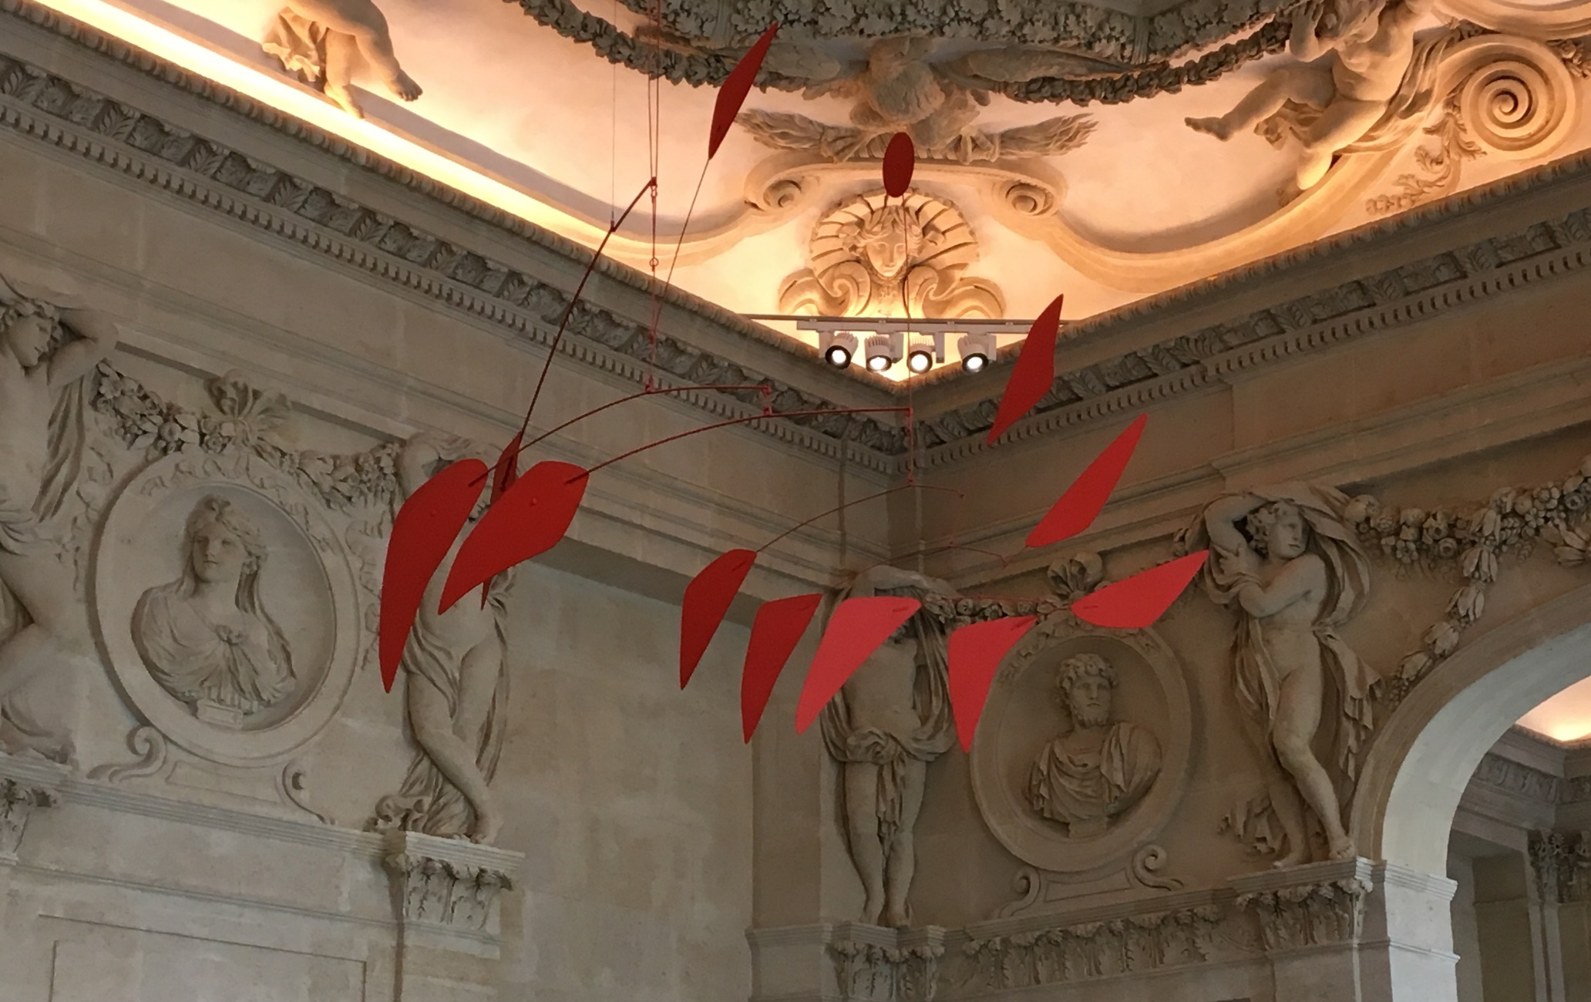
Calder Mobile (TTYN (1 of 4))
Picker Photo, Picasso Museum in Paris (Mar 2019)

Slide 34
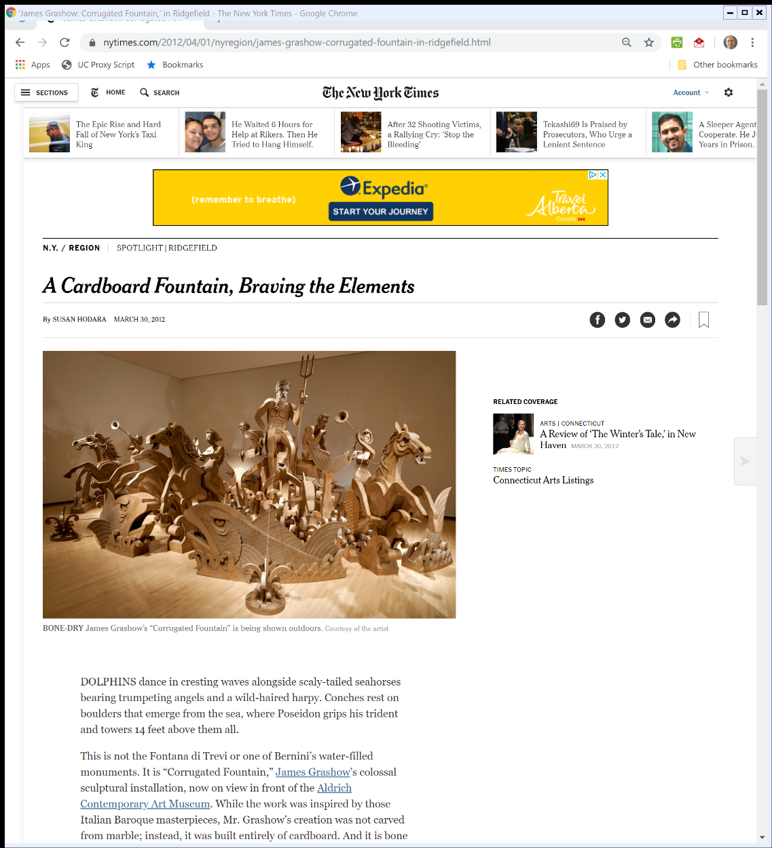

Outdoor Cardboard Sculpture (TTYN (2 of 4))
New York Times (30 Mar 2012)
Notes:
https://www.nytimes.com/2012/04/01/nyregion/james-grashow-corrugated-fountain-in-ridgefield.html

Slide 35
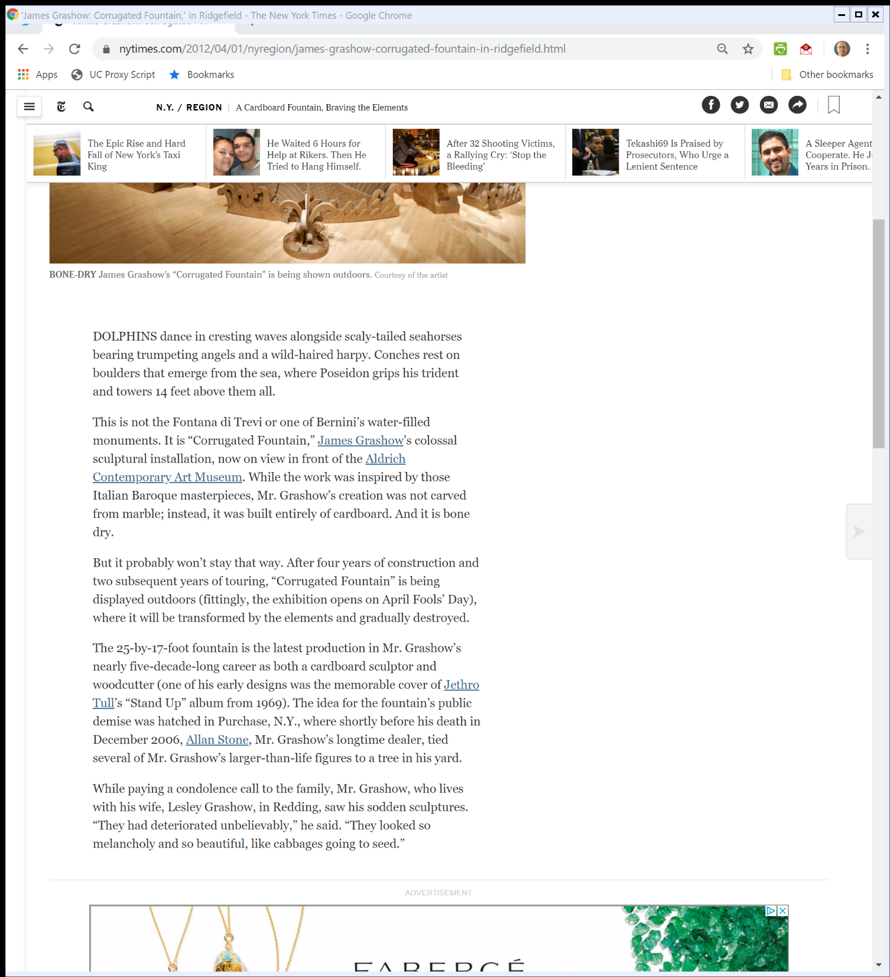
Outdoor Cardboard Sculpture (TTYN (3 of 4))
New York Times (30 Mar 2012)

Slide 36
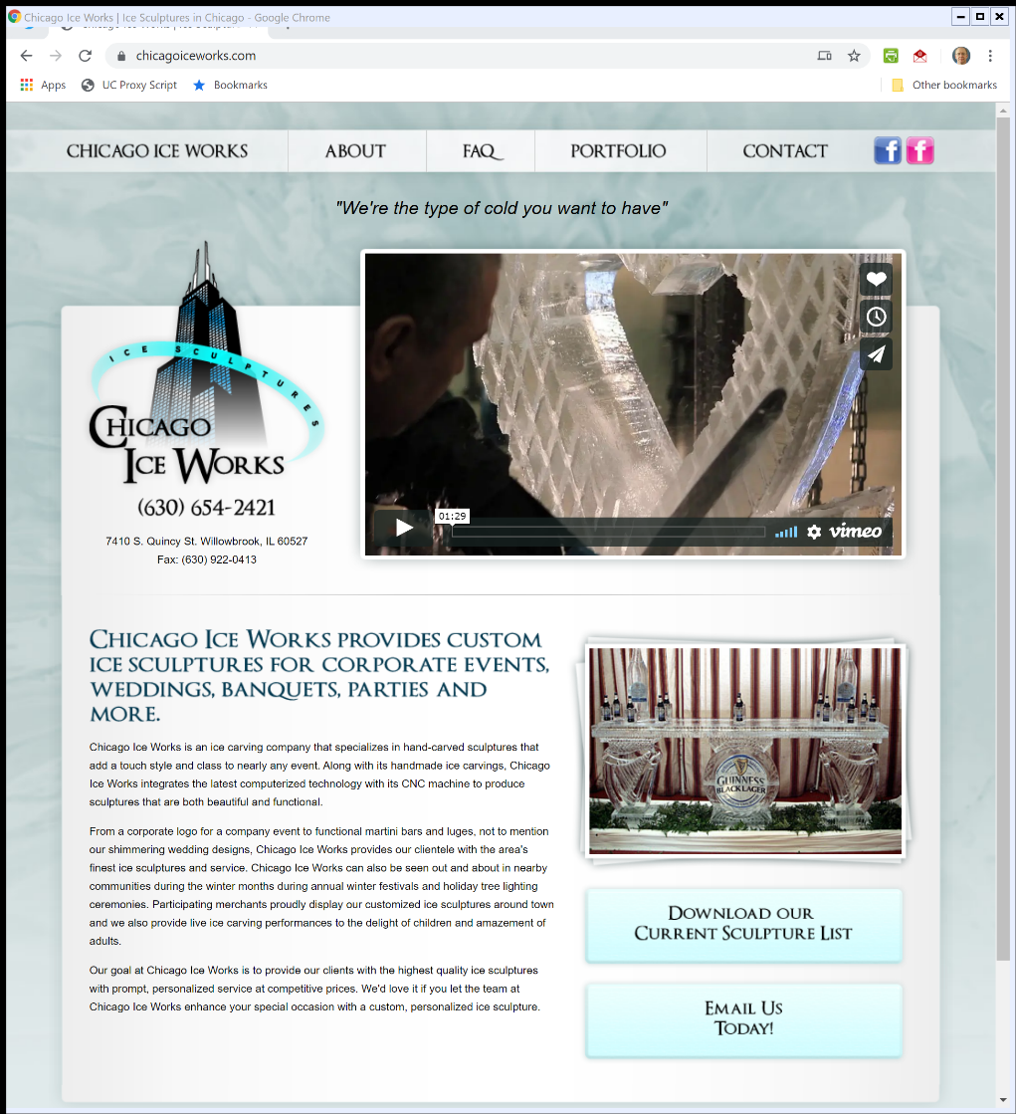

Ice Sculptures (TTYN (4 of 4))
ChicagoIceWorks.com (Visited: 4 Dec 2019)
Notes:
https://chicagoiceworks.com/

Slide 37
Kelly: Applying VARA
635 F.3d 290 (7th Cir. 2011)

Slide 38
“Fixed”
“A work is ‘fixed’ in a tangible medium of expression when its embodiment in a copy or phonorecord, by or under the authority of the author, is sufficiently permanent or stable to permit it to be perceived, reproduced, or otherwise communicated for a period of more than transitory duration. A work consisting of sounds, images, or both, that are being transmitted, is ‘fixed’ for purposes of this title if a fixation of the work is being made simultaneously with its transmission.”
17 USC 101

Slide 39
The Role Played by “Fixed”
H.R. 94-1476 (3 Sept 1976)

Slide 40
The Role Played by “Fixed”
H.R. 94-1476 (3 Sept 1976)

Slide 41
The Role Played by “Fixed”
H.R. 94-1476 (3 Sept 1976)

Slide 42
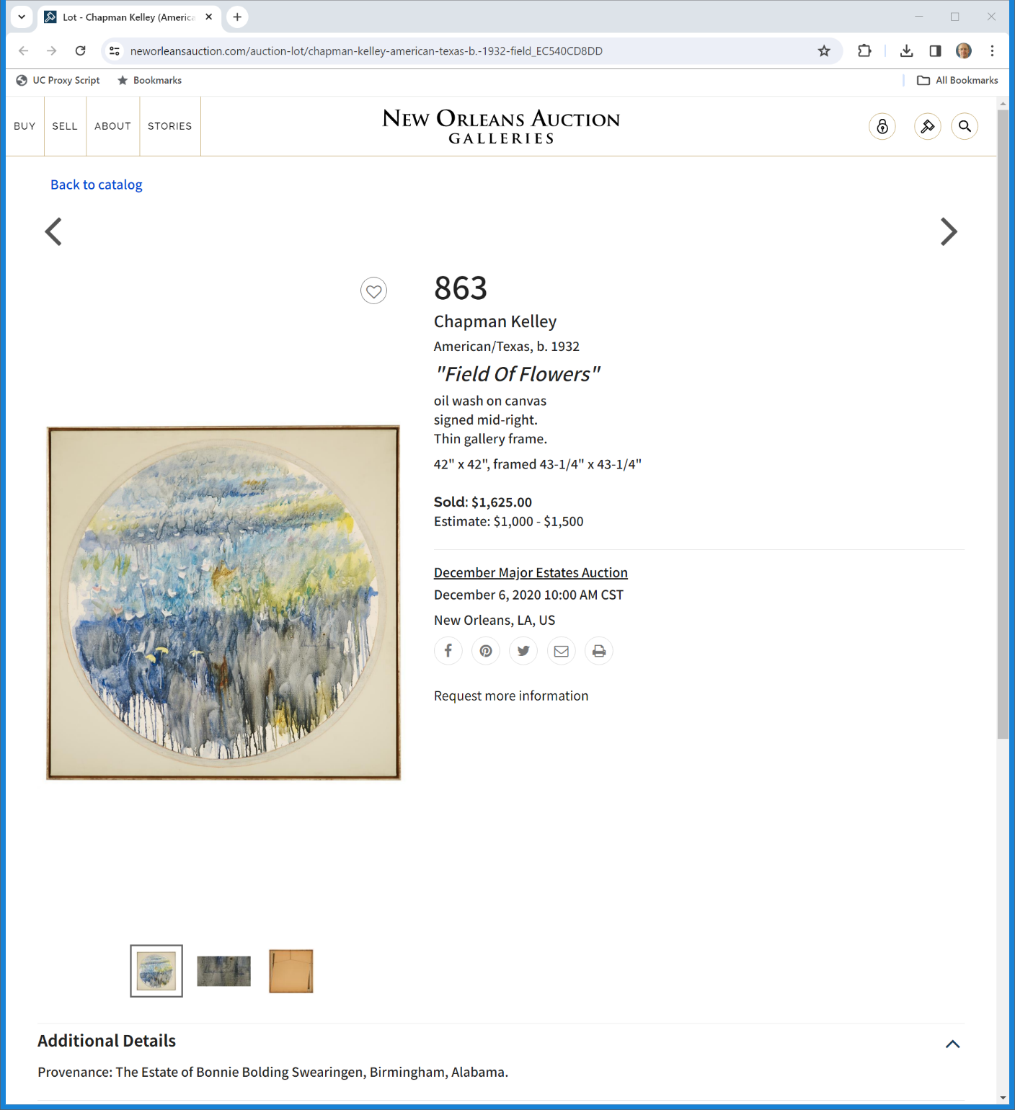

Kelley, Field of Flowers (TTYN (1 of 5))
New Orleans Auction (Visited 28 Nov 2023)
Notes:
https://www.neworleansauction.com/auction-lot/chapman-kelley-american-texas-b.-1932-field_EC540CD8DD

Slide 43
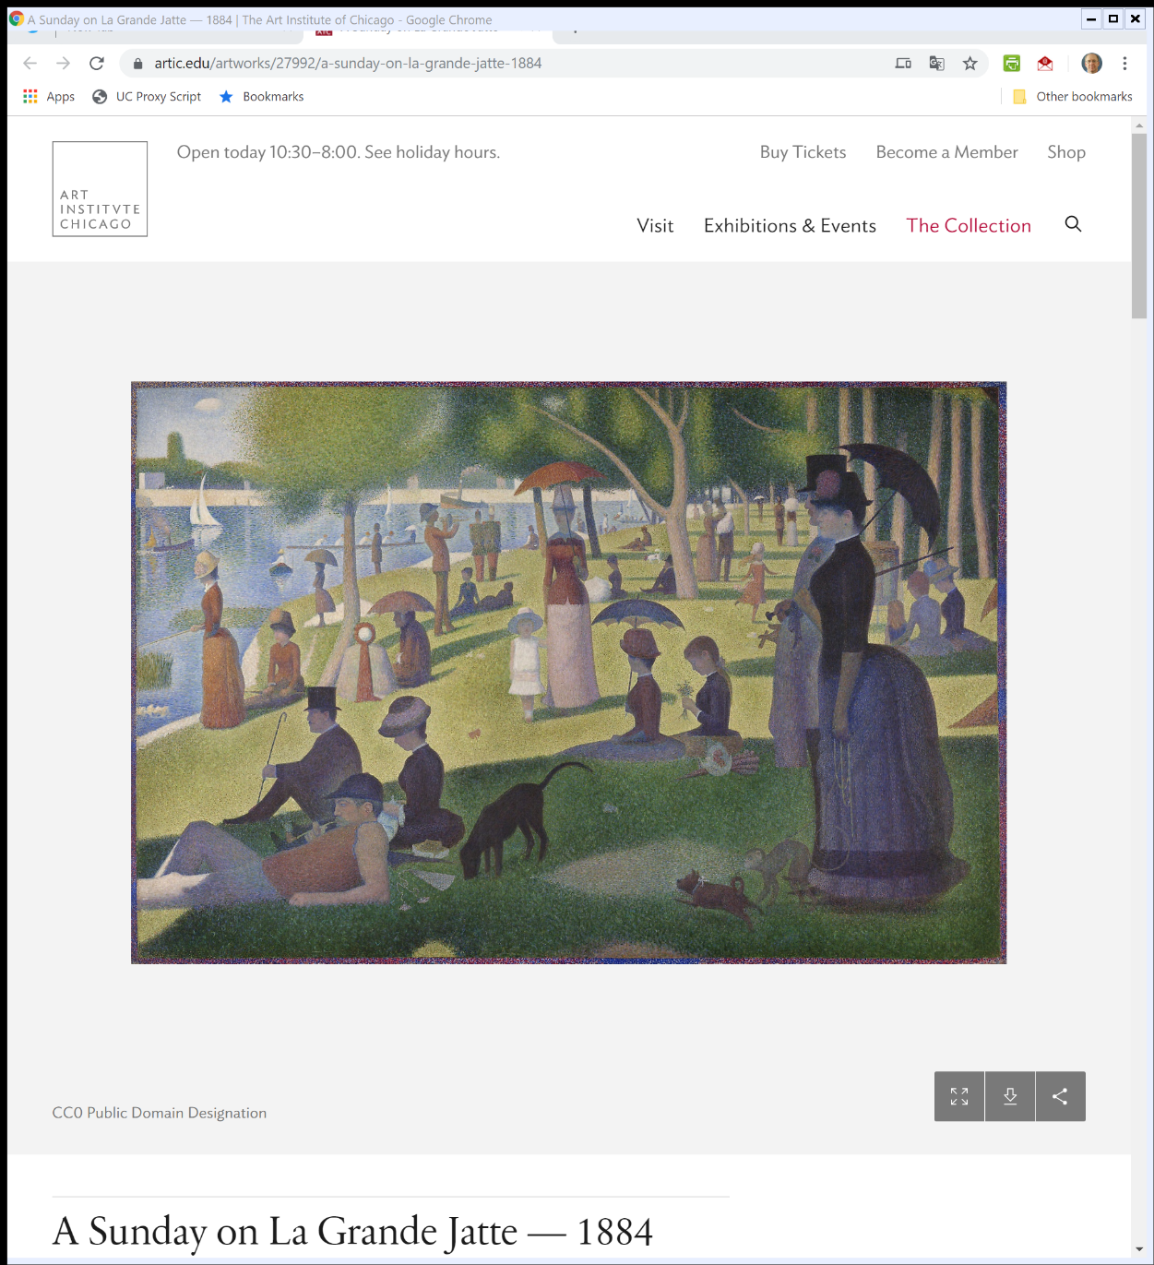

Seurat, A Sunday on La Grande Jatte (1884) (TTYN (2 of 5))
The Art Institute of Chicago (Visited: 5 Dec 2019)
Notes:
https://www.artic.edu/artworks/27992/a-sunday-on-la-grande-jatte-1884

Slide 44
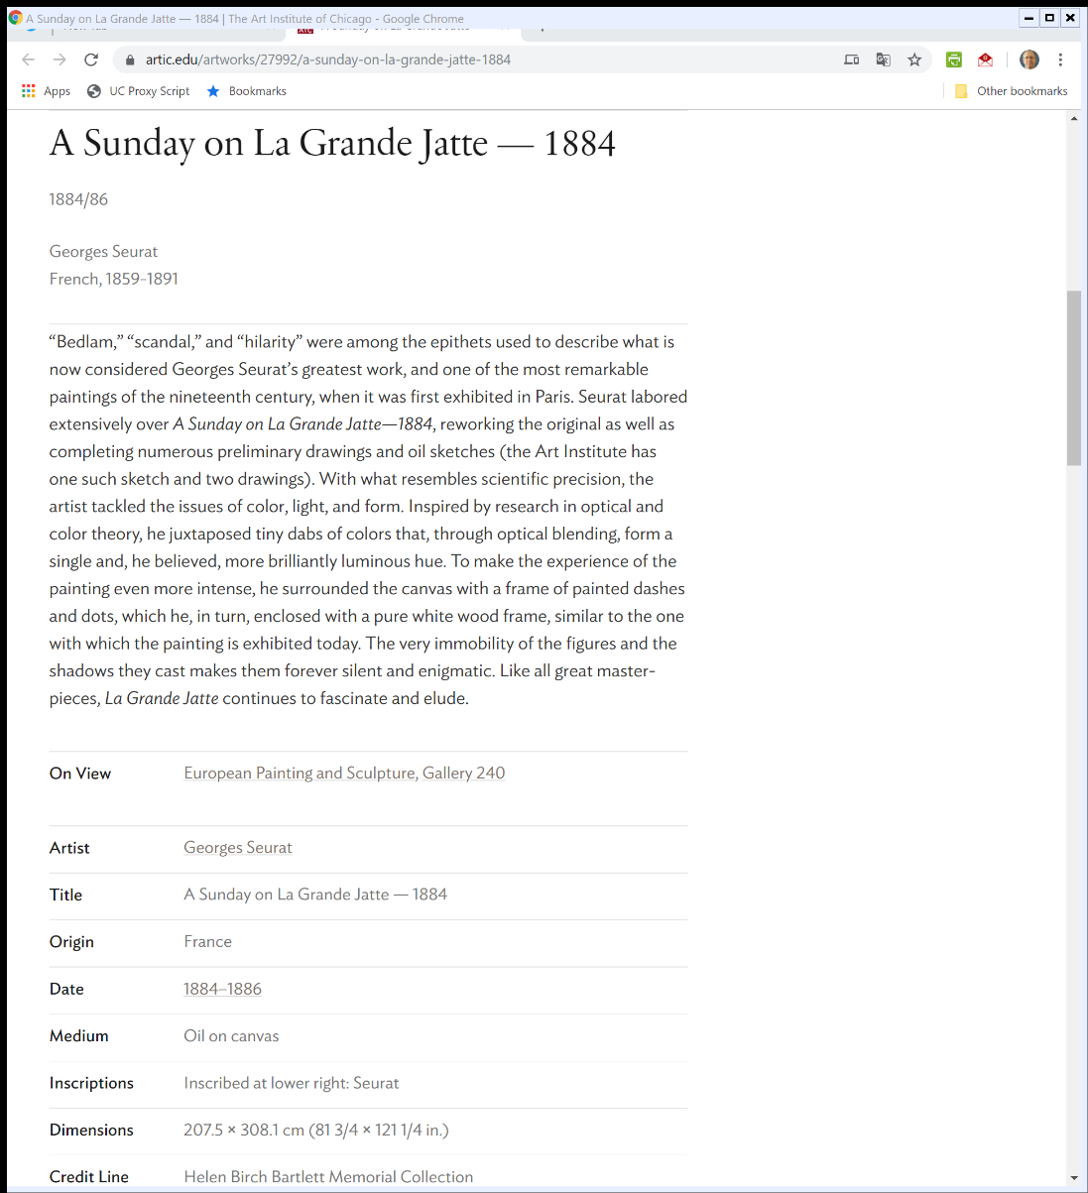
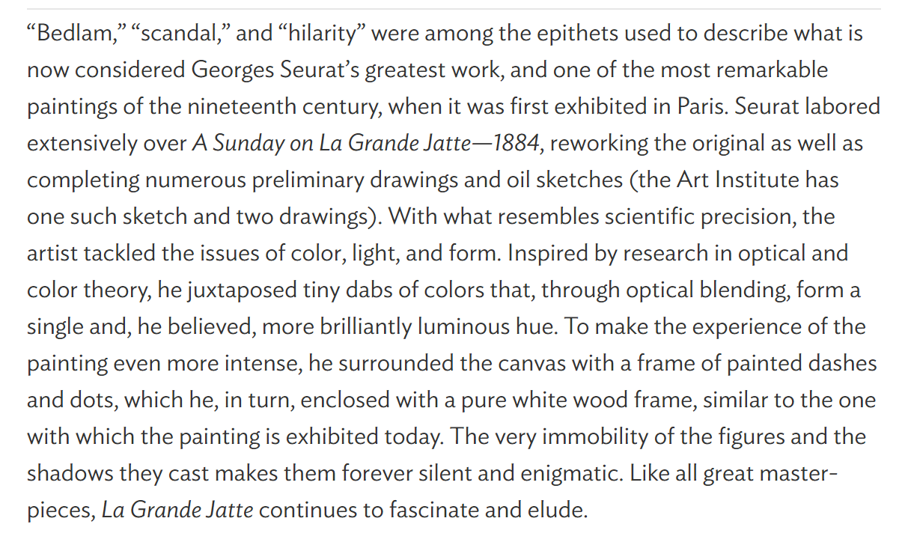
Pointillism: Small Dots, Big Picture (TTYN (3 of 5))
The Art Institute of Chicago (Visited: 5 Dec 2019)
Notes:
https://www.artic.edu/artworks/27992/a-sunday-on-la-grande-jatte-1884

Slide 45
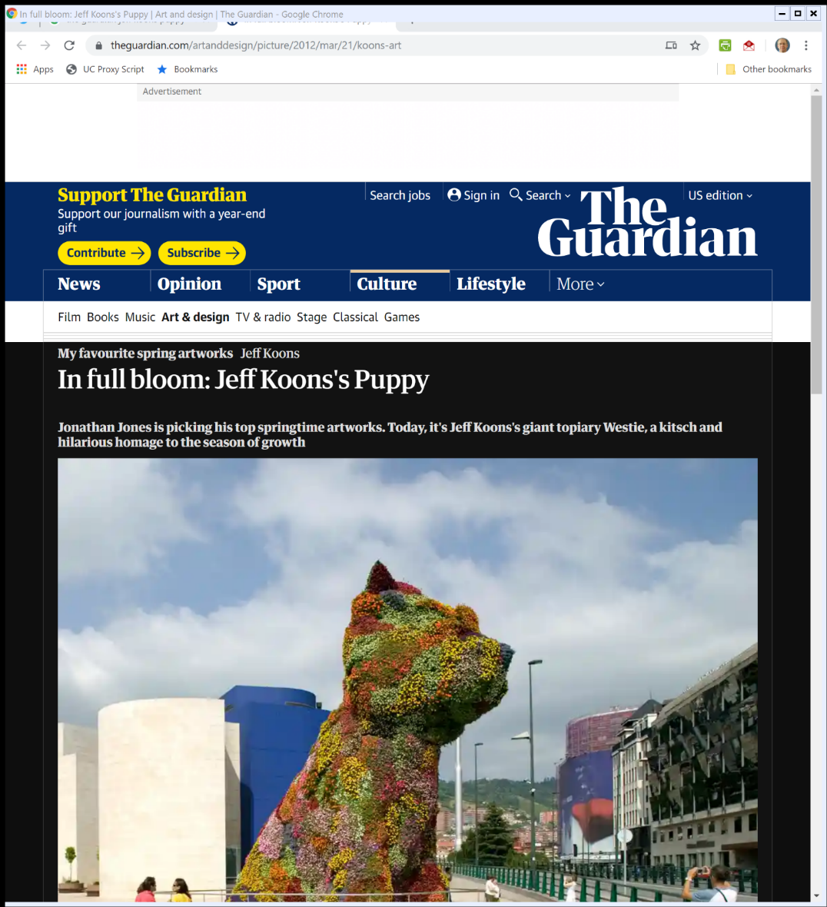
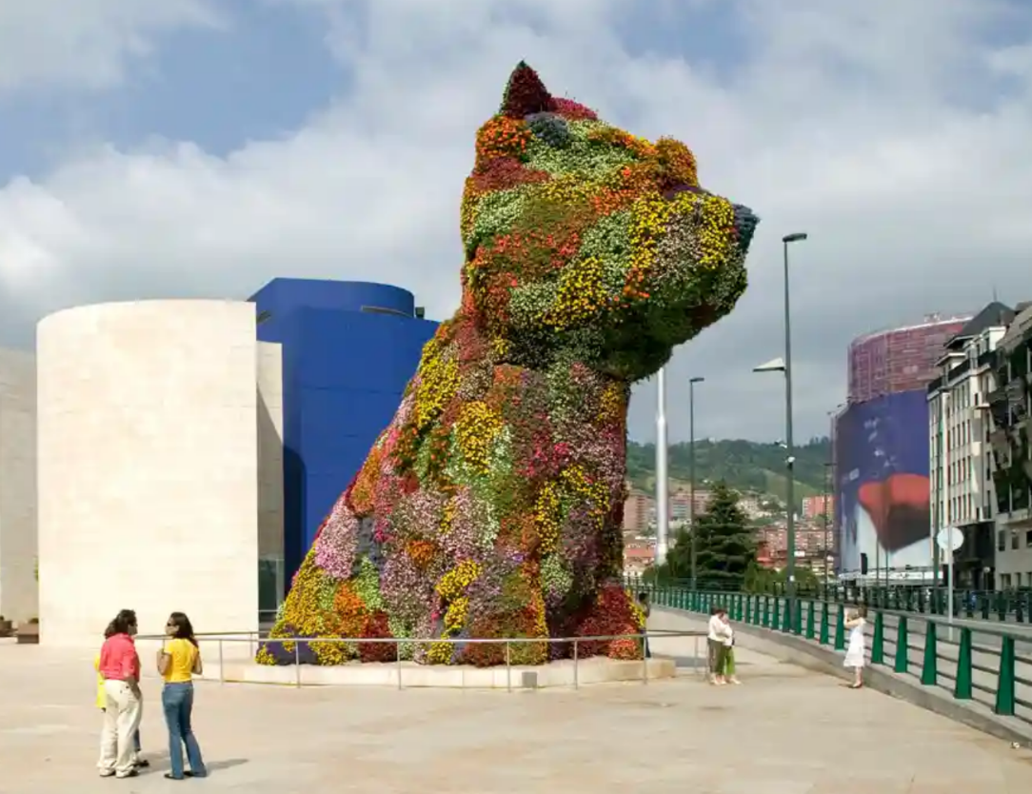
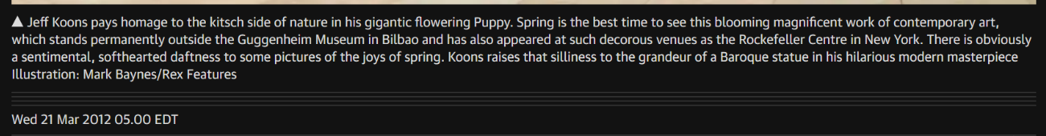
Jeff Koons, Puppy (TTYN (4 of 5))
The Guardian (21 Mar 2012)
Notes:
https://www.theguardian.com/artanddesign/picture/2012/mar/21/koons-art

Slide 46
A New Seurat Creation
TTYN (5 of 5)
Hypo
  Kelley and Seurat switch to fully-bloomed flowers as the building blocks of their works
  They create new works, not as oils on canvas, but in an enormous constructed wooden frame with dirt and flowers
OWA fixed in a TME?

Slide 47
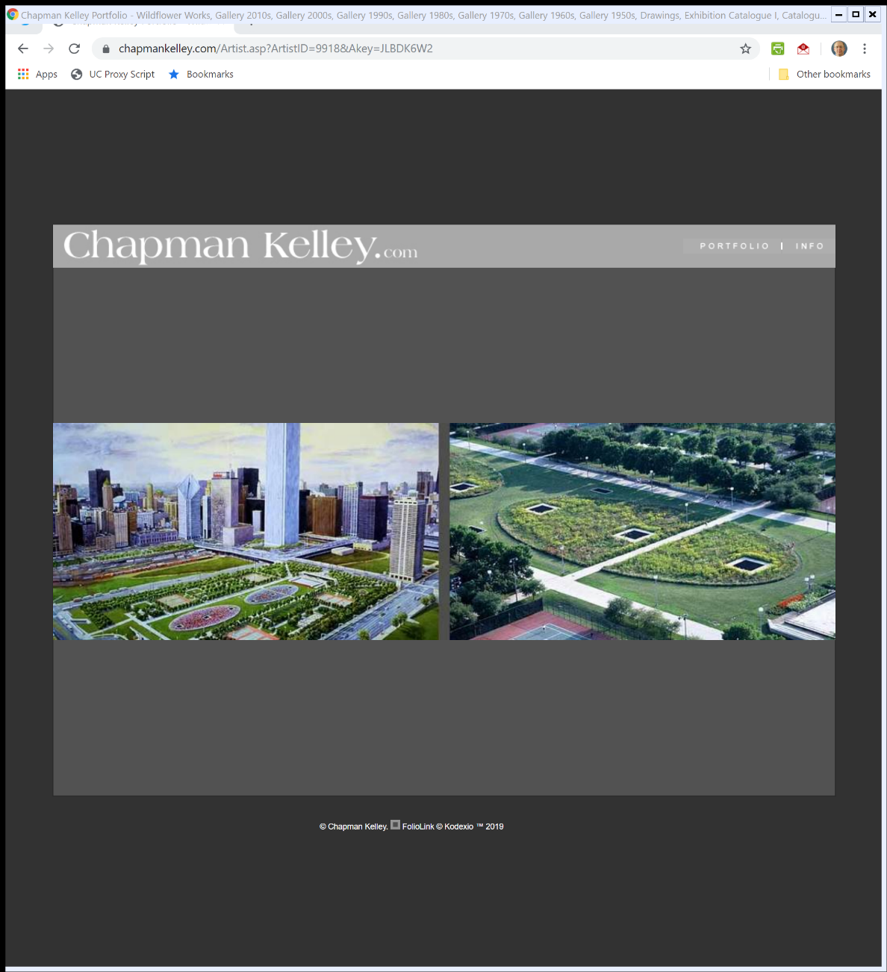
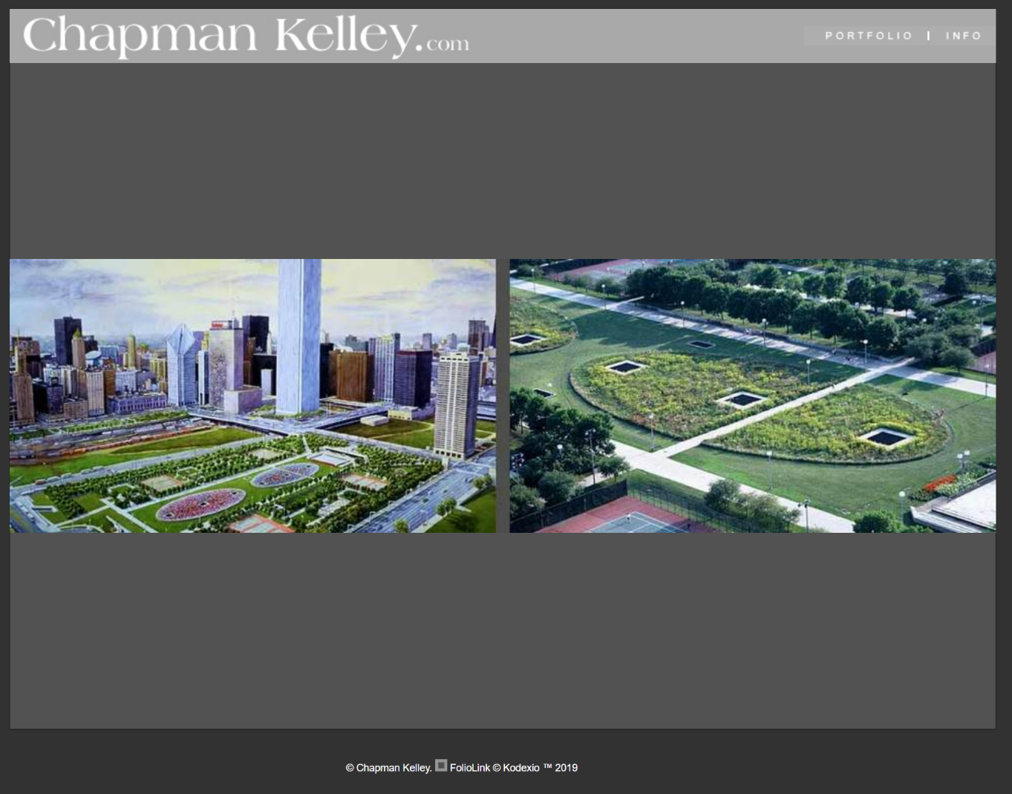
Wildflower Works
Chapmankelley.com (Visited 5 Dec 2019)

Slide 48
Wildflower Works
Kelley (7th Cir. 2011)

Slide 49
Questions re Kelley
Questions
  Is Wildflower Works a painting or a sculpture? What turns on that?
  Is it sufficiently original for copyright protection?
  Sufficiently fixed? Authored?
  Why didn’t the park district get a VARA waiver?

Slide 50
Not Authored, Not Fixed
“In the ordinary copyright case, authorship and fixation are not contested; most works presented for copyright are unambiguously authored and unambiguously fixed. But this is not an ordinary case. A living garden like Wildflower Works is neither ‘authored’ nor ‘fixed’ in the senses required for copyright. … Simply put, gardens are planted and cultivated, not authored.”
Kelley (7th Cir. 2011)

Slide 51
Not a Medium of Expression
“Of course, a human “author”—whether an artist, a professional landscape designer, or an amateur backyard gardener—determines the initial arrangement of the plants in a garden. This is not the kind of authorship required for copyright. To the extent that seeds or seedlings can be considered a “medium of expression,” they originate in nature, and natural forces—not the intellect of the gardener—determine their form, growth, and appearance.”
Kelley (7th Cir. 2011)

Slide 52
“Too Changeable”
“Moreover, a garden is simply too changeable to satisfy the primary purpose of fixation; its appearance is too inherently variable to supply a baseline for determining questions of copyright creation and infringement.”
Kelley (7th Cir. 2011)

Slide 53
Close: The California Droite de Suite and Preemption
894 F.3d 1061 (9th Cir. 2018)

Slide 54
CA Resale Royalties Act
“The California Resale Royalties Act (“CRRA”) grants artists an unwaivable right to 5% of the proceeds on any resale of their artwork under specified circumstances. To that end, the CRRA requires the seller of the artwork or the seller’s agent to withhold 5% of the resale price and pay it to the artist or, if the artist cannot be found, to the California Arts Council. If the seller or the seller’s agent fails to pay the 5% resale royalty, the artist may bring an action for damages.”
Close (9th Cir. 2018)

Slide 55
Sec. 301: Preemption
17 USC 301

Slide 56
Sec. 301: Legis History
H.R. 94-1476 (3 Sept 1976)

Slide 57
Sec. 301: Legis History
H.R. 94-1476 (3 Sept 1976)

Slide 58
Making Art and the Droit de Suite
TTYN (1 of 3)
Hypo
  Artist has produced 10 paintings with current market value each of $10,000
  Artist is considering making a new painting:
    Can expend low effort at cost of $5000 to make a new painting with a market value of $10,000

Slide 59
Making Art and the Droit de Suite
TTYN (2 of 3)
    Alternatively, can expend high effort at cost of $18,000 to make a new painting with a market value of $20,000, but doing that will also raise the value of each of the prior paintings to $20,000

Slide 60
Making Art and the Droit de Suite
TTYN (3 of 3)
Questions
  What do we want Artist to do? What will she do?
  What role might a California-style 5% droit de suite right play here?
  Do we think that this hypo captures anything meaningful about how artists produce new work?

Slide 61
Calif Sales Tax
TTYN (1 of 4)
Hypo 1
  California imposes a 5% sales tax on all sales, including resales of art
  Owner sells painting to second collector and California seeks to collect sales tax
Copyright issues? Is the sales tax preempted by Sec. 301? Does it matter how the proceeds of the tax are used?

Slide 62
Calif Capital Gains Tax
TTYN (2 of 4)
Hypo 2
  California imposes a 5% tax on all capital gains realized from the sale of objects, including resales of art
  Owner sells painting to second collector and California seeks to collect capital gains tax

Slide 63
Calif Capital Gains Tax
TTYN (3 of 4)
Copyright issues? Is the capital gains tax preempted by Sec. 301? Does it matter how the proceeds of the tax are used?

Slide 64
Calif Art Royalty Tax
TTYN (4 of 4)
Hypo 3
  California imposes a 5% royalty tax on all capital gains realized from the sale of of art
  Owner sells painting to second collector and California seeks to collect royalty tax
Copyright issues? Is the royalty tax preempted by Sec. 301? Does it matter how the proceeds of the tax are used?

Slide 65
Post-1976 Claims and Sec. 301 Preemption
“Plaintiffs’ CRRA claims covered by the 1976 Copyright Act—i.e., those concerning sales postdating the 1976 Act’s effective date of January 1, 1978—are expressly preempted by 17 U.S.C. § 301(a).”
Close (9th Cir. 2018)

Slide 66
But Not So For Claims Under 1909 Act
“The 1909 Copyright Act, however, has no express preemption provision. As such, plaintiffs’ CRRA claims covered only by the 1909 Act—i.e., those concerning sales that occurred between the CRRA’s effective date of January 1, 1977, and the 1976 Act’s effective date of January 1, 1978—cannot be expressly preempted. Nor are they preempted by conflict preemption.”
Close (9th Cir. 2018)

Slide 67
Worth More Study
Copyright Office (12 Dec 2013)

