Slide 1
Class 20: Wed 7 May 2025 Copyright Spring 2025 Enforcement and Damages
Randal C. Picker
James Parker Hall Distinguished Service Professor of Law
The Law School
The University of Chicago

Slide 2
Sec. 501: Infringement
“(a) Anyone who violates any of the exclusive rights of the copyright owner as provided by sections 106 through 121 or of the author as provided in section 106A(a), or who imports copies or phonorecords into the United States in violation of section 602, is an infringer of the copyright or right of the author, as the case may be.”
17 USC 501

Slide 3
Sec. 501: Infringement
“(b) The legal or beneficial owner of an exclusive right under a copyright is entitled, subject to the requirements of section 411 [requiring registration before suit], to institute an action for any infringement of that particular right committed while he or she is the owner of it.”
17 USC 501

Slide 4
Possible Remedies
Actions to Manage the Infringement
Sec. 502: Injunctions
Sec. 503: Impounding and destroying
Sec. 509: Seizure and forfeiture

Slide 5
Possible Remedies
Criminal Sanctions
17 USC 506
Title 18, Chapter 113: Stolen Property
18 USC 2319
18 USC 2319A
18 USC 2319B

Slide 6
Sec. 504(a): Actual Damages + Infringer Profits OR Statutory Damages
“(a) In General. Except as otherwise provided by this title, an infringer of copyright is liable for either‑‑(1) the copyright owner’s actual damages and any additional profits of the infringer, as provided by subsection (b); or (2) statutory damages, as provided by subsection (c).”
17 USC 504

Slide 7
Sec. 504(b): Actual Damages
“(b) Actual Damages and Profits. The copyright owner is entitled to recover the actual damages suffered by him or her as a result of the infringement, and any profits of the infringer that are attributable to the infringement and are not taken into account in computing the actual damages.”
17 USC 504

Slide 8
Sec. 504(b): Proving Profits
“In establishing the infringer’s profits, the copyright owner is required to present proof only of the infringer’s gross revenue, and the infringer is required to prove his or her deductible expenses and the elements of profit attributable to factors other than the copyrighted work.”
17 USC 504

Slide 9
Profits and Proof
H. Rep. 94-1476 (3 Sept 1976)

Slide 10
Sec. 504(c): Statutory Damages
“(1) Except as provided by clause (2) of this subsection, the copyright owner may elect, at any time before final judgment is rendered, to recover, instead of actual damages and profits, an award of statutory damages for all infringements involved in the action, with respect to any one work, for which any one infringer is liable individually, or for which any two or more infringers are liable jointly and severally, in a sum of not less than $750 or more than $30,000 as the court considers just. For the purposes of this subsection, all the parts of a compilation or derivative work constitute one work.”
17 USC 504

Slide 11
Sec. 504(c): Willful Infringement; Innocent Infringement
“(2) In a case where the copyright owner sustains the burden of proving, and the court finds, that infringement was committed willfully, the court in its discretion may increase the award of statutory damages to a sum of not more than $150,000. In a case where the infringer sustains the burden of proving, and the court finds, that such infringer was not aware and had no reason to believe that his or her acts constituted an infringement of copyright, the court in its discretion may reduce the award of statutory damages to a sum of not less than $200.”
17 USC 504

Slide 12
1999 Amendments: One Page
Pub. L. 106-160 (9 Dec 1999)

Slide 13
Legislative History
H. Rep. 106-216 (1 July 1999)

Slide 14
Lots of Piracy
H. Rep. 106-216 (1 July 1999)

Slide 15
And More Coming
H. Rep. 106-216 (1 July 1999)

Slide 16
Williams: Statutory Damages and Due Process
251 U.S. 63 (1919)

Slide 17
Penalties and Due Process Under the 14th Amendment
Williams (U.S. 1919)

Slide 18
BMW v. Gore
517 U.S. 559 (1996)

Slide 19
Constitutionally Required Notice
BMW (U.S. 1996)

Slide 20
Three Guideposts for Assessing Punitive Damages
BMW (U.S. 1996)

Slide 21
Not More Than 10 to 1
BMW (U.S. 1996)

Slide 22
No Bright Lines Here
BMW (U.S. 1996)

Slide 23
Sec. 505: Costs and Attorney’s Fees
“In any civil action under this title, the court in its discretion may allow the recovery of full costs by or against any party other than the United States or an officer thereof. Except as otherwise provided by this title, the court may also award a reasonable attorney’s fee to the prevailing party as part of the costs.”
17 USC 505

Slide 24
Sec. 412: Limits on Attorney’s Fees and Statutory Damages
“In any action under this title [selected carve outs], no award of statutory damages or of attorney’s fees, as provided by sections 504 and 505, shall be made for—(1) any infringement of copyright in an unpublished work commenced before the effective date of its registration; or (2) any infringement of copyright commenced after first publication of the work and before the effective date of its registration, unless such registration is made within three months after the first publication of the work.”
17 USC 412

Slide 25
Bouchat: Measuring Profits Under Sec. 504
346 F.3d 514 (4th Cir. 2003)

Slide 26


Buying Ravens Merch
Shop.baltimoreraves.com (Visited 13 Nov 2019)

Slide 27
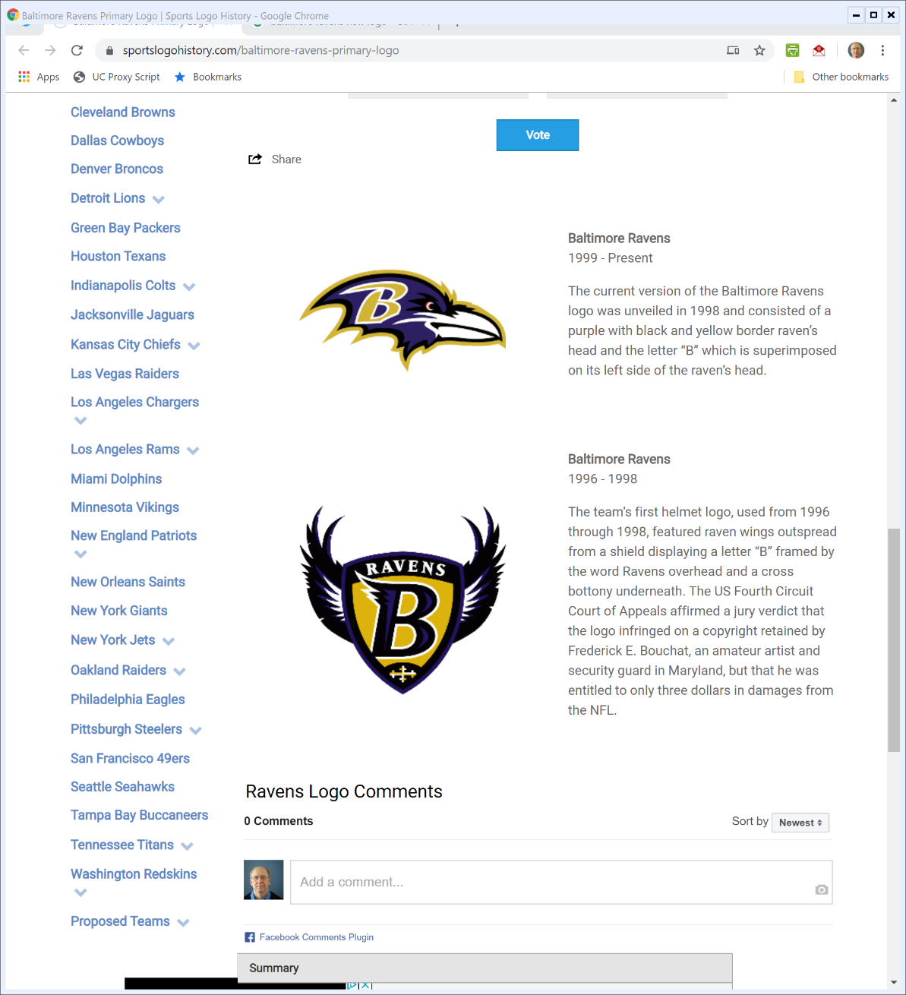
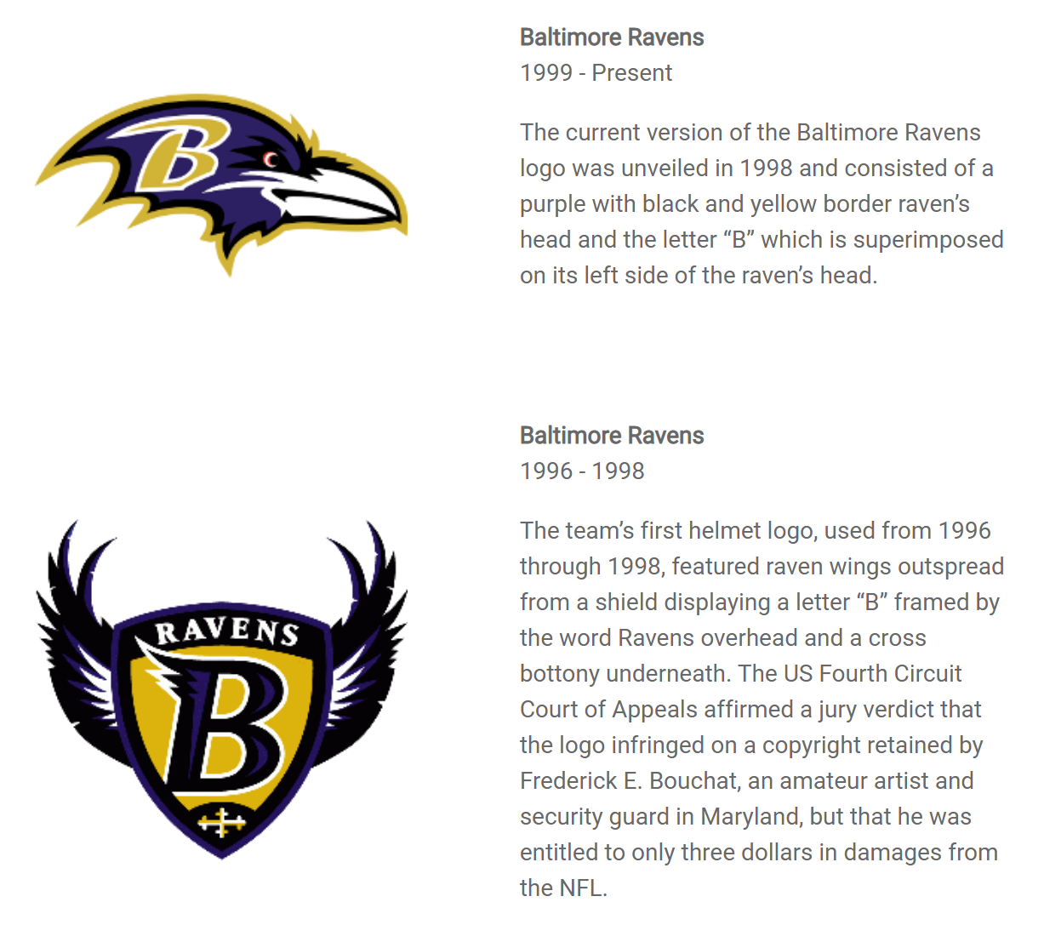
Logo Switch by Ravens
Sportslogohistory.com (Visited 13 Nov 2019))
Notes:
https://sportslogohistory.com/baltimore-ravens-primary-logo

Slide 28
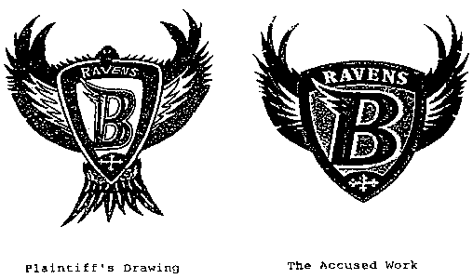
Bouchat: The Pictures
TTYN (1 of 3)

Slide 29
Infringement in Bouchat
TTYN (2 of 3)
Questions
There is a claim that one image infringes the copyright held in the other image
Do you think that you can assess the question of infringement by looking at the images? What more would you like to know to assess that?

Slide 30
Assessing Damages in Bouchat
TTYN (3 of 3)
Questions
Assuming that you find infringement, how should we apply Sections 501 to 505?
Should Bouchat get a letter and a signed helmet? $10M? Is this a good case to apply statutory damages?

Slide 31
Big Chunks of Revenues Taken Off of the Table
“Because Bouchat failed to offer any nonspeculative evidence demonstrating the existence of a genuine dispute of material fact, the court appropriately awarded summary judgment to the Defendants on the ground that the Non-Merchandise Revenues and the revenues from trading cards, video games, and game programs could not reasonably be found attributable to the infringement.”
Bouchat (4th Cir. 2003)

Slide 32
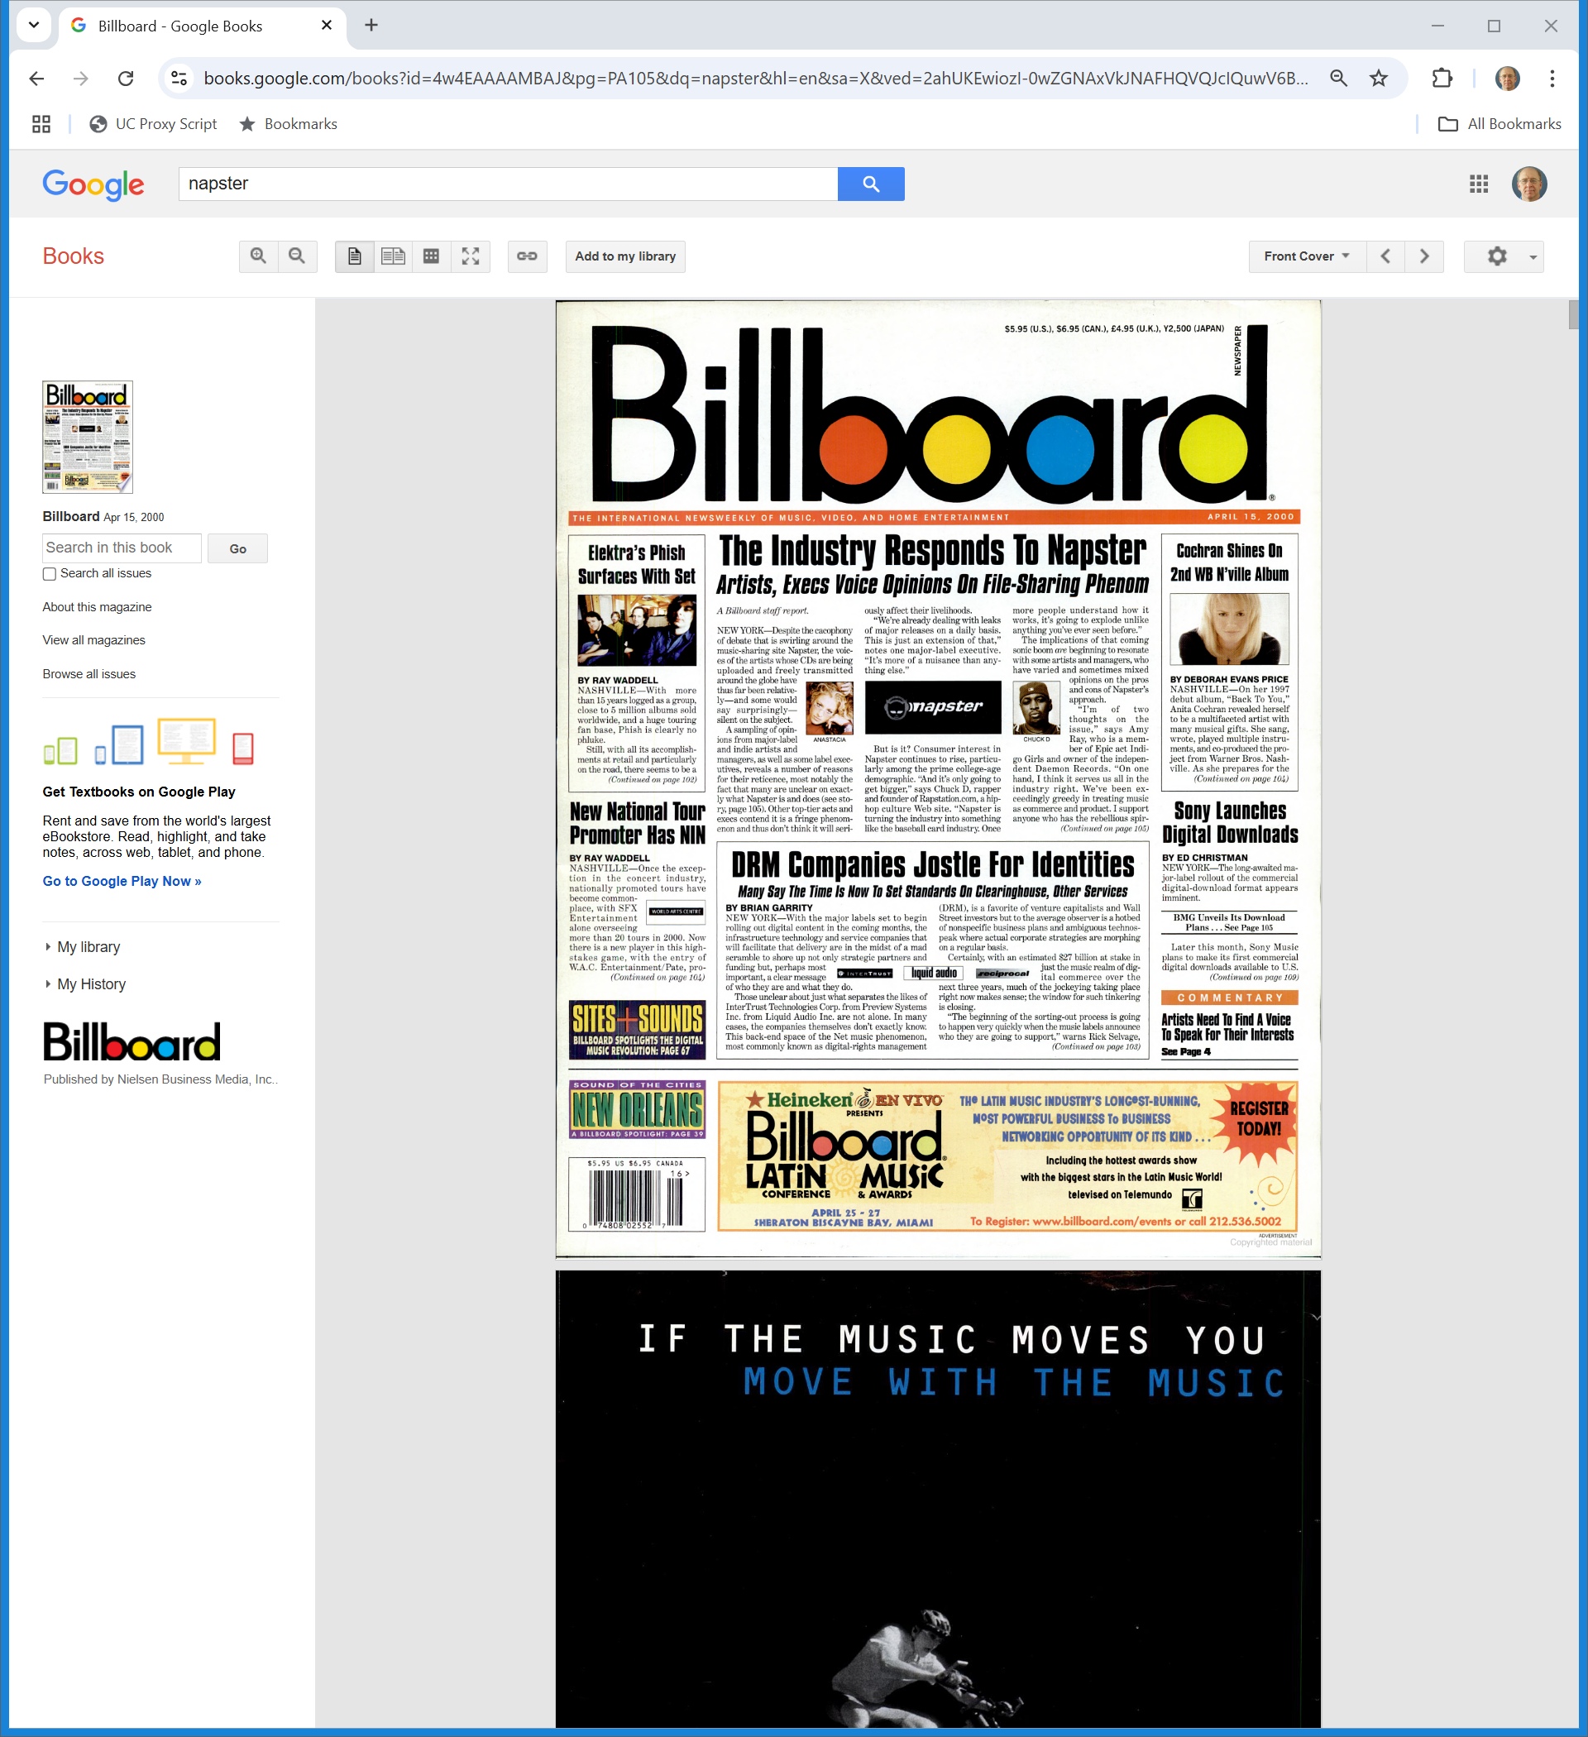
Tech and Music
Billboard (15 Apr 2000)
Notes:
https://books.google.com/books?id=4w4EAAAAMBAJ&pg=PA105&dq=napster&hl=en&sa=X&ved=2ahUKEwiozI-0wZGNAxVkJNAFHQVQJcIQuwV6BAgJEAc#v=onepage&q&f=false

Slide 33
Digital Downloads
Billboard (15 Apr 2000)
Notes:
https://books.google.com/books?id=4w4EAAAAMBAJ&pg=PA105&dq=napster&hl=en&sa=X&ved=2ahUKEwiozI-0wZGNAxVkJNAFHQVQJcIQuwV6BAgJEAc#v=onepage&q&f=false

Slide 34
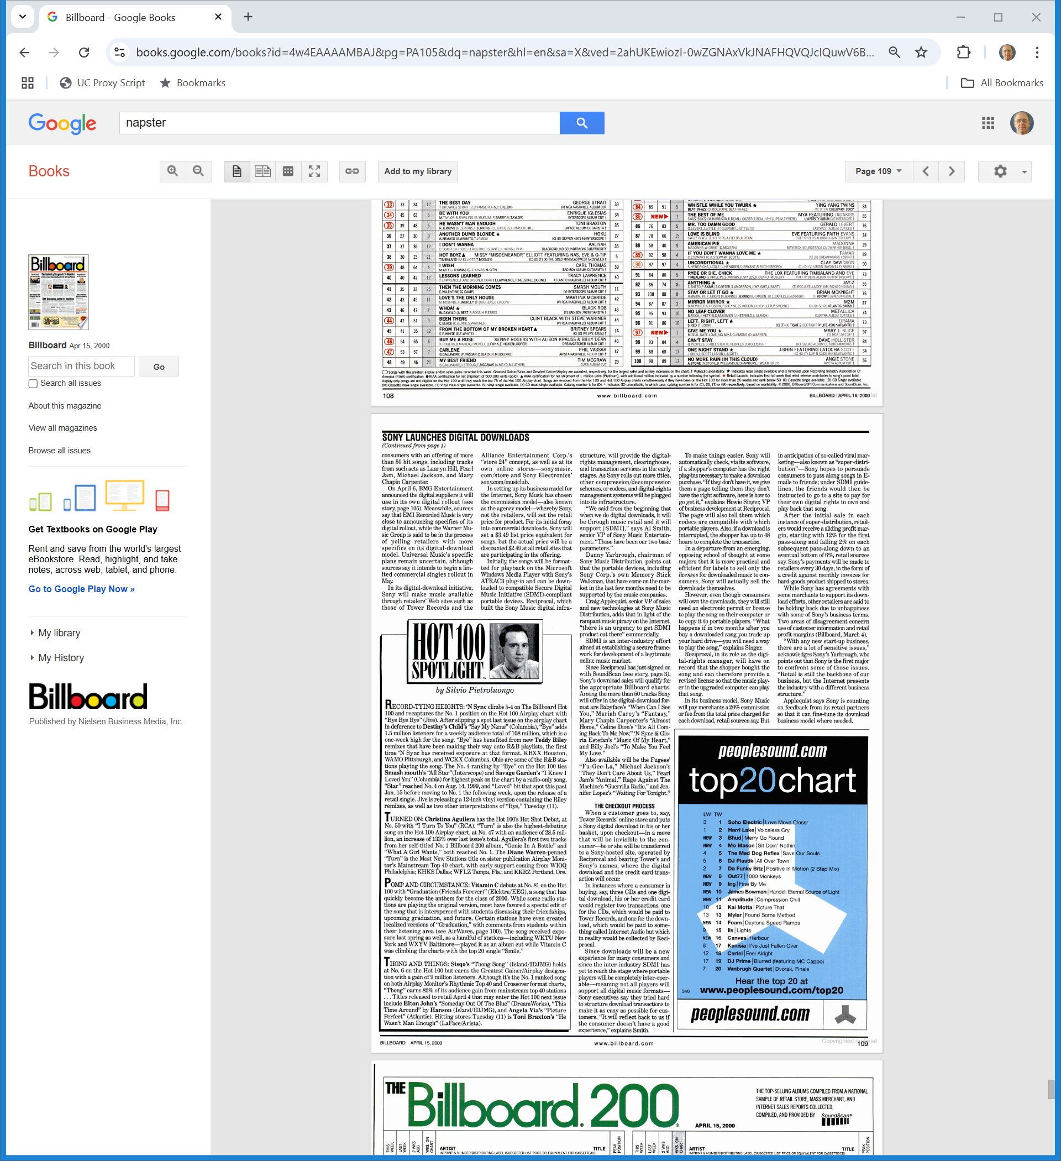
Infrastructure
Billboard (15 Apr 2000)
Notes:
https://books.google.com/books?id=4w4EAAAAMBAJ&pg=PA105&dq=napster&hl=en&sa=X&ved=2ahUKEwiozI-0wZGNAxVkJNAFHQVQJcIQuwV6BAgJEAc#v=onepage&q&f=false

Slide 35
DRM: Locks and Keys
Billboard (15 Apr 2000)
Notes:
https://books.google.com/books?id=4w4EAAAAMBAJ&pg=PA105&dq=napster&hl=en&sa=X&ved=2ahUKEwiozI-0wZGNAxVkJNAFHQVQJcIQuwV6BAgJEAc#v=onepage&q&f=false

Slide 36
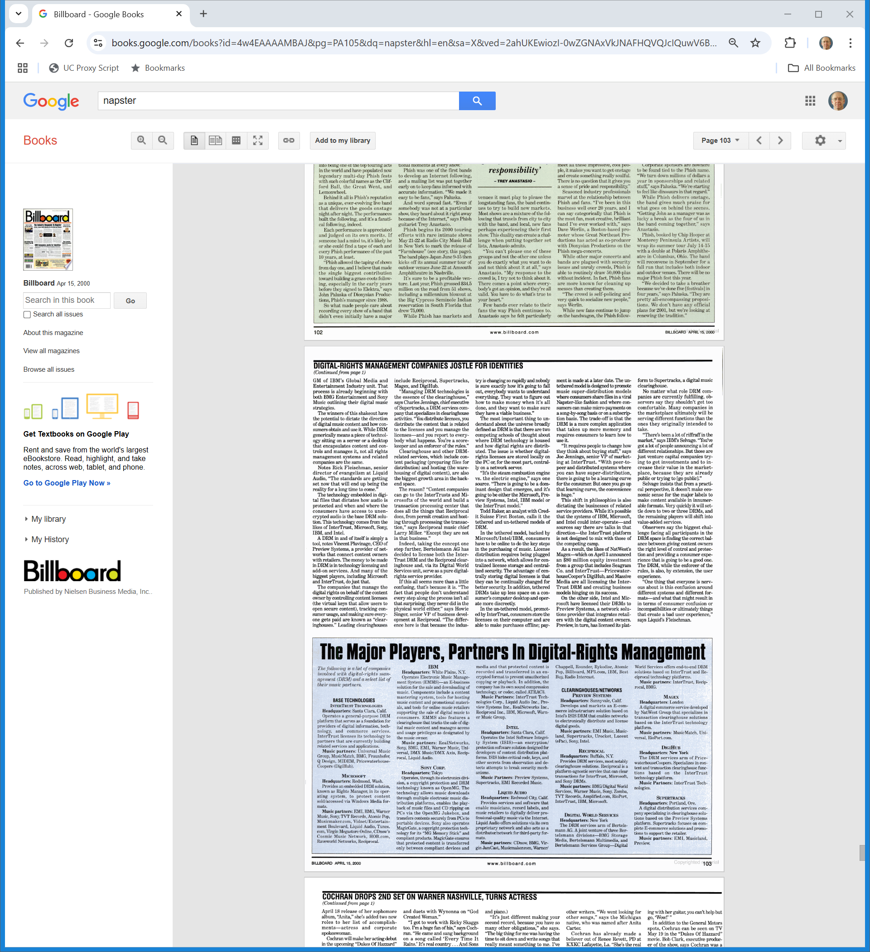
The Competition
Billboard (15 Apr 2000)
Notes:
https://books.google.com/books?id=4w4EAAAAMBAJ&pg=PA105&dq=napster&hl=en&sa=X&ved=2ahUKEwiozI-0wZGNAxVkJNAFHQVQJcIQuwV6BAgJEAc#v=onepage&q&f=false

Slide 37
Piracy
Billboard (15 Apr 2000)
Notes:
https://books.google.com/books?id=4w4EAAAAMBAJ&pg=PA105&dq=napster&hl=en&sa=X&ved=2ahUKEwiozI-0wZGNAxVkJNAFHQVQJcIQuwV6BAgJEAc#v=onepage&q&f=false

Slide 38
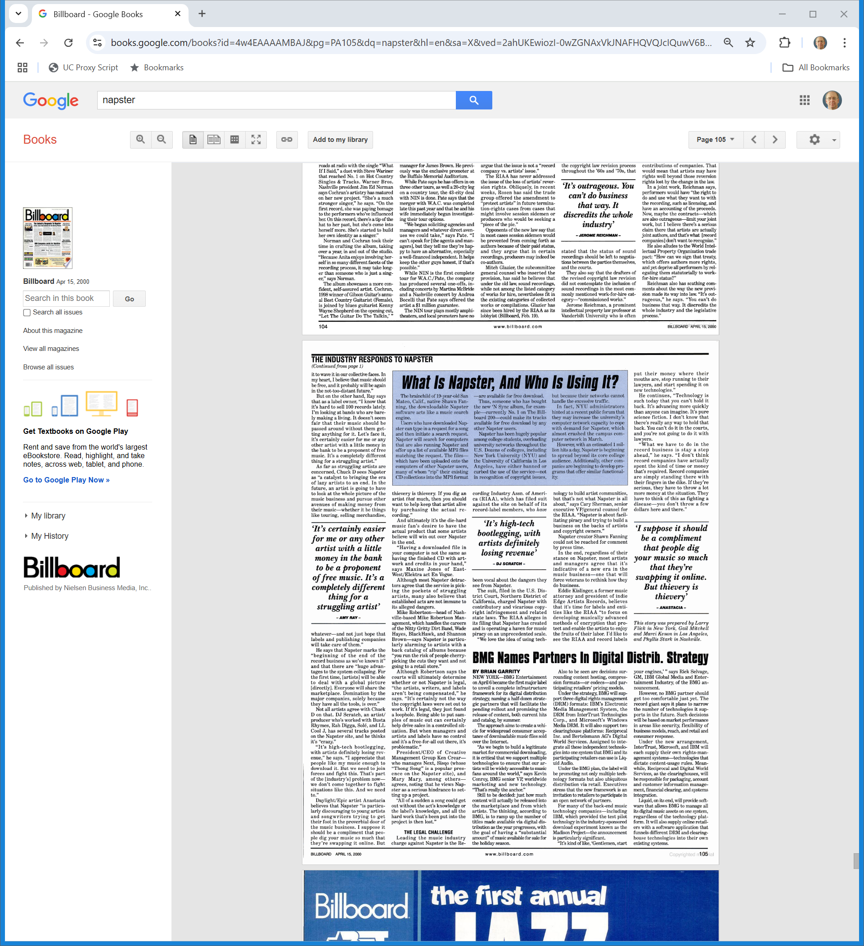
Napster?
Billboard (15 Apr 2000)
Notes:
https://books.google.com/books?id=4w4EAAAAMBAJ&pg=PA105&dq=napster&hl=en&sa=X&ved=2ahUKEwiozI-0wZGNAxVkJNAFHQVQJcIQuwV6BAgJEAc#v=onepage&q&f=false

Slide 39
Preliminary Injunction Granted
Napster, 114 F.Supp.2d 896 (N.D. Calif. Aug 10, 2000)

Slide 40
Napster Loses on Appeal
Napster, 239 F.3d 1004 (9th Cir. Feb 12, 2001)

Slide 41
Front Page News
New York Times (13 Feb 2001)

Slide 42
Jeffoboy15’s Question
New York Times (13 Feb 2001)

Slide 43
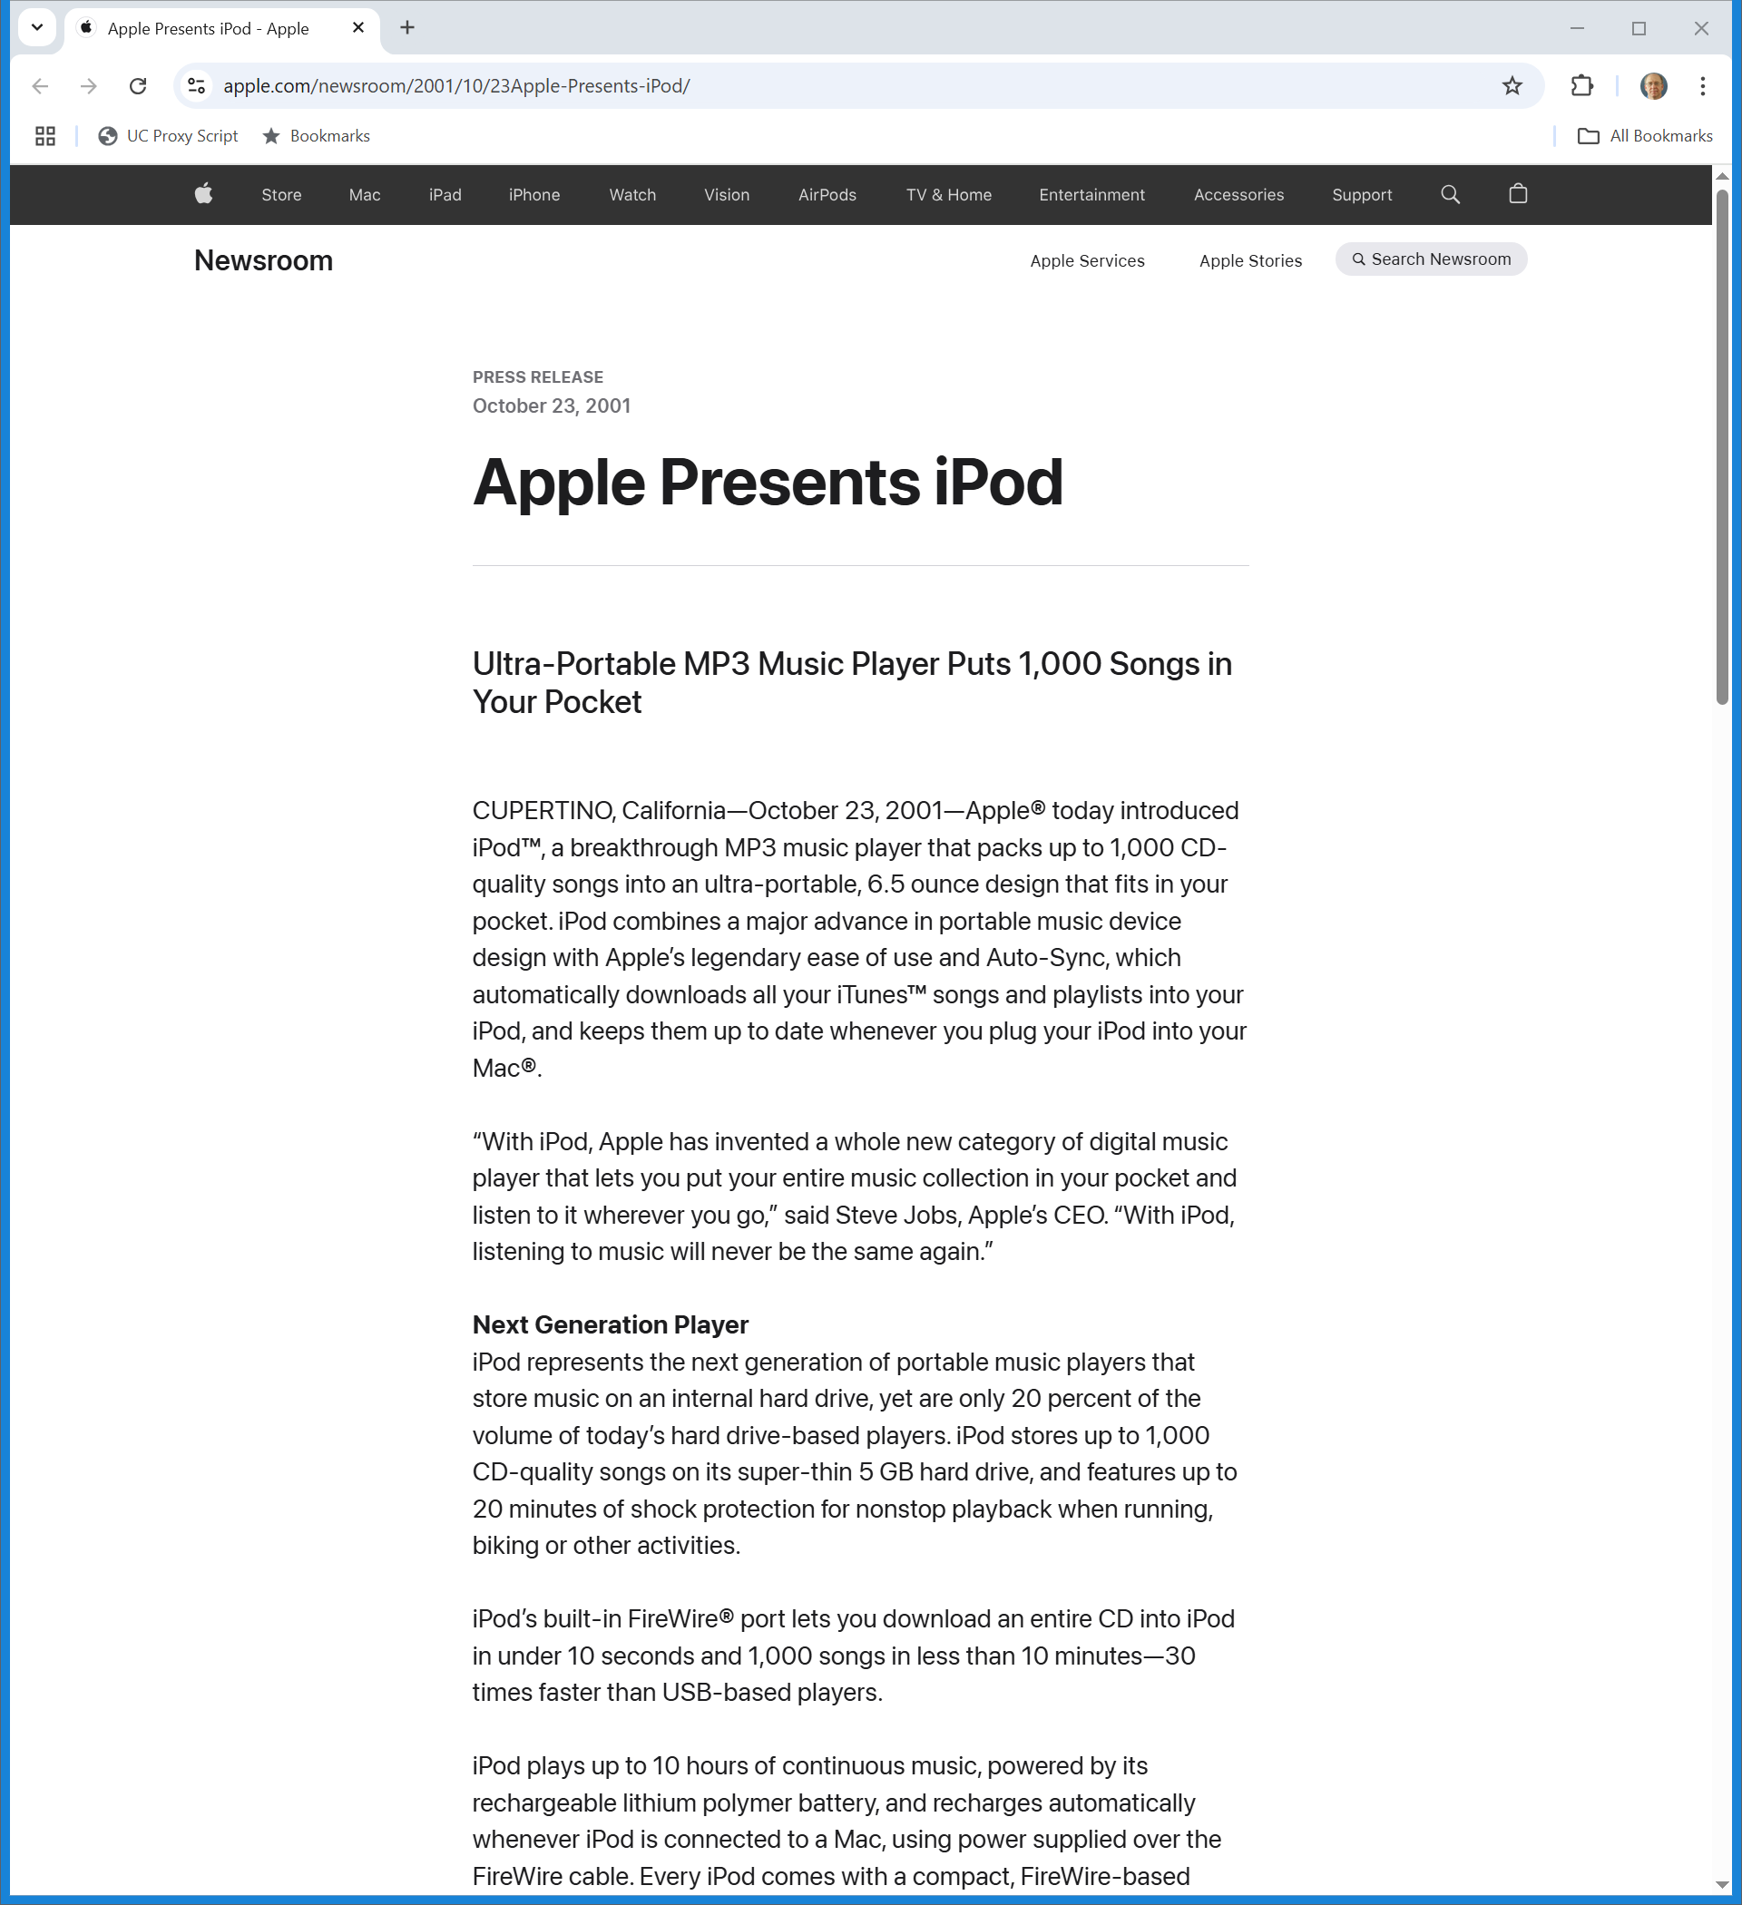
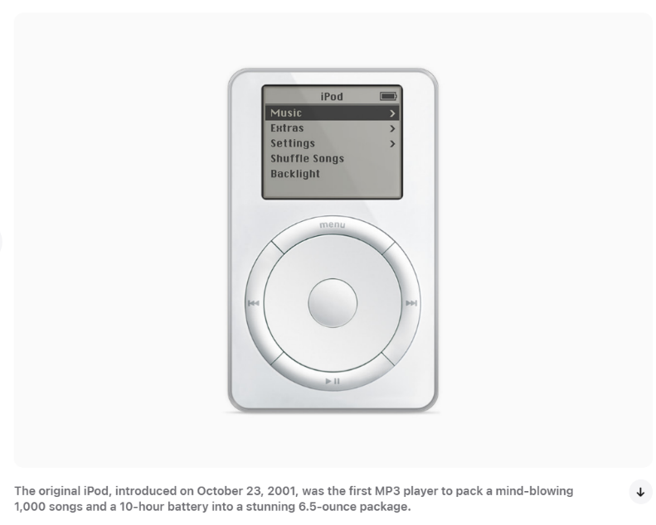
Oct 2001: iPod
Apple (23 Oct 2001)
Notes:
https://www.apple.com/newsroom/2001/10/23Apple-Presents-iPod/
https://www.apple.com/newsroom/2022/05/the-music-lives-on/

Slide 44
MP3 Players and AHRA
Diamond, 180 F.3d 1072 (9th Cir. 1999)

Slide 45
2005: Grokster: 9-0 on Inducement
Grokster, 545 U.S. 913 (2005)

Slide 46
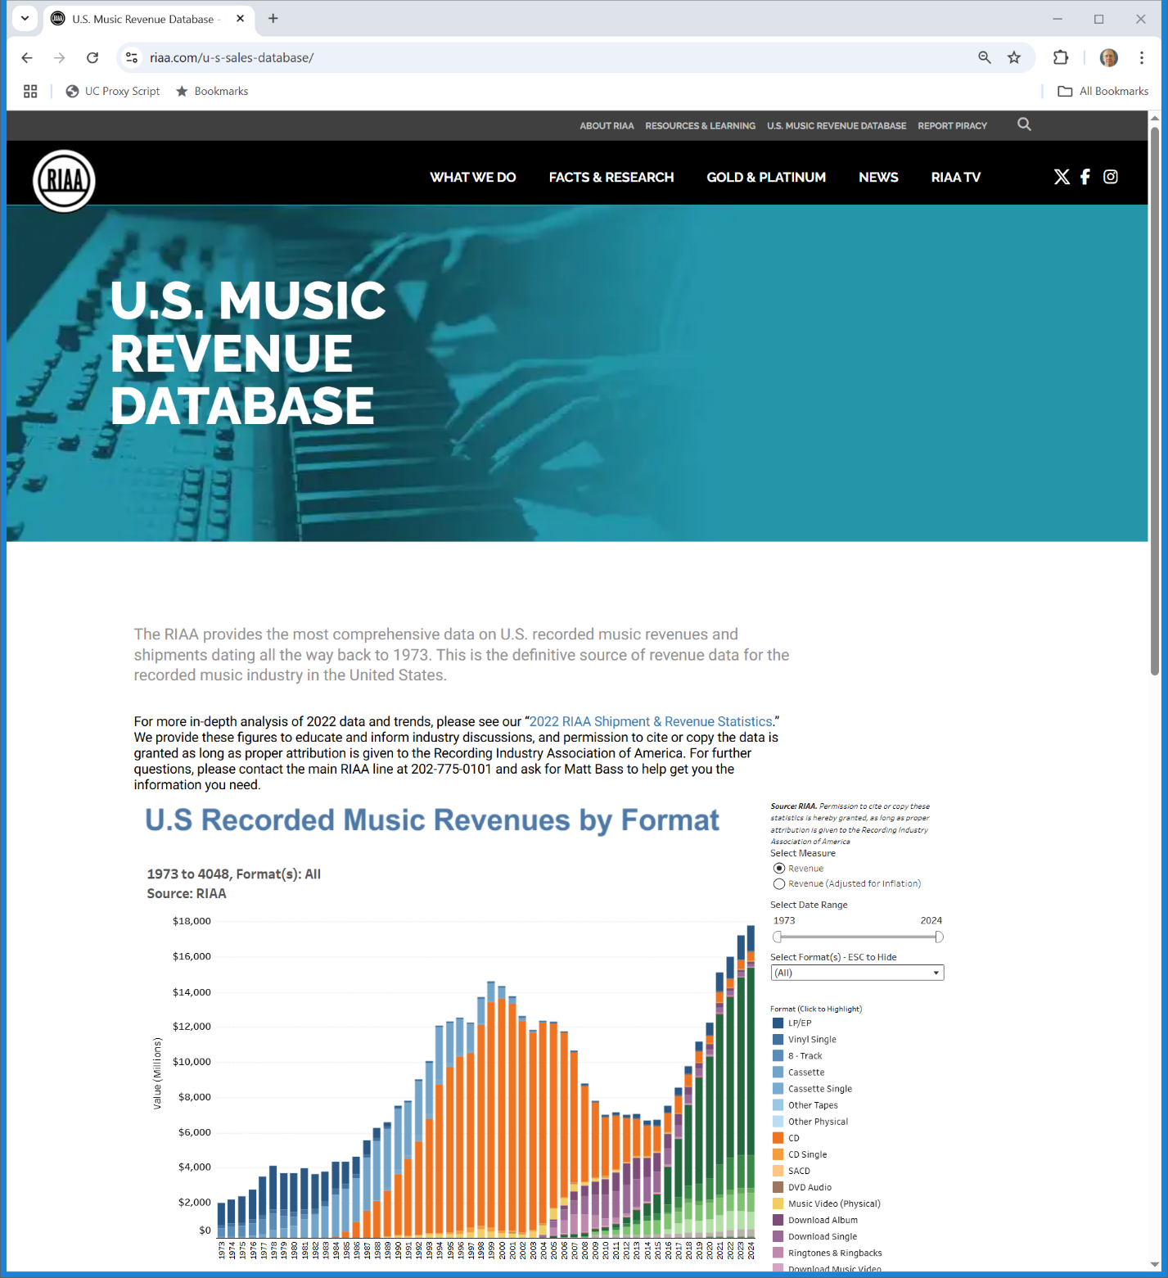
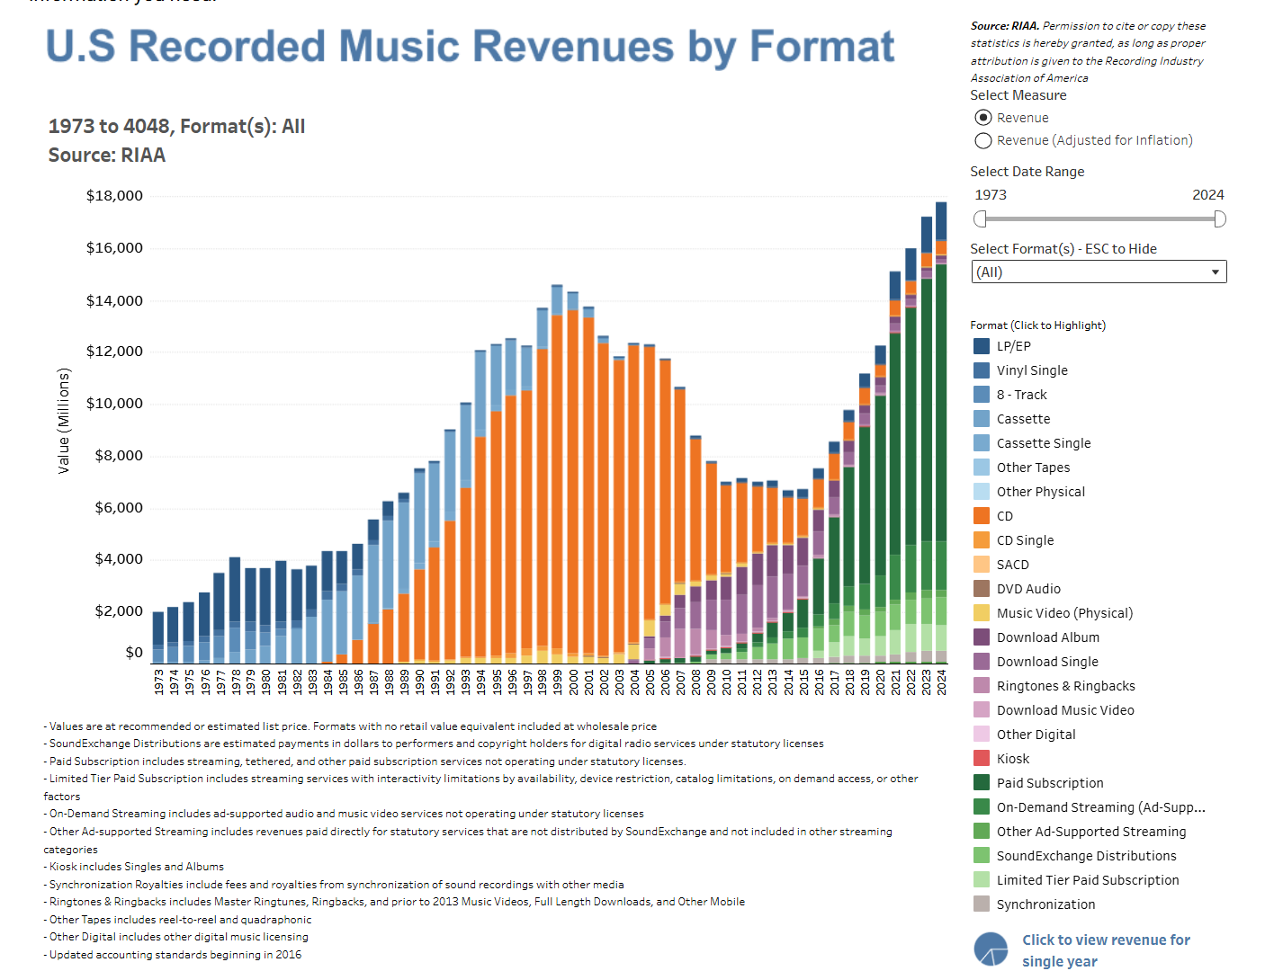
U.S. Music Revenues
RIAA (Visited 3 May 2025)
Notes:
https://www.riaa.com/u-s-sales-database/

Slide 47
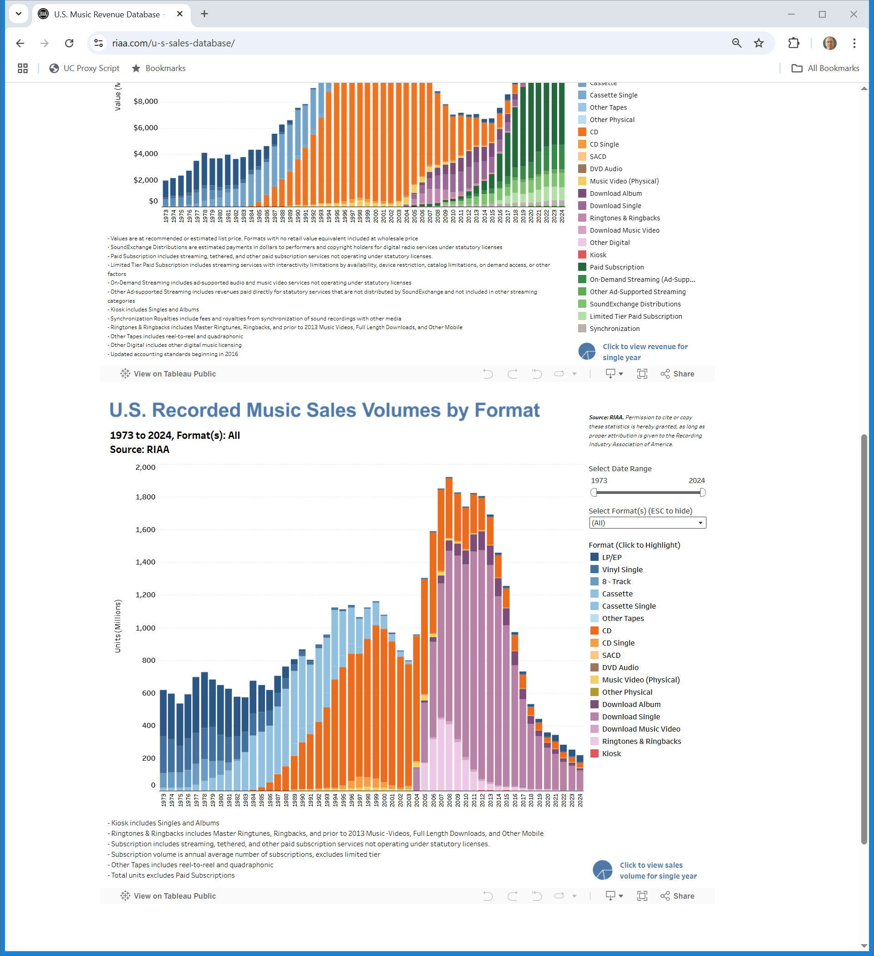
Sales
RIAA (Visited 3 May 2025)
Notes:
https://www.riaa.com/u-s-sales-database/

Slide 48
Thomas-Rasset
692 F.3d 899 (8th Cir. 2012)

Slide 49
How KaZaa Works
U.S. v. Shaffer, 472 F.3d 1219 (10th Cir. 2007)

Slide 50
How KaZaa Works
U.S. v. Shaffer, 472 F.3d 1219 (10th Cir. 2007)

Slide 51
Making Available Instruction
“The court also instructed that the act of ‘making copyrighted sound recordings available for electronic distribution on a peer-to-peer network, without license from the copyright owners, violates the copyright owners’ exclusive right of distribution, regardless of whether actual distribution has been shown.’ The jury found Thomas-Rasset liable for willful infringement and awarded the recording companies statutory damages of $9,250 per work, for a total of $222,000.”
Capitol Records (8th Cir. 2012)

Slide 52
The Copyright Violation in Thomas-Rasset
TTYN (1 of 4)
Assume
Thomas-Rasset places 24 songs in her KaZaA “My Shared Folder”
Does that suffice to show a copyright violation? If not, what other information is required? If a download takes place and is infringing, who infringes?

Slide 53
Applying 504(b) Here
TTYN (2 of 4)
Thomas-Rasset has no profits
How should we calculate actual damages?
Is this a case for statutory damages?

Slide 54
Three Jury Verdicts
TTYN (3 of 4)
Verdict 1: Oct 2007
24 songs, $9,250 per song = $222,000
Verdict 2: June 2009
24 songs, $80,000 per song = $1,920,000
Reduced by the judge to $2,250 per song = $54,000

Slide 55
Three Jury Verdicts
TTYN (4 of 4)
Verdict 3: Nov. 2010
24 songs, $62,500 per song = $1,500,000
Once again reduced by the judge to $2,250 per song = $54,000

Slide 56
Result
“For the foregoing reasons, we conclude that the recording companies are entitled to the remedies that they seek on appeal. The judgment of the district court is vacated, and the case is remanded with directions to enter a judgment for damages in the amount of $222,000, and to include an injunction that precludes Thomas-Rasset from making any of the plaintiffs’ recordings available for distribution to the public through an online media distribution system.”
Capitol Records (8th Cir. 2012)

Slide 57
Making Available Study
Copyright Office (Feb 2016)

Slide 58
Currently Covered
Copyright Office (Feb 2016)

Slide 59
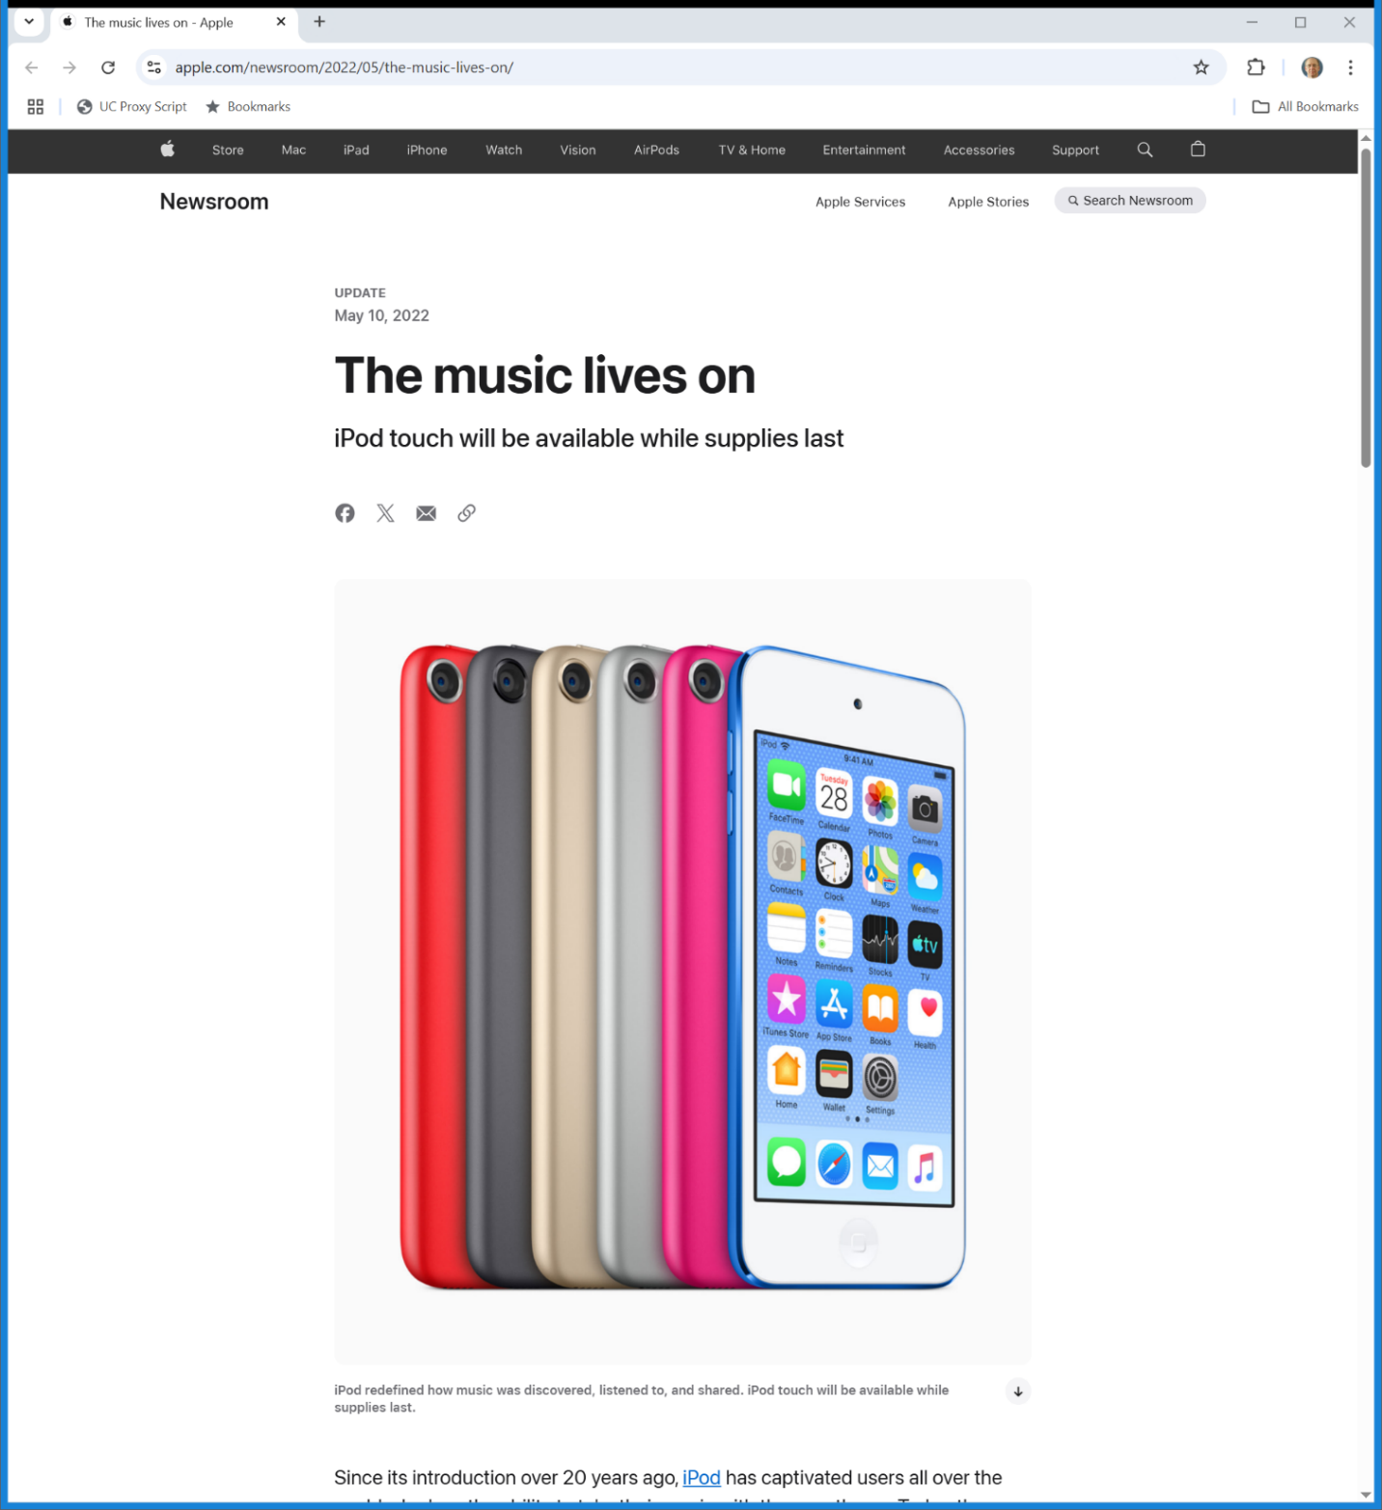
iPod Discontinued
Apple (10 May 2022)
Notes:
https://www.apple.com/newsroom/2022/05/the-music-lives-on/

