Slide 1
Class 19: Mon 5 May 2025 Copyright Spring 2025 DMCA Sec. 512
Randal C. Picker
James Parker Hall Distinguished Service Professor of Law
The Law School
The University of Chicago

Slide 2
Issues for Today
Questions
How do we build an online system at scale with user-generated content that implements Sec. 106?
Is doing that consistent with fair use under Sec. 107?

Slide 3
Digital Millennium Copyright Act
Pub. L. 105-304 (28 Oct 1998)

Slide 4
17 USC 512
Pub. L. 105-304 (28 Oct 1998)

Slide 5
And the Gory Details
Pub. L. 105-304 (28 Oct 1998)

Slide 6
DMCA Legis History
H. Rep. 105-551 (22 May 1998)

Slide 7
Safe Harbors for Greater Certainty
H. Rep. 105-551 (22 May 1998)

Slide 8
No Liability for Passive Automatic Acts (Volition)
H. Rep. 105-551 (22 May 1998)

Slide 9
Narrowing Secondary Liability
H. Rep. 105-551 (22 May 1998)

Slide 10
512(a): Common Carriers and Transitory Communications
17 USC 512

Slide 11
512(b): Caching
17 USC 512

Slide 12
512(c)(1): User Stored Content
17 USC 512

Slide 13
512(c)(2): Designated Agent for Notifications
17 USC 512

Slide 14
512(c)(3): Contents of Notification
17 USC 512

Slide 15
512(d): Links to Infringing Material
17 USC 512

Slide 16
512(g): Liability for Taking Down Content
17 USC 512

Slide 17
512(g)(3): Counter Notification
17 USC 512

Slide 18
Removing Material
TTYN (1 of 3)
Hypo 1
I post an antitrust video on YouTube
YouTube watches it and says “too Chicago School” and they remove the video
How does 17 USC 512 apply?

Slide 19
Removing Material
TTYN (2 of 3)
Hypo 2
I post an antitrust video on YouTube
YouTube has an automated filtering system and removes my video when the algorithm concludes that the video is too Chicago School
How does 17 USC 512 apply?

Slide 20
Removing Material
TTYN (3 of 3)
Hypo 3
I post an antitrust video on YouTube
A third party believes that my video infringes their copyrighted work
YouTube removes the video based on the notification from the third party
How does 17 USC 512 apply?

Slide 21
Answers
Hypo 1
This is YouTube’s own act. They don’t have any obligation to host material or distribute (but see hypo 3 and see recent non-copyright developments re common carrier status)
No 512 issues here

Slide 22
Answers
Hypo 2
YouTube runs an automated regime for filtering content.
Again baseline position is that they have no obligation to host content and can remove content via humans or algorithms

Slide 23
Answers
Hypo 3
This is basic 512 situation
To get the benefit of the 512(c)(1) safe harbor, YouTube has to comply with the notification/counternotification rules set out there

Slide 24
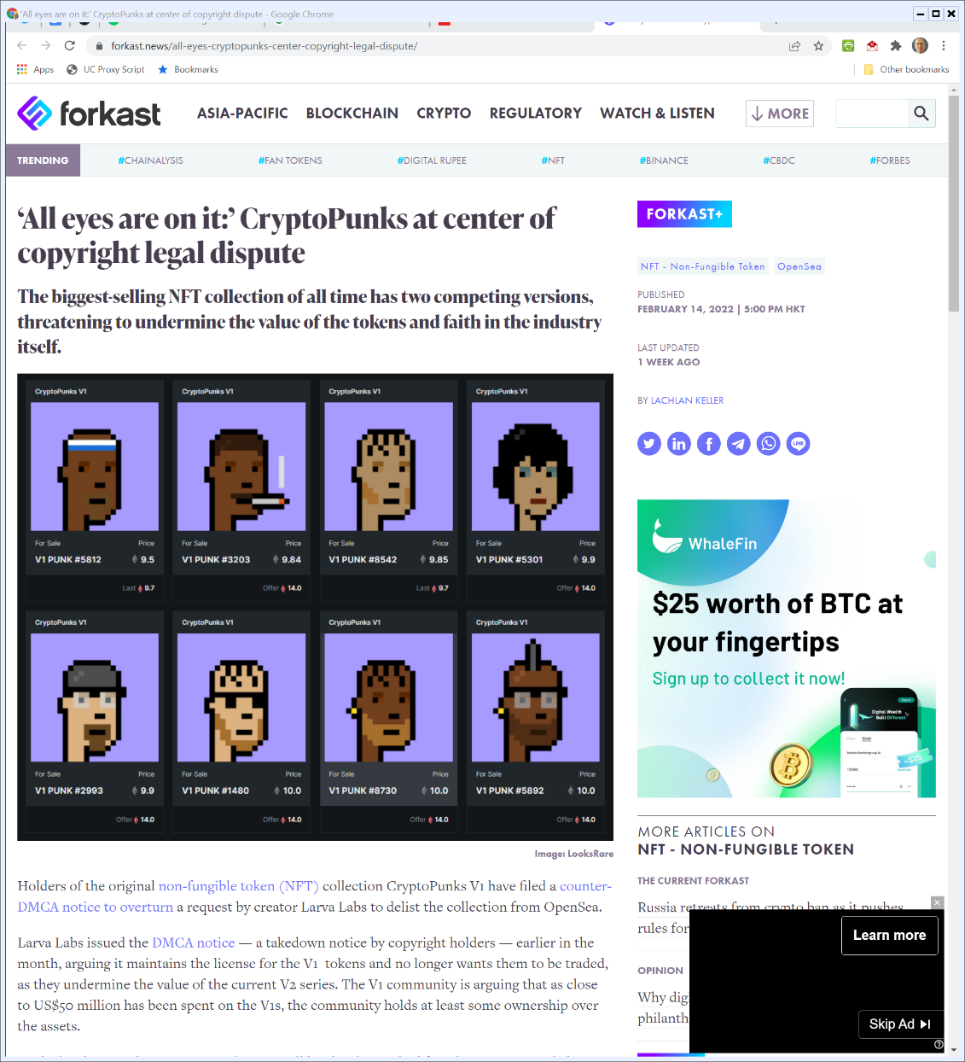
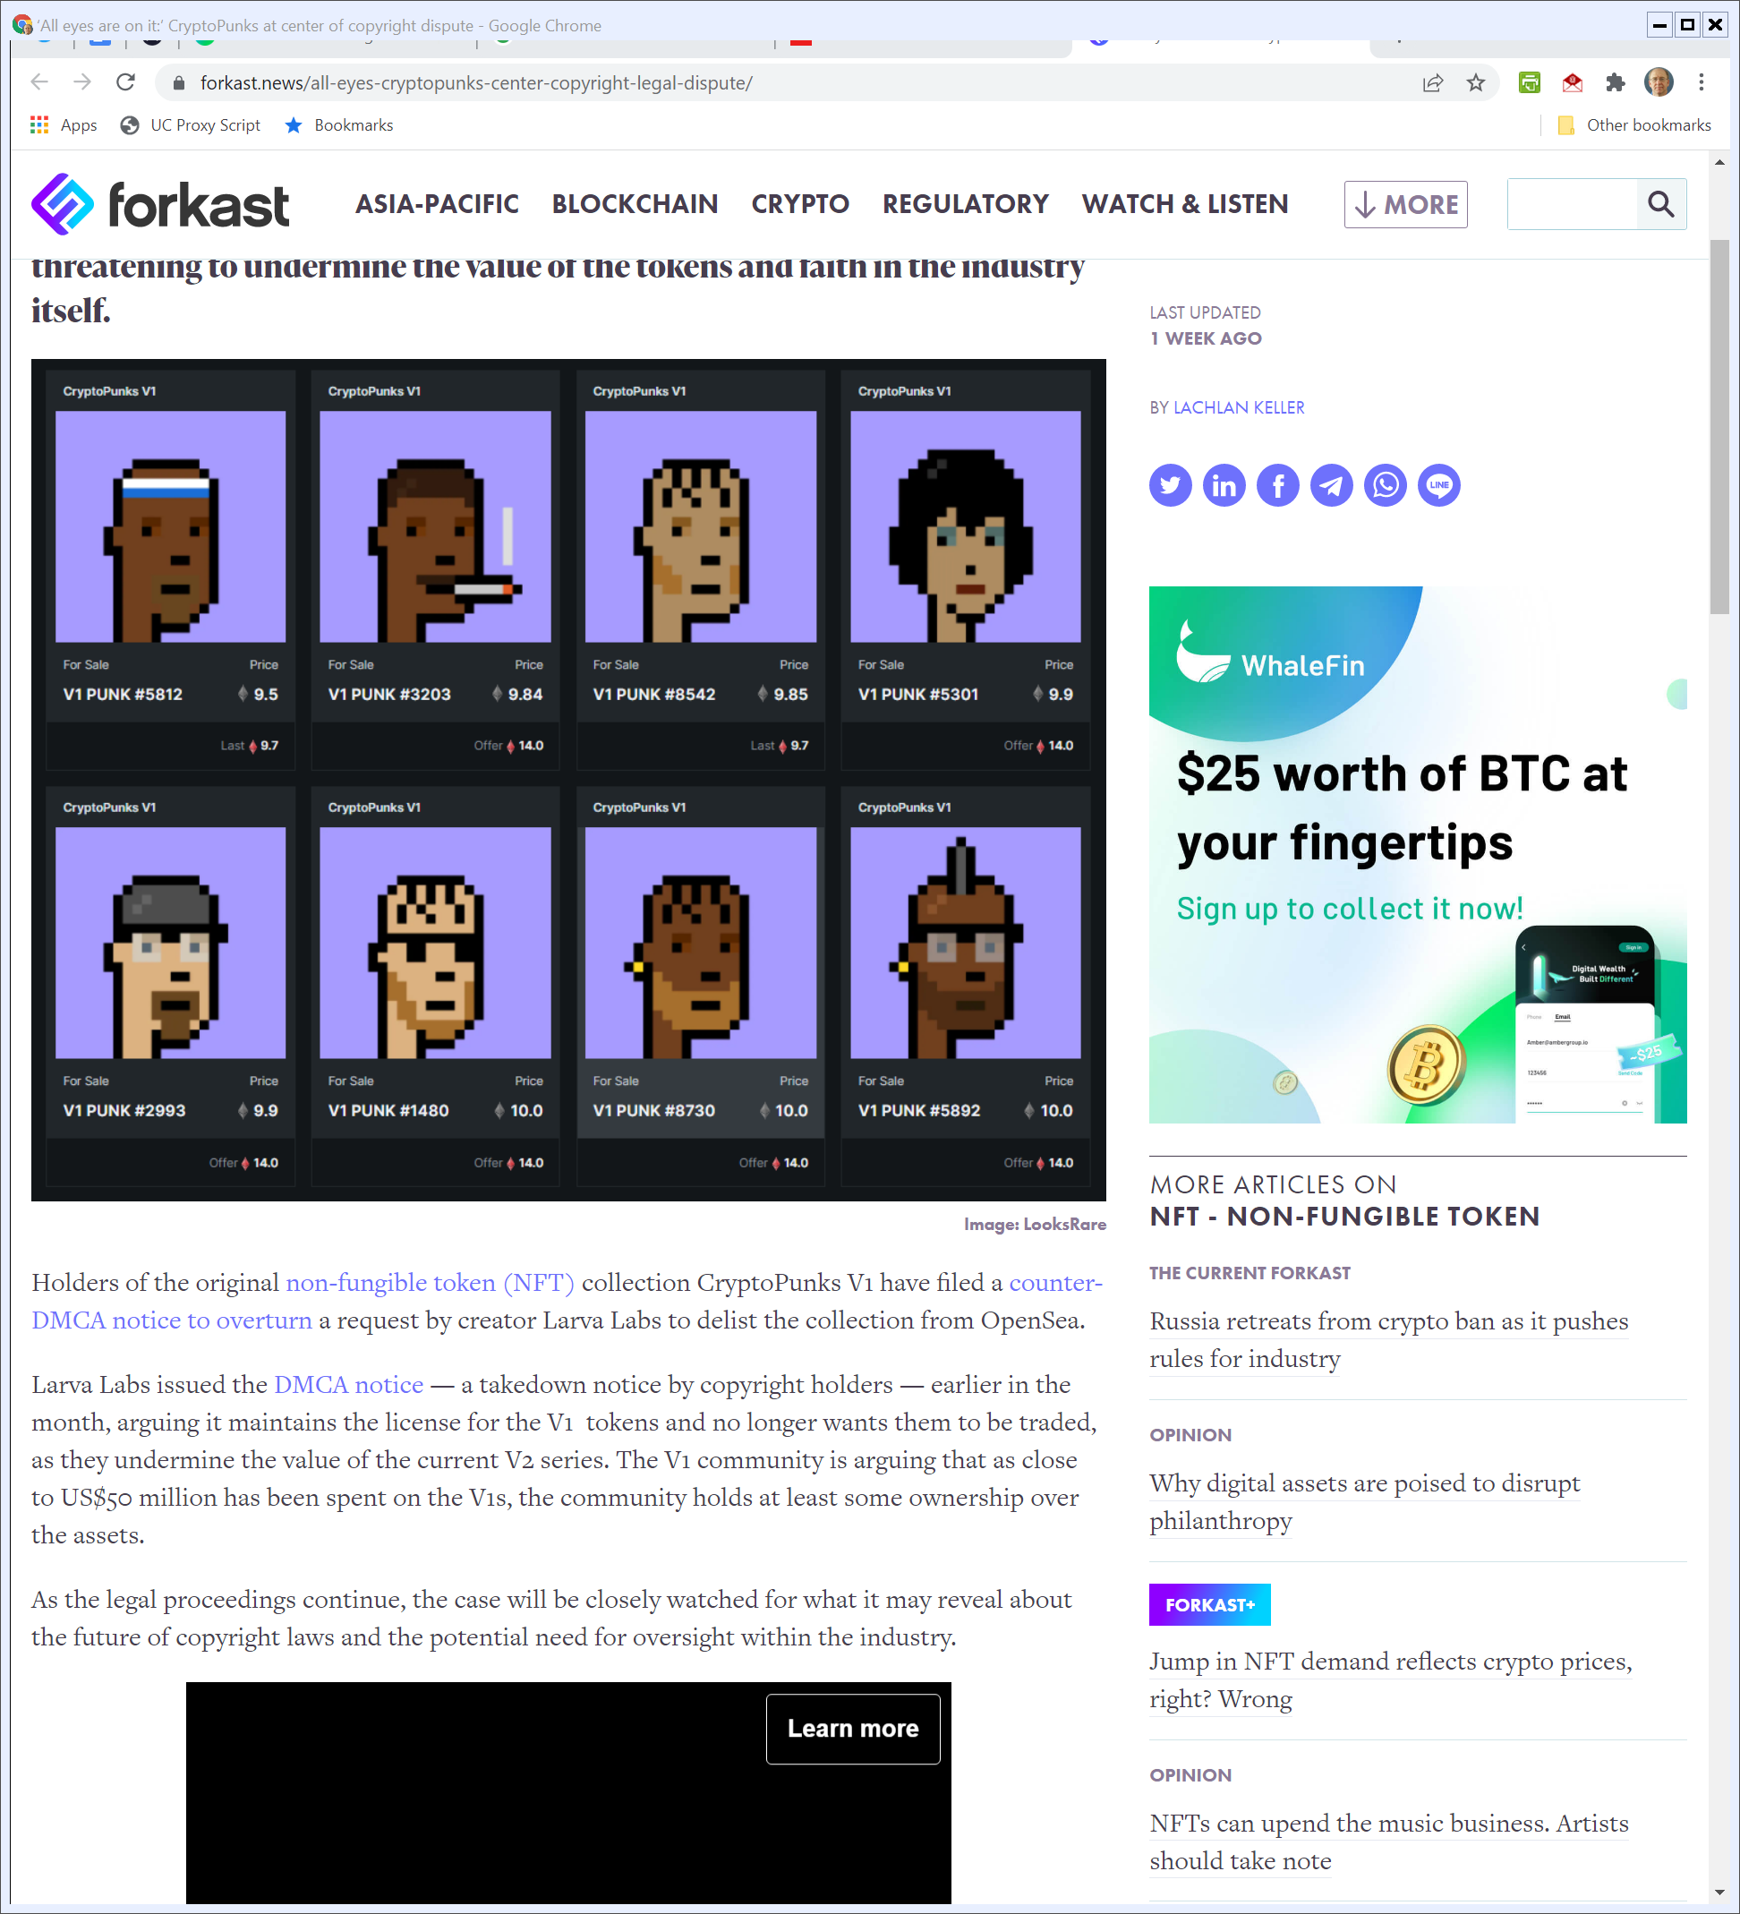
Cryptopunks Copyright Dispute
forkast (Visited 23 Feb 2022)
Notes:
https://forkast.news/all-eyes-cryptopunks-center-copyright-legal-dispute/

Slide 25
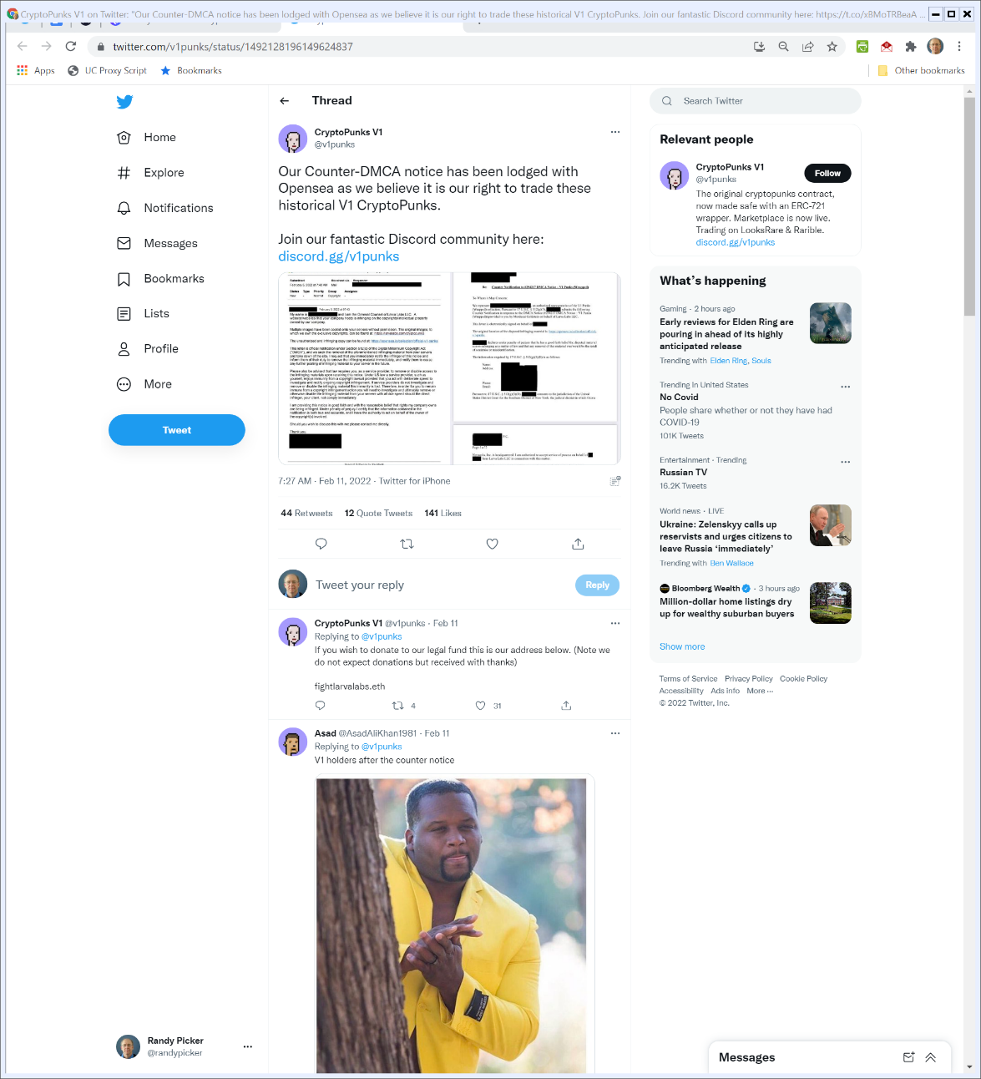
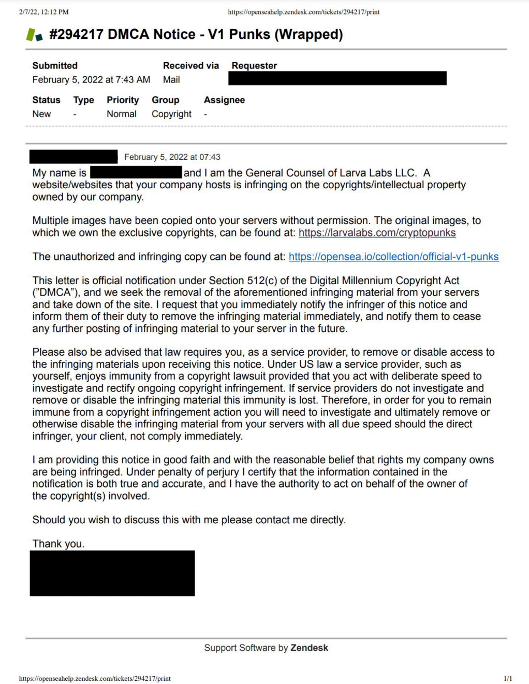
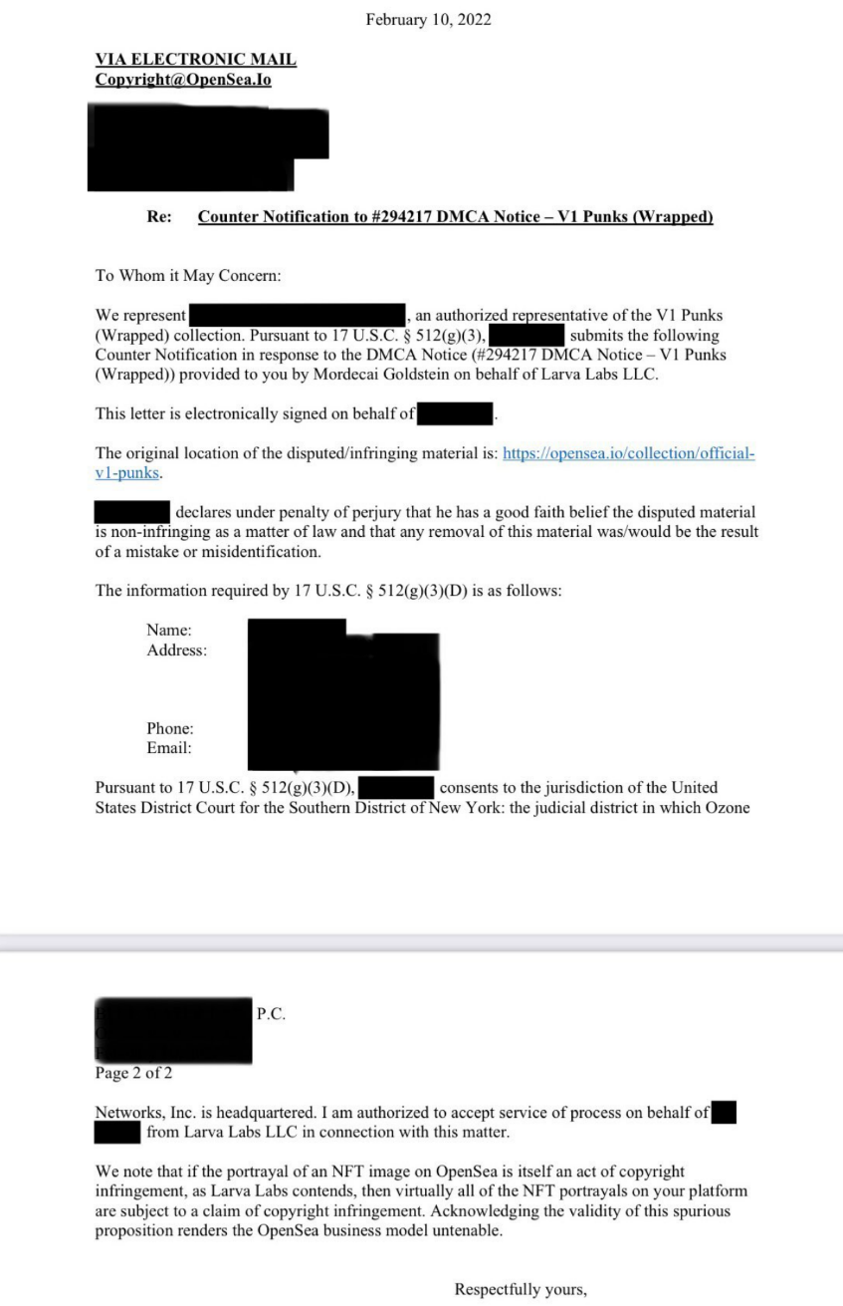
DMCA Notice and Counternotice
Twitter (11 Feb 2022)

Slide 26
512(h): Identifying Infringers
17 USC 512

Slide 27
512(i): Repeat Infringers Policy
17 USC 512

Slide 28
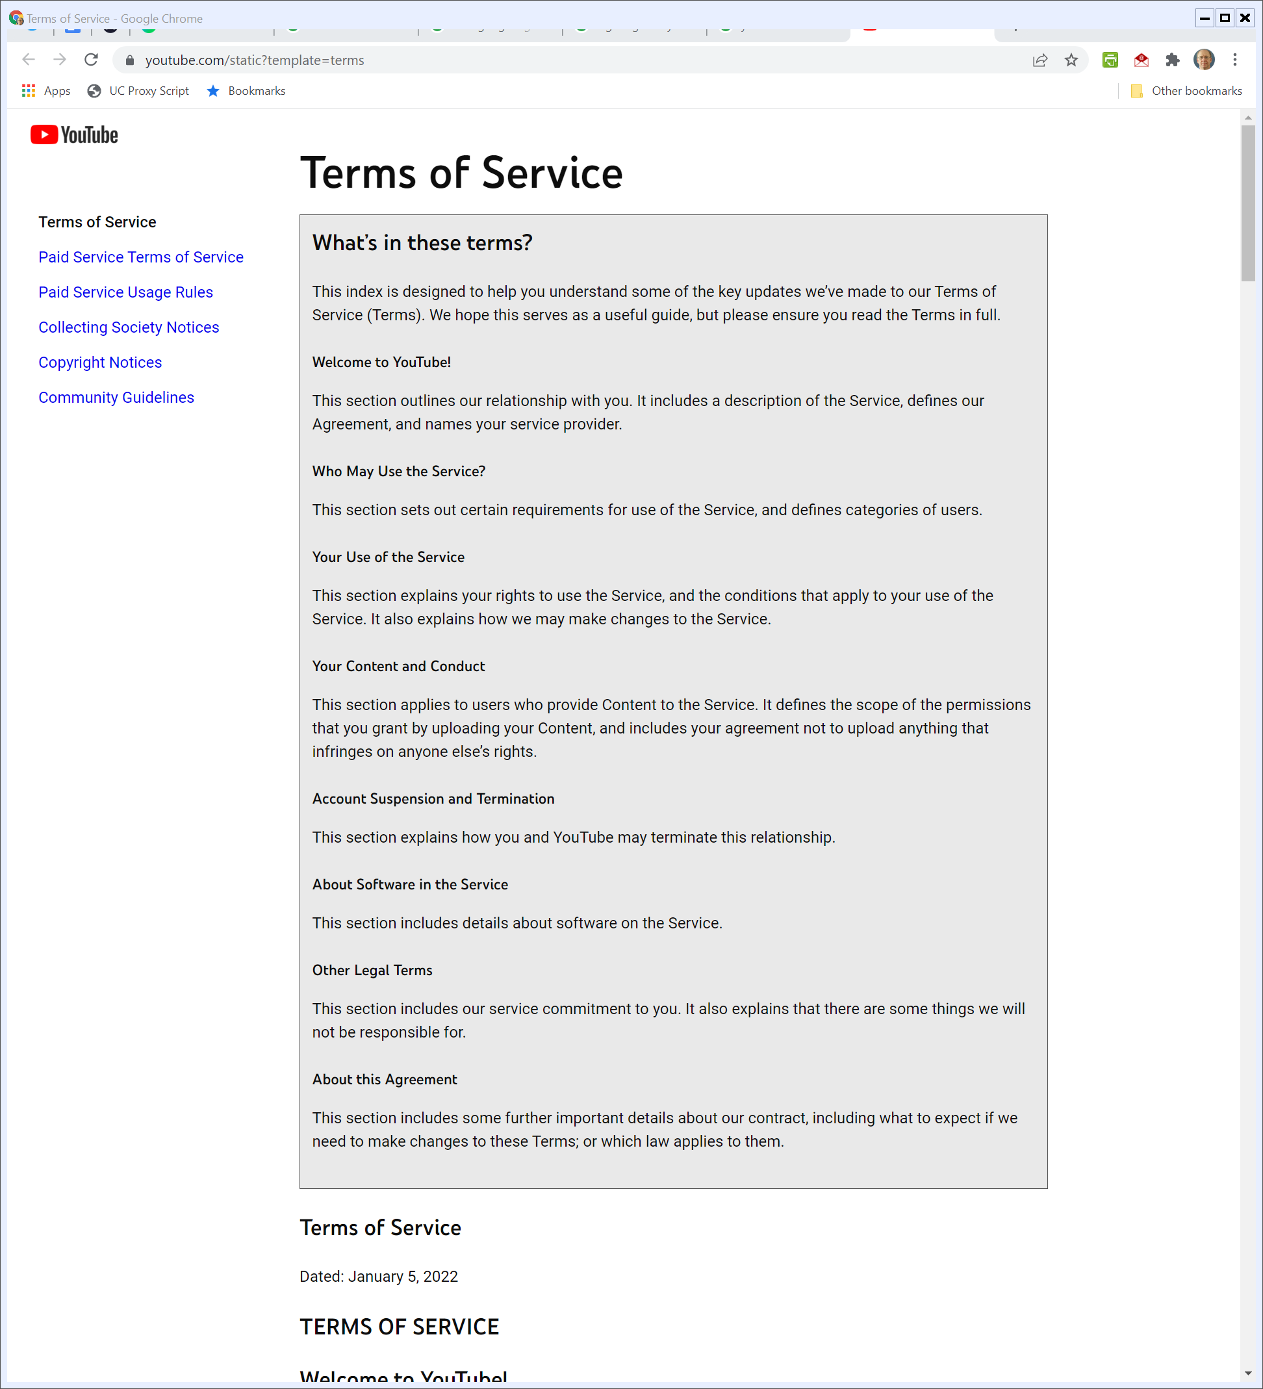
YouTube Terms of Service
YouTube (Visited 23 Feb 2022)

Slide 29
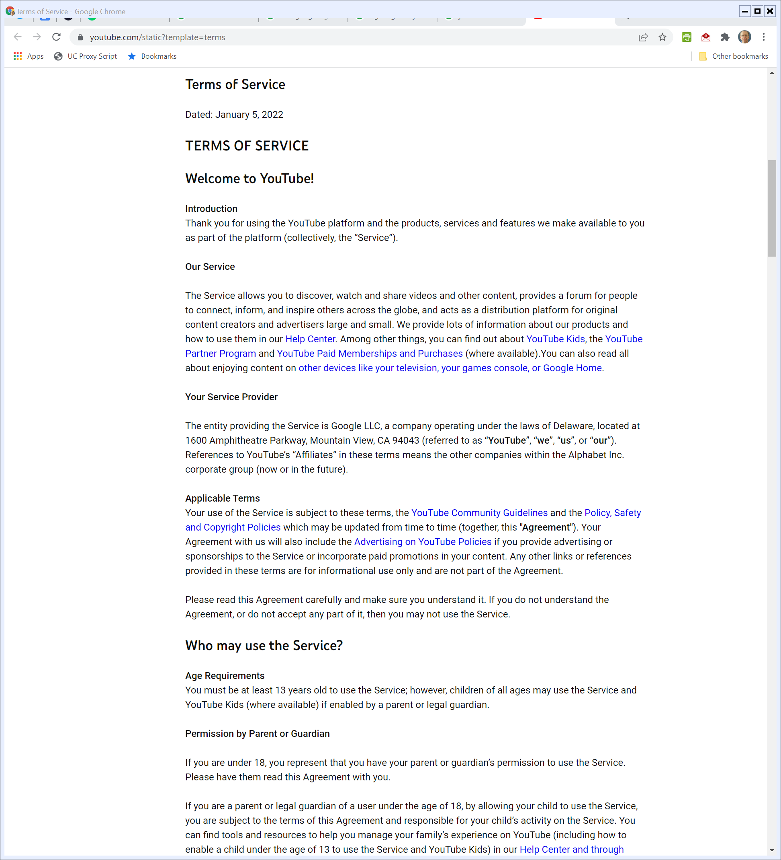
Starting Points
YouTube (Visited 23 Feb 2022)

Slide 30
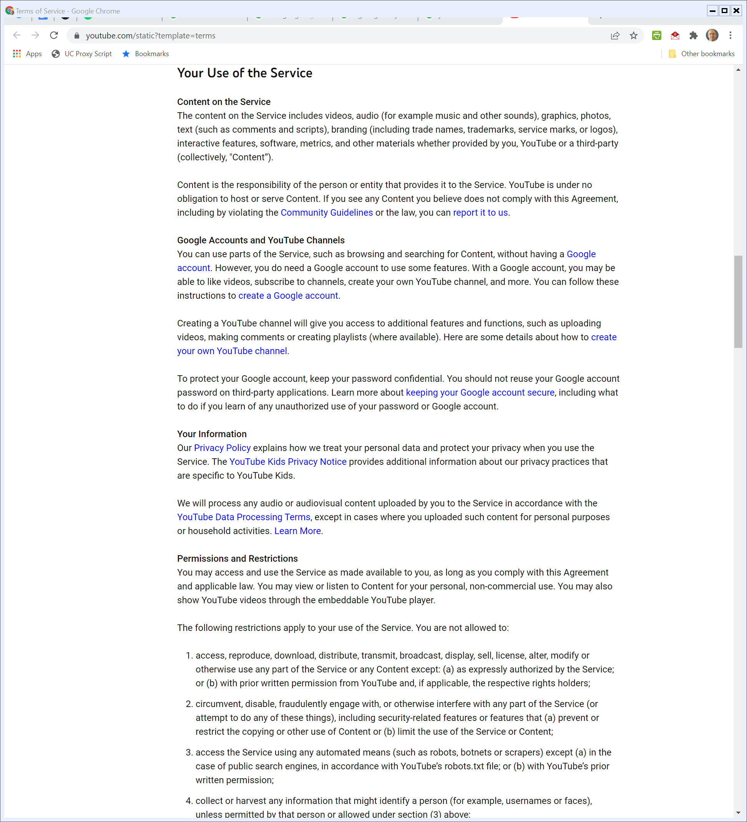
Content Obligations; No Hosting Obligations
YouTube (Visited 23 Feb 2022)

Slide 31
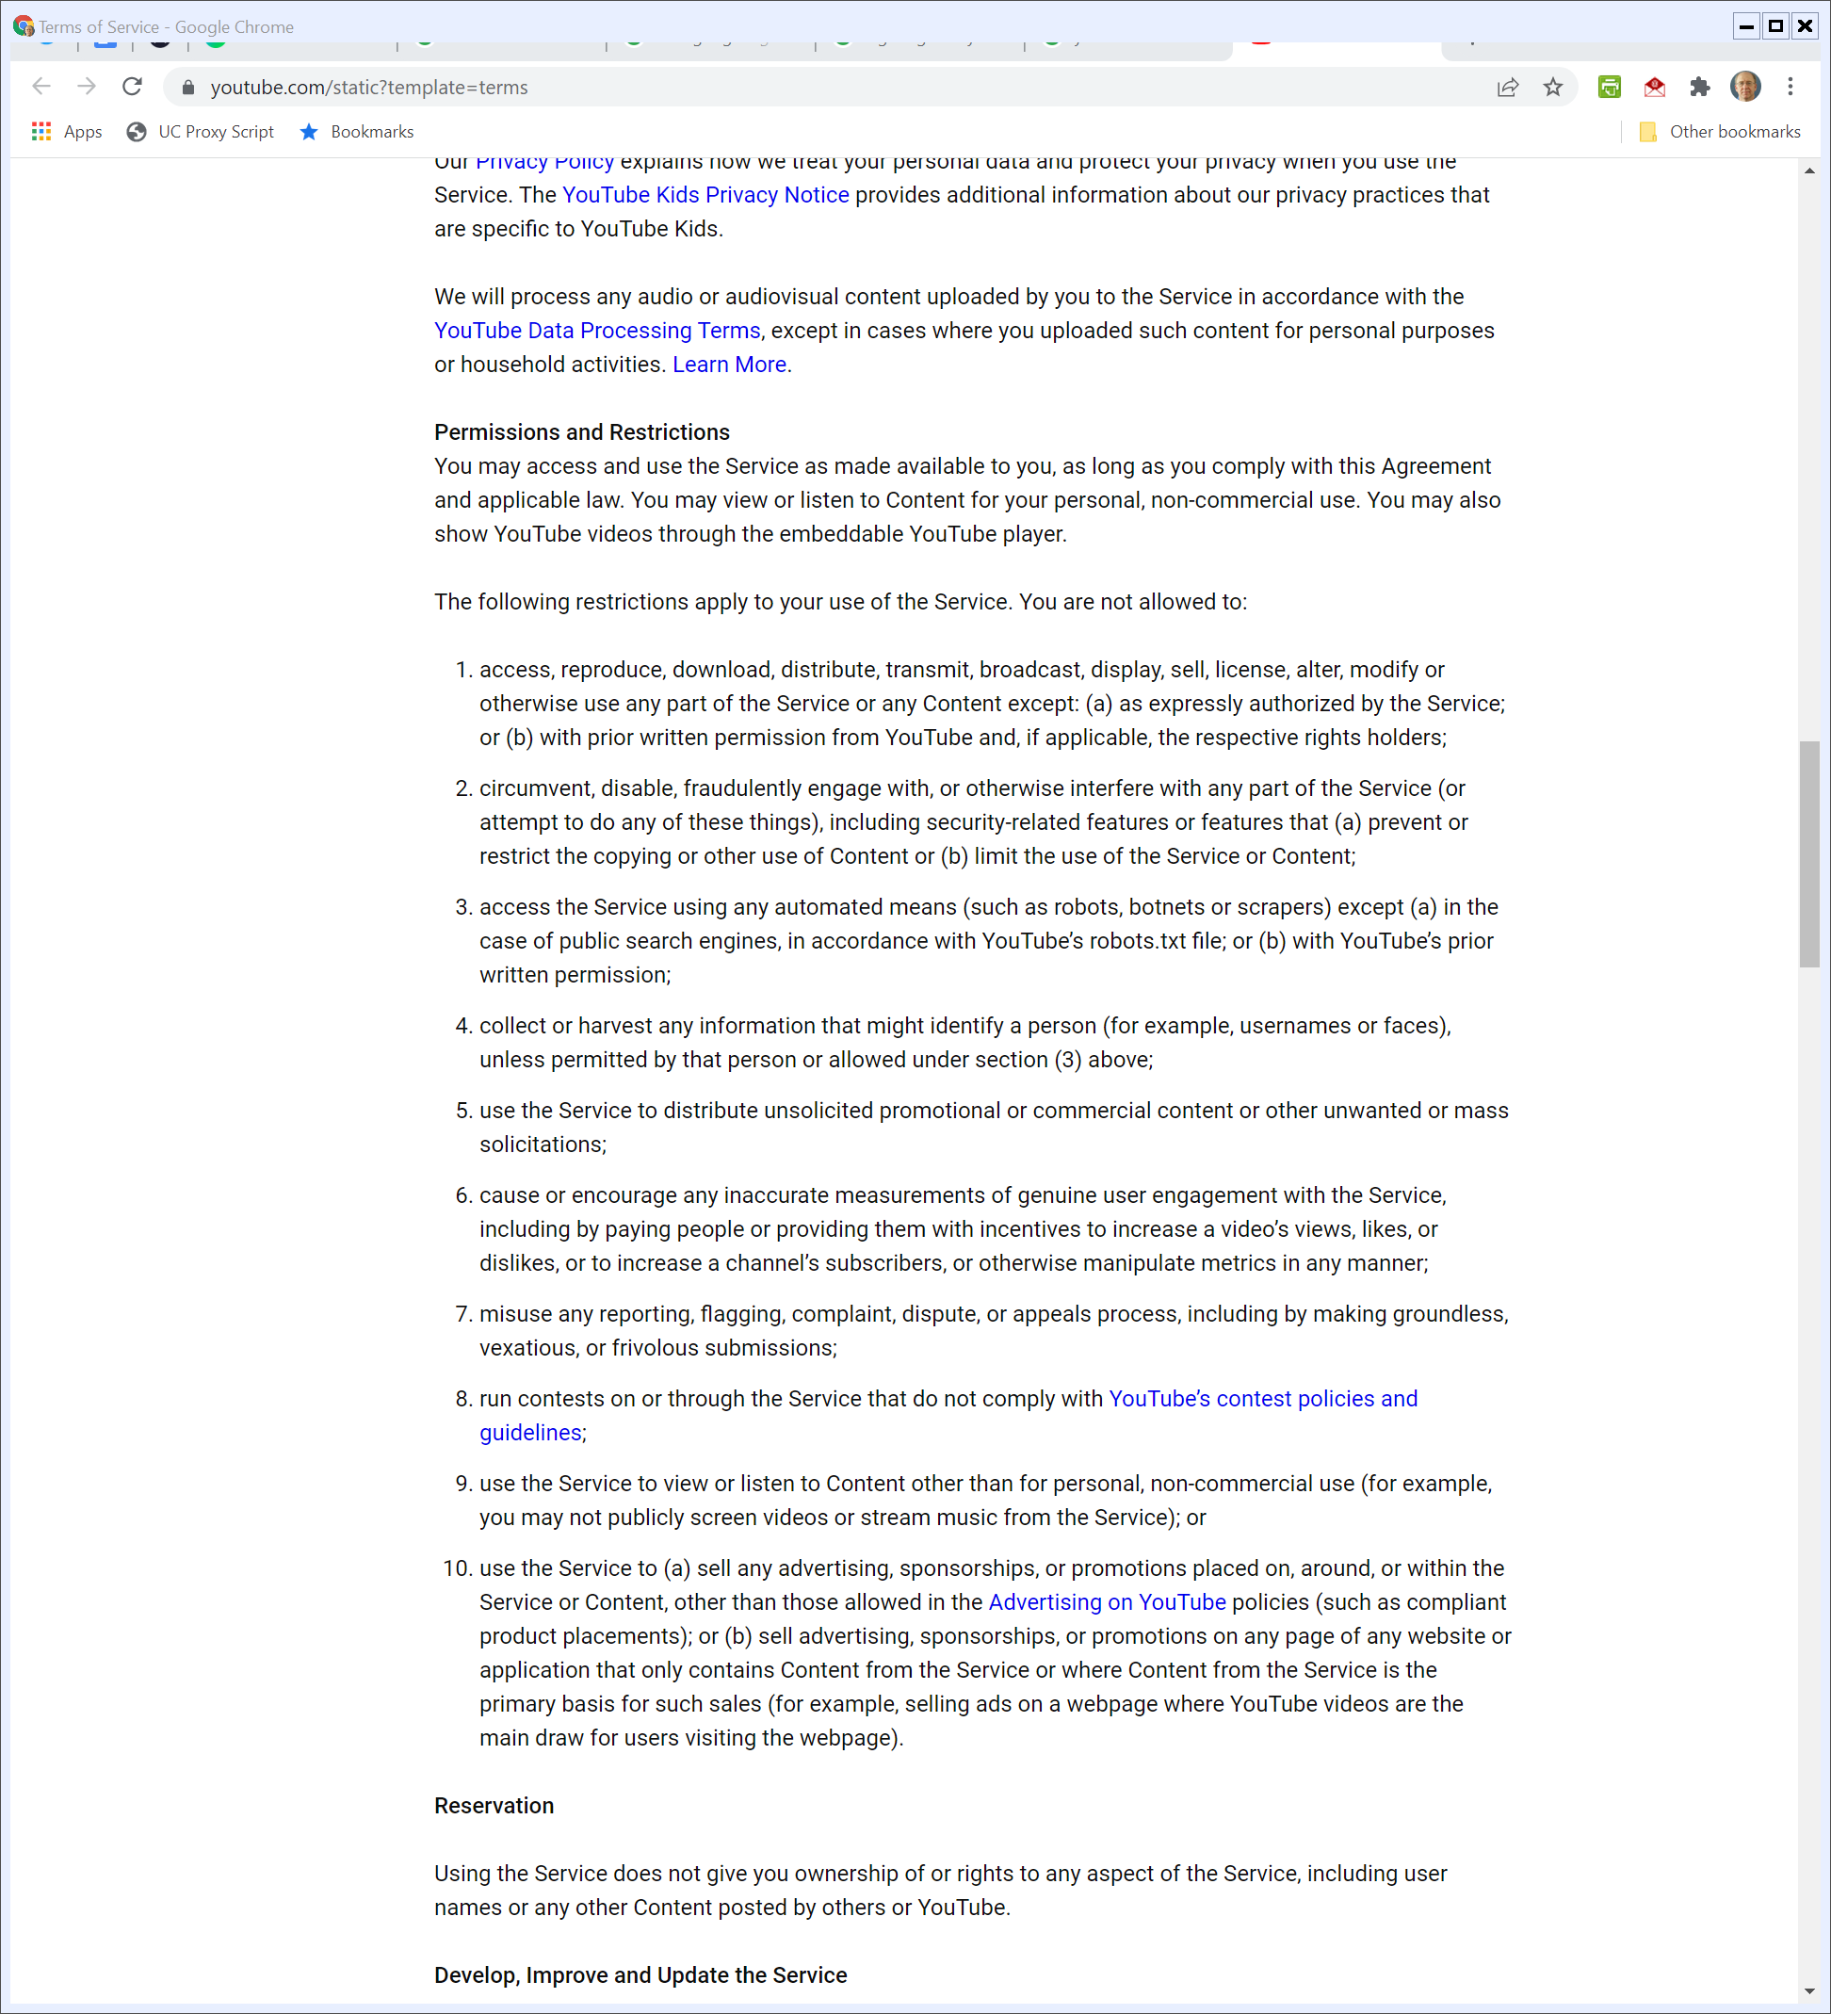
Permissions and Restrictions
YouTube (Visited 23 Feb 2022)

Slide 32
Permissions and Restrictions
YouTube (Visited 23 Feb 2022)

Slide 33
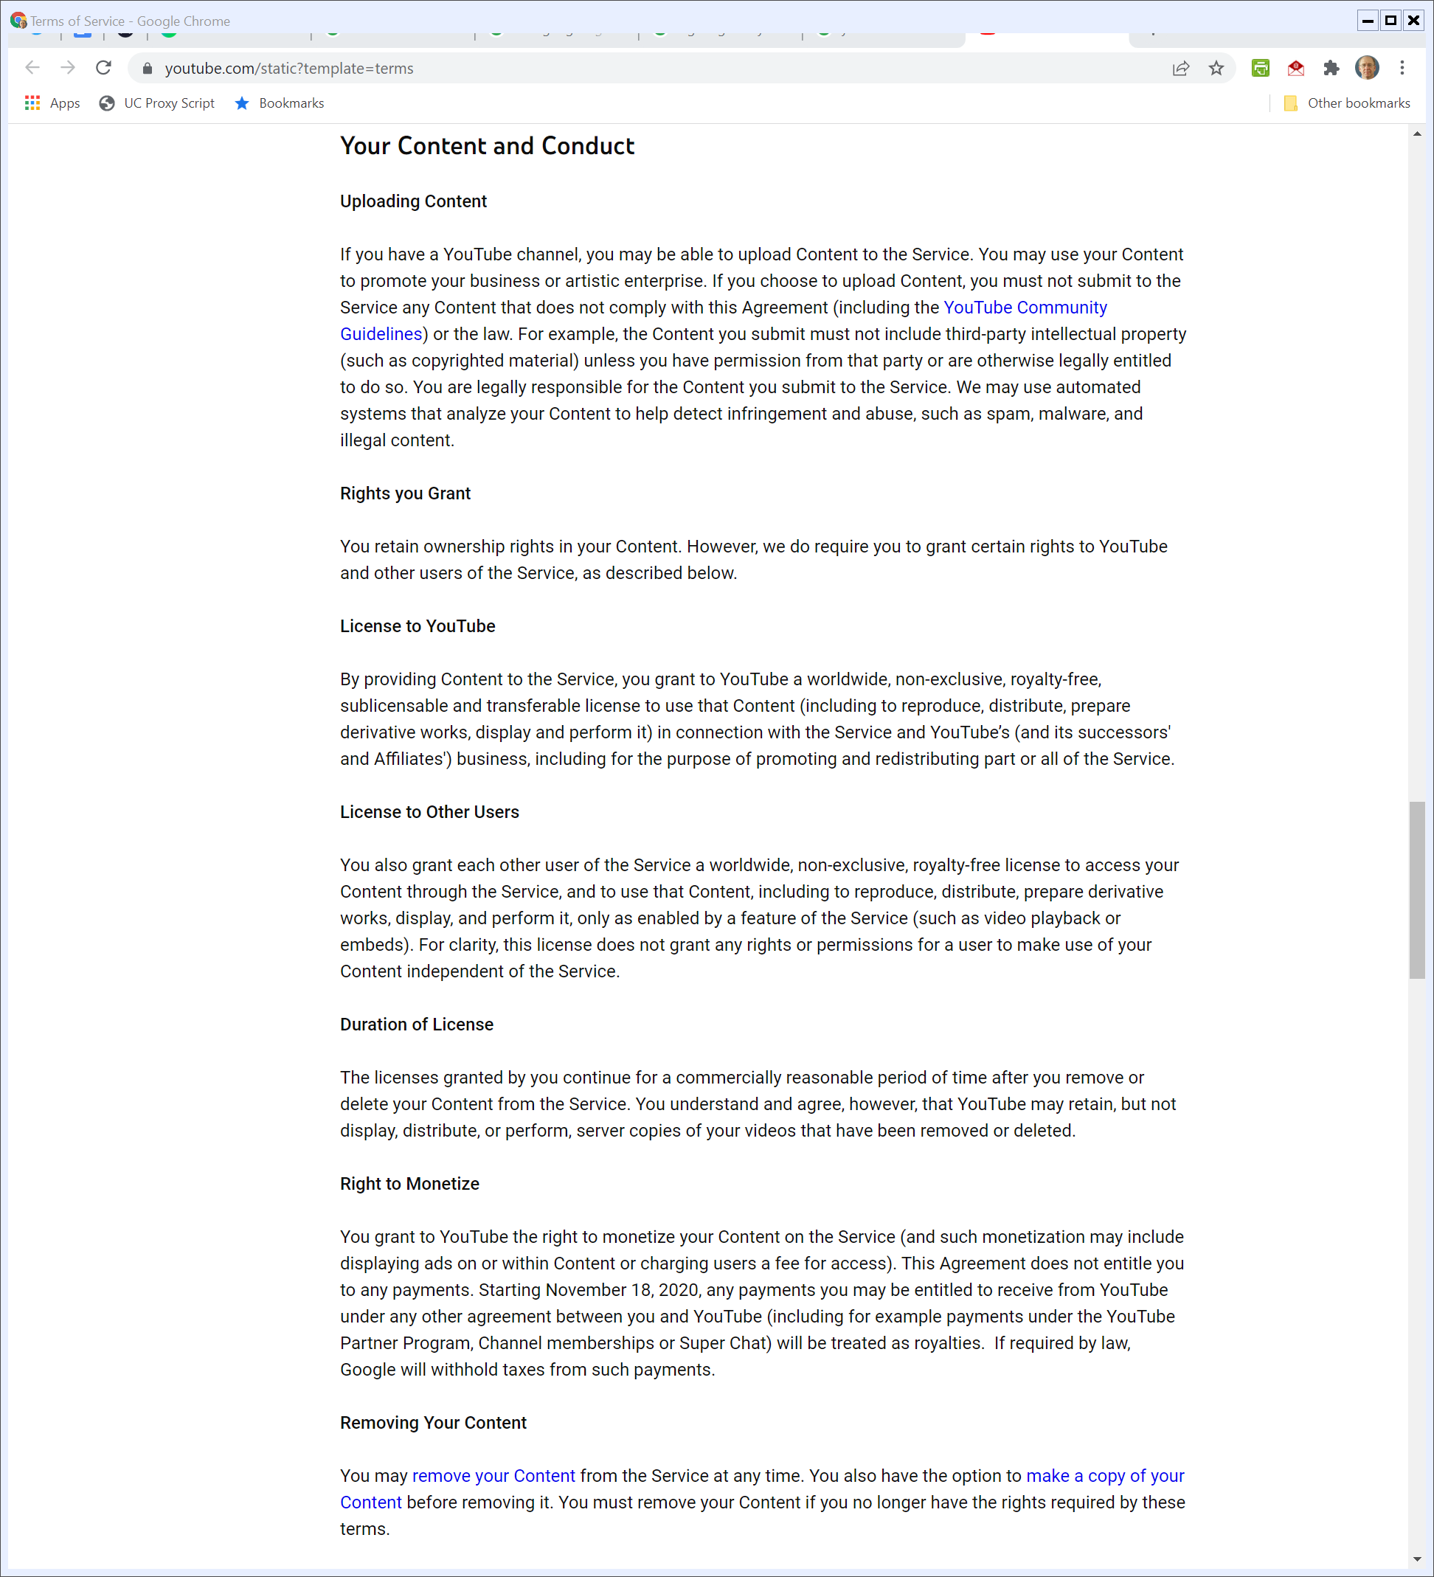
Rights and Duties re Uploaded Content
YouTube (Visited 23 Feb 2022)

Slide 34
Rights and Duties re Uploaded Content
YouTube (Visited 23 Feb 2022)

Slide 35
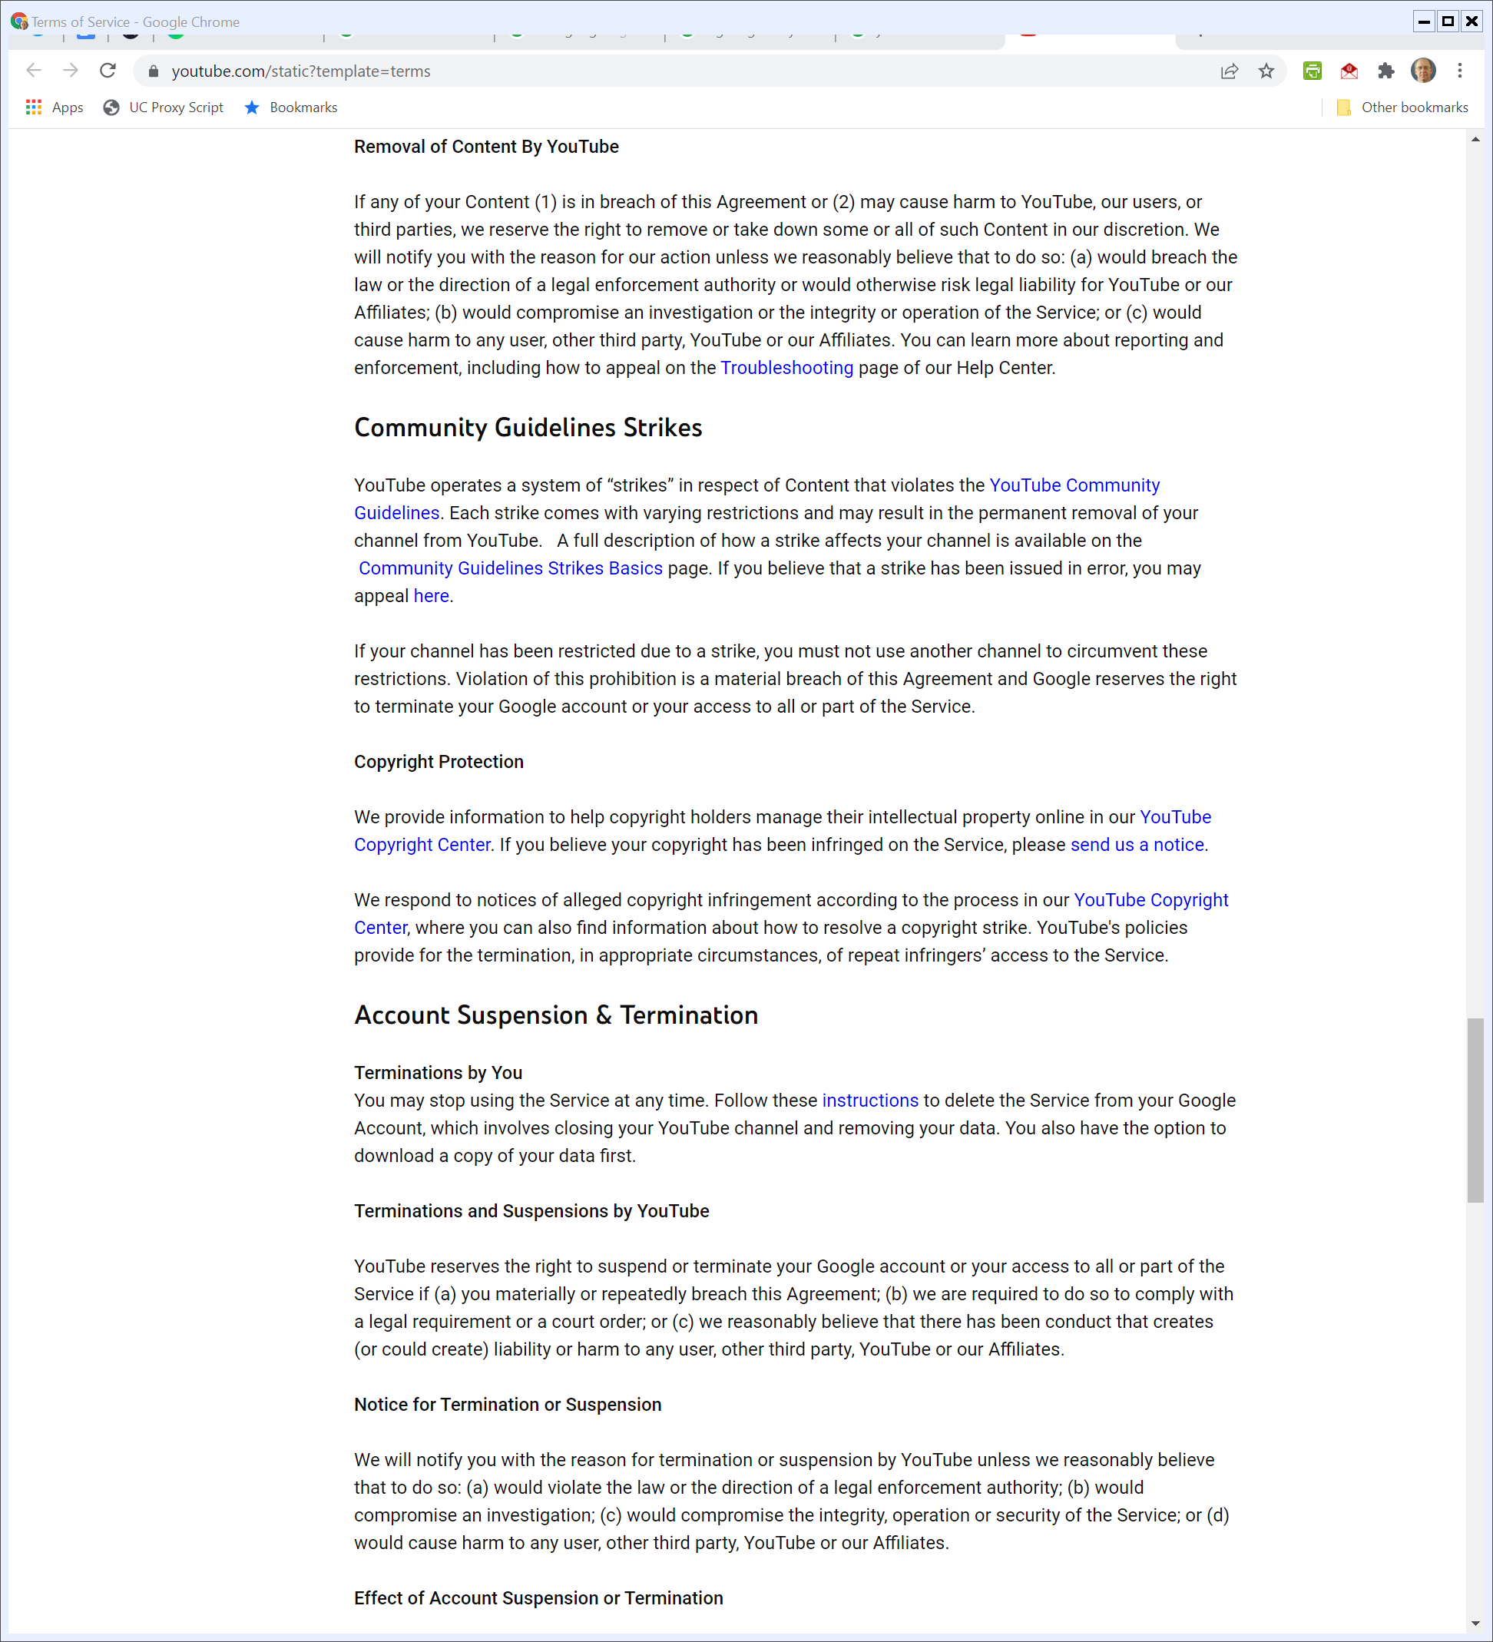
Removal of Content
YouTube (Visited 23 Feb 2022)

Slide 36
Strikes and Alleged Copyright Infringement
YouTube (Visited 23 Feb 2022)

Slide 37
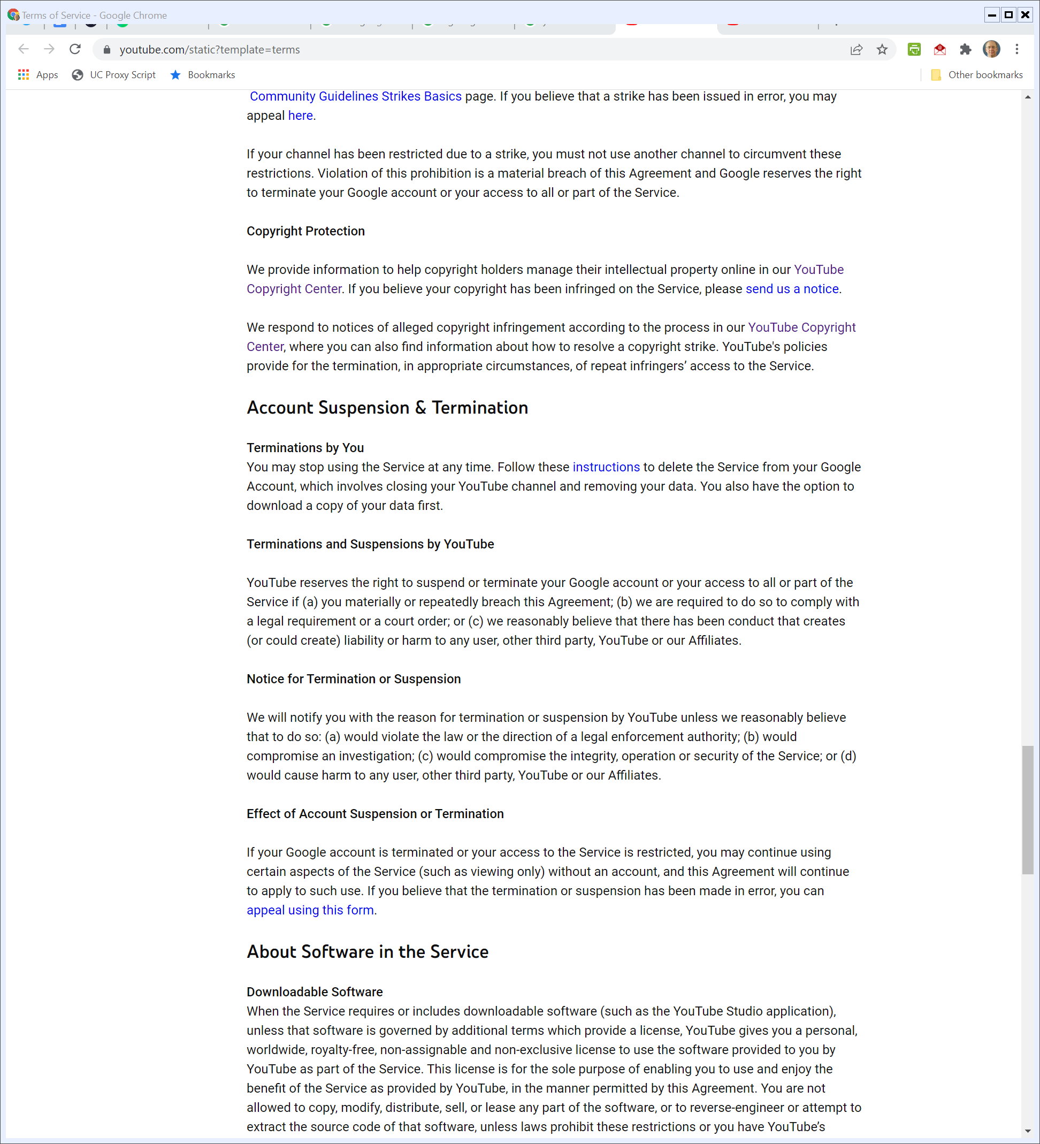
Account Termination
YouTube (Visited 23 Feb 2022)

Slide 38
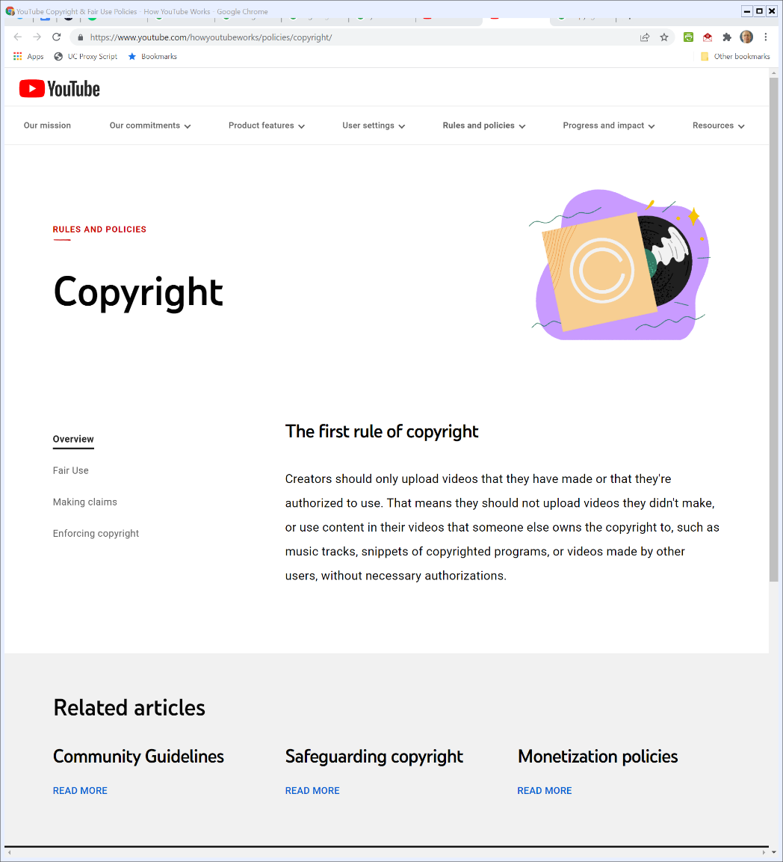

“The First Rule of Copyright”
YouTube (Visited 23 Feb 2022)
Notes:
https://www.youtube.com/howyoutubeworks/policies/copyright/

Slide 39
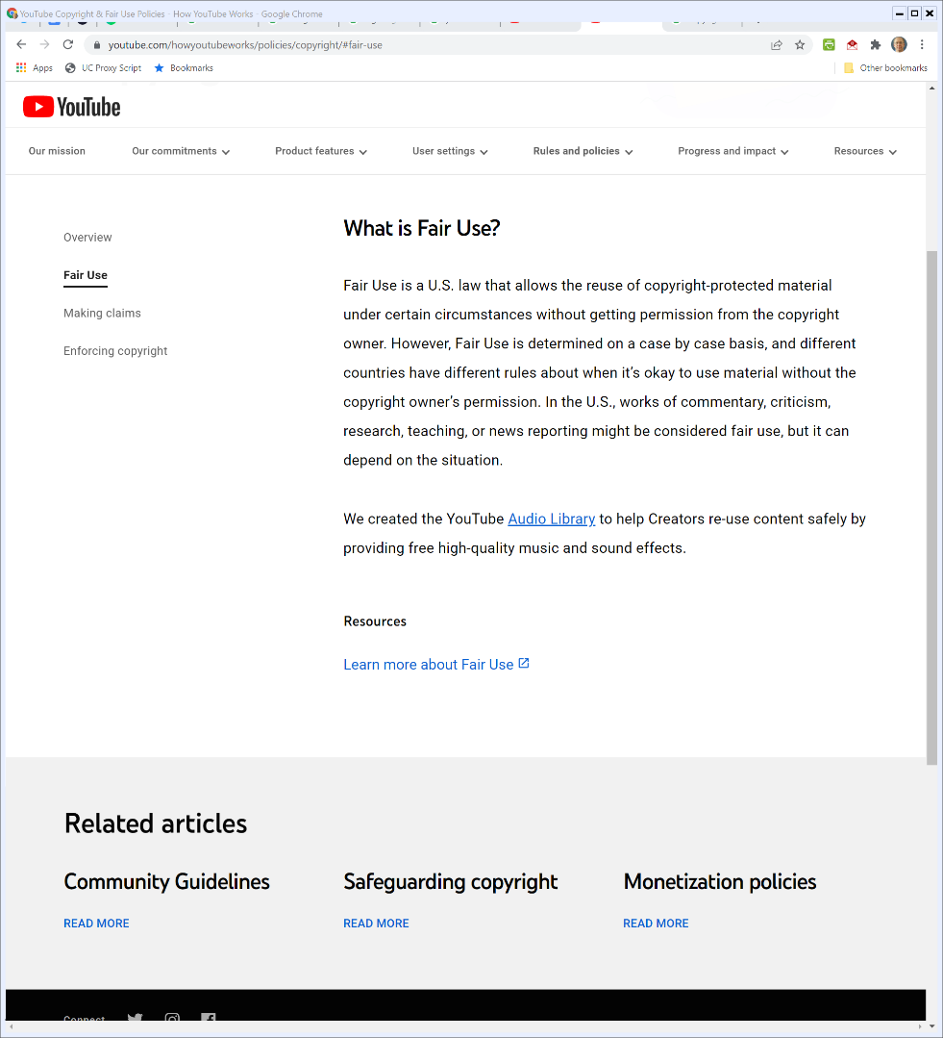
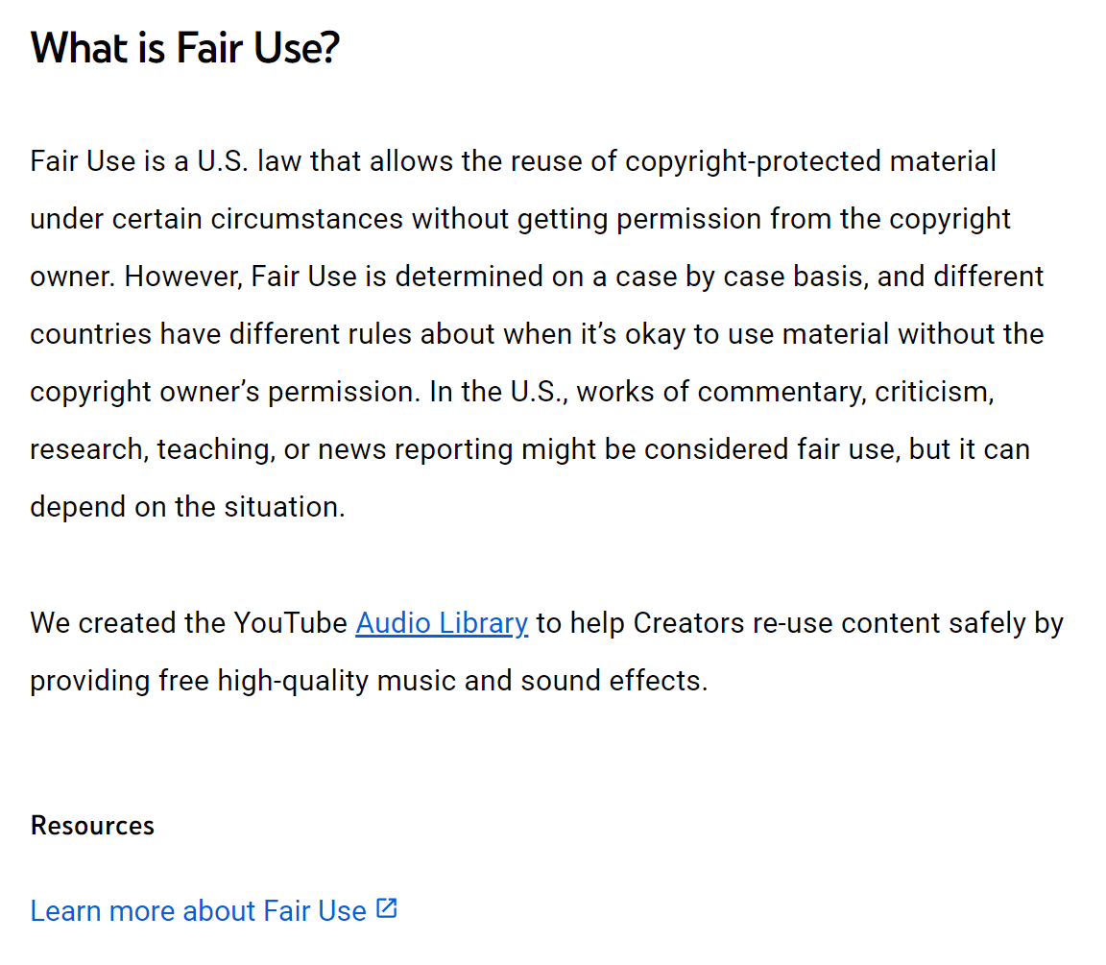
And Fair Use?
YouTube (Visited 23 Feb 2022)

Slide 40
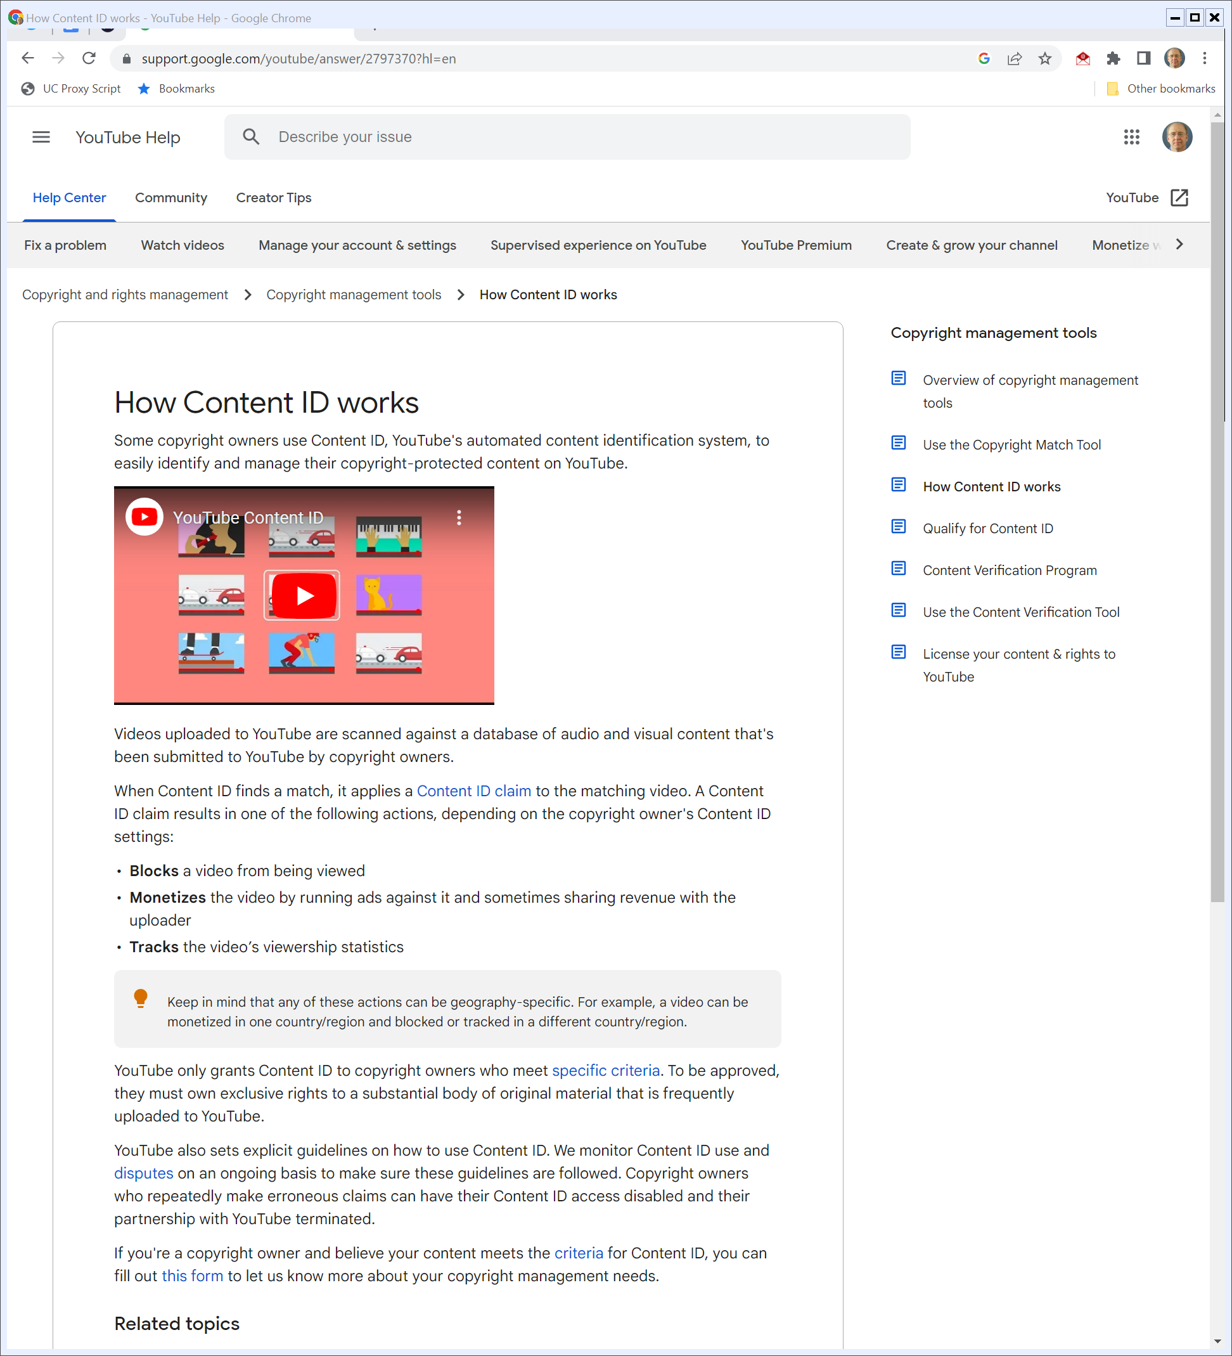
Content ID System
Google (Visited 16 Nov 2022)
Notes:
https://support.google.com/youtube/answer/2797370?hl=en

Slide 41
Content ID System
Google (Visited 16 Nov 2022)

Slide 42
Content ID Stats
How Google Fights Piracy (Nov 2018)

Slide 43
And A Response
EFF (Dec 2020)

Slide 44
YouTube Appeasement: Fair Use Replaced
EFF (Dec 2020)

Slide 45
How YouTube Distorts Speech
EFF (Dec 2020)

Slide 46
Content ID and Fair Use
EFF (Dec 2020)

Slide 47
Lenz
815 F.3d 1145 (9th Cir. 2016)

Slide 48
512(c)(3)(A)(v) (TTYN (1 of 3))
“(v) A statement that the complaining party has a good faith belief that use of the material in the manner complained of is not authorized by the copyright owner, its agent, or the law.”
17 USC 512

Slide 49
Two Links on YouTube
TTYN (2 of 3)
Link 1
Here (aXJhDltzYVQ)
Link 2
Here (N1KfJHFWlhQ)

Slide 50
Fair Use and Section 512
TTYN (3 of 3)
Questions
Is Lenz’s use of the Prince song fair use under Section 107?
How does the answer to that question matter for the Section 512 analysis?
How is Universal supposed to evaluate fair use?

Slide 51
Must Consider Fair Use Before Sending Notification
“We conclude that because 17 U.S.C. § 107 created a type of non-infringing use, fair use is ‘authorized by the law’ and a copyright holder must consider the existence of fair use before sending a takedown notification under § 512(c).”
815 F.3d 1145 (9th Cir. 2016)

Slide 52
BMG v. Cox
881 F.3d 293 (4th Cir. 2018)

Slide 53
BMG: Repeat Infringers and Section 512(i)
Key Question
What are the obligations of an ISP as to repeat infringers?

Slide 54
512(i): Repeat Infringers Policy
17 USC 512

Slide 55
BMG on Contributory Infringement
BMG Proposed Instructions (14 Dec 2015)

Slide 56
Cox 2018 Version
Cox Proposed Instructions (21 Aug 2018)

Slide 57
Role of Jury Instructions
Jury Instructions (16 Dec 2015)

Slide 58
Direct Infringment
Jury Instructions (16 Dec 2015)

Slide 59
Contributory Infringement
Jury Instructions (16 Dec 2015)

Slide 60
Contributory Infringement
Jury Instructions (16 Dec 2015)

Slide 61
Vicarious Infringement
Jury Instructions (16 Dec 2015)

Slide 62
Applying This Here
TTYN
Jury Result
Cox liable for willful contributory copyright infringement but not for vicarious infringement
How should we apply these standards to Cox’s actions?

Slide 63
13 Strikes and You Are Out (sort of) Doesn’t Cut It
“Cox failed to qualify for the DMCA safe harbor because it failed to implement its policy in any consistent or meaningful way—leaving it essentially with no policy. Accordingly, the district court did not err in holding that Cox failed to offer evidence supporting its entitlement to the § 512(a) safe harbor defense and therefore granting summary judgment on this issue to BMG.”
BMG (4th Cir. 2018)

Slide 64
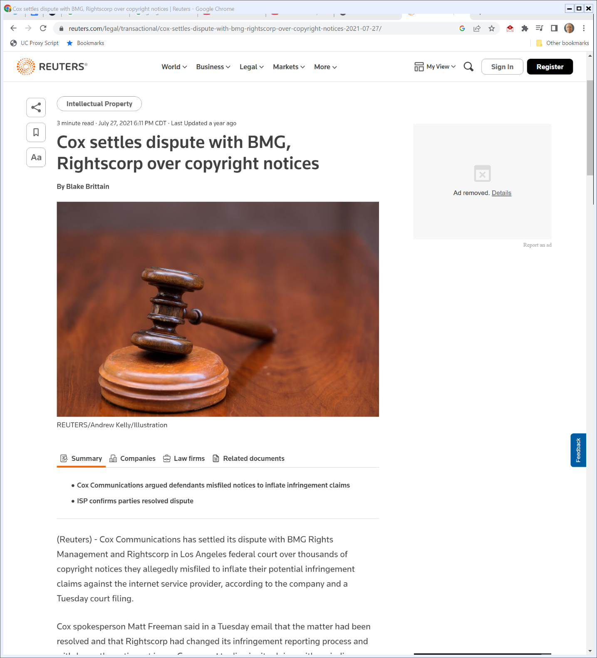
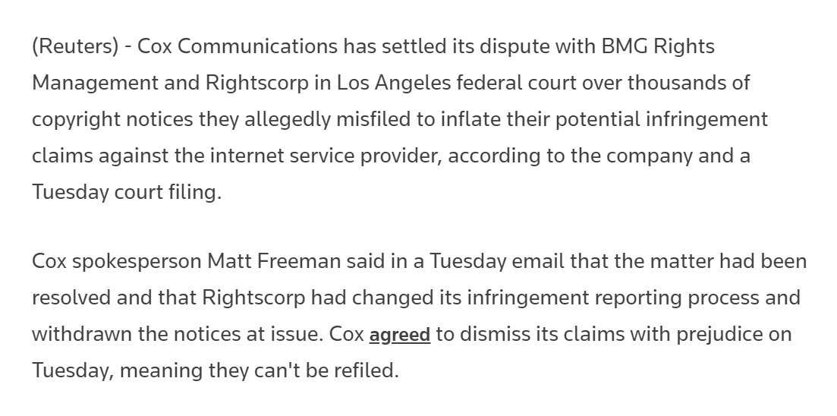
July 2021: Cox, BMG Settle
Reuters (27 July 2021)
Notes:
https://www.reuters.com/legal/transactional/cox-settles-dispute-with-bmg-rightscorp-over-copyright-notices-2021-07-27/

