Slide 1
Class 18: Thurs 1 May 2025 Copyright Spring 2025 Internet Copying
Randal C. Picker
James Parker Hall Distinguished Service Professor of Law
The Law School
The University of Chicago

Slide 2
Three Angles on Liability
1. Direct Infringement
Most of what we have done this quarter
2. Secondary Liability
When can one person be held liable for the infringement of another (vicarious liability, secondary liability)
Sony, Grokster

Slide 3
Three Angles on Liability
3. Safe Harbors
DMCA (17 USC 512)
Core of this: no liability for acts of users if …
Doesn’t create safe harbor for website’s own acts
More on this in next class

Slide 4
ARPANET December 1969
BBN Report No. 4799 (Apr 1981)

Slide 5
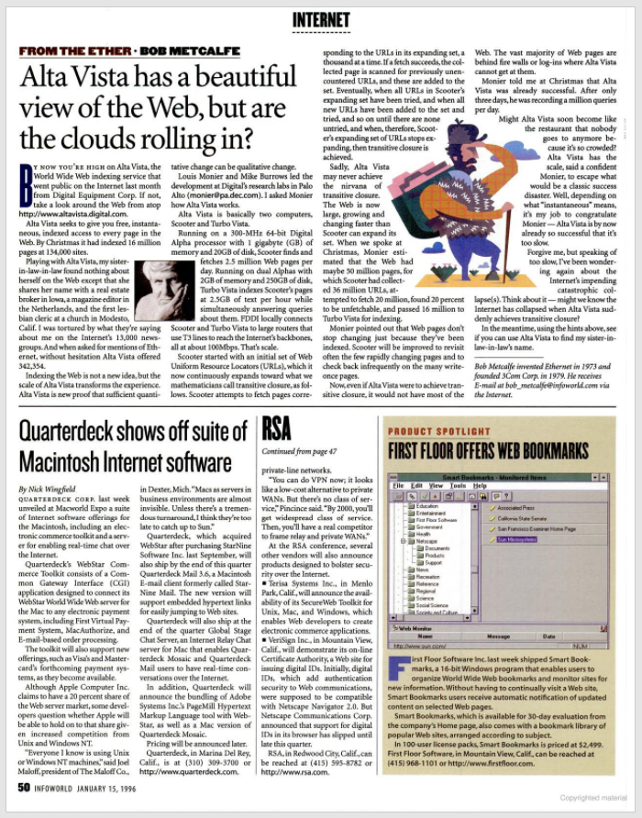
Before Google
InfoWorld (15 Jan 1996)

Slide 6
Yahoo!!
“This much is clear: Yahoo! has won the search-engine wars and is poised for much bigger things.”
Fortune (2 Mar 1998)

Slide 7
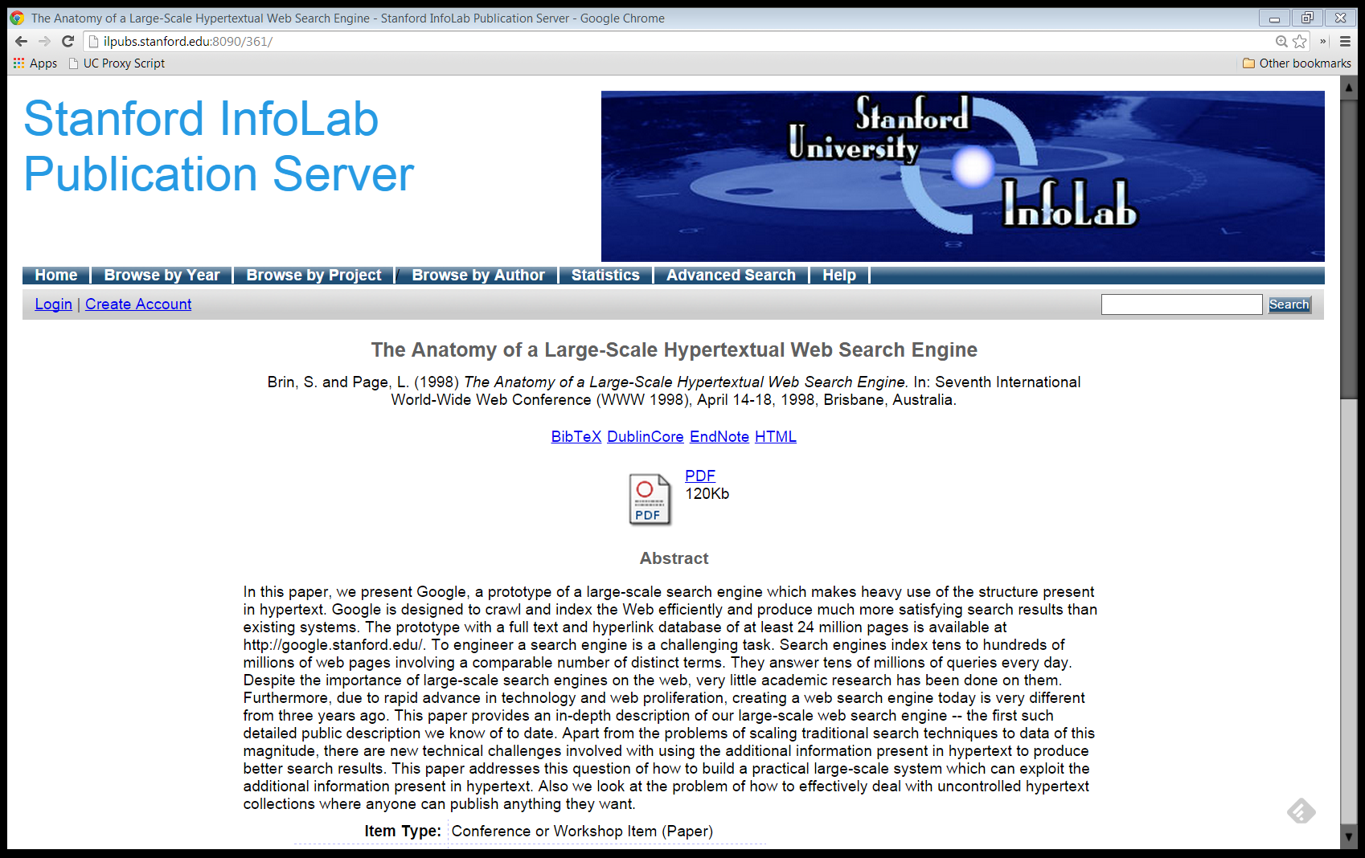
1998 Google Paper
Brin & Page (1998)

Slide 8
A Prototype Search Engine
“In this paper, we present Google, a prototype of a large-scale search engine which makes heavy use of the structure present in hypertext.”
Brin & Page (1998)

Slide 9
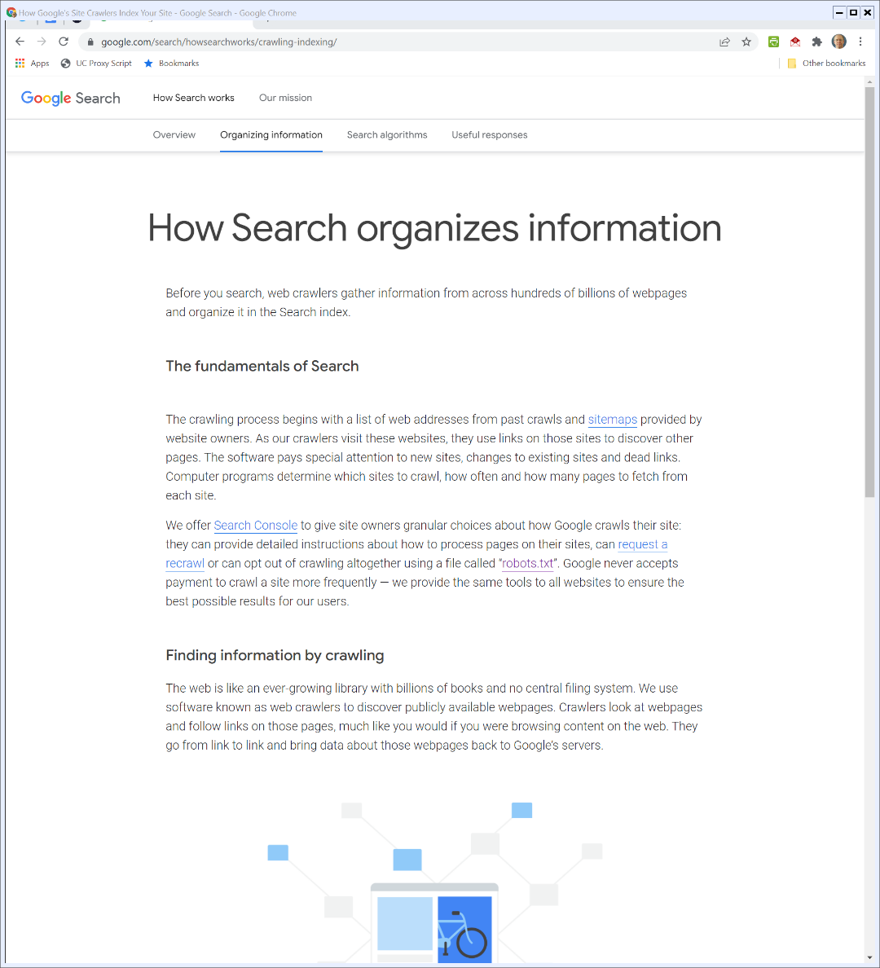
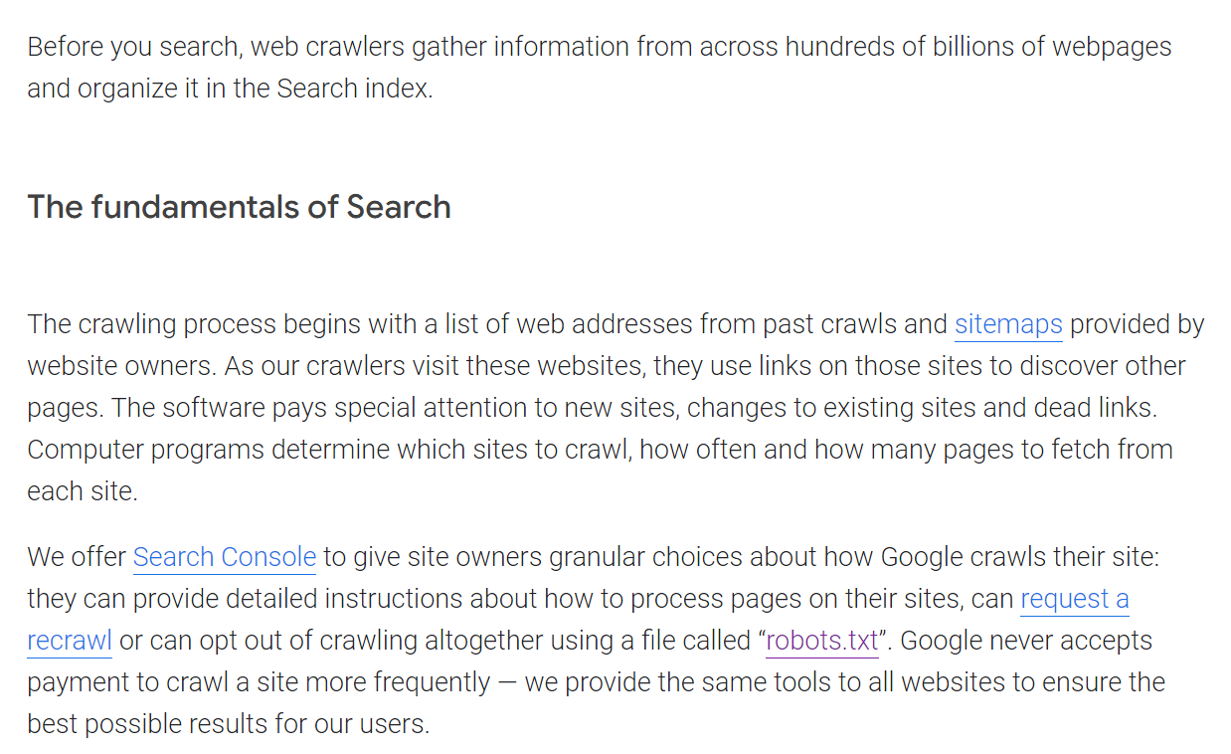
How Google Builds an Index
Google (Visited 20 Feb 2022)
Notes:
https://www.google.com/search/howsearchworks/crawling-indexing/

Slide 10
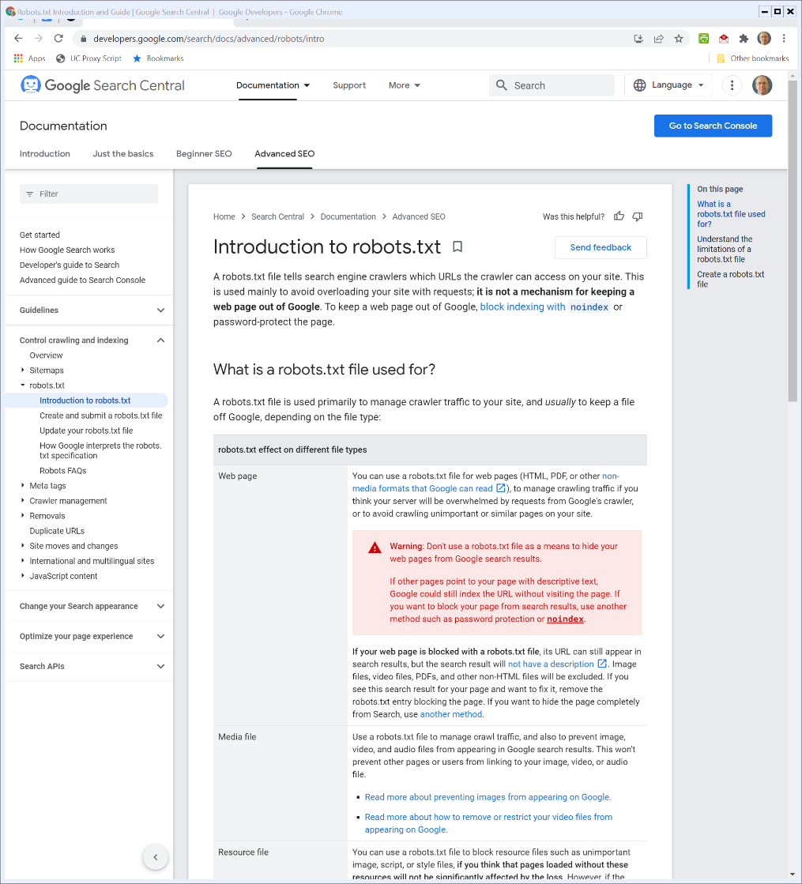

Robots.txt
Google Developer (Visited 18 Feb 2022)
Notes:
https://developers.google.com/search/docs/advanced/robots/intro

Slide 11
Brin & Page on Copyright
“It turns out that running a crawler which connects to more than half a million servers, and generates tens of millions of log entries generates a fair amount of email and phone calls. … There are also some people who do not know about the robots exclusion protocol, and think their page should be protected from indexing by a statement like, ‘This page is copyrighted and should not be indexed’, which needless to say is difficult for web crawlers to understand.”
Brin & Page (1998)

Slide 12
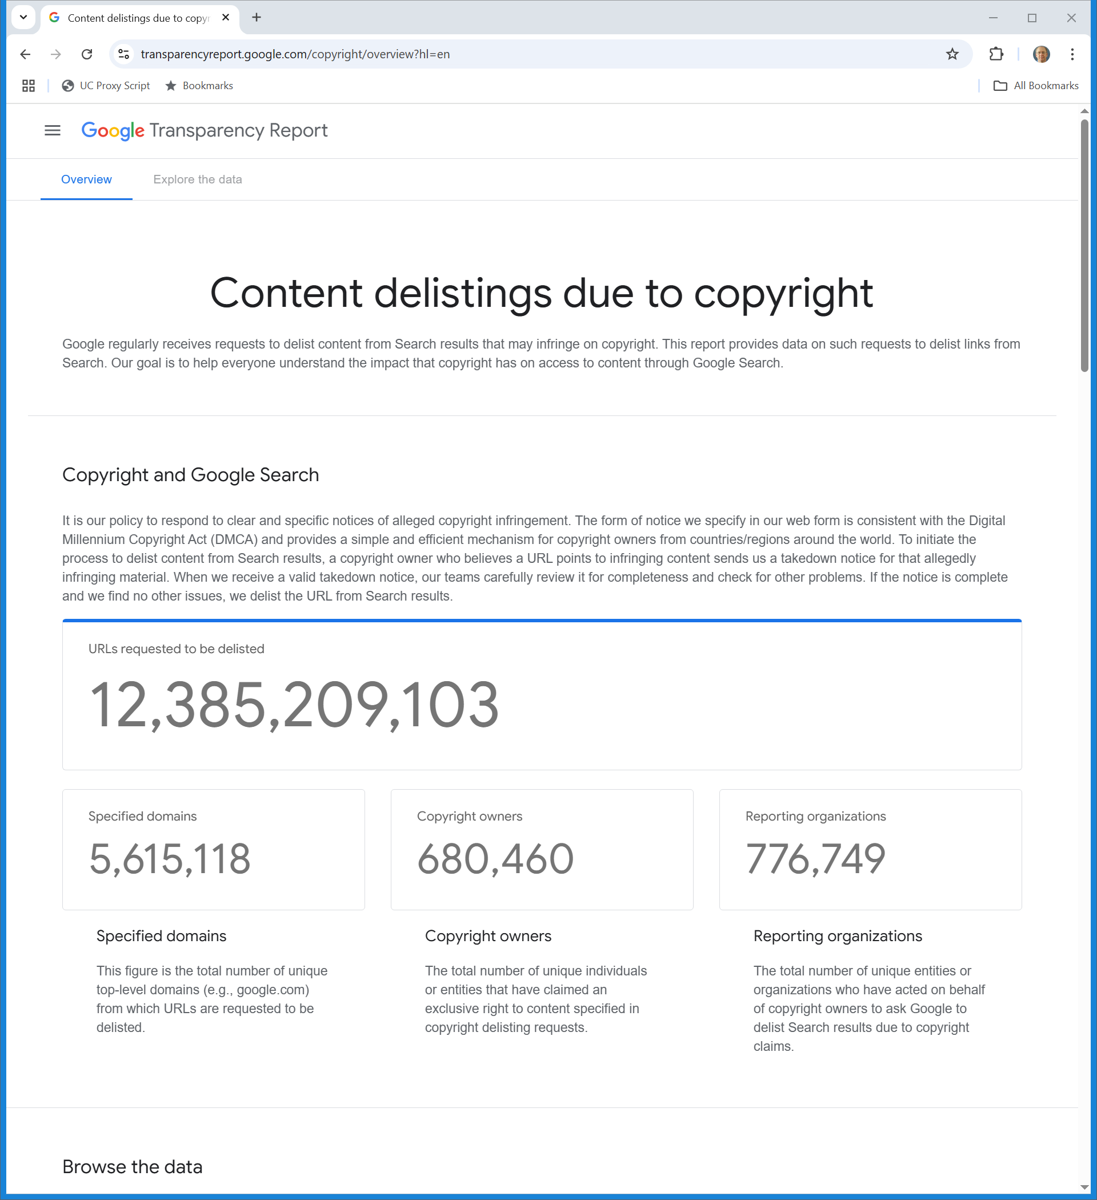
Google Delisting
Google Transparency Report (Visited 1 May 2025)
Notes:
https://transparencyreport.google.com/copyright/overview?hl=en

Slide 13
Google Delisting
Google Transparency Report (Visited 1 May 2025)
Notes:
https://transparencyreport.google.com/copyright/overview?hl=en

Slide 14
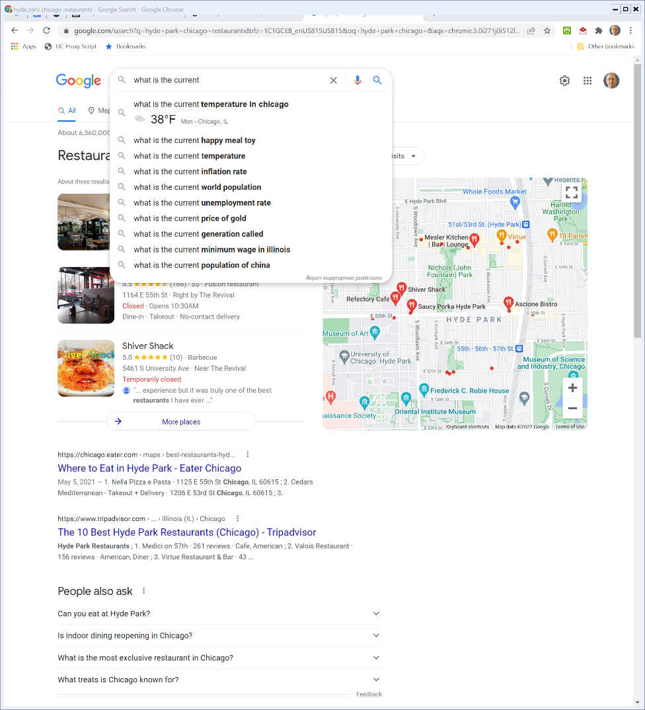

“What Is The Current …” (TTYN (1 of 6))
Google (21 Feb 2022)

Slide 15
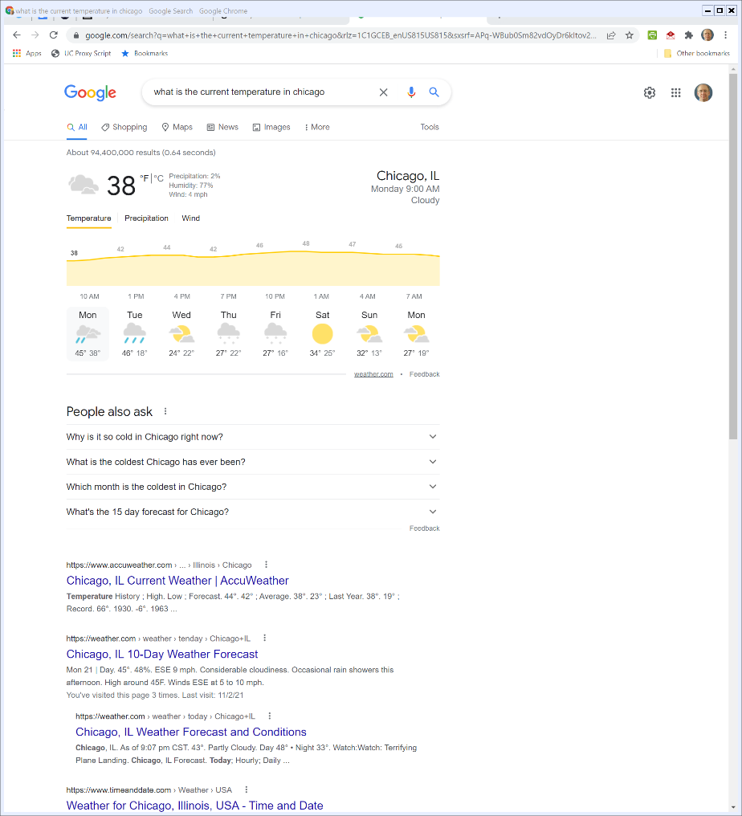
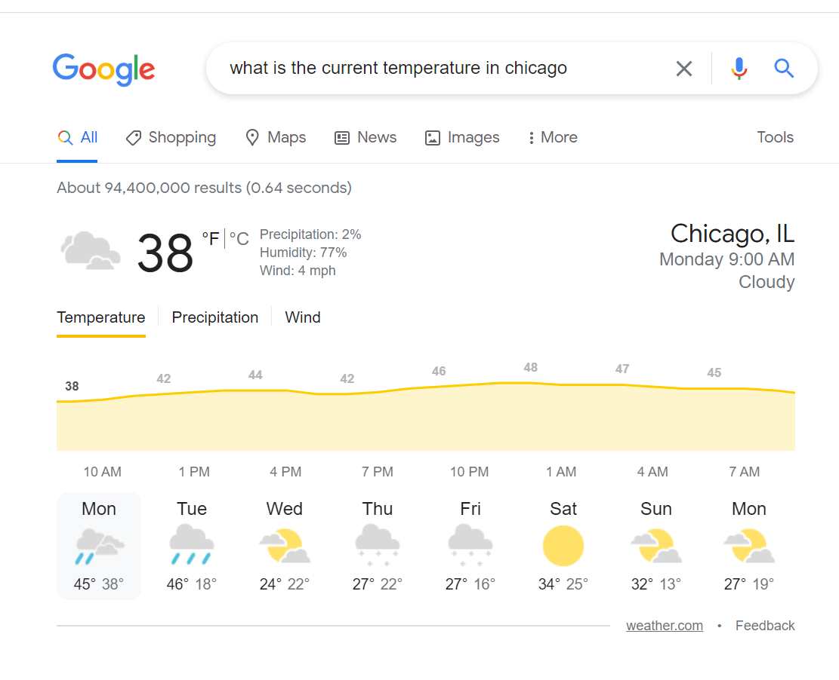
Current Temperature on Google (TTYN (2 of 6))
Google (21 Feb 2022)

Slide 16
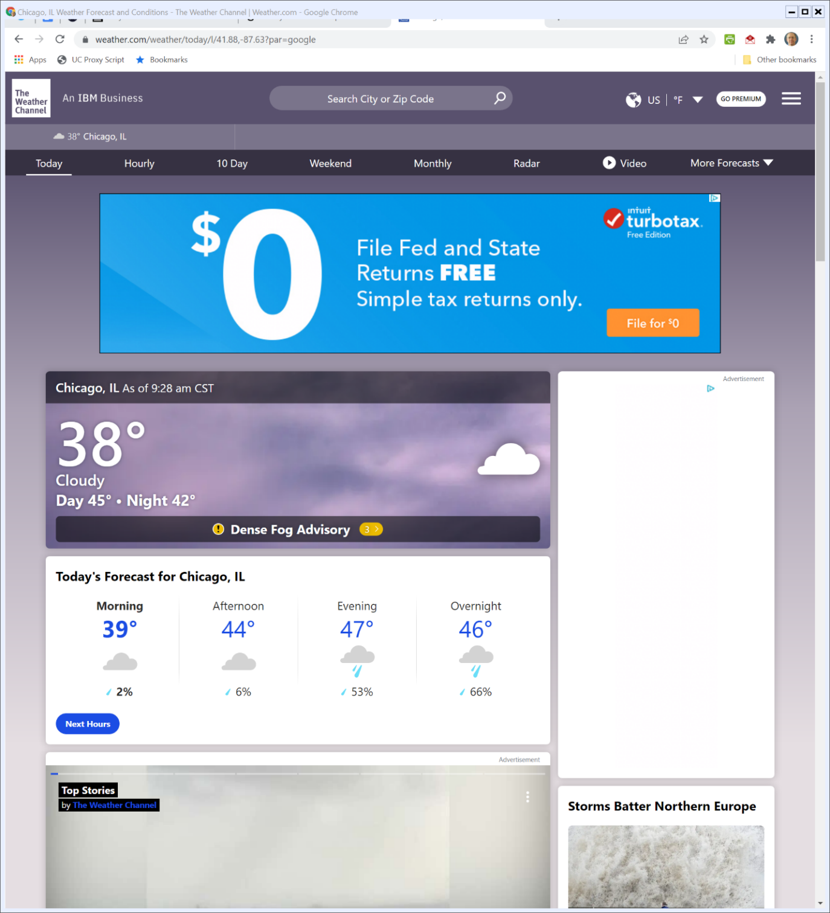
Visiting Weather.com (TTYN (3 of 6))
Weather.com (Visited 21 Feb 2022)

Slide 17
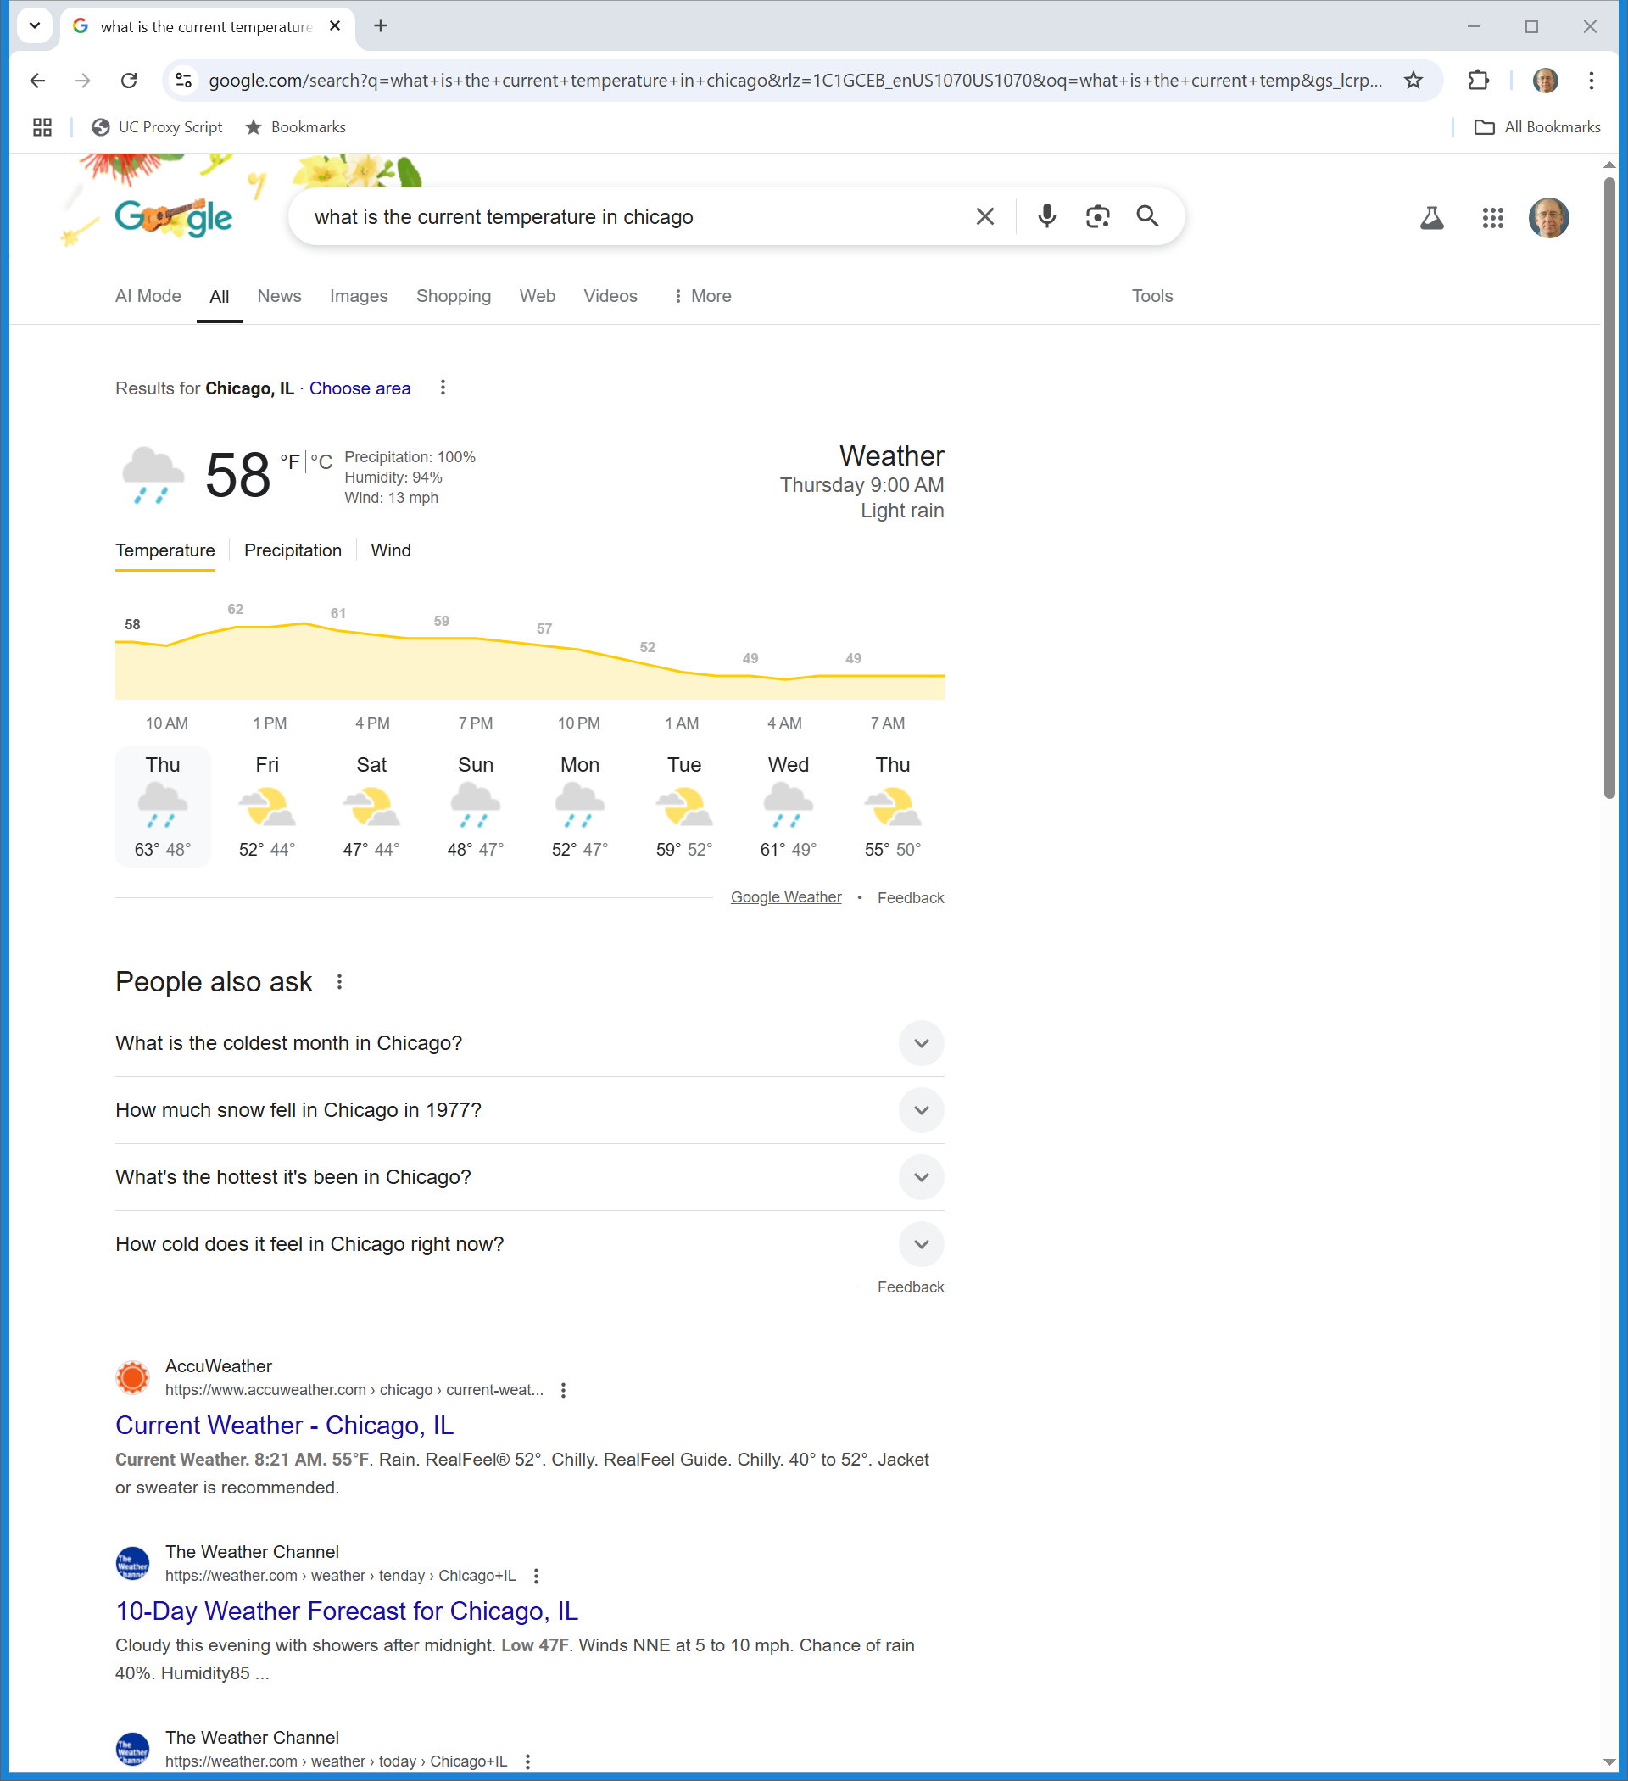
Again (TTYN (4 of 6))
Google (1 May 2025)

Slide 18
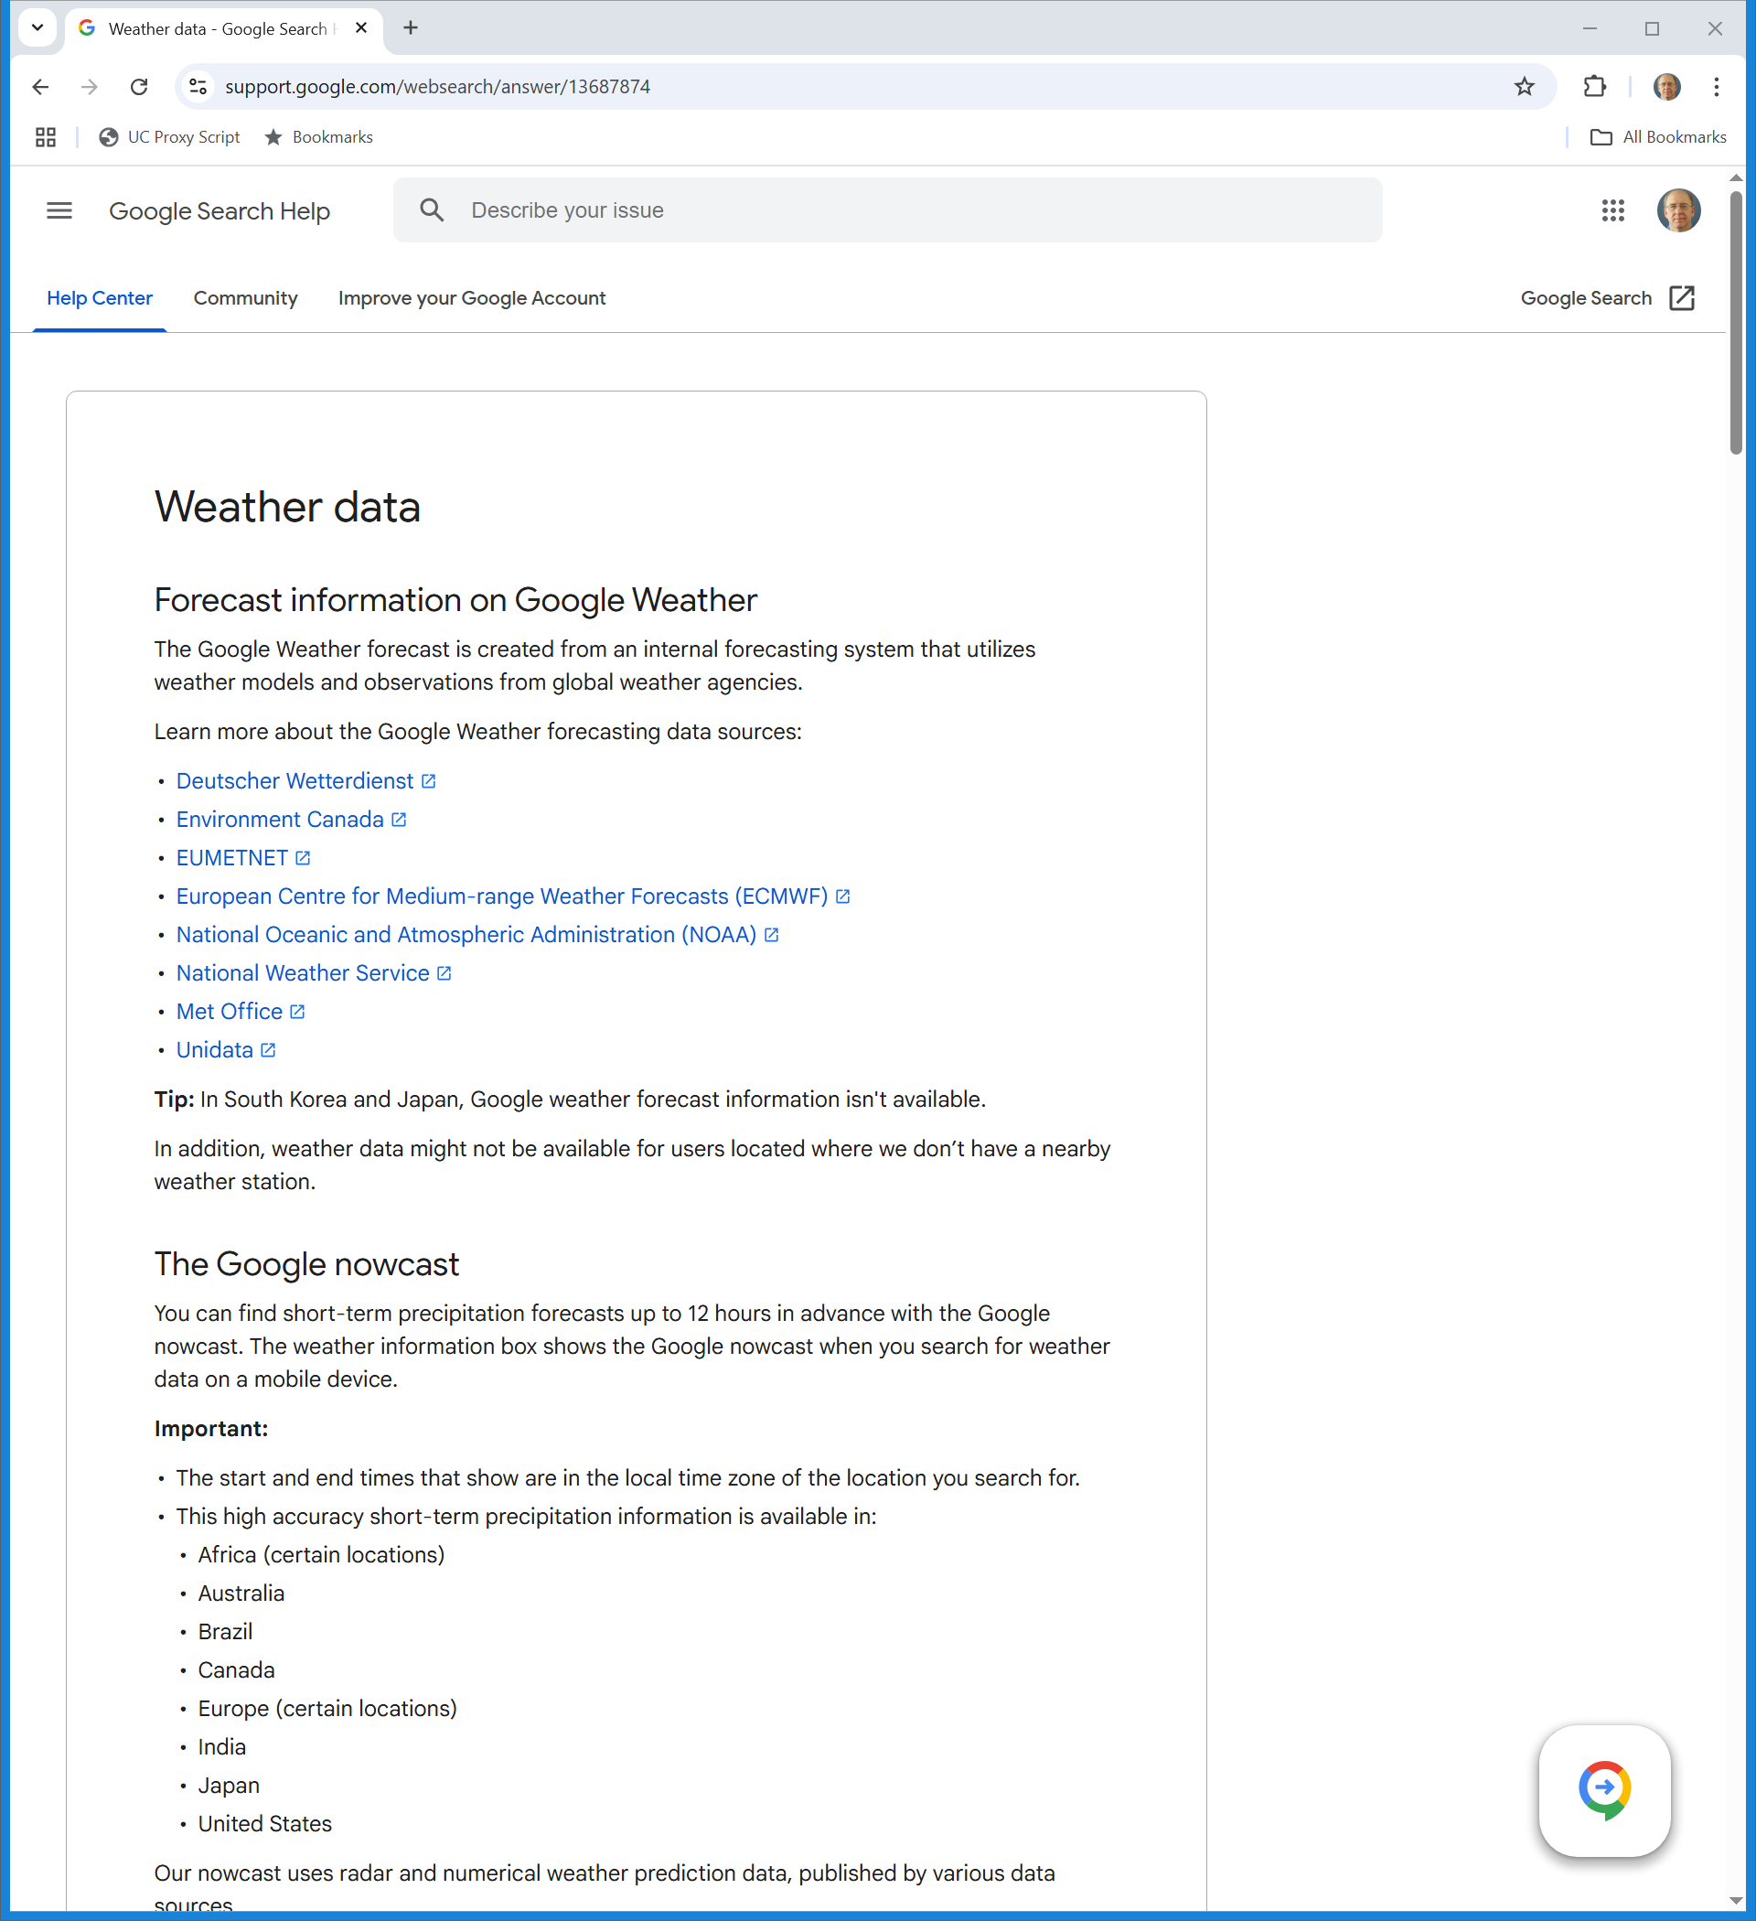
Google Weather (TTYN (5 of 6))
Google (1 May 2025)

Slide 19
Applying Copyright Here
TTYN (6 of 6)
Questions
What are the copyright issues raised here? Does the existence of robots.txt/noindex matter for this?
Does Google violate underlying copyrights when it presents info like this? Should that be seen as fair use?

Slide 20
Perfect 10
508 F.3d 1146 (9th Cir. 2007)

Slide 21
Seeing Infringing Material
TTYN (1 of 6)
Hypo 1
An art gallery has a painting hidden behind a screen
The visitor pushes a button to cause the screen to open to reveal the image
Suppose the painting is infringing. Who displays it? The gallery? The visitor?

Slide 22
Seeing Infringing Material
TTYN (2 of 6)
Hypo 2
Website S posts infringing image at URL
R learns of that URL and downloads the image
Putting fair use to the side: Is the website S a direct infringer? Is R? Both? Is this under 106(1)? 106(2)? 106(3)? 106(5)?

Slide 23
Seeing Infringing Material
TTYN (3 of 6)
Hypo 3
User U posts infringing image at URL on website S
R learns of that URL and downloads the image
Putting fair use to the side: Is website S a direct infringer? Is U? Is R? Any? All?

Slide 24
Seeing Infringing Material
TTYN (4 of 6)
Hypo 4
Website S again posts infringing image at URL
G tells that URL to R
R downloads the image
Putting fair use to the side: Is website S a direct infringer? Is R? Is G? Is G a secondary infringer?

Slide 25
Seeing Infringing Material
TTYN (5 of 6)
Questions
Does it matter if Google shows a thumbnail of the image, in addition to offering a link, in response to the search query?
And does it matter if after the link is clicked it is presented inline?
Suppose it just appears inline without a click?

Slide 26
Display, Distribution and Derivative Works
TTYN (6 of 6)
Three Questions
Who displays an image? The server where it is stored? The entity providing the html code to invoke the presentation of the image? The creator of the browser? The person who clicks the link? Someone else? Any? All?
Same questions re distribution
Is an in-line linked page a derivative work?

Slide 27
URLs via G Aren’t Directly Infringing
“Providing these HTML instructions is not equivalent to showing a copy. First, the HTML instructions are lines of text, not a photographic image. Second, HTML instructions do not themselves cause infringing images to appear on the user’s computer screen. The HTML merely gives the address of the image to the user’s browser. The browser then interacts with the computer that stores the infringing image. It is this interaction that causes an infringing image to appear on the user’s computer screen.”
Perfect 10 (9th Cir. 2007)

Slide 28
URLs via G Just Raise Secondary Liability Issues
“Google may facilitate the user’s access to infringing images. However, such assistance raises only contributory liability issues, see Metro-Goldwyn-Mayer Studios, Inc. v. Grokster, Ltd., 545 U.S. 913, 929-30 (2005), Napster, 239 F.3d at 1019, and does not constitute direct infringement of the copyright owner’s display rights.”
Perfect 10 (9th Cir. 2007)

Slide 29
And G Isn’t Distributing
“This ‘deemed distribution’ rule does not apply to Google. Unlike the participants in the Napster system or the library in Hotaling, Google does not own a collection of Perfect 10’s full-size images and does not communicate these images to the computers of people using Google’s search engine. Though Google indexes these images, it does not have a collection of stored full-size images it makes available to the public.”
Perfect 10 (9th Cir. 2007)

Slide 30
And G Isn’t Distributing
“Google therefore cannot be deemed to distribute copies of these images under the reasoning of Napster or Hotaling. Accordingly, the district court correctly concluded that Perfect 10 does not have a likelihood of success in proving that Google violates Perfect 10’s distribution rights with respect to full-size images.”
Perfect 10 (9th Cir. 2007)

Slide 31
Answers
Hypo 2
Probably should think of S as liable for infringement under 106(1), (3) and (5)
Possible to think of R as violating 106(1)

Slide 32
Answers
Hypo 3
S could face potential liability under (1), (3) and (5) as before, absent a safe harbor or requirement of a volitional act
See the safe harbors in the next class as we turn to 17 USC 512

Slide 33
Answers
Hypo 4
G is the new actor here and this is Perfect 10
G faces no direct liability for links (second liability not resolved)
G likely to win on fair use re thumbnails

Slide 34
Hunley
Hunley (9th Cir. 17 July 2023)

Slide 35
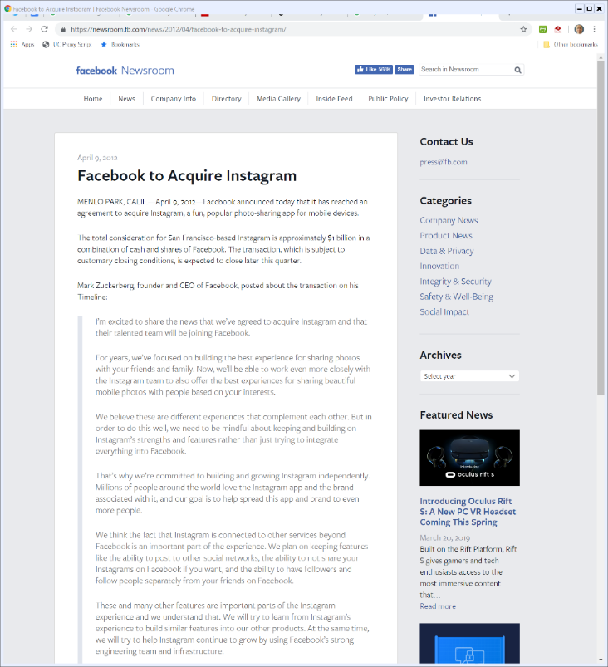

9 Apr 2012: FB Buys Instagram
Facebook PR (9 Apr 2012)
Notes:
https://newsroom.fb.com/news/2012/04/facebook-to-acquire-instagram/

Slide 36
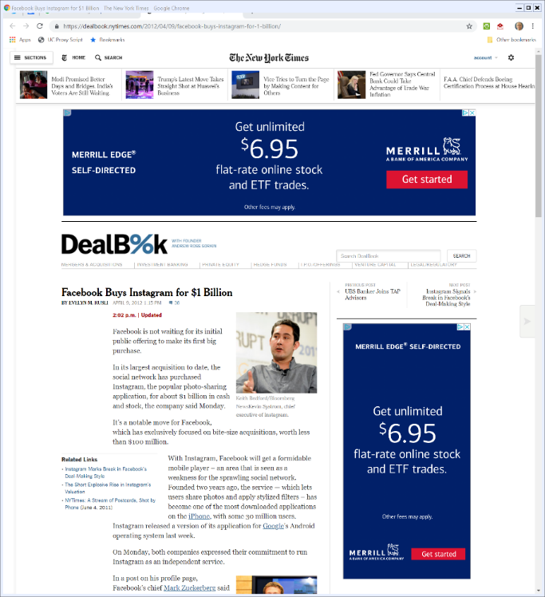

9 Apr 2012: FB Buys Instagram
NYT (9 Apr 2012)
Notes:
https://dealbook.nytimes.com/2012/04/09/facebook-buys-instagram-for-1-billion/

Slide 37
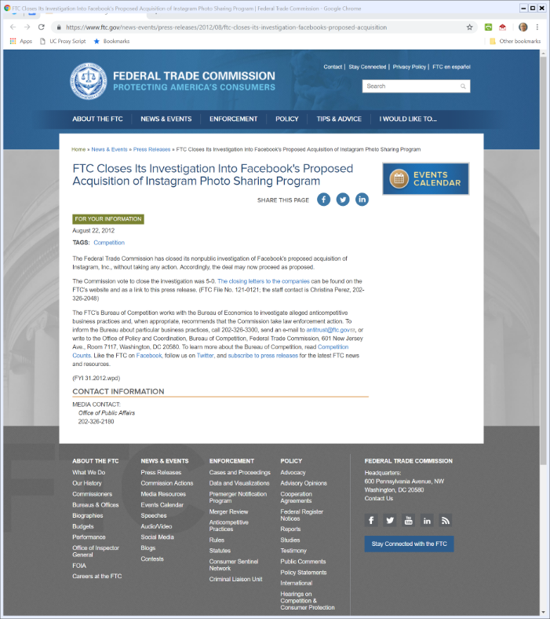
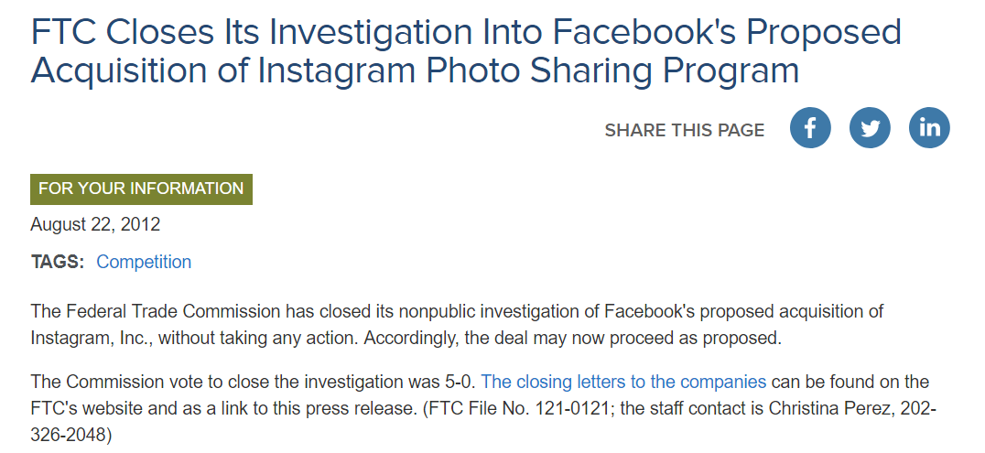
FTC Instagram Review
22 Aug 2012
Notes:
https://www.ftc.gov/news-events/press-releases/2012/08/ftc-closes-its-investigation-facebooks-proposed-acquisition

Slide 38
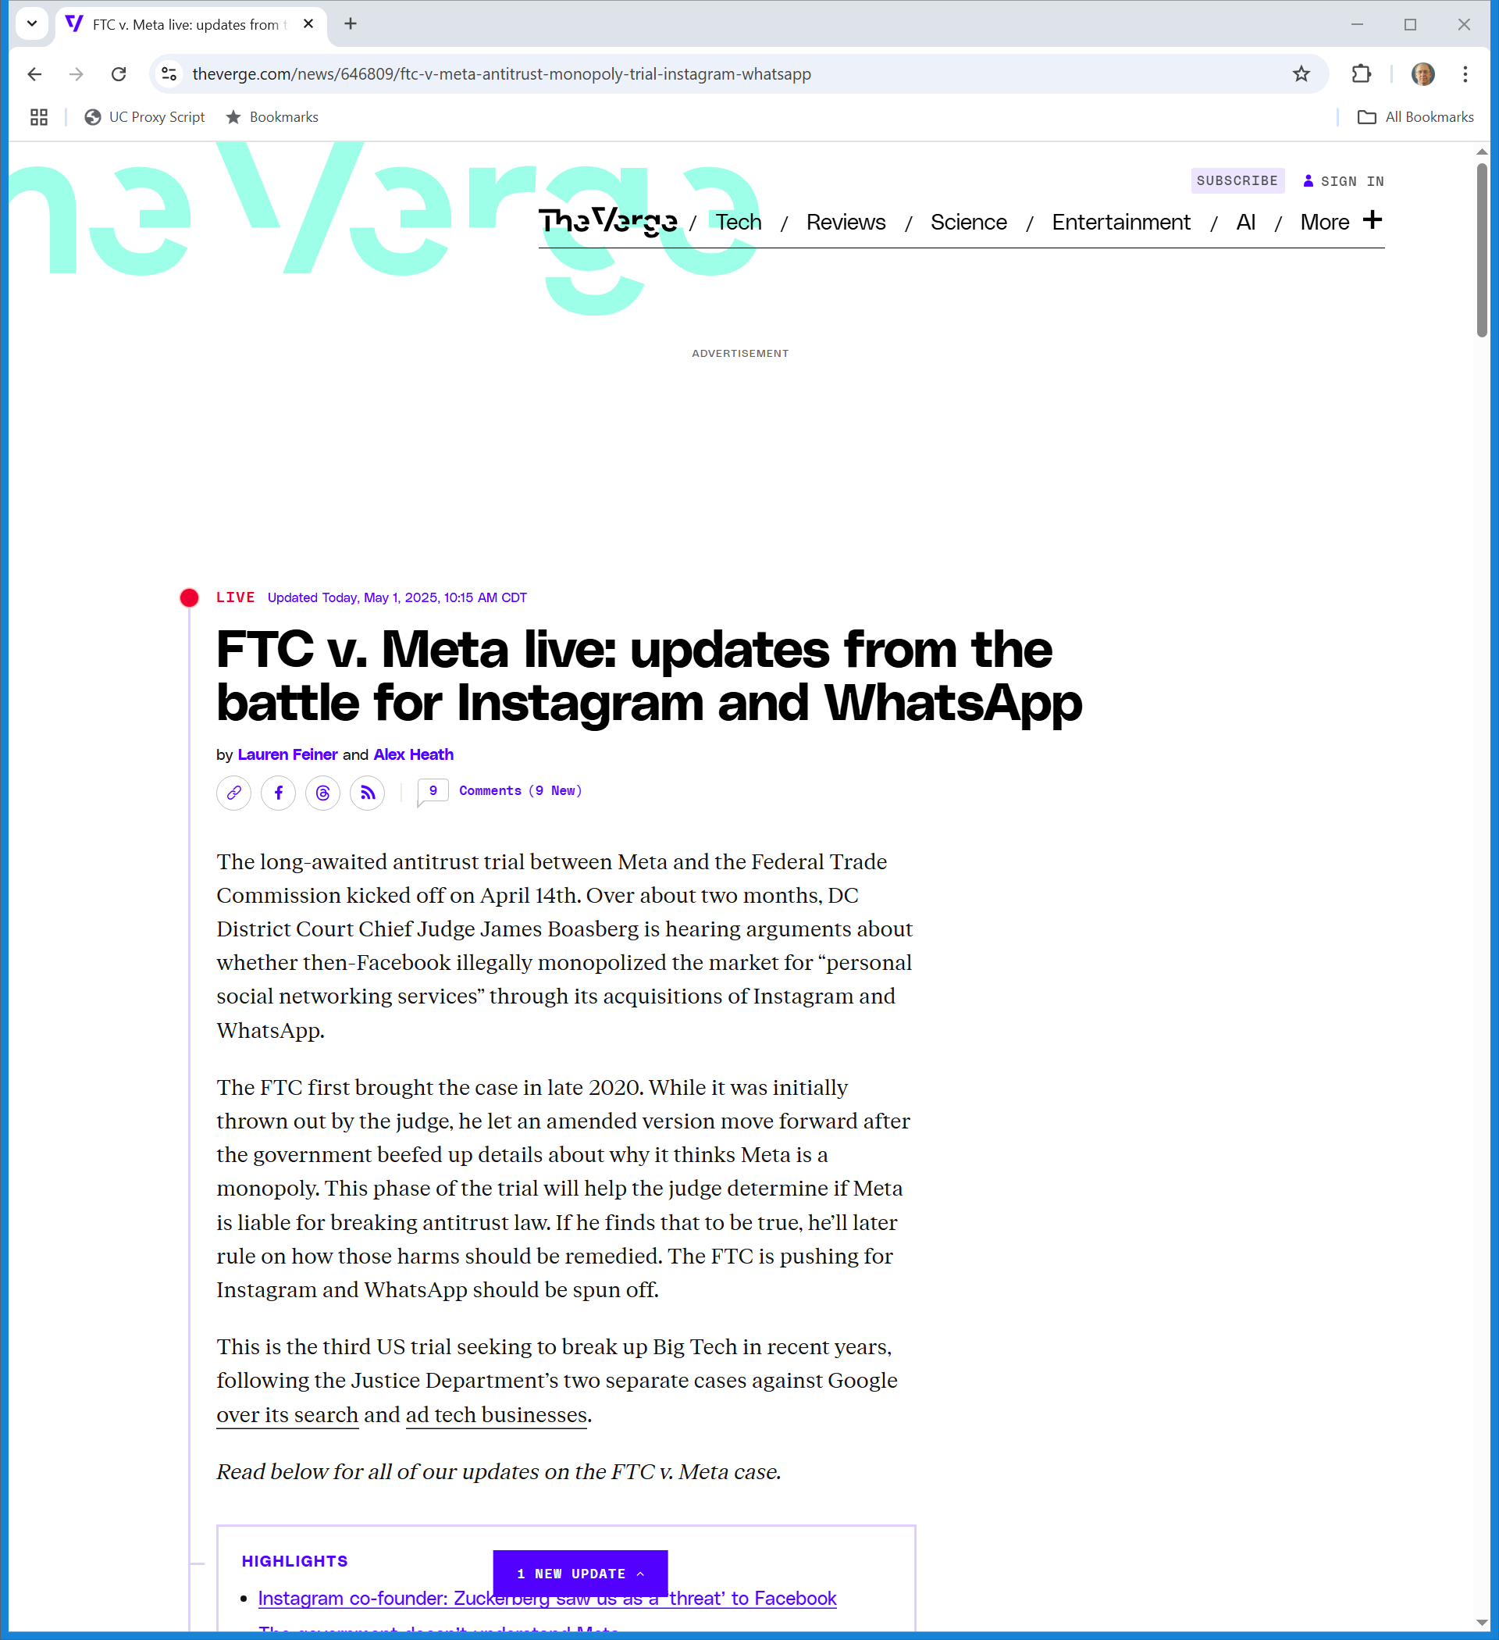
Current Antitrust Trial
The Verge (1 May 2025)
Notes:
https://www.theverge.com/news/646809/ftc-v-meta-antitrust-monopoly-trial-instagram-whatsapp

Slide 39
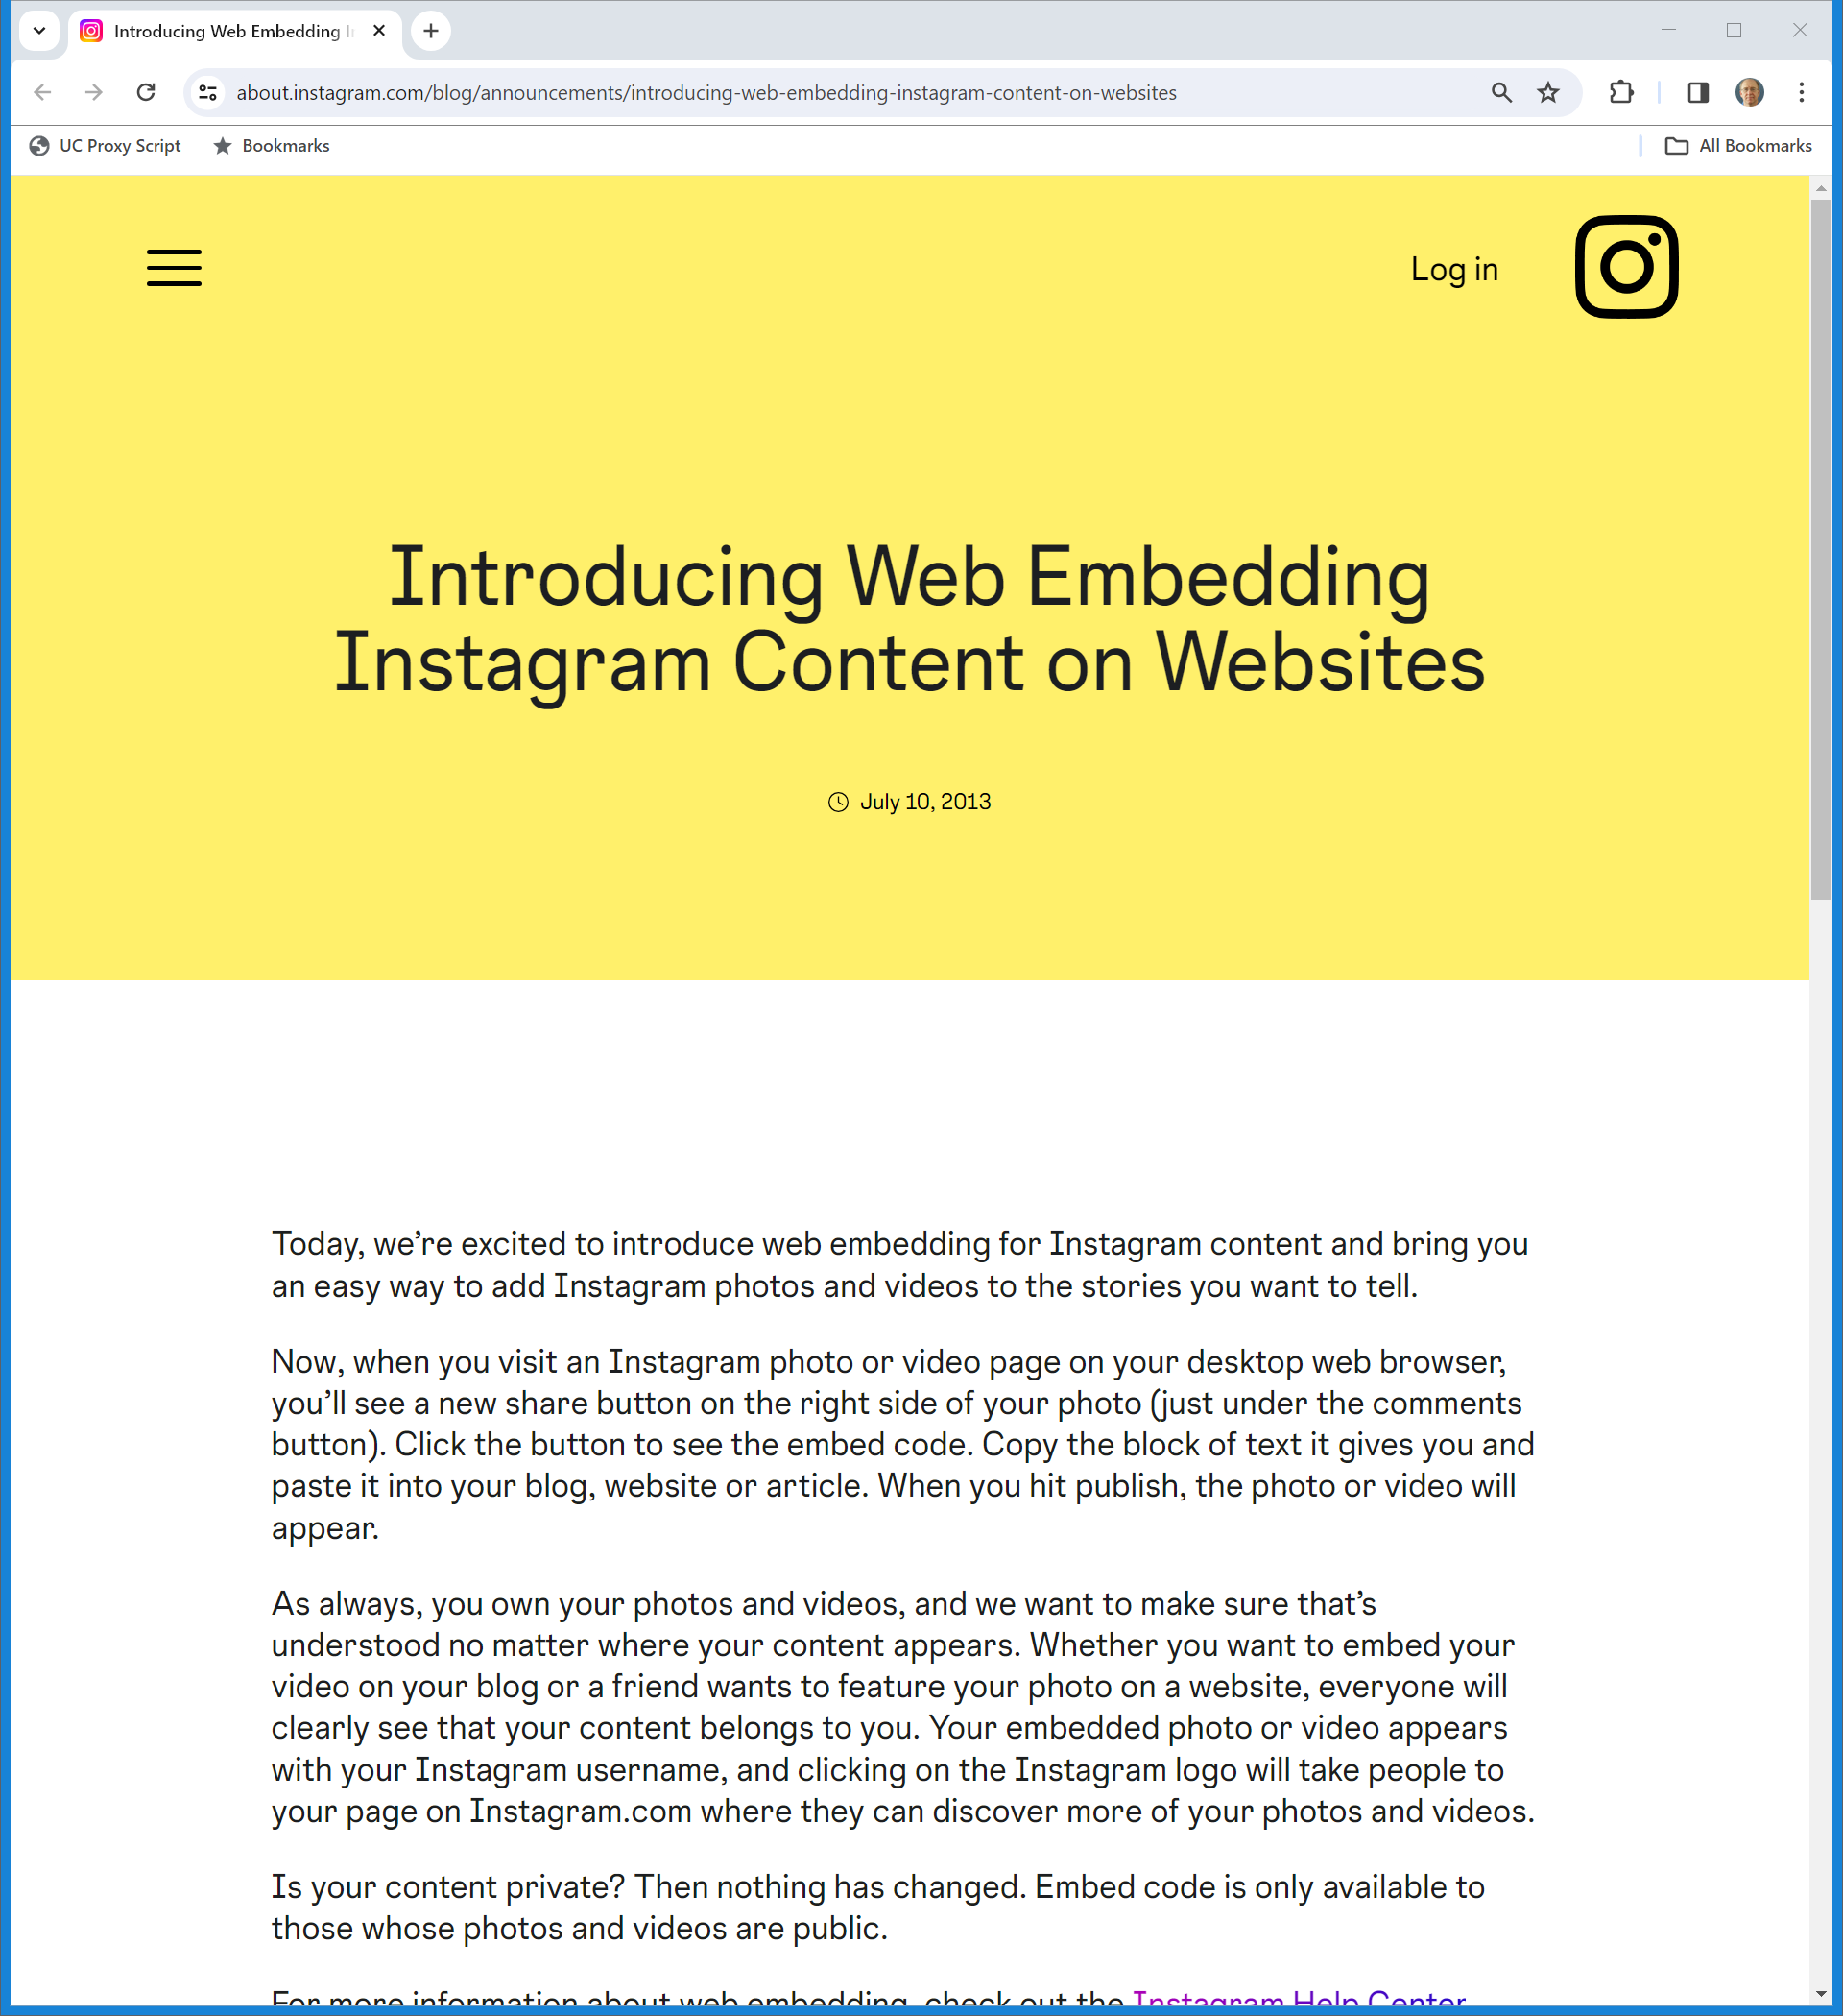
July 2013: IG Introduces Embedding
Instagram Blog (10 July 2013)
Notes:
https://about.instagram.com/blog/announcements/introducing-web-embedding-instagram-content-on-websites

Slide 40
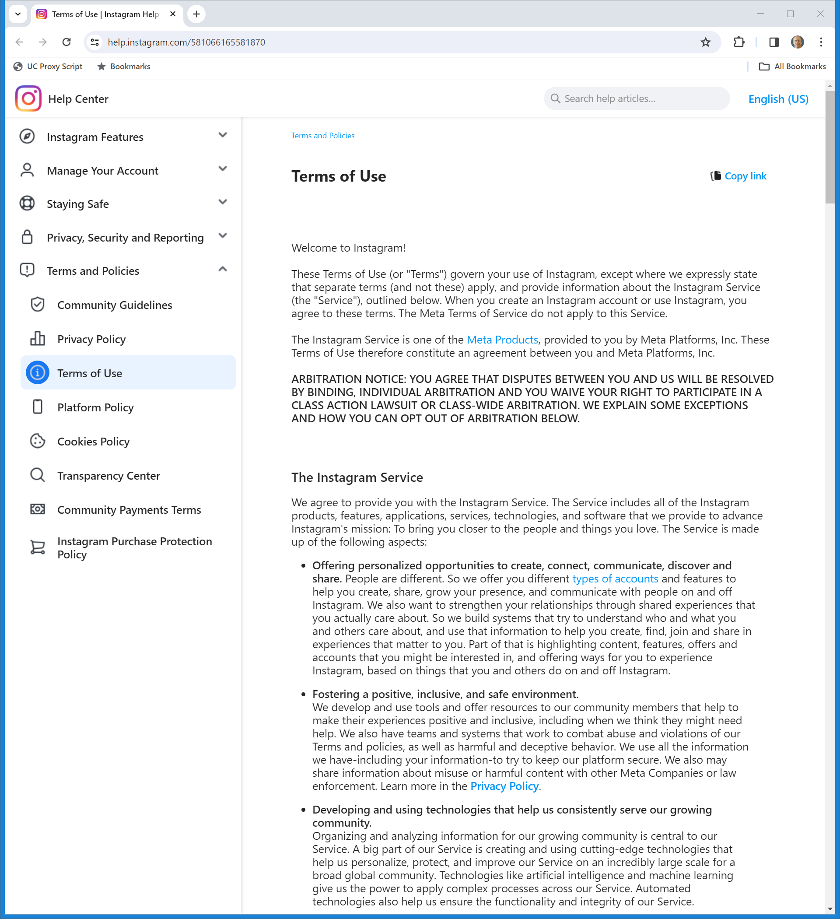
Instagram Terms of Use
IG TOU (Visited 12 Nov 2023)
Notes:
https://help.instagram.com/581066165581870

Slide 41
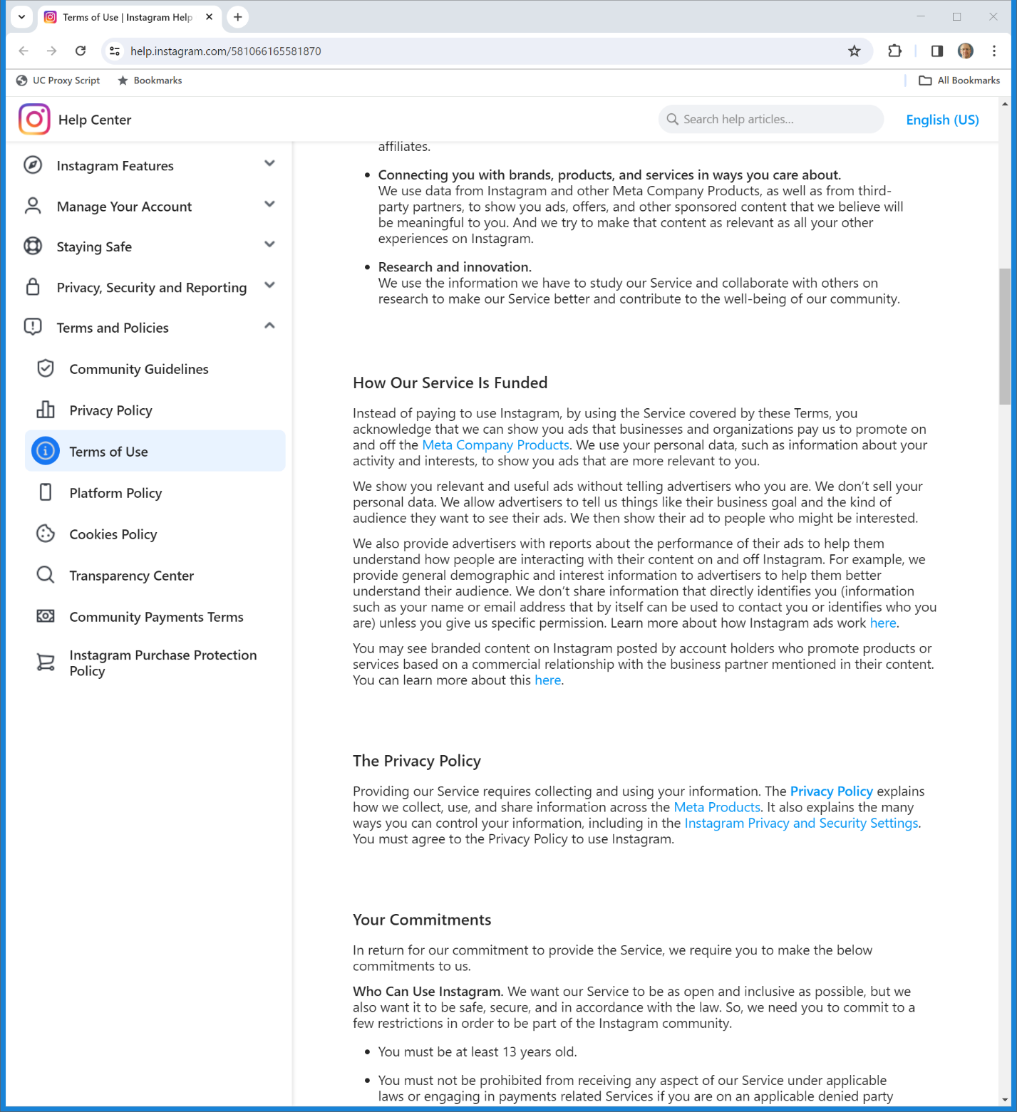
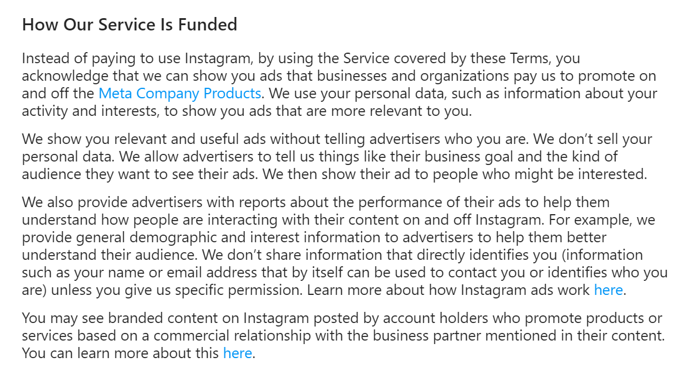
Paying for IG
IG TOU (Visited 12 Nov 2023)
Notes:
https://help.instagram.com/581066165581870

Slide 42
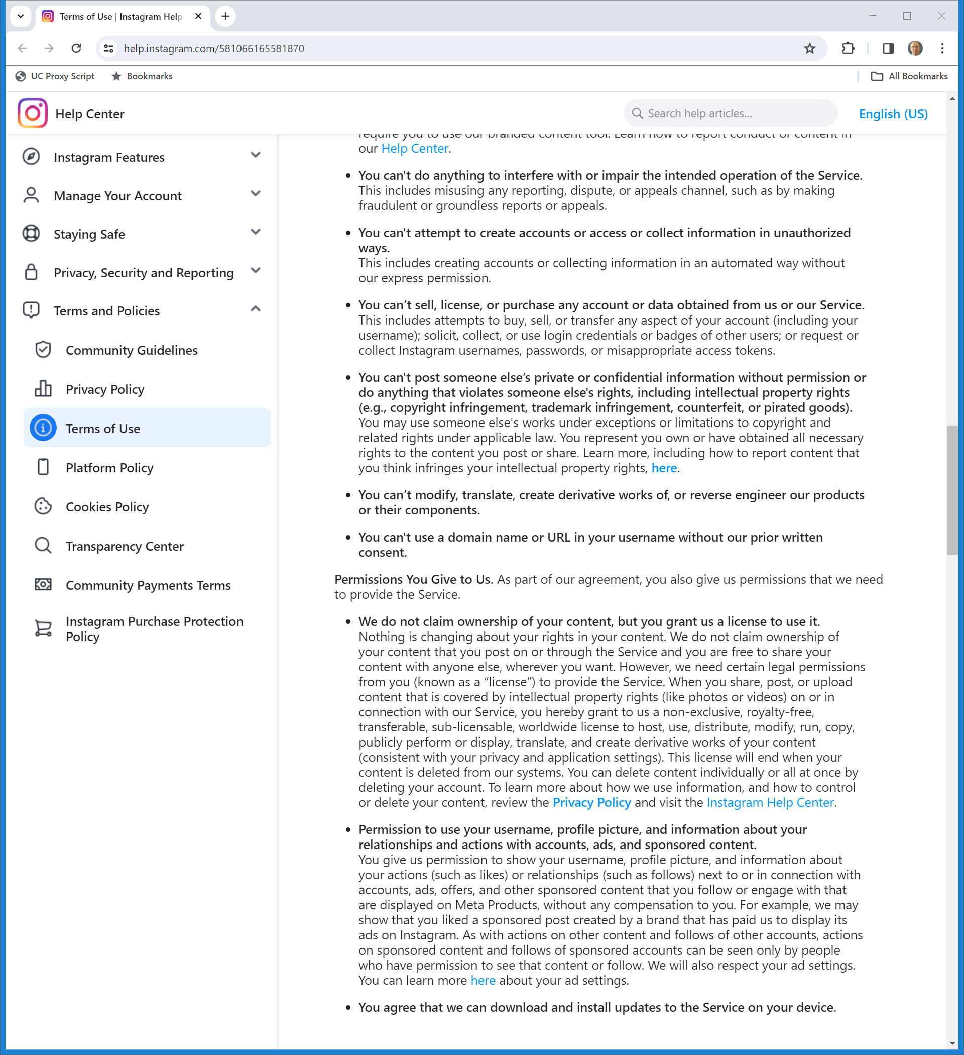
Use Restrictions and Licenses
IG TOU (Visited 12 Nov 2023)
Notes:
https://help.instagram.com/581066165581870

Slide 43
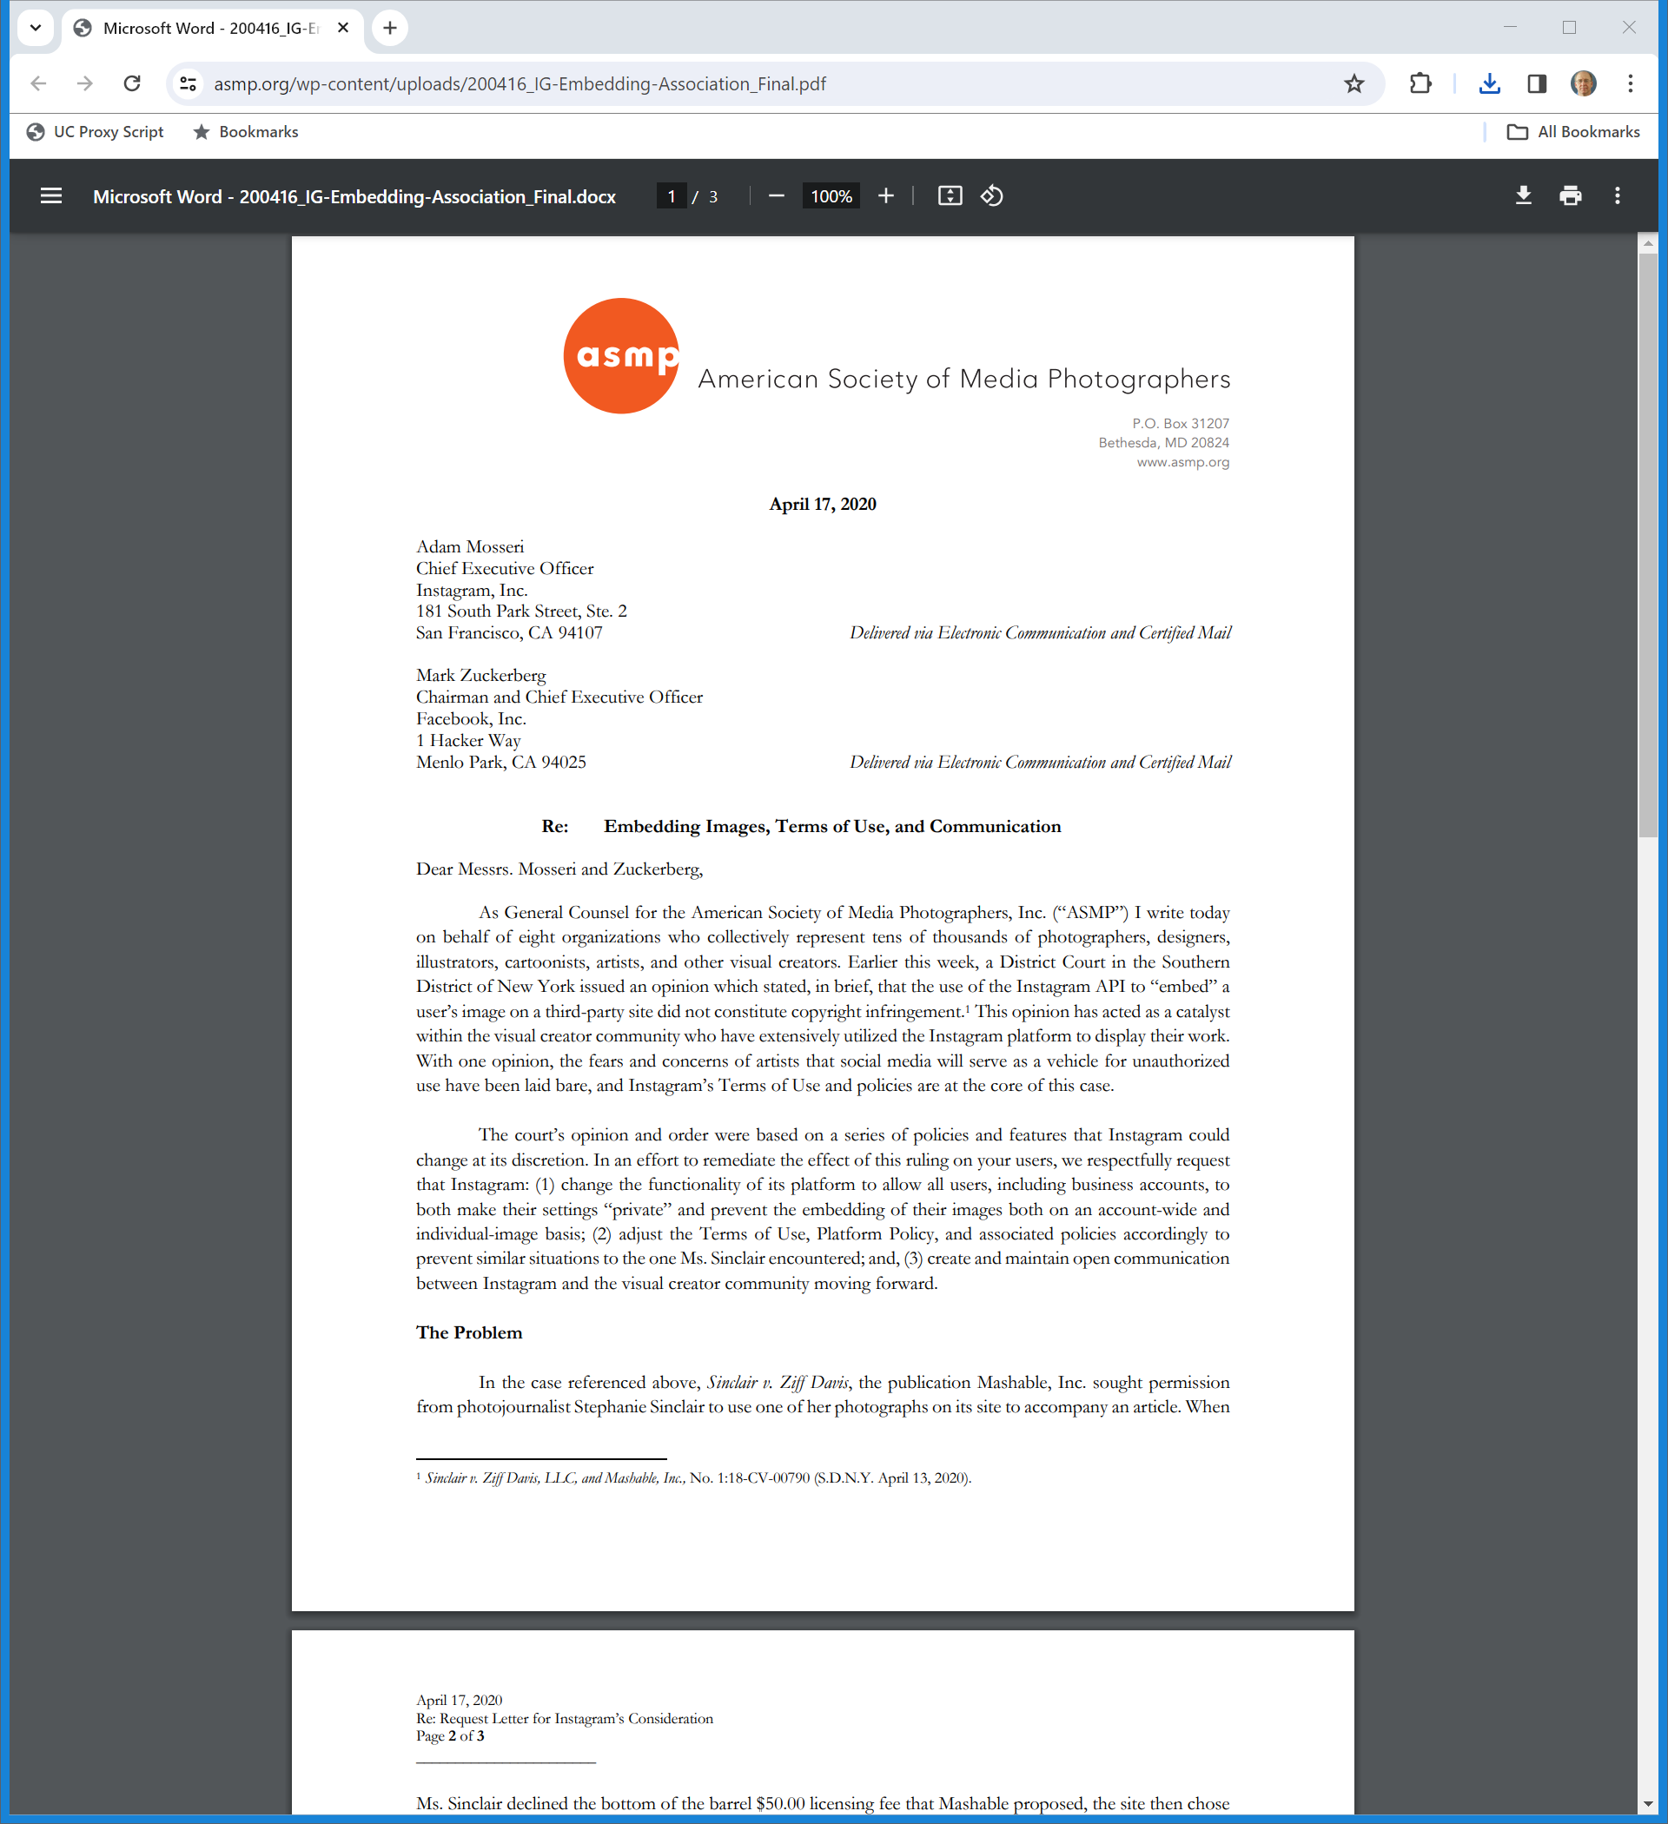
Evolving Instagram
AMSP Letter (17 Apr 2020)
Notes:
https://www.asmp.org/wp-content/uploads/200416_IG-Embedding-Association_Final.pdf

Slide 44
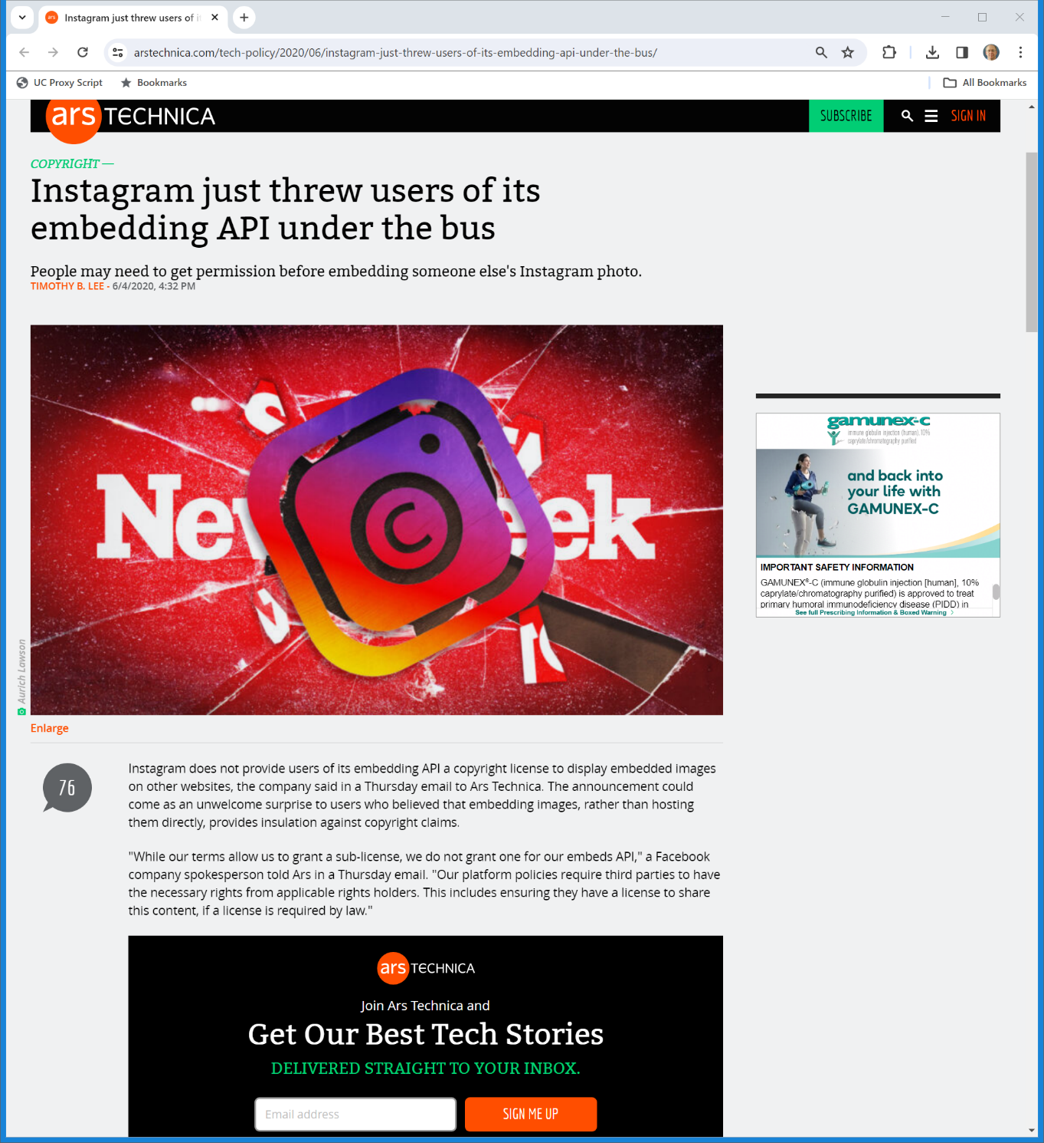

Third-Party Use and the Scope of IG Licenses
Ars Technica (4 June 2020)
Notes:
https://arstechnica.com/tech-policy/2020/06/instagram-just-threw-users-of-its-embedding-api-under-the-bus/

Slide 45
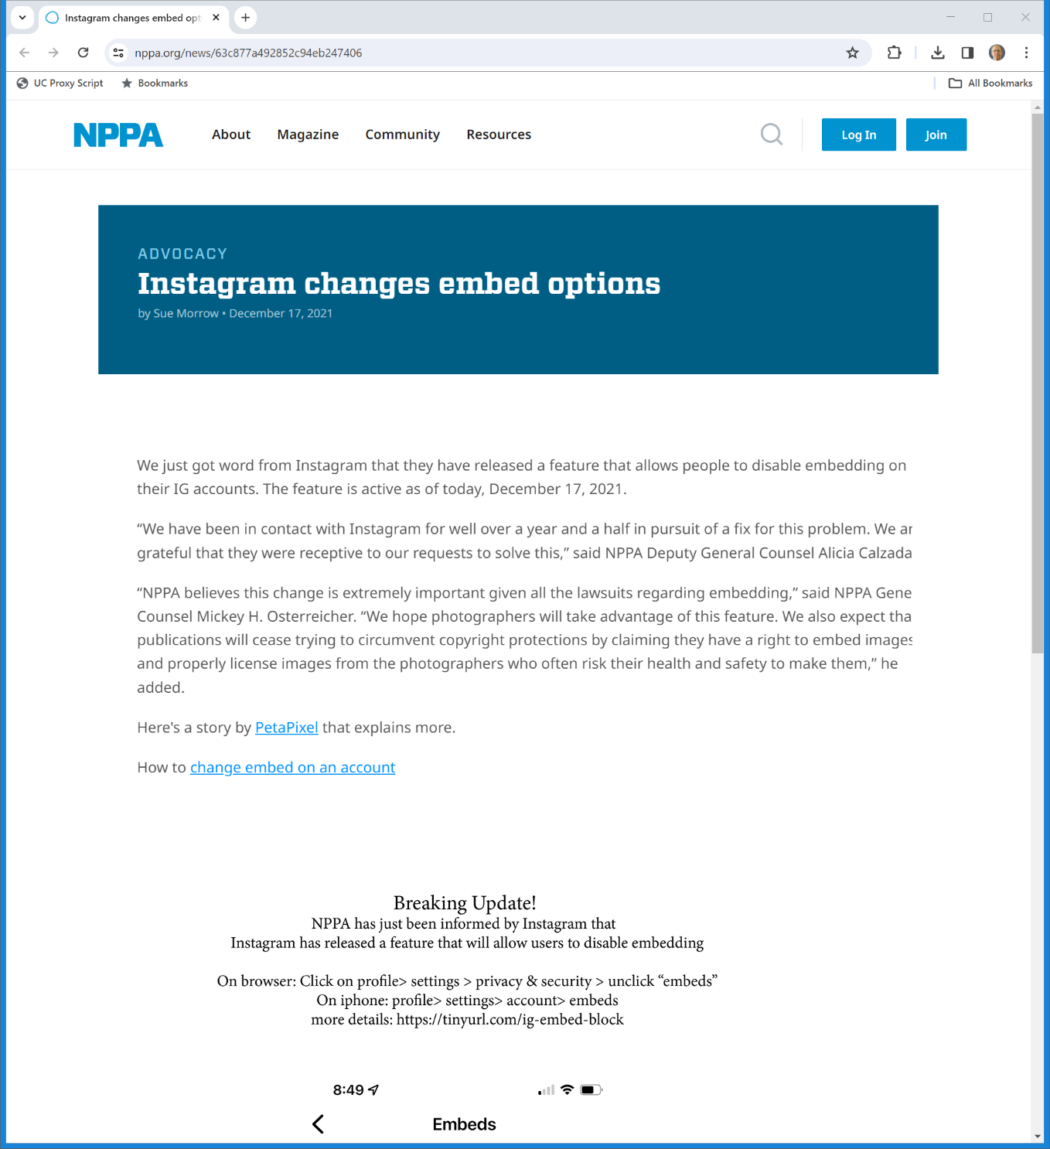

Dec 2021: IG Changes Embedding Options
NPPA (17 Dec 2021)
Notes:
https://nppa.org/news/63c877a492852c94eb247406

Slide 46
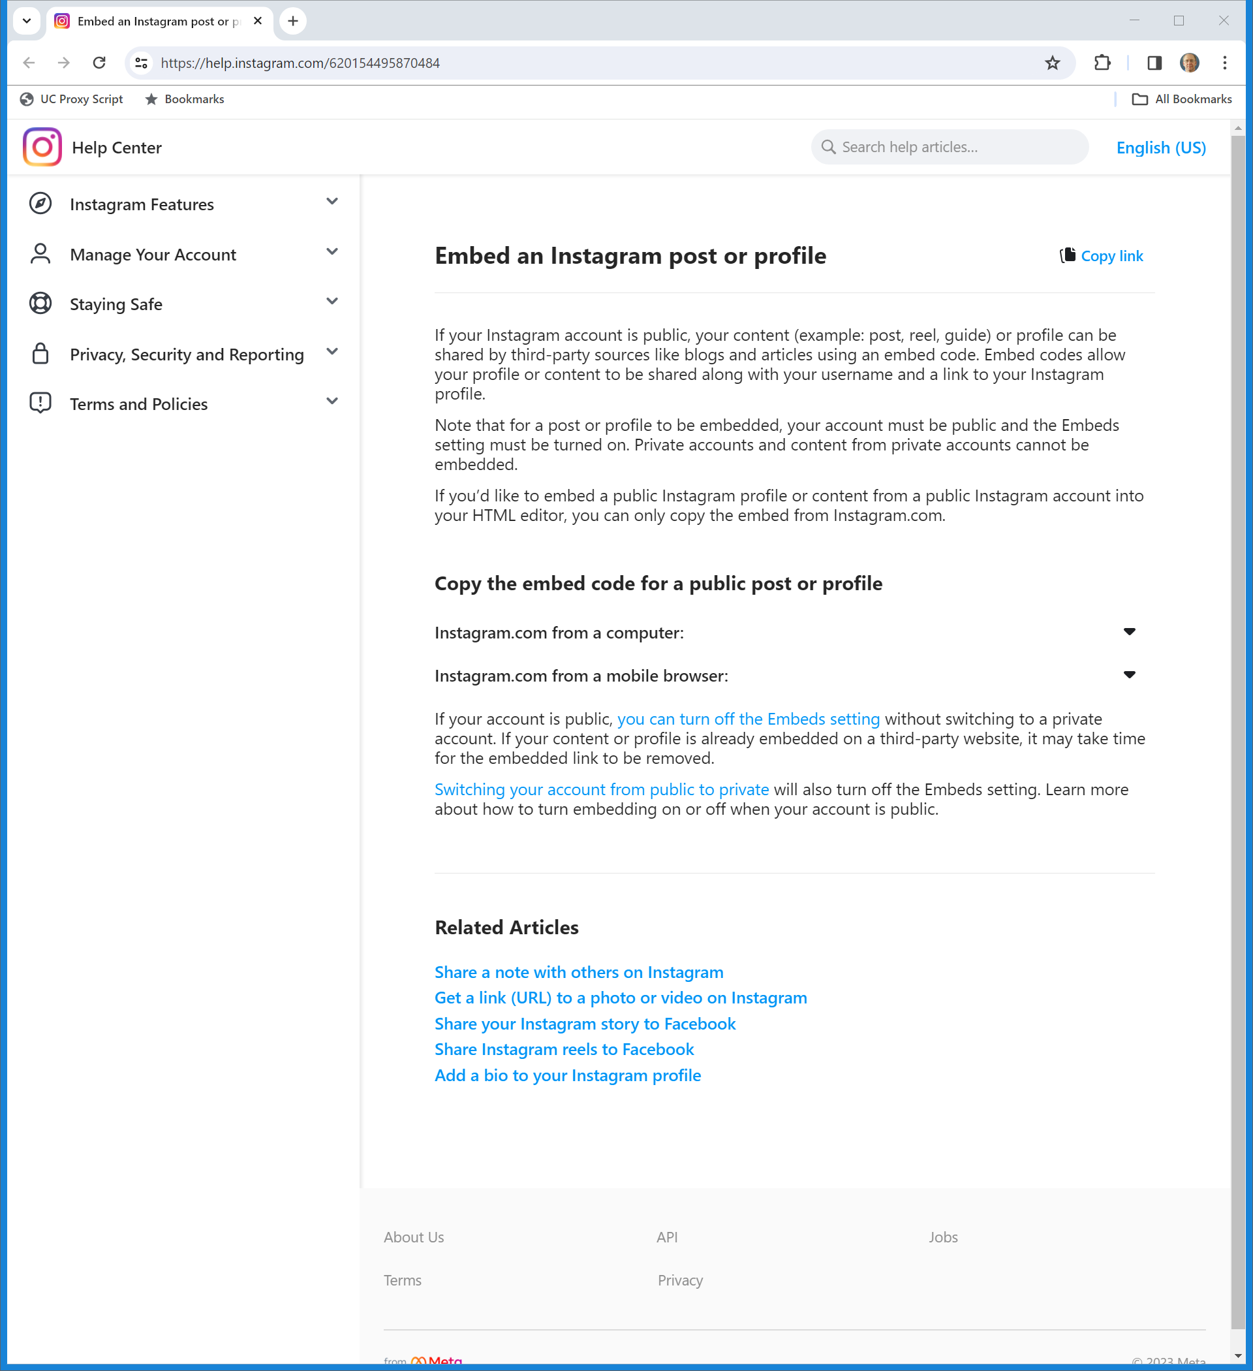
Embedding: On/Off Toggle
IG (Visited 12 Nov 2023)
Notes:
https://help.instagram.com/620154495870484

Slide 47
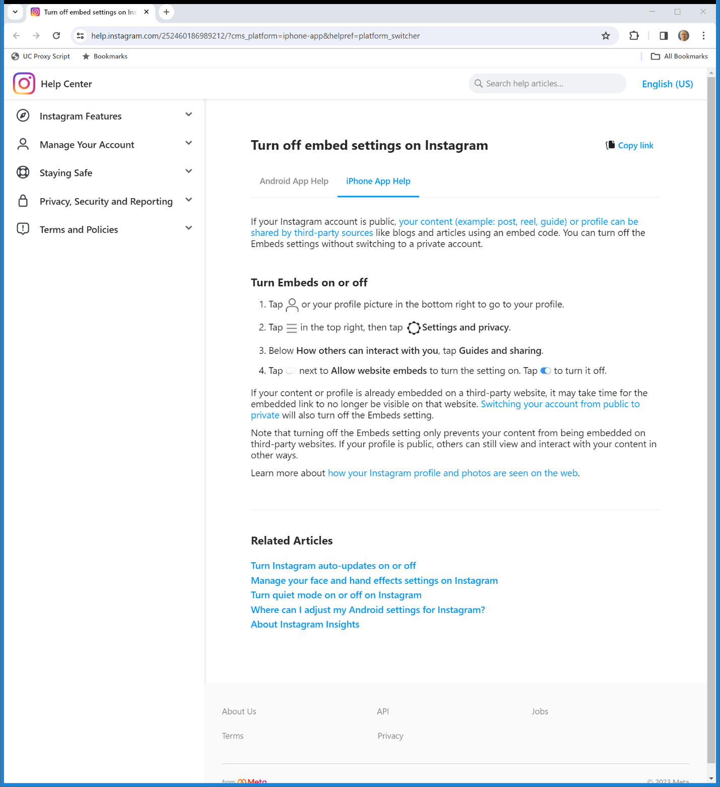

Turning Off Embedding on the iPhone
IG (Visited 12 Nov 2023)
Notes:
https://help.instagram.com/581066165581870

Slide 48
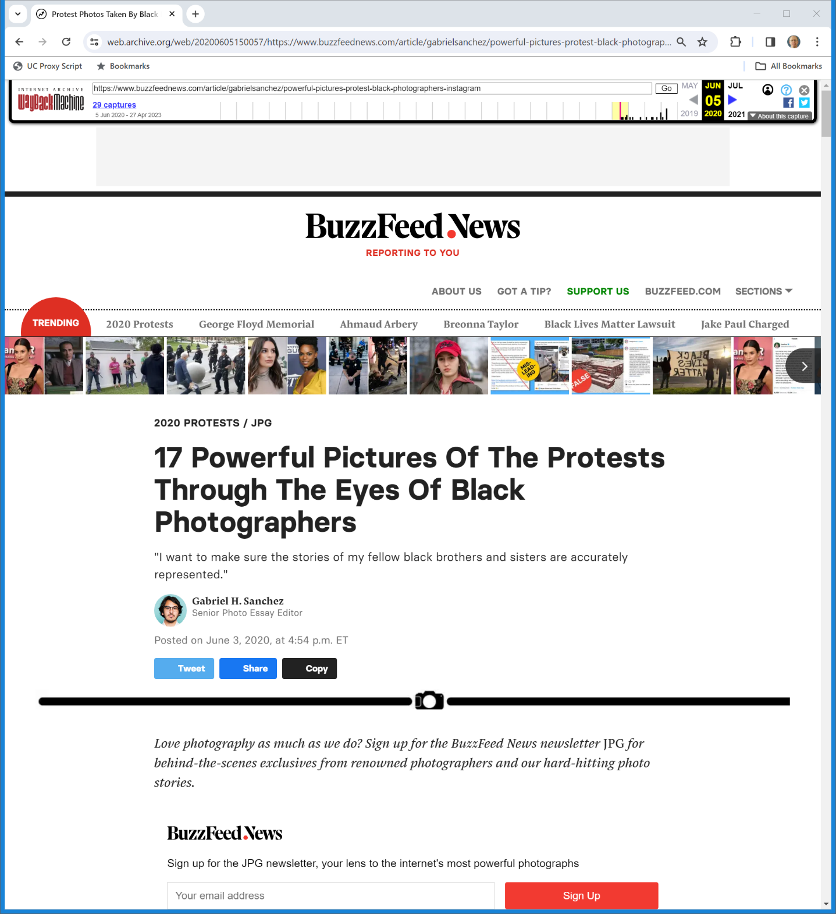
Original Buzzfeed Story
BuzzFeed (3 June 2020)
Notes:
https://web.archive.org/web/20200605150057/https://www.buzzfeednews.com/article/gabrielsanchez/powerful-pictures-protest-black-photographers-instagram

Slide 49
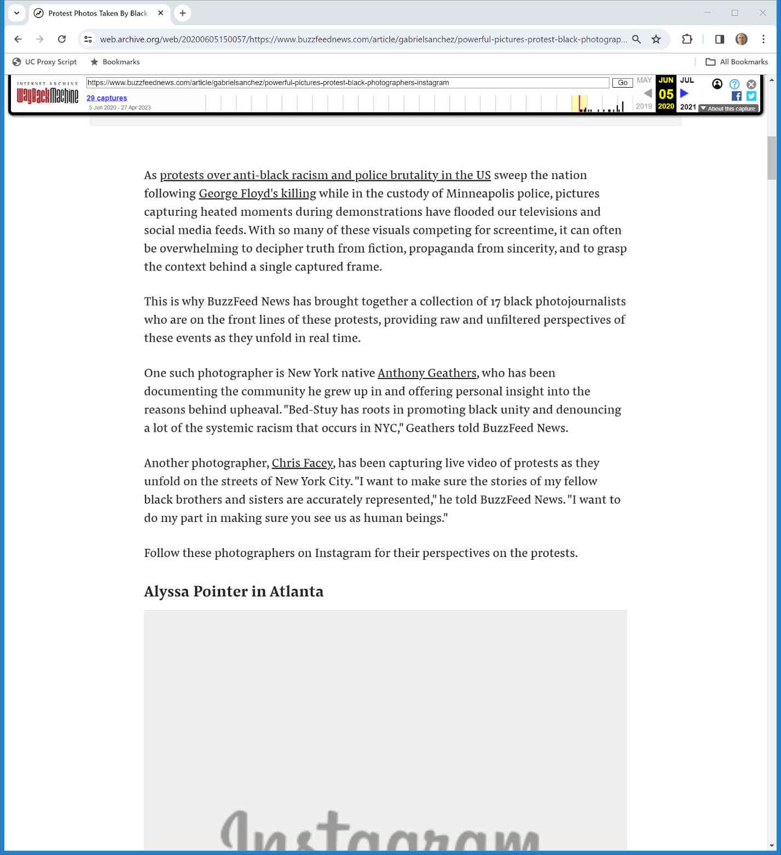
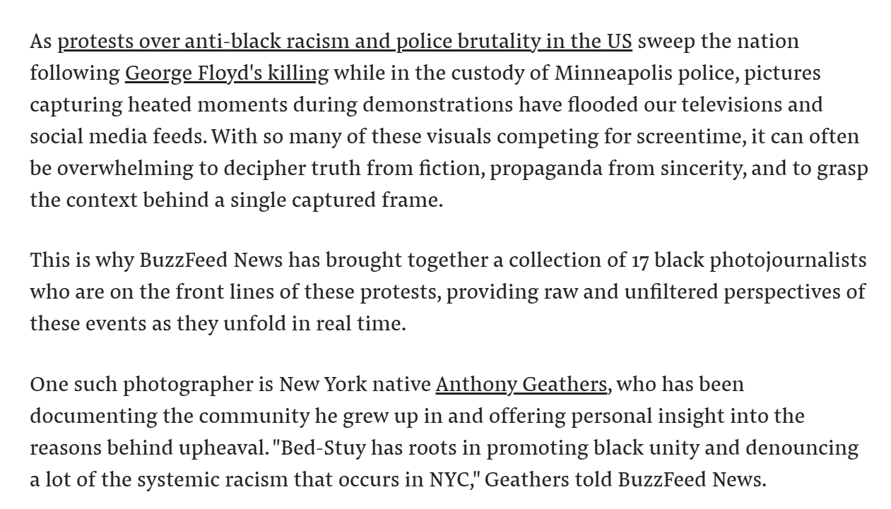
Original Buzzfeed Story
BuzzFeed (3 June 2020)
Notes:
https://web.archive.org/web/20200605150057/https://www.buzzfeednews.com/article/gabrielsanchez/powerful-pictures-protest-black-photographers-instagram

Slide 50
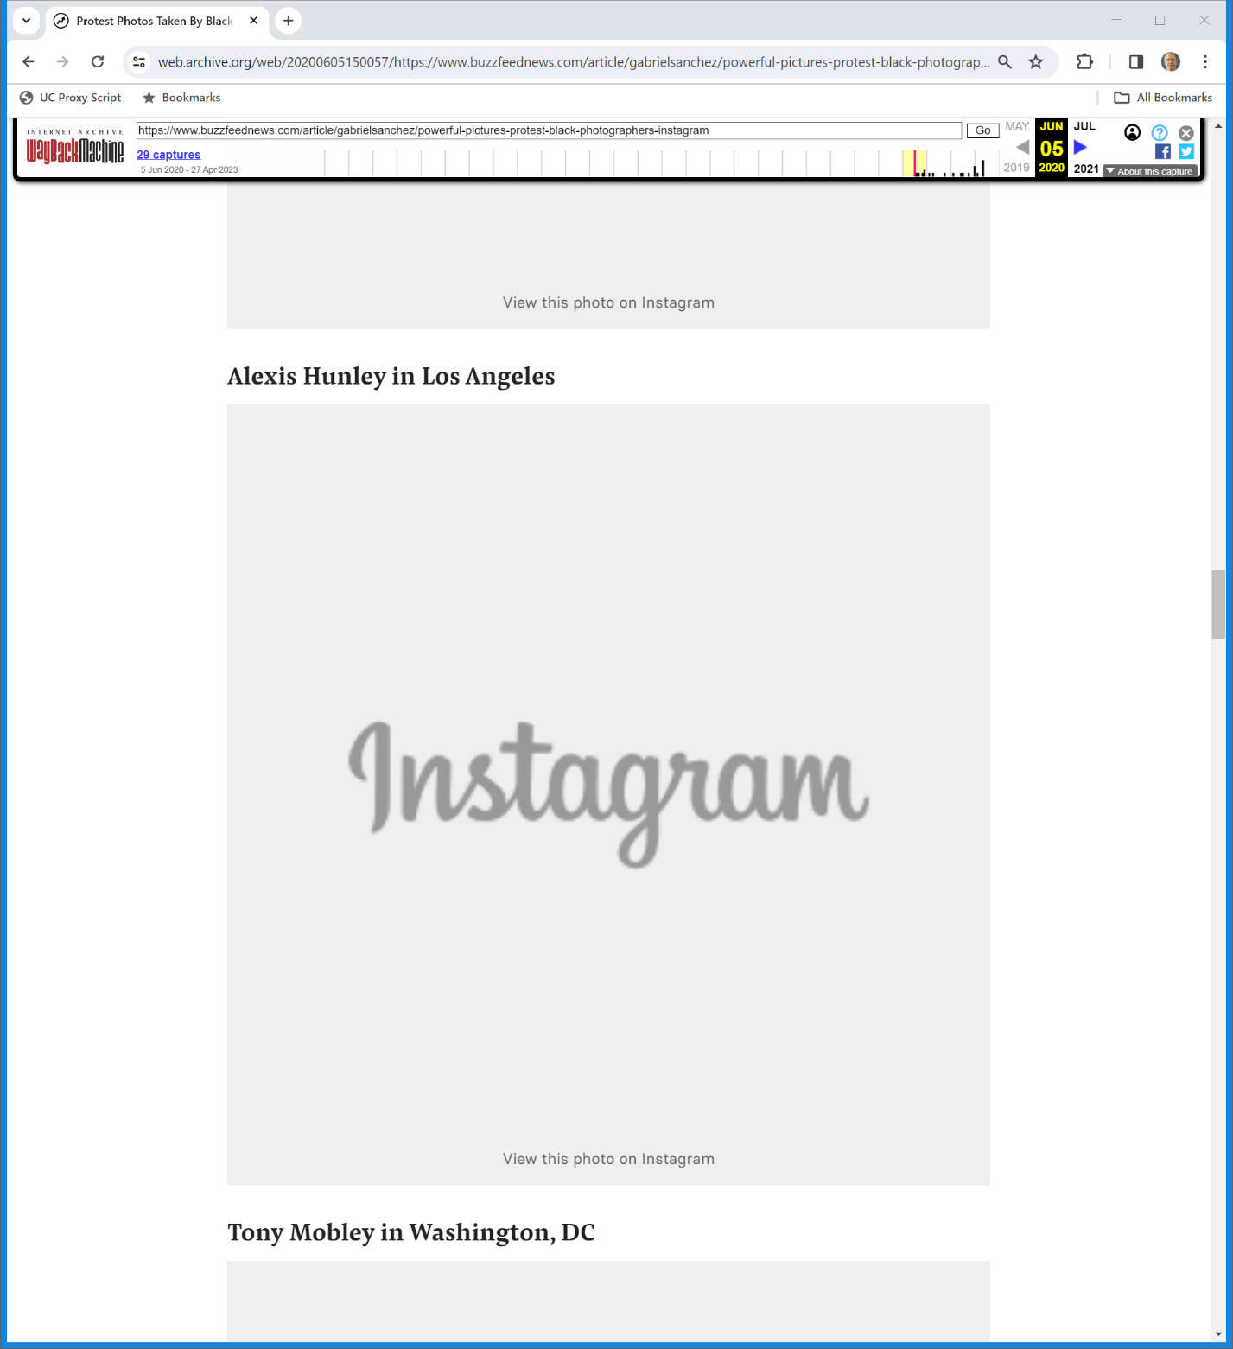
Alexis Hunley
BuzzFeed (3 June 2020)
Notes:
https://web.archive.org/web/20200605150057/https://www.buzzfeednews.com/article/gabrielsanchez/powerful-pictures-protest-black-photographers-instagram

Slide 51
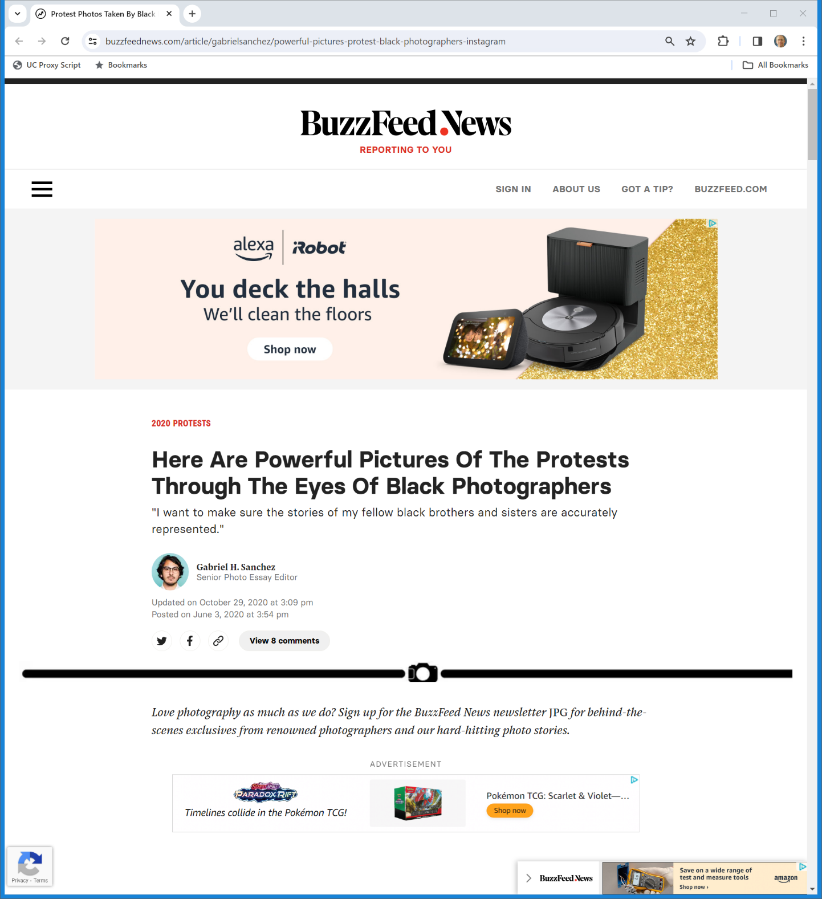
Buzzfeed Story Now
BuzzFeed (3 June 2020/29 Oct 2020)
Notes:
https://www.buzzfeednews.com/article/gabrielsanchez/powerful-pictures-protest-black-photographers-instagram

Slide 52
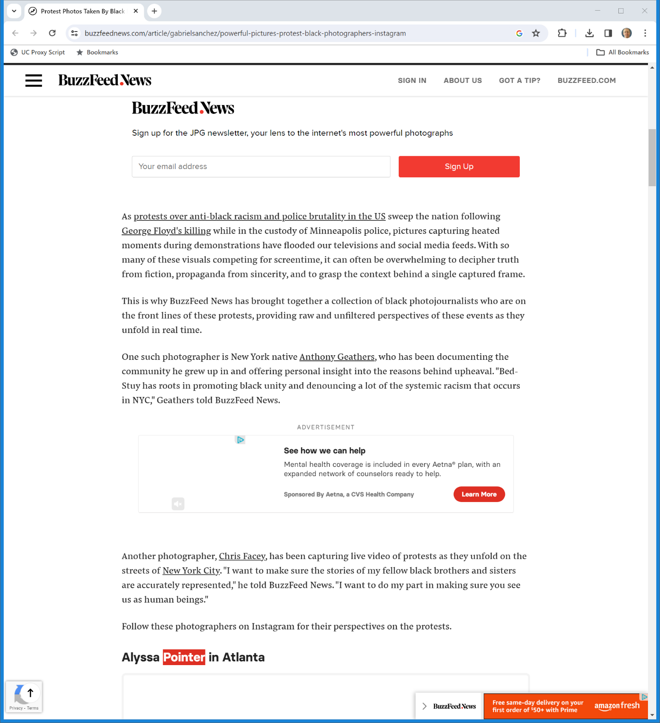
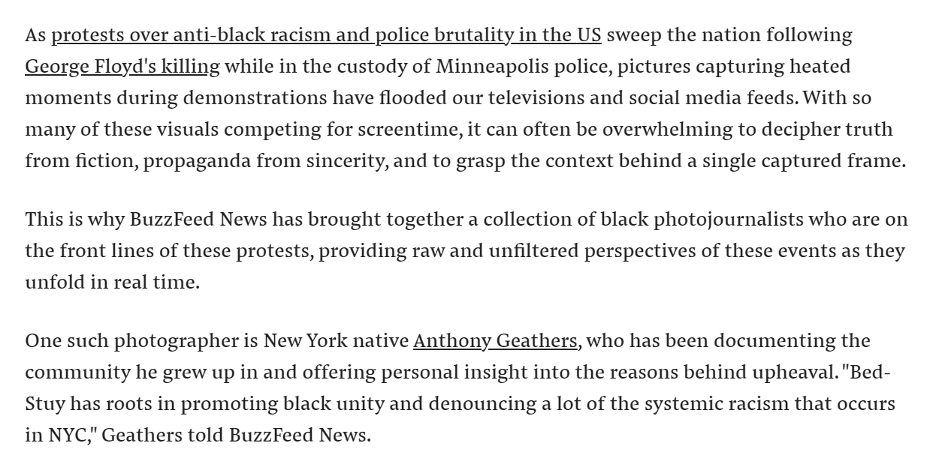
Buzzfeed Story Now
BuzzFeed (3 June 2020/29 Oct 2020)
Notes:
https://www.buzzfeednews.com/article/gabrielsanchez/powerful-pictures-protest-black-photographers-instagram

Slide 53
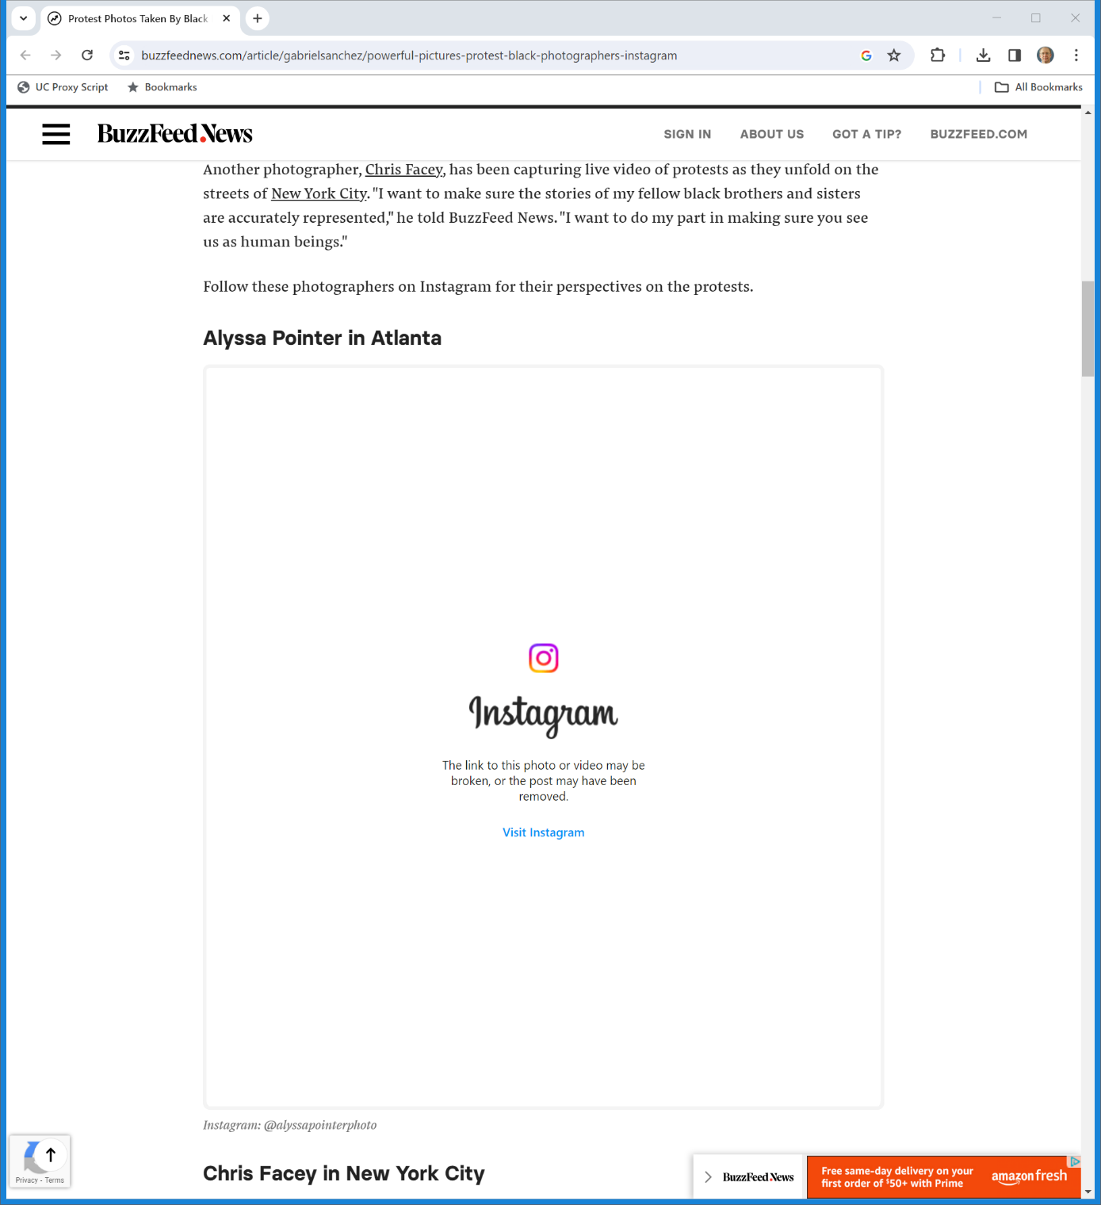
Buzzfeed Story Now
BuzzFeed (3 June 2020/29 Oct 2020)
Notes:
https://www.buzzfeednews.com/article/gabrielsanchez/powerful-pictures-protest-black-photographers-instagram

Slide 54
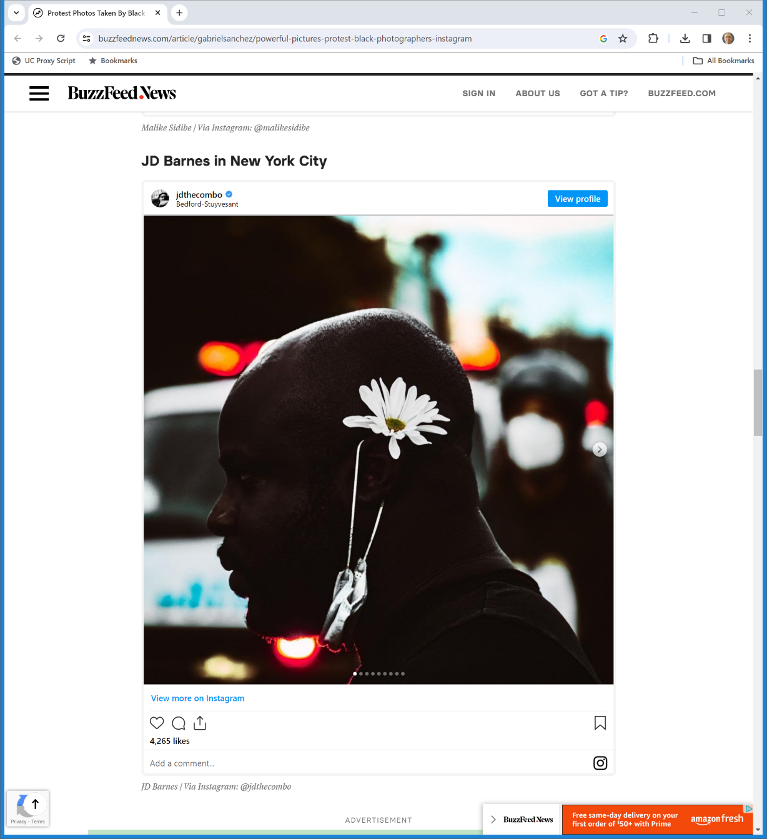
Buzzfeed Story Now (and Hunley is Gone)
BuzzFeed (3 June 2020/29 Oct 2020)
Notes:
https://www.buzzfeednews.com/article/gabrielsanchez/powerful-pictures-protest-black-photographers-instagram

Slide 55
Hunley’s Photo
Hunley (9th Cir. 2023)

Slide 56
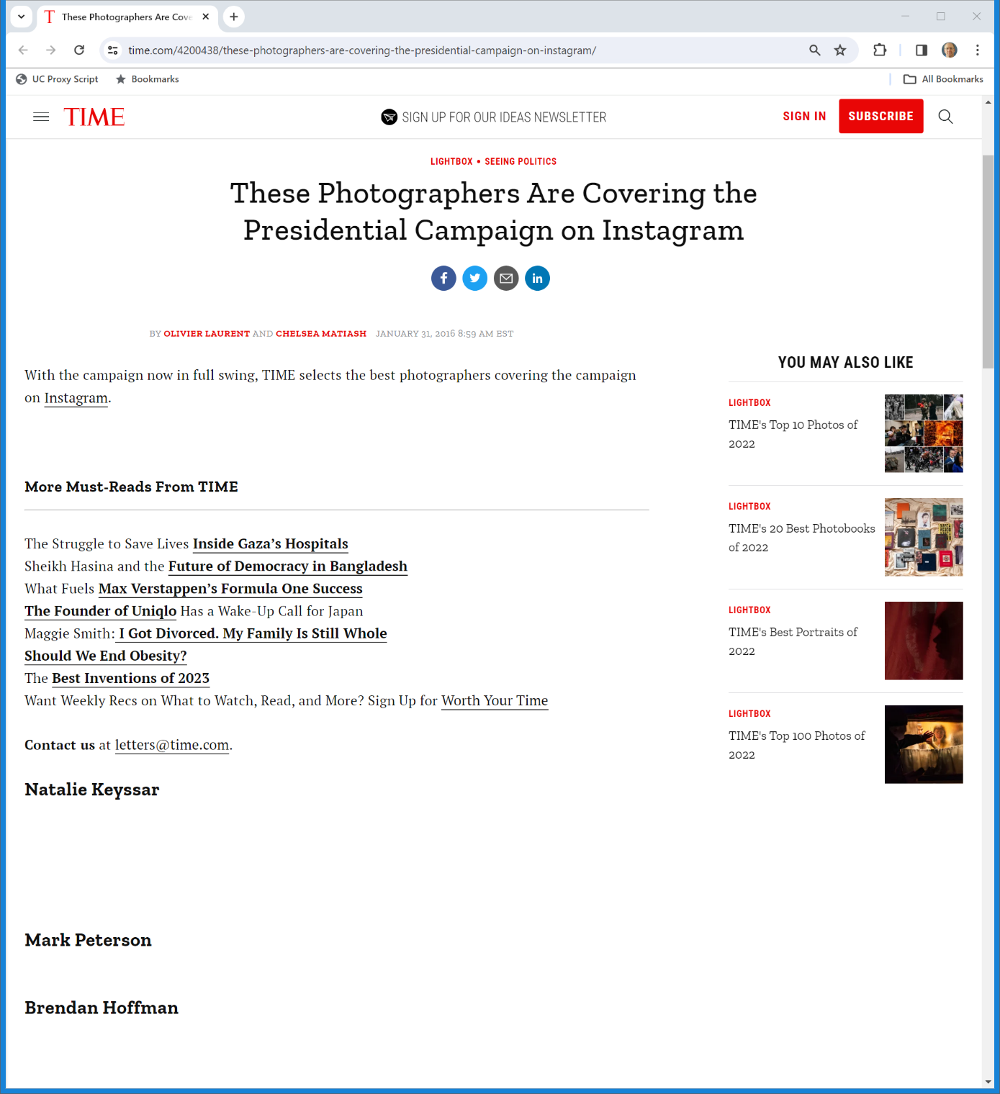
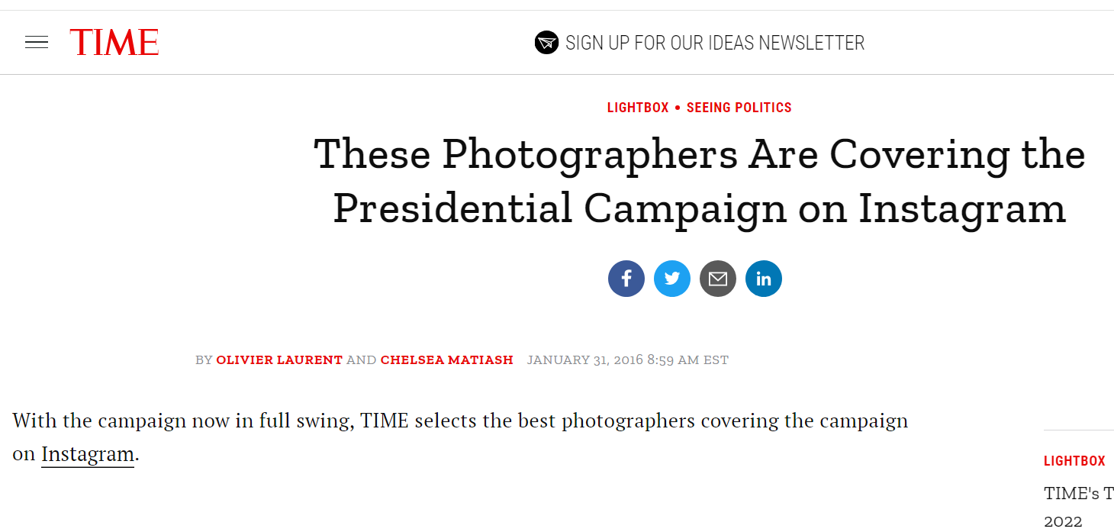
Time Magazine Story
Time (31 Jan 2016)
Notes:
https://time.com/4200438/these-photographers-are-covering-the-presidential-campaign-on-instagram/

Slide 57
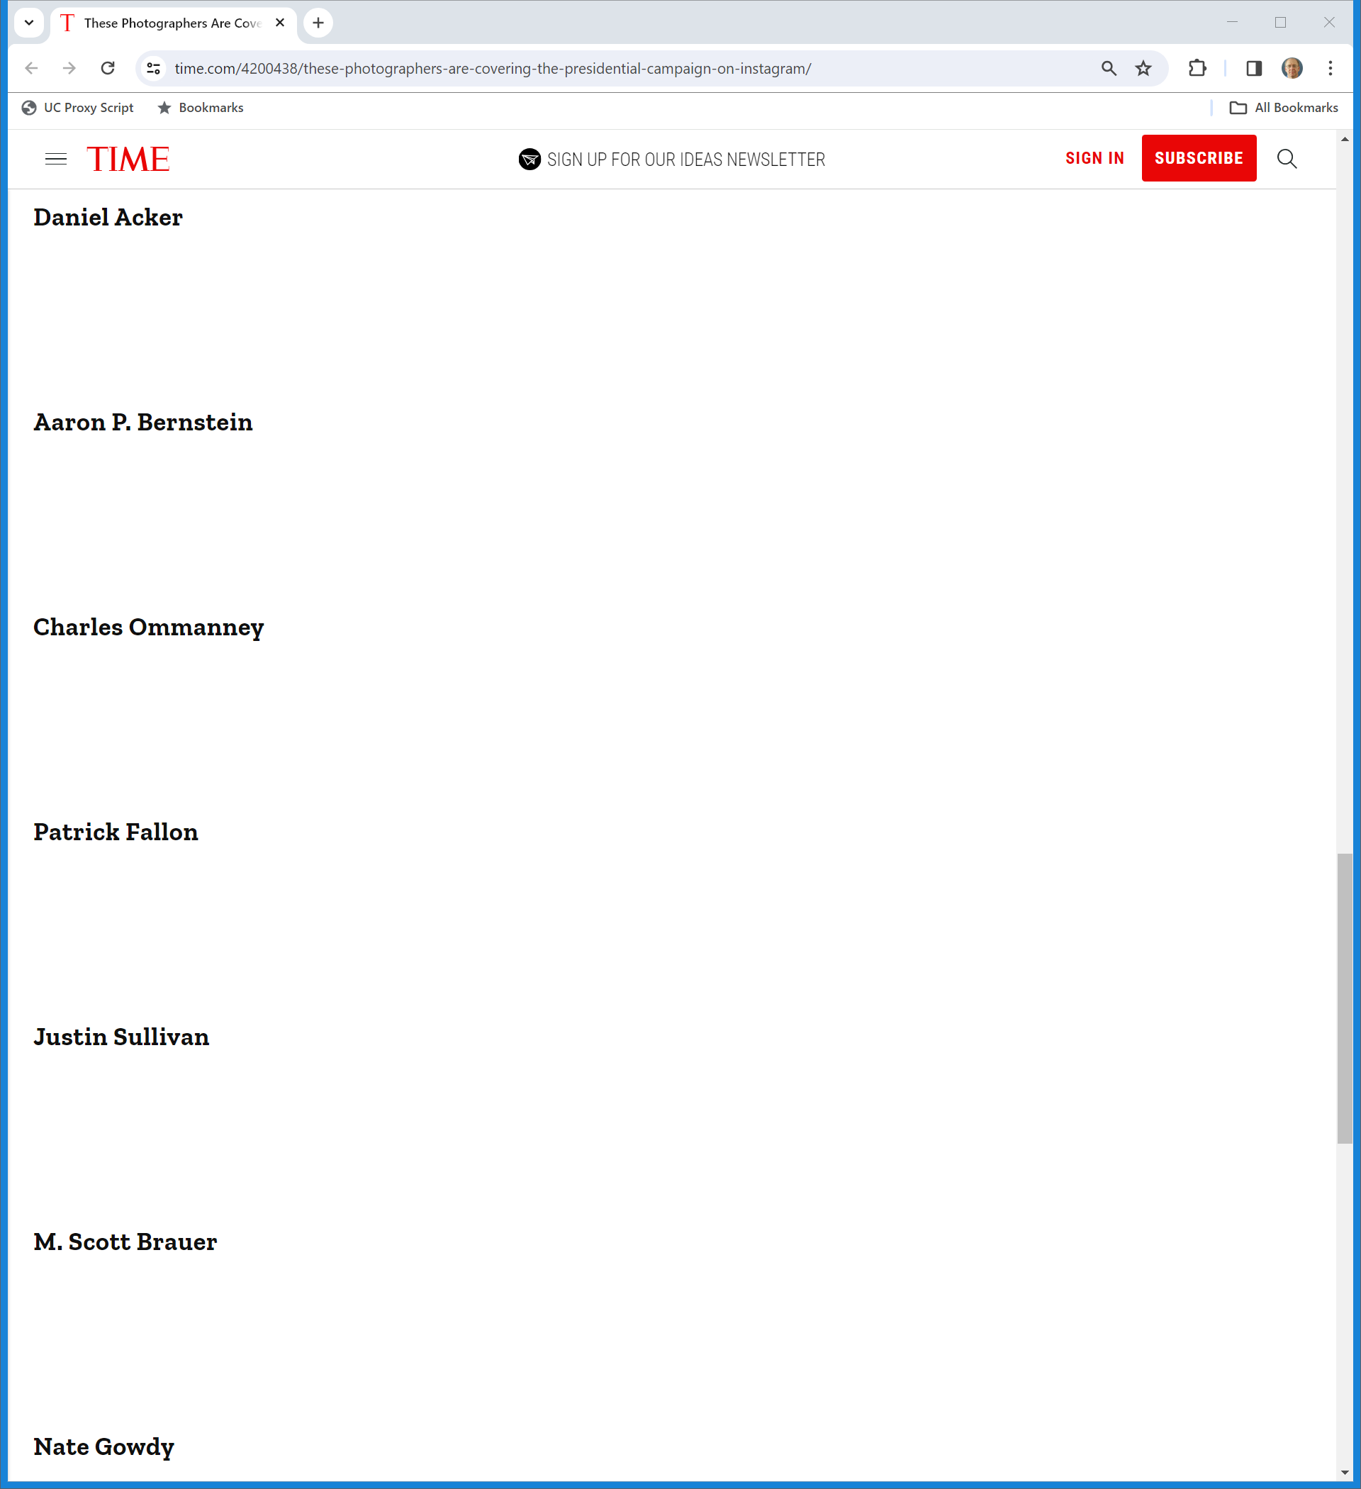
Time Magazine Story
Time (31 Jan 2016)
Notes:
https://time.com/4200438/these-photographers-are-covering-the-presidential-campaign-on-instagram/

Slide 58
Brauer’s Photo
Hunley (9th Cir. 17 July 2023)

Slide 59
Understanding the News Stories
TTYN (1 of 5)
Hypo
How should we think of the stories in BuzzFeed and Time?
Are these derivative works? Collective works? Compilations?
How do those questions intersect with the more technical questions about where the images are being served from?

Slide 60
Collective Work; Compilation (TTYN (2 of 5))
“A ‘collective work’ is a work, such as a periodical issue, anthology, or encyclopedia, in which a number of contributions, constituting separate and independent works in themselves, are assembled into a collective whole.”
“A ‘compilation’ is a work formed by the collection and assembling of preexisting materials or of data that are selected, coordinated, or arranged in such a way that the resulting work as a whole constitutes an original work of authorship. The term ‘compilation’ includes collective works.”
17 USC 101

Slide 61
Derivative Works (TTYN (3 of 5))
“A ‘derivative work’ is a work based upon one or more preexisting works, such as a translation, musical arrangement, dramatization, fictionalization, motion picture version, sound recording, art reproduction, abridgment, condensation, or any other form in which a work may be recast, transformed, or adapted. A work consisting of editorial revisions, annotations, elaborations, or other modifications which, as a whole, represent an original work of authorship, is a ‘derivative work’.”
17 USC 101

Slide 62
Sec. 103 (TTYN (4 of 5))
17 USC 103

Slide 63
Compilations v. Derivative Works (TTYN (5 of 5))
H. Rep. 94-1476 (3 Sept 1976)

Slide 64
IG Displayed, not BuzzFeed or Time
“Time and BuzzFeed wrote the HTML instructions that caused browsers to show Hunley and Brauer’s photographs on Time and BuzzFeed websites. However, under Perfect 10 these instructions did not constitute “display [of] a copy.” … Rather, Instagram displayed a copy of the copyrighted works Hunley posted on its platform, and the web browser formatted and displayed the images alongside additional content from Time and BuzzFeed.”
Hunley (9th Cir. 2023)

Slide 65
No Primary Liability, No Secondary Liability
“Because BuzzFeed and Time embedded—but did not store—the underlying copyrighted photographs, they are not guilty of direct infringement. … Without direct infringement, Hunley cannot prevail on any theory of secondary liability. … As a result, Instagram is not secondarily liable (under any theory) for the resulting display. The district court did not err in dismissing this case on the basis of the Server Test.”
Hunley (9th Cir. 2023)

