Slide 1
Class 17: Wed 30 Apr 2025 Copyright Spring 2025 Video Games
Randal C. Picker
James Parker Hall Distinguished Service Professor of Law
The Law School
The University of Chicago

Slide 2
Xmas 1975: Pong at Home
New York Times (25 Dec 1975)

Slide 3
2024 Global Games
Newzoo (Aug 2024)
Notes:
https://newzoo.com/insights/trend-reports/newzoo-global-games-market-report-2022-free-version

Slide 4
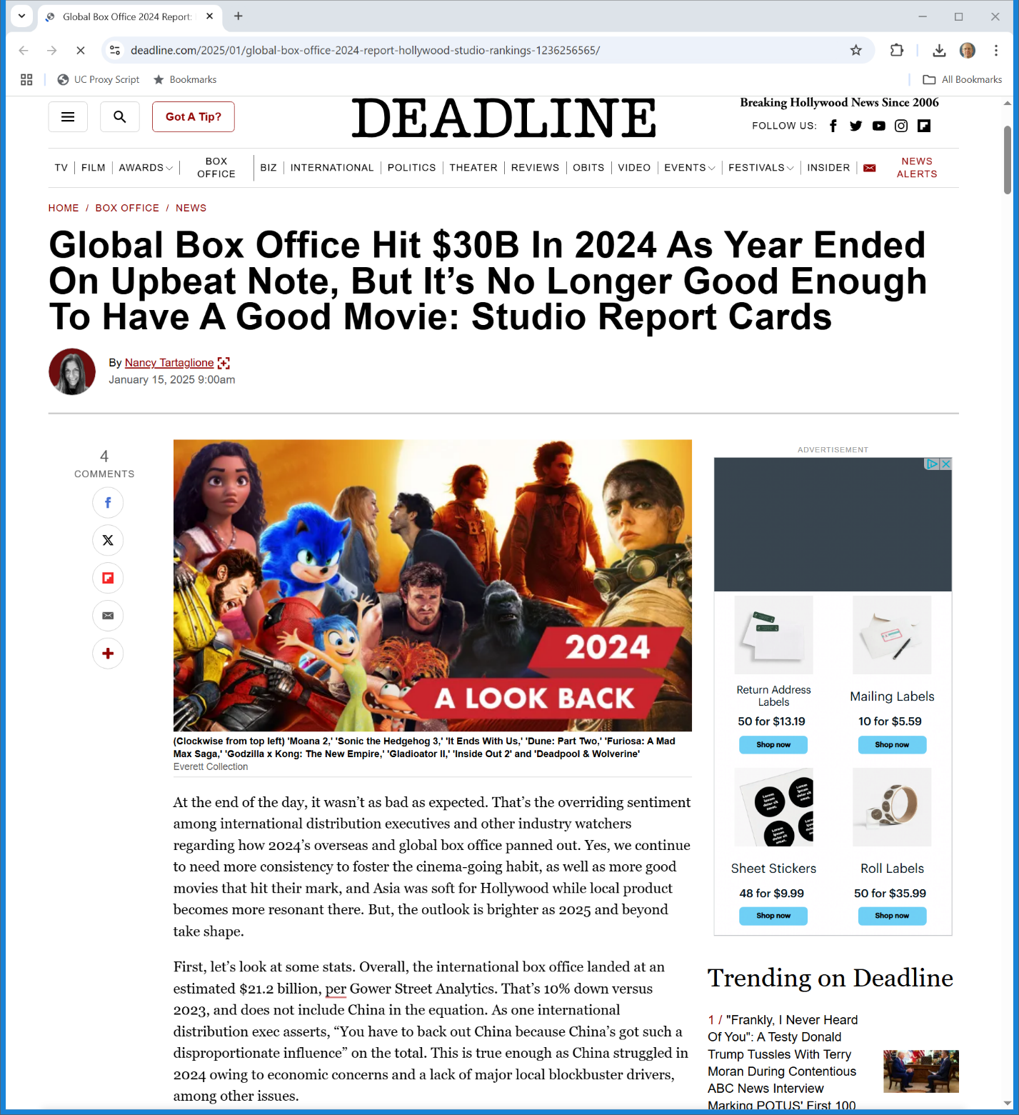
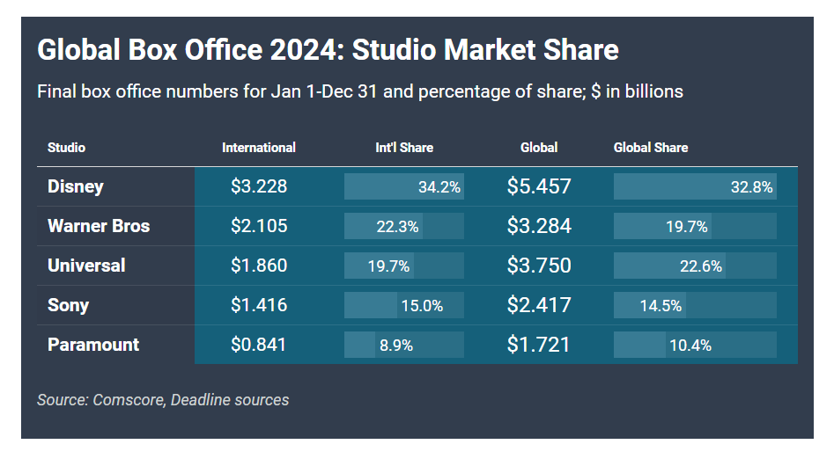
Movie Box Office v. Games
Deadline (15 Jan 2025)
Notes:
https://deadline.com/2025/01/global-box-office-2024-report-hollywood-studio-rankings-1236256565/

Slide 5
Sega v. Accolade
977 F.2d 1510 (9th Cir. 1993)

Slide 6
Game Consoles
TTYN (1 of 3)
Hypo
Three alternative business models for game consoles
Version 1: Sell console at full cost-based price and allow open access for game making (anyone can make cartridges and they don’t have to pay any fees for access to the console)

Slide 7
Game Consoles
TTYN (2 of 3)
Hypo
Version 2: Sell console at below the cost of making them and control access to the console; charge fees for access (either direct access fees or require firms to manufacture their cartridges though your facilities)

Slide 8
Game Consoles
TTYN (3 of 3)
Hypo
Version 3: Sell console at below the cost of making them and allow open access for game making
Questions
What is at stake here? Which of those are sustainable? What was Sega doing?

Slide 9
Sega v. Accolade (CA9 1993)
Key Questions
Why did Accolade want to copy Sega’s work? Does that matter?
Should the fact that the copying produced an intermediate work rather than the final work matter?

Slide 10
Sega v. Accolade (CA9 1993)
Key Questions
How should we understand the copying of the code that invoked the SEGA trademark?

Slide 11
How Should We Understand the Copying Here?
“Moreover, as we discuss below, no other method of studying those requirements was available to Accolade. On these facts, we conclude that Accolade copied Sega’s code for a legitimate, essentially non-exploitative purpose, and that the commercial aspect of its use can best be described as of minimal significance.”
Sega (9th Cir. 1993)

Slide 12
How Should We Understand the Copying Here?
“We further note that we are free to consider the public benefit resulting from a particular use notwithstanding the fact that the alleged infringer may gain commercially. … Public benefit need not be direct or tangible, but may arise because the challenged use serves a public interest. In the case before us, Accolade’s identification of the functional requirements for Genesis compatibility has led to an increase in the number of independently designed video game programs offered for use with the Genesis console.”
Sega (9th Cir. 1993)

Slide 13
How Should We Understand the Copying Here?
“It is precisely this growth in creative expression, based on the dissemination of other creative works and the unprotected ideas contained in those works, that the Copyright Act was intended to promote.”
Sega (9th Cir. 1993)

Slide 14
DMCA Legislative History
H. Rep. 105-796 (8 Oct 1998)

Slide 15
Treaty Implementation
H. Rep. 105-796 (8 Oct 1998)

Slide 16
1996 WIPO Copyright Treaty
WIPO (20 Dec 1996)

Slide 17
Technological Measures
WIPO Copyright Treaty (20 Dec 1996)

Slide 18
Orienting within the DMCA
Distinguishing
Access controls (1201(a))
You may possess a copy of the work but the technological control prevents you from accessing the work
Copyright controls (1201(b))
You can access the work, but the technological control prevents you from copying it (or making some other 106 use)

Slide 19
Sec. 1201(a)(1)(A): No Circumvention
“(a)(1)(A) No person shall circumvent a technological measure that effectively controls access to a work protected under this title.”
17 USC 1201

Slide 20
Exemptions
“(a)(1)(B) The prohibition contained in subparagraph (A) shall not apply to persons who are users of a copyrighted work which is in a particular class of works, if such persons are, or are likely to be in the succeeding 3‑year period, adversely affected by virtue of such prohibition in their ability to make noninfringing uses of that particular class of works under this title, as determined under subparagraph (C).”
17 USC 1201

Slide 21
Librarian of Congress Rulemaking
“(C) [Anticircumvention rulemaking procedure]
(D) The Librarian shall publish any class of copyrighted works for which the Librarian has determined, pursuant to the rulemaking conducted under subparagraph (C), that noninfringing uses by persons who are users of a copyrighted work are, or are likely to be, adversely affected, and the prohibition contained in subparagraph (A) shall not apply to such users with respect to such class of works for the ensuing 3‑year period.”
17 USC 1201

Slide 22
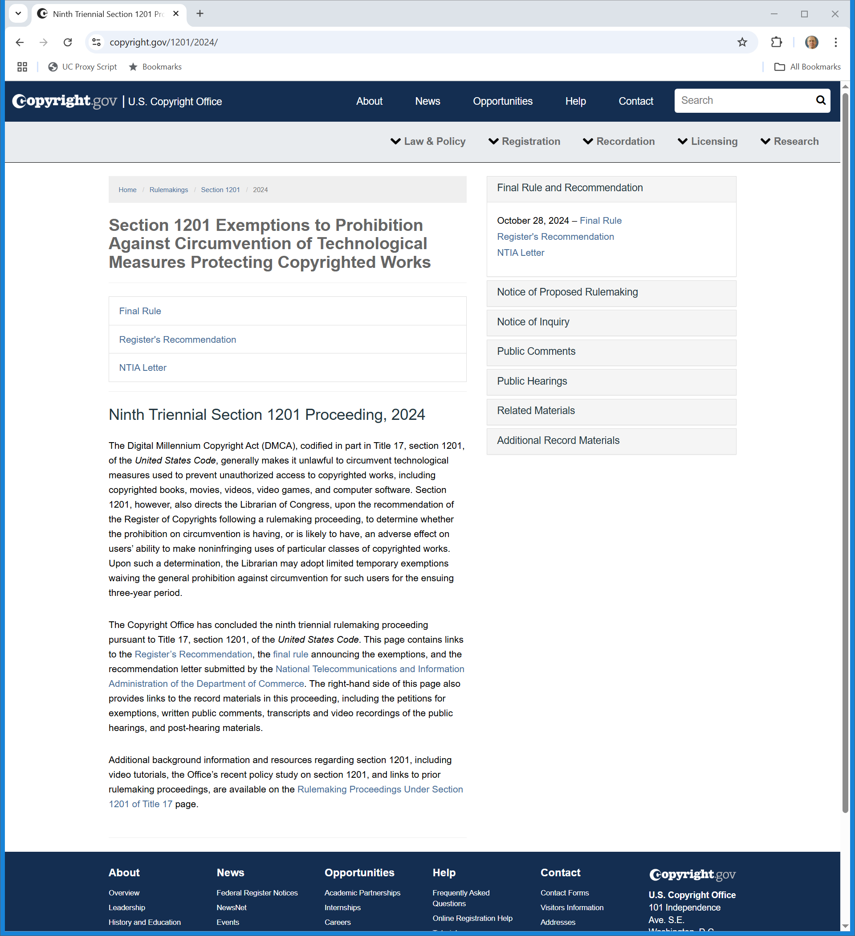
DMCA Rulemaking
Copyright.gov (Visited 30 Apr 2025)
Notes:
https://www.copyright.gov/1201/2024/

Slide 23
DMCA Rulemaking (14 pages)
89 FR 85437 (28 Oct 2024)

Slide 24
Sec. 1201(a)(2): Access Control Tech Trafficking
“(a)(2) No person shall manufacture, import, offer to the public, provide, or otherwise traffic in any technology, product, service, device, component, or part thereof, that‑‑(A) is primarily designed or produced for the purpose of circumventing a technological measure that effectively controls access to a work protected under this title; … .”
17 USC 1201

Slide 25
Sec. 1201(a)(3): Key Definitions
“(3) As used in this subsection—(A) to ‘circumvent a technological measure’ means to descramble a scrambled work, to decrypt an encrypted work, or otherwise to avoid, bypass, remove, deactivate, or impair a technological measure, without the authority of the copyright owner; and (B) a technological measure ‘effectively controls access to a work’ if the measure, in the ordinary course of its operation, requires the application of information, or a process or a treatment, with the authority of the copyright owner, to gain access to the work.”
17 USC 1201

Slide 26
Sec. 1201(b)(1): Trafficking re Copyright TCMs
“(b)(1) No person shall manufacture, import, offer to the public, provide, or otherwise traffic in any technology, product, service, device, component, or part thereof, that‑‑ (A) is primarily designed or produced for the purpose of circumventing protection afforded by a technological measure that effectively protects a right of a copyright owner under this title [17 U.S.C.A. § 1 et seq.] in a work or a portion thereof … .”
17 USC 1201

Slide 27
Sec. 1201(b)(2): Key Definitions
“(2) As used in this subsection—(A) to ‘circumvent protection afforded by a technological measure’ means avoiding, bypassing, removing, deactivating, or otherwise impairing a technological measure; and (B) a technological measure ‘effectively protects a right of a copyright owner under this title’ if the measure, in the ordinary course of its operation, prevents, restricts, or otherwise limits the exercise of a right of a copyright owner under this title.”
17 USC 1201

Slide 28
Fair Use Unaffected
“(c)(1) Nothing in this section shall affect rights, remedies, limitations, or defenses to copyright infringement, including fair use, under this title [17 U.S.C.A. § 1 et seq.].”
17 USC 1201

Slide 29
1201 Exceptions
(d): Libraries, archives and educational institutions
(e): Law enforcement, intelligence and government
(f): Reverse engineering
(g): Encryption research
(h): Minors

Slide 30
1201 Exceptions
(i): Protection of personally identifying information
(j): Security testing
(k): Analog devices

Slide 31
MDY v. Blizzard
629 F.3d 928 (9th Cir. 2010)

Slide 32
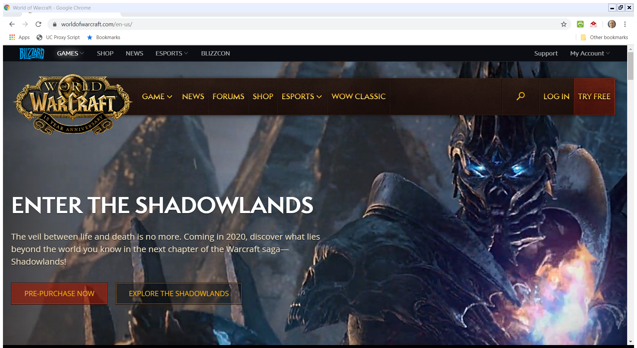
MMORPG: Massively multiplayer online role-playing game
World of Warcraft

Slide 33
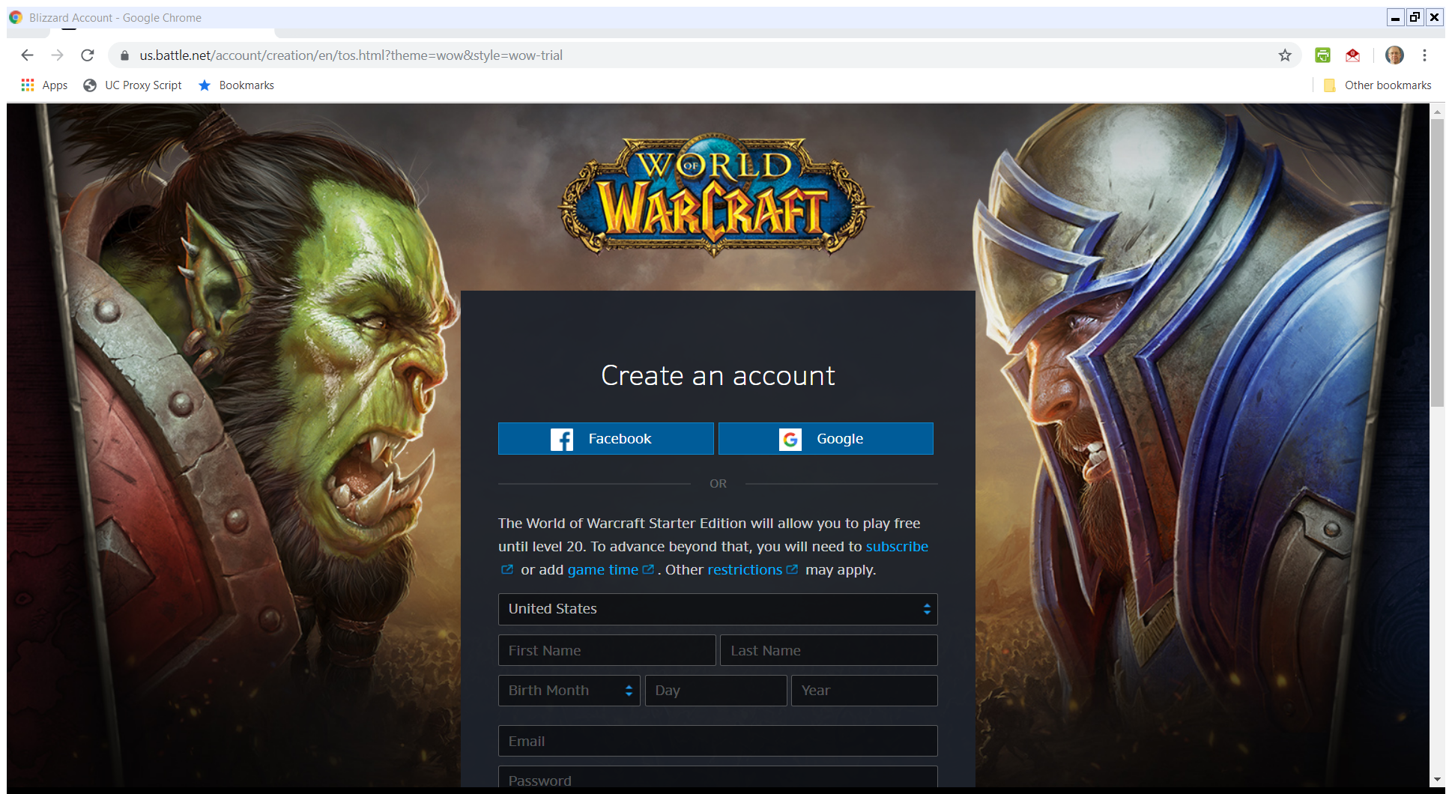
Start Free Then $
WOW (Visited: 23 Nov 2019)

Slide 34
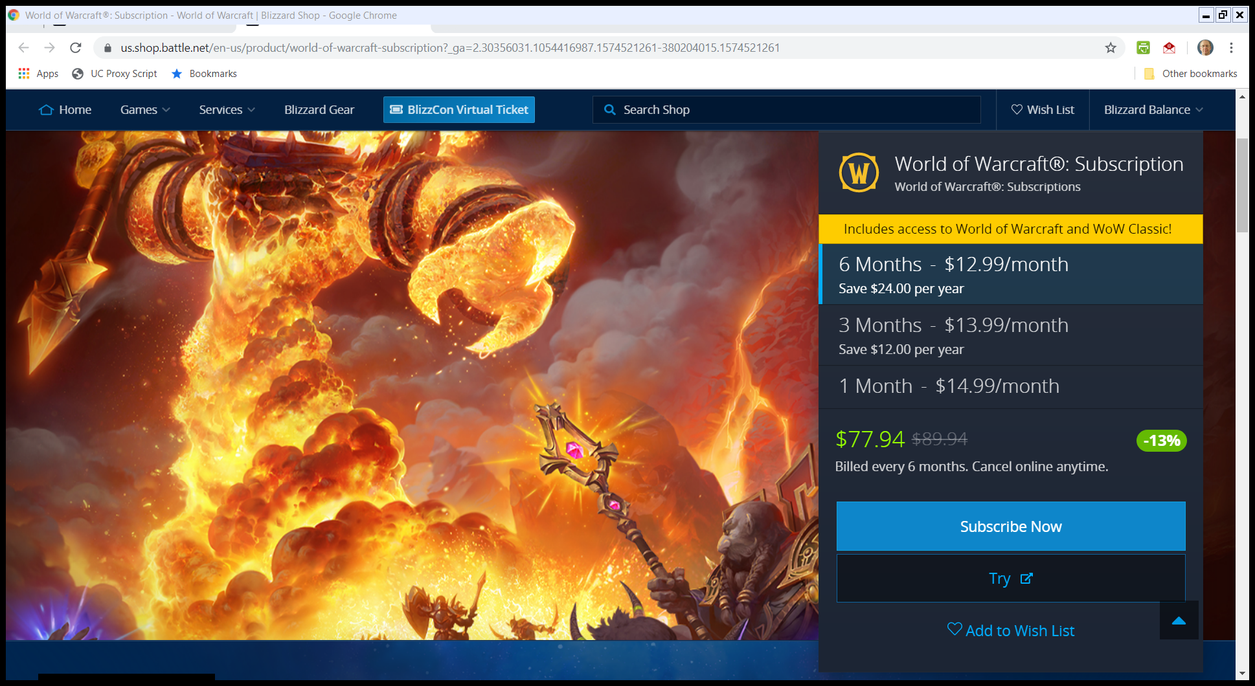
Subscription Prices
WOW Prices (Visited: 23 Nov 2019)

Slide 35
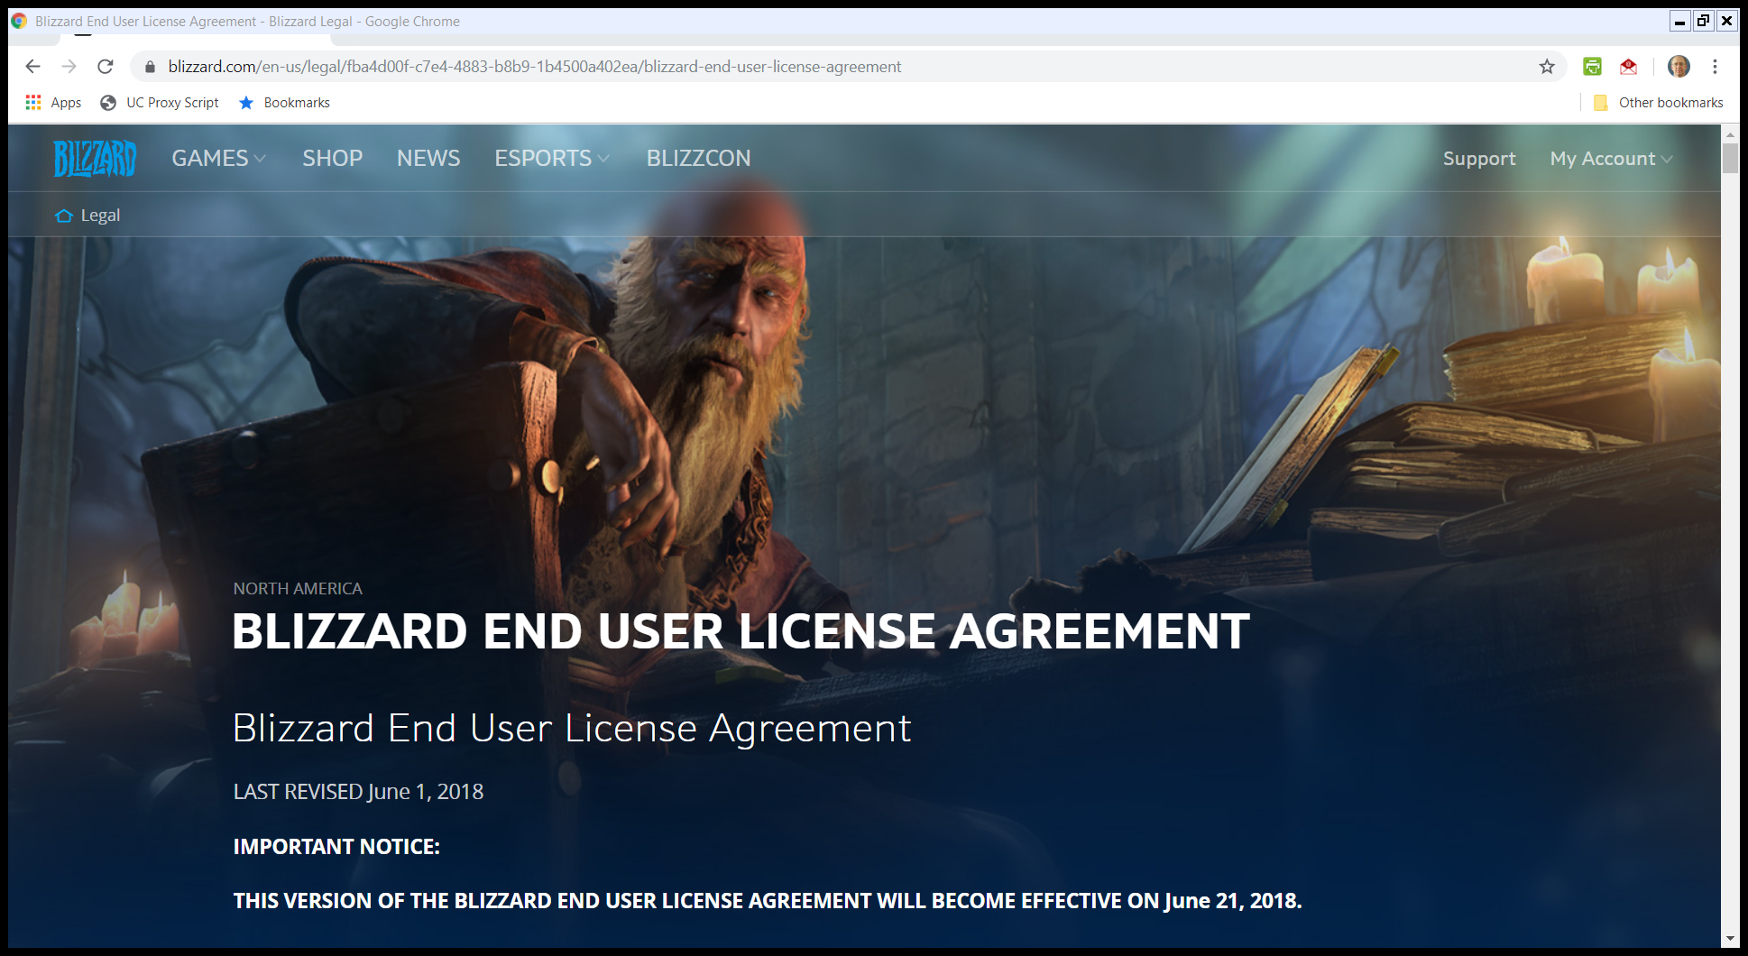
Blizzard EULA
Blizzard EULA (as of 1 June 2018)

Slide 36
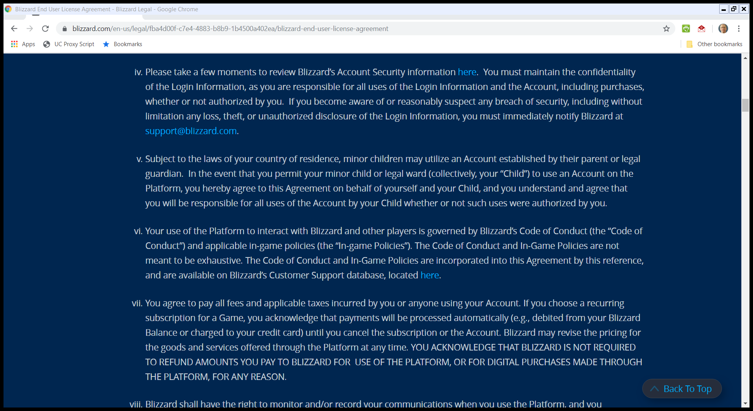
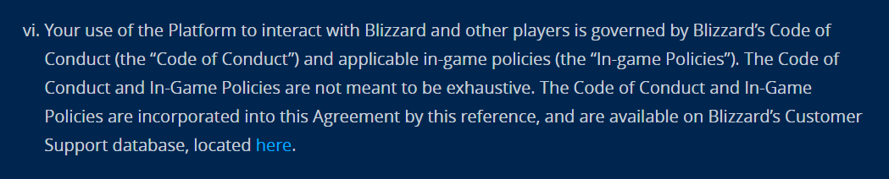
Code of Conduct
Blizzard EULA (as of 1 June 2018)

Slide 37
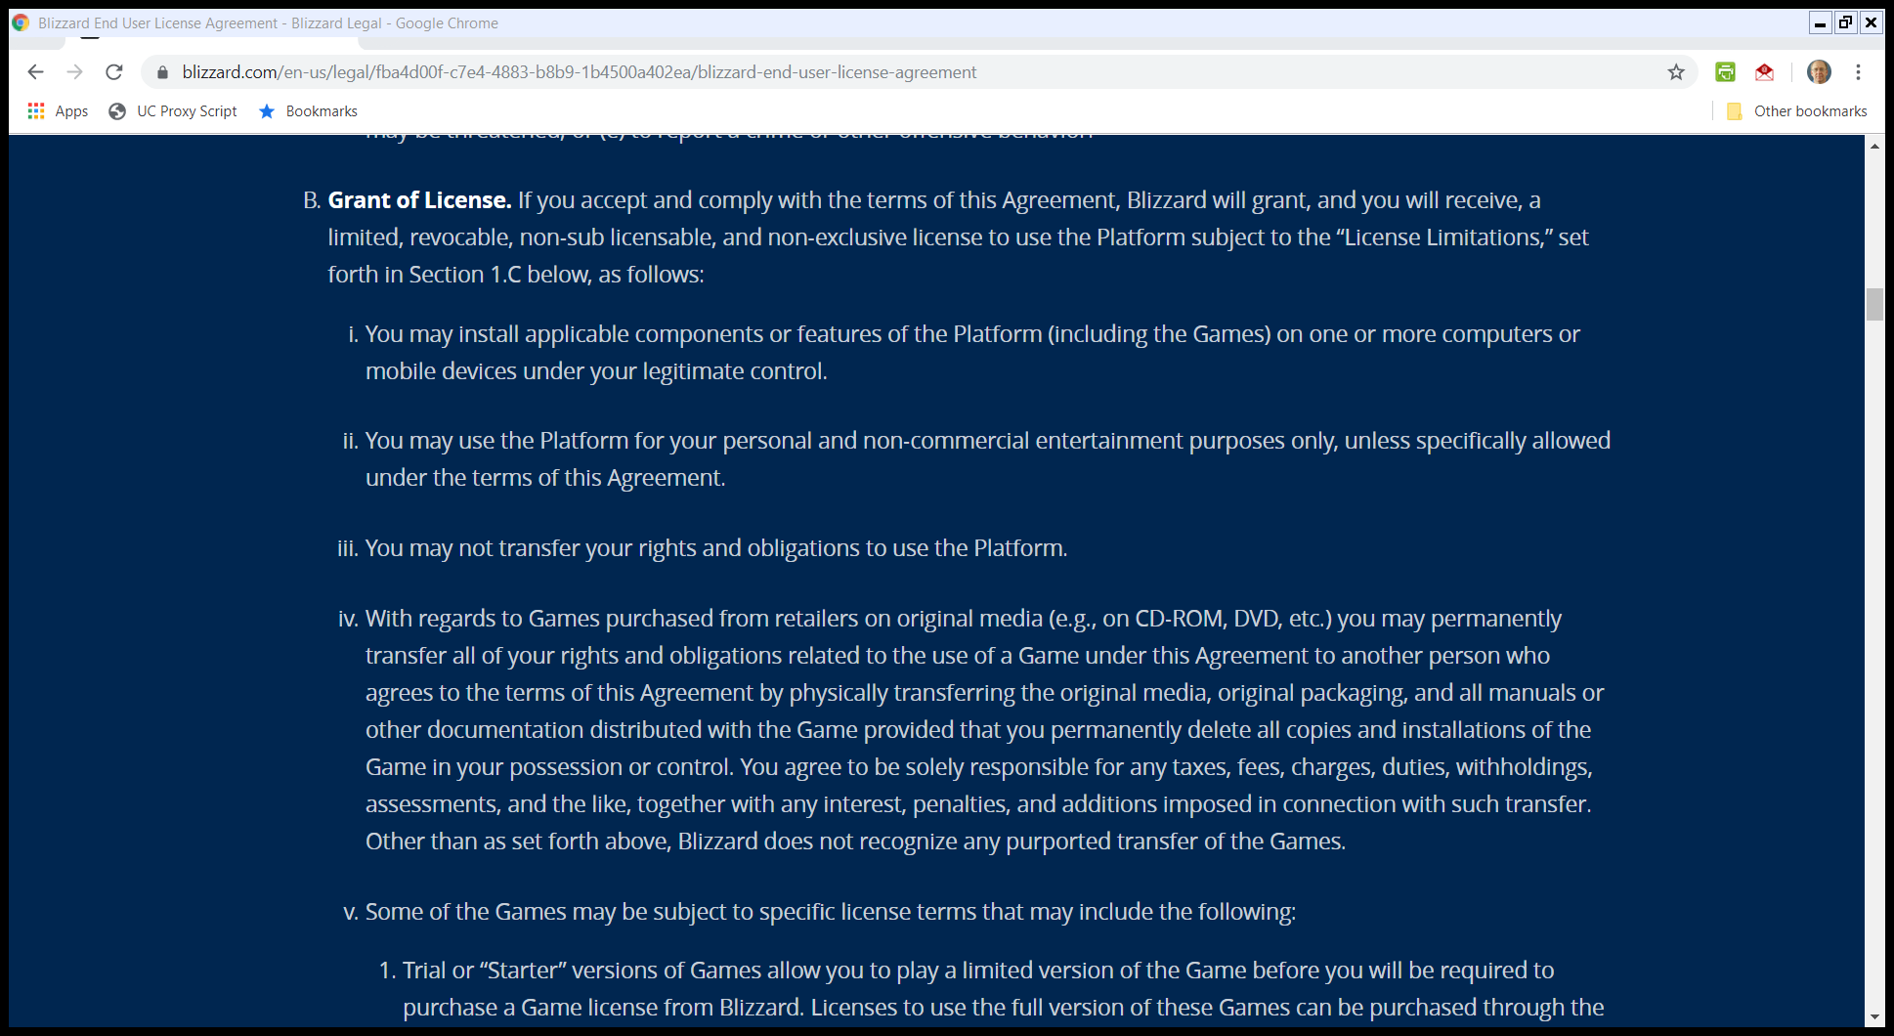
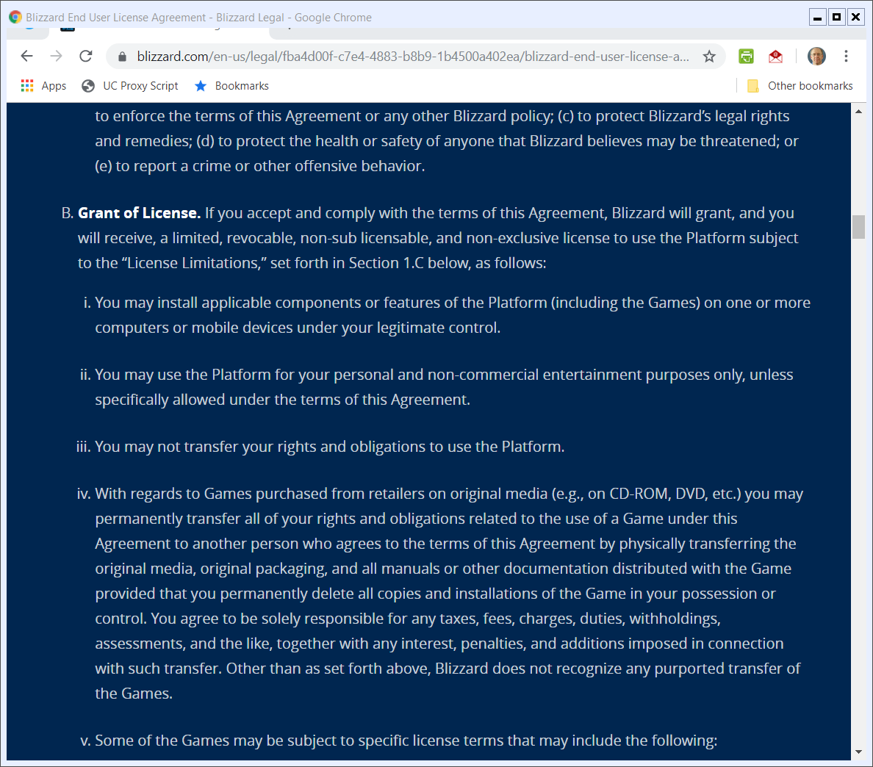
License
Blizzard EULA (as of 1 June 2018)

Slide 38
1st Sale Rights on Physical Media
Blizzard EULA (as of 1 June 2018)

Slide 39
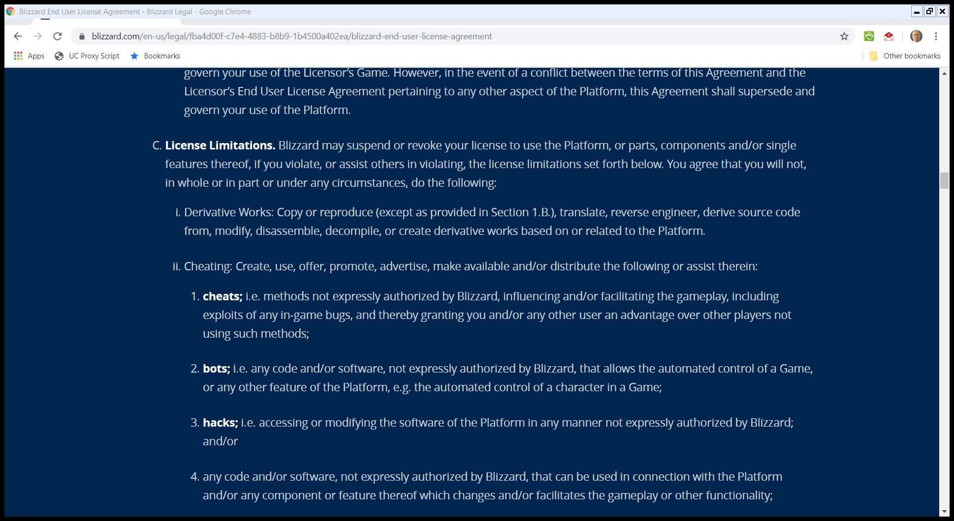
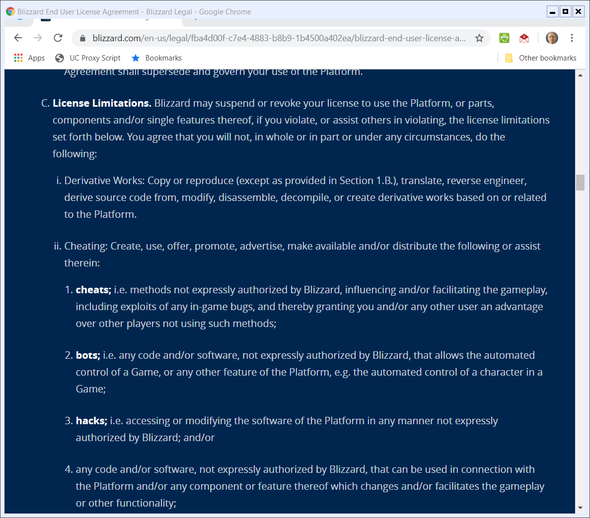
License Limits: Derivative Works
Blizzard EULA (as of 1 June 2018)

Slide 40
License Limits: Cheating
Blizzard EULA (as of 1 June 2018)

Slide 41
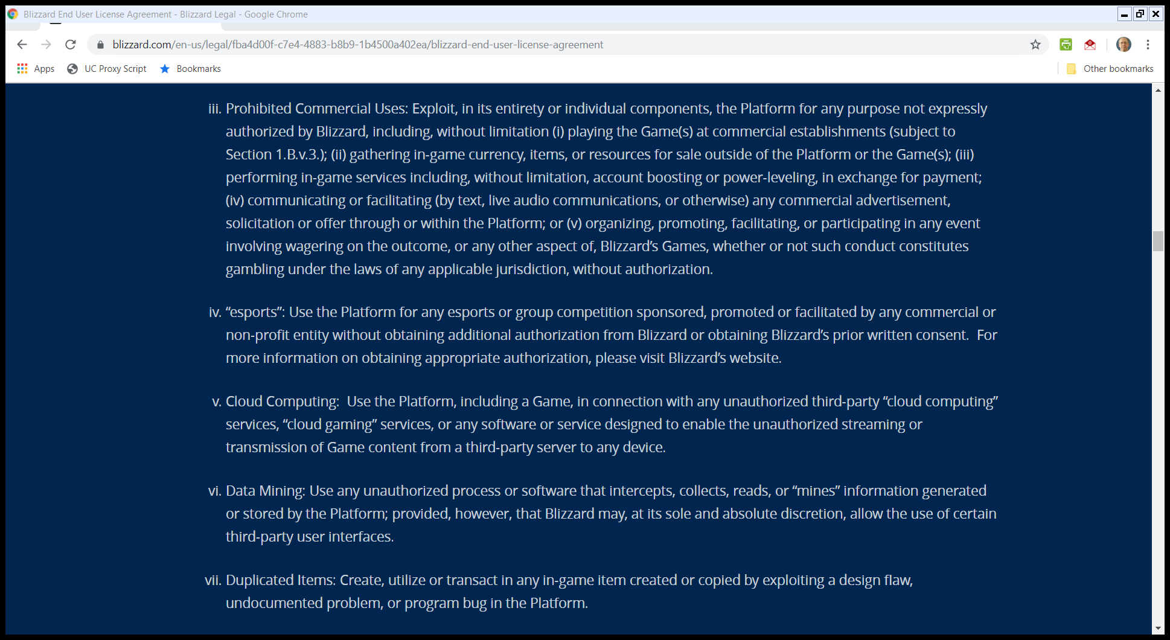
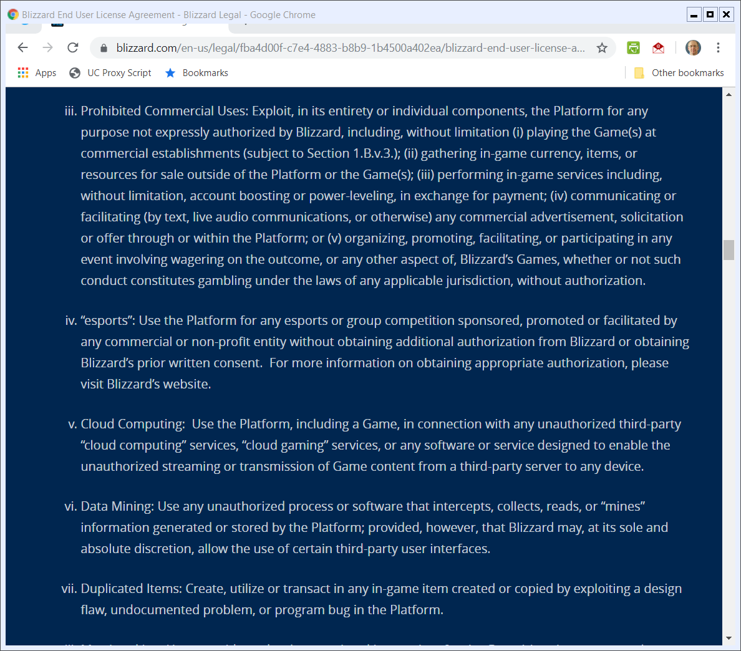
Commercial Use Limits
Blizzard EULA (as of 1 June 2018)

Slide 42
Commercial Use Limits
Blizzard EULA (as of 1 June 2018)

Slide 43
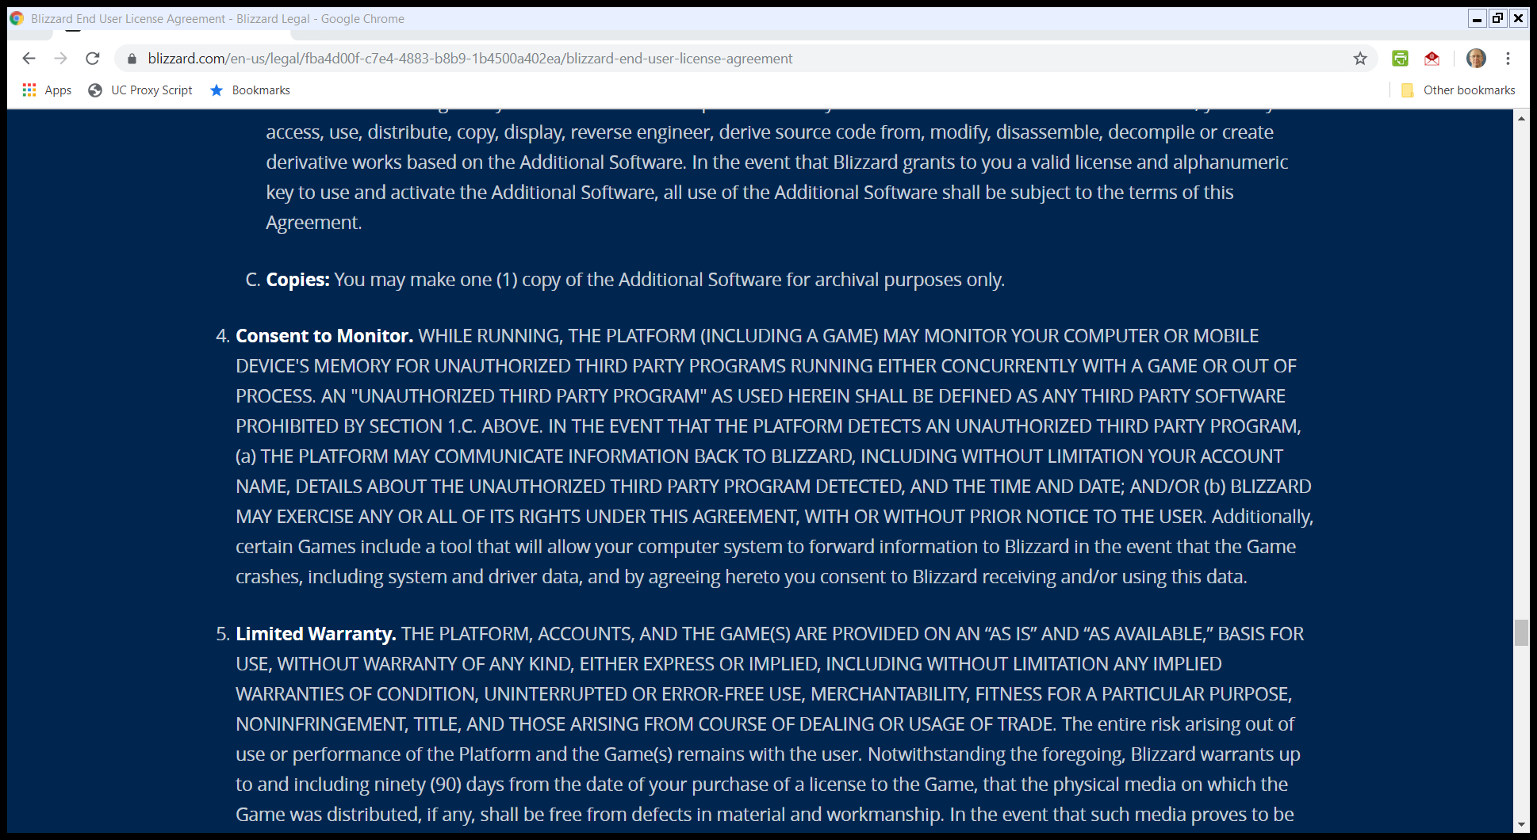
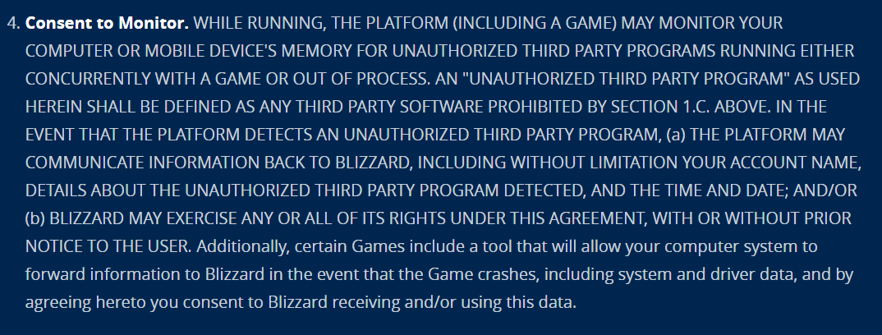
Monitoring of Use
Blizzard EULA (as of 1 June 2018)

Slide 44
Infringement v. Breach
Use of WoW and Glider Together
The Blizzard EULA/TOU bars the use of software like Glider in the play of WoW.
If a player uses Glider, is that a breach of the EULA/TOU? An infringement of copyright? What turns on that?

Slide 45
Copyright Licenses and Contract Violations
“‘A copyright owner who grants a nonexclusive, limited license ordinarily waives the right to sue licensees for copyright infringement, and it may sue only for breach of contract.’ Sun I, 188 F.3d at 1121 (internal quotations omitted). However, if the licensee acts outside the scope of the license, the licensor may sue for copyright infringement. Id. (citing S.O.S., Inc. v. Payday, Inc., 886 F.2d 1081, 1087 (9th Cir. 1989)). …”
Blizzard (9th Cir. 2010)

Slide 46
Contractual Covenants v. License Conditions
“We refer to contractual terms that limit a license’s scope as ‘conditions,’ the breach of which constitute copyright infringement. We refer to all other license terms as ‘covenants,’ the breach of which is actionable only under contract law. We distinguish between conditions and covenants according to state contract law, to the extent consistent with federal copyright law and policy. …”
Blizzard (9th Cir. 2010)

Slide 47
Infringement v. Breach
Key Issues
Copyright infringement means, for example, that the statutory damage regime in 504(c) would apply
Jurisdiction
Statutes of limitation

Slide 48
Policing Copyright and Contract
Issue
To what extent will we allow copyright holders to turn what would otherwise just be contractual breaches into copyright violations with the resulting consequences
The conditions/covenants analysis tries to police this boundary.

Slide 49
Applying this Here
Blizzard’s Copyrights
Having the copyright in WoW doesn’t give Blizzard an independent right to bar a player from running Microsoft Outlook at the same time
Don’t treat as a condition anything that attempts to create an obligation that doesn’t originate from copyright law itself.

Slide 50
Just Contract Terms Here
“We conclude that for a licensee’s violation of a contract to constitute copyright infringement, there must be a nexus between the condition and the licensor’s exclusive rights of copyright. Here, WoW players do not commit copyright infringement by using Glider in violation of the ToU. MDY is thus not liable for secondary copyright infringement, which requires the existence of direct copyright infringement.”
Blizzard (9th Cir. 2010)

Slide 51
Sec. 301: Preemption
17 USC 301

Slide 52
Tortious Interference with Contract
Section 301 Applied Here
TIwC claim not equivalent to copyright, hence not preempted.

Slide 53
Playing WOW
TTYN (1 of 5)
Hypo 1
I buy an online subscription for WOW
After 100 hours of play, I have reached level 35 and have amassed skills, loot and weapons
The first 100 hours was sheer drudgery, but now I am excited to play going forward
Copyright issues?

Slide 54
Playing WOW
TTYN (2 of 5)
Hypo 2
I buy an online subscription for WOW
I hire a 14 year old kid in the neighborhood to come play under my subscription
Eventually “I” have reached level 35 and have amassed skills, loot and weapons
Now I am excited to play going forward
Copyright issues?

Slide 55
Playing WOW
TTYN (3 of 5)
Hypo 3
I buy an online subscription for WOW
I license a software bot to come play under my subscription
Eventually “I” have reached level 35 and have amassed skills, loot and weapons
Now I am excited to play going forward
Copyright issues?

Slide 56
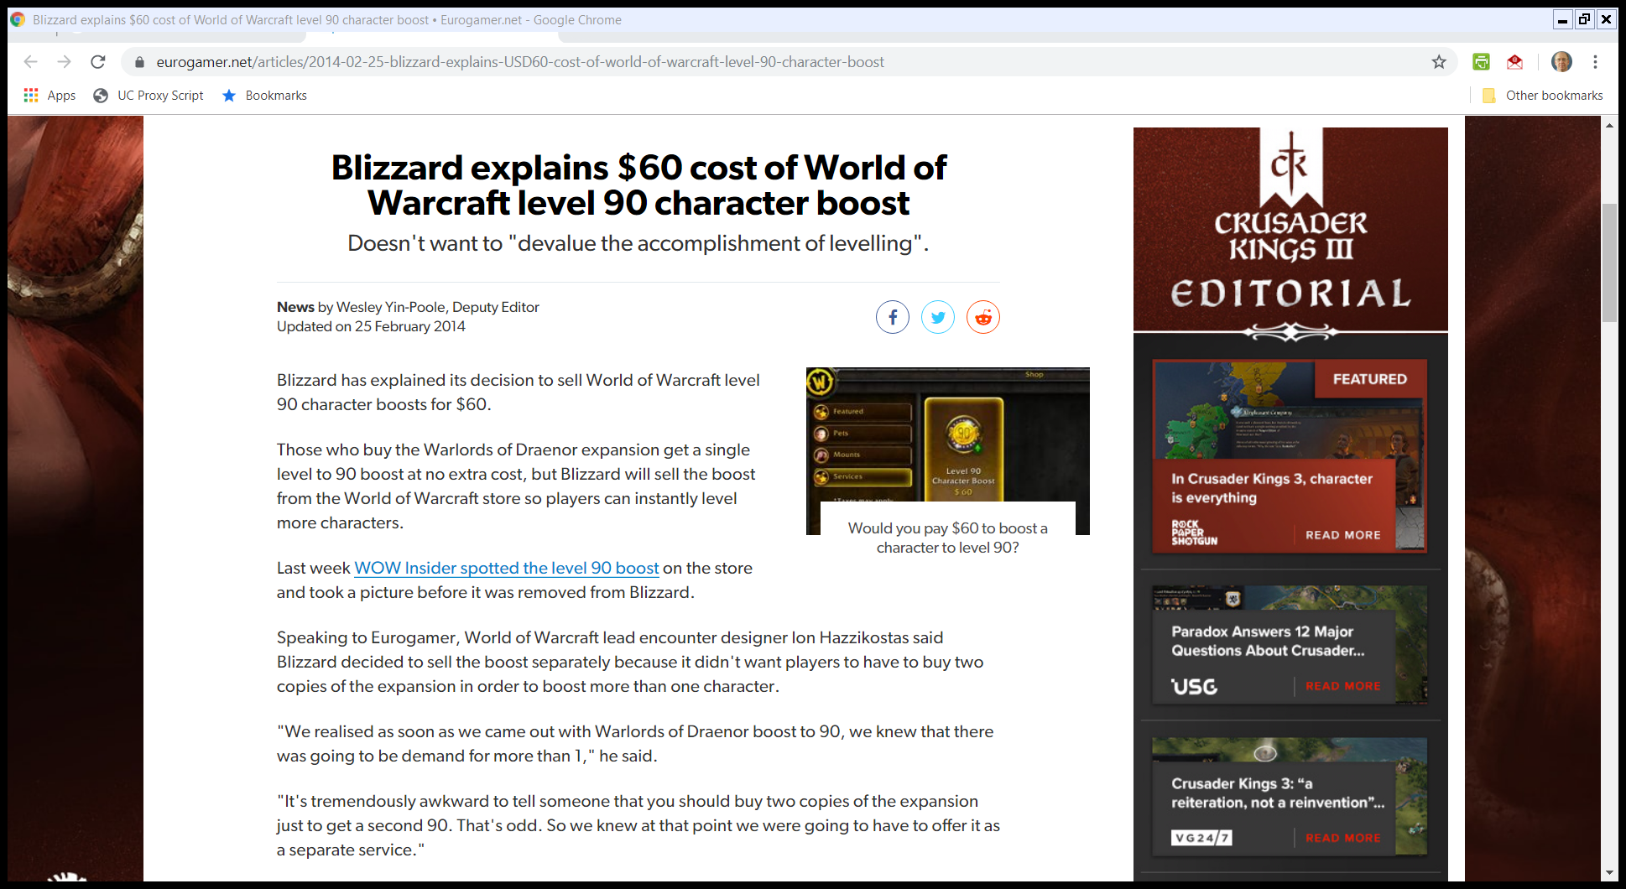
Selling Levels (TTYN (4 of 5))
Eurogamer.net (25 Feb 2014)
Notes:
https://www.eurogamer.net/articles/2014-02-25-blizzard-explains-USD60-cost-of-world-of-warcraft-level-90-character-boost

Slide 57
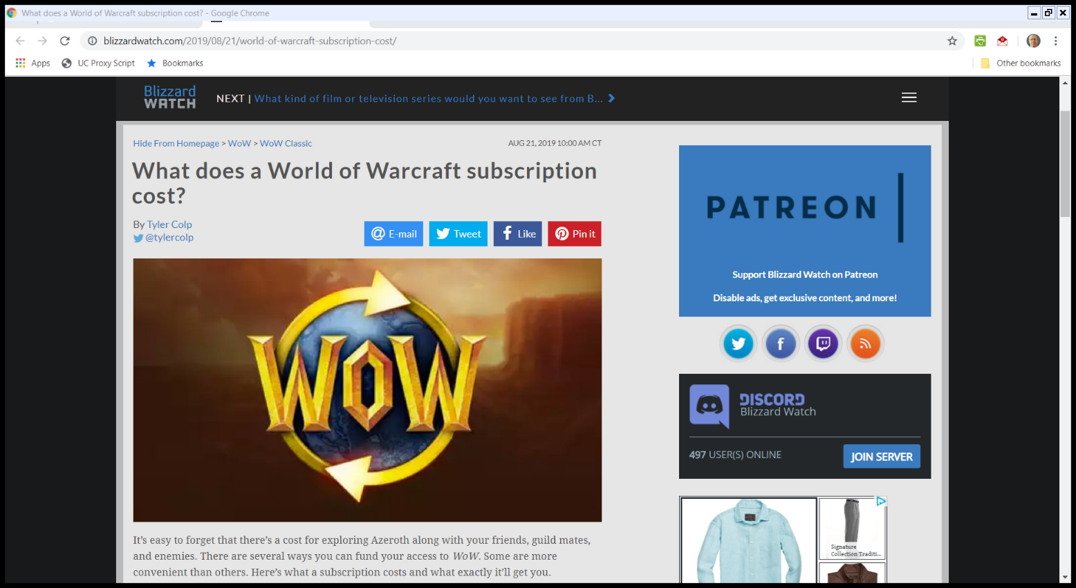
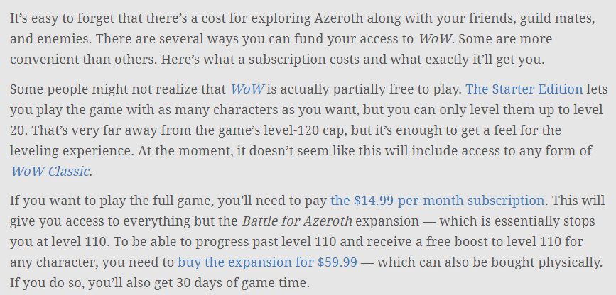
Paying for Levels (TTYN (5 of 5))
BlizzardWatch.com (21 Aug 2019)
Notes:
https://blizzardwatch.com/2019/08/21/world-of-warcraft-subscription-cost/

Slide 58
The DMCA Issue in Blizzard
Two Slices
Literal elements vs. non-literal elements
Located on PC vs. located on Blizzard server
And remember the statutory slice
Is the TPM (technological protection measure) here directed at access to the work or controlling the rights of the copyright holder?

Slide 59
The DMCA Issue in Blizzard
Analysis
Blizzard TPM is Access Control, not Copyright Control
This means 1201(a) is the applicable rule, not 1201(b)

Slide 60
The DMCA Issue in Blizzard
PC-Based Material
Warden doesn’t exercise full control over access to WoW
Not fully subject to TPM and thus not covered by 1201(a)
Server-Based Materials
Warden acts as a more systematic TPM and hence MDY subject to 1201(a)(2)

Slide 61
Alternative Ways to Access Literal Elements
“We agree with the district court that MDY’s Glider does not violate DMCA § 1201(a)(2) with respect to WoW’s literal elements and individual non-literal elements, because Warden does not effectively control access to these WoW elements. First, Warden does not control access to WoW’s literal elements because these elements—the game client’s software code— are available on a player’s hard drive once the game client software is installed. … ”
Blizzard (9th Cir. 2010)

Slide 62
Alternative Ways to Access Nonliteral Elements
“[WoW’s] individual nonliteral components may be accessed by a user without signing on to the server. … For instance, a user may call up and listen to the roar a particular monster makes within the game. Or the user may call up a virtual image of that monster.”
Blizzard (9th Cir. 2010)

Slide 63
The Lexmark Comparison
“Our conclusion is in accord with the Sixth Circuit’s decision in Lexmark International v. Static Control Components, 387 F.3d 522 (6th Cir. 2004). In Lexmark, the plaintiff sold laser printers equipped with an authentication sequence, verified by the printer’s copyrighted software, that ensured that only plaintiff’s own toner cartridges could be inserted into the printers. The defendant sold microchips capable of generating an authentication sequence that rendered other manufacturers’ cartridges compatible with plaintiff’s printers.”
Blizzard (9th Cir. 2010)

Slide 64
The Lexmark Comparison
“The Sixth Circuit held that plaintiff’s § 1201(a)(2) claim failed because its authentication sequence did not effectively control access to its copyrighted computer program. Rather, the mere purchase of one of plaintiff’s printers allowed ‘access’ to the copyrighted program. Any purchaser could read the program code directly from the printer memory without encountering the authentication sequence.”
Blizzard (9th Cir. 2010)

Slide 65
The Lexmark Comparison
“The authentication sequence thus blocked only one form of access: the ability to make use of the printer. However, it left intact another form of access: the review and use of the computer program’s literal code.”
Blizzard (9th Cir. 2010)

