Slide 1
Class 16: Mon 28 Apr 2025
Copyright Spring 2025
Music: Sampling and Covers
Randal C. Picker
James Parker Hall Distinguished Service Professor of Law
The Law School
The University of Chicago

Slide 2
What Is Today About?
Possible answers
  6.23 seconds of sound
  The ability to remix freely and create culture

Slide 3
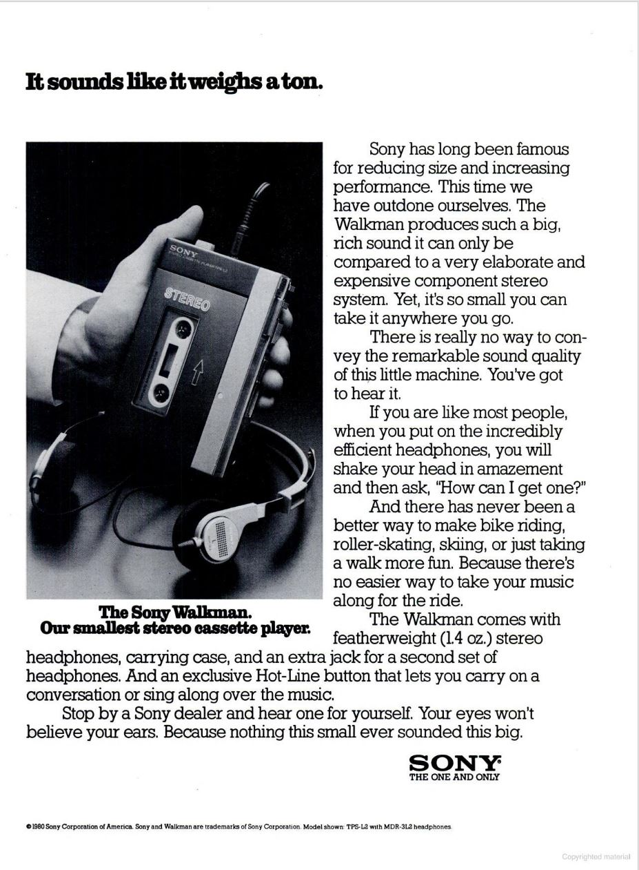
Sony Walkman
New York Magazine (13 Oct 1980)
Notes:
https://books.google.com/books?id=IeQCAAAAMBAJ&pg=PA7&dq=sony+walkman+1980&hl=en&sa=X&ved=2ahUKEwj_vZLli_uMAxXn_8kDHfZ5OYUQuwV6BAgEEAc#v=onepage&q=sony%20walkman%201980&f=false

Slide 4
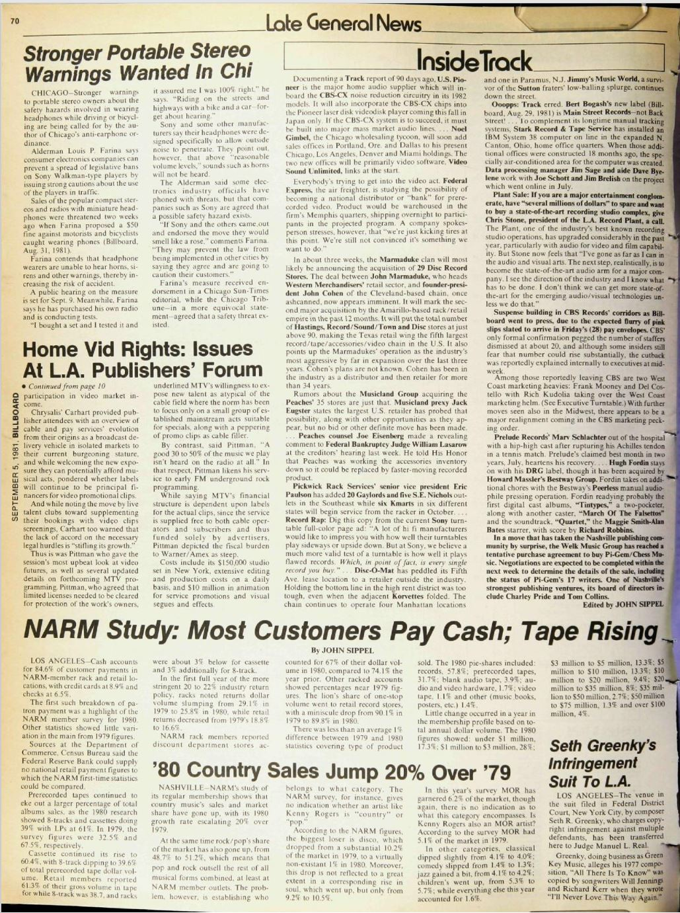
More Fun = Less Safe?
Billboard Magazine (5 Sept 1981)

Slide 5
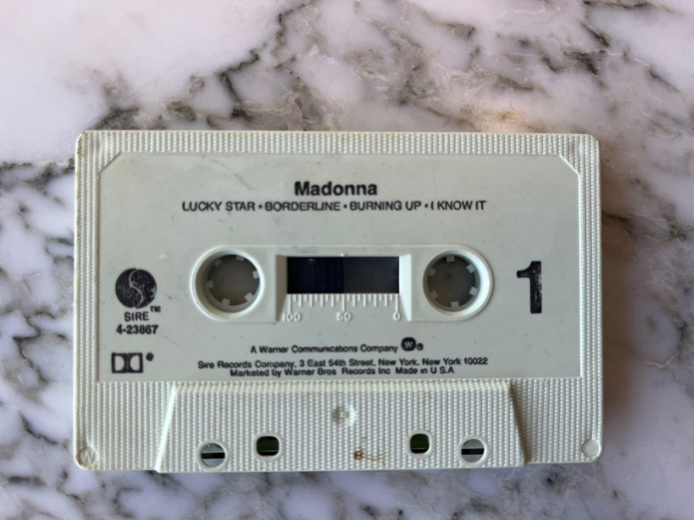
Madonna Side 1

Slide 6
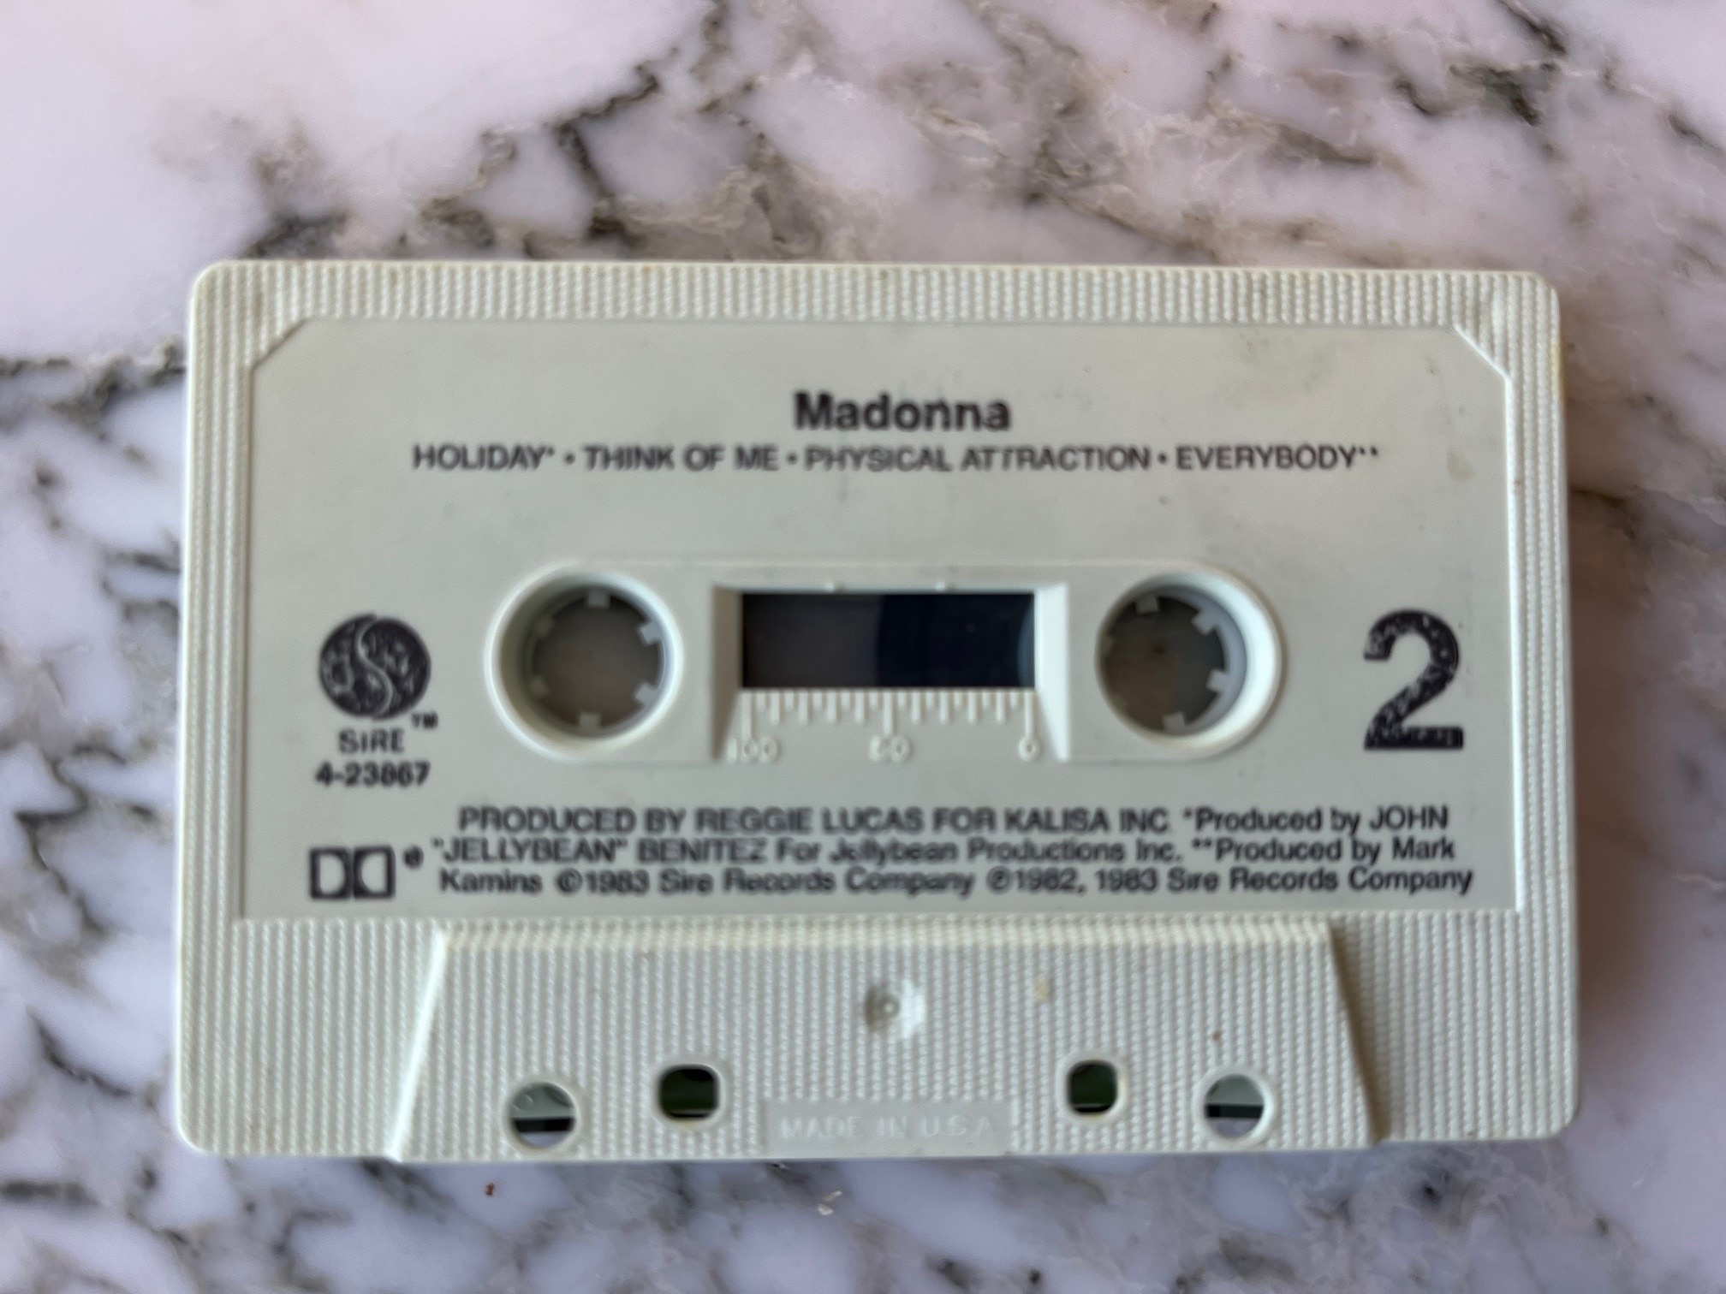
Madonna Side 2

Slide 7
Sec. 106 (No 106(6))
Pub. L. 94-553 (19 Oct 1976)

Slide 8
Sec. 114
Pub. L. 94-553 (19 Oct 1976)

Slide 9
Sec 114: Scope of Sound Recording Rights
“(a) The exclusive rights of the owner of copyright in a sound recording are limited to the rights specified by clauses (1), (2), (3) and (6) of section 106, and do not include any right of performance under section 106(4).”
17 USC 114

Slide 10
Radio Fights
H.R. 94-1476 (3 Sept 1976)

Slide 11
Sec. 114 Again
“(b) The exclusive right of the owner of copyright in a sound recording under clause (1) of section 106 is limited to the right to duplicate the sound recording in the form of phonorecords or copies that directly or indirectly recapture the actual sounds fixed in the recording.”
17 USC 114

Slide 12
Limited Derivative Works Rights
“The exclusive right of the owner of copyright in a sound recording under clause (2) of section 106 is limited to the right to prepare a derivative work in which the actual sounds fixed in the sound recording are rearranged, remixed, or otherwise altered in sequence or quality.”
17 USC 114

Slide 13
Can’t Block Independent Fixation of Sounds
“The exclusive rights of the owner of copyright in a sound recording under clauses (1) and (2) of section 106 do not extend to the making or duplication of another sound recording that consists entirely of an independent fixation of other sounds, even though such sounds imitate or simulate those in the copyrighted sound recording.”
17 USC 114

Slide 14
Copying Performance Is Fine; Just Can’t Use Substantial Part of Actual Sounds
H.R. 94-1476 (3 Sept 1976)

Slide 15
And Limited Derivative Works Right
H.R. 94-1476 (3 Sept 1976)

Slide 16
1976 Act: Sec. 115
Pub. L. 94-553 (19 Oct 1976)

Slide 17
1909 Sec. 1(e) Cover Right Continued
H.R. 94-1476 (3 Sept 1976)

Slide 18
Adding Sec 106(6)
Pub. L. 104-39 (1 Nov 1995)

Slide 19
Background
H. Rep. 104-274 (11 Oct 1995)

Slide 20
Why the New Right?
H. Rep. 104-274 (11 Oct 1995)

Slide 21
Broadcast Radio Protected But Narrow New Right Built
H. Rep. 104-274 (11 Oct 1995)

Slide 22
More Sec. 106
“(6) in the case of sound recordings, to perform the copyrighted work publicly by means of a digital audio transmission.”
17 USC 106

Slide 23
67 Pages of Dense Text
Pub. L. 115-264 (11 Oct 2018)

Slide 24
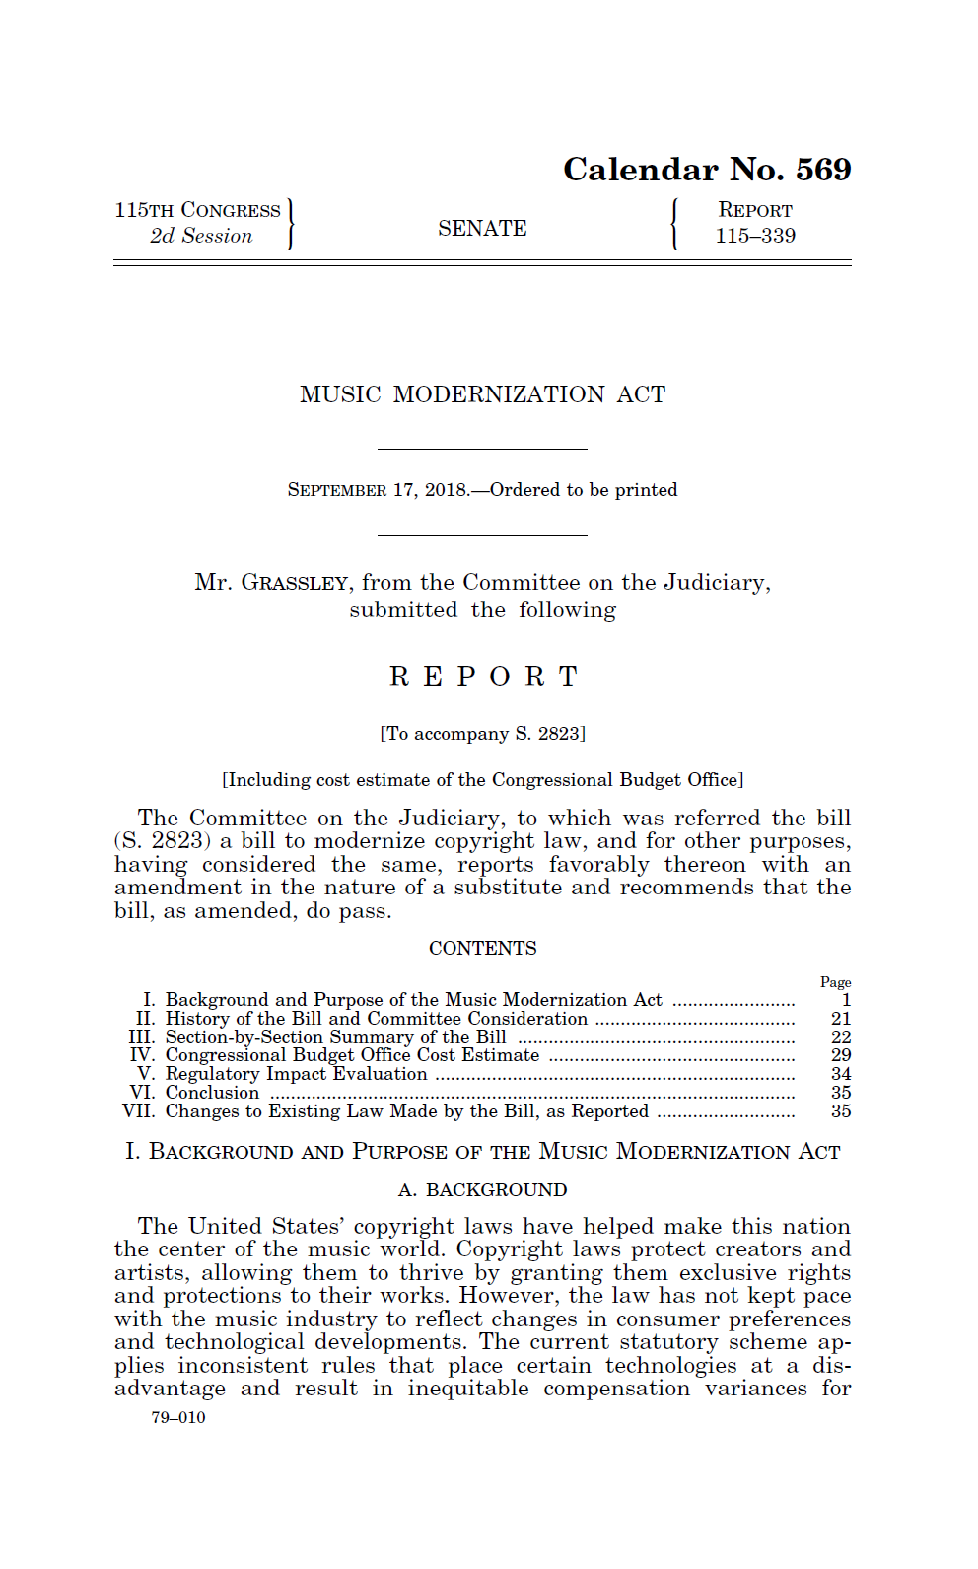
Music Modernization Act of 2018
S. Rep. 115-339 (17 Sept 2018)

Slide 25
Updating Cover Right for Digital Age
S. Rep. 115-339 (17 Sept 2018)

Slide 26
Current Sec. 115
17 USC 115

Slide 27
Newton and Ciccone
Once Damned or Twice-Damned?
  To sample recorded music, do you need to license both the sound recording and the musical composition or can you just license the sound recording?
  Does it matter how big the sample is?

Slide 28
Remixes: Newton v. Diamond
Core Facts
  1978: Newton composes Choir
  1988: Newton records Choir and licenses all rights in sound recording to ECM for $5000
  1992: Beastie Boys get license from ECM to sample Choir, produce Pass the Mic
  Newton sues for copyright infringement of his musical composition

Slide 29
Newton v. Diamond
388 F.3d 1189 (9th Cir. 2004)

Slide 30
Newton Contract with ECM
“(1) [Newton] herewith grants, transfers and assigns to ECM without limitations and restrictions whatsoever the exclusive rights to record his performances and to exploit these recordings in perpetuity throughout the world in any manner whatsoever.”
Newton (9th Cir. 2004)

Slide 31
Newton Contract with ECM
“3) The grant of rights according to section 1) especially, includes the rights to manufacture in quantity [sic], to distribute, to license to others, as well as to perform the recordings in public and to utilize it in radio, TV, or in other ways without any restrictions.”
Newton (9th Cir. 2004)

Slide 32
ECM to Beasties Boys
“[ECM Records], as owner of the applicable sound recording rights, including but not limited to recording, reproduction, synchronization and performing rights, grants to Beastie Boys, its licensees, assigns, employees and agents (the “Licensed Parties”), the irrevocable non-exclusive license and right to copy portions (if any) of the sound recording entitled “Choir” performed by James Newton (the “Sample”).”
Newton (9th Cir. 2004)

Slide 33
ECM to Beastie Boys
“to embody the sample in some or all versions of the selection entitled “Pass the Mic” by the Beastie Boys (all versions of “Pass the Mic” which contain the Sample are referred to as the “Selection”); to reproduce, distribute and otherwise exploit the Sample as part of the Selection in all media, whether now known or hereinafter developed, including, without limitation, all record formats throughout the world in perpetuity.”
Newton (9th Cir. 2004)

Slide 34
De Minimus Infringement Test
“A leading case on de minimis infringement in our circuit is Fisher v. Dees, 794 F.2d 432 (9th Cir.1986), where we observed that a use is de minimis only if the average audience would not recognize the appropriation.”
Newton (9th Cir. 2004)

Slide 35
Understanding Newton
TTYN (1 of 4)
Questions
  What rights do the contracts create? Are there any holes/problems here?
  What does the musical work on the third slide in the set control? What are the differences between the musical work and the sound recording?

Slide 36
Understanding Newton
TTYN (2 of 4)
Questions
  How should we evaluate the sound recordings on the fourth slide in the set?
  Is the use de minimis?

Slide 37
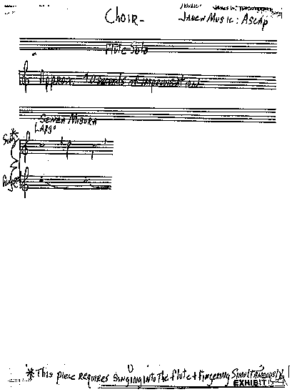
TTYN (3 of 4)
Newton (9th Cir. 2004)

Slide 38
The Sound Recordings
TTYN (4 of 4)
Link Here
  https://blogs.law.gwu.edu/mcir/case/newton-v-diamond/

Slide 39
Result: Newton Loses
“On the undisputed facts of this case, we conclude that an average audience would not discern Newton’s hand as a composer, apart from his talent as a performer, from Beastie Boys’ use of the sample. The copying was not significant enough to constitute infringement. Beastie Boys’ use of the ‘Choir’ composition was de minimis.”
Newton (9th Cir. 2004)

Slide 40
Ciccone
824 F.3d 871 (9th Cir. 2016)

Slide 41
The Central Questions
TTYN (1 of 3)
Key Qs
  How does Sec. 114 apply to music sampling of a sound recording?
  If the Beastie Boys and Madonna win, what limits the scope of permitted sampling?

Slide 42
Ciccone: The Sound Recordings
TTYN (2 of 3)
Ooh I Love It (Love Break)
  Here (9irkIvpoI-A)
  Around 4:38 and forward
Vogue I
  Here (GuJQSAiODqI)
  0:56, 1:02, 3:41, 4:05, 4:18?

Slide 43
Ciccone: The Sound Recordings
TTYN (3 of 3)
Vogue II
  Here (yzG_3UJ-LvU)
  1:10, 1:16, more?

Slide 44
De Minimis Rule Applies to Sound Recordings
“Because we conclude that Congress intended to maintain the ‘de minimis’ exception for copyrights to sound recordings, we take the unusual step of creating a circuit split by disagreeing with the Sixth Circuit’s contrary holding in Bridgeport.”
Ciccione (9th Cir. 2016)

Slide 45
Covers: Sec. 115 Compulsory License for Certain Musical Works
17 U.S.C. 115

Slide 46
Covers: Limits
17 U.S.C. 115

Slide 47
Circular on Traditional Cover Right
Copyright Office Circular 73A

Slide 48
Statutory License?
Copyright Office Circular 73A

Slide 49
The Cover Right I
TTYN (1 of 2)
Hypo 1
  You write a new song, “The Copyright Blues”
  I buy the sheet music for the song and record it and distribute CDs of my sound recording
Copyright issues?

Slide 50
The Cover Right II
TTYN (2 of 2)
Hypo 2
  You write and record a new song, “The Copyright Blues.” You distribute it on CD.
  I buy the sheet music for the song and record my version of it and distribute CDs of my sound recording
Copyright issues?

Slide 51
Hypos 1 and 2 Answers
Derivative Works
  My sound recording will be a derivative work of the sheet music (sound recordings are specifically referenced in the derivative works definition)
  You have the exclusive right to control derivative works under Sec. 106(2), unless something else calls off that right
  Any call offs? Yes: Sec. 115, if original sound recording has already been distributed

Slide 52
Hypos 1 and 2 Answers
First Mover Advantage
  Sec. 115 allows the second mover to distribute his/her “copy” of the musical work, once the owner of the copyright in the musical work has allowed one distribution of a phonorecord of the work
Described as “mechanical licensing”

Slide 53
Hypos 1 and 2 Answers
Sound Recording Issues
  Have I copied your sound recording?
  No; this is an independent fixation

Slide 54
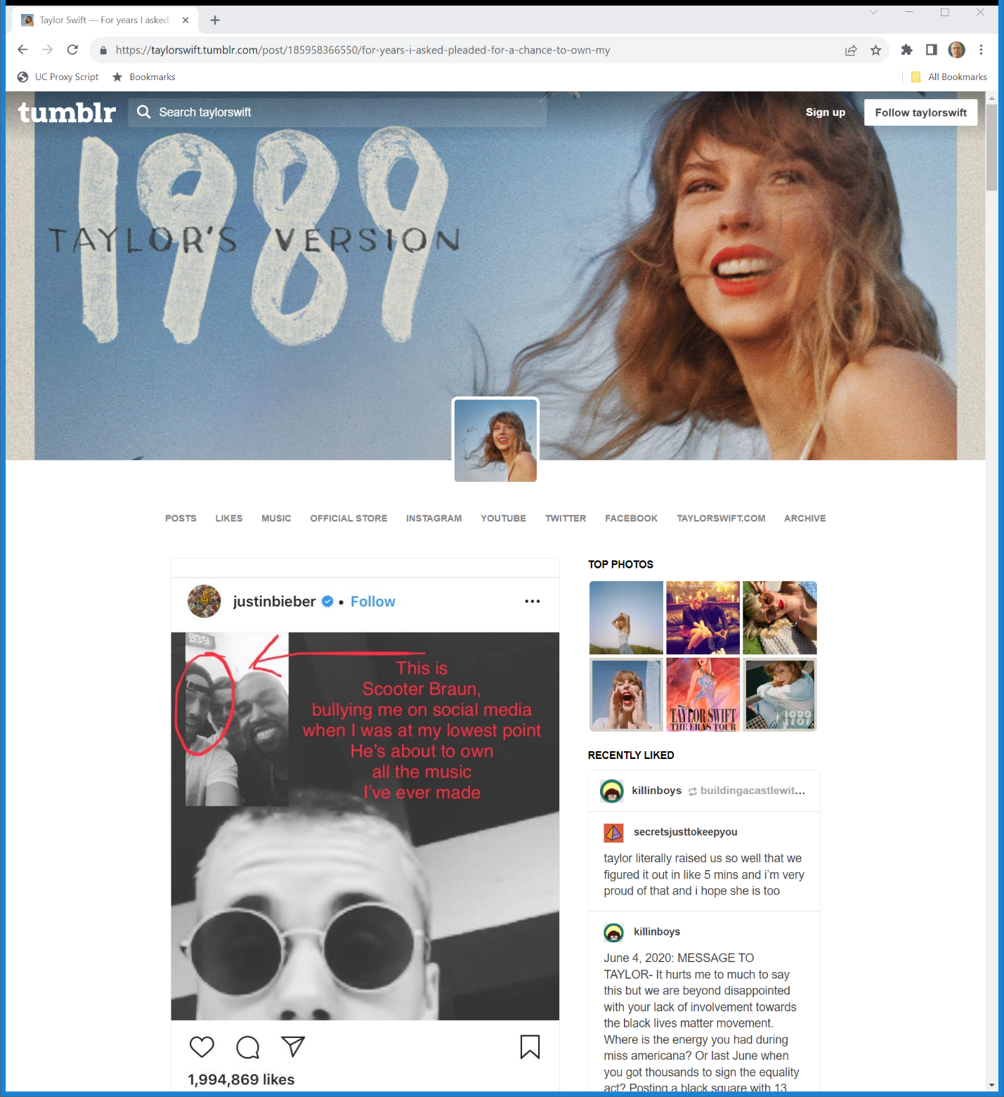
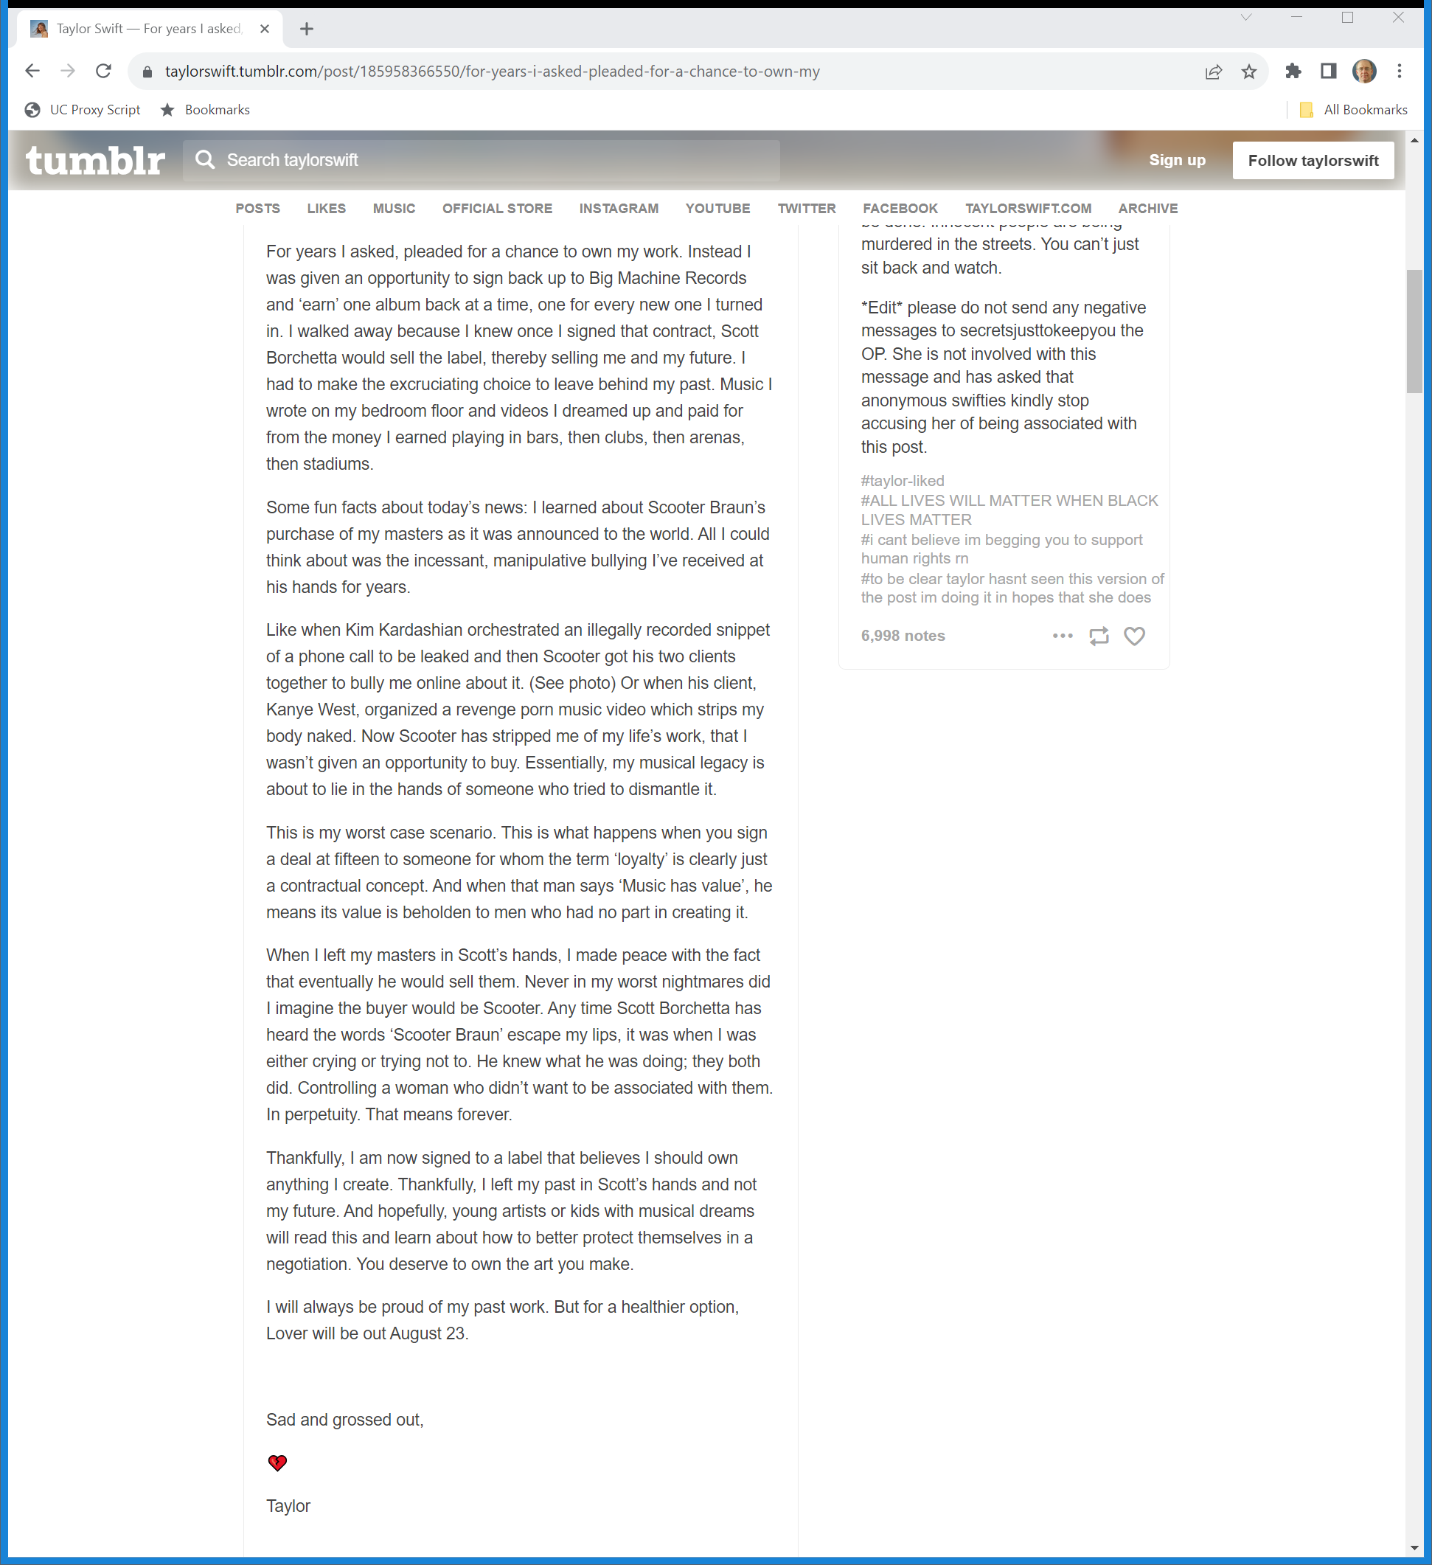
Taylor’s Not Happy
Taylor Swift Tumblr (30 June 2019)
Notes:
https://taylorswift.tumblr.com/post/185958366550/for-years-i-asked-pleaded-for-a-chance-to-own-my

Slide 55
Taylor’s Not Happy
Taylor Swift Tumblr (30 June 2019)
Notes:
https://taylorswift.tumblr.com/post/185958366550/for-years-i-asked-pleaded-for-a-chance-to-own-my

Slide 56
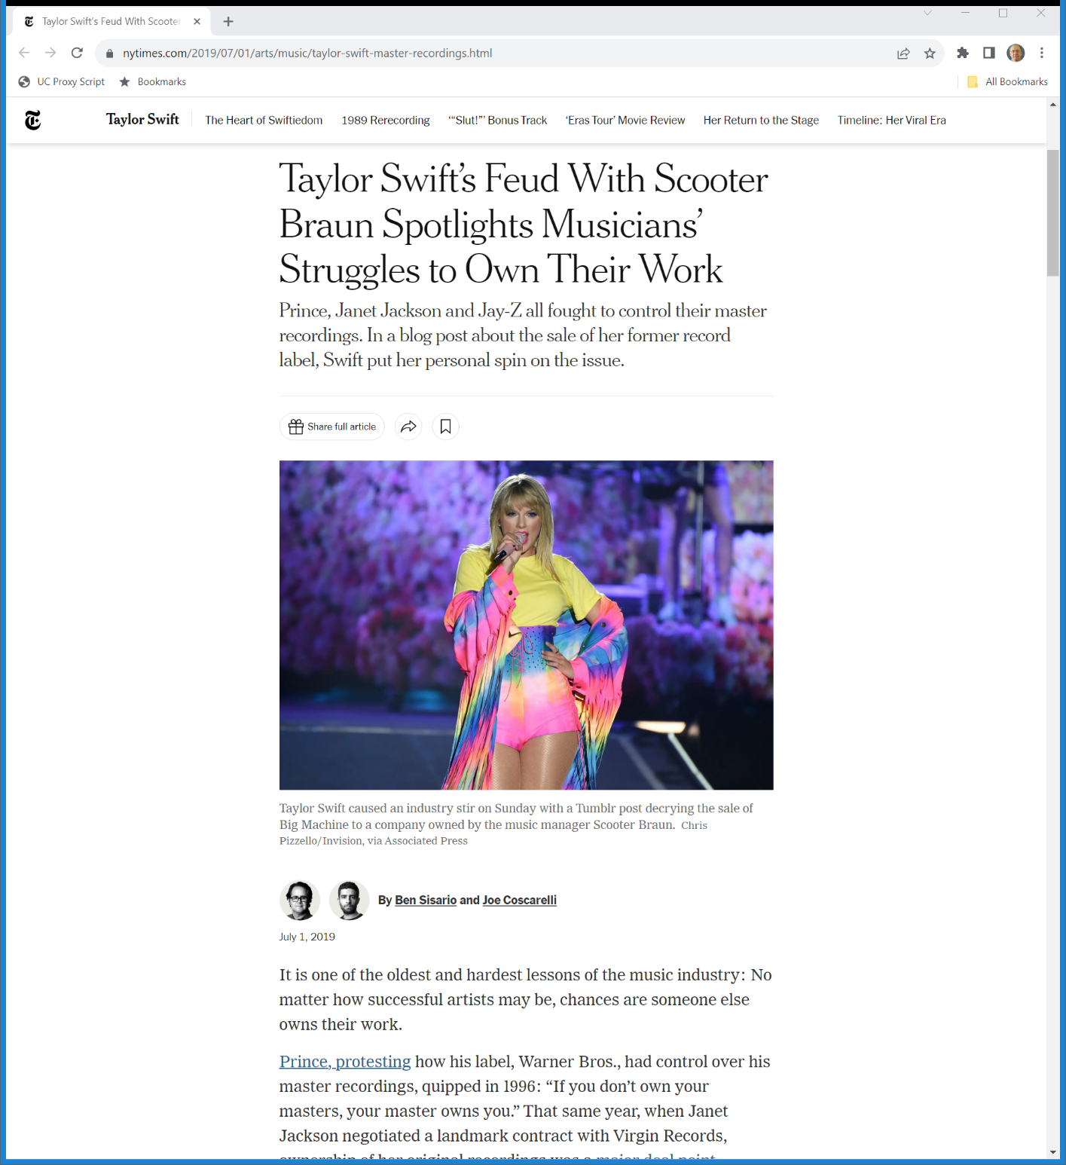
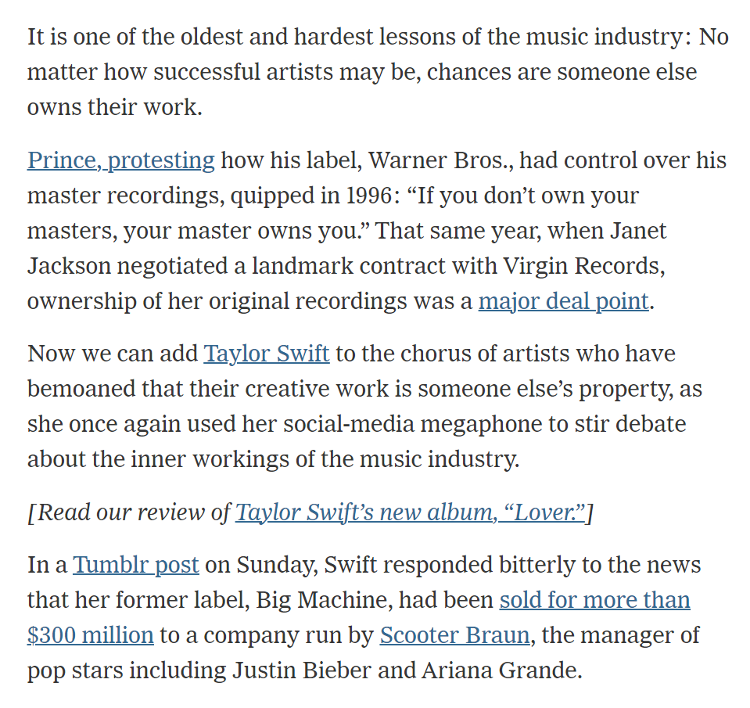
Owning the Masters
New York Times (1 July 2019)
Notes:
https://www.nytimes.com/2019/07/01/arts/music/taylor-swift-master-recordings.html

Slide 57
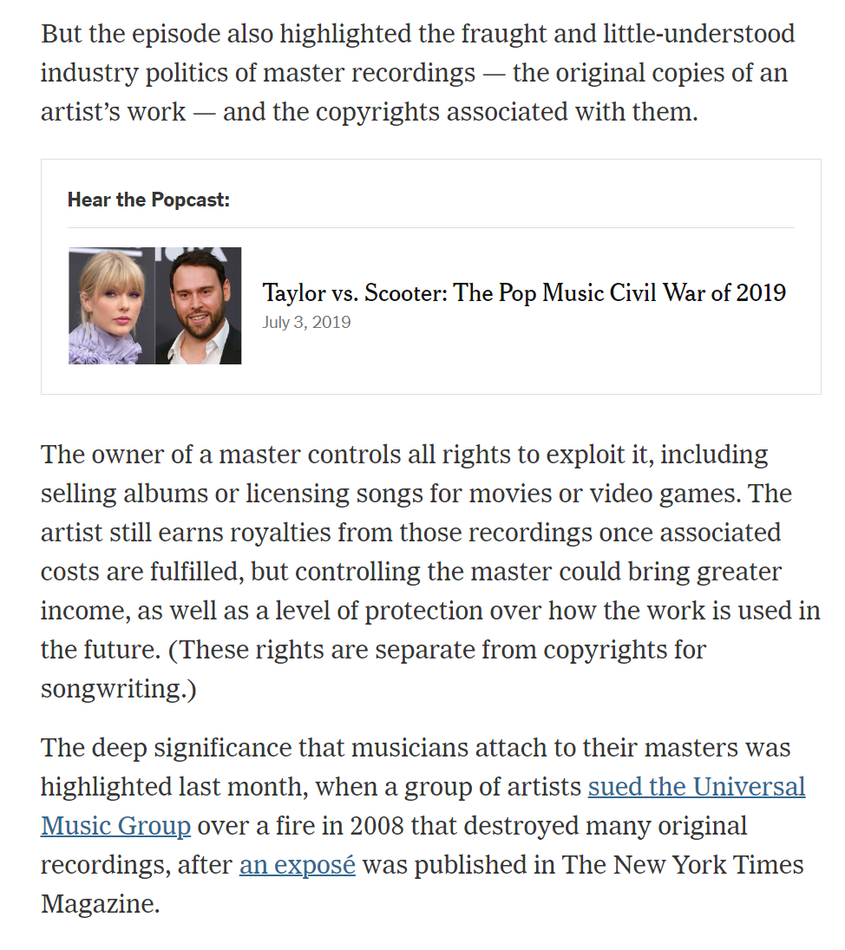
Masters and Copyright
New York Times (1 July 2019)
Notes:
https://www.nytimes.com/2019/07/01/arts/music/taylor-swift-master-recordings.html

Slide 58
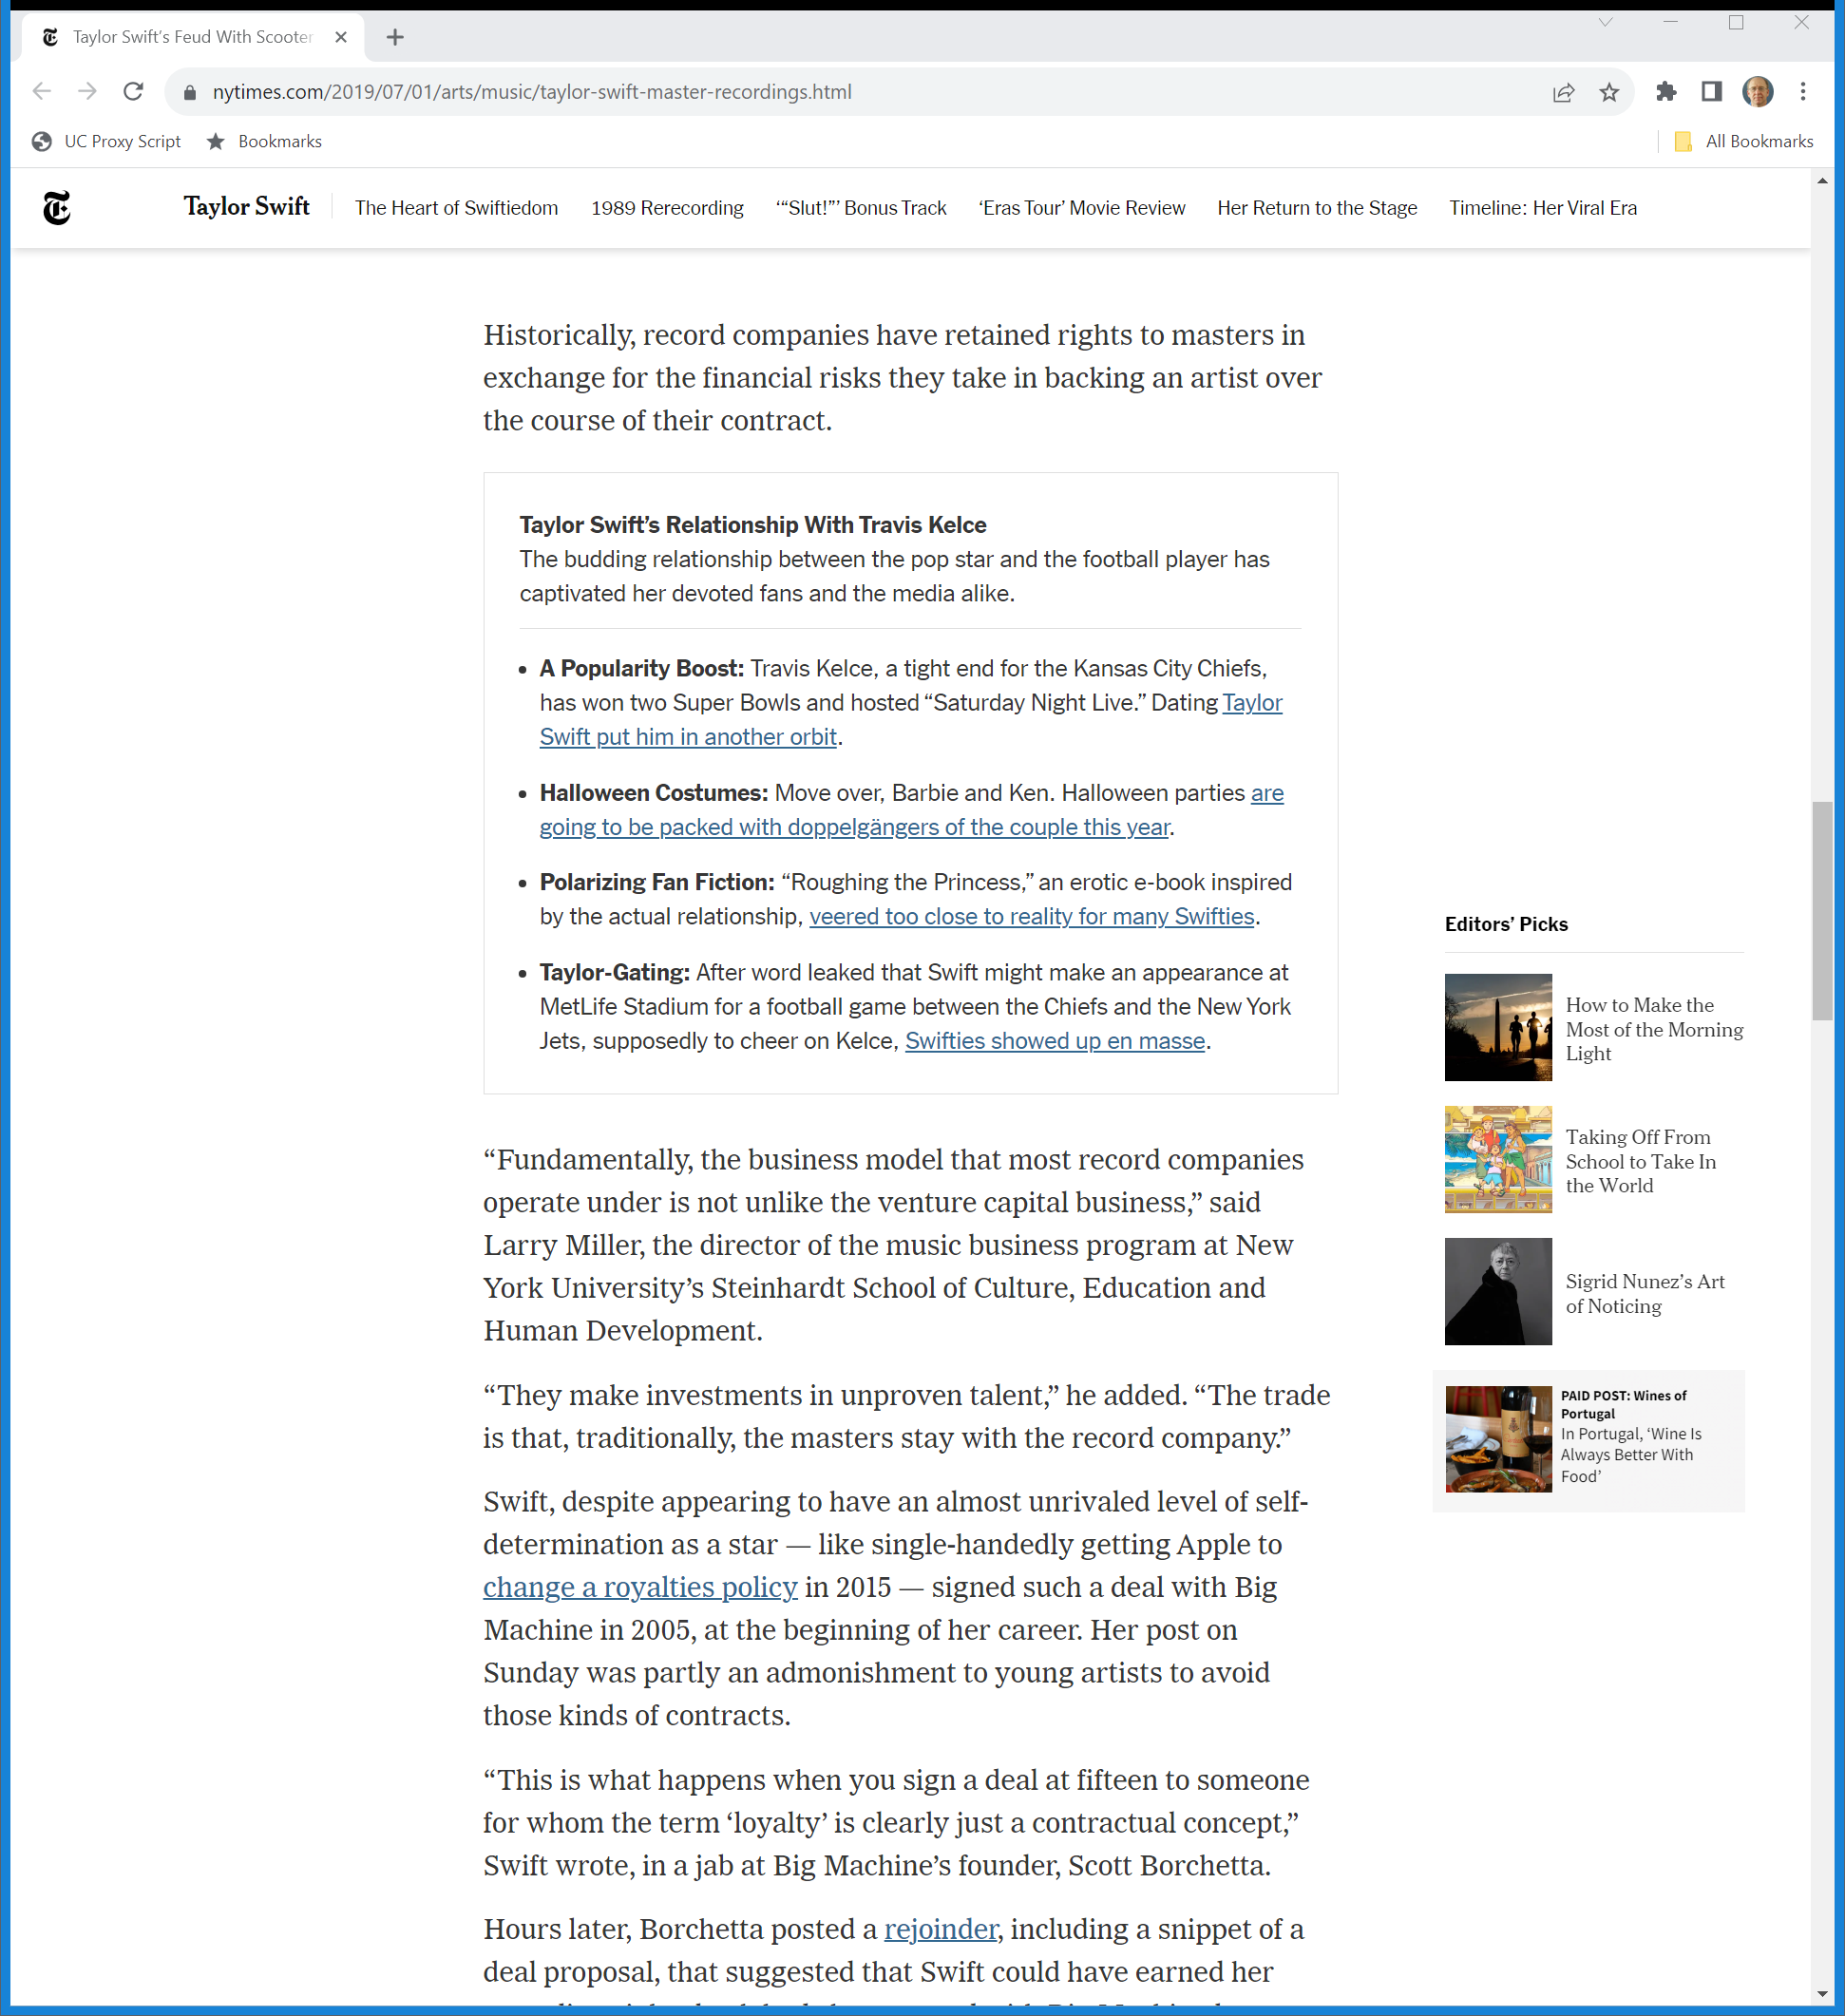
Risky Investments
New York Times (1 July 2019)
Notes:
https://www.nytimes.com/2019/07/01/arts/music/taylor-swift-master-recordings.html

Slide 59
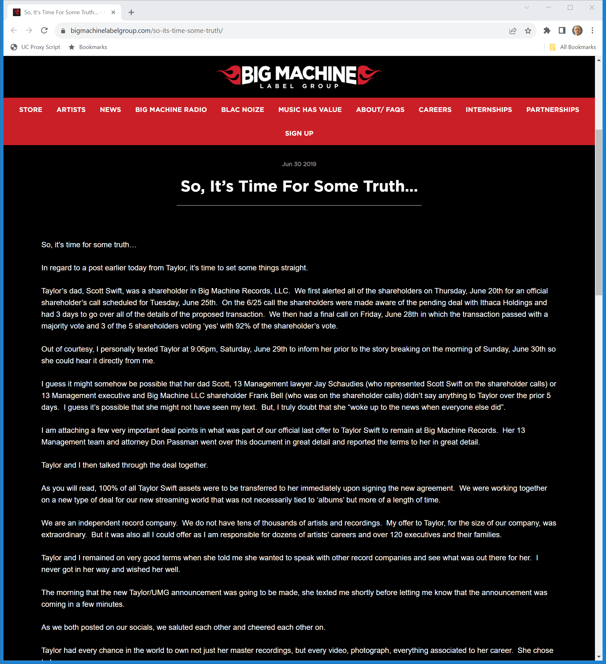
The Other Side?
BMLG Response (30 June 2019)
Notes:
https://www.bigmachinelabelgroup.com/so-its-time-some-truth/

Slide 60
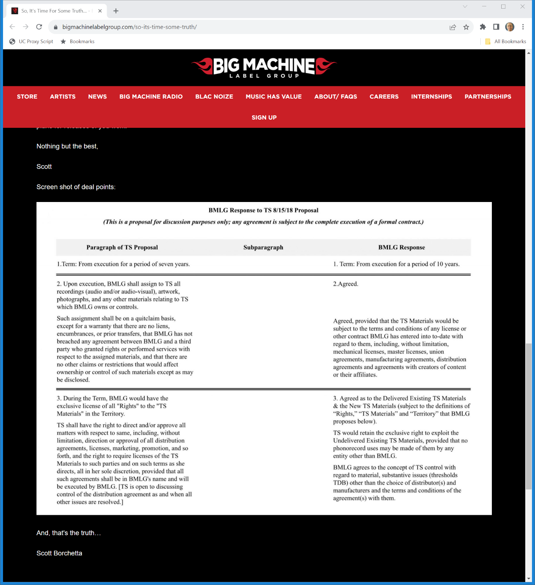
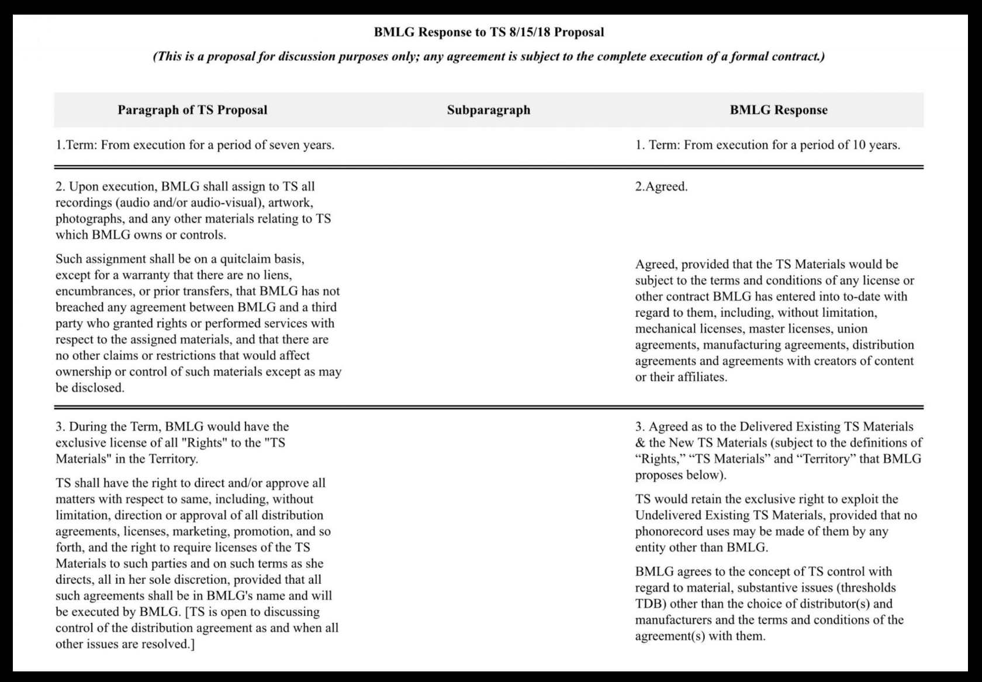
Proposed Deal Terms
BMLG Response (30 June 2019)
Notes:
https://www.bigmachinelabelgroup.com/so-its-time-some-truth/

Slide 61
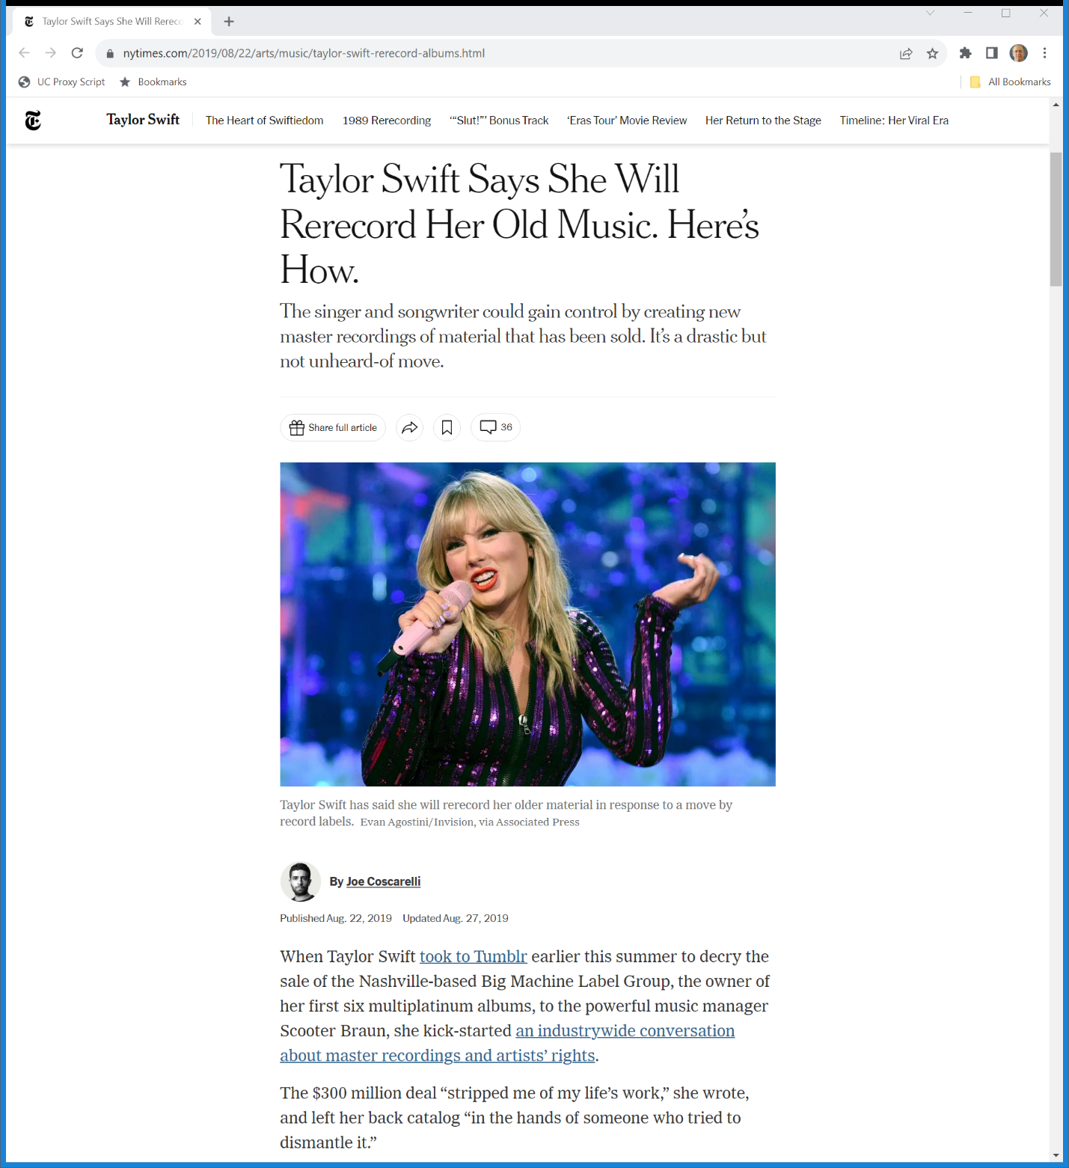
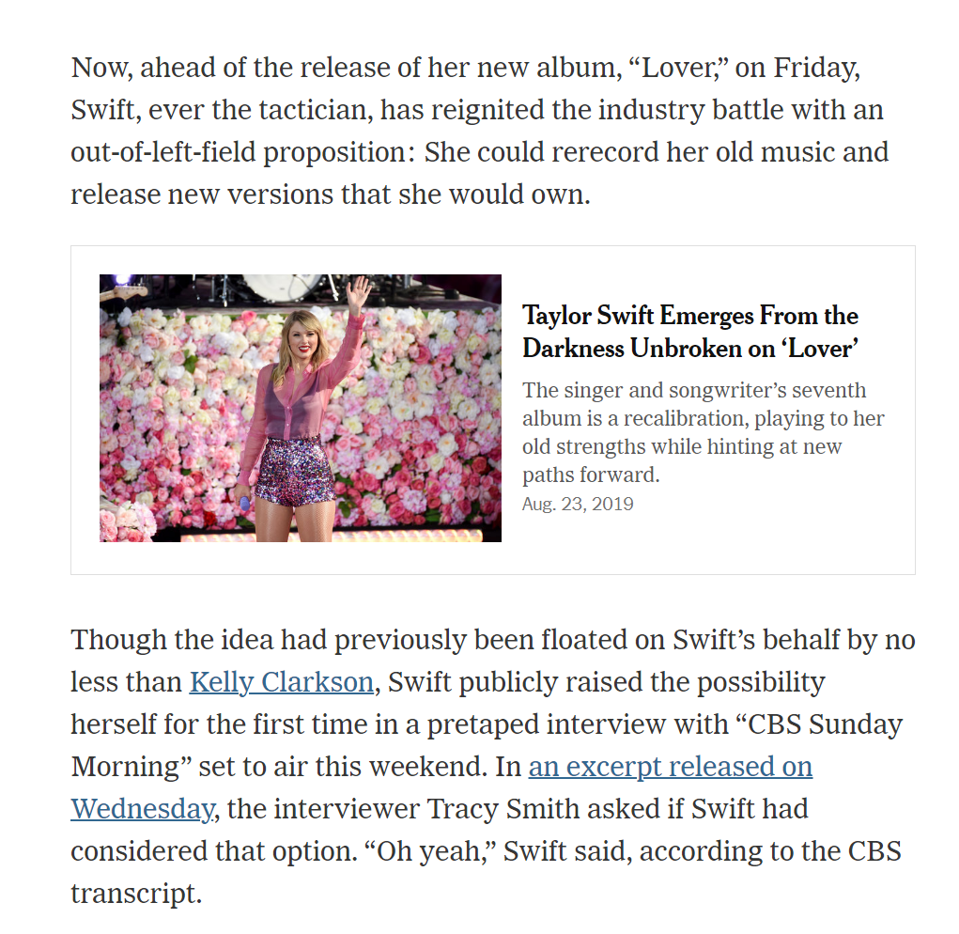
Taylor’s Versions?
New York Times (22 Aug 2019)
Notes:
https://www.nytimes.com/2019/08/22/arts/music/taylor-swift-rerecord-albums.html

Slide 62
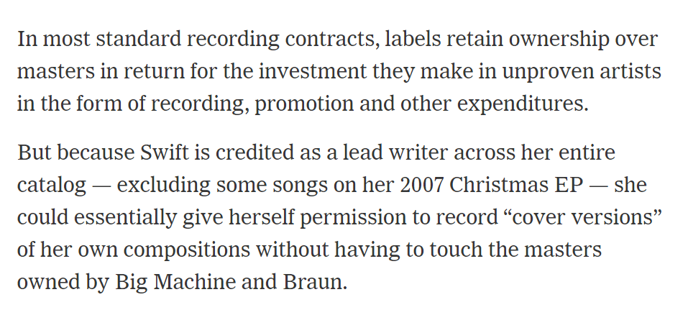
Will Taylor Cover Taylor?
New York Times (22 Aug 2019)
Notes:
https://www.nytimes.com/2019/08/22/arts/music/taylor-swift-rerecord-albums.html

Slide 63
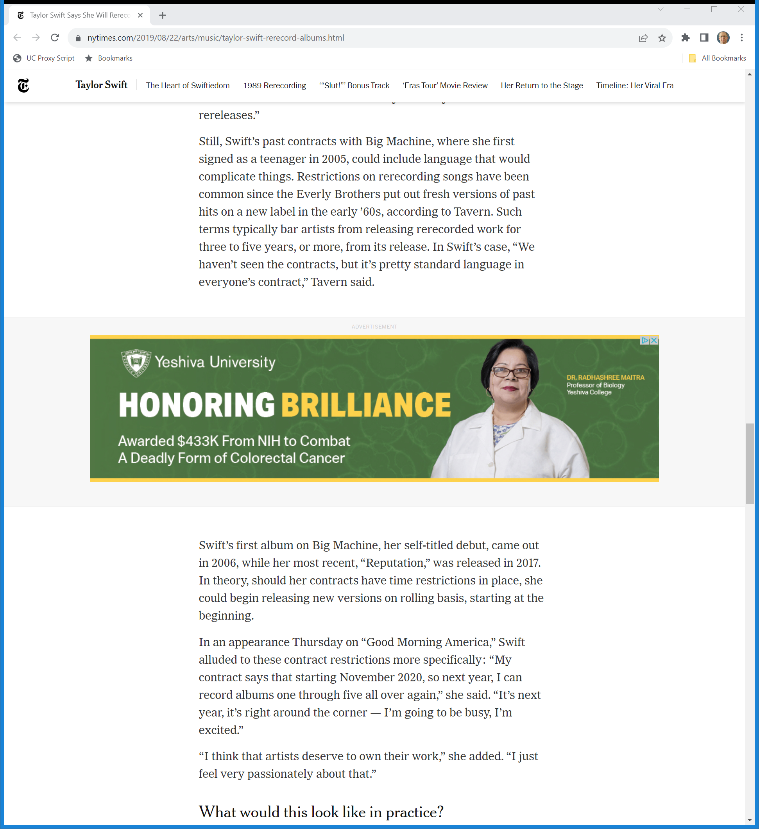
Swift’s Past Contracts
New York Times (22 Aug 2019)
Notes:
https://www.nytimes.com/2019/08/22/arts/music/taylor-swift-rerecord-albums.html

Slide 64
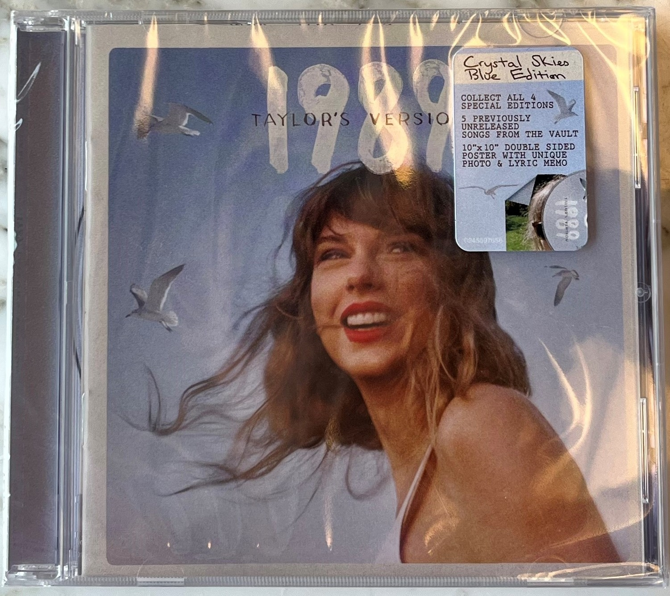
1989 (Taylor’s Version)

Slide 65
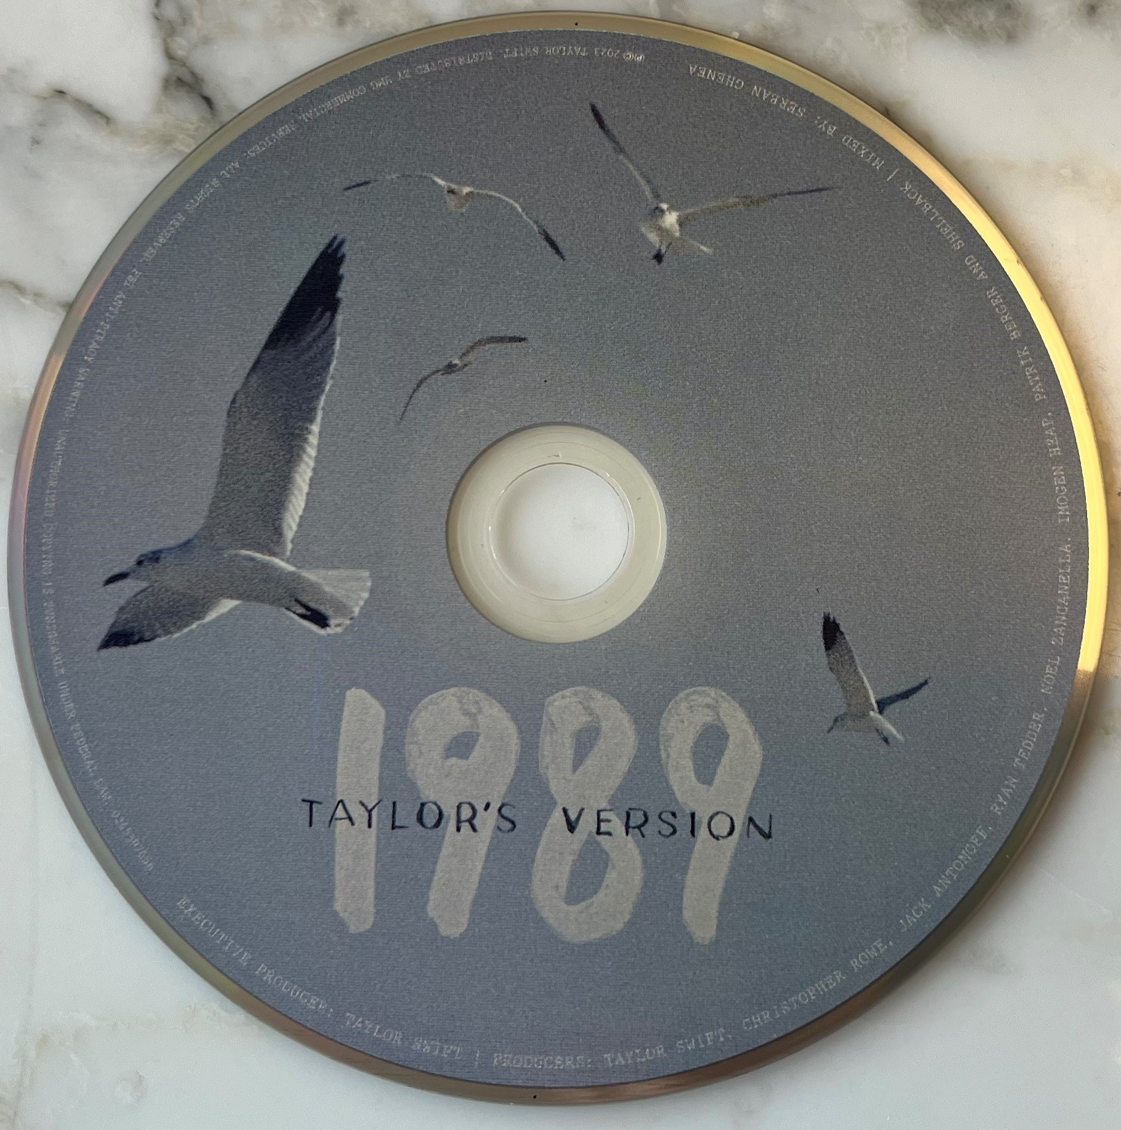
CD Itself
1989 (6 Nov 2023)

Slide 66
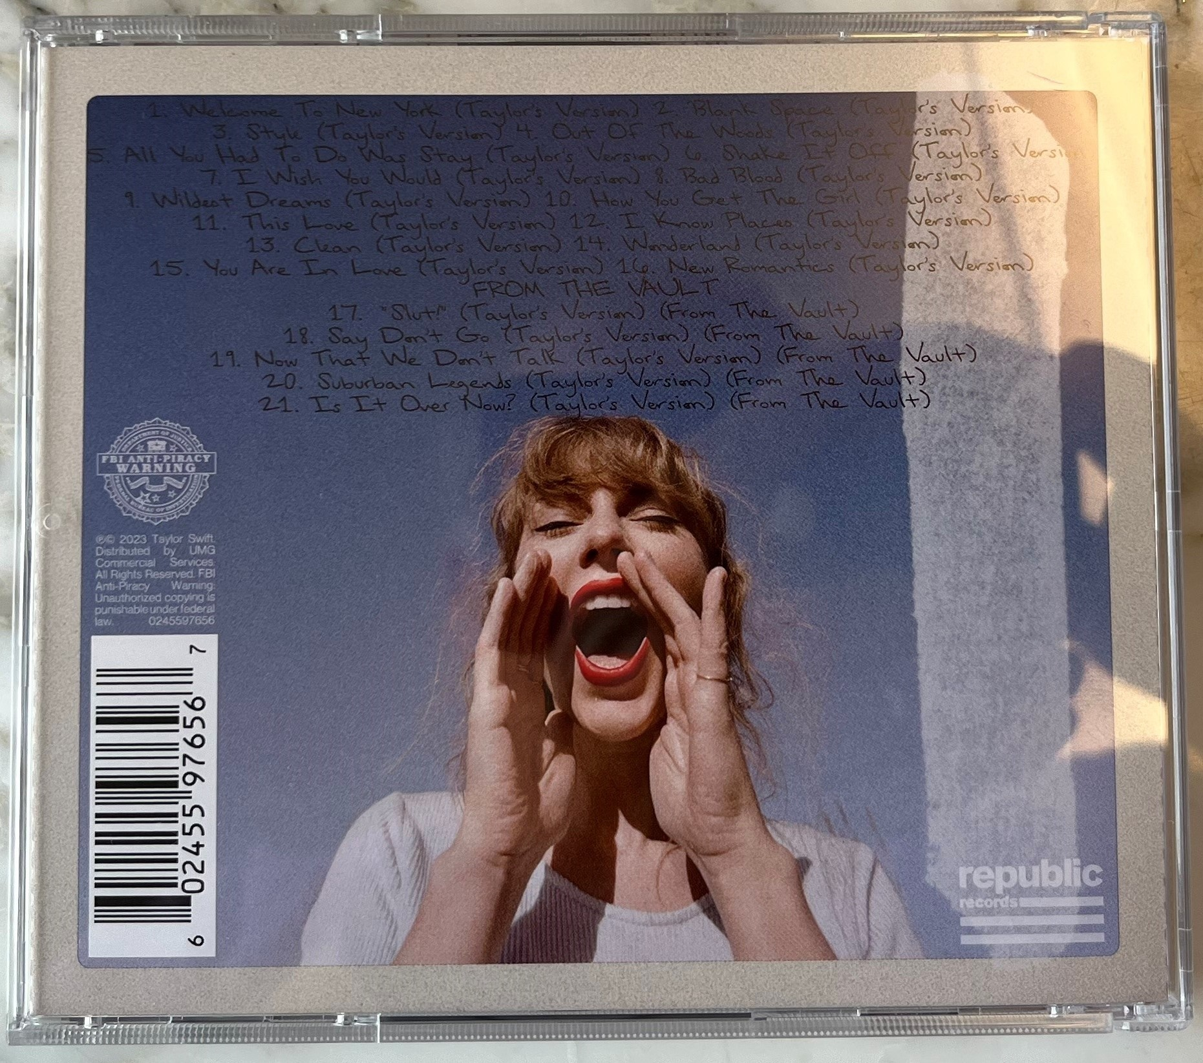
Back of the Jewel Box (21 Songs)
1989 (6 Nov 2023)

Slide 67
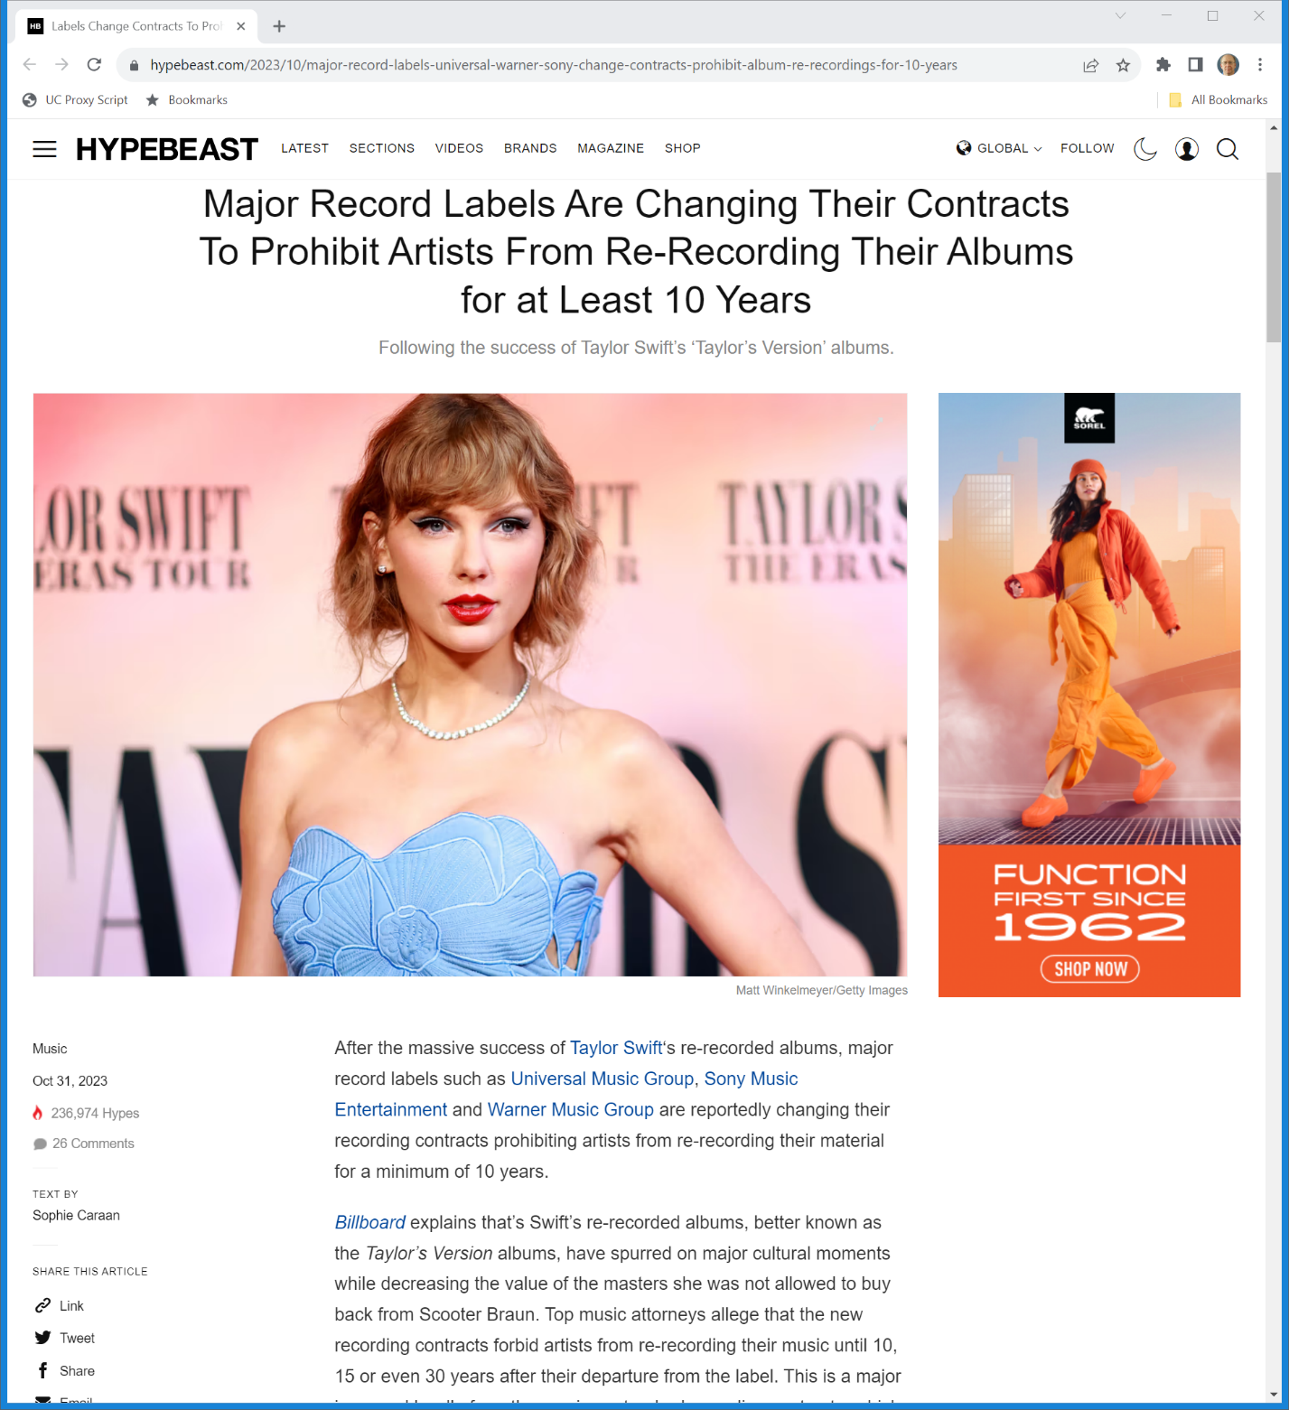
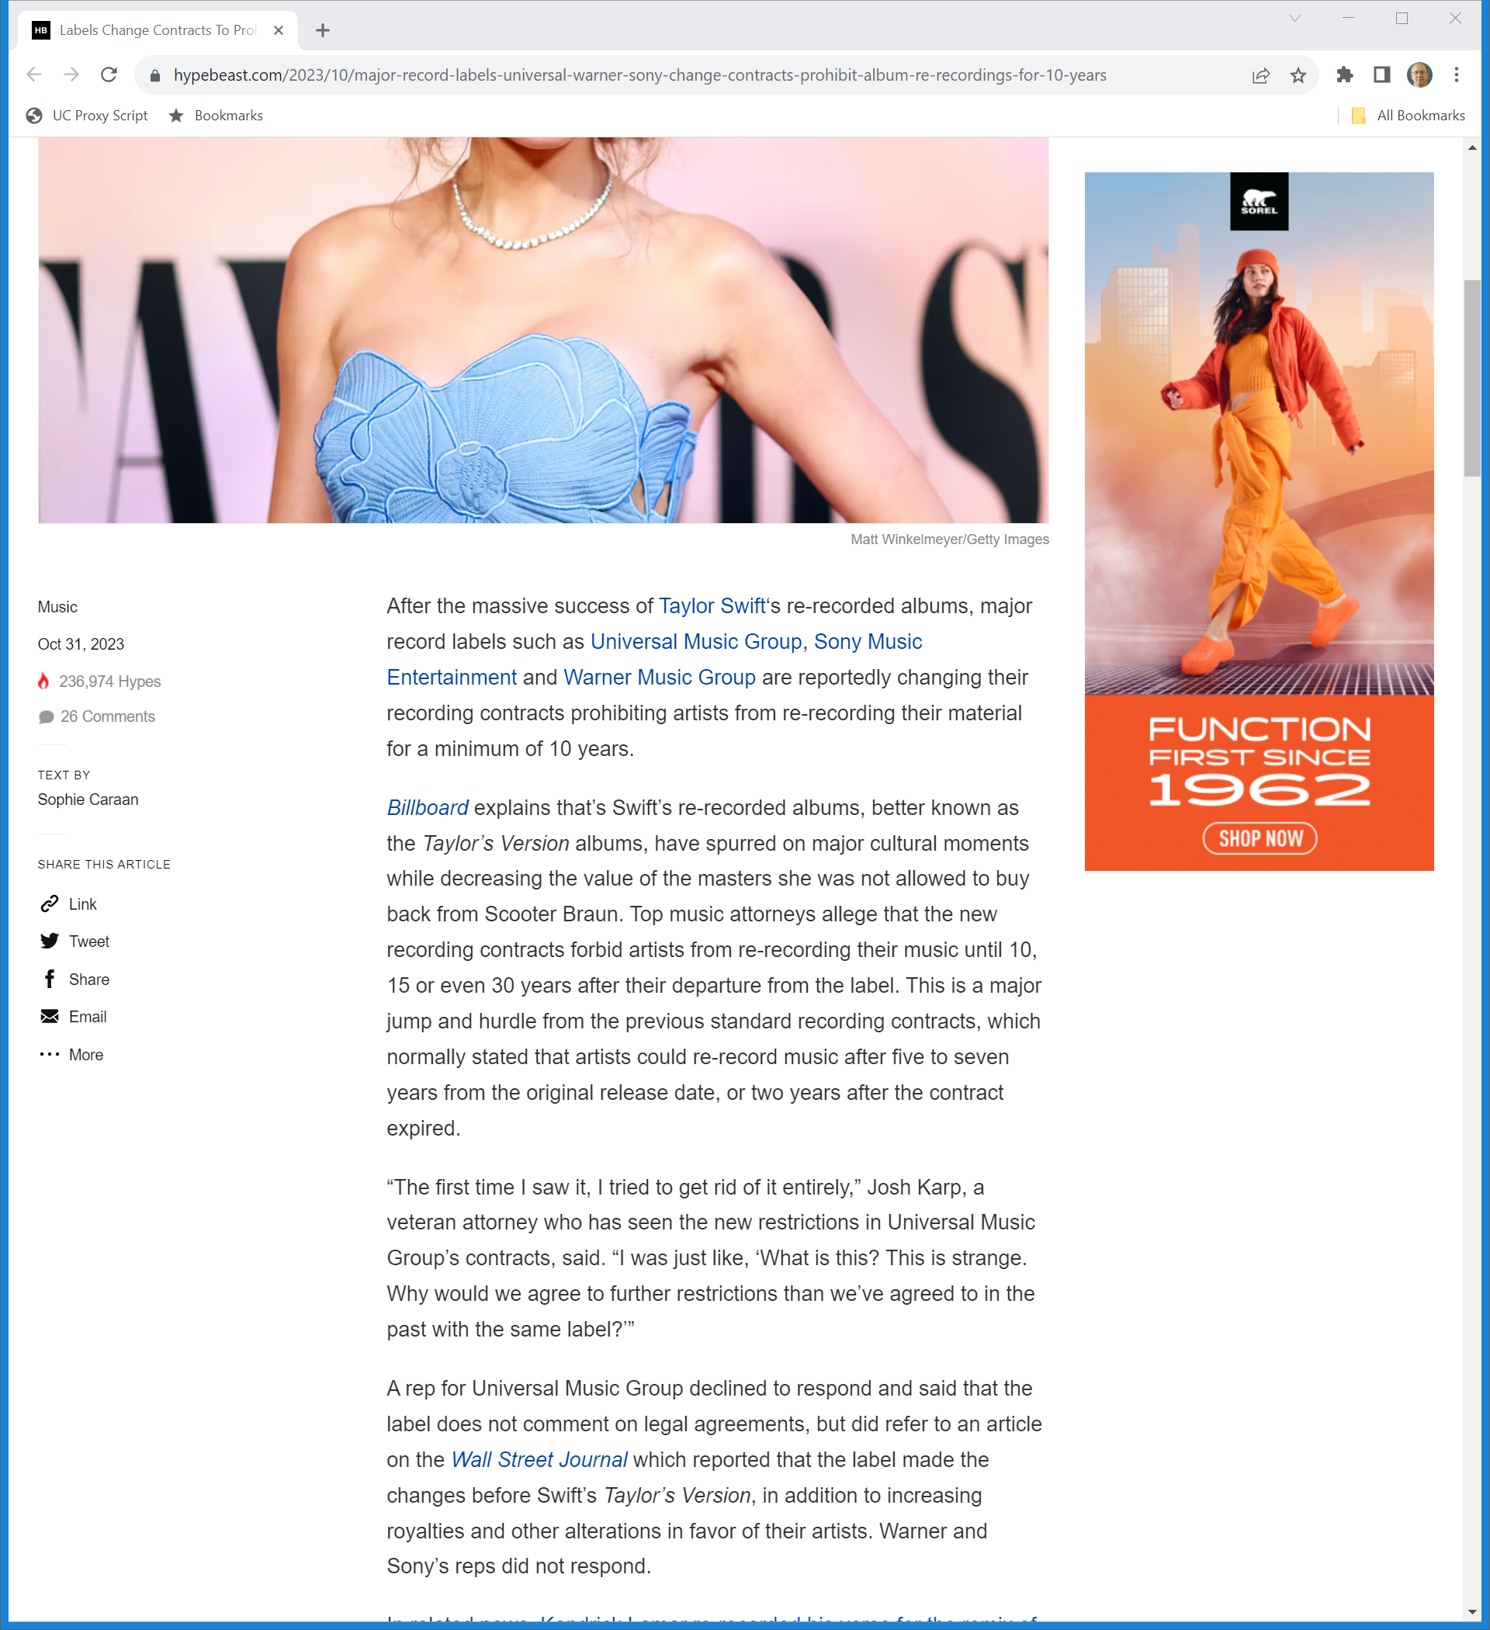
New Limits on Rerecording
Hypebeast (31 Oct 2023)
Notes:
https://hypebeast.com/2023/10/major-record-labels-universal-warner-sony-change-contracts-prohibit-album-re-recordings-for-10-years

