Slide 1
Class 15: Thurs 24 Apr 2025 Copyright Spring 2025 Music: Scope of Rights
Randal C. Picker
James Parker Hall Distinguished Service Professor of Law
The Law School
The University of Chicago

Slide 2
Back to Sec. 102: Looking for Music
17 USC 102

Slide 3
“Musical Work” Is Undefined
“Of the seven items listed, four are defined in section 101. The three undefined categories—‘musical works,’ ‘dramatic works,’ and ‘pantomimes and choreographic works’—have fairly settled meanings.”
H. Rep. 94-1476 (3 Sept 1976)

Slide 4
More Definitions: Copies
“‘Copies’ are material objects, other than phonorecords, in which a work is fixed by any method now known or later developed, and from which the work can be perceived, reproduced, or otherwise communicated, either directly or with the aid of a machine or device. The term ‘copies’ includes the material object, other than a phonorecord, in which the work is first fixed.”
17 USC 101

Slide 5
“Phonorecords”: Sounds
“‘Phonorecords’ are material objects in which sounds, other than those accompanying a motion picture or other audiovisual work, are fixed by any method now known or later developed, and from which the sounds can be perceived, reproduced, or otherwise communicated, either directly or with the aid of a machine or device. The term ‘phonorecords’ includes the material object in which the sounds are first fixed.”
17 USC 101

Slide 6
“Sound Recordings”
“‘Sound recordings’ are works that result from the fixation of a series of musical, spoken, or other sounds, but not including the sounds accompanying a motion picture or other audiovisual work, regardless of the nature of the material objects, such as disks, tapes, or other phonorecords, in which they are embodied.”
17 USC 101

Slide 7
Oct 1971: Bringing Sound Recordings into Copyright
Pub. L. 92-140 (15 Oct 1971)

Slide 8
Sound Recording Piracy
H. Rep (22 Sept 1971)

Slide 9
Sound Recording Piracy
H. Rep (22 Sept 1971)

Slide 10
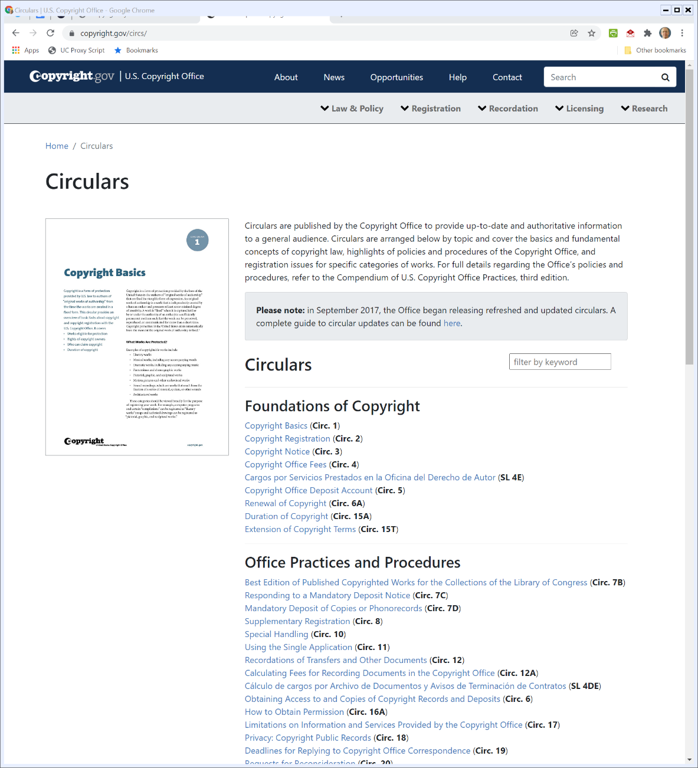
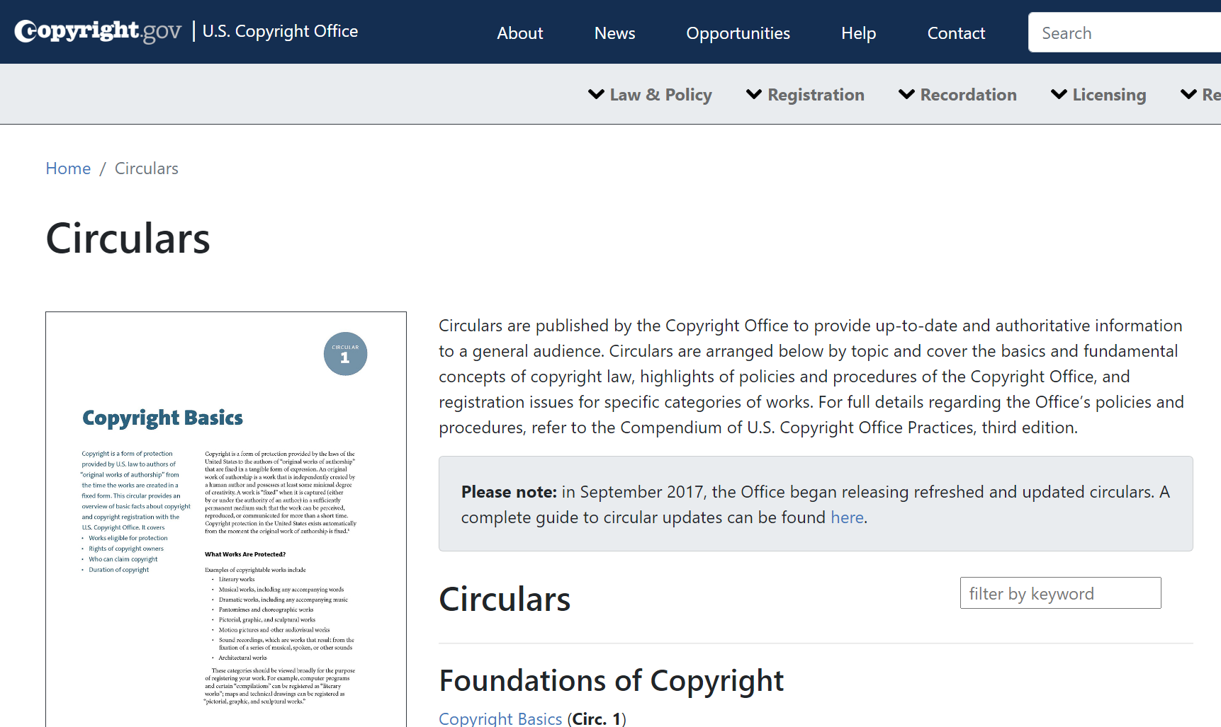
Circulars
U.S. Copyright Office Website (Visited 26 Jan 2022)
Notes:
https://www.copyright.gov/circs/

Slide 11
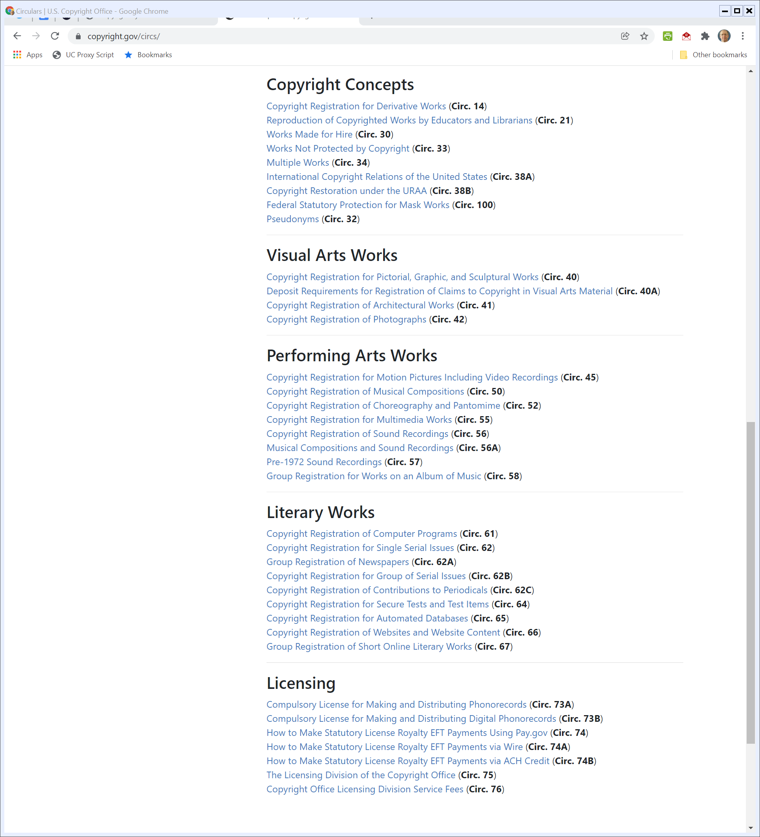
Circulars: Performing Arts Works
U.S. Copyright Office Website (Visited 26 Jan 2022)

Slide 12
Registering Musical Compositions
Circular 50

Slide 13
Registering Musical Compositions
Circular 50

Slide 14
Registering Musical Compositions
Circular 50

Slide 15
More Registration
Copyright Circular 56A

Slide 16
One Registration If …
Copyright Circular 56A

Slide 17
Creating a Tune I
TTYN (1 of 2)
Hypo 1
In my office, on paper, note by note, I create a new song (just notes, no words)
I stop writing and declare my song completed
Do I have a copyright in the new song? Is there a musical composition? A sound recording?

Slide 18
Creating a Tune II
TTYN (2 of 2)
Hypo 2
At home, sitting at the piano, note by note, I create a new song (just notes, no words) and I record that song as I play it
I stop playing, turn off the recorder and declare my song completed
Do I have a copyright in the new song? Is there a musical composition? A sound recording?

Slide 19
Hypo 1 Answer
Q1 and Q2: Yes and Yes
Assuming minimal originality, this will qualify as a musical work covered by 102(a)(2)
And this is a musical composition
Q3: No
Requires sounds and no sounds so far

Slide 20
Hypo 2 Answer
Q1 and Q2: Yes and Yes
Fixation is media neutral; no preference for paper vs. recording device
There was no preexisting work in either version of the hypo; it was created note by note in both cases

Slide 21
Hypo 2 Answer
Q1 and Q2: Yes and Yes
The definition of fixation focuses on whether the work is “sufficiently permanent or stable to permit it to be perceived, reproduced, or otherwise communicated for a period of more than transitory duration”
The recording should work and will be a musical composition (musical work)

Slide 22
Hypo 2 Answer
Q3: Yes
This is a classic sound recording.
Hypo 2 seems to be how Got to Give It Up was created by Marvin Gaye

Slide 23
Next Step: Radio
Hypo
I am a DJ and want to play a song on the radio
What copyright issues does that raise?
Does it matter whether the radio is being broadcast over the air using spectrum or just over the internet?

Slide 24
Next Step: Radio
Hypo
Does the phonorecord matter? Suppose it is vinyl from 1968? A CD from 1985? A digital file on a computer from 2022?

Slide 25
Radio and Musical Works
Analysis
Playing a song on the radio means that there has been a public performance of both the musical work and the sound recording
The ASCAP/BMI licensing regime deals with royalties for the musical work
That regime is independent of the method of broadcast (over-the-air vs. over-the-internet)

Slide 26
Radio and Sound Recordings
Analysis
ASCAP/BMI are only about musical works (and non-dramatic performance at that)
Sound recordings break down differently; return to Sec. 106(6)

Slide 27
Sec. 106(6): Digital Audio Transmissions Right
“Subject to sections 107 through 121 the owner of copyright under this title has the exclusive rights to do and to authorize any of the following:
(6) in the case of sound recordings, to perform the copyrighted work publicly by means of a digital audio transmission;”
17 USC 106

Slide 28
Digital Performance Right in Sound Recordings Act of 1995
Pub. L. 104-39 (1 Nov 1995)

Slide 29
Legislative History
H. Rep. 104-274 (11 Oct 1995)

Slide 30
Free Use of Sound Recordings for Traditional Radio
H. Rep. 104-274 (11 Oct 1995)

Slide 31
Back to Radio and Sound Recordings
Analysis
Sec. 106(6) (and parts of Sec. 114) make clear that over-the-air radio doesn’t infringe when it performs sound recordings, while digital audio transmissions are within copyright and therefore must be paid for.

Slide 32
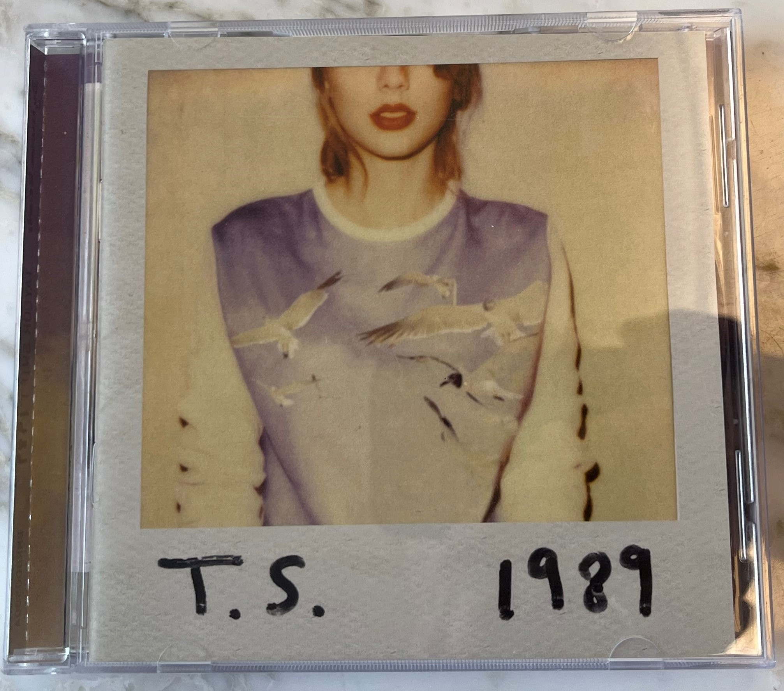
T.S. 1989

Slide 33
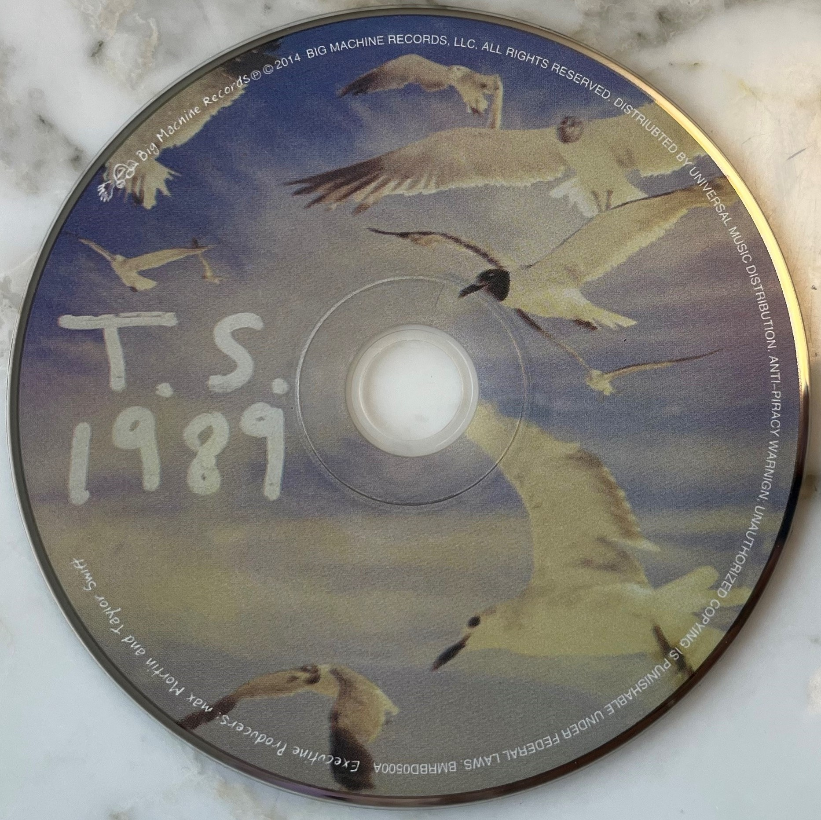
The CD Itself
T.S. 1989 (6 Nov 2023)

Slide 34
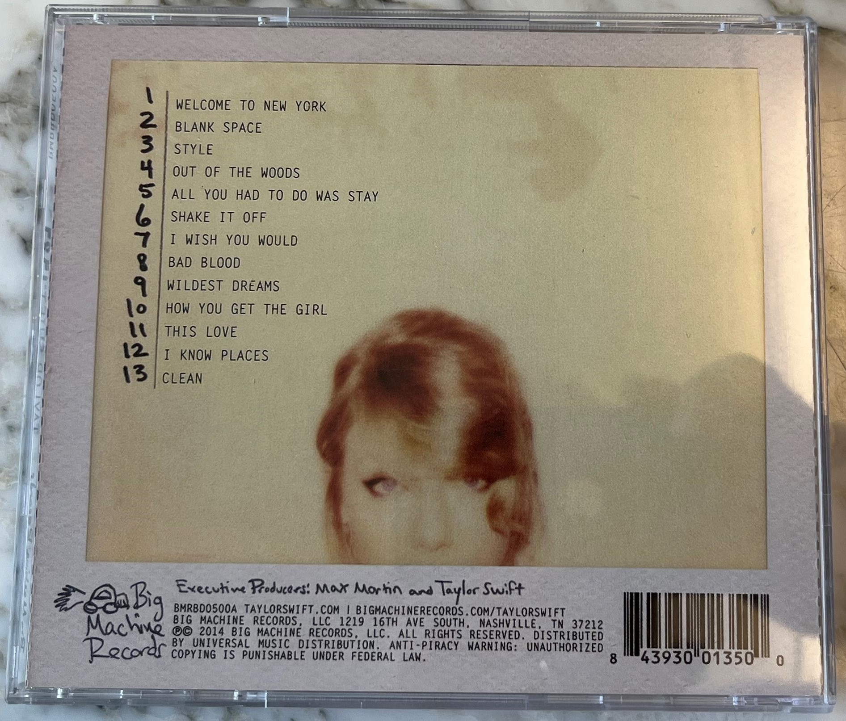
Back of the Jewel Box
T.S. 1989 (6 Nov 2023)

Slide 35
Sec. 401: Notice of Copyright
17 USC 401

Slide 36
Sec. 401: Notice of Copyright: Carrots, Not Sticks
17 USC 401

Slide 37
Sec. 402: Sound Recordings/Phonorecords Notice
17 USC 402

Slide 38
Skidmore v. Led Zeppelin
952 F.3d 1051 (9th Cir. 2020)

Slide 39
A First Example
TTYN (1 of 3)
Play the Music
https://blogs.law.gwu.edu/mcir/case/inplay-michael-skidmore-v-led-zeppelin/
Does the second song infringe the first song?

Slide 40
Jury Instruction No. 16 (TTYN (2 of 3))
Skidmore (9th Cir. 2020)

Slide 41
Jury Instruction No. 20 (TTYN (3 of 3))
Skidmore (9th Cir. 2020)

Slide 42
Jury Verdict: Not Substantially Similar
Skidmore (9th Cir. 2020)

Slide 43
Williams v. Gaye
895 F.3d 1106 (9th Cir. 2018)

Slide 44
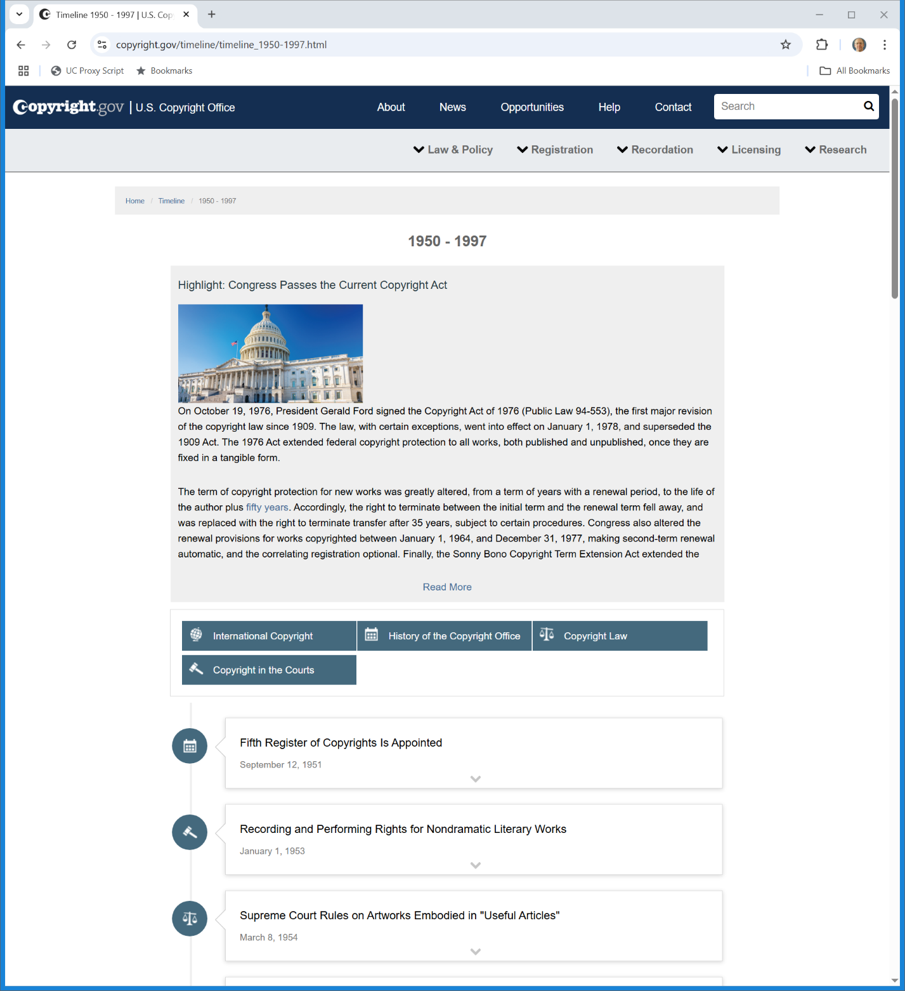

Effective Date of 1976 Act
Copyright.gov (Visited 24 Apr 2025)
Notes:
https://www.copyright.gov/timeline/timeline_1950-1997.html

Slide 45
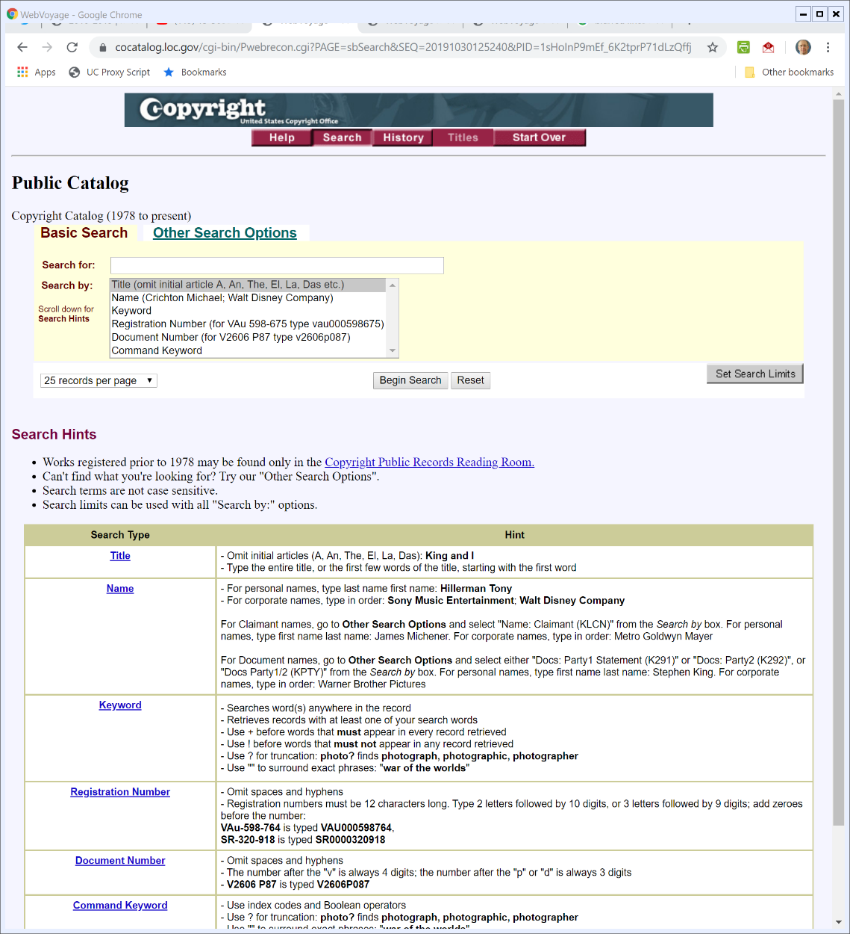

Looking for Copyrights
U.S. Copyright Public Catalog
Notes:
https://cocatalog.loc.gov/cgi-bin/Pwebrecon.cgi?DB=local&PAGE=First

Slide 46
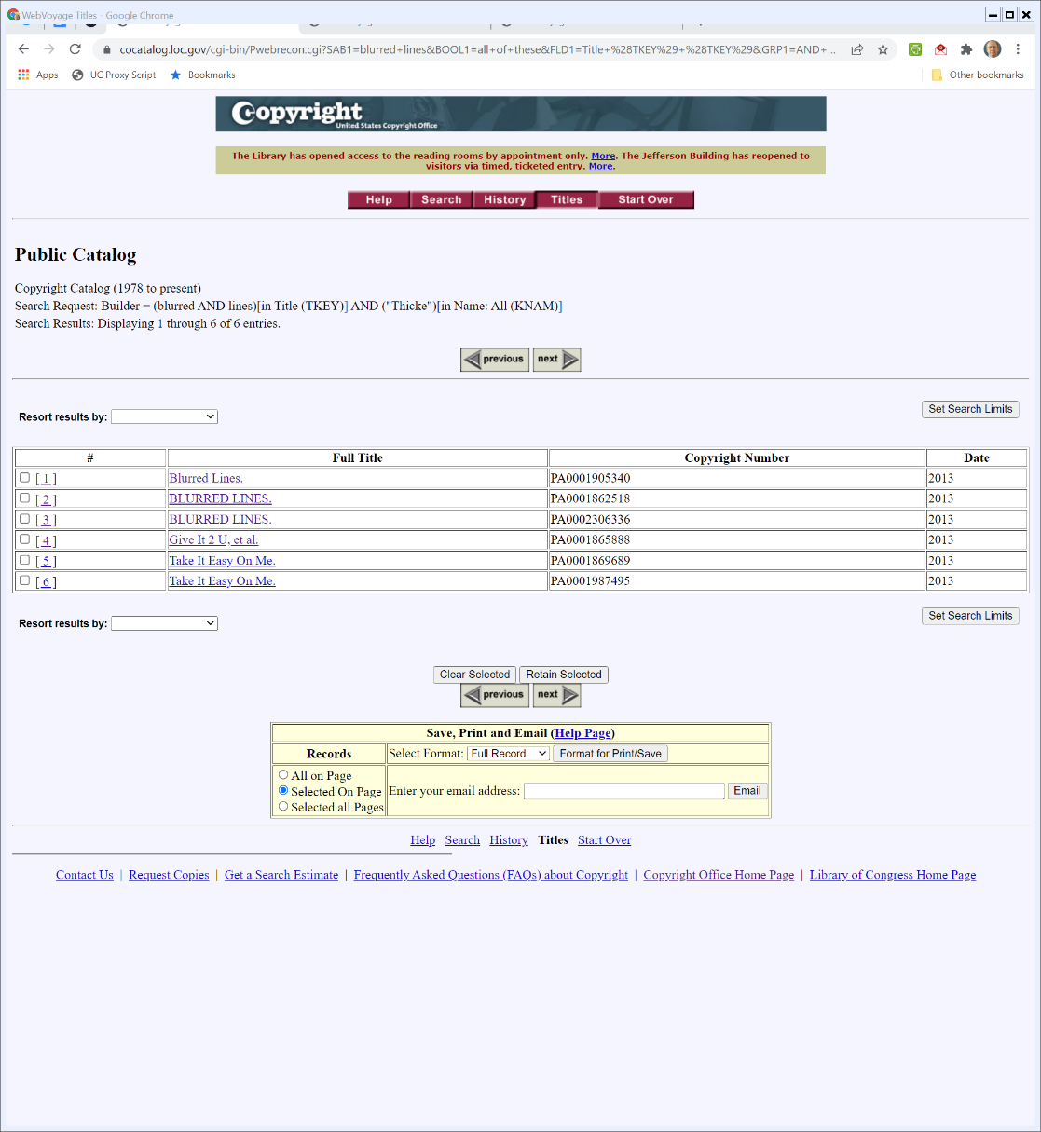
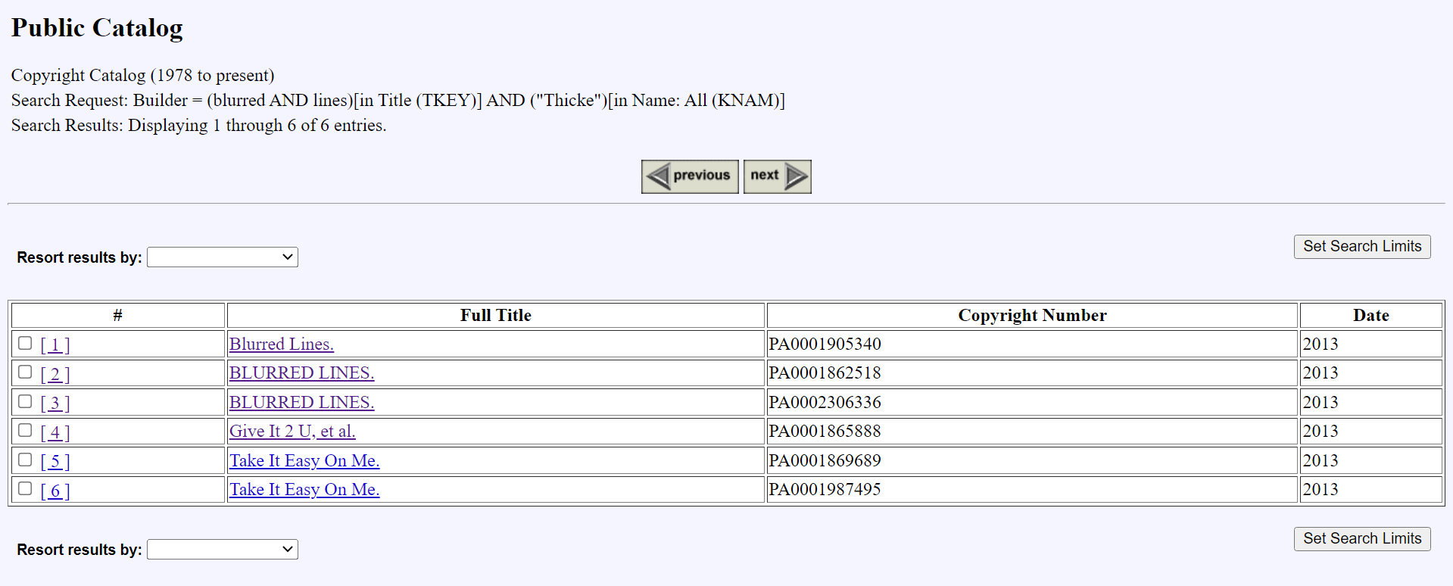
Finding Blurred Lines
Search on U.S. Copyright Catalog

Slide 47
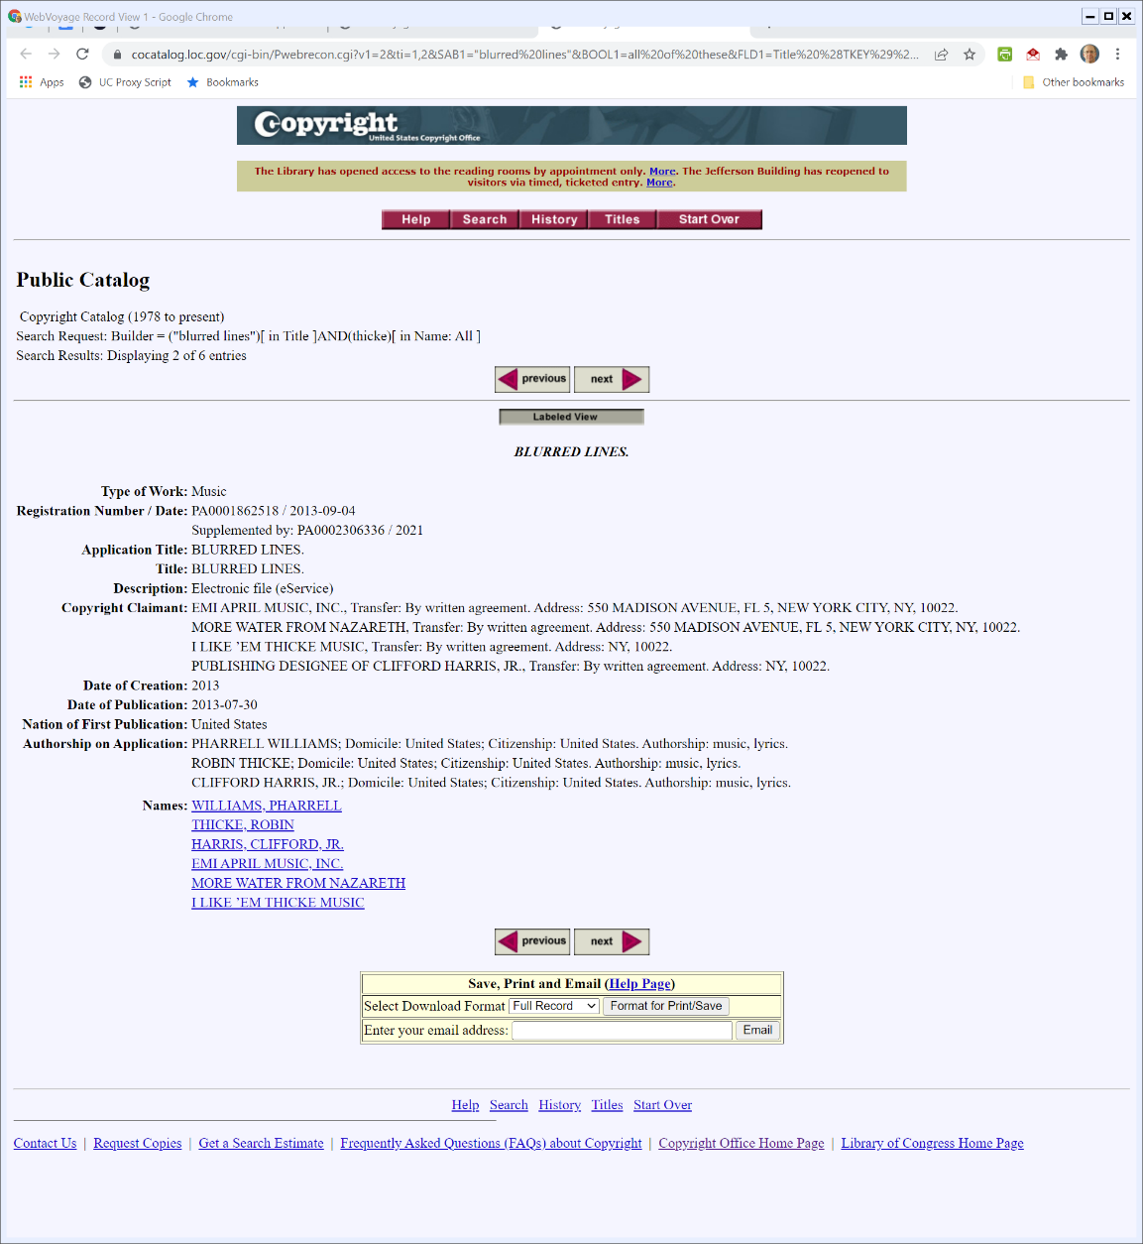
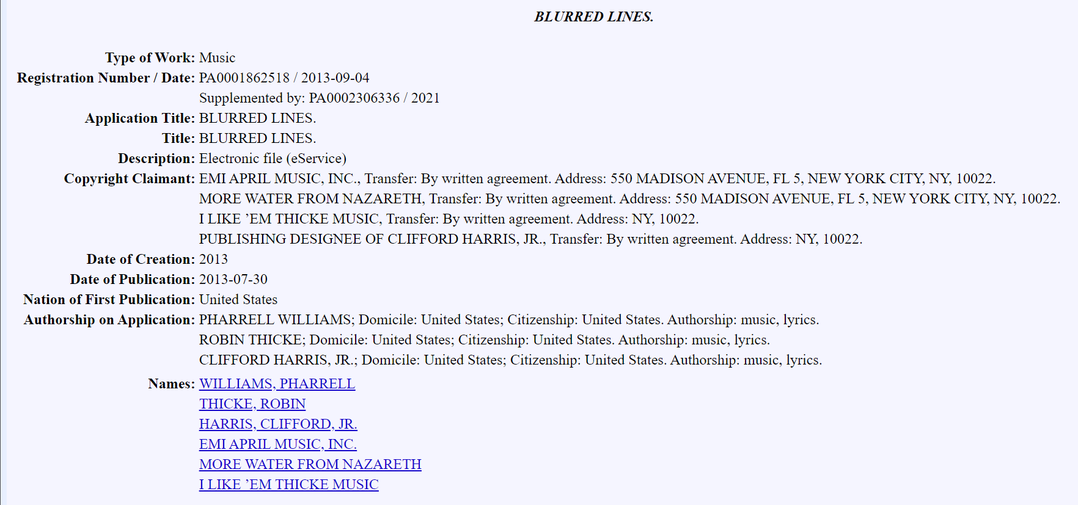
Finding Blurred Lines
Search on U.S. Copyright Catalog

Slide 48
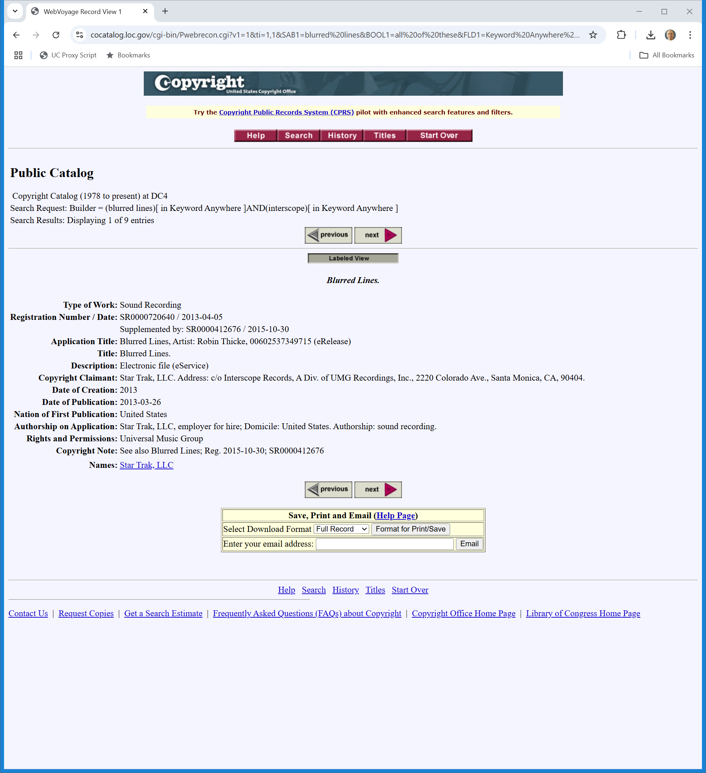
Finding Blurred Lines
Search on U.S. Copyright Catalog
Notes:
https://cocatalog.loc.gov/cgi-bin/Pwebrecon.cgi?v1=1&ti=1,1&SAB1=blurred%20lines&BOOL1=all%20of%20these&FLD1=Keyword%20Anywhere%20%28GKEY%29&GRP1=AND%20with%20next%20set&SAB2=interscope&BOOL2=as%20a%20phrase&FLD2=Keyword%20Anywhere%20%28GKEY%29&CNT=25&PID=LAxe1cnD2R5XxDhI0eBAham5gMkRilr&SEQ=20250424113025&SID=1

Slide 49
A Second Example
TTYN (1 of 3)
Got to Give It Up (The Deposit Copy?)
This? (but see comments) (and not here) (Ayyy-03ITDg)
Blurred Lines
Here (CeKpscEfM28)

Slide 50
Jury Instruction No. 42 (TTYN (2 of 3))
Williams (9th Cir. 2018)

Slide 51
Jury Instruction No. 43 (TTYN (3 of 3))
Williams (9th Cir. 2018)

Slide 52
Two-Part Test for Substantial Similarity
“We use a two-part test for substantial similarity: an extrinsic test and an intrinsic test. … For a jury to find substantial similarity, there must be evidence on both the extrinsic and intrinsic tests. … A district court applies only the extrinsic test on a motion for summary judgment, as the intrinsic test is reserved exclusively for the trier of fact.”
Williams (9th Cir. 2018)

Slide 53
Two-Part Test for Substantial Similarity
“The extrinsic test is objective. Swirsky, 376 F.3d at 845. It ‘considers whether two works share a similarity of ideas and expression as measured by external, objective criteria.’ Id. Application of ‘[t]he extrinsic test requires ‘analytical dissection of a work and expert testimony.’’ Id. … .”
Williams (9th Cir. 2018)

Slide 54
Differences between Extrinsic and Intrinsic Tests
“An analytical dissection, in turn, ‘requires breaking the works ‘down into their constituent elements, and comparing those elements for proof of copying as measured by ‘substantial similarity.’’’ Id. (quoting Rice v. Fox Broad. Co., 148 F. Supp. 2d 1029, 1051 (C.D. Cal. 2001)).”
Williams (9th Cir. 2018)

Slide 55
Differences between Extrinsic and Intrinsic Tests
“The intrinsic test, on the other hand, is subjective. Three Boys Music, 212 F.3d at 485. It “asks ‘whether the ordinary, reasonable person would find the total concept and feel of the works to be substantially similar.’” Id. (quoting Pasillas v. McDonald’s Corp., 927 F.2d 440, 442 (9th Cir. 1991)).”
Williams (9th Cir. 2018)

Slide 56
Proving the Musical Work: Deposit Copy v. Sound Recording
“The Gayes assert that Marvin Gaye’s studio recording may establish the scope of a compositional copyright, despite the 1909 Act’s lack of protection for sound recordings. The Thicke Parties, on the other hand, elevate the deposit copy as the quintessential measure of the scope of copyright protection. Nevertheless, because we do not remand the case for a new trial, we need not, and decline to, resolve this issue in this opinion.”
Williams (9th Cir. 2018)

Slide 57
The Procedural Posture of the Case
“First, the dissent incorrectly concludes that there are no procedural obstacles barring entry of judgment as a matter of law for the Thicke Parties. The dissent is unable to distinguish the Supreme Court’s decision in Ortiz, which prevents us from reviewing the district court’s order denying summary judgment after a full trial on the merits. 562 U.S. at 183–84.”
Williams (9th Cir. 2018)

Slide 58
The Procedural Posture of the Case
“Second, the Thicke Parties, like the Gayes, failed to make a Rule 50(a) motion for judgment as a matter of law at trial. Their failure to do so “precludes consideration of a Rule 50(b) motion for judgment as a matter of law.” Tortu, 556 F.3d at 1083.”
Williams (9th Cir. 2018)

Slide 59
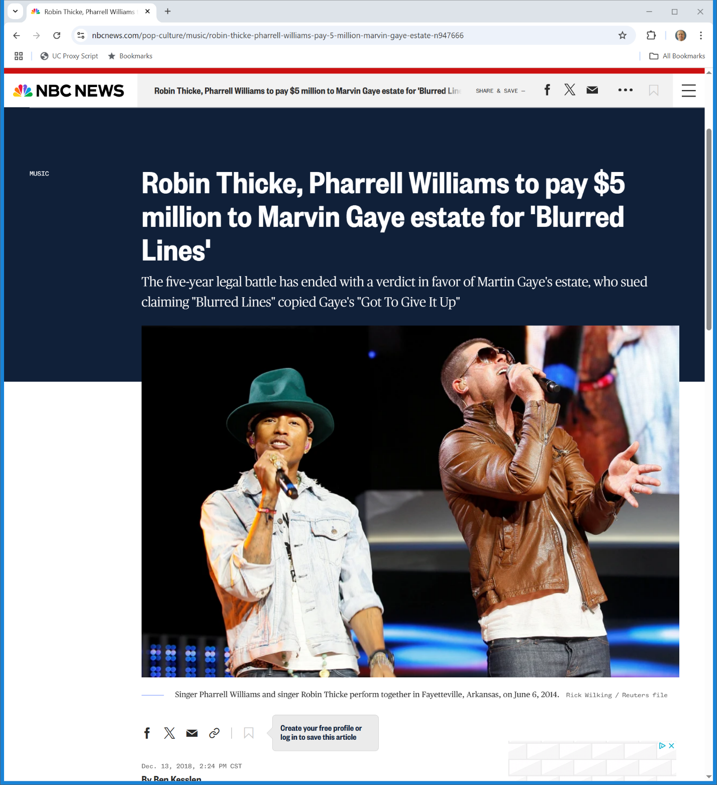
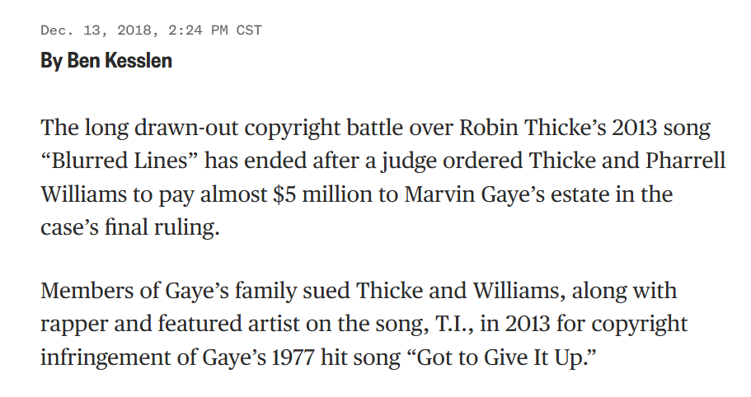
$5M
NBC News (13 Dec 2018)
Notes:
https://www.nbcnews.com/pop-culture/music/robin-thicke-pharrell-williams-pay-5-million-marvin-gaye-estate-n947666

Slide 60
More?
Sheeran, 120 F.4th 1066 (2nd Cir. 2024)

Slide 61
More?
Sheeran, 120 F.4th 1066 (2nd Cir. 2024)

Slide 62
More Info on Chord Sequences
Ed Sheeran on Howard Stern
Try this: (NcCKlsTgjeM)
4 Chord Song
Here (5pidokakU4I)

