Slide 1
Class 14: Wed 23 Apr 2025 Copyright Spring 2025 Capturing TV Signals
Randal C. Picker
James Parker Hall Distinguished Service Professor of Law
The Law School
The University of Chicago

Slide 2
1909 Copyright Act
“… shall have the exclusive right … [t]o perform or represent the copyrighted work publicly if it be a drama …”
Pub. L. 60-349 (4 Mar 1909)

Slide 3
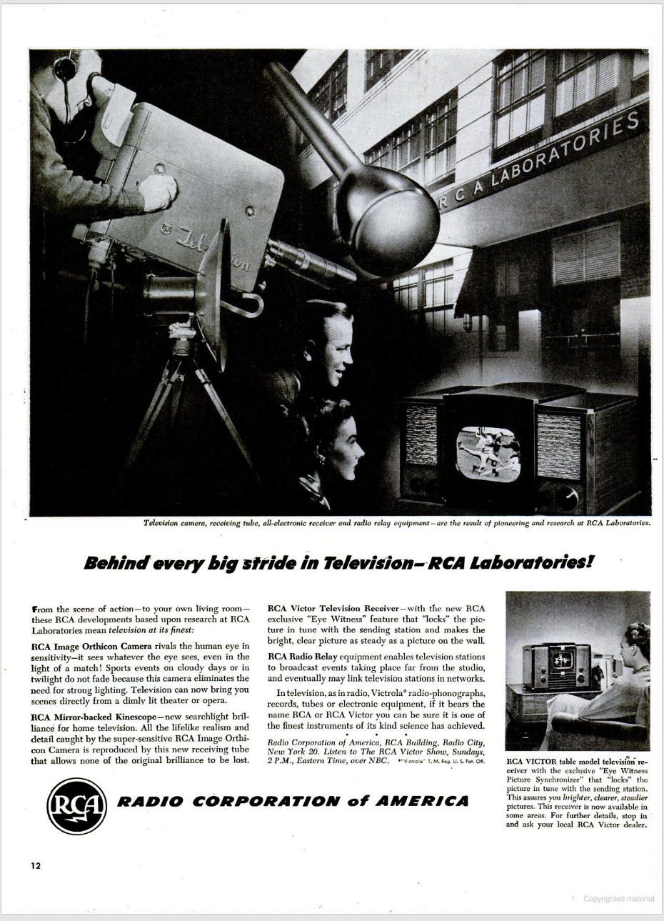
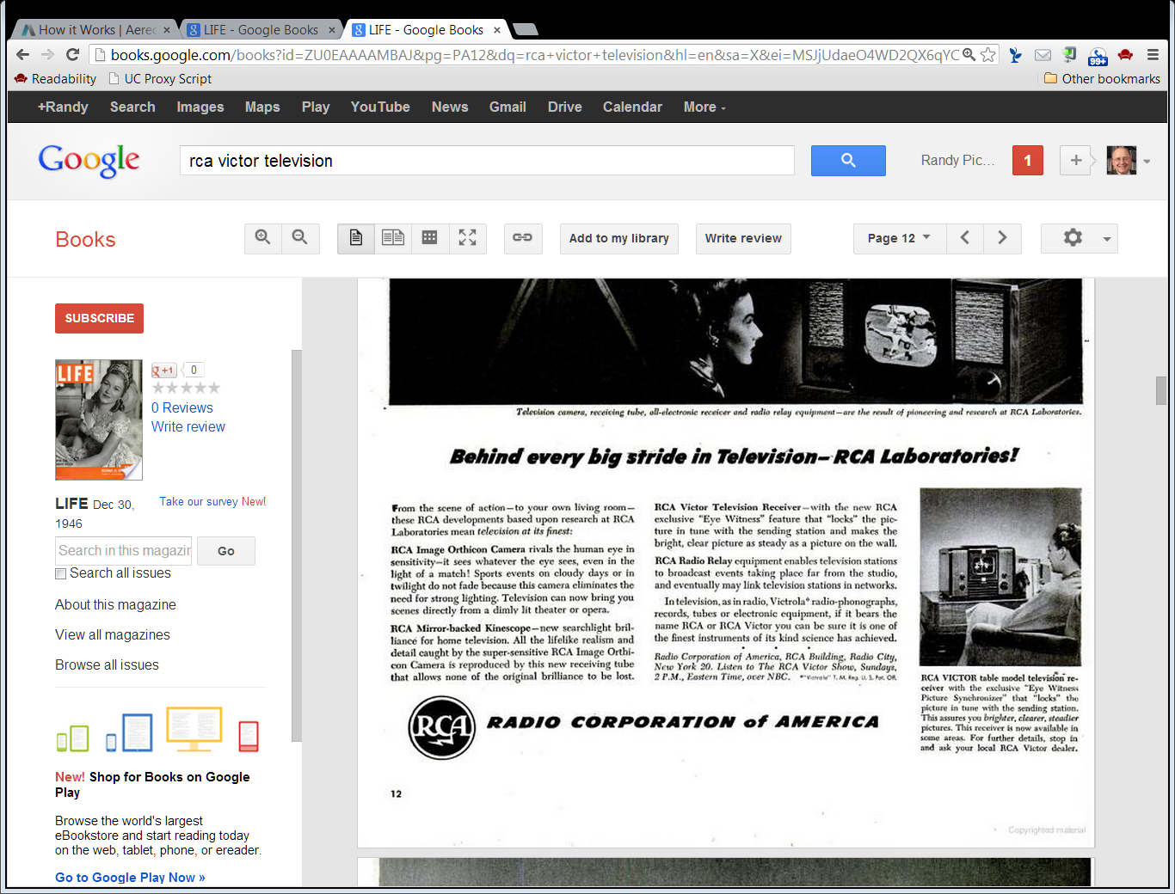
1946: Six Commercial TV Stations in U.S.
Life Magazine (30 Dec 1946)
Notes:
https://books.google.com/books?id=ZU0EAAAAMBAJ&pg=PA2&dq=life+magazine+december+30+1946&hl=en&sa=X&ved=2ahUKEwik8vCk74P7AhUghIkEHZyQCCEQuwV6BAgHEAY#v=onepage&q&f=false

Slide 4
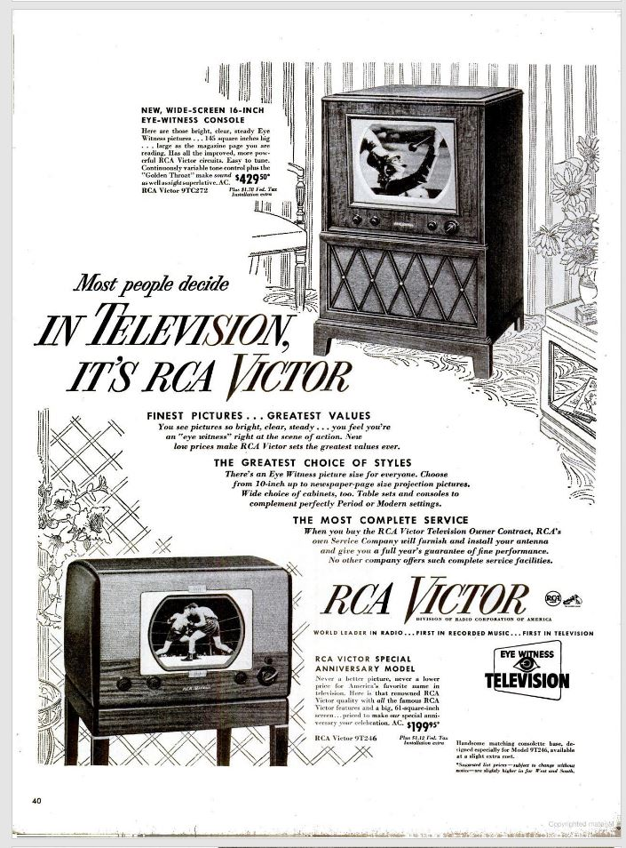
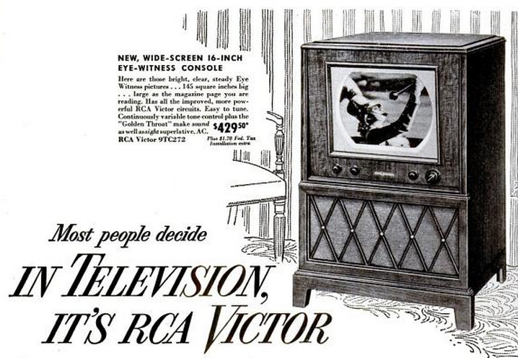
16-Inch Wide-Screen
Life Magazine (12 Sept 1949)
Notes:
https://books.google.com/books?id=yUkEAAAAMBAJ&pg=PA40&dq=life+magazine+september+12+1949+rca+victor&hl=en&sa=X&ved=2ahUKEwiA4IeTn-z1AhVVkokEHcTMDE8QuwV6BAgIEAY#v=onepage&q&f=false

Slide 5
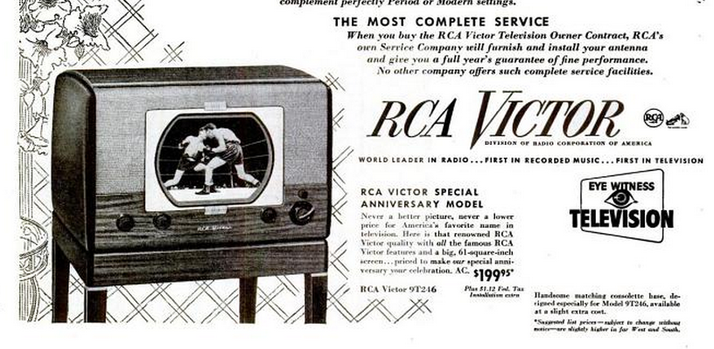
Antenna Installation
Life Magazine (12 Sept 1949)
Notes:
https://books.google.com/books?id=yUkEAAAAMBAJ&pg=PA40&dq=life+magazine+september+12+1949+rca+victor&hl=en&sa=X&ved=2ahUKEwiA4IeTn-z1AhVVkokEHcTMDE8QuwV6BAgIEAY#v=onepage&q&f=false

Slide 6
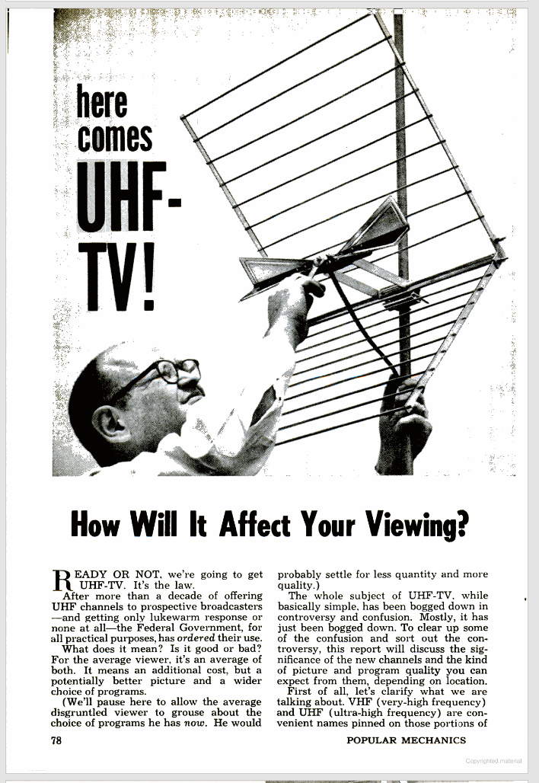
UHF Channels
Popular Mechanics (Dec 1962)

Slide 7
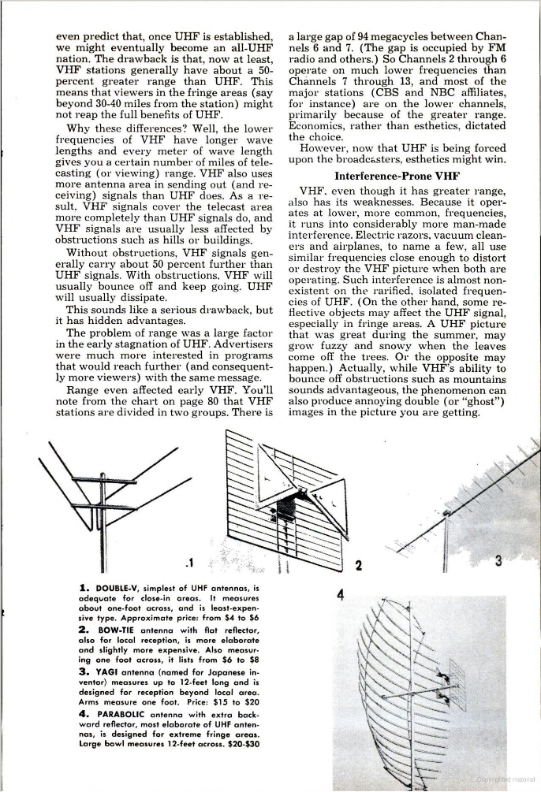
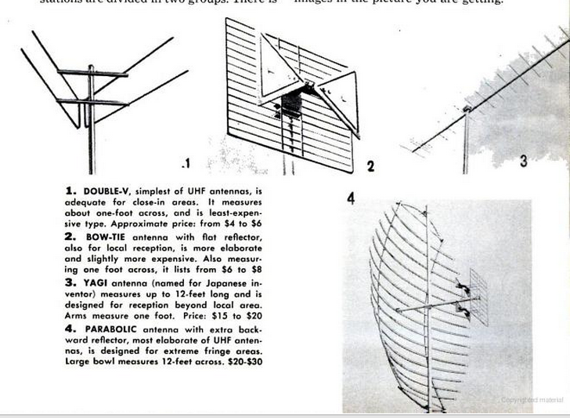
Requires A New Antenna
Popular Mechanics (Dec 1962)

Slide 8
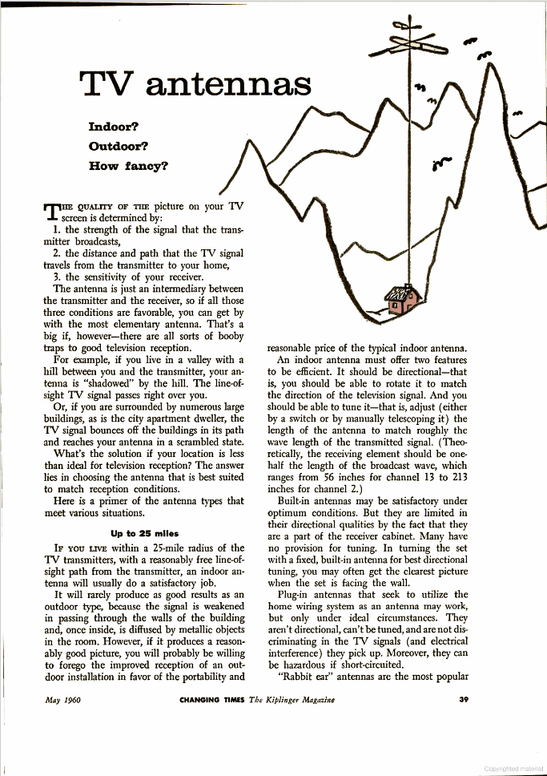
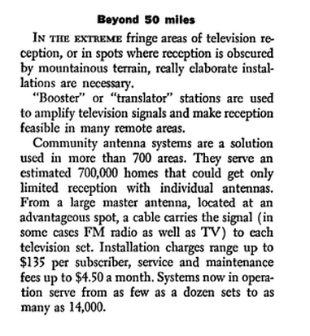
Shared Antennae (Community Antenna TV) (CATV) (Cable)
Kiplinger’s Personal Finance (May 1960)

Slide 9
Controlling TV Signals
Stylized Situation
It is 1960. A small West Virginia town has only two local over-the-air TV stations
Company sets up antenna/mechanism to capture stations from Penn, Ohio and Wheeling, W Va
Customers of company pay fee to company to view all five stations pumped through company’s system

Slide 10
Controlling TV Signals
Copyright violation?
Does company violate Sec. 106(1)’s copy right?
Sec. 106(3)’s distribution right?
Sec. 106(4)’s public performance right?
Of course, 106 as such not in place until 1976 statute

Slide 11
Fortnightly
392 U.S. 390 (1968)

Slide 12
Who Does the Performing?
“Broadcasters perform. Viewers do not perform. Thus, while both broadcaster and viewer play crucial roles in the total television process, a line is drawn between them. One is treated as active performer; the other, as passive beneficiary. When CATV is considered in this framework, we conclude that it falls on the viewer’s side of the line.”
Fortnightly (U.S. 1968)

Slide 13
CATV Is Just An Antenna
“Essentially, a CATV system no more than enhances the viewer’s capacity to receive the broadcaster’s signals; it provides a well-located antenna with an efficient connection to the viewer’s television set.”
Fortnightly (U.S. 1968)

Slide 14
Individual Could Do This
“… If an individual erected an antenna on a hill, strung a cable to his house, and installed the necessary amplifying equipment, he would not be ‘performing’ the programs he received on his television set.”
Fortnightly (U.S. 1968)

Slide 15
Teleprompter
415 U.S. 394 (1974)

Slide 16
Importing Signals Isn’t a Change
“By importing signals that could not normally be received with current technology in the community it serves, a CATV system does not, for copyright purposes, alter the function it performs for its subscribers.”
Teleprompter (U.S. 1974)

Slide 17
Signals Are In the Air
“…The electronic signals it receives and rechannels have already been “released to the public” even though they may not be normally available to the specific segment of the public served by the CATV system.”
Teleprompter (U.S. 1974)

Slide 18
Doesn’t Disrupt Broadcast Business Model
“By extending the range of viewability of a broadcast program, CATV systems thus do not interfere in any traditional sense with the copyright holders’ means of extracting recompense for their creativity or labor.”
Teleprompter (U.S. 1974)

Slide 19
Broadcast Ads Will Be Seen By More Viewers
“… From the point of view of the copyright holders, such market changes will mean that the compensation a broadcaster will be willing to pay for the use of copyrighted material will be calculated on the basis of the size of the direct broadcast market augmented by the size of the CATV market.”
Teleprompter (U.S. 1974)

Slide 20
1976 Copyright Act
Changed public performance right to bring cable into the statute
Created statutory license regime for secondary transmissions to ensure cable access
Pub. L. 94-553 (19 Oct 1976)

Slide 21
Sec. 111: Secondary Cable Transmissions
17 USC 111

Slide 22
Sec. 111: Secondary Cable Transmissions
“(1) Subject to the provisions of clauses (2), (3), and (4) of this subsection and section 114(d), secondary transmissions to the public by a cable system of a primary transmission made by a broadcast station licensed by the Federal Communications Commission ….”
17 USC 111

Slide 23
Sec. 111: Secondary Cable Transmissions
“… and embodying a performance or display of a work shall be subject to compulsory licensing upon compliance with the requirements of subsection (d) where the carriage of the signals comprising the secondary transmission is permissible under the rules, regulations, or authorizations of the Federal Communications Commission.”
17 USC 111

Slide 24
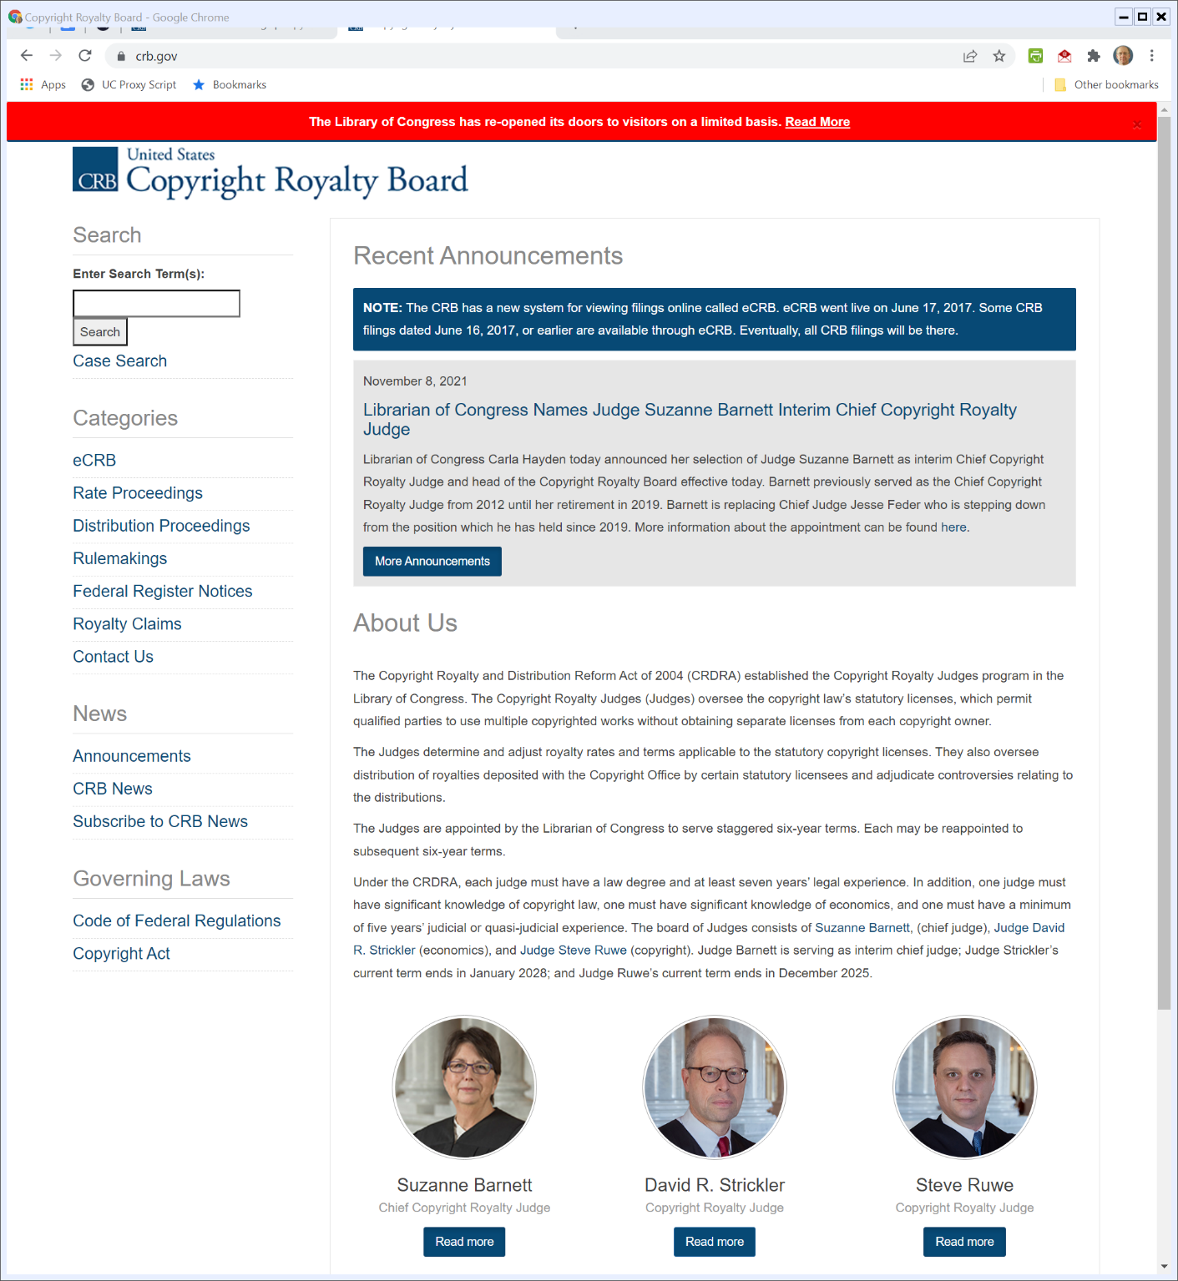
The Copyright Royalty Board
CRB.gov (Visited 9 Feb 2022)

Slide 25
Sony Betamax Intro in Japan
WSJ (17 Apr 1975)

Slide 26
Technical Specifications
WSJ (17 Apr 1975)

Slide 27
Likely Market
WSJ (17 Apr 1975)

Slide 28
Video Discs as Alternative
WSJ (17 Apr 1975)

Slide 29
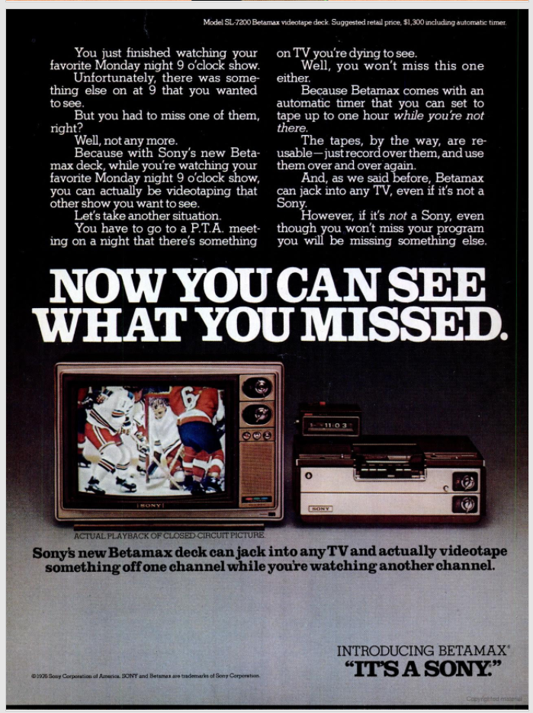
Sony Betamax Ad
New York Magazine (14 June 1976)

Slide 30
Sony Betamax Ad
New York Magazine (14 June 1976)

Slide 31
Sony Betamax Ad
New York Magazine (14 June 1976)

Slide 32
$1300
New York Magazine (14 June 1976)

Slide 33
Copyright Lawsuit
Chicago Tribune (13 Nov 1976)

Slide 34
Sony
464 U.S. 417 (U.S. 1984)

Slide 35
Primary Liability in Patent Law: Sec. 271(a)
“(a) Except as otherwise provided in this title, whoever without authority makes, uses or sells any patented invention, within the United States during the term of the patent therefor, infringes the patent.”
Sony (U.S. 1984)

Slide 36
Secondary Liability in Patent Law: Inducement: Sec. 271(b)
“(b) Whoever actively induces infringement of a patent shall be liable as an infringer.”
Sony (U.S. 1984)

Slide 37
Secondary Liability in Patent Law: Contributory Infringement: Sec. 271(c)
“(c) Whoever sells a component of a patented machine, manufacture, combination or composition, or a material or apparatus for use in practicing a patented process, constituting a material part of the invention, knowing the same to be especially made or especially adapted for use in an infringement of such patent, and not a staple article or commodity of commerce suitable for substantial noninfringing use, shall be liable as a contributory infringer.”
Sony (U.S. 1984)

Slide 38
The Design of the VCR
TTYN (1 of 3)
Consider the design choices for the VCR:
Recorder (has a tuner) rather than just pre-recorded tape player
Pause/fast forward buttons
No capability for recognizing “jamming” signals to prevent recording
Should Sony have been liable for these design choices?

Slide 39
Design Incentives I
TTYN (2 of 3)
Hypo
Suppose copying machine generates $1 million in beneficial uses and $10 million in social harm
What should happen? What does Sony say about this?

Slide 40
Design Incentives II
TTYN (3 of 3)
Hypo
Suppose product generates $10 million in beneficial noninfringing uses and $1000 in infringing uses/harms
Suppose producer could spend $5 to eliminate $1000 in infringing uses
What should happen? How does Sony address this?

Slide 41
“Substantial Noninfringing Uses”
“Accordingly, the sale of copying equipment, like the sale of other articles of commerce, does not constitute contributory infringement if the product is widely used for legitimate, unobjectionable purposes. Indeed, it need merely be capable of substantial noninfringing uses.”
Sony (U.S. 1984)

Slide 42
Home Time-Shifting of Free TV is Fair Use
“When these factors are all weighed in the ‘equitable rule of reason’ balance, we must conclude that this record amply supports the District Court's conclusion that home time-shifting is fair use.”
Sony (U.S. 1984)

Slide 43
Sony Isn’t Secondarily Liable
“The Betamax is, therefore, capable of substantial noninfringing uses. Sony’s sale of such equipment to the general public does not constitute contributory infringement of respondents’ copyrights.”
Sony (U.S. 1984)

Slide 44
Grokster
545 U.S. 913 (2005)

Slide 45
Inducement Liability
“The question is under what circumstances the distributor of a product capable of both lawful and unlawful use is liable for acts of copyright infringement by third parties using the product. We hold that one who distributes a device with the object of promoting its use to infringe copyright, as shown by clear expression or other affirmative steps taken to foster infringement, is liable for the resulting acts of infringement by third parties.”
Grokster (U.S. 2005)

Slide 46
Grokster in the Sup Ct
Two Cuts
Grokster loses 9-0 on an inducement theory
We get a 3-3-3 decision on Sony
Souter, Thomas & Scalia: 9th Cir wrong on Sony and no more
Ginsberg, The Chief Justice & Kennedy: Liable under Sony
Breyer, Stevens & O’Connor: Not liable under Sony

Slide 47
Who Records?
TTYN (1 of 3)
Hypo
I buy a Sony Betamax
I master the recording interface and record a TV show
Copyright issues? If so, am I the infringer? Is Sony? If me, can Sony be held liable for my copying?

Slide 48
Who Records?
TTYN (2 of 3)
Hypo
Many consumers find it hard to record TV shows
A new firm offers to record shows on your behalf: tell them what you want, they record for a fee, you pick up the tape
Copyright issues?

Slide 49
Who Records?
TTYN (3 of 3)
Hypo
A new firm records every show broadcast on TV:
“Meant to record it but didn’t? No problem.”
You pay a fee for the taped program
Copyright issues?

Slide 50
Building a Video Recording Device
TTYN (1 of 3)
Hypo: The VCR
Sony invents a device that makes it possible for a home user to make copies of TV shows at home
The device sits in the consumer’s home and uses magnetic tapes to make copies.
Is Sony a direct infringer? A contributory infringer?

Slide 51
Building a Video Recording Device
TTYN (2 of 3)
Hypo: The DVR
Sony replaces magnetic tapes with a hard disk but the box otherwise operates as before
Is Sony a contributory infringer? A direct infringer? Does it matter of Sony also provides a TV schedule service to the device?

Slide 52
Building a Video Recording Device
TTYN (3 of 3)
Hypo: Remote Cable DVR
The DVR is provided by the cable company Cablevision which moves the hard drive from the consumer’s home to its centralized facility
Cablevision then uses its cable wires to make it possible for the consumer to play the show
Is Cablevision a contributory infringer? A direct infringer?

Slide 53
Cartoon Network
536 F.3d 121 (2nd Cir. 2008)

Slide 54
Remote Storage DVR
“Defendant-Appellant Cablevision Systems Corporation (‘Cablevision’) wants to market a new ‘Remote Storage’ Digital Video Recorder system (‘RS-DVR’), using a technology akin to both traditional, set-top digital video recorders, like TiVo (‘DVRs’),and the video-on-demand (‘VOD’) services provided by many cable companies.”
Cartoon Network (2nd Cir. 2008)

Slide 55
Infringement?
“Plaintiffs-Appellees produce copyrighted movies and television programs that they provide to Cablevision pursuant to numerous licensing agreements. They contend that Cablevision, through the operation of its RS-DVR system as proposed, would directly infringe their copyrights both by making unauthorized reproductions, and by engaging in public performances, of their copyrighted works.”
Cartoon Network (2nd Cir. 2008)

Slide 56
No Liability
“Because we conclude that Cablevision would not directly infringe plaintiffs’ rights under the Copyright Act by offering its RS-DVR system to consumers, we reverse the district court’s award of summary judgment to plaintiffs, and we vacate its injunction against Cablevision.”
Cartoon Network (2nd Cir. 2008)

Slide 57
Aereo (U.S. 2014)
573 U.S. 431 (2014)

Slide 58
Sec. 106(4): Public Performance Right
“Subject to sections 107 through 121, the owner of copyright under this title has the exclusive rights to do and to authorize any of the following: … (4) in the case of literary, musical, dramatic, and choreographic works, pantomimes, and motion pictures and other audiovisual works, to perform the copyrighted work publicly;”
17 USC 106

Slide 59
Sec. 101: “To Perform”
“To ‘perform’ a work means to recite, render, play, dance, or act it, either directly or by means of any device or process or, in the case of a motion picture or other audiovisual work, to show its images in any sequence or to make the sounds accompanying it audible.”
17 USC 101

Slide 60
Sec. 101: “Publicly”
“(2) to transmit or otherwise communicate a performance or display of the work to a place specified by clause (1) or to the public, by means of any device or process, whether the members of the public capable of receiving the performance or display receive it in the same place or in separate places and at the same time or at different times.”
17 USC 101

Slide 61
Sec. 101: “Transmit”
“To ‘transmit’ a performance or display is to communicate it by any device or process whereby images or sounds are received beyond the place from which they are sent.”
17 USC 101

Slide 62
Performing
H.R. 94-1476 (3 Sept 1976)

Slide 63
Needs to Be Public Performance to Infringe
H.R. 94-1476 (3 Sept 1976)

Slide 64
And Publicly?
H.R. 94-1476 (3 Sept 1976)

Slide 65
Aereo I
TTYN (1 of 4)
Hypo
Aereo offers to anyone that Aereo will come to your house and install a 30-foot outdoor TV antenna
Is Aereo violating 106(4)? Does it matter how long the wire is connecting the antenna to your TV?

Slide 66
Aereo II
TTYN (2 of 4)
Hypo
Aereo offers to install an antenna for you at a location not your house
Is Aereo violating 106(4)? Does it matter how big the antenna is? How long the wire is connecting the antenna to your TV?

Slide 67
Aereo III
TTYN (3 of 4)
Hypo
Aereo offers to install an antenna for you at a location not your house and also offers a remote DVR service
Does this change the analysis from Aereo II? Is this actually Aereo? Is Aereo the actor here or is the customer? Does each act of watching involve a public performance?

Slide 68
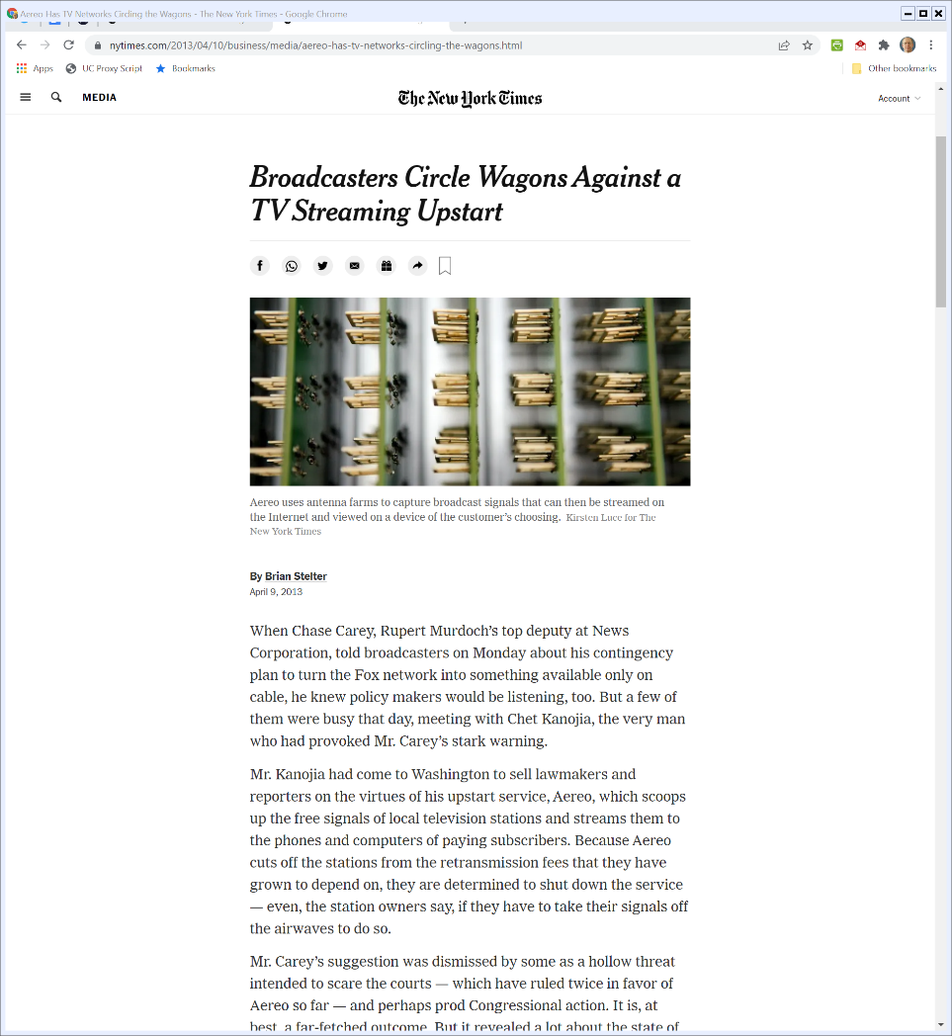
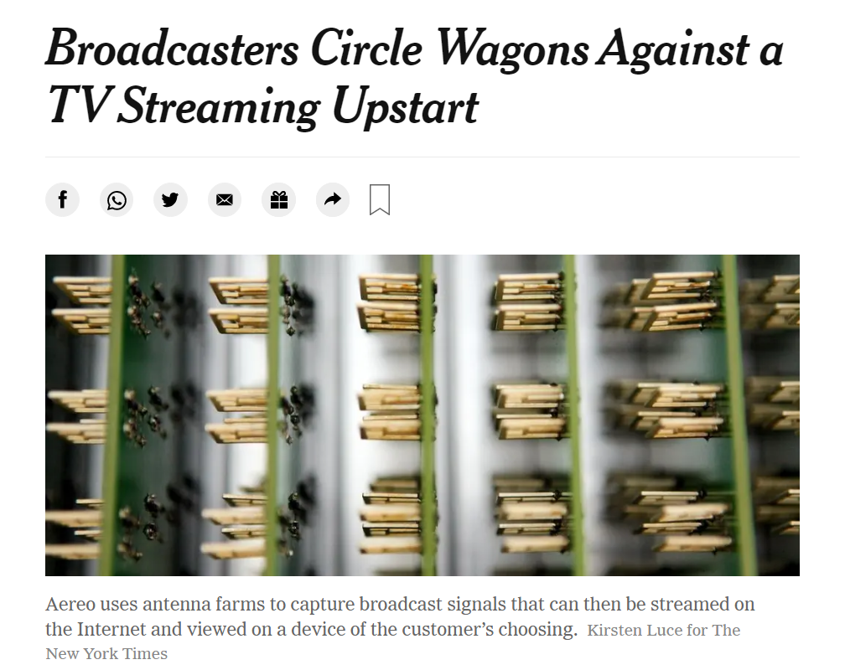
TTYN (4 of 4)
New York Times (9 Apr 2013)
Notes:
https://www.nytimes.com/2013/04/10/business/media/aereo-has-tv-networks-circling-the-wagons.html

Slide 69
Fortnightly and Teleprompter Déjà Vu
“In sum, having considered the details of Aereo’s practices, we find them highly similar to those of the CATV systems in Fortnightly and Teleprompter. And those are activities that the 1976 amendments sought to bring within the scope of the Copyright Act. Insofar as there are differences, those differences concern not the nature of the service that Aereo provides so much as the technological manner in which it provides the service. We conclude that those differences are not adequate to place Aereo’s activities outside the scope of the Act.”
Aereo (U.S. 2014)

Slide 70
Dissent: Customer Performs, Not Aereo
“In sum, Aereo does not ‘perform’ for the sole and simple reason that it does not make the choice of content. And be-cause Aereo does not perform, it cannot be held directly lia­ble for infringing the Networks’ public-performance right.”
Aereo (U.S. 2014)

Slide 71
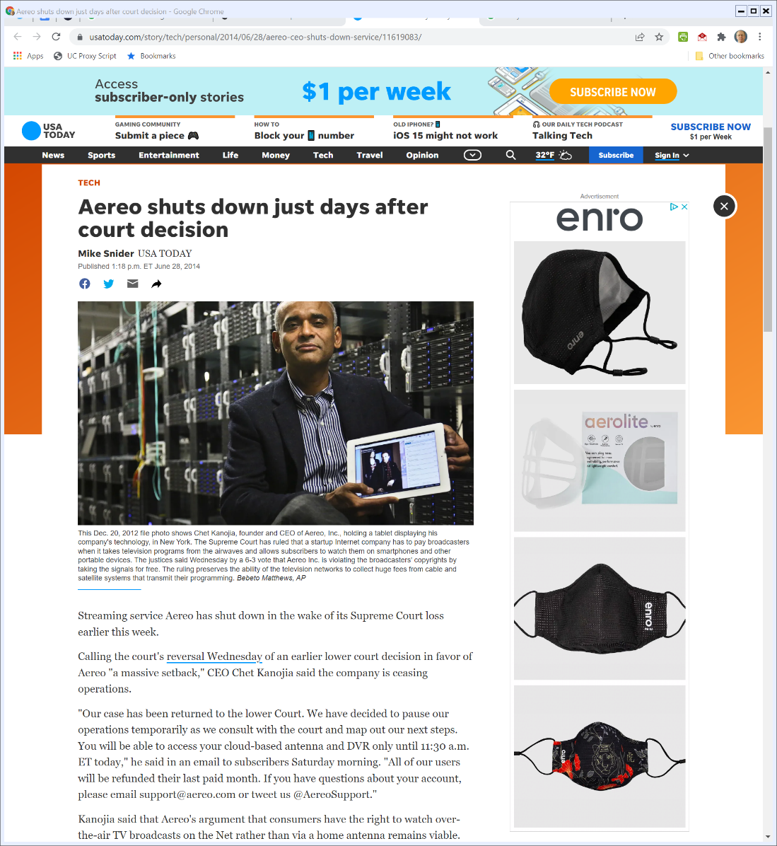
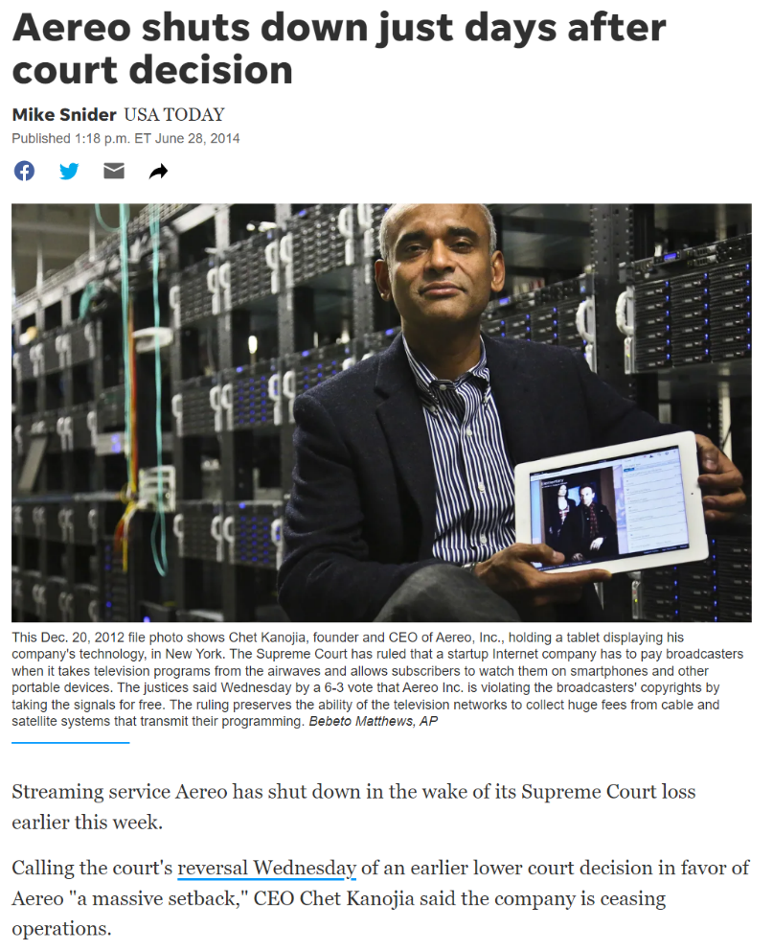
Aereo Shuts Down
USA Today (28 June 2014)
Notes:
https://www.usatoday.com/story/tech/personal/2014/06/28/aereo-ceo-shuts-down-service/11619083/

