Slide 1
Class 13: Mon 21 Apr 2025
Copyright Spring 2025
Fair Use
Randal C. Picker
James Parker Hall Distinguished Service Professor of Law
The Law School
The University of Chicago

Slide 2
Blanch v. Koons
467 F.3d 244 (2nd Cir. 2006)

Slide 3
Use/Re-Use
TTYN (1 of 3)
Hypo
  Photographer (P) takes the image on the next slide
  P believes Artist has re-used that work in the work on the third slide
Is the alleged use infringing? Is the use fair?

Slide 4
Original Work (TTYN (2 of 3))
Photograph by Andrea Blanch, Allure Magazine (Aug 2000)

Slide 5
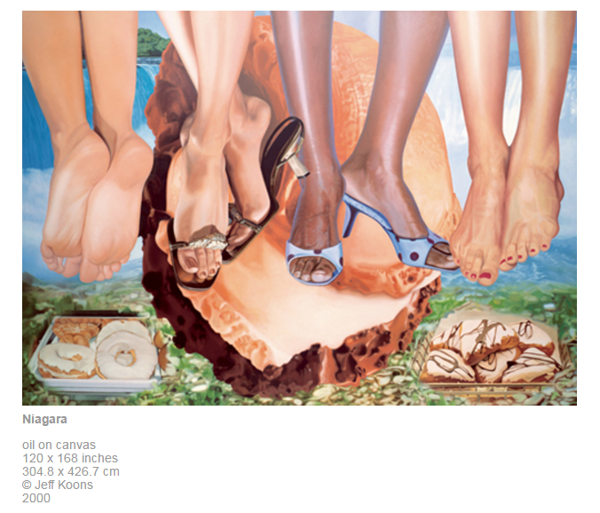
Subsequent Work (TTYN (3 of 3))
Niagara, Jeff Koons (2000)

Slide 6
Applying Campbell
“The test for whether ‘Niagara’s’ use of ‘Silk Sandals’ is ‘transformative,’ then, is whether it ‘merely supersedes the objects of the original creation, or instead adds something new, with a further purpose or different character, altering the first with new expression, meaning, or message.’ Campbell, 510 U.S. at 579 … The test almost perfectly describes Koons’s adaptation of ‘Silk Sandals’:”
Blanch v. Koons (2nd Cir. 2006)

Slide 7
Satire, Not Parody
“ ‘Niagara,’ on the other hand, may be better characterized for these purposes as satire—its message appears to target the genre of which ‘Silk Sandals’ is typical, rather than the individual photograph itself.”
Blanch v. Koons (2nd Cir. 2006)

Slide 8
Koons Wins
“Having explored the statutory factors and weighed them together in light of the purposes of copyright, Campbell, 510 U.S. at 78, we think that the district court’s conclusion was correct — that copyright law’s goal of ‘promoting the Progress of Science and useful Arts,’ U.S. Const., art. I, § 8. cl. 8,”
Blanch v. Koons (2nd Cir. 2006)

Slide 9
Koons Wins
“would be better served by allowing Koons’s use of ‘Silk Sandals’ than by preventing it. We therefore conclude that neither he nor the other defendants engaged in or are liable for copyright infringement. We affirm the judgment of the district court.”
Blanch v. Koons (2nd Cir. 2006)

Slide 10
Kienitz
766 F.3d 756 (7th Cir. 2014)

Slide 11
At The Musée Picasso Paris
TTYN (1 of 4)
Hypo
  Consider the images capture in the photographs on the next three slides
  Assume that current U.S. copyright law applied when they were created
Which would be copyrightable? Which would not?

Slide 12
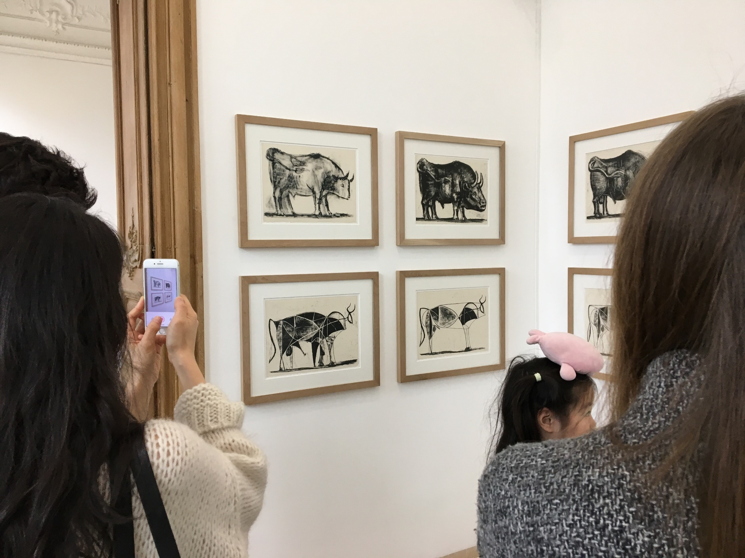
At the Musée Picasso Paris (TTYN (2 of 4))
Picker (Mar 2019)

Slide 13
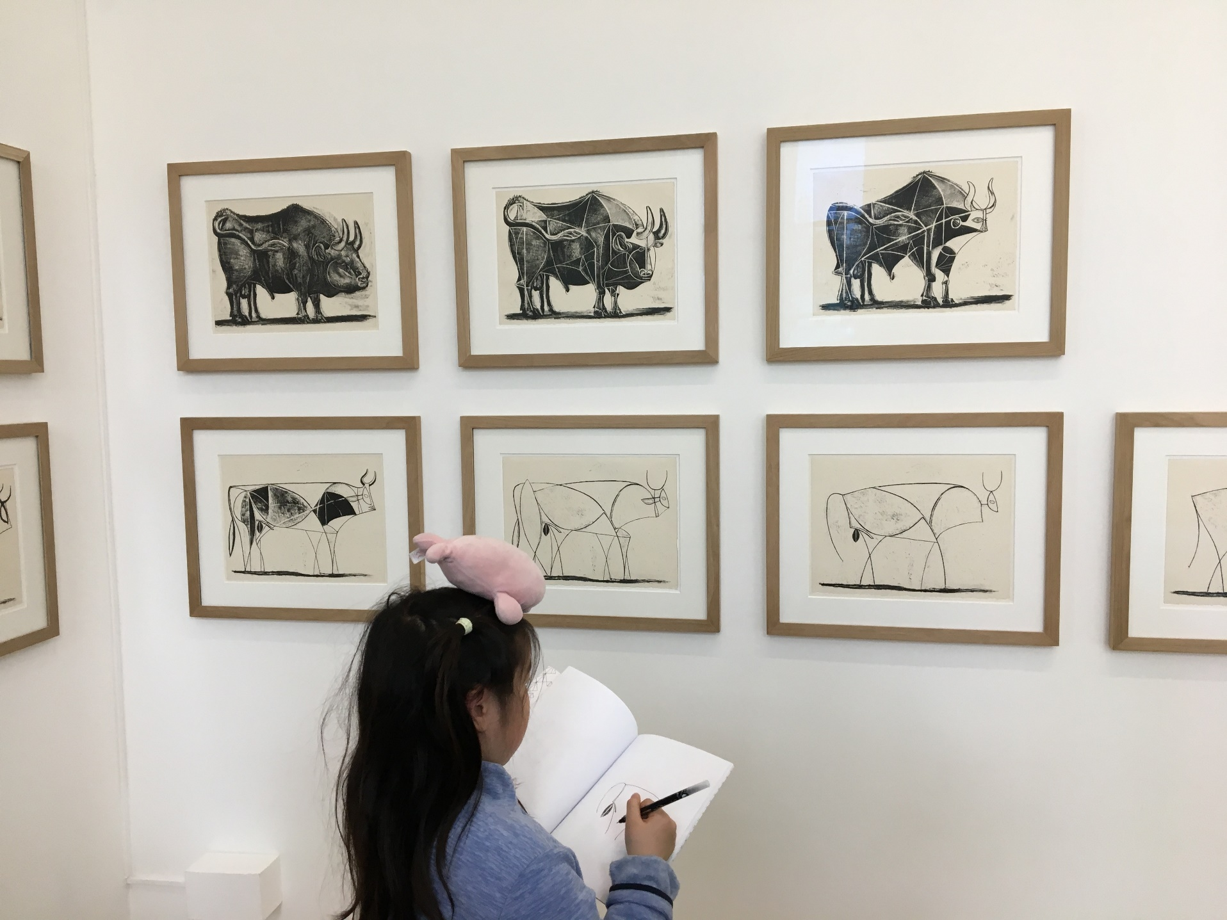
At the Musée Picasso Paris (TTYN (3 of 4))
Picker (Mar 2019)

Slide 14
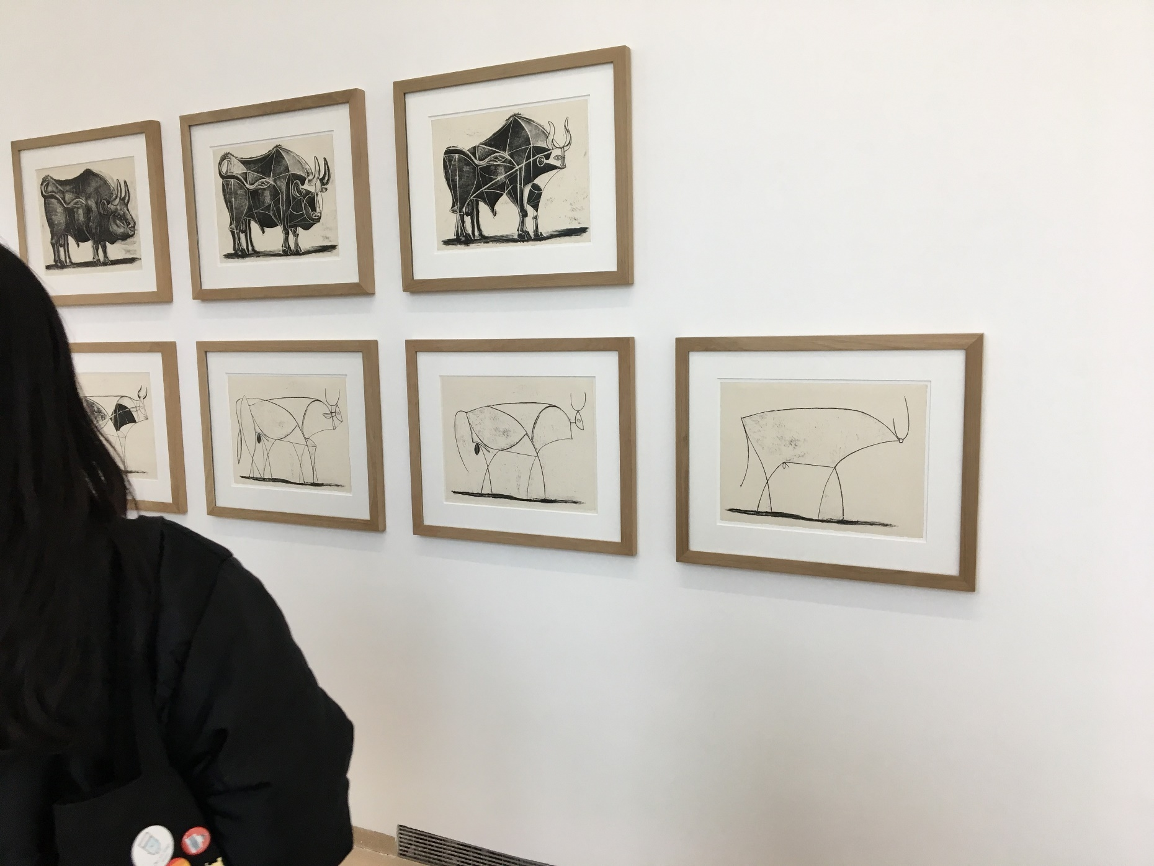
At the Musée Picasso Paris (TTYN (4 of 4))
Picker (Mar 2019)

Slide 15
Use/Re-Use
TTYN (1 of 4)
Hypo
  Artist encounters mayor of town on street and makes a quick sketch; barely an outline
  Takes it home and pops it into Photoshop and produces this image
Copyright status of sketch? Image on right?

Slide 16
Use/Re-Use
TTYN (2 of 4)
Hypo
  Photographer encounters mayor of town on street and takes a photo
  Takes it home and pops it into Photoshop and produces this image
Copyright status of photo? Image on right?

Slide 17
Use/Re-Use
TTYN (3 of 4)
Hypo
  Creator downloads photo of mayor of town from town website
  Pops it into Photoshop and produces this image
Copyright status of photo on website? Image on right?

Slide 18
The Works in Kienitz (TTYN (4 of 4))
Kienitz (7th Cir. 2014)

Slide 19
Can’t Square Transformation and Derivative Works
“We’re skeptical of Cariou’s approach, because asking exclusively whether something is ‘transformative’ not only replaces the list in §107 but also could override 17 U.S.C. §106(2), which protects derivative works. To say that a new use transforms the work is precisely to say that it is derivative and thus, one might suppose, protected under §106(2). Cariou and its predecessors in the Second Circuit do not explain how every ‘transformative use’ can be ‘fair use’ without extinguishing the author’s rights under §106(2).”
Kienitz (7th Cir. 2014)

Slide 20
Applying the Fourth Factor Here
“We think it best to stick with the statutory list, of which the most important usually is the fourth (market effect). We have asked whether the contested use is a complement to the protected work (allowed) rather than a substitute for it (prohibited). … A t-shirt or tank top is no substitute for the original photograph. Nor does Kienitz say that defendants disrupted a plan to license this work for apparel. Kienitz does not argue that defendants’ products have reduced the demand for the original work or any use of it that he is contemplating.”
Kienitz (7th Cir. 2014)

Slide 21
Erasing from the Original?
“Defendants removed so much of the original that, as with the Cheshire Cat, only the smile remains. Defendants started with a low-resolution version posted on the City’s website, so much of the original’s detail never had a chance to reach the copy; the original’s background is gone; its colors and shading are gone; the expression in Soglin’s eyes can no longer be read; after the posterization (and reproduction by silk-screening), the effect of the lighting in the original is almost extinguished.”
Kienitz (7th Cir. 2014)

Slide 22
What Does This Mean?
“What is left, besides a hint of Soglin’s smile, is the outline of his face, which can’t be copyrighted. Defendants could have achieved the same effect by starting with a snapshot taken on the street.”
Kienitz (7th Cir. 2014)

Slide 23
2021: Sup Ct on Fair Use (6-2)
Google v. Oracle (U.S. 2021)

Slide 24
For Android
“Google envisioned an Android platform that was free and open, such that software developers could use the tools found there free of charge. Its idea was that more and more developers using its Android platform would develop ever more Android-based applications, all of which would make Google’s Android-based smartphones more attractive to ultimate consumers. Consumers would then buy and use ever more of those phones. … That vision required attracting a sizeable number of skilled programmers.”
Google v. Oracle (U.S. 2021)

Slide 25
For Java
“About six million programmers had spent considerable time learning, and then using, the Java language. Many of those programmers used Sun’s own popular Java SE platform to develop new programs primarily for use in desktop and laptop computers. That platform allowed developers using the Java language to write programs that were able to run on any desktop or laptop computer, regardless of the underlying hardware … .”
Google v. Oracle (U.S. 2021)

Slide 26
And the Conflict
“Shortly after acquiring the Android firm, Google began talks with Sun about the possibility of licensing the entire Java platform for its new smartphone technology. But Google did not want to insist that all programs written on the Android platform be in­teroperable. … Ap­parently, for reasons related to this disagreement, Google’s negotiations with Sun broke down. Google then built its own platform.”
Google v. Oracle (U.S. 2021)

Slide 27
The Nature of Declaring Code?
“In our view, for the reasons just described, the declaring code is, if copyrightable at all, further than are most computer pro­grams (such as the implementing code) from the core of cop­yright. That fact diminishes the fear, expressed by both the dissent and the Federal Circuit, that application of ‘fair use’ here would seriously undermine the general copyright protection that Congress provided for computer programs. And it means that this factor, ‘the nature of the copyrighted work,’ points in the direction of fair use.”
Google v. Oracle (U.S. 2021)

Slide 28
Purpose & Character: Creating New (Derivative?) Products
“Here Google’s use of the Sun Java API seeks to create new products. It seeks to expand the use and usefulness of Android-based smartphones. Its new product offers programmers a highly creative and innovative tool for a smartphone environment. To the extent that Google used parts of the Sun Java API to create a new platform that could be readily used by programmers, its use was consistent with that creative ‘progress’ that is the basic constitutional objective of copyright itself.”
Google v. Oracle (U.S. 2021)

Slide 29
Search “Derivative” on Majority Opinion
Questions
  What do you find?
  Does that bother you?

Slide 30
P&C: Utility of API Reuse
“The jury heard that shared interfaces are necessary for different programs to speak to each other. It heard that the reimplementation of interfaces is necessary if programmers are to be able to use their acquired skills. It heard that the reuse of APIs is common in the industry. It heard that Sun itself had used pre-existing interfaces in creating Java. And it heard that Sun executives thought that widespread use of the Java programming language, including use on a smartphone platform, would benefit the company.”
Google v. Oracle (U.S. 2021)

Slide 31
Amount & Substantiality: Locks and Keys
“Google’s basic objective was not simply to make the Java programming language usable on its Android systems. It was to permit programmers to make use of their knowledge and experience using the Sun Java API when they wrote new programs for smartphones with the Android platform. In principle, Google might have created its own, different system of declaring code.”
Google v. Oracle (U.S. 2021)

Slide 32
Amount & Substantiality: Locks and Keys
“But the jury could have found that its doing so would not have achieved that basic objective. In a sense, the declaring code was the key that it needed to unlock the programmers’ creative energies. And it needed those energies to create and to improve its own innovative Android systems. We consequently believe that this ‘substantiality’ factor weighs in favor of fair use.”
Google v. Oracle (U.S. 2021)

Slide 33
All About Third-Party Knowledge of the API
“This source of Android’s prof­itability has much to do with third parties’ (say, programmers’) investment in Sun Java programs. It has corre­spondingly less to do with Sun’s investment in creating the Sun Java API. We have no reason to believe that the Copyright Act seeks to protect third parties’ investment in learn­ing how to operate a created work.”
Google v. Oracle (U.S. 2021)

Slide 34
AWF v. Goldsmith
598 U.S. 508 (2023)

Slide 35
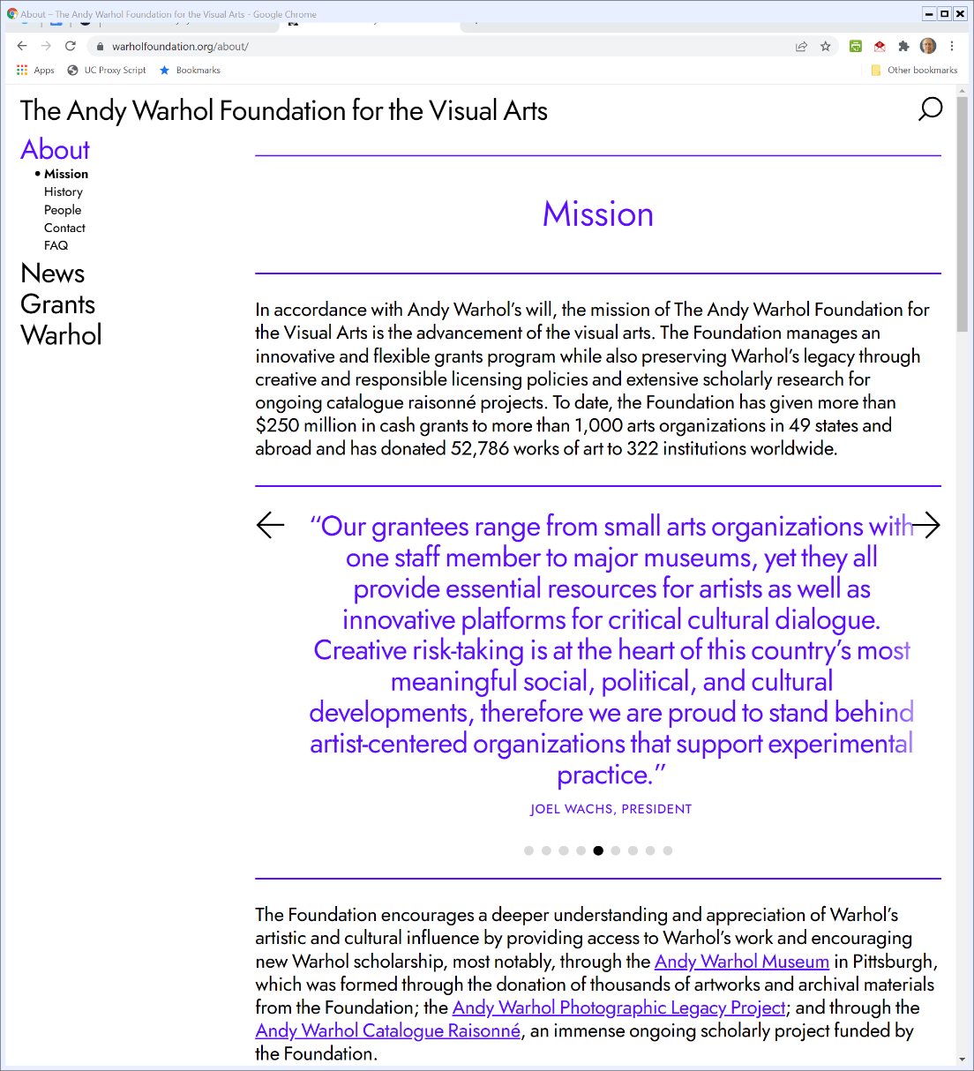

The Warhol Foundation
AWF Website (Visited 8 Feb 2022)
Notes:
https://warholfoundation.org/about/

Slide 36
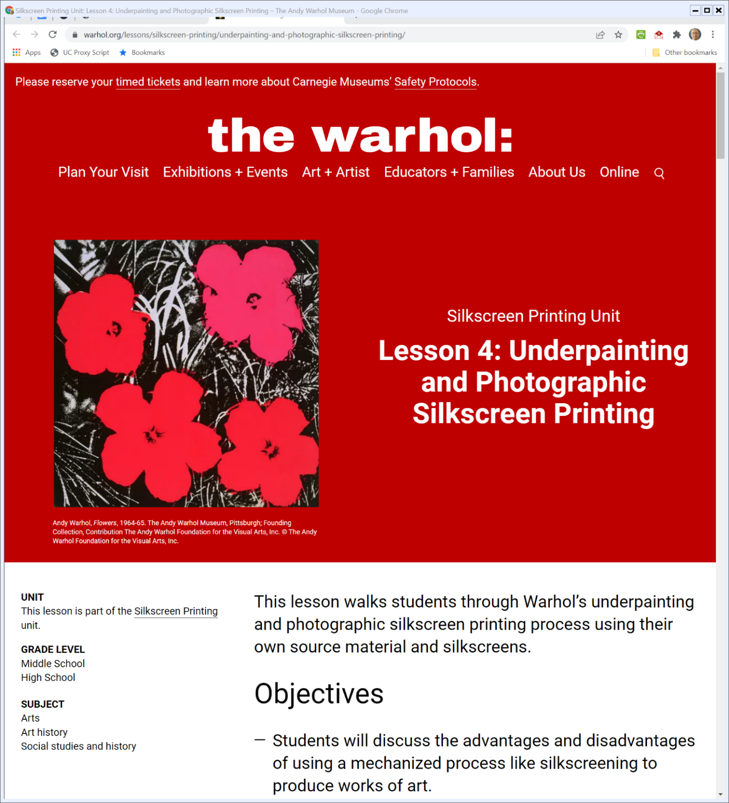

The Warhol Museum
Warhol.org (Visited 9 Feb 2022)
Notes:
https://www.warhol.org/lessons/silkscreen-printing/underpainting-and-photographic-silkscreen-printing/

Slide 37
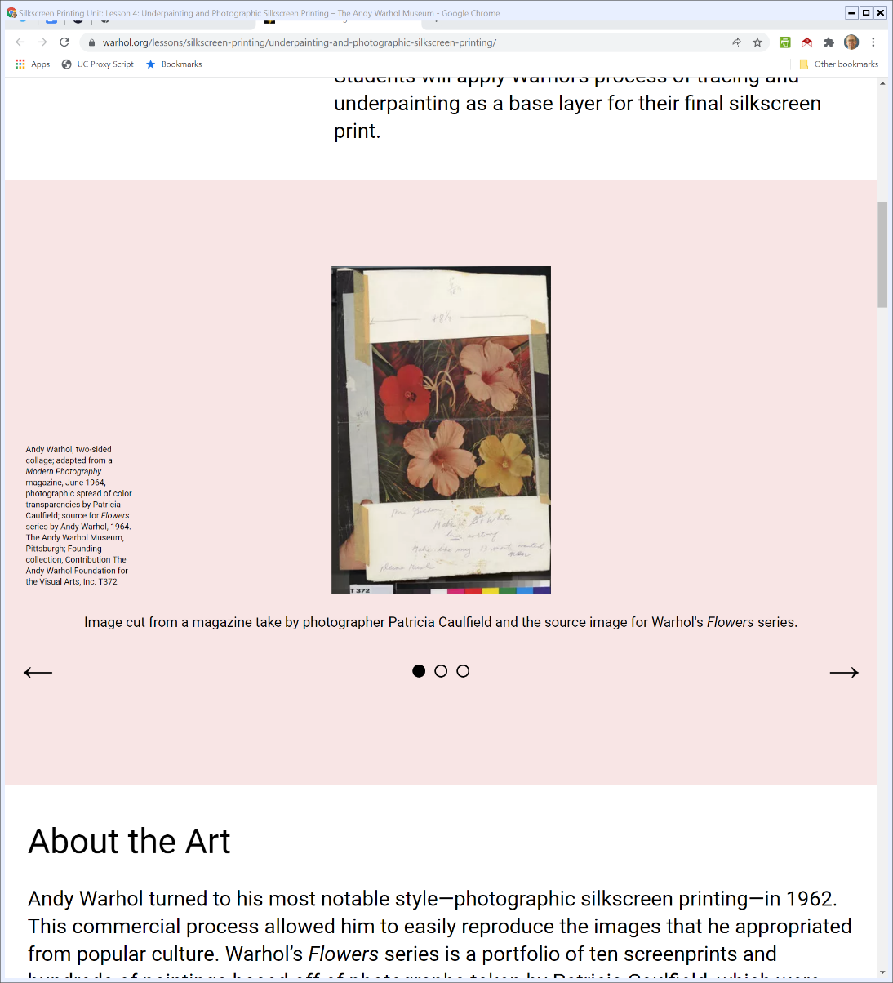
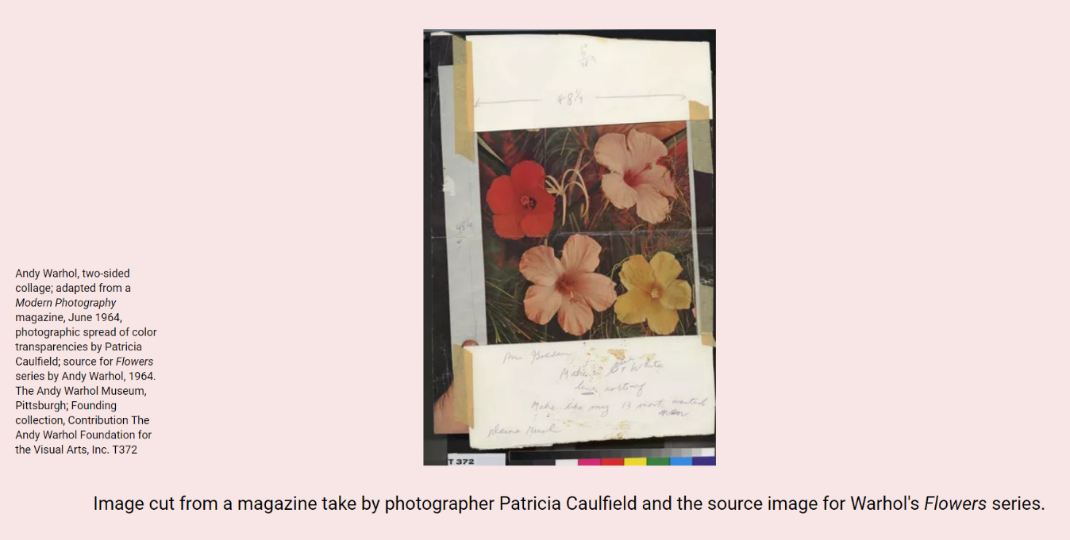
Making Flowers
Warhol.org (Visited 9 Feb 2022)
Notes:
https://www.warhol.org/lessons/silkscreen-printing/underpainting-and-photographic-silkscreen-printing/

Slide 38
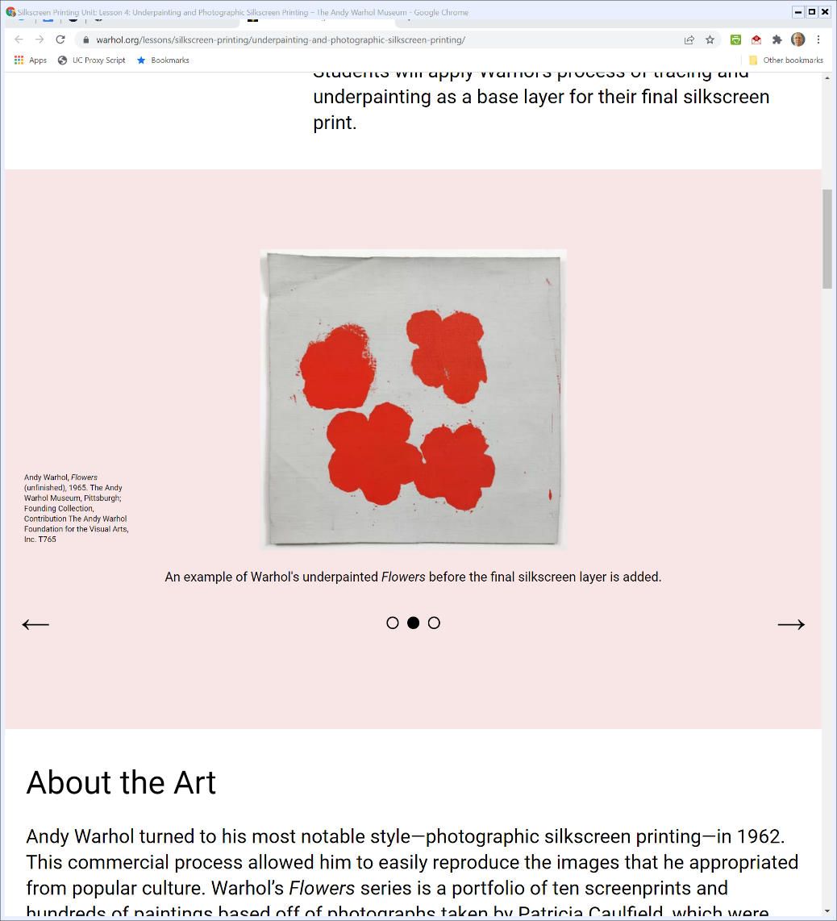

Making Flowers
Warhol.org (Visited 9 Feb 2022)
Notes:
https://www.warhol.org/lessons/silkscreen-printing/underpainting-and-photographic-silkscreen-printing/

Slide 39
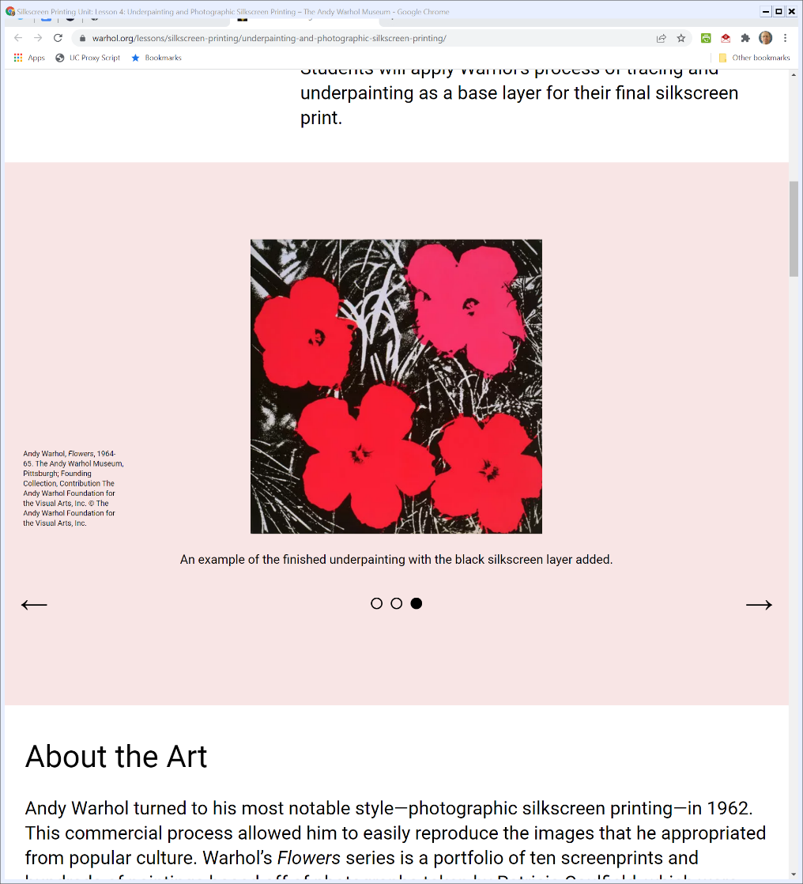
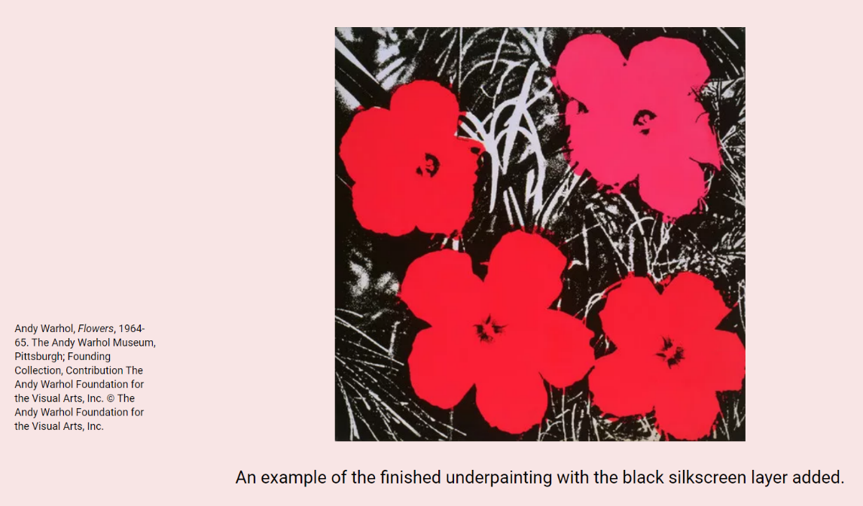
Making Flowers
Warhol.org (Visited 9 Feb 2022)
Notes:
https://www.warhol.org/lessons/silkscreen-printing/underpainting-and-photographic-silkscreen-printing/

Slide 40
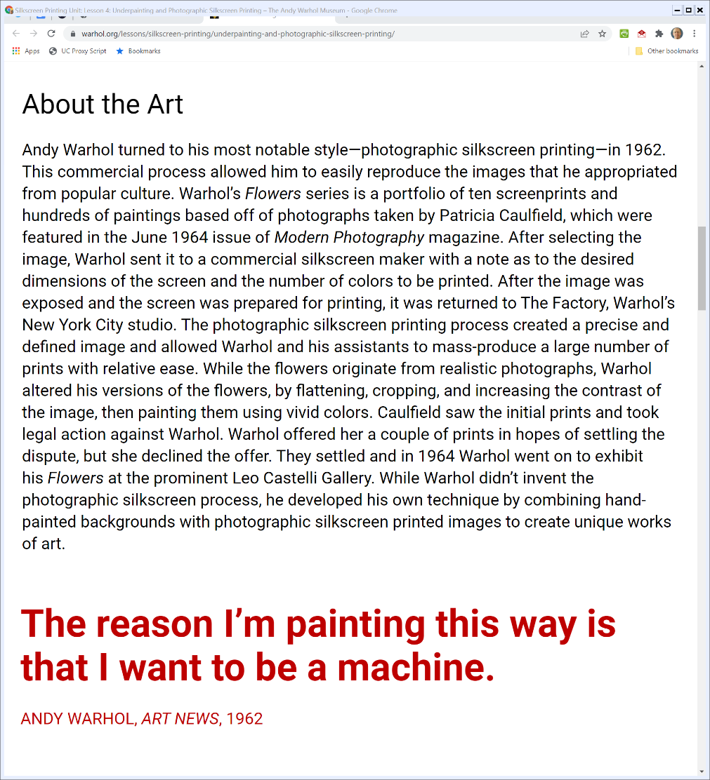

And the Copyright Fight
Warhol.org (Visited 9 Feb 2022)
Notes:
https://www.warhol.org/lessons/silkscreen-printing/underpainting-and-photographic-silkscreen-printing/

Slide 41
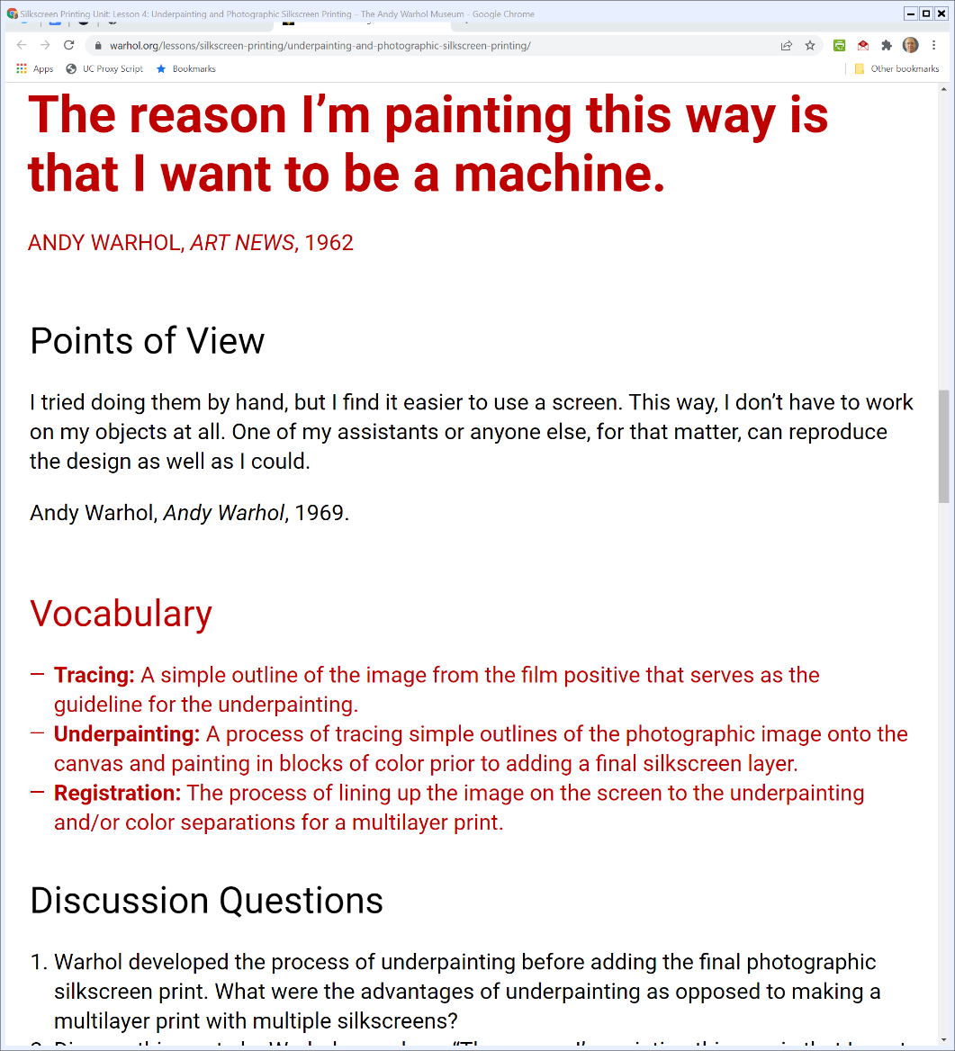

And the Process: Trace, Underpaint, Print
Warhol.org (Visited 9 Feb 2022)
Notes:
https://www.warhol.org/lessons/silkscreen-printing/underpainting-and-photographic-silkscreen-printing/

Slide 42
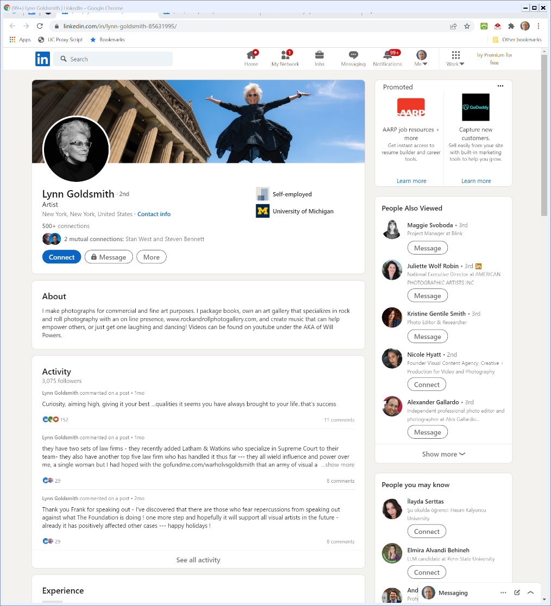

Lynn Goldsmith: 42 Years as An Artist
linkedIn (Visited 8 Feb 2022)
Notes:
https://www.linkedin.com/in/lynn-goldsmith-85631995/

Slide 43
Limited Use Rights Granted
Vanity Fair Contract (29 Oct 1984)

Slide 44
$400; More Limits
Vanity Fair Contract (29 Oct 1984)

Slide 45
And Done
Vanity Fair Contract (29 Oct 1984)

Slide 46
Goldsmith Photo
Warhol (US 2023)

Slide 47
Understanding Warhol’s Production Process
Neil Printz Declaration (12 Oct 2018)

Slide 48
Using Photographs
Neil Printz Declaration (12 Oct 2018)

Slide 49
Using Photographs
Neil Printz Declaration (12 Oct 2018)

Slide 50
Andy Takes Photos Too
Neil Printz Declaration (12 Oct 2018)

Slide 51
Creating the VF Image
Neil Printz Declaration (12 Oct 2018)

Slide 52
Warhol’s Silk-Screen Printer
Neil Printz Declaration (12 Oct 2018)

Slide 53
Additional Steps
Neil Printz Declaration (12 Oct 2018)

Slide 54
The VF Layout
Warhol (US 2023)

Slide 55
Andy Creates Prince
TTYN (1 of 5)
Hypo
  Prince goes to Warhol’s studio and poses
  Andy paints a portrait
Does Andy get a copyright in the work he has created?

Slide 56
Andy Creates Prince
TTYN (2 of 5)
Hypo
  Prince isn’t around. Andy gets a photograph to be used as an artist’s reference. Assume Goldsmith is the photographer.
  Andy paints a portrait of Prince from the reference.
Is the portrait a derivative work of the photograph? What, if anything, does Andy have rights to?

Slide 57
Andy Creates Prince
TTYN (3 of 5)
Would the situation change if Andy was looking at 10 different photos of Prince while he was creating his painting?

Slide 58
Andy Creates Prince
TTYN (4 of 5)
Hypo
  Again, Goldsmith photograph as artist’s reference.
  Andy creates a portrait of Prince from the reference using his silkscreen process
Is this different from the prior hypo?

Slide 59
VF Prints Prince
TTYN (5 of 5)
Hypo
  Prince dies and VF wants to print a picture of him along with text for its story
  VF contracts with AWF for an image from the Prince series that seems to be outside of the original contract with G
What are the relevant uses here? Andy’s use of G’s photo? VF’s use of G’s photo?

Slide 60
Issue is Application of First Factor
“In this Court, the sole question presented is whether the first fair use factor, ‘the purpose and character of the use, including whether such use is of a commercial nature or is for nonprofit educational purposes,’ §107(1), weighs in favor of AWF’s recent commercial licensing to Condé Nast. On that narrow issue, and limited to the challenged use, the Court agrees with the Second Circuit: The first factor favors Goldsmith, not AWF.”
Warhol (US 2023)

Slide 61
Transformativeness and Derivatives
“In other words, the owner has a right to derivative transformations of her work. … But an overbroad concept of transformative use, one that includes any further purpose, or any different character, would narrow the copyright owner’s exclusive right to create derivative works. To preserve that right, the degree of transformation required to make ‘transformative’ use of an original must go beyond that required to qualify as a derivative.”
Warhol (US 2023)

Slide 62
Use v. Use
“In sum, the first fair use factor considers whether the use of a copyrighted work has a further purpose or different character, which is a matter of degree, and the degree of difference must be balanced against the commercial nature of the use. If an original work and a secondary use share the same or highly similar purposes, and the secondary use is of a commercial nature, the first factor is likely to weigh against fair use, absent some other justification for copying.”
Warhol (US 2023)

Slide 63
Fn 8: Understanding Google
“That is, Google put Sun’s code to use in the ‘distinct and different computing environment’ of its own Android platform, a new system created for new products. Ibid. Moreover, the use was justified in that context because ‘shared interfaces are necessary for different programs to speak to each other’ and because ‘reimplementation of interfaces is necessary if programmers are to be able to use their acquired skills.’”
Warhol (US 2023)

Slide 64
What Is the Use Here?
“The purpose of that use is, still, to illustrate a magazine about Prince with a portrait of Prince. Although the purpose could be more specifically described as illustrating a magazine about Prince with a portrait of Prince, one that portrays Prince somewhat differently from Goldsmith’s photograph (yet has no critical bearing on her photograph), that degree of difference is not enough for the first factor to favor AWF, given the specific context of the use.”
Warhol (US 2023)

Slide 65
What Is the Use Here?
“To hold otherwise would potentially authorize a range of commercial copying of photographs, to be used for purposes that are substantially the same as those of the originals.”
Warhol (US 2023)

Slide 66
Can’t Just Use It Because It Works Well
“As Judge Leval has explained, ‘[a] secondary author is not necessarily at liberty to make wholesale takings of the original author’s expression merely because of how well the original author’s expression would convey the sec­ondary author’s different message.’ Authors Guild, 804 F.3d, at 215.”
Warhol (US 2023)

Slide 67
Warhol’s Work Isn’t Transformative???
“Today, the Court declares that Andy Warhol’s eye-popping silkscreen of Prince—a work based on but dramatically altering an existing photograph—is (in copyright lingo) not ‘transformative.’”
Warhol (US 2023)

Slide 68
No One Makes Anything New Alone
“For, let’s be honest, artists don’t create all on their own; they cannot do what they do without borrowing from or otherwise making use of the work of others. That is the way artistry of all kinds—visual, musical, literary—happens (as it is the way knowledge and invention generally develop).”
Warhol (US 2023)

Slide 69
Is This the Right Question?
“A thought experiment may pound the point home. Suppose you were the editor of Vanity Fair or Condé Nast, publishing an article about Prince. You need, of course, some kind of picture. An employee comes to you with two options: the Goldsmith photo, the Warhol portrait. Would you say that you don’t really care? That the employee is free to flip a coin?”
Warhol (US 2023)

Slide 70
Boiling Down the Majority Opinion
“All of Warhol’s artistry and social commentary is negated by one thing: Warhol licensed his portrait to a magazine, and Goldsmith sometimes licensed her photos to magazines too. That is the sum and substance of the majority opinion.”
Warhol (US 2023)

Slide 71
Why Should Andy Have to Talk About Lynn?
“If Warhol had used Goldsmith’s photo to comment on or critique Goldsmith’s photo, he might have availed himself of that factor’s benefit (though why anyone would be interested in that work is mysterious). But because he instead commented on society—the dehumanizing culture of celebrity—he is (go figure) out of luck.”
Warhol (US 2023)

Slide 72
Isn’t What Warhol Actually Did Better?
“Would that Goldsmith-focused work (whatever it might be) have more meaningfully advanced creative progress, which is copy­right’s raison d’être, than the work he actually made? I can’t see how; more like the opposite. The majority’s preference for the directed work, apparently on grounds of necessity, again reflects its undervaluing of transformative copying as a core part of artistry.”
Warhol (US 2023)

Slide 73
Fn 5: What of Derivative Works?
“The majority asserts that it is “aware of no authority for the proposition” that the fourth factor can thus protect against unlicensed film adaptations, insisting that the first factor must do (or at least share in) the work. Ante, at 29, n. 17; see ante, at 16, 28–29, 36. But Google is the “authority for the proposition”: That’s just what it said, in so many words. ….”
Warhol (US 2023)

Slide 74
Fn 5: What of Derivative Works?
“… But assuming the majority’s approach, as stated re­peatedly in its opinion, is truly the majority’s approach, factor 1 won’t help the author in the book-to-film situation. Under that approach, it is the fourth factor, not the first, which has to “take[] care of derivative works like book-to-film adaptations.” Ante, at 29, n. 17. ….”
Warhol (US 2023)

