Slide 1
Class 12: Thurs 17 Apr 2025
Copyright Spring 2025
Fair Use
Randal C. Picker
James Parker Hall Distinguished Service Professor of Law
The Law School
The University of Chicago

Slide 2
Sec. 107: Fair Use
17 USC 107

Slide 3
Not in the Statute Before 1976
H.R. 94-1476 (3 Sept 1976)

Slide 4
And Not Going to Define it Here
H.R. 94-1476 (3 Sept 1976)

Slide 5
New Tech: The Fight Over Photocopies
H.R. 94-1476 (3 Sept 1976)

Slide 6
No Broad Exemption for Classroom Copying
H.R. 94-1476 (3 Sept 1976)

Slide 7
Broad Strokes, No Freeze
H.R. 94-1476 (3 Sept 1976)

Slide 8
Situating Fair Use
Fair Use v. Fair Access
  Copyright isn’t in the main an access regime
  You might be able to make a use that would be fair—noninfringing—but still have no right to access the underlying work

Slide 9
Situating Fair Use
Fair Use Right?
  Section 107 provides that uses that qualify are not infringing meaning that no copyright violation arises
  That doesn’t say that the use can’t violate other law
  Fair use is an affirmative defense (Campbell)

Slide 10
Situating Fair Use
Fair Use Right?
  Much talk of fair use “right” (and see 17 USC 108(f)(4)) but affirmative defense framing better tracks overall statutory conception set out in 107

Slide 11
Campbell (U.S. 1994)
510 U.S. 569 (1994)

Slide 12
The Music
TTYN
Columbia/GWU Music Infringement Site
  https://blogs.law.gwu.edu/mcir/case/campbell-v-acuff-rose/
Questions
  Does the second work infringe on the first work?
  If so, is the use protected as a fair use under Section 107?

Slide 13
Replace the Original Work or Add to It?
“The central purpose of this investigation is to see, in Justice Story’s words, whether the new work merely ‘supersede[s] the objects’ of the original creation, … or instead adds something new, with a further purpose or different character, altering the first with new expression, meaning, or message; it asks, in other words, whether and to what extent the new work is ‘transformative.’ Leval 1111.”
Campbell (US 1994)

Slide 14
The Role of Transformative Use
“Although such transformative use is not absolutely necessary for a finding of fair use, … the goal of copyright, to promote science and the arts, is generally furthered by the creation of transformative works. Such works thus lie at the heart of the fair use doctrine’s guarantee of breathing space within the confines of copyright … and the more transformative the new work, the less will be the significance of other factors, like commercialism, that may weigh against a finding of fair use.”
Campbell (US 1994)

Slide 15
What is Parody?
“The germ of parody lies in the definition of the Greek parodeia, quoted in Judge Nelson’s Court of Appeals dissent, as ‘a song sung alongside another.’ 972 F.2d, at 1440, quoting 7 Encyclopedia Britannica 768 (15th ed. 1975). Modern dictionaries accordingly describe a parody as a ‘literary or artistic work that imitates the characteristic style of an author or a work for comic effect or ridicule,’.”
Campbell (US 1994)

Slide 16
What is Parody?
“or as a ‘composition in prose or verse in which the characteristic turns of thought and phrase in an author or class of authors are imitated in such a way as to make them appear ridiculous.’ ….”
Campbell (US 1994)

Slide 17
Can’t Use the Prior Work Just to Grab Attention
“If, on the contrary, the commentary has no critical bearing on the substance or style of the original composition, which the alleged infringer merely uses to get attention or to avoid the drudgery in working up something fresh, the claim to fairness in borrowing from another’s work diminishes accordingly (if it does not vanish), and other factors, like the extent of its commerciality, loom larger.”
Campbell (US 1994)

Slide 18
Parody v. Satire
“Parody needs to mimic an original to make its point, and so has some claim to use the creation of its victim’s (or collective victims’) imagination, whereas satire can stand on its own two feet and so requires justification for the very act of borrowing.”
Campbell (US 1994)

Slide 19
The Need for Control?
Applying Copyright’s Incentive Theory
  Do we think that we need to give the author control over potential parodies to get the author to create the work in the first place?
  How many authors won’t create if they can’t control subsequent parodies?
Does this mean that the fair use analysis is too ex post and insufficiently ex ante?

Slide 20
Use the Best Known Part of the Work
“When parody takes aim at a particular original work, the parody must be able to ‘conjure up’ at least enough of that original to make the object of its critical wit recognizable. … What makes for this recognition is quotation of the original’s most distinctive or memorable features, which the parodist can be sure the audience will know. … But using some characteristic features cannot be avoided.”
Campbell (US 1994)

Slide 21
What Was Used Here?
“It is true, of course, that 2 Live Crew copied the characteristic opening bass riff (or musical phrase) of the original, and true that the words of the first line copy the Orbison lyrics. But if quotation of the opening riff and the first line may be said to go to the ‘heart’ of the original, the heart is also what most readily conjures up the song for parody, and it is the heart at which parody takes aim.”
Campbell (US 1994)

Slide 22
Applying the Fourth Factor
“The enquiry ‘must take account not only of harm to the original but also of harm to the market for derivative works.’ Harper & Row, supra, at 568. Since fair use is an affirmative defense, its proponent would have difficulty carrying the burden of demonstrating fair use without favorable evidence about relevant markets.”
Campbell (US 1994)

Slide 23
Applying the Fourth Factor
“In moving for summary judgment, 2 Live Crew left themselves at just such a disadvantage when they failed to address the effect on the market for rap derivatives, and confined themselves to uncontroverted submissions that there was no likely effect on the market for the original.”
Campbell (US 1994)

Slide 24
Understanding Copyright Harm
“We do not, of course, suggest that a parody may not harm the market at all, but when a lethal parody, like a scathing theater review, kills demand for the original, it does not produce a harm cognizable under the Copyright Act.”
Campbell (US 1994)

Slide 25
Applying the Four Factors
The Four Factors
  (1) Purpose and Character of the Use
  (2) The Nature of the Copyrighted Work
  (3) The Amount Used
  (4) The Effect on the Market/Value of the Work

Slide 26
Applying the Four Factors
(1) Purpose and Character of the Use
  Commercial use doesn’t necessarily result in unfair use
(2) The Nature of the Copyrighted Work
  Music is core copyright expression

Slide 27
Applying the Four Factors
(3) Amount Used
  Lyrics OK, remand on question of “whether repetition of the bass riff is excessive copying”
(4) Market for Work
  Includes market for derivative work; remand for info on market for rap versions of Pretty Woman

Slide 28
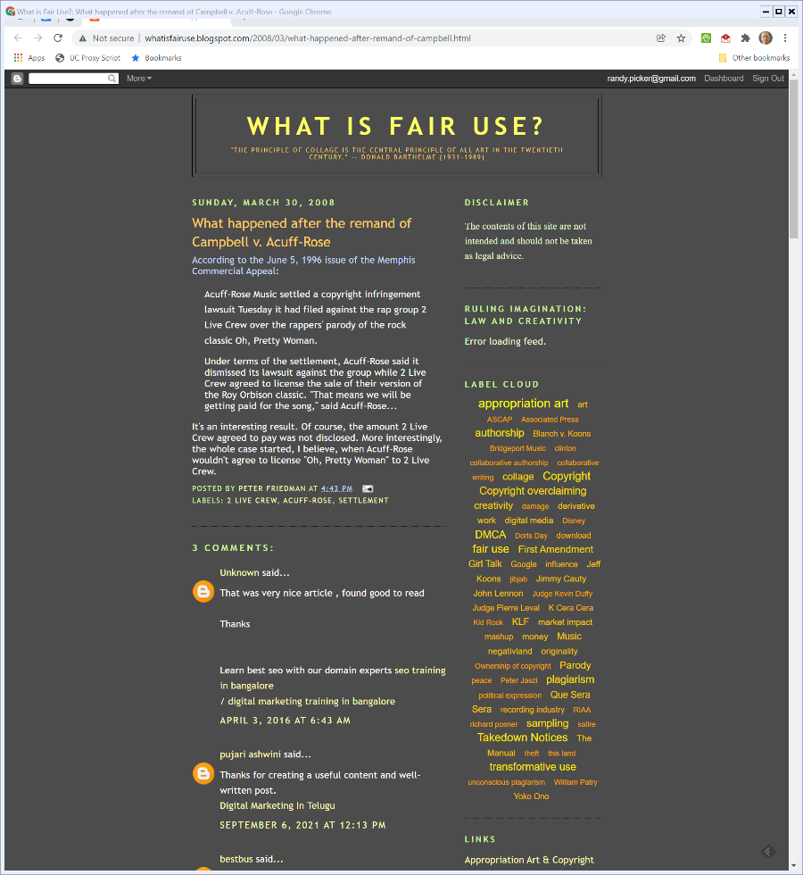
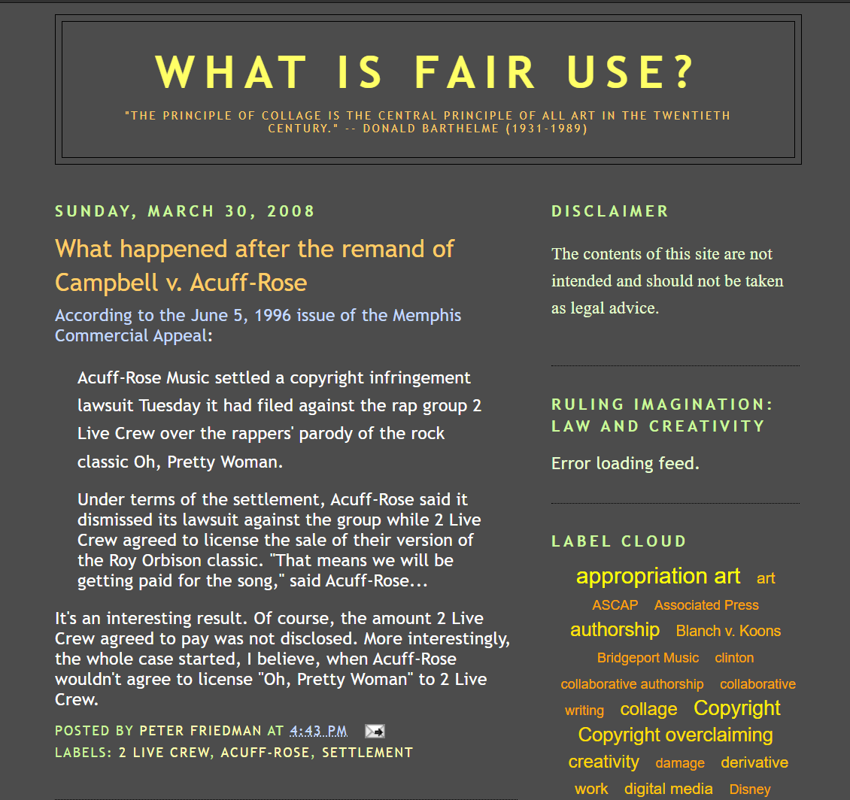
Settled on Remand?
Friedman (30 Mar 2008)
Notes:
http://whatisfairuse.blogspot.com/2008/03/what-happened-after-remand-of-campbell.html

Slide 29
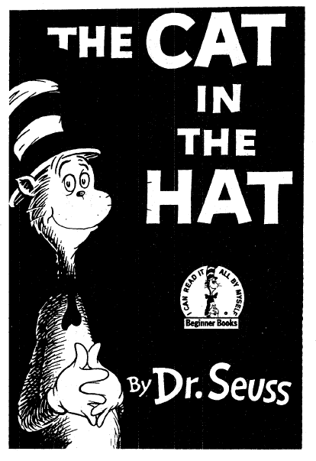
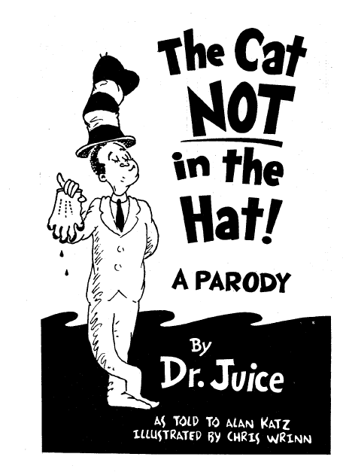
TTYN (1 of 3)
Dr. Seuss v. Penguin, 109 F.3d 1394 (9th Cir. 1997)

Slide 30
TTYN (2 of 3)
Dr. Seuss (9th Cir. 1997)

Slide 31
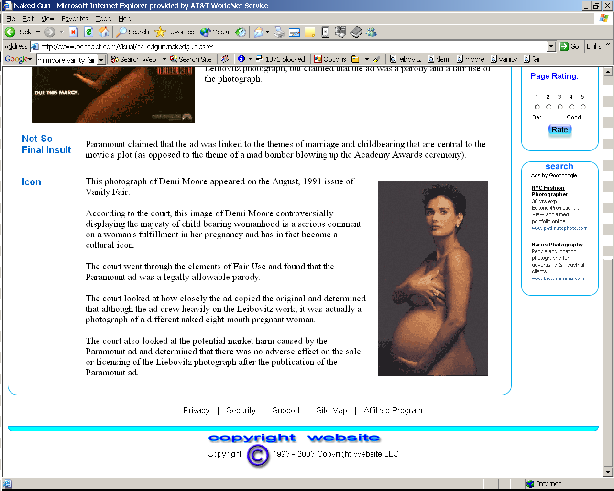
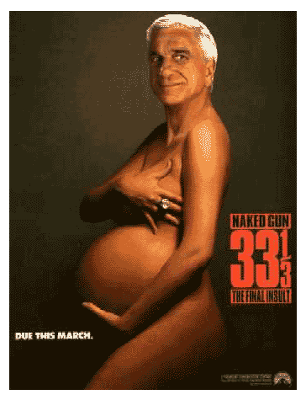
TTYN (3 of 3)
Leibovitz v. Paramount, 137 F.3d 109 (2nd Cir. 1998)

Slide 32
Not Criticizing The Cat in the Hat
“These stanzas and the illustrations simply retell the Simpson tale. Although The Cat NOT in the Hat! does broadly mimic Dr. Seuss’ characteristic style, it does not hold his style up to ridicule. The stanzas have “no critical bearing on the substance or style of” The Cat in the Hat.”
Dr. Seuss (9th Cir. 1997)

Slide 33
It’s All in the Smirk
“Whether it ‘comments’ on the original is a somewhat closer question. Because the smirking face of Nielsen contrasts so strikingly with the serious expression on the face of Moore, the ad may reasonably be perceived as commenting on the seriousness, even the pretentiousness, of the original.”
Leibovitz (2nd Cir. 1998)

Slide 34
Ridicule?
“The contrast achieves the effect of ridicule that the Court recognized in Campbell would serve as a sufficient ‘comment’ to tip the first factor in a parodist’s favor.”
Leibovitz (2nd Cir. 1998)

Slide 35
Commenting on the Original
“Being different from an original does not inevitably ‘comment’ on the original. Nevertheless, the ad is not merely different; it differs in a way that may reasonably be perceived as commenting, through ridicule, on what a viewer might reasonably think is the undue self-importance conveyed by the subject of the Leibovitz photograph.”
Leibovitz (2nd Cir. 1998)

Slide 36
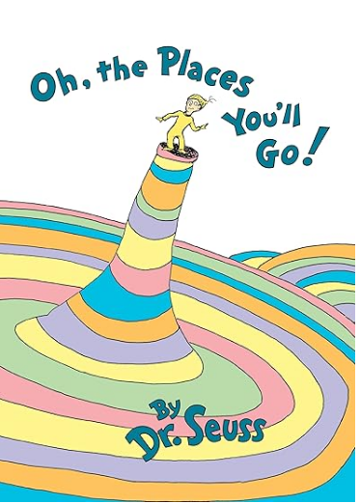
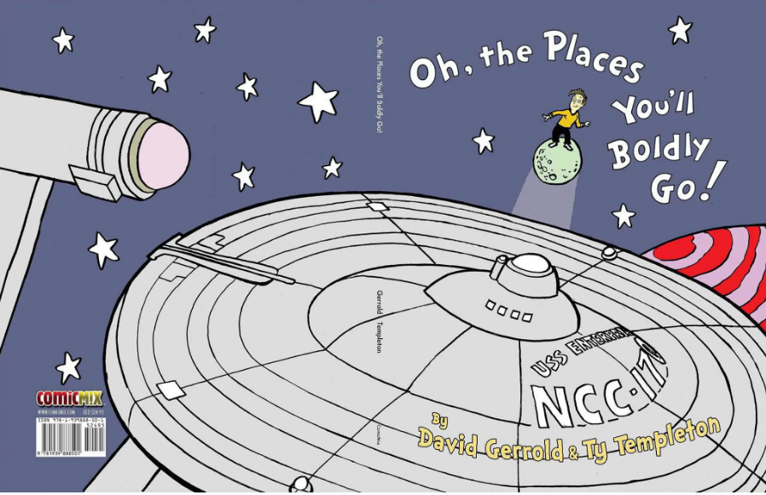
Going Places?
Amazon/New York Times (21 Dec 2020)
Notes:
https://www.nytimes.com/2020/12/21/business/dr-seuss-star-trek-comicmix.html

Slide 37
A Seuss Parody?
Dr. Seuss Enterprises, 983 F.3d 443 (9th Cir. 2020)

Slide 38
The People in Black Robes
“The creators thought their Star Trek primer would be ‘pretty well protected by parody,’ but acknowledged that ‘people in black robes’ may disagree. Indeed, we do.”
Dr. Seuss Enterprises, 983 F.3d 443 (9th Cir. 2020)

Slide 39
Parody Videos I?
TTYN (1 of 2)
Apple/Hillary/Fortnite
  Original 1984 Apple commercial (VtvjbmoDx-I)
  Obama campaign ad (6h3G-lMZxjo)
  #FreeFortnite video (euiSHuaw6Q4)

Slide 40
Parody Videos II?
TTYN (2 of 2)
George Bush/U2
  U2 live (EM4vblG6BVQ)
  The George Bush version (Hdn_AAKusl8)

Slide 41
Bill Graham Archives
448 F.3d 606 (2nd Cir. 2006)

Slide 42
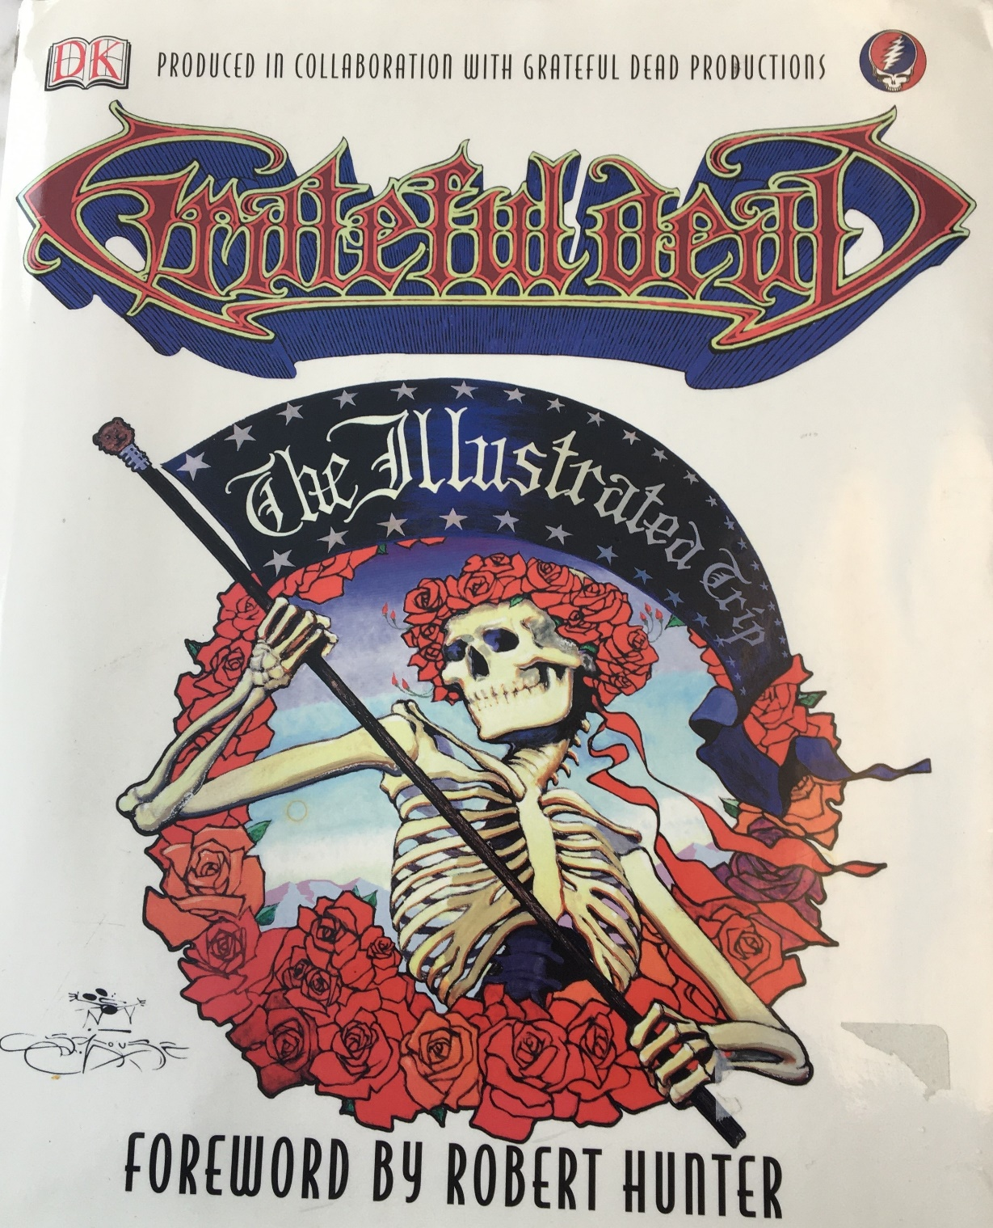
Grateful Dead: The Illustrated Trip
DK Publishing (2003)

Slide 43
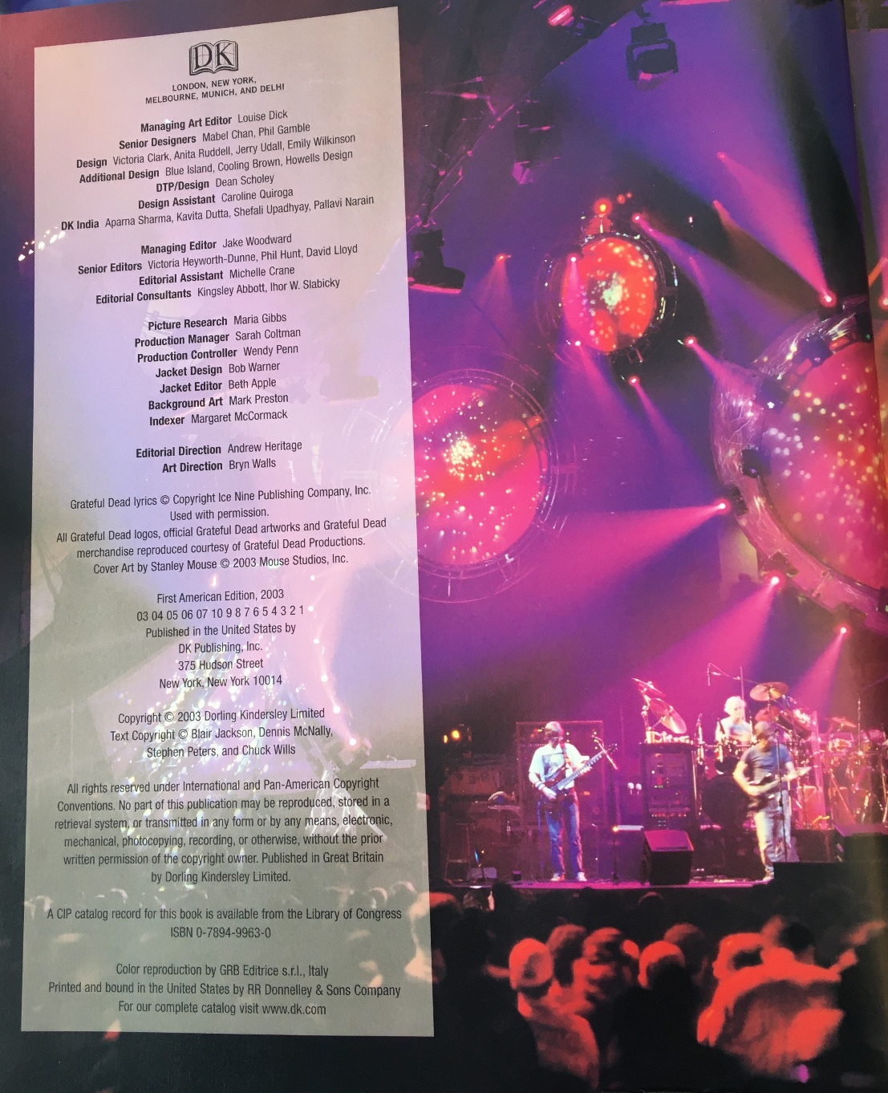

Copyright Page
The Illustrated Trip (2003)

Slide 44
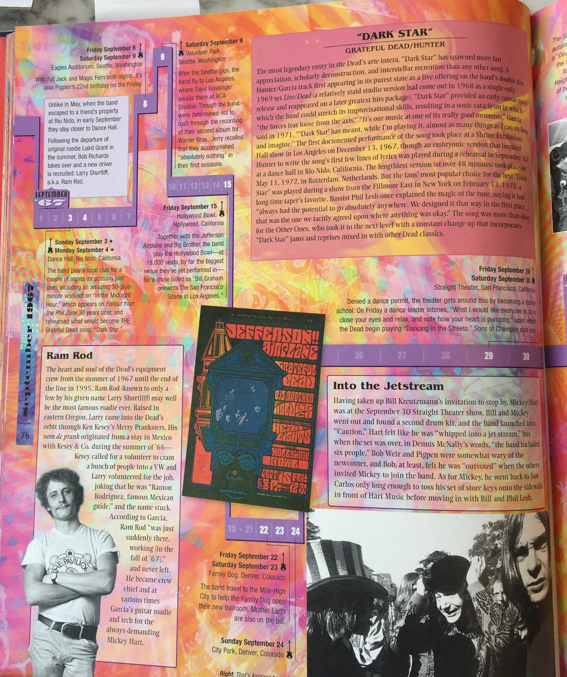
A Concert Poster
The Illustrated Trip (2003)

Slide 45
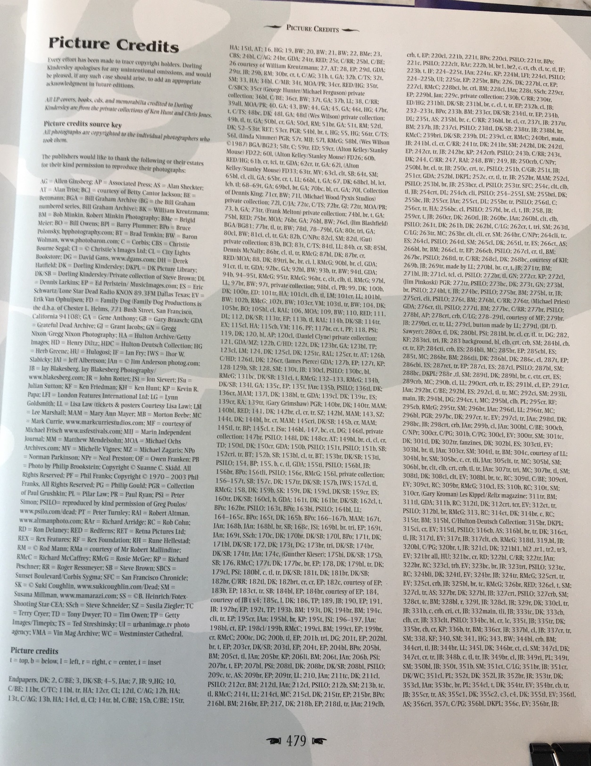
Copyrighted Works as Inputs
The Illustrated Trip (2003)

Slide 46
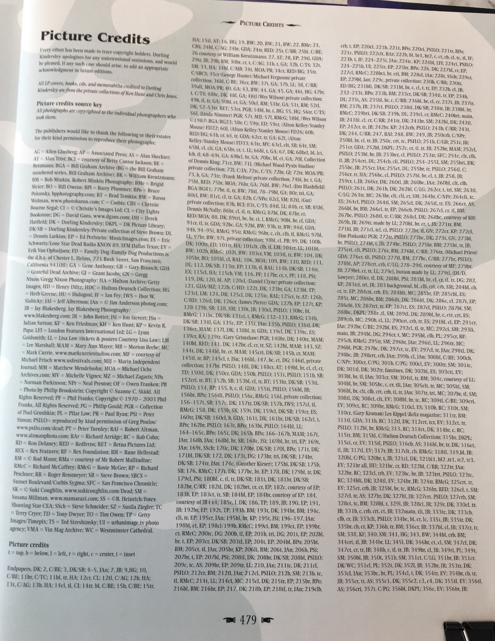
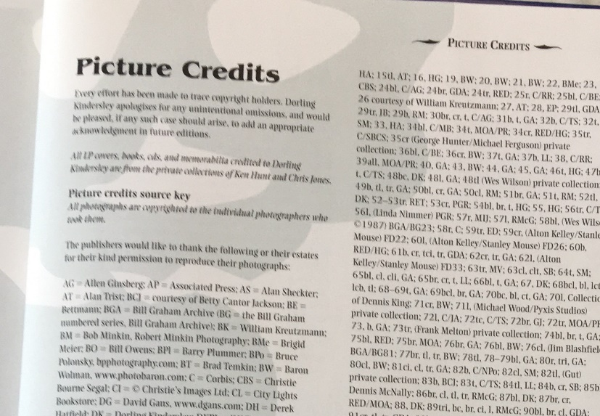
Copyright Clearance
The Illustrated Trip (2003)

Slide 47
Change in Use of Posters
“In the instant case, DK’s purpose in using the copyrighted images at issue in its biography of the Grateful Dead is plainly different from the original purpose for which they were created. Originally, each of BGA’s images fulfilled the dual purposes of artistic expression and promotion.”
Bill Graham Archives (2nd Cir. 2006)

Slide 48
Historical Artifacts
“The posters were apparently widely distributed to generate public interest in the Grateful Dead and to convey information to a large number people about the band’s forthcoming concerts. In contrast, DK used each of BGA’s images as historical artifacts to document and represent the actual occurrence of Grateful Dead concert events featured on Illustrated Trip’s timeline.”
Bill Graham Archives (2nd Cir. 2006)

Slide 49
4th Factor and Derivative Works Market
“In the instant case, the parties agree that DK’s use of the images did not impact BGA’s primary market for the sale of the poster images. Instead, we look to whether DK’s unauthorized use usurps BGA’s potential to develop a derivative market. Appellant argues that DK interfered with the market for licensing its images for use in books. Appellant contends that there is an established market for licensing its images and it suffered both the loss of royalty revenue directly from DK and the opportunity to obtain royalties from others.”
Bill Graham Archives (2nd Cir. 2006)

Slide 50
4th Factor: Traditional v. Transformative Markets
“Moreover, Appellant asserts that it established a market for licensing its images, and in this case expressed a willingness to license images to DK. Neither of these arguments shows impairment to a traditional, as opposed to a transformative market.”
Bill Graham Archives (2nd Cir. 2006)

Slide 51
Can’t Just Offer to License What Would Otherwise be Fair Use
“In a case such as this, a copyright holder cannot prevent others from entering fair use markets merely ‘by developing or licensing a market for parody, news reporting, educational or other transformative uses of its own creative work.’’ Castle Rock, 150 F.3d at 146 n. 11. ‘[C]opyright owners may not preempt exploitation of transformative markets … .’ Id.”
Bill Graham Archives (2nd Cir. 2006)

