Slide 1
Class 10: Mon 14 Apr 2025: 2:45
Copyright Spring 2025
The Public Domain: Duration and Renewal
Randal C. Picker
James Parker Hall Distinguished Service Professor of Law
The Law School
The University of Chicago

Slide 2
302(a): Life + 70 Years
“Copyright in a work created on or after January 1, 1978, subsists from its creation and, except as provided by the following subsections, endures for a term consisting of the life of the author and 70 years after the author’s death.”
17 USC 302

Slide 3
302(c): Min{95 Years from Pub, 120 Years from Creation}
“In the case of an anonymous work, a pseudonymous work, or a work made for hire, the copyright endures for a term of 95 years from the year of its first publication, or a term of 120 years from the year of its creation, whichever expires first.”
17 USC 302

Slide 4
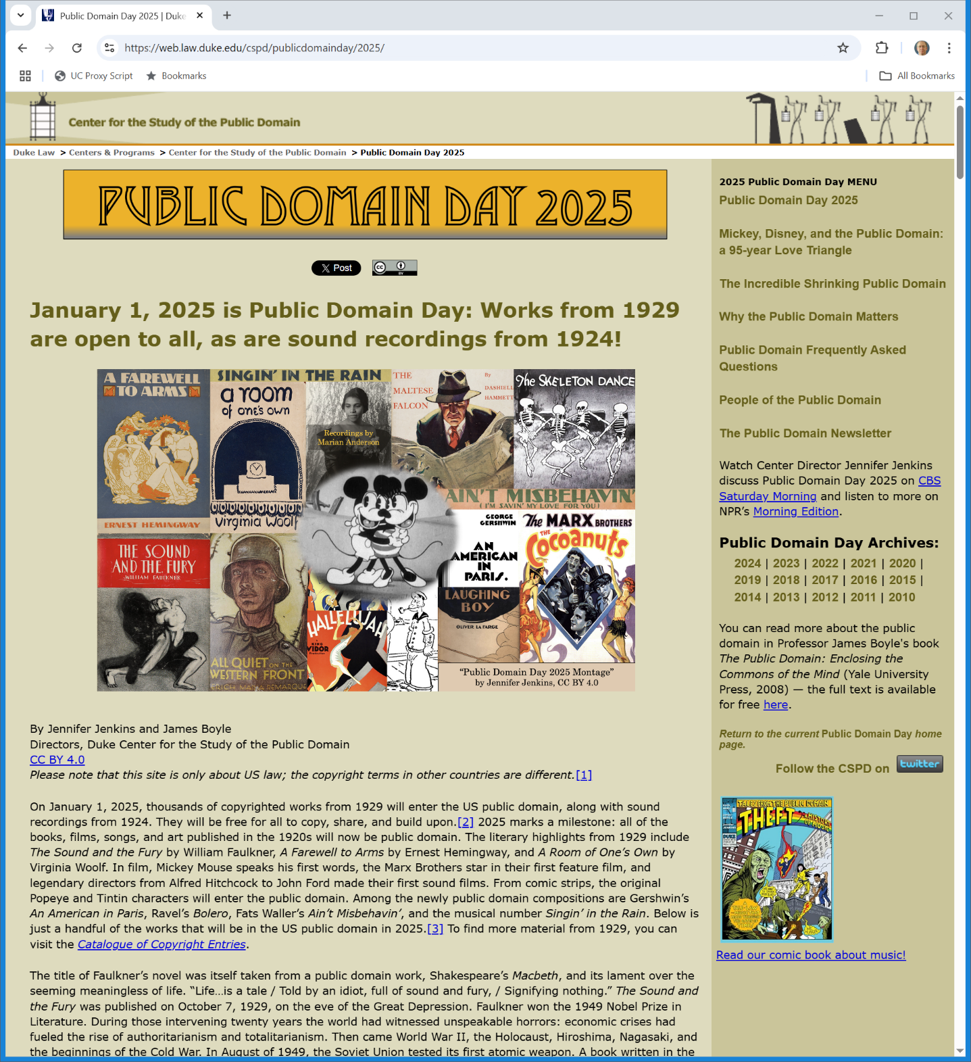
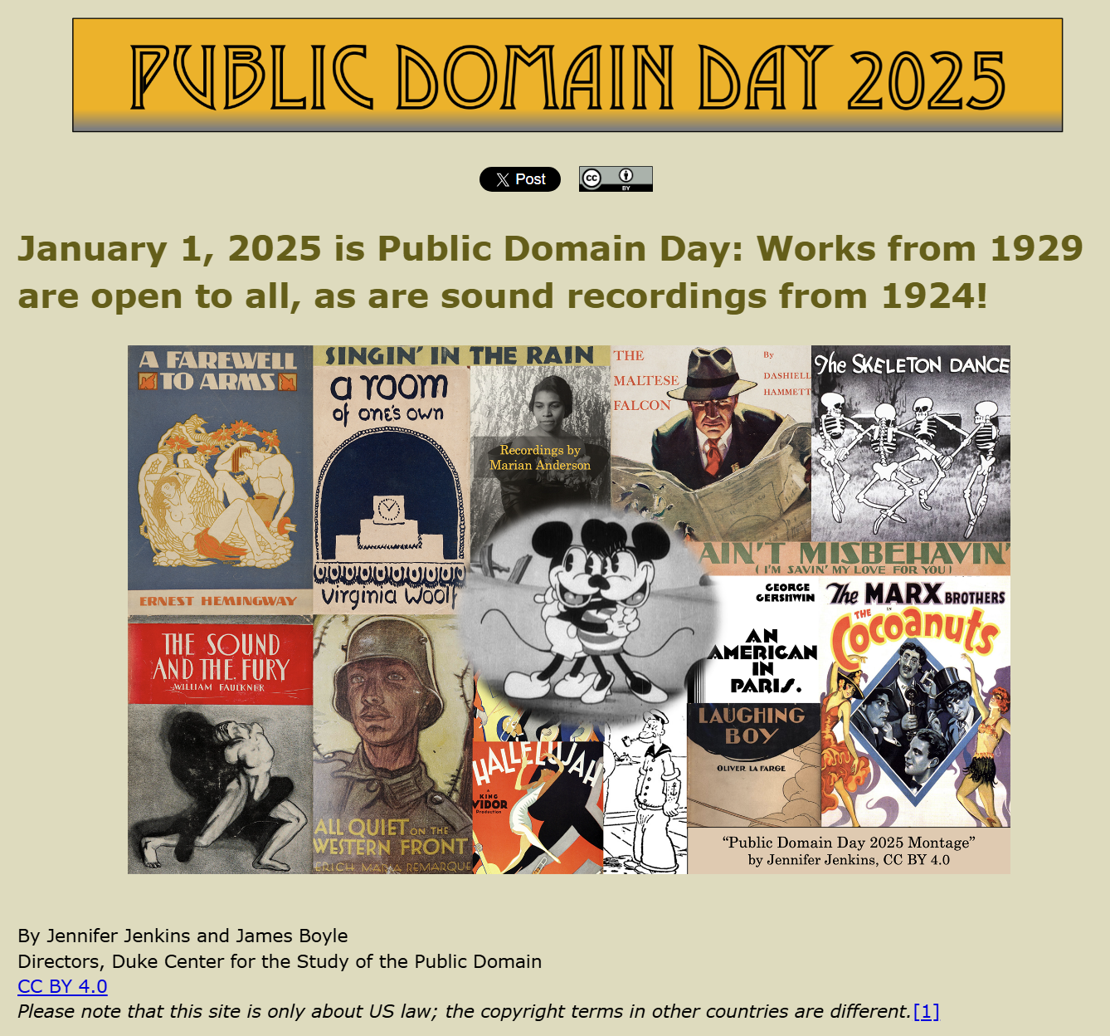
1 Jan 2025: Public Domain Expanded
Duke Law Public Domain (Visited 12 Apr 2025)
Notes:
https://web.law.duke.edu/cspd/publicdomainday/2025/

Slide 5
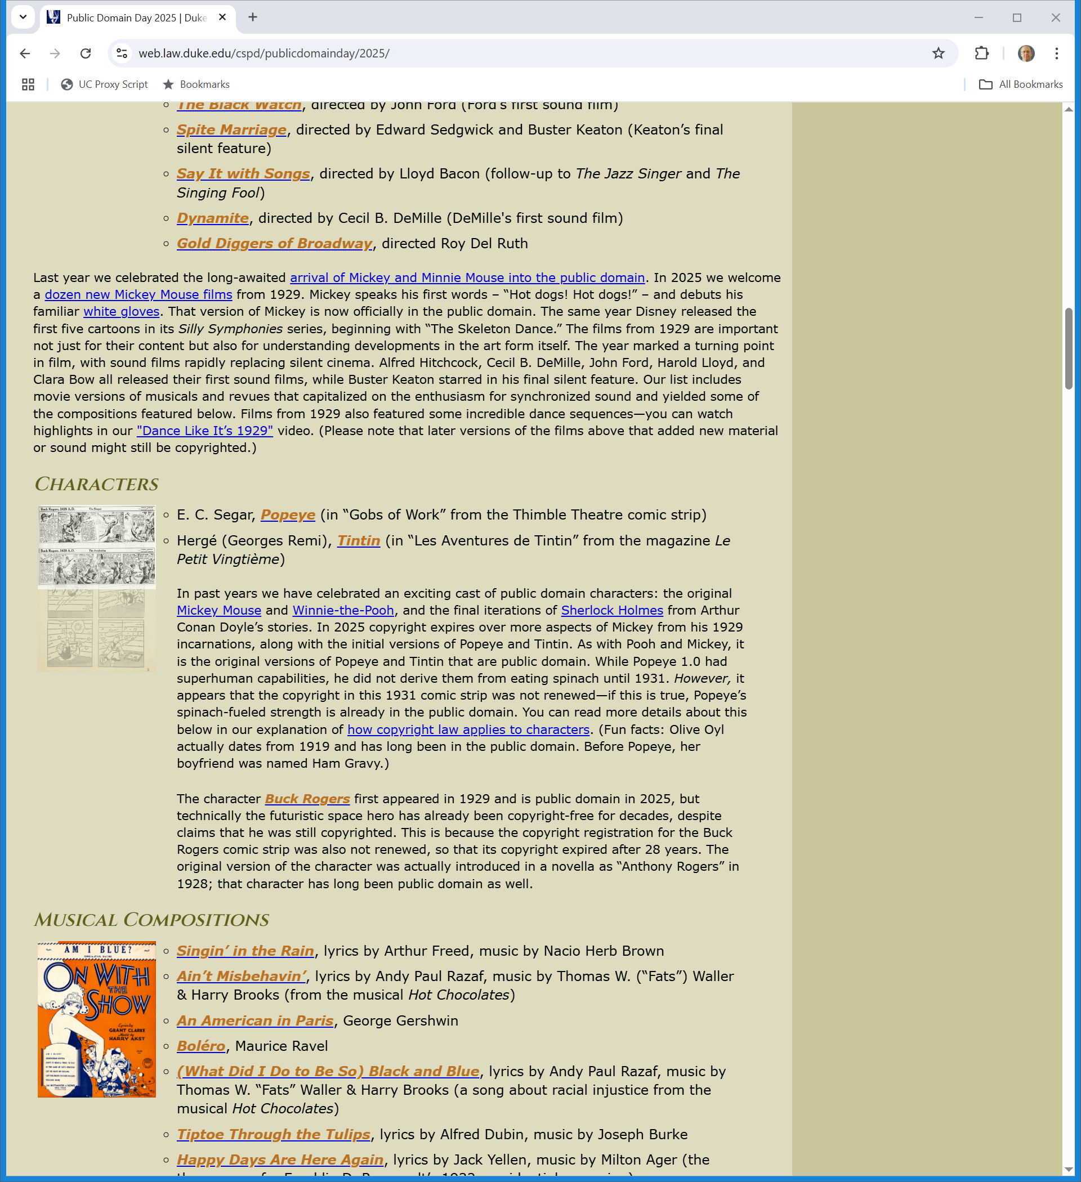
More Mickey
Duke Law Public Domain (Visited 12 Apr 2025)
Notes:
https://web.law.duke.edu/cspd/publicdomainday/2025/

Slide 6
Characters
Duke Law Public Domain (Visited 12 Apr 2025)
Notes:
https://web.law.duke.edu/cspd/publicdomainday/2025/

Slide 7
Buck Rogers and Non-Renewal
Duke Law Public Domain (Visited 12 Apr 2025)
Notes:
https://web.law.duke.edu/cspd/publicdomainday/2025/

Slide 8
Copyright Act of 1790
Act of First Congress (31 May 1790)

Slide 9
Duration: Two 14-Year Terms Possible; Term tied to Recording with Copyright Office
Act of First Congress (31 May 1790)

Slide 10
Duration: Two 14-Year Terms Possible (with 2nd Recording)
Act of First Congress (31 May 1790)

Slide 11
28 Year Initial Term in Copyright Act of 1831 (and still recording)
Act of 3 Feb 1831

Slide 12
1831 Act: 28 + 14 = 42 possible (with 2nd Recording)
Act of 3 Feb 1831

Slide 13
Duration under the 1831 Act
Key Features
  28 years duration from the time of recording of the copyright as provided in the act
  14-year renewal term possible with second recording

Slide 14
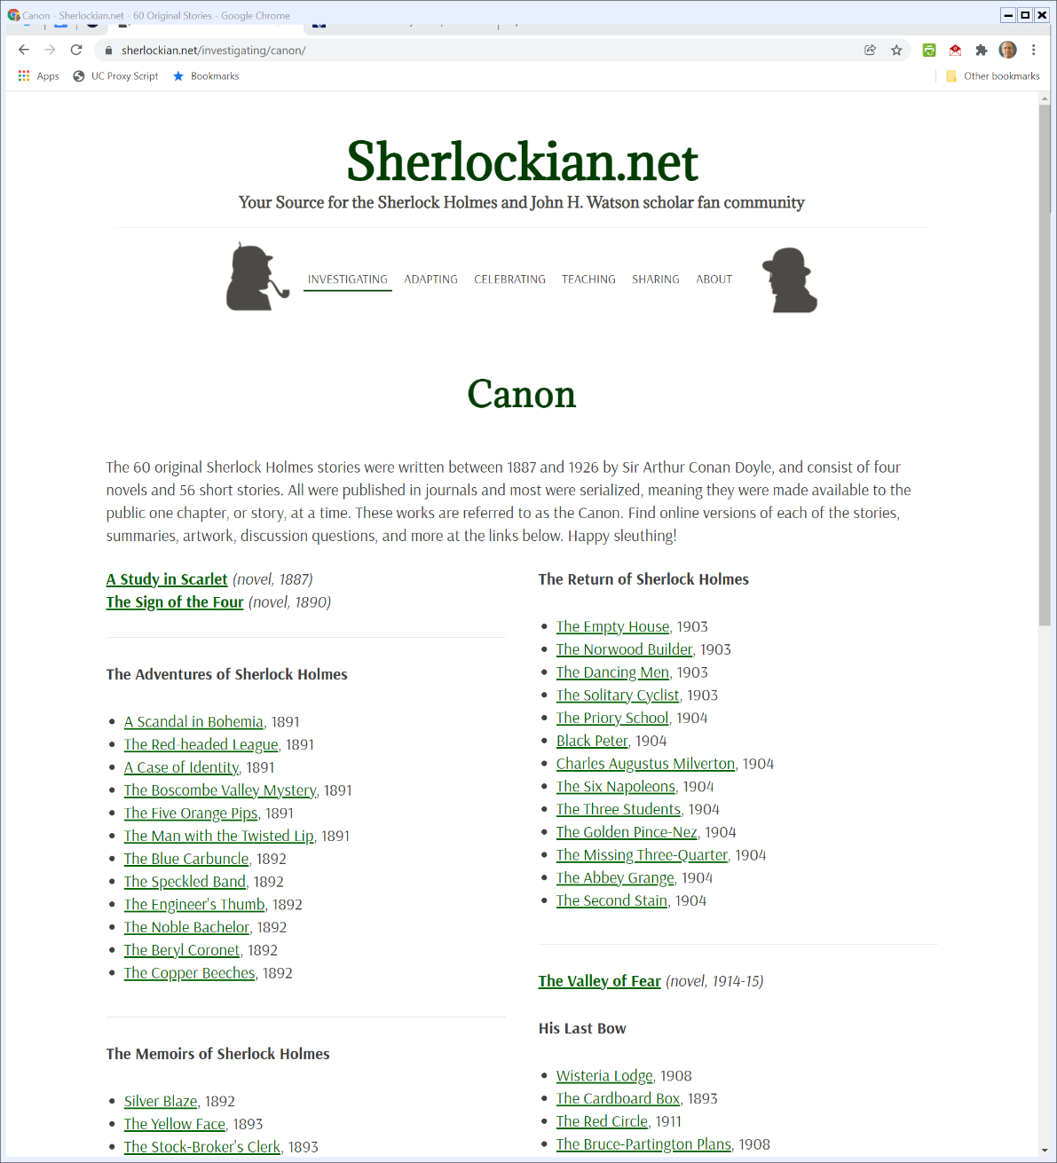
Doyle Born: 22 May 1859; Died: 7 July 1930
Sherlockian.net (Visited 28 Jan 2022)
Notes:
https://www.sherlockian.net/investigating/canon/

Slide 15
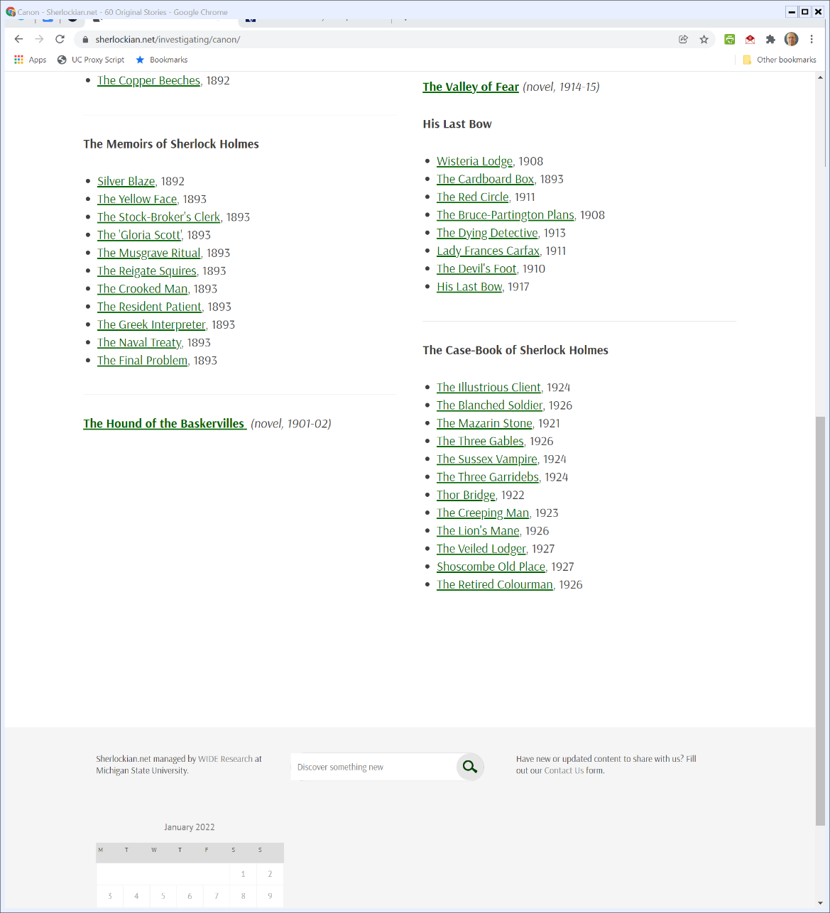
And More
Sherlockian.net (Visited 28 Jan 2022)
Notes:
https://www.sherlockian.net/investigating/canon/

Slide 16
Holmes and the Public Domain
The Current Statute
  Life of the author + 70 years
  Doyle died in 1930, so everything entered the public domain around 2000?
Not so fast

Slide 17
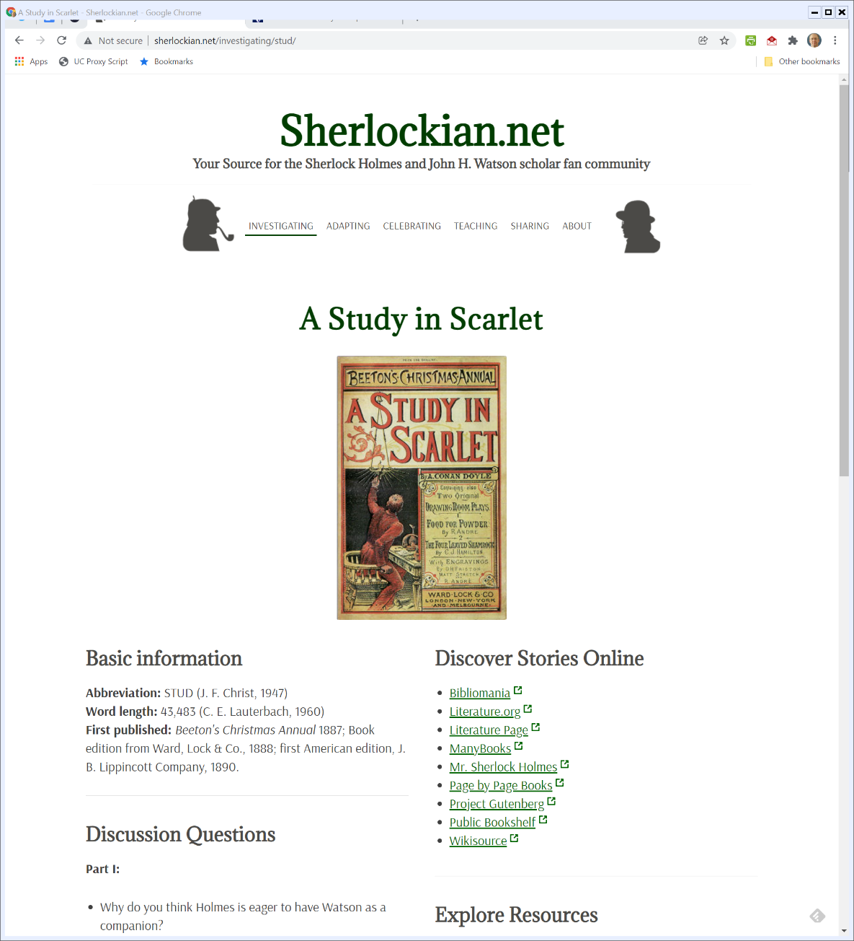

At the Start: A Study in Scarlet
Sherlockian.net (Visited 28 Jan 2022)
Notes:
https://www.sherlockian.net/investigating/canon/

Slide 18
A Study in Scarlet
Do the Numbers
  American Publication: 1890
  Assume appropriate initial copyright, then initial term 28 years and assume appropriate renewal for second 14-year term
  Should have entered the public domain in 1932

Slide 19
Copyright Act of 1909 (14 pages)
Act of 4 Mar 1909

Slide 20
1909 Act Duration: New Works: 28 + 28 = 56 (and tied to publication, not recording but note extension application)
Act of 4 Mar 1909

Slide 21
1909 Act Duration: Existing Works: Extended to Term of New Law
Act of 4 Mar 1909

Slide 22
Duration under the 1909 Act
Key Features
  Newly-Copyrighted Works
    Initial 28-year term from date of first publication
    Copyright could be forfeited if formalities weren’t met
    Second renewal term of an additional 28-years possible

Slide 23
Duration under the 1909 Act
Key Features
  Existing Works
    For works still in copyright, 56-year term extended to them depending on facts

Slide 24
A Study in Scarlet
Do the Numbers
  American Publication: 1890
  First 28-year term ends 1918, so in copyright at passage of 1909 Act
  Then eligible for second 28-year term under the 1909 Act
  Should have entered the public domain in say 1946 (and presumably did)

Slide 25
The Looming Public Domain
Approaching 1965
  1909 created 56-year duration, so 1909 + 56 would have meant works under 1909 Act would have started entering public domain
  Congress started studying this in 1955
  Extension expected but date uncertain; what to do?

Slide 26
Temporary Copyright Extensions
Pub. L. 87-668 (19 Sept. 1962)

Slide 27
Extensions of Existing Copyrights under 1909 Act
Add More Years
  Congress passed nine temporary extensions for existing works in anticipation of broader copyright legislation (the 1976 act)
Means works didn’t enter public domain

Slide 28
1976 Act: Life + 50 Key
H.R. 94-1476 (3 Sept 1976)

Slide 29
Before 1976: Publication, Initial Term, Renewal
H.R. 94-1476 (3 Sept 1976)

Slide 30
Too Short; And Serious Works Recognized Late
H.R. 94-1476 (3 Sept 1976)

Slide 31
Public Domain Still Pretty Pricy
H.R. 94-1476 (3 Sept 1976)

Slide 32
Death is Certain Event
H.R. 94-1476 (3 Sept 1976)

Slide 33
Renewal Is a Bad System
H.R. 94-1476 (3 Sept 1976)

Slide 34
Duration Under the 1976 Act
Key Event Shift
  Point of creation triggers copyright, not publication
For New Works Jan 1, 1978 and forward
  Life of the author + 50 years from the point of creation

Slide 35
Duration Under the 1976 Act
What about works in existence before Jan 1, 1978? Three categories:
  Already in the public domain
  Not in the public domain and not in the copyright system (e.g., created but unpublished)
  Already in the copyright system

Slide 36
Duration Under the 1976 Act
In the Public Domain? Stay in the Public Domain
  Sec. 103 of the 1976 Act: “This Act does not provide copyright protection for any work that goes into the public domain before January 1, 1978.”

Slide 37
Duration Under the 1976 Act
Sec. 303: Created but Unpublished
  Applies the new life + 50 from creation rule to these works with the proviso that can’t expire before Dec 31, 2002 and if published before then won’t expire before Dec 31, 2007

Slide 38
Duration Under the 1976 Act
Sec. 304: Already in the Copyright System
  Two further subcategories (but 75 years)
    Works in their first term
      Get original 28 year term and can renew for second term of 47 years (for a total copyright of 75 years)

Slide 39
Duration Under the 1976 Act
Sec. 304: Already in the Copyright System
  Works in their second term
      Second term extended so as to make total term 75 years.
  Amended in 1992 and 1998

Slide 40
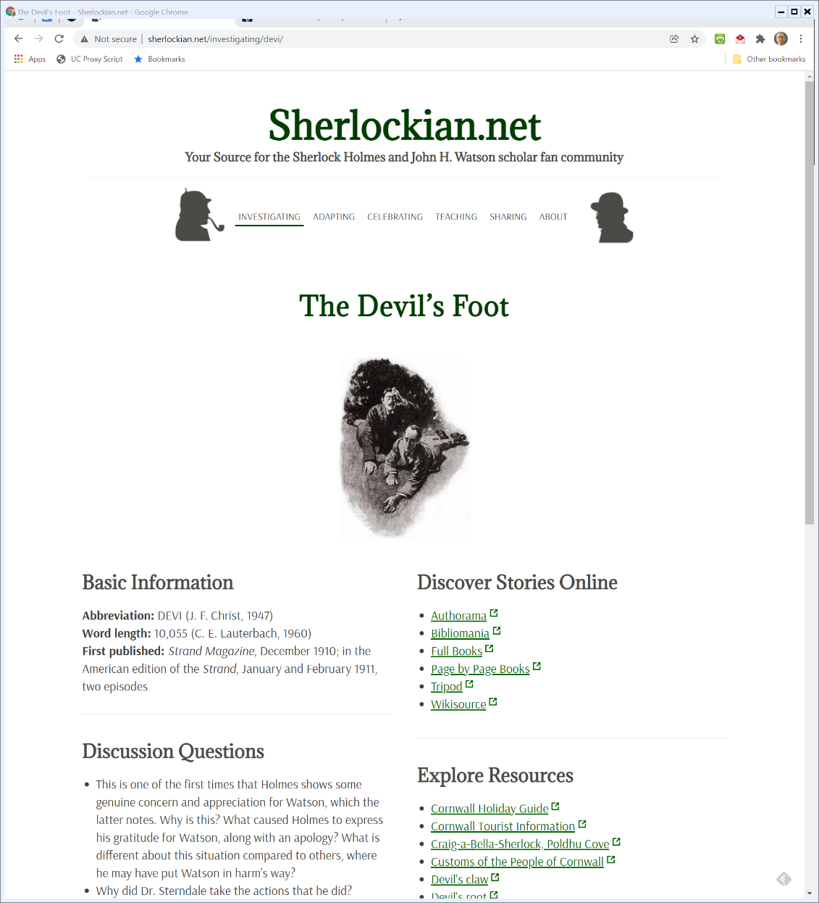

Post-1909 Act: The Devil’s Foot
Sherlockian.net (Visited 28 Jan 2022)
Notes:
https://www.sherlockian.net/investigating/canon/

Slide 41
The Devil’s Foot
Do the Numbers
  American Publication: 1911
  Assume appropriate initial copyright, then initial term 28 years
  Assume appropriate renewal for second 28 year term
  Should have entered the public domain in 1967

Slide 42
The Devil’s Foot
But Didn’t
  Interim extension statutes would have protected it
  Under 1976 Act, would have been in second term and received new regime total of 75 years from publication
Should then enter public domain in say 1986 (and, presumably, did so)

Slide 43
1909 Act Entry into the Public Domain
To Sum
  New works created under the 1909 act didn’t enter the public domain 56 years in
  Temporary extensions took those to the 1976 act
  That act moved those works to a 75 year term
  In 1984, 1909 act works start entering the public domain

Slide 44
Rolling Forward from 1984
Copyright Renewal Act of 1992
  Changed rules regarding renewal to match structure of the current statute
  304(a)(1) provides for automatic renewal for second term
  No longer required to file for second term of renewal

Slide 45
Rolling Forward from 1984
Copyright Renewal Act of 1992
  Works don’t enter the public domain through non-renewal
  1992 – 28 = 1964
    Works before 1964 could have failed to file for second term and if so would have entered the public domain

Slide 46
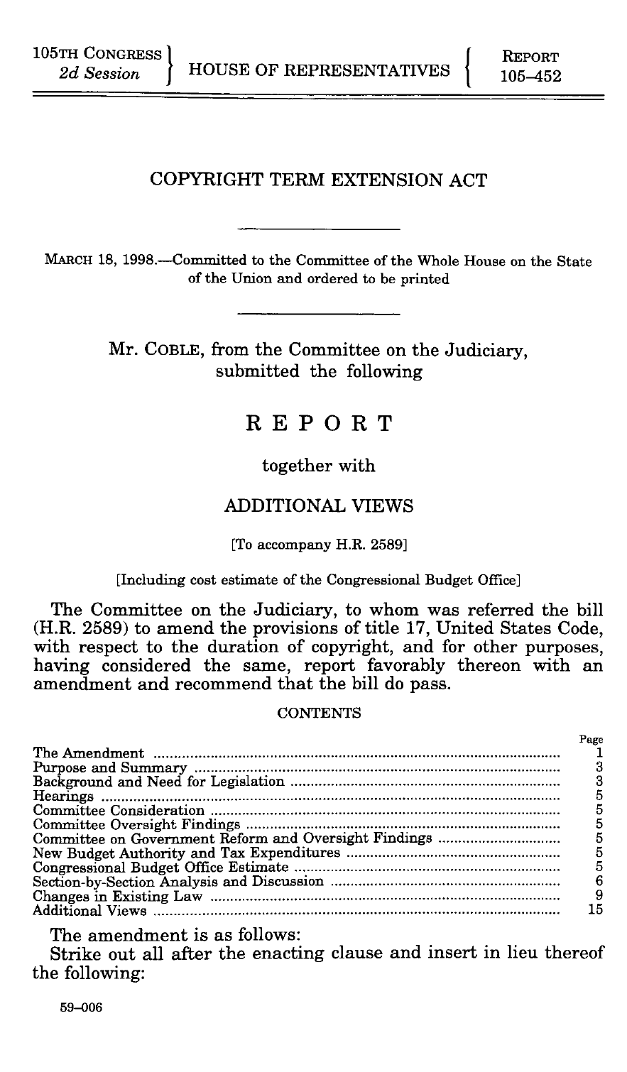
CTEA Legislative History
House Report (18 Mar 1998)

Slide 47
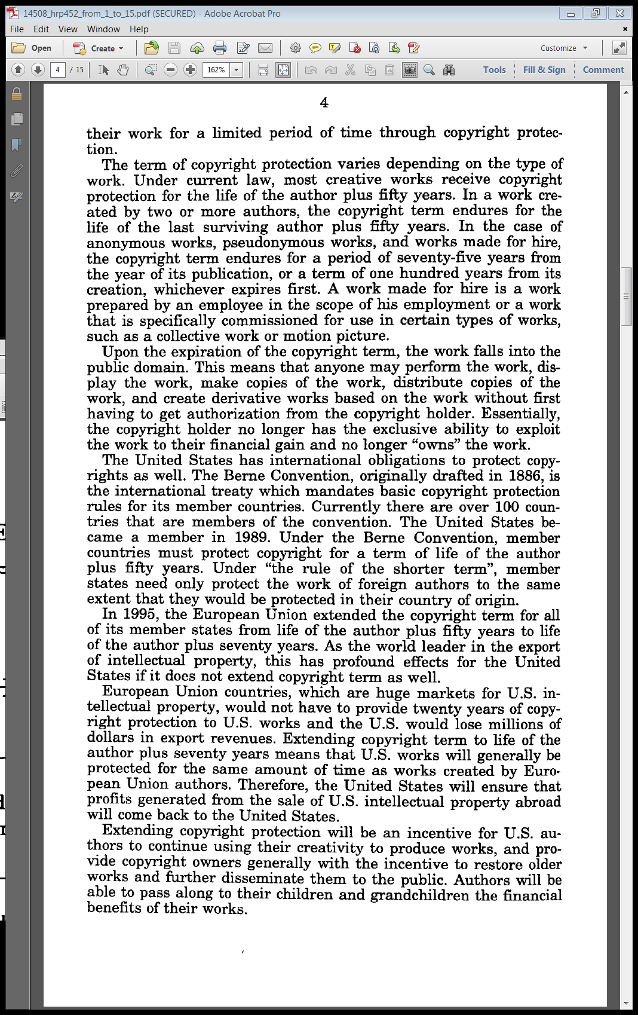
U.S. Treaty Obligations Under the Berne Convention
House Report (18 Mar 1998)

Slide 48
1995: EU Went to Life + 70; Doesn’t Have to Extend to U.S. works unless U.S. matches
House Report (18 Mar 1998)

Slide 49
Benefits of Extension?
House Report (18 Mar 1998)

Slide 50
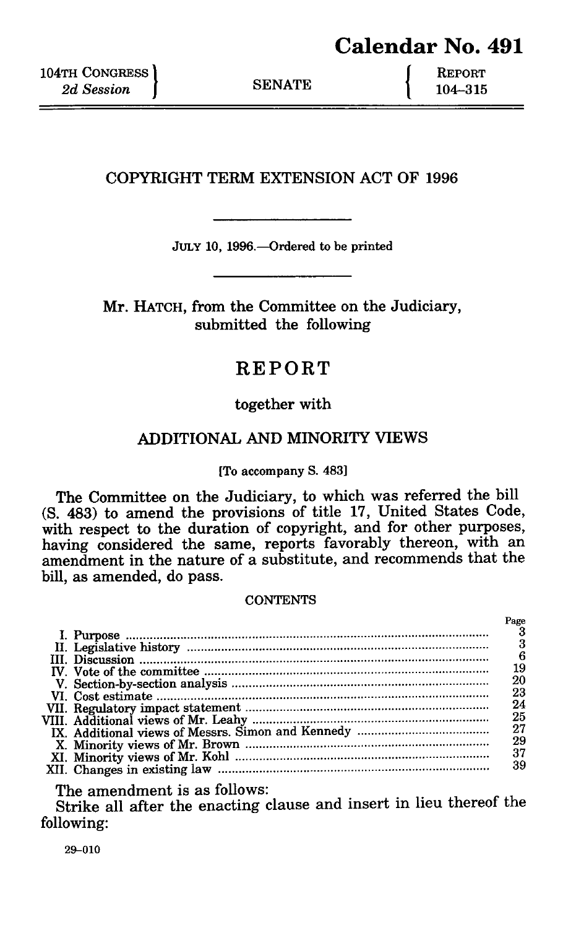
CTEA Legislative History
Senate Report (10 July 1996)

Slide 51
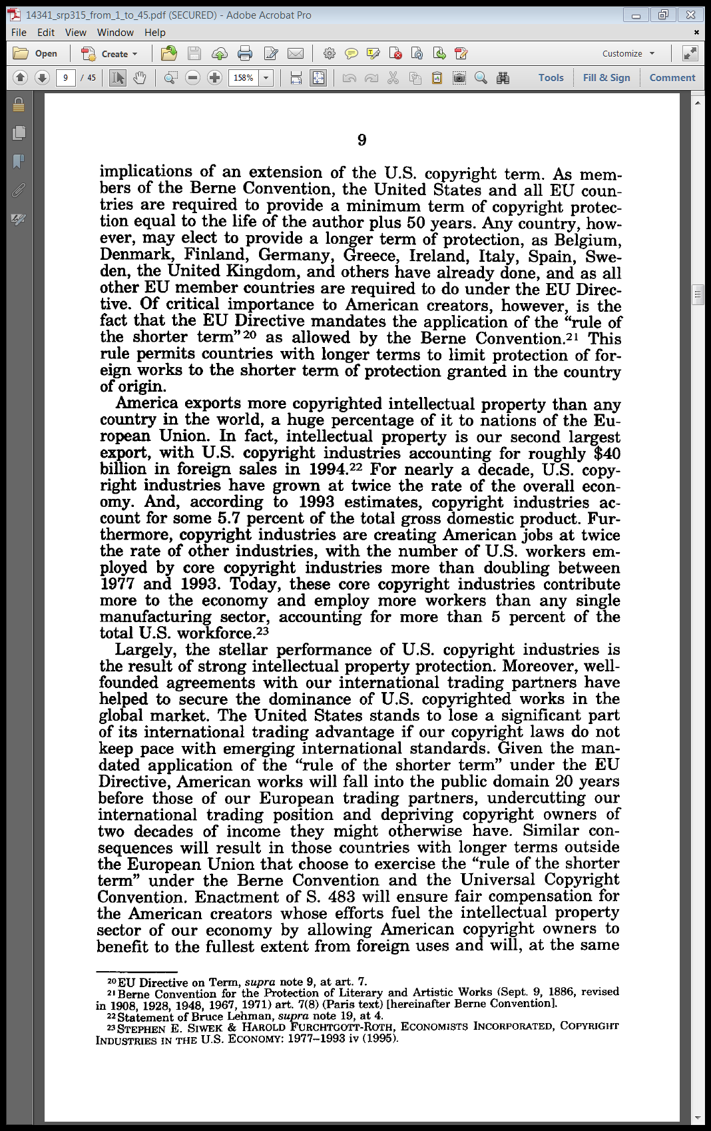
EU Rule of the Shorter Term
Senate Report (10 July 1996)

Slide 52
Importance of Copyright to U.S. Economy
Senate Report (10 July 1996)

Slide 53
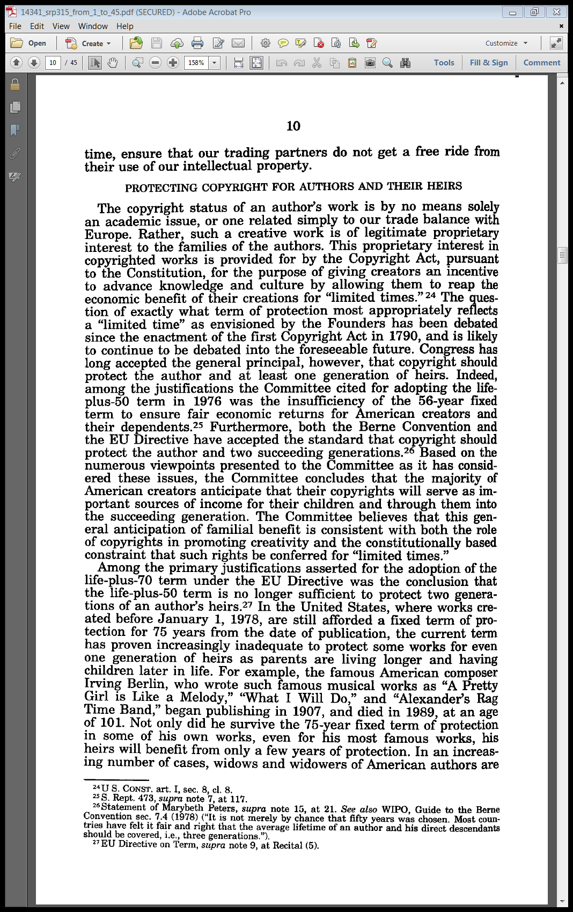
Think of the Children (and Their Children)
Senate Report (10 July 1996)

Slide 54
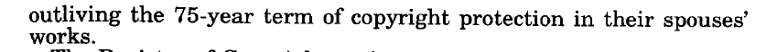
People Are Living a Long Time
Senate Report (10 July 1996)

Slide 55
1998: 20 More Years
Sony Bono CTEA (27 Oct 1998)

Slide 56
Rolling Forward from 1984
Copyright Term Extension Act of 1998
  Added twenty years to duration for works still in copyright
  Applied on going forward basis and to preexisting works

Slide 57
Rolling Forward from 1984
Copyright Term Extension Act of 1998
  For 14 years—1984 to 1998—works exited copyright and entered the public domain
  This covers works from 1909 to before 1923 (1998 - 75)
    75-year term in place prior to passage of CTEA would have expired for works published prior to 1923

Slide 58
Rolling Forward from 1984
Copyright Term Extension Act of 1998
  95 years is the new magic number for pre-1976 Act works
Take a simple example
  Book published on 2 Jan 1926. Gets 95 years, so expired on 2 Jan 2021? Not quite: the Sec 305 wrinkle

Slide 59
Sec. 305: Terminal Date
“All terms of copyright provided by sections 302 through 304 run to the end of the calendar year in which they would otherwise expire.”
17 USC 305

Slide 60
Rolling Forward from 1984
Take a simple example:
  Book published on, say, 2 Jan 1926. Gets 95 years, so expired on 2 Jan 2021?
  Not quite: the Sec 305 wrinkle
  Under 305, duration for this book expired on 31 Dec 2021
  Went into public domain on 1 Jan 2022

Slide 61
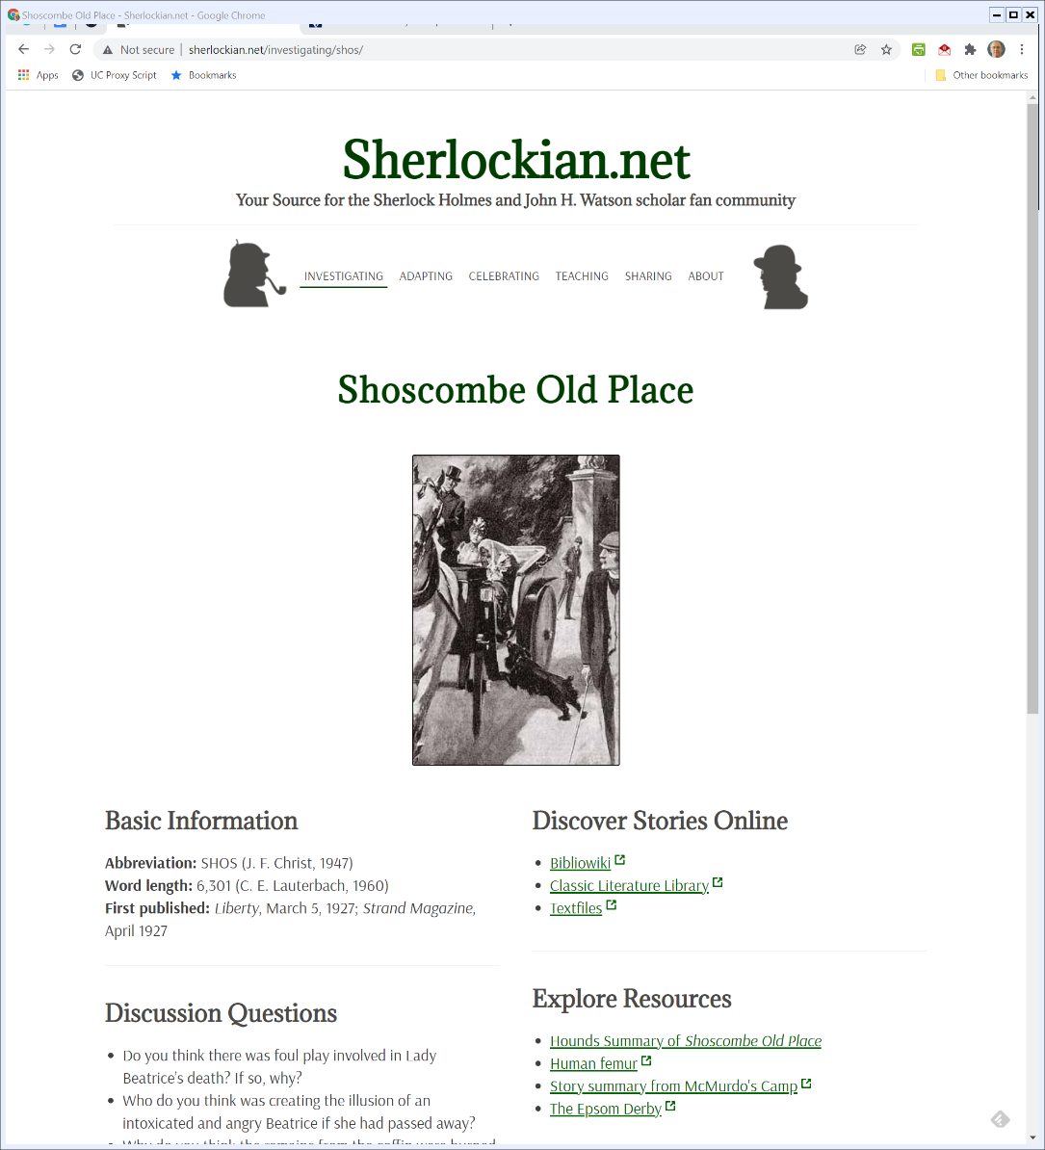
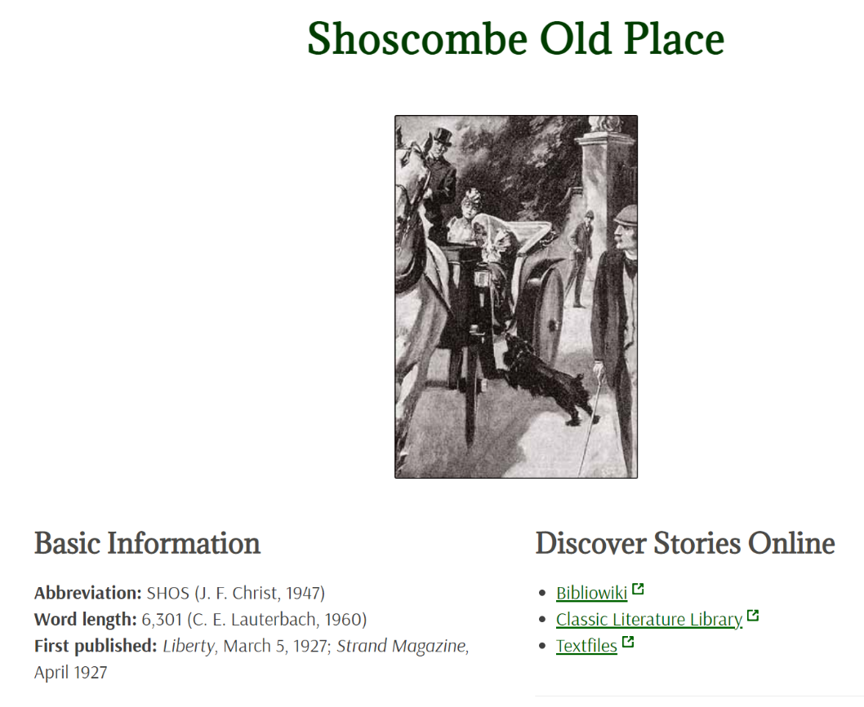
1927: Shoscombe Old Place
Sherlockian.net (Visited 28 Jan 2022)
Notes:
https://www.sherlockian.net/investigating/canon/

Slide 62
Shoscombe Old Place
Do the Numbers
  American Publication: Say 1927
  Assume appropriate initial copyright, then initial term 28 years
  Assume appropriate renewal for second 28 year term
  1927 + 56 = 1983

Slide 63
Shoscombe Old Place
  Still in copyright on Jan 1, 1978, effective date of 1976 Act
  That means triggered revised 75-year period
  1927 + 75 = 2002
  But still alive at time of CTEA, so another 20 years = 2022 (31 Dec 2022 per Sec. 305)

Slide 64
Shoscombe Old Place
  Doyle (estate really) gets 95 years from date of publication so until 1 Jan 2023
  Doyle died in 1930, so had life + 70 date from time of creation run over the enter time all of Doyle would have entered public domain on 1 Jan 2001
  Extensions plus switch in metric (terms of years vs lifespan of author) really extended this out

Slide 65
Klinger (CA7 2014)
755 F.3d 596 (7th Cir. 2014)

Slide 66
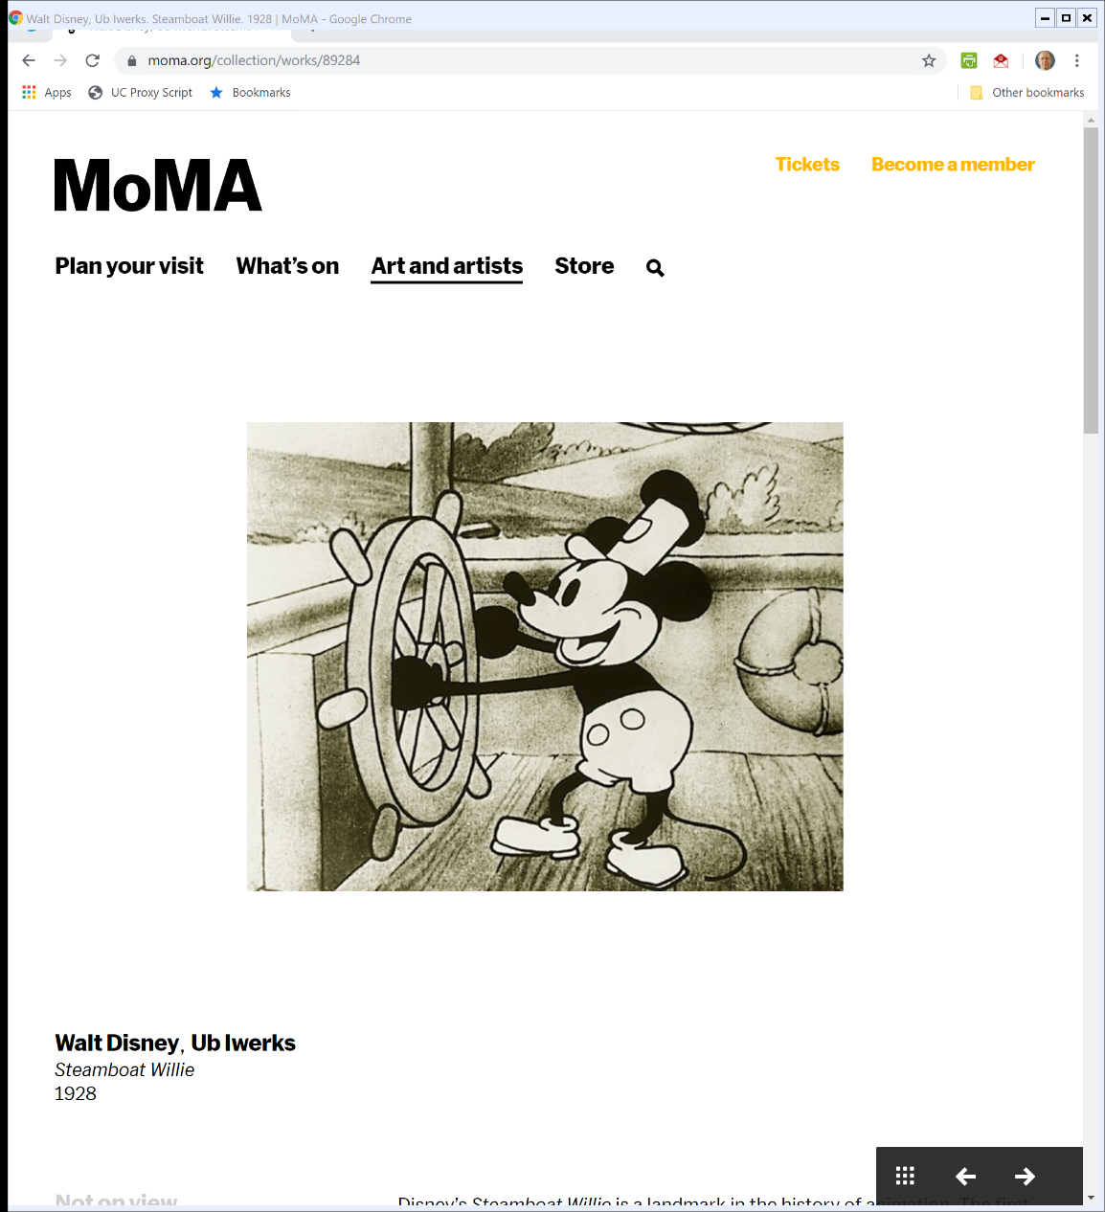
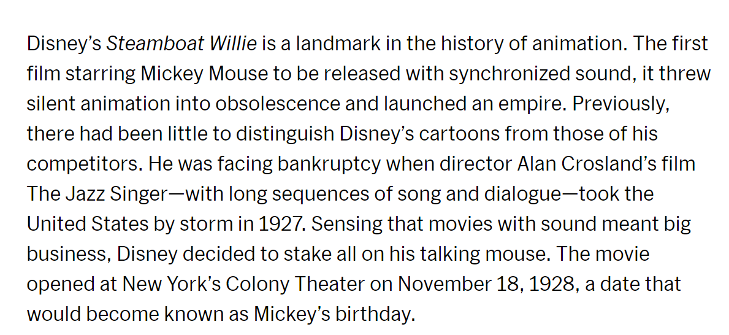
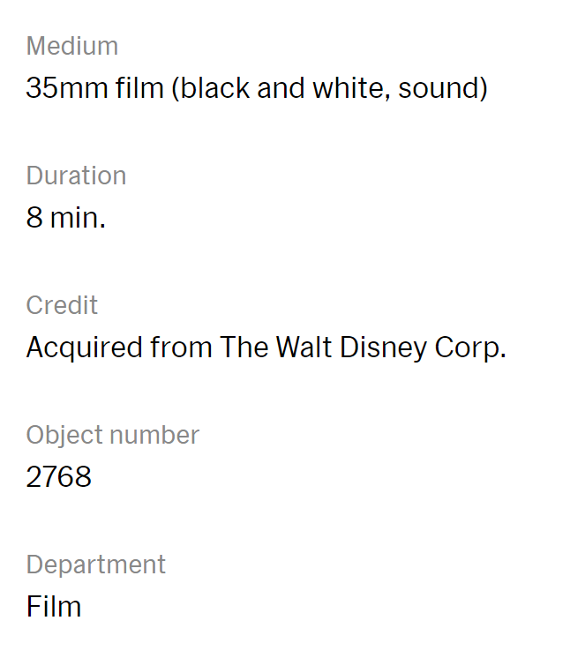
18 Nov 1928: Steamboat Willie
MoMA

Slide 67
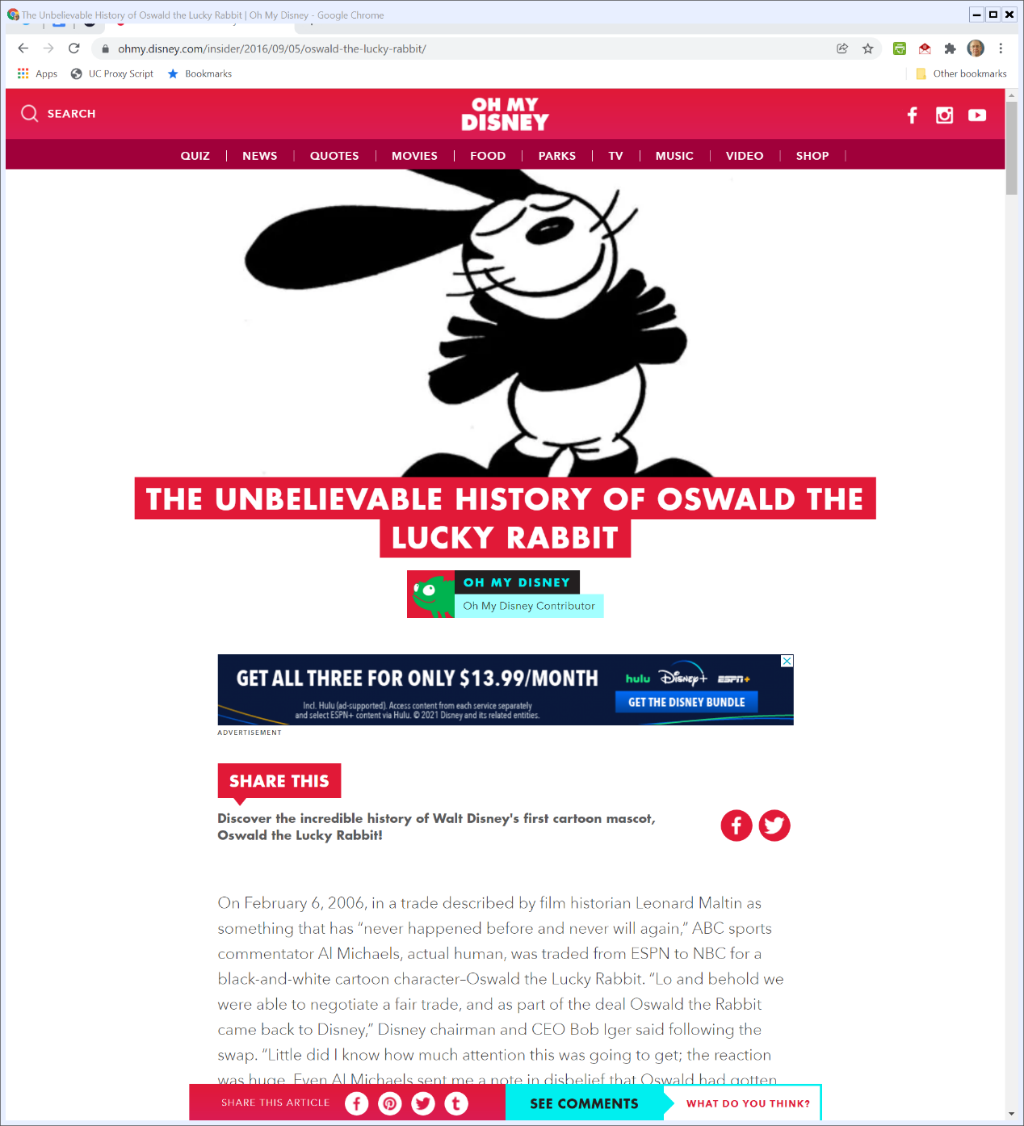
Oswald the Lucky Rabbit
Disney.com (Visited on 31 Jan 2022)
Notes:
https://ohmy.disney.com/insider/2016/09/05/oswald-the-lucky-rabbit/

Slide 68
Constitution
The Congress shall have the Power . . .
  To promote the progress of science and the useful arts, by securing for limited times to authors and inventors the exclusive right to their respective writings and discoveries;
  (Art. I, § 8, cl. 8)

Slide 69
Duration
Starting Questions
  What is the right duration looking forward?
  What is the right way to structure duration?
  Under what circumstances, if any, should we want Congress to extend duration for existing works?
  Does Congress have the power to do that?

Slide 70
Eldred (U.S. 2003) (7-2)
537 U.S. 1986 (2003)

Slide 71
Early Breyer
Breyer (HLR 1970)

Slide 72
Longer Terms Won’t Induce More Effort
Breyer (HLR 1970)

Slide 73
Longer Terms Won’t Induce More Effort
Breyer (HLR 1970)

Slide 74
One-Period Present Value
Numbers
  10% interest rate
  From Today to Tomorrow
    $1 today is worth $1.10 one year from now
  From Tomorrow to Today
    $1.10 one year from now is worth $1 today

Slide 75
One-Period Present Value
Formulas

Slide 76
Two-Period Present Value
Numbers
  From Today to Tomorrow to The Period After Tomorrow
    $1 today—present value—is worth $1.10 one year from now, is worth 1.21 two years from now
  From Two Years from Now to Today
    A future value of $1.21 two years from now is worth $1 today

Slide 77
Two-Period Present Value
Formulas

Slide 78
Two-Period Stream
Question
  What is $1.10 one year from now + $1.21 two years from now worth today?
We have done this already!
  $1.10 one year from now is worth $1 today
  $1.21 two years from now is worth $1 today
  Together, they are worth $2 today

Slide 79
Two-Period Stream Again
Question
  What is $1 one year from now + $1 two years from now worth today?
Answer
  $1/1.1 + $1/1.21 = 1.735

Slide 80
N-Period Stream
Assumptions
  Stream will pay fixed amount C in every period
  One-period interest rate r is same in every period
What is the formula that tells us the present value of a stream of N periodic payments of C?

Slide 81
N-Period Stream
Formula

Slide 82
Forever Period Stream
Formula

Slide 83
Do the Numbers
Assumptions
  C = $100
  R = 10% (0.1)
Value Today of $100 a Year Forever
  $1000
Value Today of $100 a Year for Fifty-Five Years
  $994.71

Slide 84
Do the Numbers
Value Today of $100 a Year for Years 56 to Forever
  $5.29

Slide 85
Benefits of Public Domain
Increased consumptive use
Increased productive use
  Eliminates coordination costs of licensed use: can be difficult to know who to license from
  Reduces price for licensed use

Slide 86
Eldred
Core Facts
  Congress passes the Copyright Term Extension Act adding 20 years to copyrights
  Applies both for new copyrighted works and existing copyrighted works
  Eldred challenges the extension as unconstitutional for existing works as violative of Copyright Clause and 1st Amendment

Slide 87
Copyright Clause
What does “for limited Times” mean if Congress can extend existing copyrights?
  What limits the power to do that?
  How is Congress promoting science and the useful arts in extending the duration of existing works?

Slide 88
First Amendment
Does increased control over expression interfere with the First Amendment?

Slide 89
The Scope of the Public Domain
“As we said in Harper & Row, this ‘idea/expression dichotomy strike[s] a definitional balance between the First Amendment and the Copyright Act by permitting free communication of facts while still protecting an author’s expression.’ 471 U.S., at 556 (internal quotation marks omitted). Due to this distinction, every idea, theory, and fact in a copyrighted work becomes instantly available for public exploitation at the moment of publication. See Feist, 499 U.S., at 349-350.”
Eldred (U.S. 2003)

Slide 90
The Scope of the Public Domain
“Second, the ‘fair use’ defense allows the public to use not only facts and ideas contained in a copyrighted work, but also expression itself in certain circumstances.”
Eldred (U.S. 2003)

Slide 91
Stevens Dissent on Expectations of the Members of the Public
“Neither the purpose of encouraging new inventions nor the overriding interest in advancing progress by adding knowledge to the public domain is served by retroactively increasing the inventor’s compensation for a completed invention and frustrating the legitimate expectations of members of the public who want to make use of it in a free market.”
Eldred (U.S. 2003)

Slide 92
Stevens Dissent on Expectations of the Members of the Public
“Because those twin purposes provide the only avenue for congressional action under the Copyright/Patent Clause of the Constitution, any other action is manifestly unconstitutional.”
Eldred (U.S. 2003)

Slide 93
Breyer Dissent on Economics of Duration
“No potential author can reasonably believe that he has more than a tiny chance of writing a classic that will survive commercially long enough for the copyright extension to matter. After all, if, after 55 to 75 years, only 2% of all copyrights retain commercial value, the percentage surviving after 75 years or more (a typical pre-extension copyright term)-must be far smaller..”
Eldred (U.S. 2003)

Slide 94
Breyer Dissent on Economics of Duration
“And any remaining monetary incentive is diminished dramatically by the fact that the relevant royalties will not arrive until 75 years or more into the future, when, not the author, but distant heirs, or shareholders in a successor corporation, will receive them.”
Eldred (U.S. 2003)

Slide 95
Breyer Dissent on Economics of Duration
“Using assumptions about the time value of money provided us by a group of economists (including five Nobel prize winners), it seems fair to say that, for example, a 1% likelihood of earning $100 annually for 20 years, starting 75 years into the future, is worth less than seven cents today.”
Eldred (U.S. 2003)

Slide 96
And the Appendix
Eldred (U.S. 2003)

