Slide 1
Class 9: Mon 14 Apr 2025: 8:30 am Copyright Spring 2025 First-Sale Doctrine
Randal C. Picker
James Parker Hall Distinguished Service Professor of Law
The Law School
The University of Chicago

Slide 2
Key Questions for Today
Issues/Questions
How does copyright matter for the sharing of books? At any particular time or over time?
Publishers will be interested in geographic separation of copyrighted works to price discriminate. Can they do that consistent with U.S. copyright law?

Slide 3
Organizing Secondary Markets
Three Situations Involving Shared Objects/Works
One owner, many users: libraries
One owner, many users: rental markets
Sequential ownership: used books

Slide 4
Role of Libraries in Sharing and Use
17 USC 108

Slide 5
Pretty Detailed
17 USC 108

Slide 6
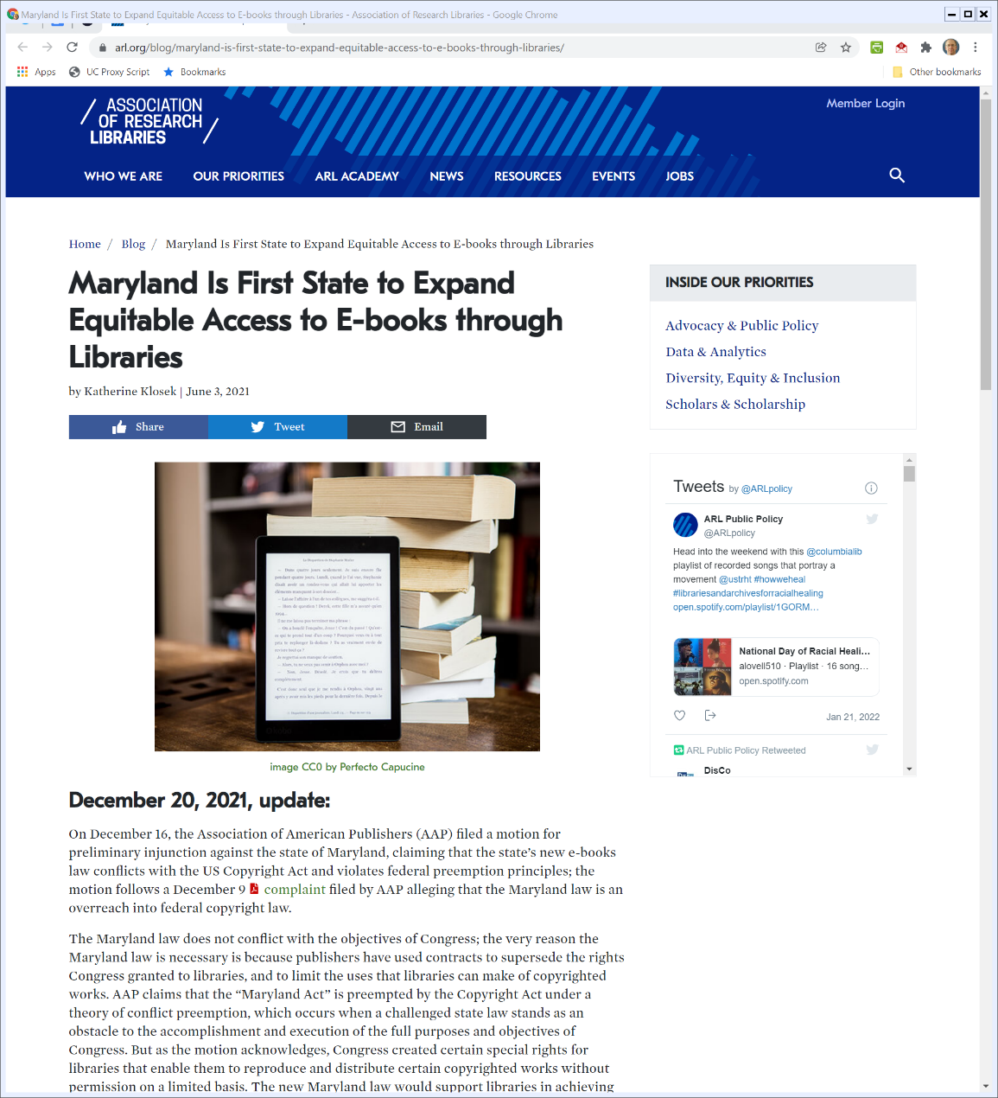
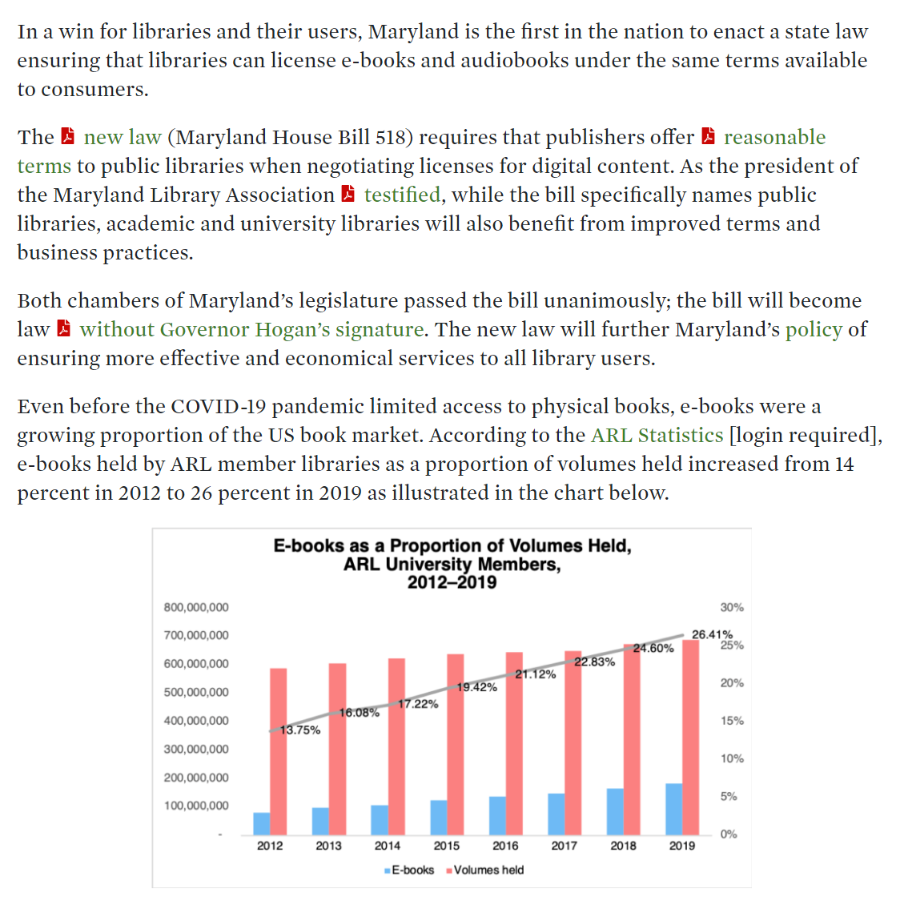
State E-Book Statutes and Libraries
Association of Research Libraries (20 Dec 2021)
Notes:
https://www.arl.org/blog/maryland-is-first-state-to-expand-equitable-access-to-e-books-through-libraries/

Slide 7
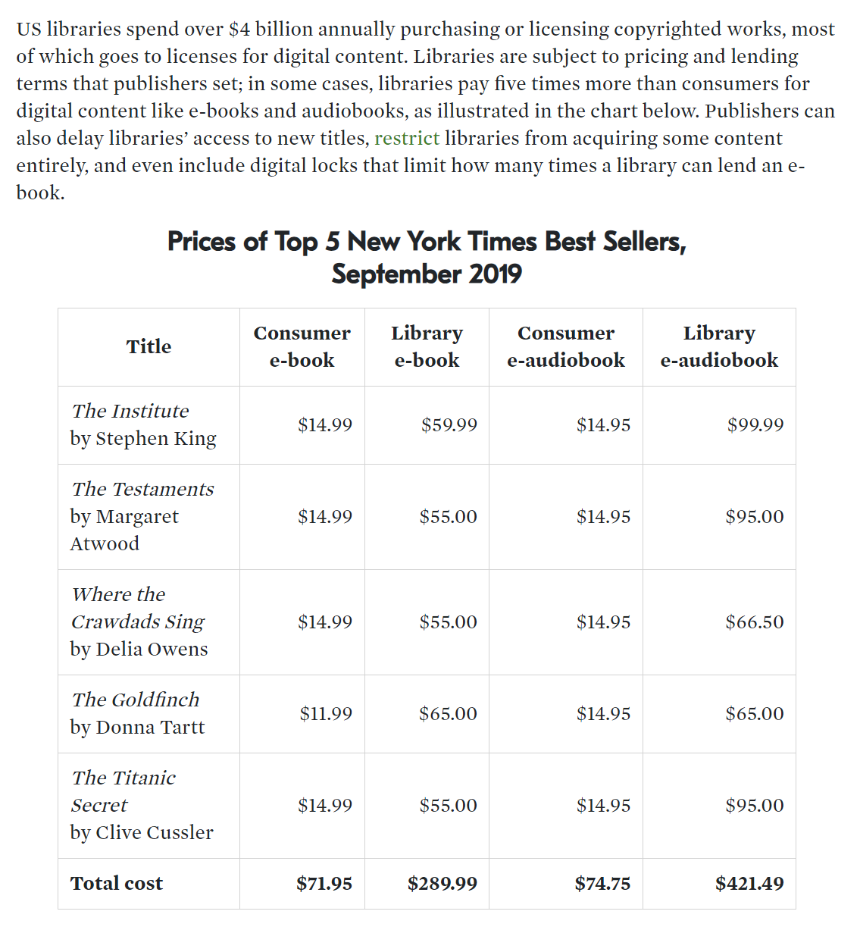
State E-Book Statutes and Libraries
Association of Research Libraries (20 Dec 2021)
Notes:
https://www.arl.org/blog/maryland-is-first-state-to-expand-equitable-access-to-e-books-through-libraries/

Slide 8
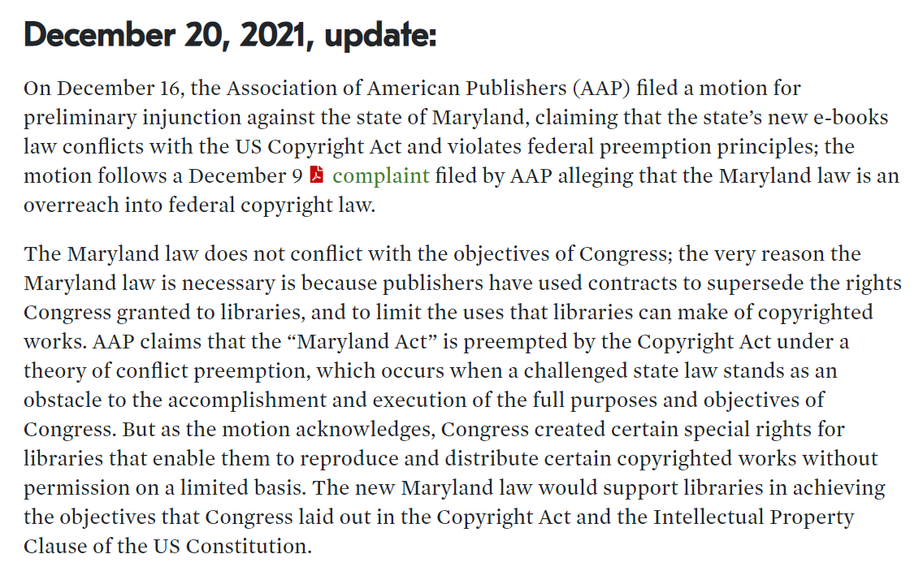
State E-Book Statutes and Libraries
Association of Research Libraries (20 Dec 2021)
Notes:
https://www.arl.org/blog/maryland-is-first-state-to-expand-equitable-access-to-e-books-through-libraries/

Slide 9
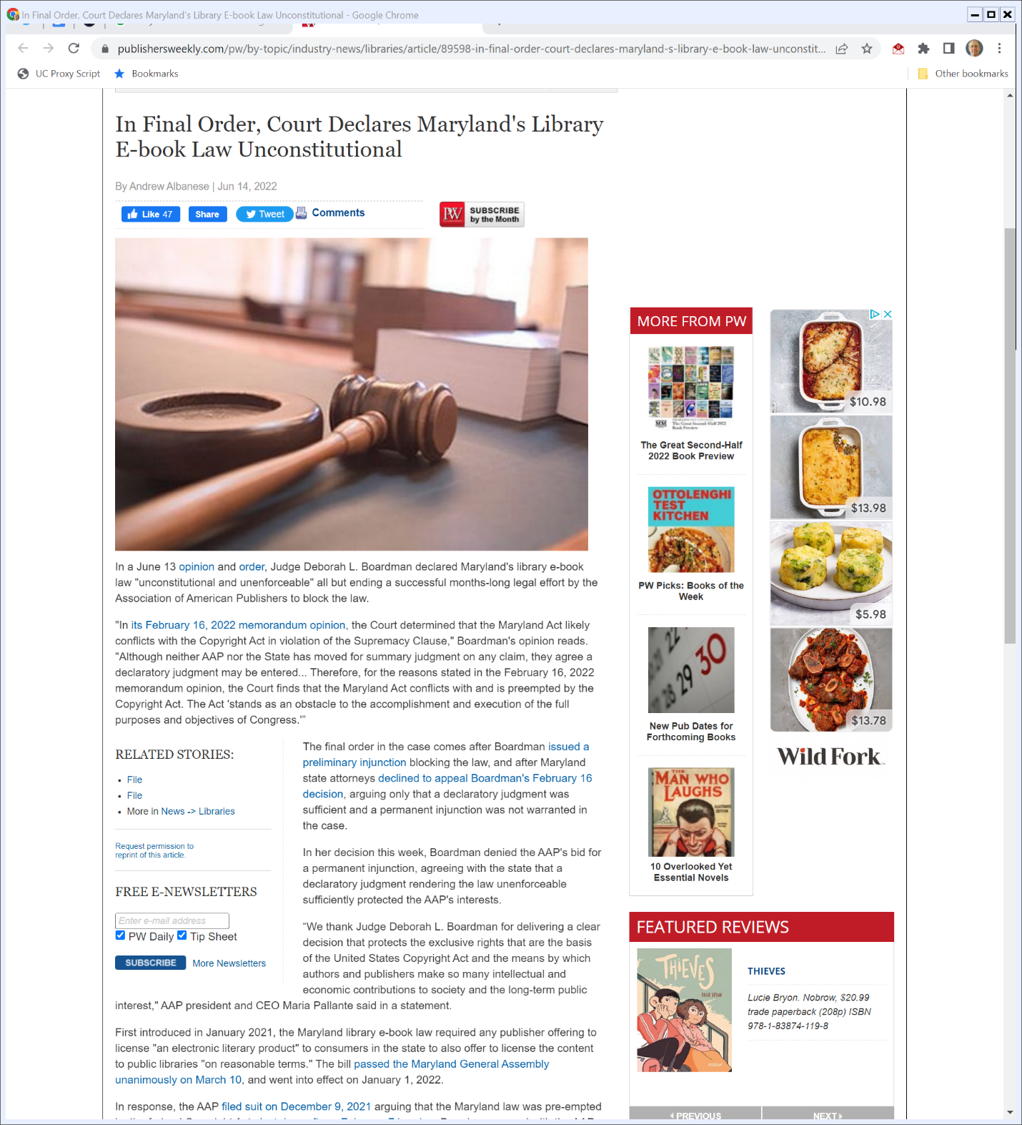

Unconstitutional
Publishers Weekly (14 June 2022)
Notes:
https://www.publishersweekly.com/pw/by-topic/industry-news/libraries/article/89598-in-final-order-court-declares-maryland-s-library-e-book-law-unconstitutional.html

Slide 10


Wiley eTextbooks
Inside Higher Ed (28 Sept 2022)
Notes:
https://www.insidehighered.com/news/2022/09/28/publisher-blocks-access-ebooks-students-faculty-scramble

Slide 11
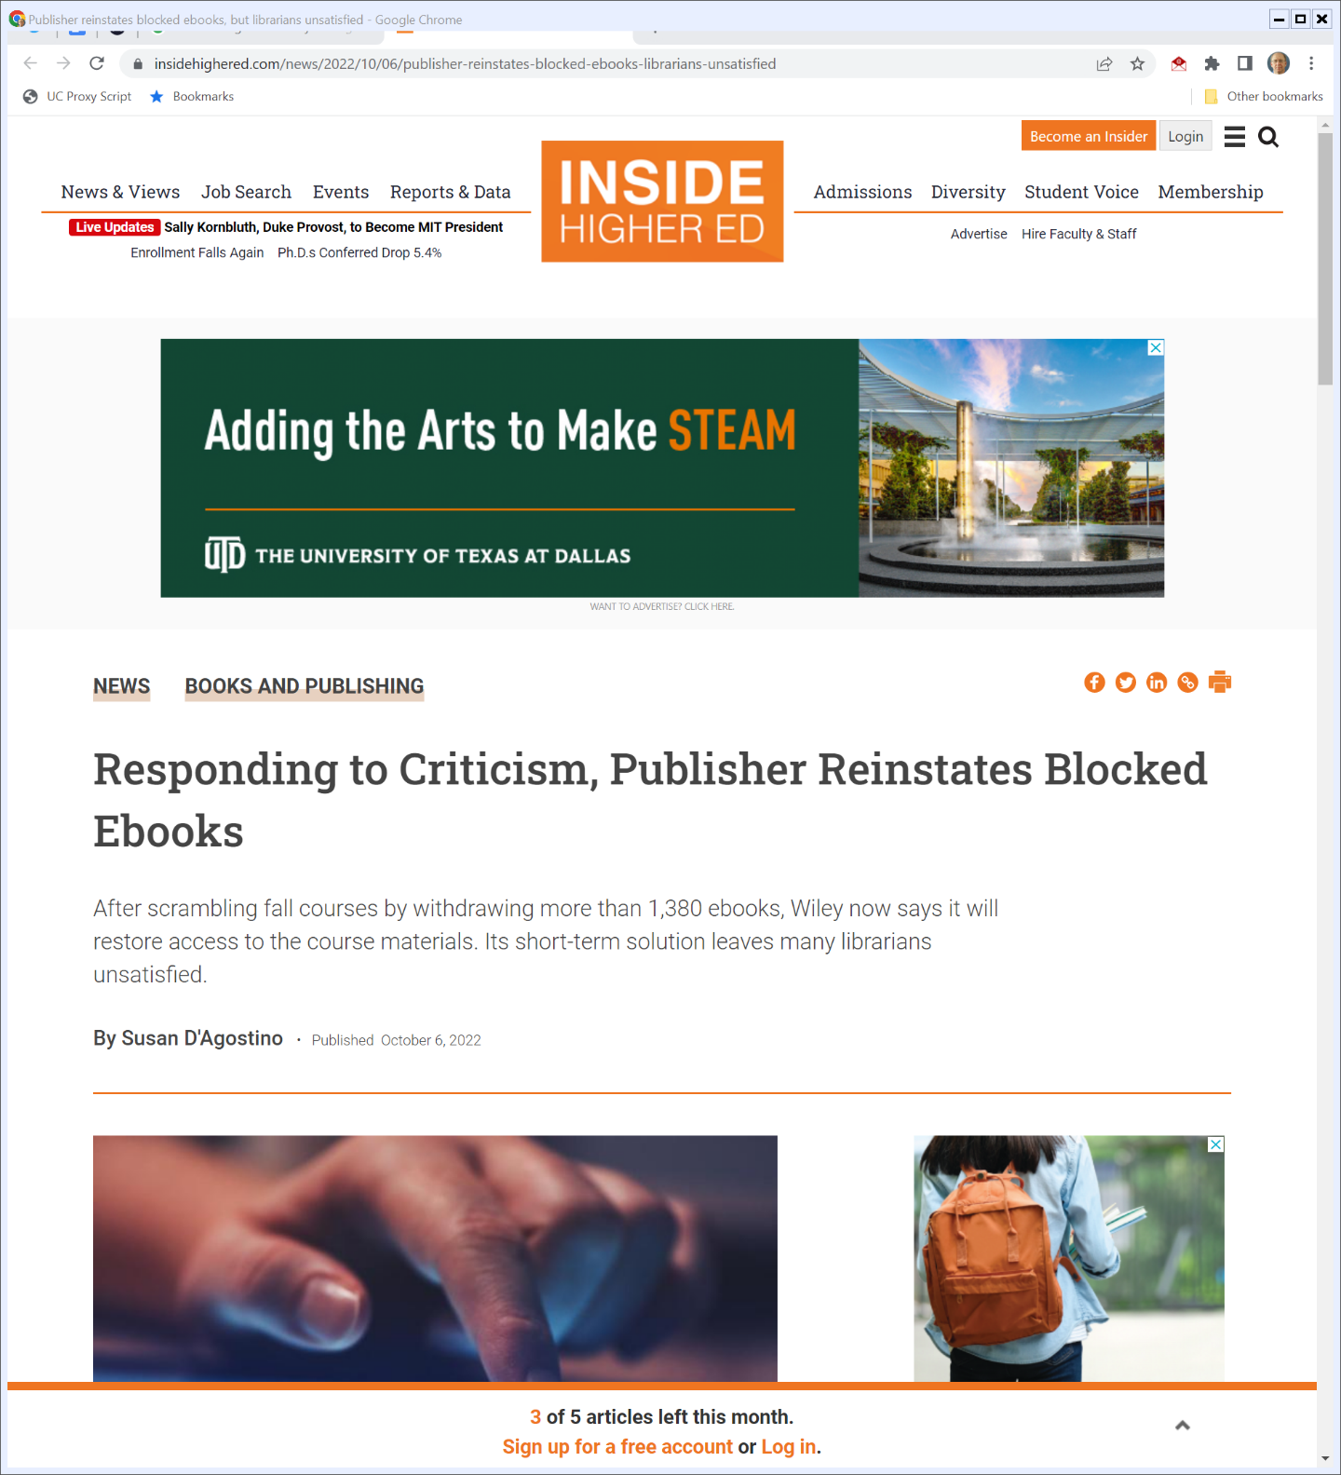
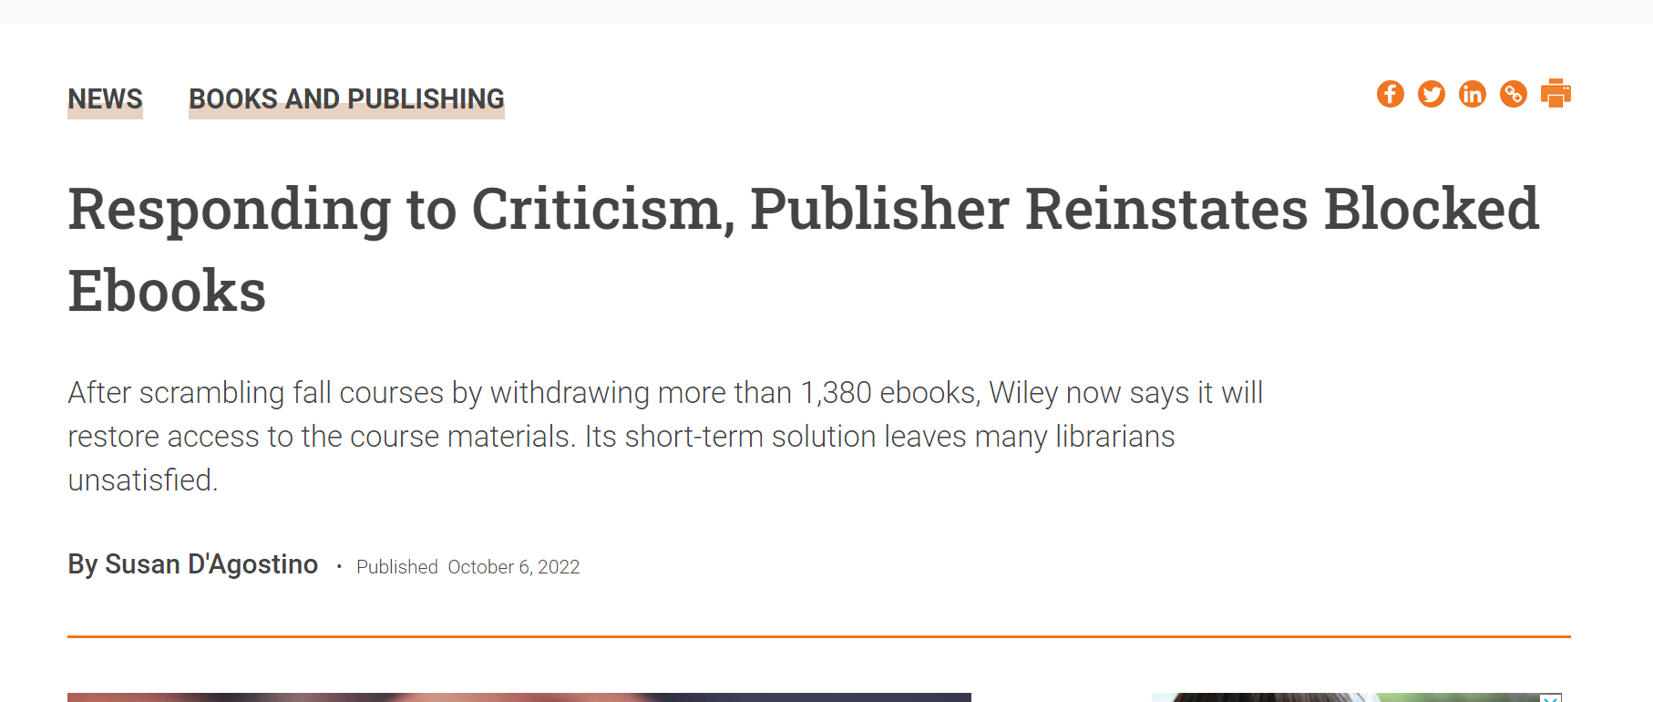
And Then Wiley Caved
Inside Higher Ed (6 Oct 2022)
Notes:
https://www.insidehighered.com/news/2022/10/06/publisher-reinstates-blocked-ebooks-librarians-unsatisfied

Slide 12
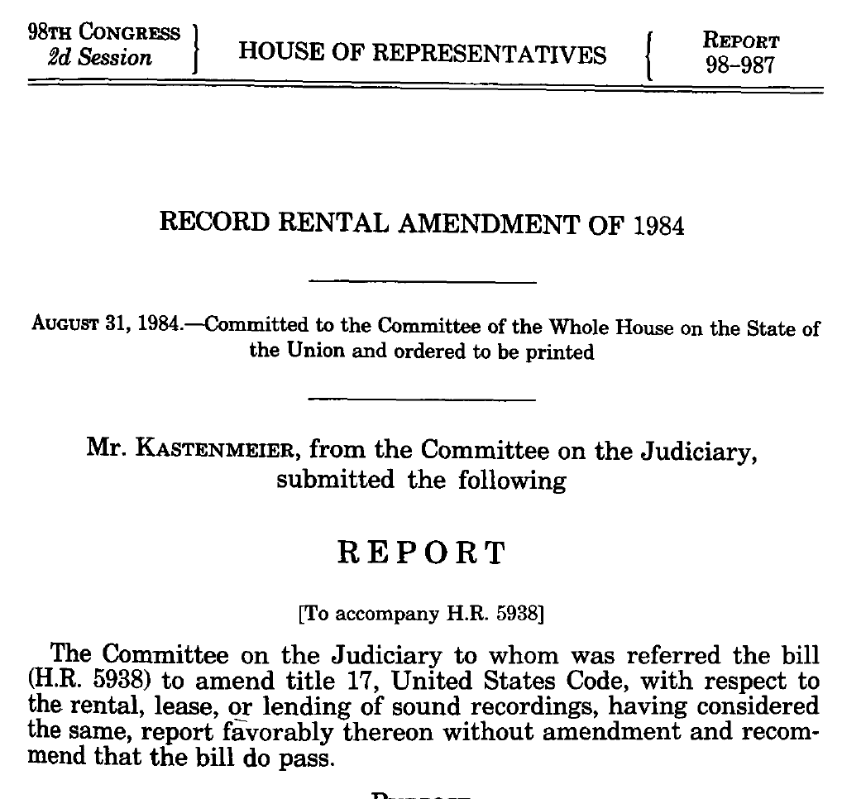
Music Copying Circa 1984
House Report (31 Aug 1984)

Slide 13
“Never, Ever Buy Another Record”
House Report (31 Aug 1984)

Slide 14
Record Rental Amendments of 1984
Pub. L. 98-450 (4 Oct 1984)

Slide 15
Limits on Renting of Phonorecords and Computer Programs
17 USC 109(b)

Slide 16
Bobbs-Merrill (U.S. 1908)
210 U.S. 339 (1908)

Slide 17
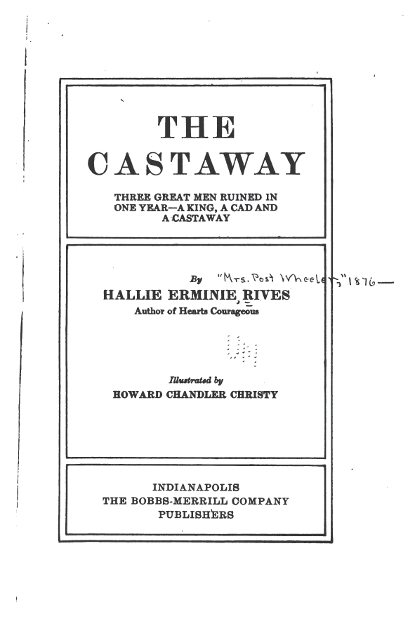
The Castaway

Slide 18
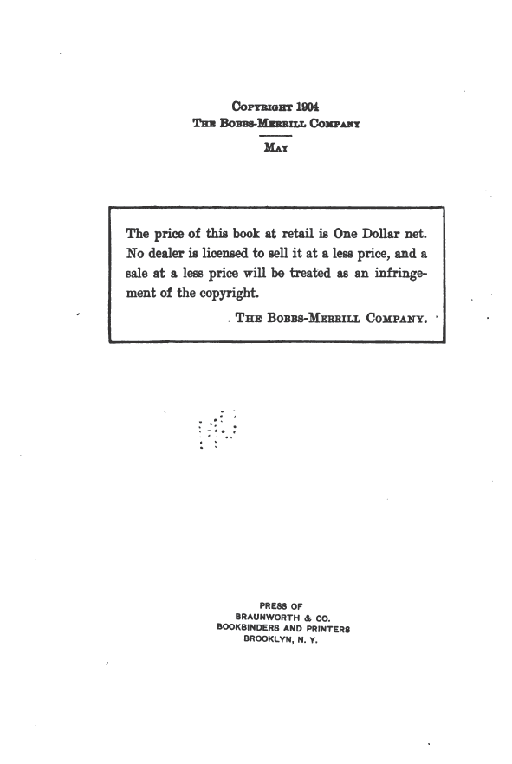
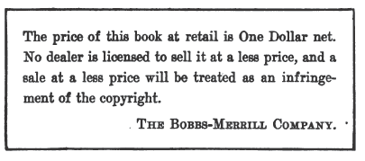
Copyright Page
The Castaway

Slide 19
Selling the Book
Core Facts
Bobbs-Merrill sells The Castaway with the reservations notice beneath the copyright statement in each copy of the book
Macy’s is selling the book for 89 cents
Macy’s bought the book from wholesalers; everyone knew of the notice; no contracts regarding sales price

Slide 20
Sec. 4592
“Any citizen of the United States or resident therein, who shall be the author, inventor, designer, or proprietor of any book, map, chart, dramatic or musical composition, engraving, cut, print, or photograph or negative thereof, or of a painting, drawing, chromo, statute, statuary, and of models or designs intended to be perfected as”
Bobbs-Merrill (U.S. 1908)

Slide 21
Sec. 4592
“works of the fine arts, and the executors, administrators, or assigns of any such person, shall, upon complying with the provisions of this chapter, have the sole liberty of printing, reprinting, publishing, completing, copying, executing, finishing, and vending the same. U.S. Comp. Stat. 1901, p. 3406.”
Bobbs-Merrill (U.S. 1908)

Slide 22
Need Privity
“In our view the copyright statutes, while protecting the owner of the copyright in his right to multiply and sell his production, do not create the right to impose, by notice, such as is disclosed in this case, a limitation at which the book shall be sold at retail by future purchasers, with whom there is no privity of contract.”
Bobbs-Merrill (U.S. 1908)

Slide 23
Not the Intent of the Statute
“To add to the right of exclusive sale the authority to control all future retail sales, by a notice that such sales must be made at a fixed sum, would give a right not included in the terms of the statute, and, in our view, extend its operation, by construction, beyond its meaning, when interpreted with a view to ascertaining the legislative intent in its enactment.”
Bobbs-Merrill (U.S. 1908)

Slide 24
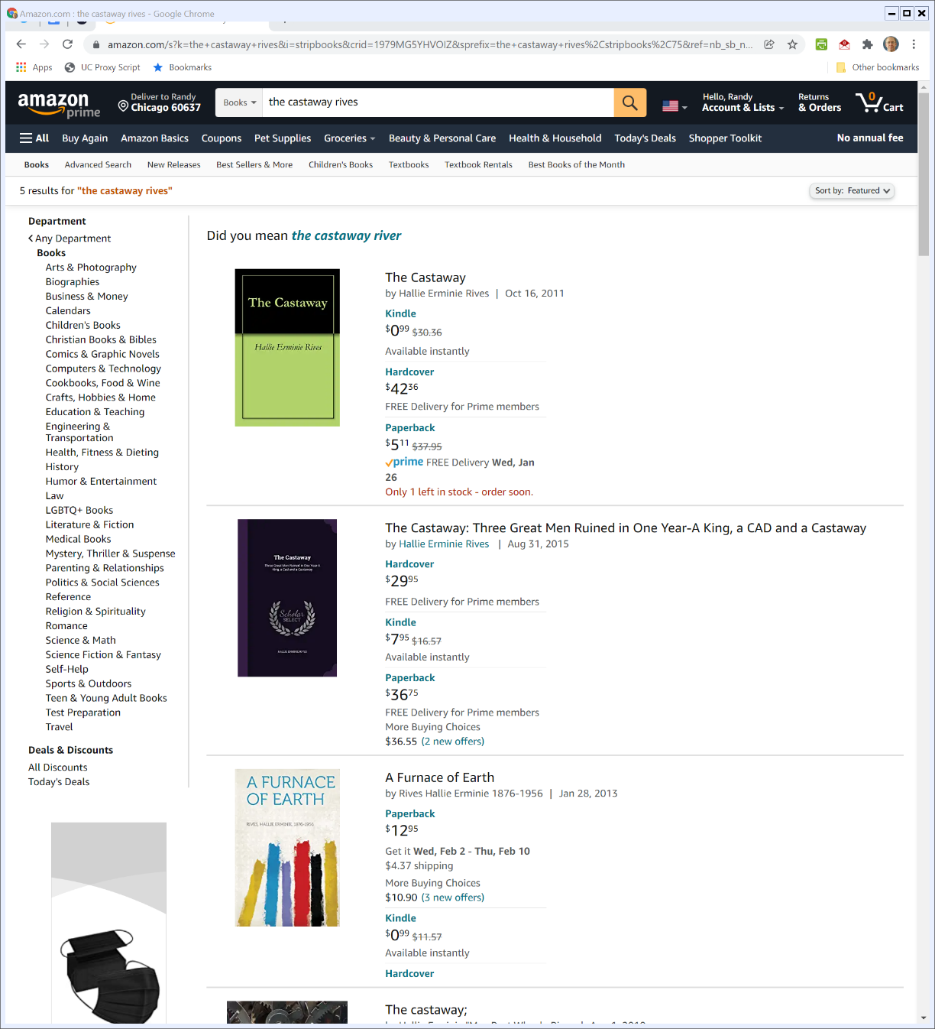

Buying the Castaway
Amazon (Visited 22 Jan 2022)

Slide 25
Sec. 106(3): The Distribution Right
“Subject to sections 107 through 122, the owner of copyright under this title has the exclusive rights to do and to authorize any of the following: … (3) to distribute copies or phonorecords of the copyrighted work to the public by sale or other transfer of ownership, or by rental, lease, or lending;”
17 USC 106

Slide 26
Sec. 109(a): The First-Sale Doctrine
“Notwithstanding the provisions of section 106(3), the owner of a particular copy or phonorecord lawfully made under this title, or any person authorized by such owner, is entitled, without the authority of the copyright owner, to sell or otherwise dispose of the possession of that copy or phonorecord.”
17 USC 109

Slide 27
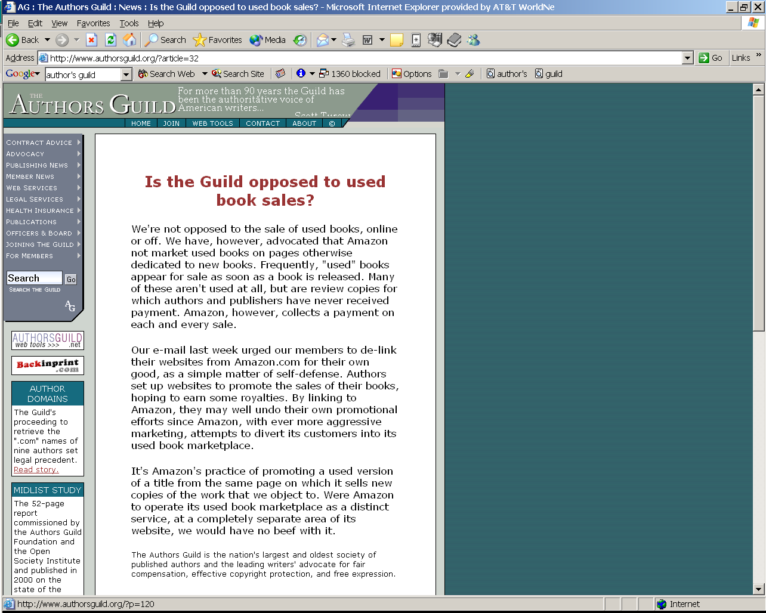
Circa 2002 (?): Selling Used Books
The Authors Guild

Slide 28
Feb 1842: Charles Dickens Visits U.S.
New York Tribune (14 Feb 1842)

Slide 29
Need New Int’l Copyright Law to Solve Problem
New York Tribune (14 Feb 1842)

Slide 30
Berne Convention

Slide 31
Berne Convention Implementation Act of 1988
Pub. L. 100-568 (31 Oct 1988)

Slide 32
Sec. 104: National Origin
17 USC 104

Slide 33
Sec. 104: Not Berne Directly
17 USC 104

Slide 34
Used Books in Buffalo, NY
TTYN (1 of 4)
Hypo 1: All U.S.
Author, a U.S. citizen, writes book in U.S.
Author prints book in the U.S. bearing a U.S. copyright.
Author sells book to Customer, a U.S. citizen, in the U.S.
Customer seeks to resell the book to Buyer, a U.S. citizen, in the U.S.

Slide 35
Used Books in Buffalo, NY
TTYN (2 of 4)
Does Section 109 apply to this?

Slide 36
Used Books in Toronto
TTYN (3 of 4)
Hypo 2: All Canadian
A Canadian citizen writes a book in Toronto and prints the book in Canada bearing a Canadian copyright.
Author sells the book to Customer, a Canadian citizen, in Canada.
Customer seeks to resell the book to Buyer, a Canadian citizen, in Canada.

Slide 37
Used Books in Toronto
TTYN (4 of 4)
Question
When Author goes into a Canadian court to try to block the sale of the book to Buyer should the Buyer rely on Section 109?

Slide 38
Hypo 1 Answer
Yes, of course
This is exactly what the first-sale doctrine, developed in Bobbs-Merrill and added to the statute in Section 109, covers

Slide 39
Hypo 2: Answer
I doubt it
Hard to see any relevance that U.S. law and Sec. 109 would have in this situation
Right question is whether Canada has some version of the first sale doctrine. It appears to do so: see Theberge v. Galerie D’Art, [2002] 2 S.C.R. 336
Author probably loses under Canadian law

Slide 40
Hypo 2: Answer
Different Question
Is the Canadian book “lawfully made under this title” as Section 109 puts it?
What turns on the answer to that question?

Slide 41
Sec. 501: Infringement
“Anyone who violates any of the exclusive rights of the copyright owner as provided by sections 106 through 122 or of the author as provided in section 106A(a), or who imports copies or phonorecords into the United States in violation of section 602, is an infringer of the copyright or right of the author, as the case may be.”
17 USC 501

Slide 42
Sec. 602: Imports and Exports
“(a)(1) Importation into the United States, without the authority of the owner of copyright under this title, of copies or phonorecords of a work that have been acquired outside the United States is an infringement of the exclusive right to distribute copies or phonorecords under section 106, actionable under section 501.”
17 USC 602

Slide 43
Sec. 602: Imports and Exports
“(a)(2) Importation into the United States or exportation from the United States, without the authority of the owner of copyright under this title, of copies or phonorecords, the making of which either constituted an infringement of copyright, or which would have constituted an infringement of copyright if this title had been applicable, is an infringement of the exclusive right to distribute copies or phonorecords under section 106, actionable under sections 501 and 506.”
17 USC 602

Slide 44
Sec. 602 Legislative History: Piracy and Unlawful Imports of the Lawfully Made
H.R. 94-1476 (3 Sept 1976)

Slide 45
Piracy and the Public Domain
H.R. 94-1476 (3 Sept 1976)

Slide 46
Infringing Distribution
H.R. 94-1476 (3 Sept 1976)

Slide 47
Used Books in Buffalo, NY (Printed in Toronto)
TTYN (1 of 2)
Hypo 3: Add Canadian Printing
U.S. citizen writes book in the U.S.
Author prints the book in Toronto bearing a U.S. copyright.
Author moves the book from Toronto to Buffalo
Author sells the book to Customer, a U.S. citizen, in the U.S.

Slide 48
Used Books in Buffalo, NY (Printed in Toronto)
TTYN (2 of 2)
Customer seeks to resell the book to Buyer, a U.S. citizen, in the U.S.
Questions
How does the printing of the books in Toronto matter? Does that mean that Canadian law somehow applies? Does the printing there somehow alter that application of 109?
What does importation do?

Slide 49
Hypo 3 Answer
602 Not Applicable Here
Both (a)(1) and (a)(2) are keyed to importation without the authority of the copyright owner.
Here it is the copyright owner who printed in Toronto and who is bringing the books back into the U.S.

Slide 50
Hypo 3 Answer
What Does that Mean about First Sale?
Are the books printed in Toronto no longer “lawfully made under this title” and therefore outside of 109(a) first sale?
This is Breyer’s central concern in Kirtsaeng.

Slide 51
Hypo 3 Answer
Not clear but
Really doubt courts would give publishers option on application of first sale (meaning if publisher prints outside of U.S. making it possible for publisher to evade application of first sale)
But that does treat book printed outside the country as “lawfully made under this title” as Breyer does.

Slide 52
Used Books in Toronto (Printed in Buffalo)
TTYN (1 of 4)
Hypo 4
A U.S. author prints a book in the U.S. bearing a U.S. copyright.
Author exports the book to Canada where she sells the book to Customer, a Canadian citizen, in Canada
Customer seeks to resell the book to Buyer, a Canadian citizen, in Canada

Slide 53
Used Books in Toronto (Printed in Buffalo)
TTYN (2 of 4)
Question
When Author goes into a Canadian court to try to block the sale of the book to Buyer should the Buyer rely on Section 109?

Slide 54
Used Books in Buffalo (Export and Reimportation)
TTYN (3 of 4)
Hypo 5
A U.S. author prints a book in the U.S. bearing a U.S. copyright.
Author exports the book to Canada where she sells the book to Customer, a Canadian citizen, in Canada

Slide 55
Used Books in Buffalo (Export and Reimportation)
TTYN (4 of 4)
Customer in turn exports the book back to the U.S. where Customer seeks to resell the book to Buyer, a U.S. citizen, in Buffalo
Does Section 109 apply to this case? Section 602?
This is Quality King.

Slide 56
Hypo 4 Answer
Multiple Angles
“Lawfully made under this title” language seems to attach at point of printing in U.S. meaning first sale rights have attached
That said, might easily find local Canadian court would apply local law in face of conflict (int’l conflicts of law Q)

Slide 57
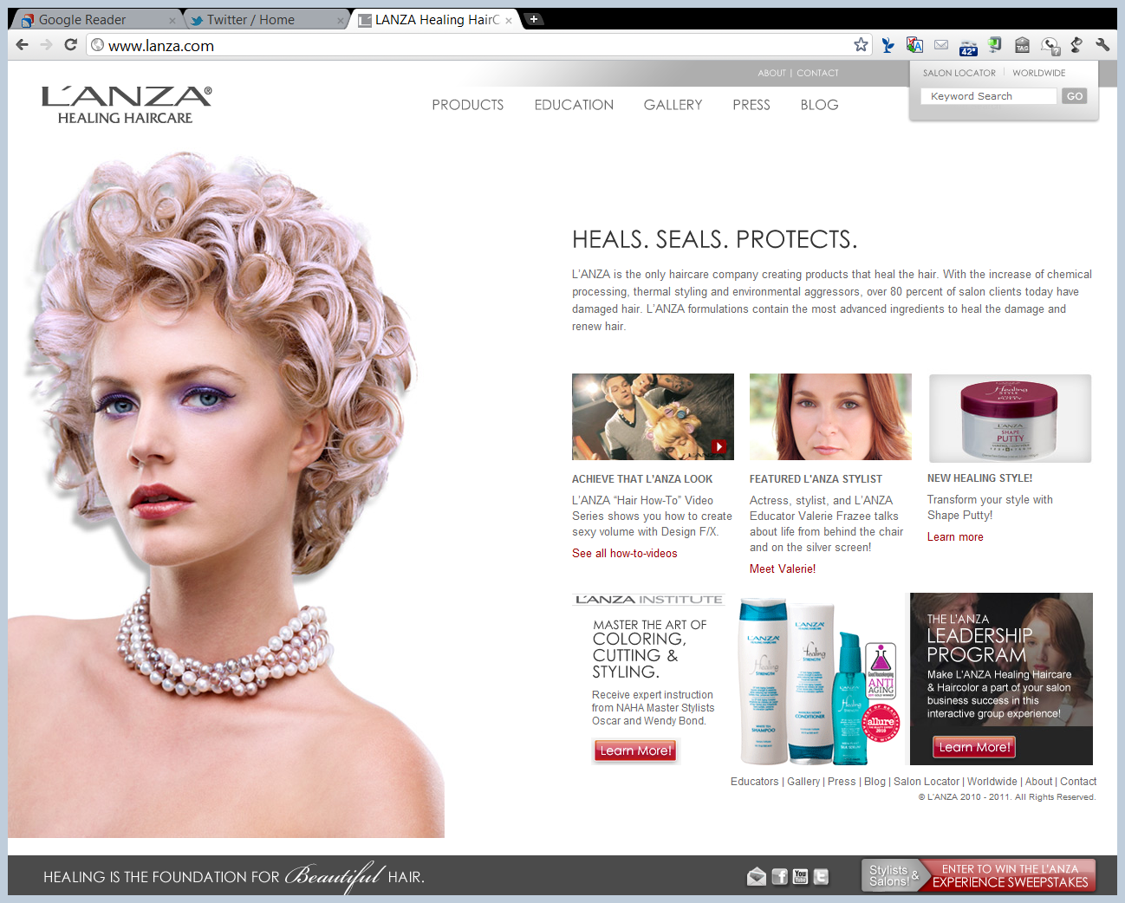
Copyright and Shampoo

Slide 58
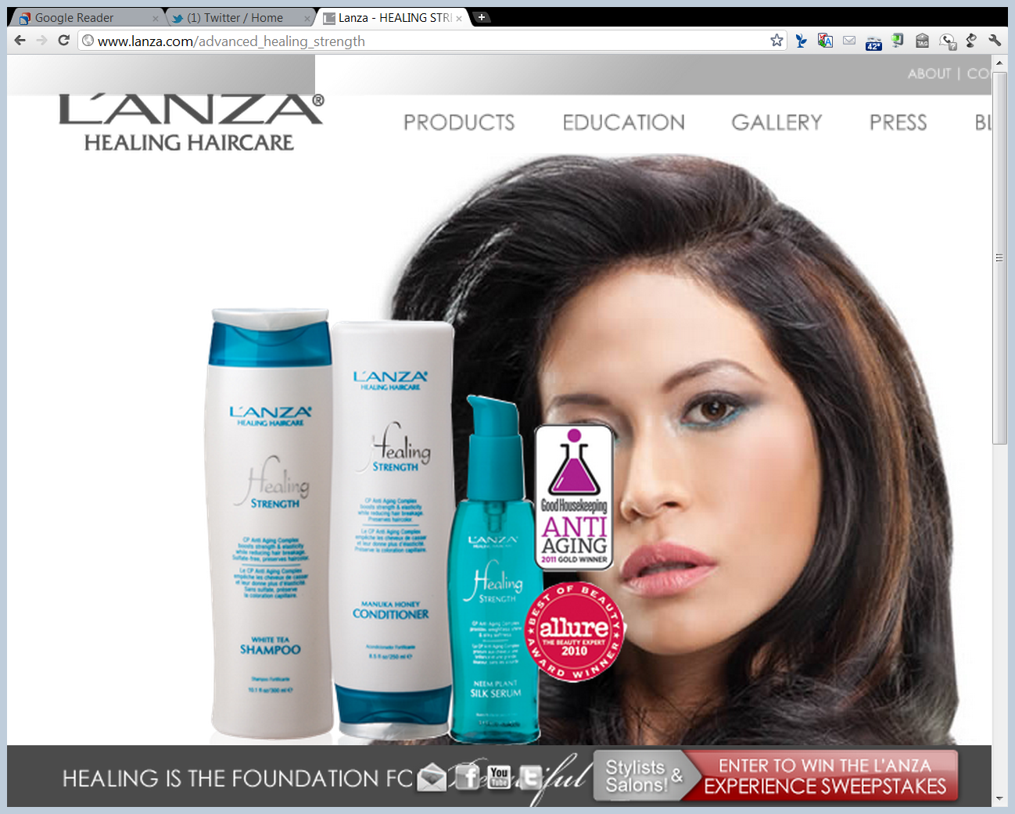
Focus on the Bottles

Slide 59
Quality King (U.S. 1998)
523 U.S. 135 (1998)

Slide 60
Quality King Result
This is the “round trip” case
Books started in US, left and returned
Under Quality King, 109(a) first-sale rights “attach”
Attach based on location of printing in US—“lawfully made under this title”
That is independent of where the particular copy of the book is sold (see fn. 14)

Slide 61
How Does First Sale Apply to Imported Works?
Quality King (U.S. 1998)

Slide 62
Label as Price Discrim Tool
Quality King (U.S. 1998)

Slide 63
Broad Protection of First-Sale Doctrine
Quality King (U.S. 1998)

Slide 64
Ginsburg Concurrence: Round Trip Case Here
Quality King (U.S. 1998)

Slide 65
Hypo 5 Answer
Quality King Analysis
L’Anza loses as first-sale doctrine attached on production in U.S.
Question: Why does this answer importation question under 602?

Slide 66
Kirtsaeng (U.S. 2013)
568 U.S. 519 (2013)

Slide 67
Making, Selling, Importing
TTYN (1 of 2)
Hypo 6: US Printing, Foreign Sale
Author prints a copyrighted book in the US
Author sells copies in the US for $50
Author exports copies to Canada and sell them there for $25
Importer buys in Canada for $25, takes the book to the US and sells for $35
How does Sec. 602 apply to this situation?

Slide 68
Making, Selling, Importing
TTYN (2 of 2)
Hypo 7: Foreign Printing, Foreign Sale
Author prints a copyrighted book in the US and sell copies in the US for $50
Author also prints copies in Canada and sell them there for $25
Importer buys in Canada for $25, takes the book to the US and sells for $35
How does Sec. 602 apply to this situation?

Slide 69
Hypo 6 Answer
Per Quality King
First-sale right attaches on production in the U.S.
Might think that 602(a)(1) would block this but doesn’t, as the reference to 106 understood to pick up limit on 106 in 109

Slide 70
Hypo 7 Answer
This is Kirtsaeng
Key Question
Does first sale attach given printing overseas as in my hypo of books printed in Toronto and imported by Wiley for sale in U.S.?
Or does 602(a)(1) preclude this?
Majority (Breyer) says yes; Ginsburg, dissenting, says no.

Slide 71
Wiley’s American Edition Copyright Page
“Copyright © 2008 John Wiley & Sons, Inc. All rights reserved. ... Printed in the United States of America.”
Kirtsaeng (U.S. 2013)

Slide 72
Wiley’s Asian Edition Copyright Page
“Copyright © 2008 John Wiley & Sons (Asia) Pte Ltd[.] All rights reserved. This book is authorized for sale in Europe, Asia, Africa, and the Middle East only and may be not exported out of these territories.”
Kirtsaeng (U.S. 2013)

Slide 73
Wiley’s Asian Edition Copyright Page
“Exportation from or importation of this book to another region without the Publisher’s authorization is illegal and is a violation of the Publisher’s rights. The Publisher may take legal action to enforce its rights.... Printed in Asia.”
Kirtsaeng (U.S. 2013)

Slide 74
Geographic Scope of U.S. Law?
“Thus, ordinary English permits us to say that the Act ‘applies’ to an Irish manuscript lying in its author’s Dublin desk drawer as well as to an original recording of a ballet performance first made in Japan and now on display in a Kyoto art gallery.”
Kirtsaeng (U.S. 2013)

Slide 75
Ginsburg, J., dissenting: Not So
“The Copyright Act, it has been observed time and again, does not apply extraterritorially. See United Dictionary Co. v. G. & C. Merriam Co., 208 U.S. 260, 264 (1908) (copyright statute requiring that U.S. copyright notices be placed in all copies of a work did not apply to copies published abroad because U.S. copyright laws have no ‘force’ beyond the United States’ borders); …”
Kirtsaeng (U.S. 2013)

Slide 76
Early Breyer
Breyer (HLR 1970)

