Slide 1
Class 8: Thurs 10 Apr 2025
Copyright Spring 2025
Functional Works: Computer Software; Derivative Works
Randal C. Picker
James Parker Hall Distinguished Service Professor of Law
The Law School
The University of Chicago

Slide 2
Key Questions for Today
Issues/Questions
  Software is inherently functional yet covered by copyright
  What is the expression?
  How do we police the lines between copyrightable expression and uncopyrightable ideas/functionality?

Slide 3
Key Questions for Today
Issues/Questions
  More particularly, how do we square Sec. 102(b) with the idea that software is generally within copyright?
  And should it matter that the copyright choices we make will shape entry and competition in these markets?

Slide 4
Key Questions for Today
Issues/Questions
  On derivative works, the core idea is reasonably straightforward but what do the limiting cases tell us about that idea?

Slide 5
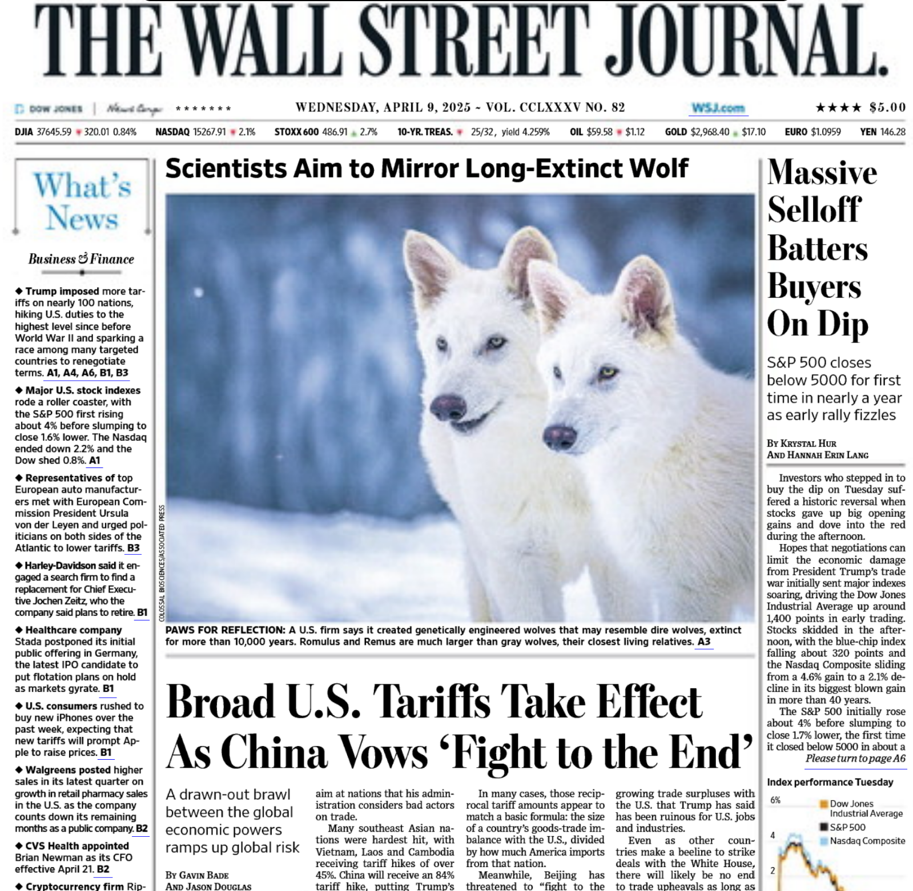
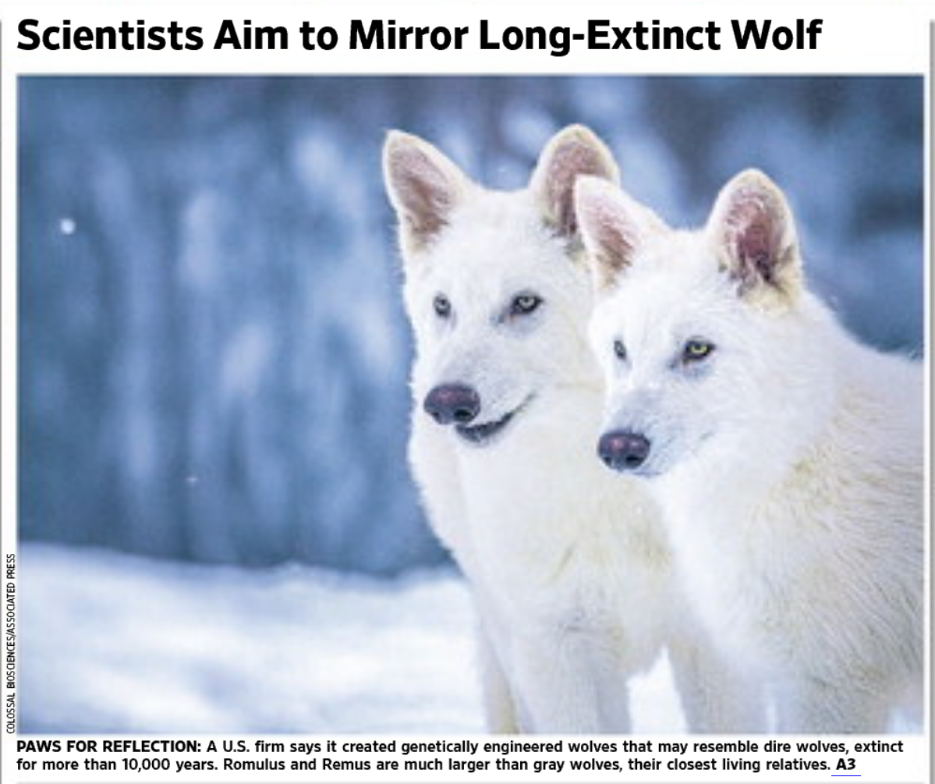
Bringing Back Extinct Wolves?
WSJ (9 Apr 2025)

Slide 6
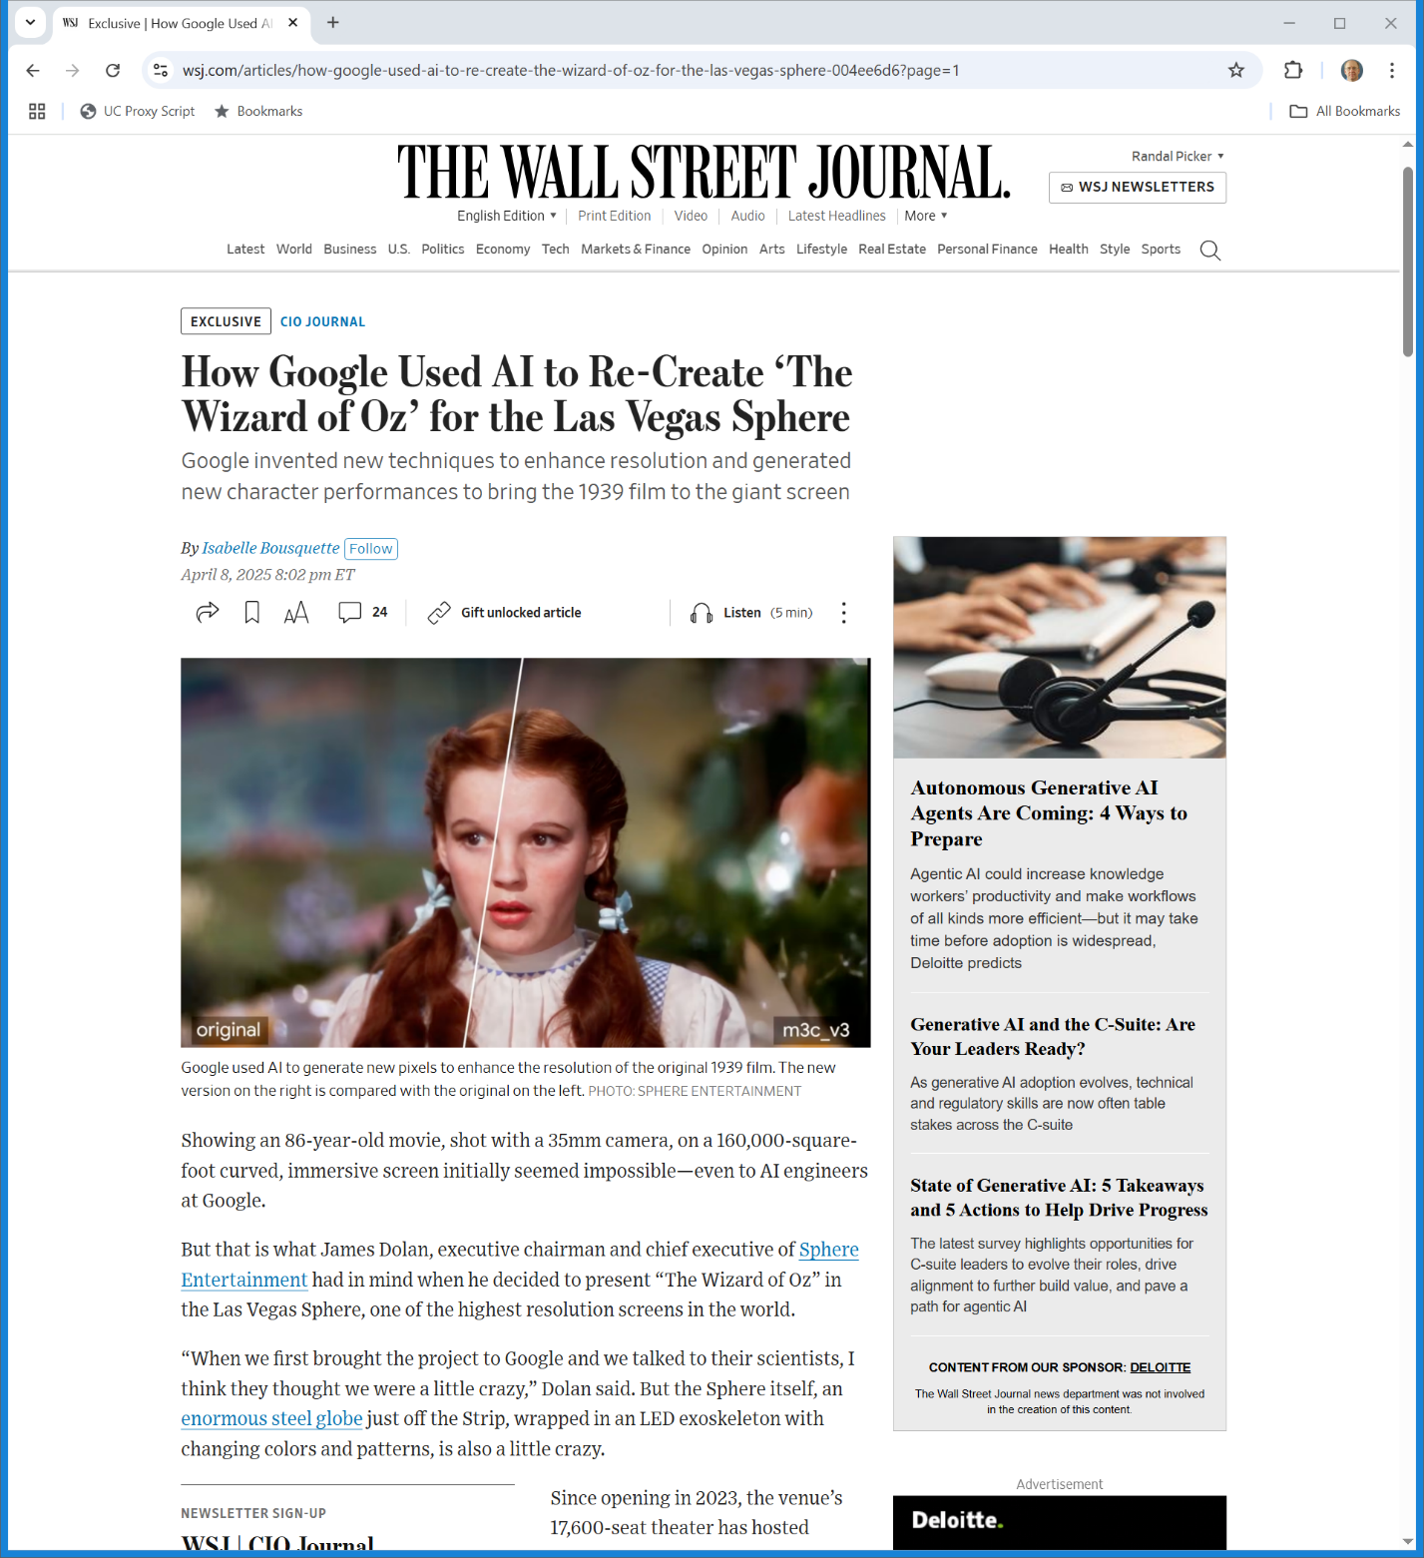

AI Oz
WSJ (9 Apr 2025)

Slide 7
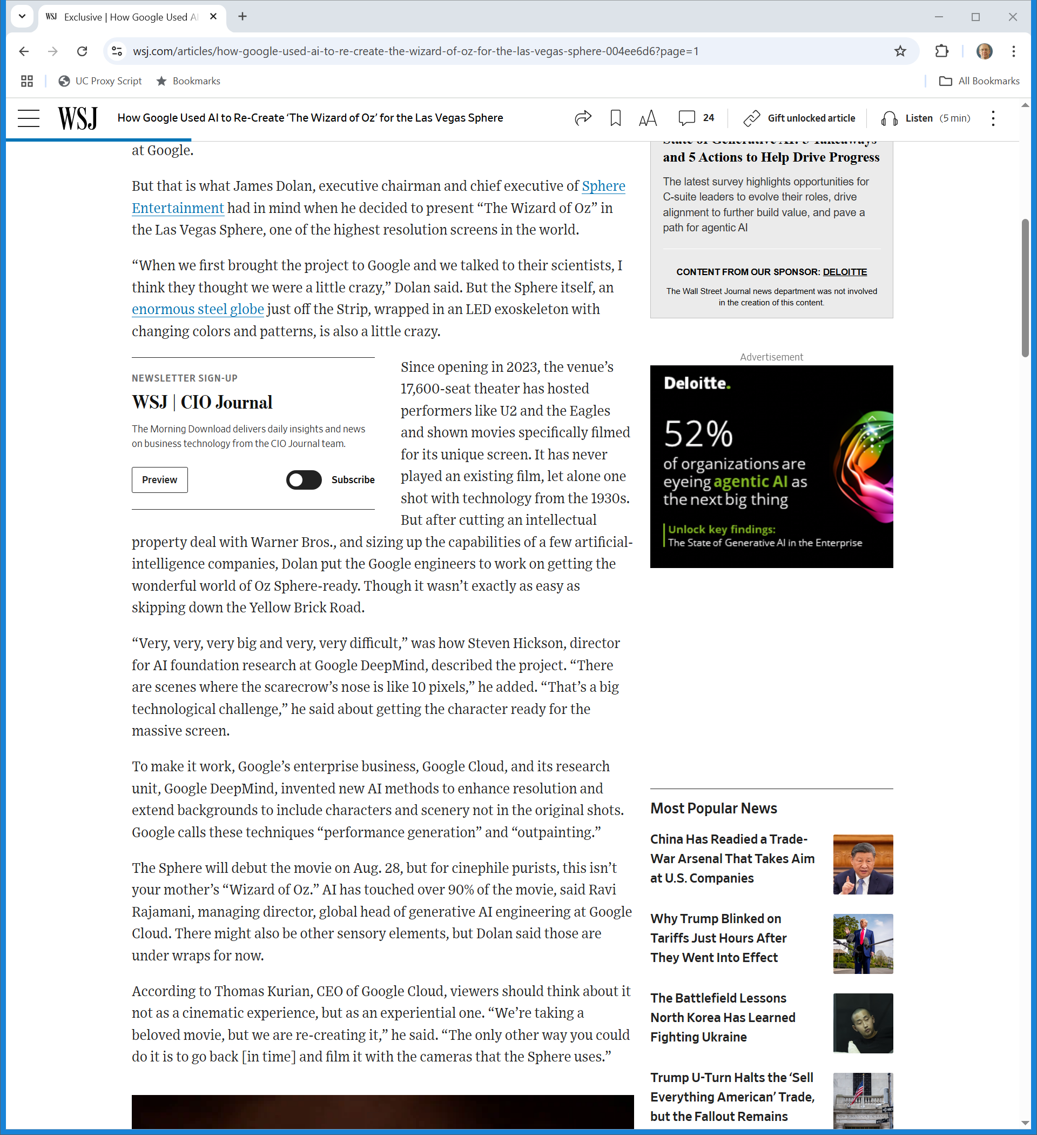
IP and Then AI
WSJ (9 Apr 2025)

Slide 8
New Stuff
WSJ (9 Apr 2025)

Slide 9
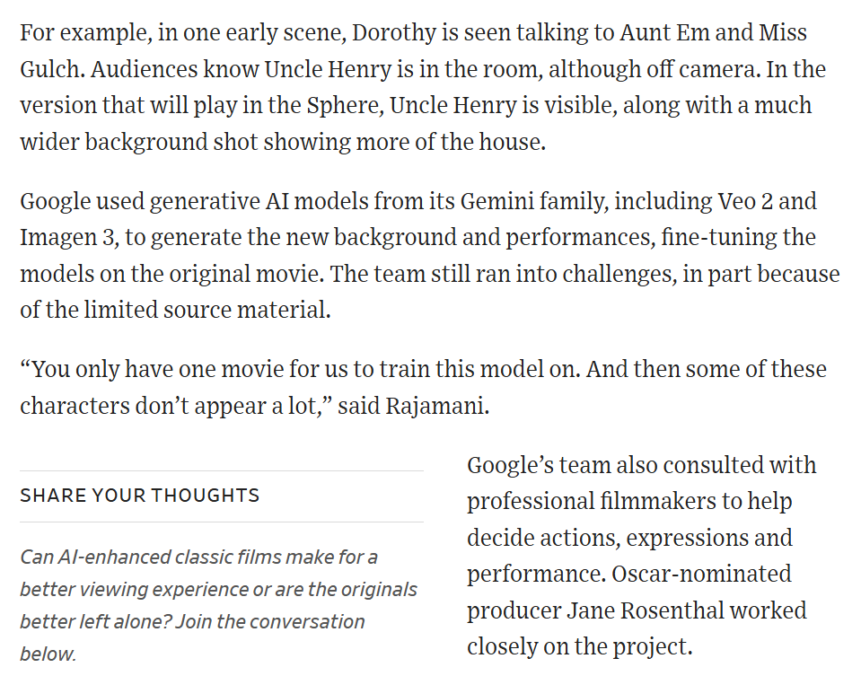
Adding Uncle Henry
WSJ (9 Apr 2025)

Slide 10
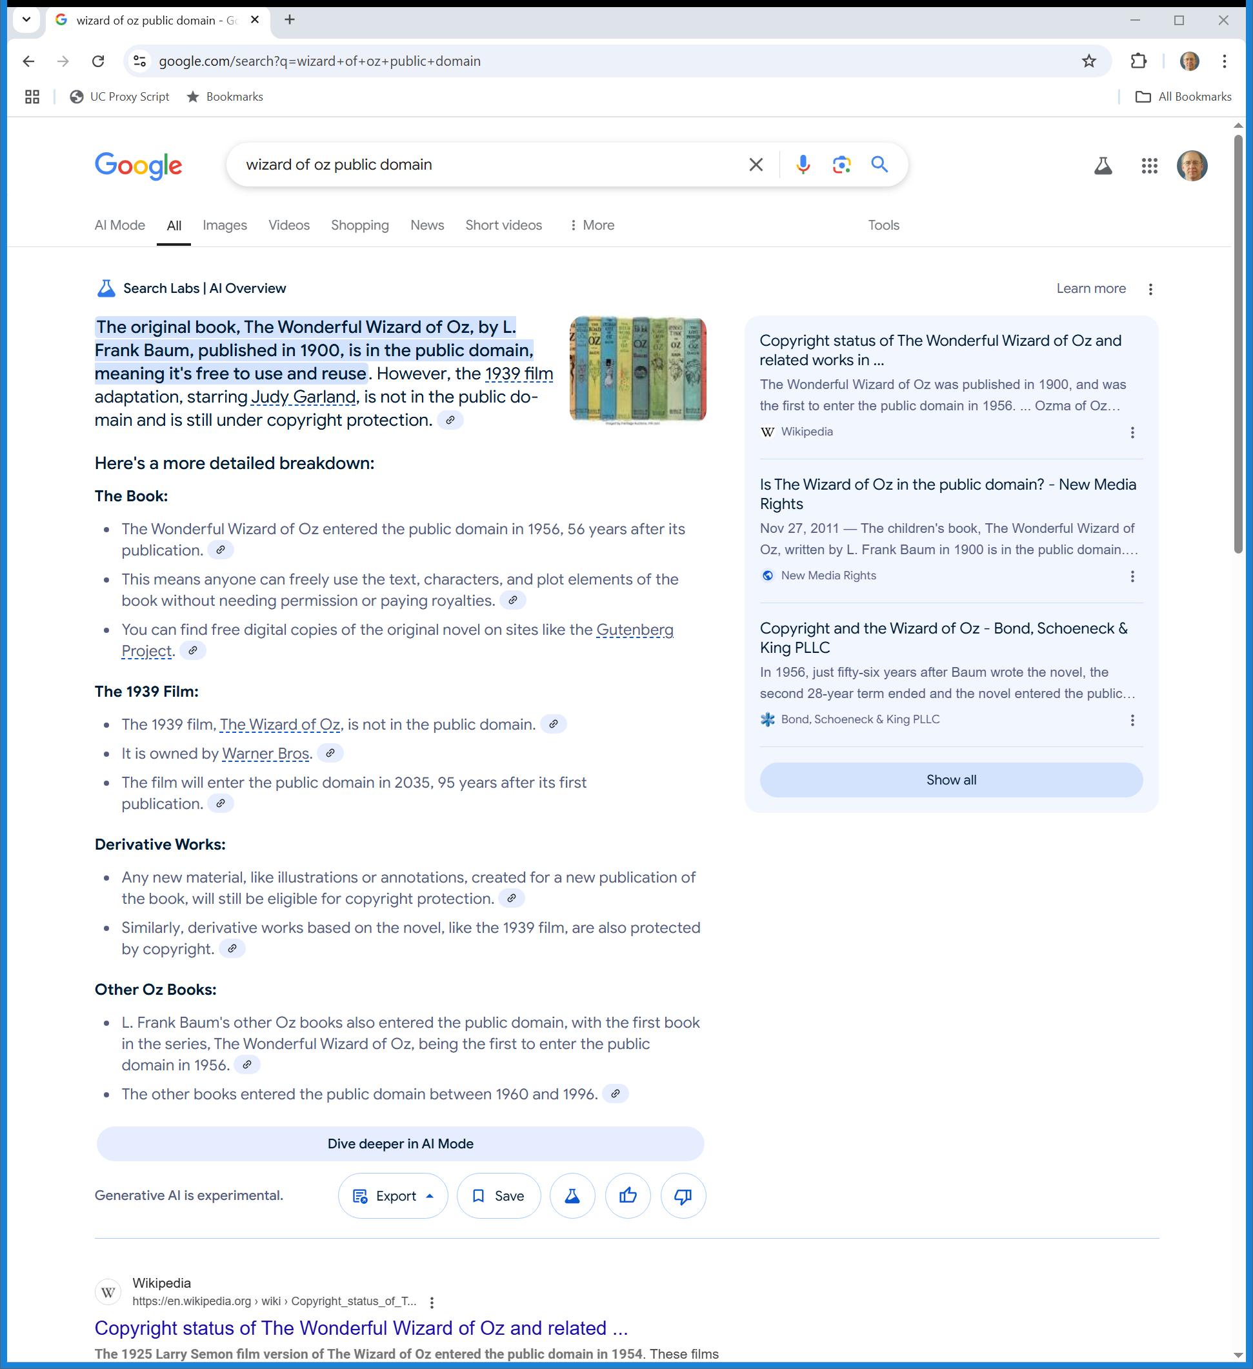
Oz and the Public Domain
Google (10 Apr 2025)
Notes:
https://www.google.com/search?q=wizard+of+oz+public+domain

Slide 11
Oz and the Public Domain
Google (10 Apr 2025)
Notes:
https://www.google.com/search?q=wizard+of+oz+public+domain

Slide 12
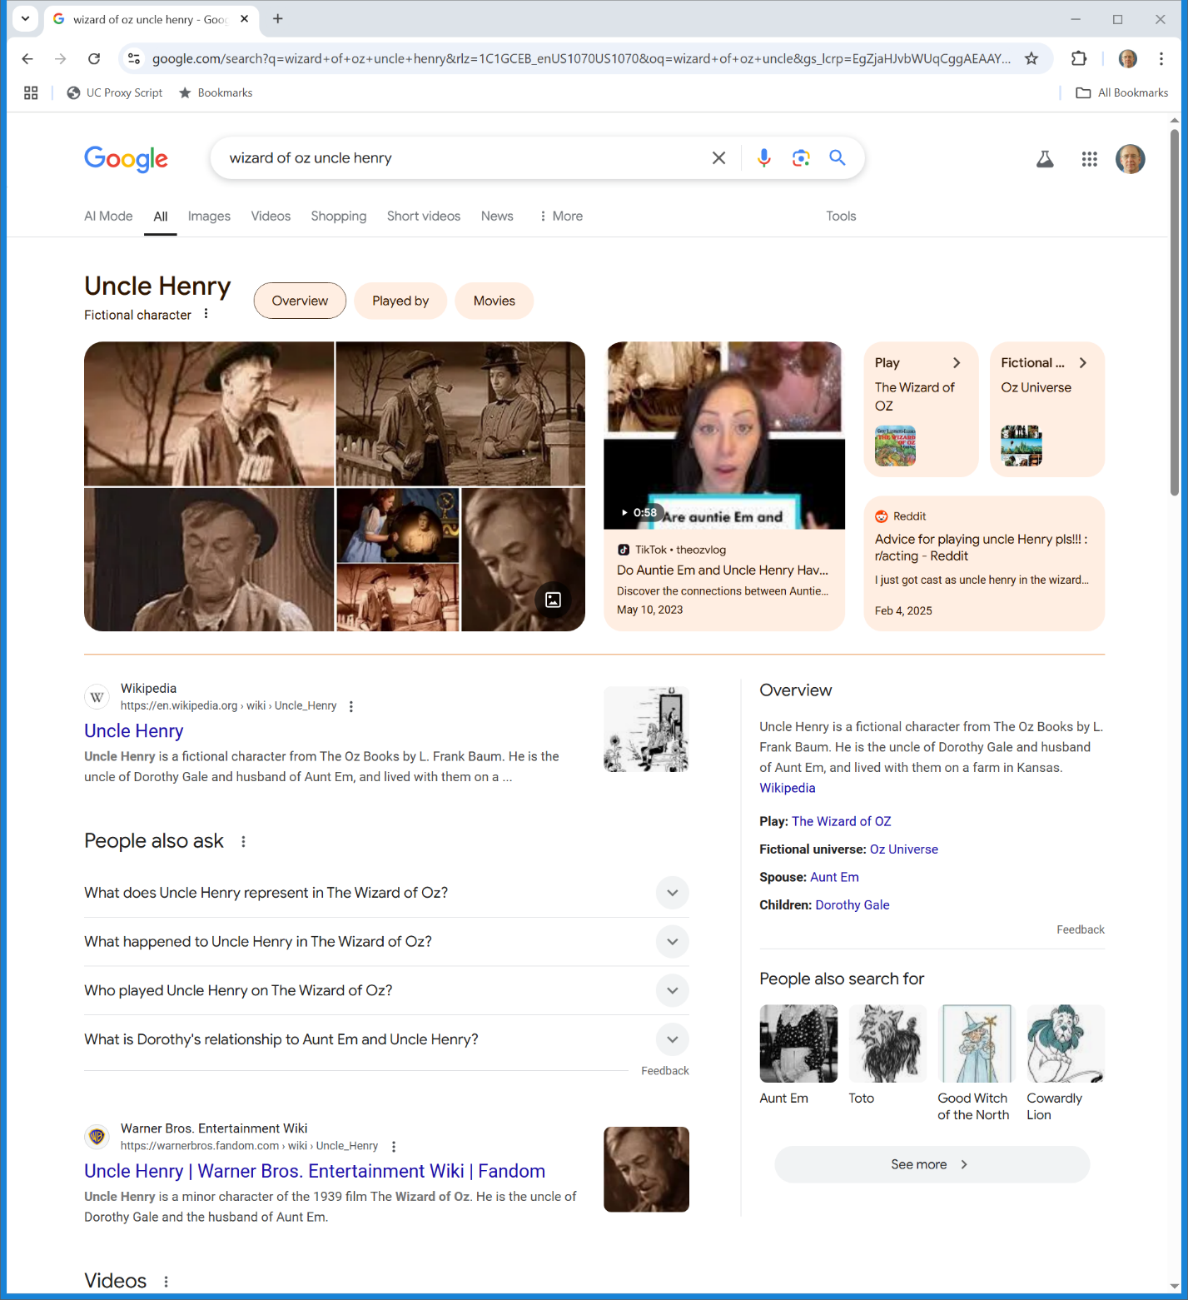

Uncle Henry
Google (10 Apr 2025)

Slide 13
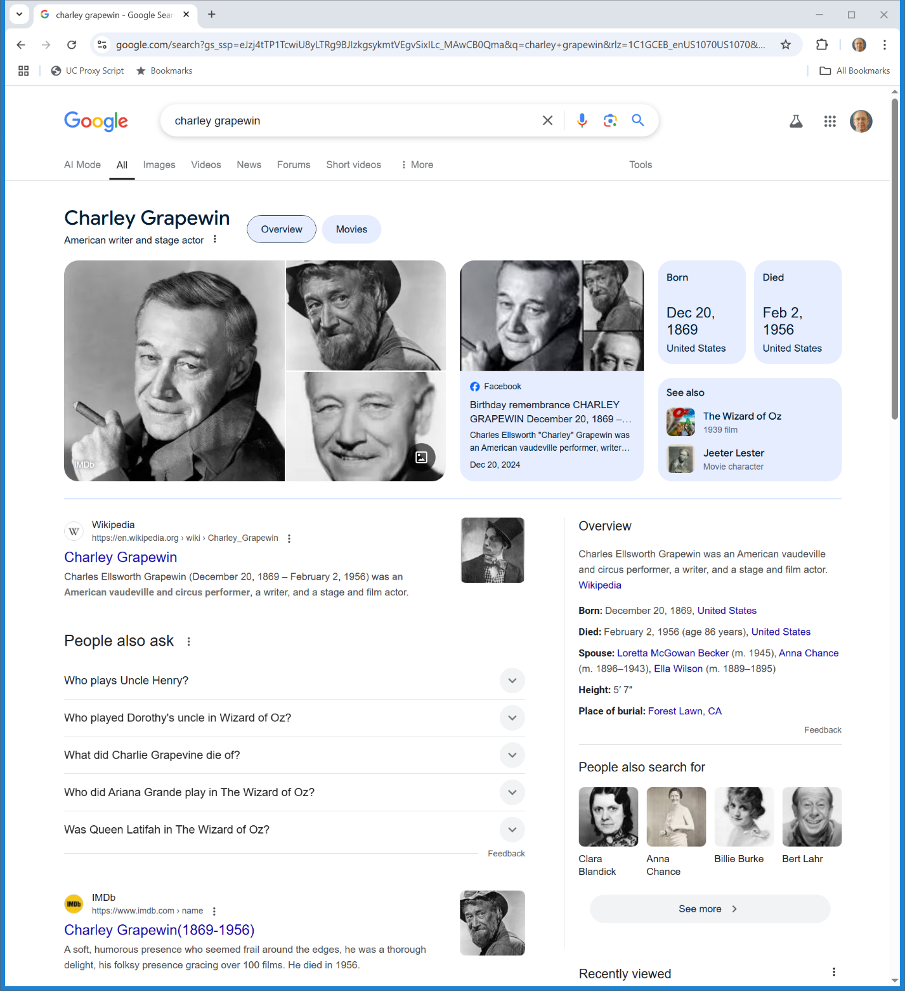
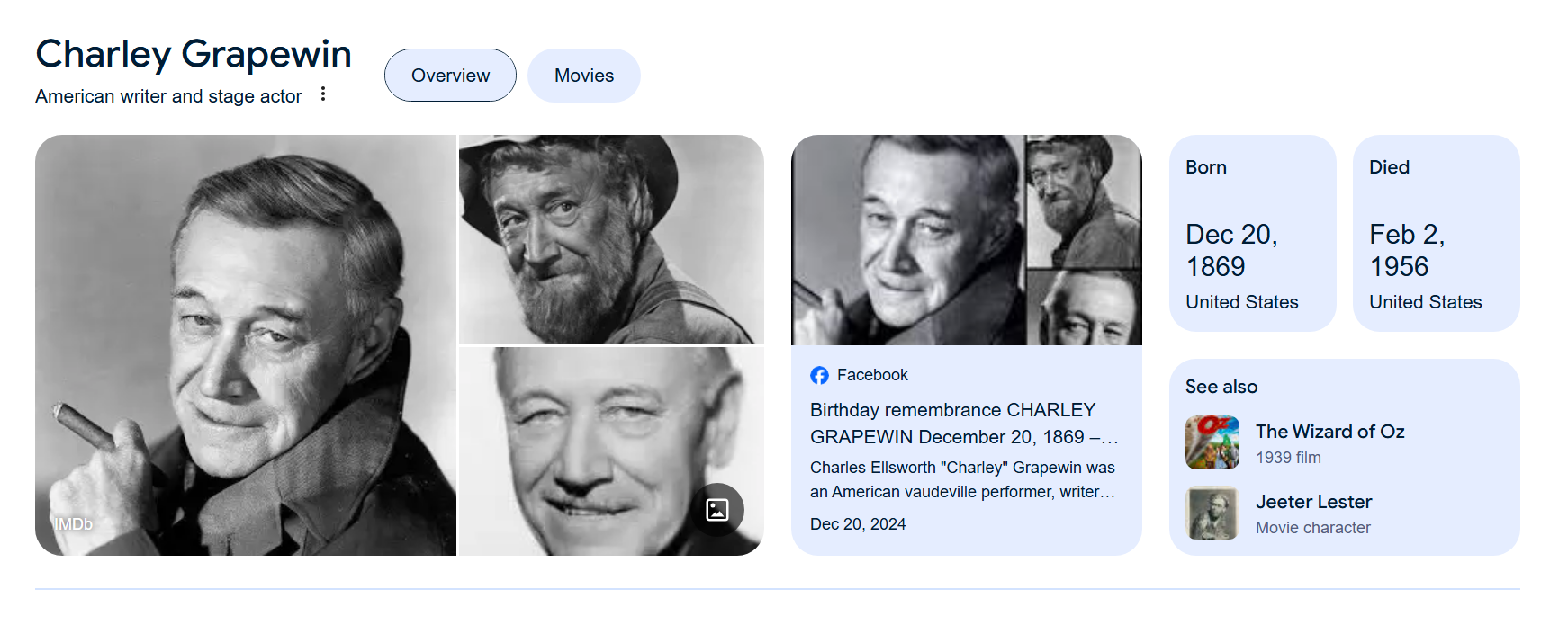
Right of Publicity?
Google (10 Apr 2025)

Slide 14
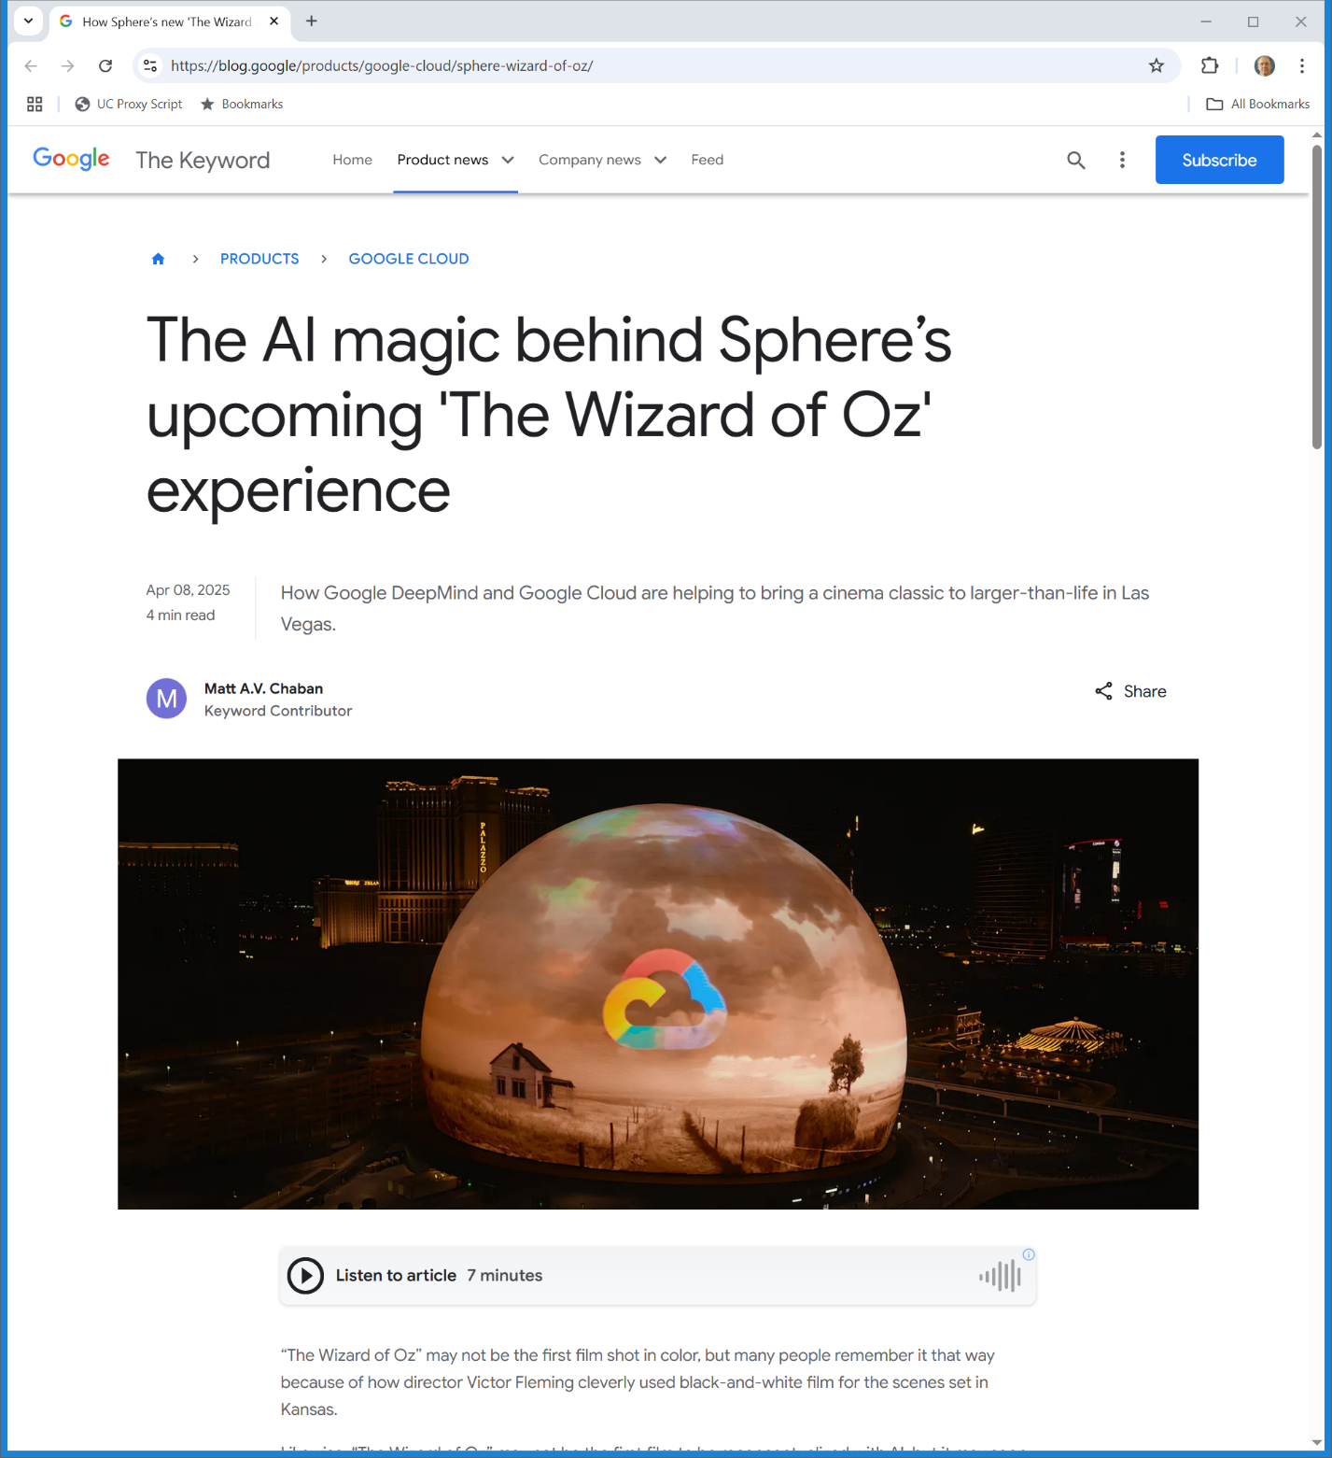
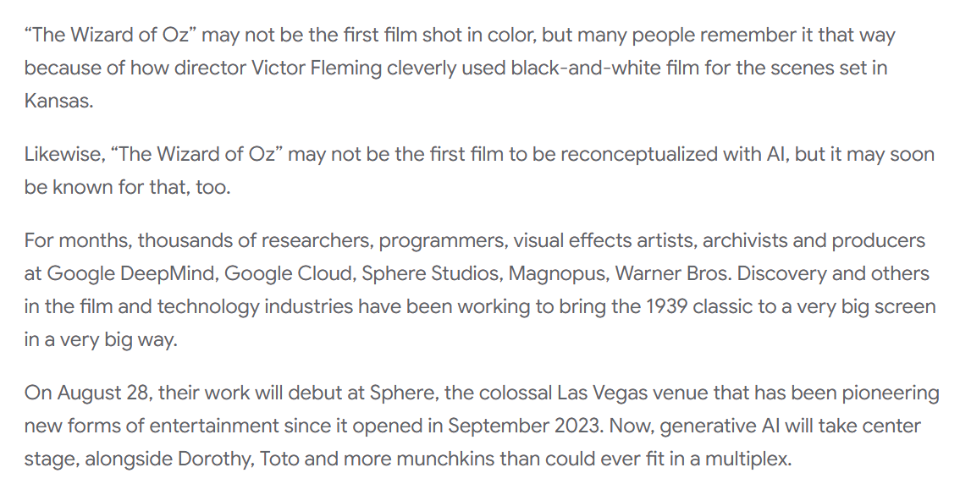
The Tech Behind All of This
Google (8 Apr 2025)
Notes:
https://blog.google/products/google-cloud/sphere-wizard-of-oz/

Slide 15
Patenting Software
U.S. 3,380,029 (23 Apr 1968)

Slide 16
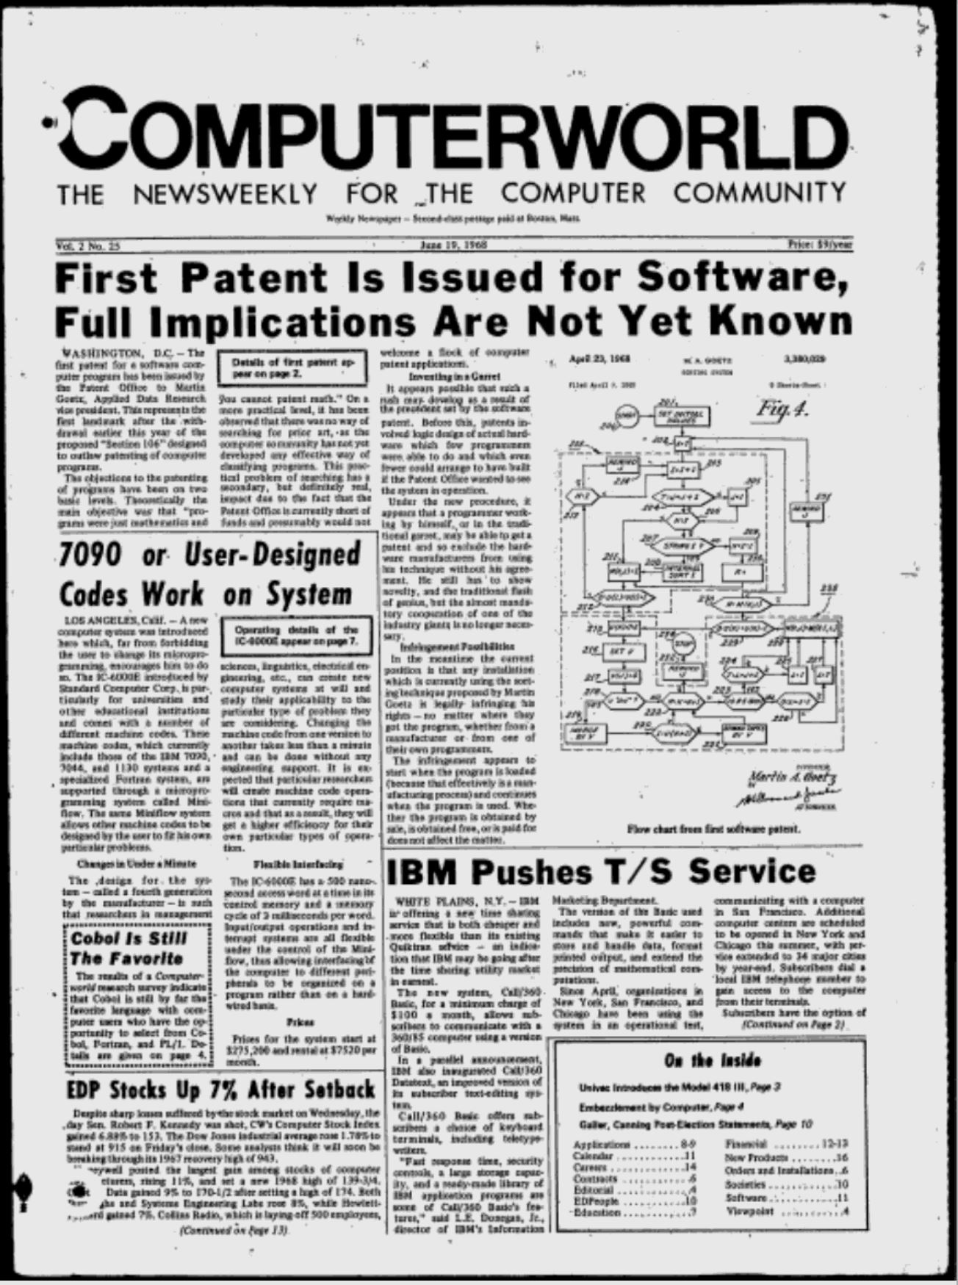
First Software Patent
Computerworld (19 June 1968)

Slide 17
CONTU: Computers and Copiers
Pub. L. 93-573 (31 Dec 1974)

Slide 18
1976 Act: Sec. 117: Just Sit Tight
Pub. L. 94-553 (19 Oct 1976)

Slide 19
Sec. 117 Legislative History: Don’t Know the Answers Yet
H. Rep. 94-1476 (3 Sept 1976)

Slide 20
Sec. 117 Legislative History: Apply Law from Before
H. Rep. 94-1476 (3 Sept 1976)

Slide 21
CONTU
CONTU Report (31 July 1978)

Slide 22
Software as OWAs
CONTU Report (31 July 1978)

Slide 23
1980 IP Act
Pub. L. 96-517 (12 Dec 1980)

Slide 24
New Sec. 117
Pub. L. 96-517 (12 Dec 1980)

Slide 25
New Sec. 117
Pub. L. 96-517 (12 Dec 1980)

Slide 26
Legislative History
H. Rep. 96-1307 Part I (9 Sept 1980)

Slide 27
Decline in U.S. R&D
H. Rep. 96-1307 Part I (9 Sept 1980)

Slide 28
Implementing CONTU
H. Rep. 96-1307 Part I (9 Sept 1980)

Slide 29
Repealing Old Sec. 117
H. Rep. 96-1307 Part I (9 Sept 1980)

Slide 30
“Computer Program” Definition
“A ‘computer program’ is a set of statements or instructions to be used directly or indirectly in a computer in order to bring about a certain result.”
17 USC 101

Slide 31
Situating Computer Programs
H.R. 94-1476 (3 Sept 1976)

Slide 32
Back to Sec. 102: Where Are Computer Programs?
17 USC 102

Slide 33
Computer Programs are … Literary Works
H.R. 94-1476 (3 Sept 1976)

Slide 34
But Remember 102(b)’s Limits
H.R. 94-1476 (3 Sept 1976)

Slide 35
Current Sec. 117
11 USC 117

Slide 36
Sec. 117(c): Maintenance or Repair
11 USC 117

Slide 37
Putting This to Work
TTYN (1 of 2)
Hypo 1
  Apple builds the Apple II computer. Hardware plus an operating system and other key programs
  Third parties write Apple II compatible software
  Franklin builds an Apple II clone and distributes copies of Apple’s software to its customers

Slide 38
Putting This to Work
TTYN (2 of 2)
Questions
  Does Franklin violate Section 106?
  Does it matter if some of Apple’s software is installed in the Apple II on a chip?
  Can a chip be a TME (tangible medium of expression)?

Slide 39
Apple Wins (On Appeal)
744 F.2d 1240 (3rd Cir. 1983)

Slide 40
Property Rights v. Competition?
New York Times (2 Sept 1983)

Slide 41
Putting This to Work
TTYN (1 of 4)
Hypo 2
  IBM releases it personal computer, the IBM PC, on 12 Aug 1981
  A key piece of software to run the PC, authored by IBM, was the BIOS. It was embedded in hardware in the IBM PC
  IBM claimed a copyright in the BIOS

Slide 42
Putting This to Work
TTYN (2 of 4)
  Compaq is an entrant and its business plan is to build a portable IBM PC clone
  They will get an operating system from Microsoft and the CPU from Intel
  But they need the BIOS and they plan to duplicate it through a two-step “clean room” reverse-engineering process

Slide 43
Putting This to Work
TTYN (3 of 4)
  Step 1
    Have one team study the BIOS (and IBM had helpfully issued a detailed manual setting out the BIOS)
    That team was to produce a detailed specification of the functions the BIOS

Slide 44
Putting This to Work
TTYN (4 of 4)
  Step 2
    The second team, fully separate from the first team and therefore never exposed the actual BIOS code, was to write software implementing the functions specified by the first team
Does Compaq violate Section 106?

Slide 45
$500M In Sales in Third Year
New York Times (2 Feb 1986)

Slide 46
The Macintosh
Macworld (Jan 1984)

Slide 47
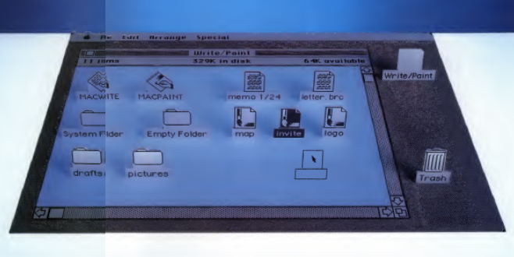
The Mac Desktop
Macworld (Jan 1984)

Slide 48
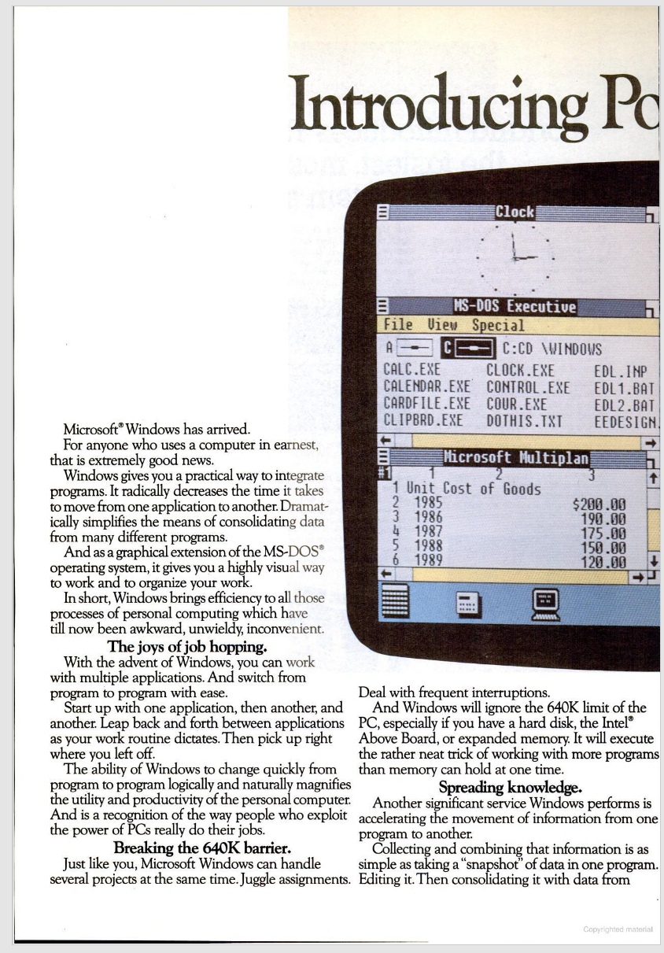
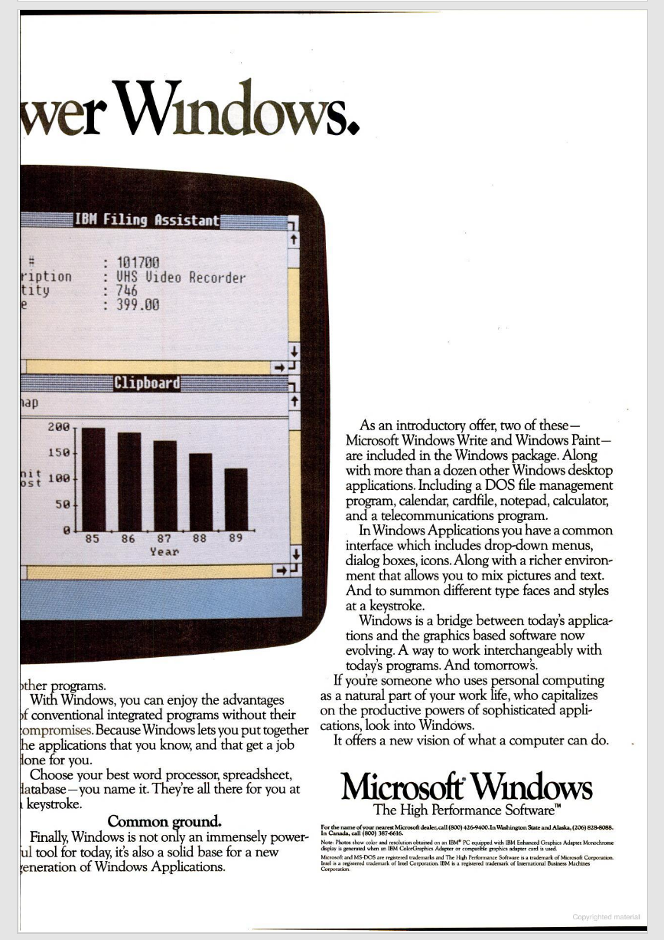
Nov 1985: Windows 1.0 Released
InfoWorld (9 Dec 1985)

Slide 49
Putting This to Work
TTYN (1 of 2)
Hypo 3
  What exactly is copyrightable on the original Mac desktop?
  Individual icons? Particular ones? The trash can?
  The overall “look and feel” of the desktop? Is the desktop an “audiovisual work?”

Slide 50
Putting This to Work
TTYN (2 of 2)
Did Microsoft violate Apple’s copyrights when it released Windows?

Slide 51
The GUI: Software Look and Feel: MS Wins
35 F.3d 1435 (9th Cir. 1994)

Slide 52
A Mix of Copyright and Contract
New York Times (20 Sept 1994)

Slide 53
Lotus and Methods of Operation
49 F.3d 807 (1st Cir. 1995)

Slide 54
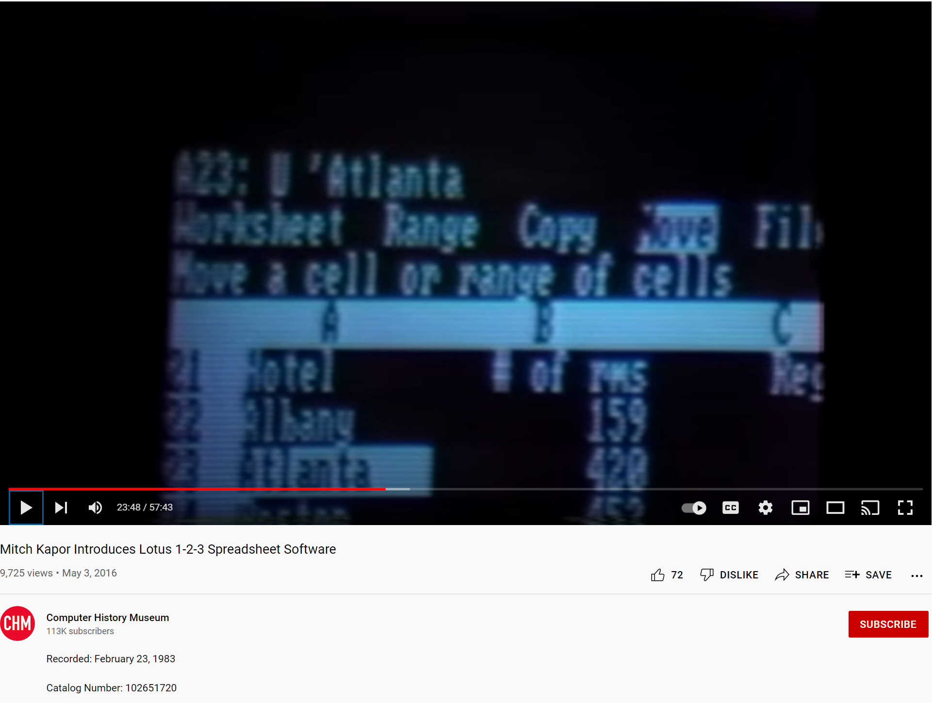
What Did Lotus Look Like?
Mitch Kapor (23 Feb 1983)
Notes:
https://www.youtube.com/watch?v=g46m0vBC9fk

Slide 55
Lotus Explodes (And Others Want In)
New York Times (13 Feb 1984)

Slide 56
Ties in the Sup Ct
516 U.S. 233 (1996)

Slide 57
Lotus v Borland Questions
1. Why did Borland want to imitate Lotus’s interface?
2. How will interface creation incentives be muted if we allow imitation?
3. What benefits will flow from allowing imitation?

Slide 58
Lotus v Borland Questions
4. How does Sec. 102(b) apply here?
5. And is Borland’s use a fair use under Sec. 107?

Slide 59
The Menu/Commands and Expression
Designing the Menu and Commands
  Many choices possible, perhaps an infinite number
  Lotus chose one from the multitude
Shouldn’t this be thought of as expressive?
If not expressive enough, can’t Lotus fix that by being more expressive?

Slide 60
Expression Isn’t the Point Here
Look at 102(b) Again
  In no case does copyright protection for an original work of authorship extend to any idea, procedure, process, system, method of operation, concept, principle, or discovery, regardless of the form in which it is described, explained, illustrated, or embodied in such work

Slide 61
Expression Isn’t the Point Here
Meaning?
  Even if expressive, if the expression operates as a method of operation, the expression can’t be copyrighted
How should we determine what constitutes a method of operation under Sec. 102(b)?

Slide 62
Upfront Choice?
“The fact that Lotus developers could have designed the Lotus menu command hierarchy differently is immaterial to the question of whether it is a ‘method of operation.’ In other words, our initial inquiry is not whether the Lotus menu command hierarchy incorporates any expression. Rather, our initial inquiry is whether the Lotus menu command hierarchy is a ‘method of operation.’”
Lotus (1st Cir. 1995)

Slide 63
Irrelevant
“Concluding, as we do, that users operate Lotus 1-2-3 by using the Lotus menu command hierarchy, and that the entire Lotus menu command hierarchy is essential to operating Lotus 1-2-3, we do not inquire further whether that method of operation could have been designed differently. The ‘expressive’ choices of what to name the command terms and how to arrange them do not magically change the uncopyrightable menu command hierarchy into copyrightable subject matter.”
Lotus (1st Cir. 1995)

Slide 64
June 1995: IBM Buys Lotus
New York Times (12 June 1995)

Slide 65
Sec. 106(1,2): Reproduction Right; Derivative Works Right
“Subject to sections 107 through 121 the owner of copyright under this title has the exclusive rights to do and to authorize any of the following:
  to reproduce the copyrighted work in copies or phonorecords;
  to prepare derivative works based upon the copyrighted work;”
17 USC 106

Slide 66
Derivative Works Definition
“A ‘derivative work’ is a work based upon one or more preexisting works, such as a translation, musical arrangement, dramatization, fictionalization, motion picture version, sound recording, art reproduction, abridgment, condensation, or any other form in which a work may be recast, transformed, or adapted.”
17 USC 101

Slide 67
Derivative Works Definition
“A work consisting of editorial revisions, annotations, elaborations, or other modifications which, as a whole, represent an original work of authorship, is a ‘derivative work’.”
17 USC 101

Slide 68
Unlawful Uses
“103(a) The subject matter of copyright as specified by section 102 includes compilations and derivative works, but protection for a work employing preexisting material in which copyright subsists does not extend to any part of the work in which such material has been used unlawfully.”
17 USC 103

Slide 69
Scope of Copyright in Derivative Works
“103(b) The copyright in a compilation or derivative work extends only to the material contributed by the author of such work, as distinguished from the preexisting material employed in the work, and does not imply any exclusive right in the preexisting material. The copyright in such work is independent of, and does not affect or enlarge the scope, duration, ownership, or subsistence of, any copyright protection in the preexisting material.”
17 USC 103

Slide 70
Lee v. A.R.T. Co.
125 F.3d 580 (7th Cir. 1997)

Slide 71
Lee v. A.R.T. Co.
Core Facts
  Annie Lee sells art notecards and lithographs to Deck the Walls
  Deck the Walls sells those to A.R.T. Co.
  ART glues cards to tiles, resells tiles
Lee sues ART alleging that ART is creating a derivative work, in violation of Sec. 106(2). Who wins?

Slide 72
The Card on a Tile
Hypo
  Lee creates notecard and claims copyright
  Lee glues card to tile and claims copyright on the card-on-a-tile
How many copyrights does she get? Does this eliminate competition in one medium?

Slide 73
Analysis
Answer
  Clear copyright on notecard
  As to card-on-a-tile
    103(b): The copyright in a compilation or derivative work extends only to the material contributed by the author of such work, as distinguished from the preexisting material employed in the work

Slide 74
Analysis
    What is contributed by the author of the card-on-a-tile?
  103 deals with compilations and derivative works in parallel
  Like Feist on compilations, gluing the notecard to a title lacks sufficient incremental originality
  Can’t separately copyright card-on-a-tile

Slide 75
Do We Need More?
No Copyright in Card-on-a-Tile
  True for Lee, true for ART
Does the absence of copyrightability of the card answer the question as to whether Lee can block ART?

Slide 76
Interoperability and Derivative Works
Rimini Street, 123 F.4th 986 (9th Cir. 2024)

Slide 77
Creation and Derivation
“‘In a broad sense, almost all works are derivative works in that in some degree they are derived from pre-existing works.’”
Rimini (9th Cir. 2024)

Slide 78
Not Just Interoperability
“So to be ‘based upon’ another work requires copying of the kind exhibited in translations, movie adaptations, and reproductions. Mere interoperability isn’t enough.”
Rimini (9th Cir. 2024)

Slide 79
Incorporation
“Thus, Congress’s list of examples suggests that a ‘derivative work’ must be in the subset of works substantially incorporating the preexisting work. Once again, whether a work is interoperable with another work doesn’t tell us if it substantially incorporates the other work.”
Rimini (9th Cir. 2024)

