Slide 1
Class 7: Mon 7 Apr 2025 Copyright Spring 2025 Functional Works: Useful Articles
Randal C. Picker
James Parker Hall Distinguished Service Professor of Law
The Law School
The University of Chicago

Slide 2
Topics for the Day
Key Questions
How do we separate form and function?
What is the functional part? What is the artistic or expressive part?
How do we police the boundaries between the two?

Slide 3
Topics for the Day
Key Questions
Today, perhaps more than any other day so far, we have cases about people who are in business to make money and the question is how does copyright matter there?
In both cases, someone comes forward and says “I want to copy what you have done.” Why do they want to do that?

Slide 4
Sec. 102: Subject Matter of Copyright
17 USC 102

Slide 5
PGS Works
“‘Pictorial, graphic, and sculptural works’ include two-dimensional and three-dimensional works of fine, graphic, and applied art, photographs, prints and art reproductions, maps, globes, charts, diagrams, models, and technical drawings, including architectural plans. Such works shall include works of artistic craftsmanship insofar as their form but not their mechanical or utilitarian aspects are concerned;”
Title 17

Slide 6
Useful Article Designs
“the design of a useful article, as defined in this section, shall be considered a pictorial, graphic, or sculptural work only if, and only to the extent that, such design incorporates pictorial, graphic, or sculptural features that can be identified separately from, and are capable of existing independently of, the utilitarian aspects of the article.”
Title 17

Slide 7
Useful Article Definition
“A ‘useful article’ is an article having an intrinsic utilitarian function that is not merely to portray the appearance of the article or to convey information. An article that is normally a part of a useful article is considered a ‘useful article’.”
Title 17

Slide 8
Sec. 113: PGS Rights Limitations
Title 17

Slide 9
Sec. 113 Legislative History
H. Rep. 94-1476

Slide 10
Sec. 113 Legislative History
H. Rep. 94-1476

Slide 11
1902 Statute on Ornamental Designs
32 Stat. 193 (1902)

Slide 12
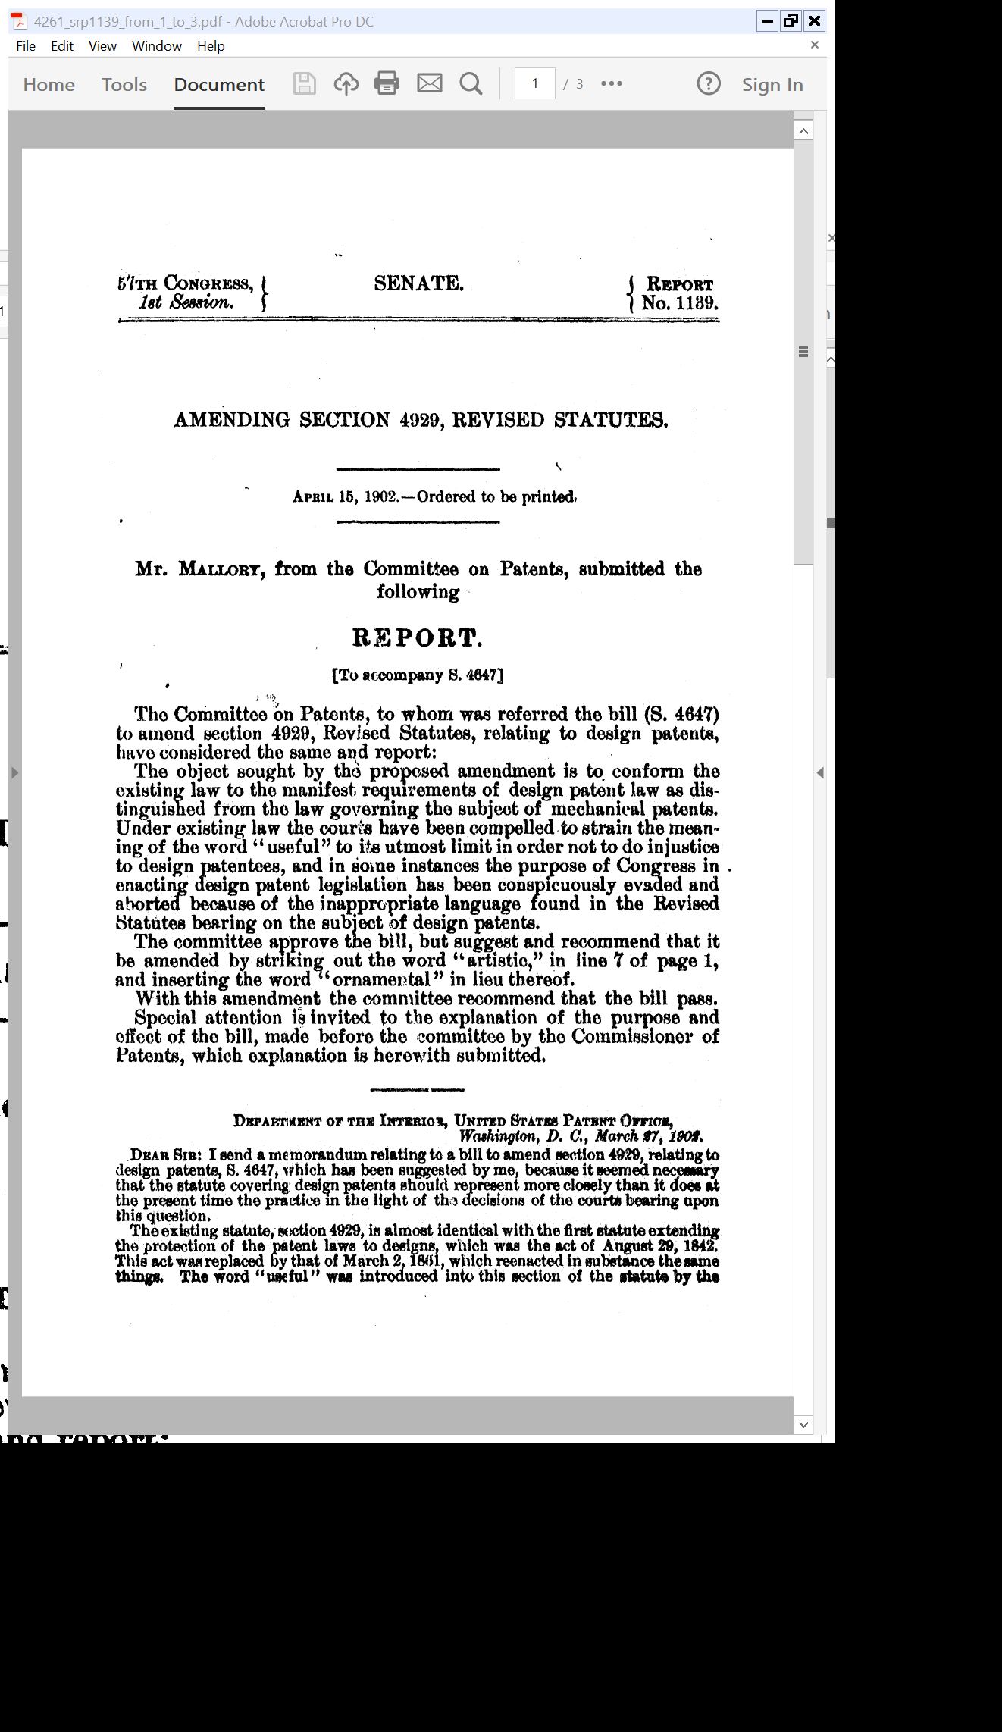
Dump Useful; And Ornamental, Not Artistic
Senate Report (15 Apr 1902)

Slide 13
Why Make Changes?
Senate Report (15 Apr 1902)

Slide 14
Sec. 171: Patents for Designs
Title 35

Slide 15
Sec. 173: 15 Years
Title 35

Slide 16
“The Ornamental Design of an Electronic Device, as Shown and Described”
D618,677 (29 June 2010)

Slide 17
Pages 2 and 3
D618,677 (29 June 2010)

Slide 18
Pages 4 and 5
D618,677 (29 June 2010)

Slide 19
Page 6
D618,677 (29 June 2010)

Slide 20
Design Patents in Action
Apple v Samsung Complaint (15 Apr 2011)

Slide 21
Jury Verdict
“We, the jury, unanimously agree to the answers to the following questions and return them under the instructions of this Court as our verdict in this case.”
Amended Verdict Form (24 Aug 2012)

Slide 22
Utility Patent Infringement
Amended Verdict Form (24 Aug 2012)

Slide 23
Design Patent Infringement
Amended Verdict Form (24 Aug 2012)

Slide 24
Damages Award
Amended Verdict Form (24 Aug 2012)

Slide 25
Damages by Device
Amended Verdict Form (24 Aug 2012)

Slide 26
Mazer (U.S. 1954)
347 U.S. 201 (1954)

Slide 27
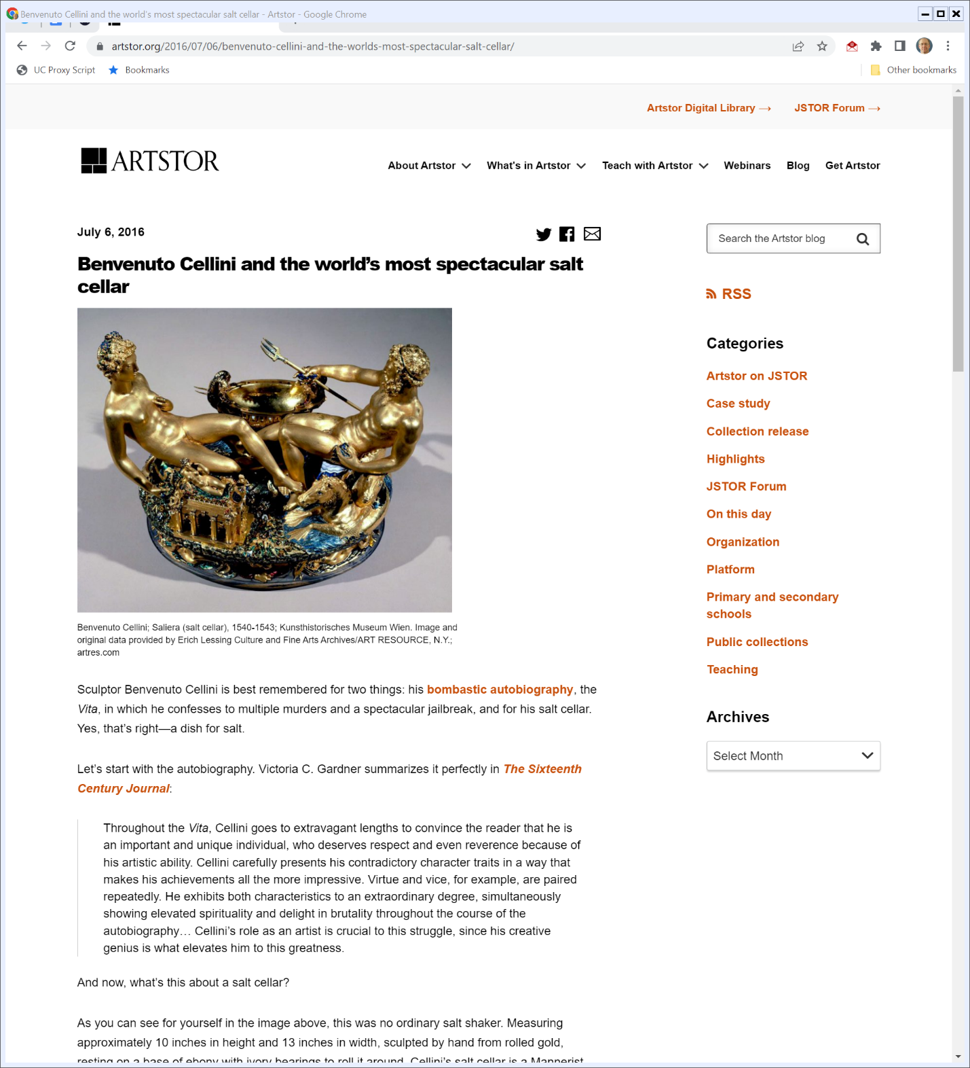

The Salt Cellar (TTYN (1 of 5))
Artstor (6 July 2016)
Notes:
https://www.artstor.org/2016/07/06/benvenuto-cellini-and-the-worlds-most-spectacular-salt-cellar/

Slide 28
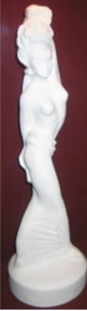
The Lamp/Statutette (TTYN (2 of 5))
Mazer v. Stein (U.S. 1954)

Slide 29
Belt Buckles (TTYN (3 of 5))
Kieselstein-Cord (2nd Cir. 1980)

Slide 30
Mannequin Torsos (TTYN (4 of 5))
Carol Barnhart (2nd Cir. 1980)

Slide 31
Bicycle Racks (TTYN (5 of 5))
Brandir (2nd Cir. 1987)

Slide 32
Results
Cases
Mazur (statuette): Copyrightable
Kieselstein-Cord (belt buckles): Copyrightable
Carol Barnhart (torso): Not copyrightable (2-1)
Brandir (bike rack): Not copyrightable (2-1)

Slide 33
Rack as Industrial Design
“Had Brandir merely adopted one of the existing sculptures as a bicycle rack, neither the application to a utilitarian end nor commercialization of that use would have caused the object to forfeit its copyrighted status. Comparison of the RIBBON Rack with the earlier sculptures, however, reveals that while the rack may have been derived in part from one of more ‘works of art,’ it is in its final form essentially a product of industrial design.”
Brandir (2nd Cir. 1987)

Slide 34
Understanding the RIBBON Rack
“It is unnecessary to determine whether to the art world the RIBBON Rack properly would be considered an example of minimalist sculpture. The result under the copyright statute is not changed. Using the test we have adopted, it is not enough that, to paraphrase Judge Newman, the rack may stimulate in the mind of the reasonable observer a concept separate from the bicycle rack concept.”
Brandir (2nd Cir. 1987)

Slide 35
Form and Function Linked Together
“While the RIBBON Rack may be worthy of admiration for its aesthetic qualities alone, it remains nonetheless the product of industrial design. Form and function are inextricably intertwined in the rack, its ultimate design being as much the result of utilitarian pressures as aesthetic choices. Indeed, the visually pleasing proportions and symmetricality of the rack represent design changes made in response to functional concerns.”
Brandir (2nd Cir. 1987)

Slide 36
Good Design: Fusion of Function and Aesthetics
“Judging from the awards the rack has received, it would seem in fact that Brandir has achieved with the RIBBON Rack the highest goal of modern industrial design, that is, the harmonious fusion of function and aesthetics.”
Brandir (2nd Cir. 1987)

Slide 37
Design Patents and Copyright Can Overlap
“We do hold that the patentability of the statuettes, fitted as lamps or unfitted, does not bar copyright as works of art. Neither the Copyright Statute nor any other says that because a thing is patentable it may not be copyrighted. We should not so hold. Unlike a patent, a copyright gives no exclusive right to the art disclosed; protection is given only to the expression of the idea--not the idea itself.”
Mazer (U.S. 1954)

Slide 38
Just Can’t Copy
“Absent copying there can be no infringement of copyright. Thus, respondents may not exclude others from using statuettes of human figures in table lamps; they may only prevent use of copies of their statuettes as such or as incorporated in some other article.”
Mazer (U.S. 1954)

Slide 39
Star Athletica (U.S. 2017)
580 U.S. 405 (2017)

Slide 40

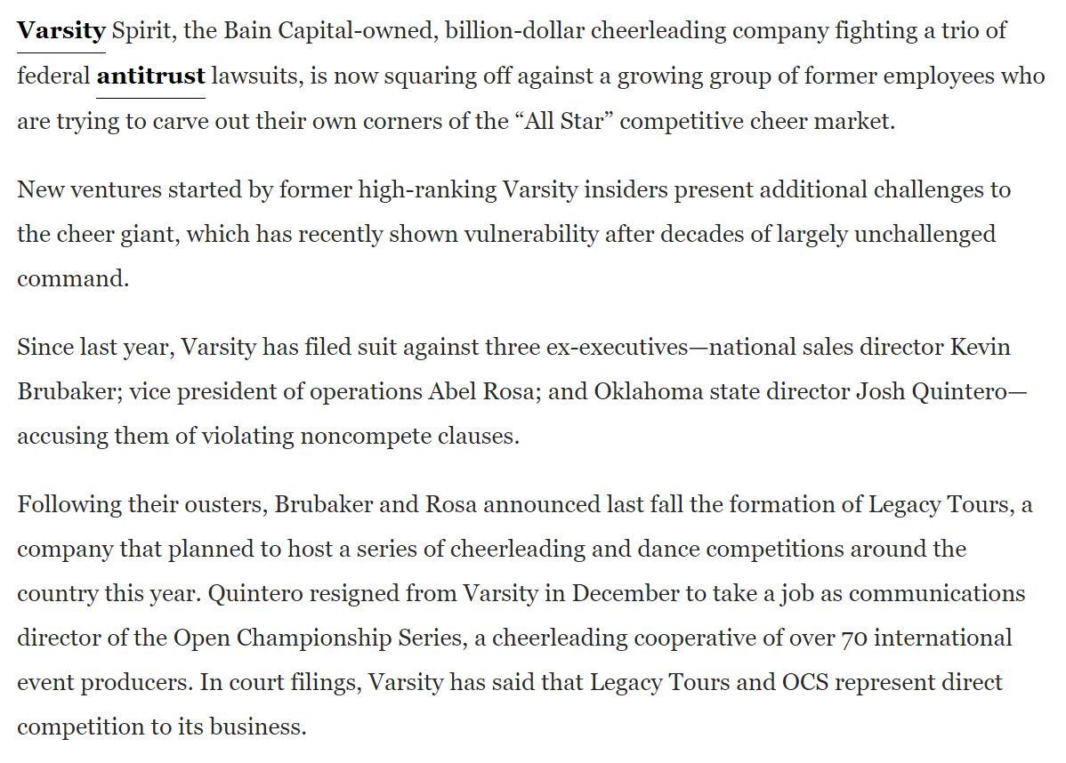
Why Copy Cheerleading Uniforms?
Spotico (13 Oct 2021)
Notes:
https://www.sportico.com/leagues/other-sports/2021/accused-monopolist-varsity-spirit-1234643664/

Slide 41
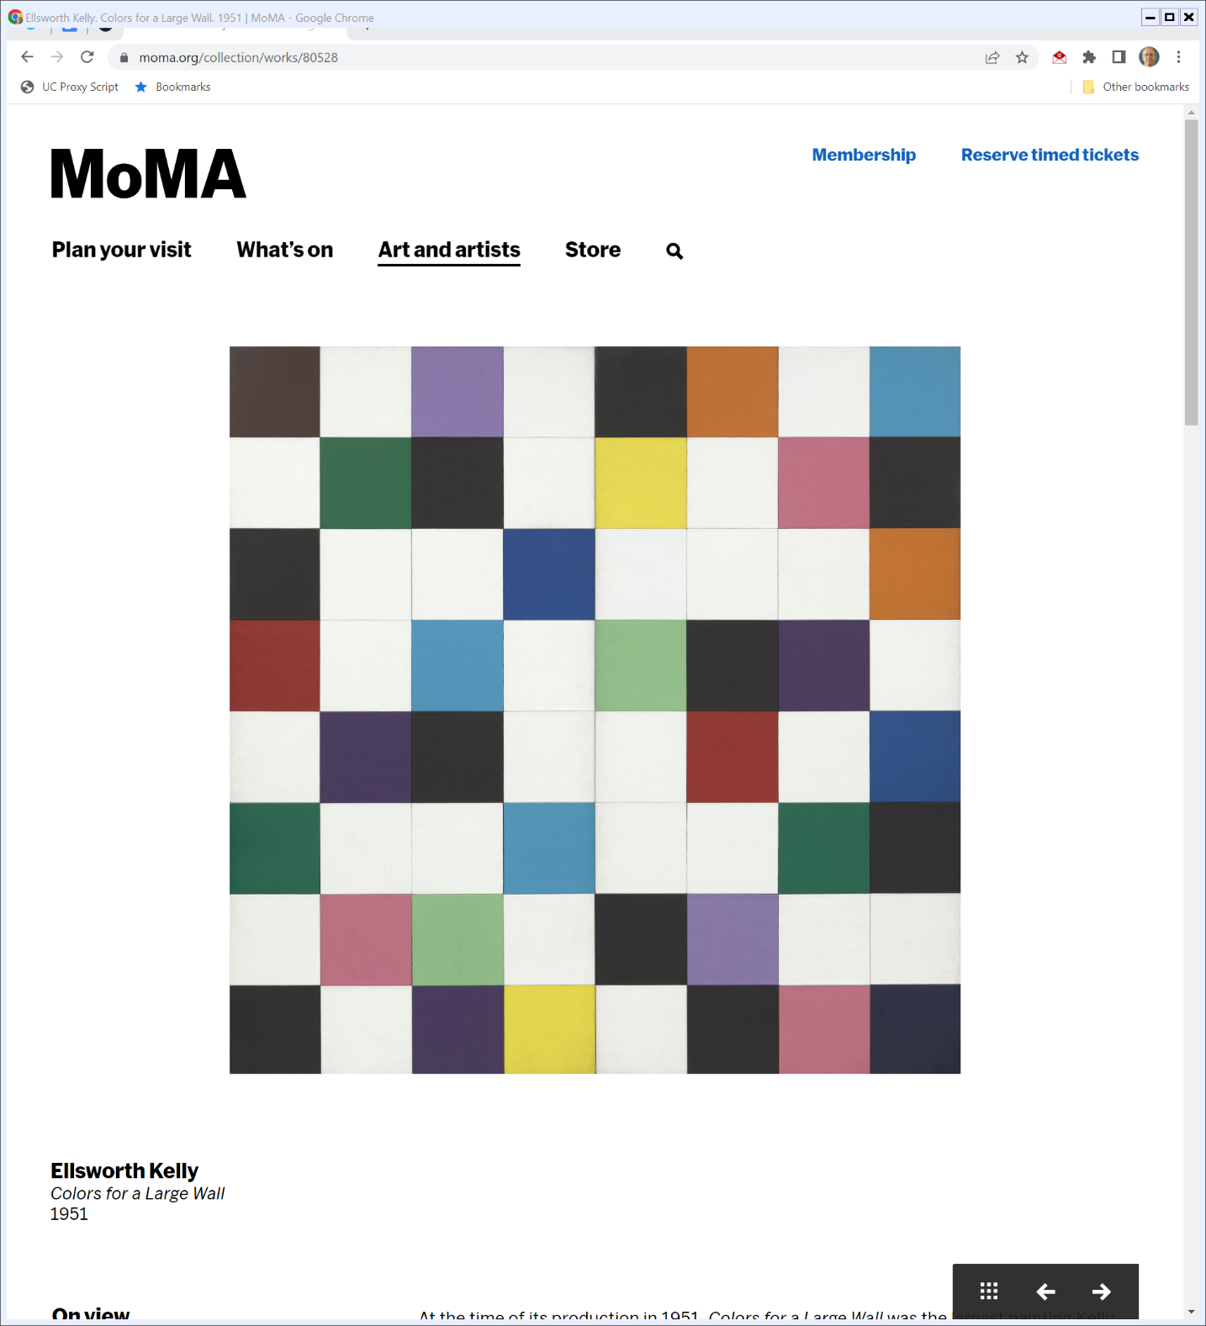
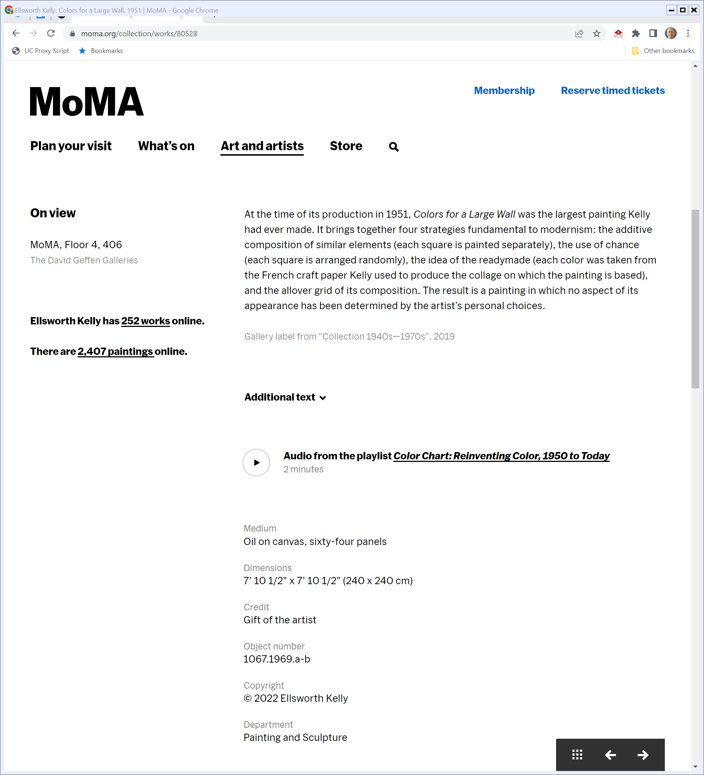
2D PGS (TTYN (1 of 5))
MoMA (Visited 13 Oct 2022)
Notes:
https://www.moma.org/collection/works/80528

Slide 42
Using Colors for a Large Wall
TTYN (2 of 5)
Hypo
X takes a picture of the Kelly painting, puts it on t-shirts and sells them.
Y takes a picture of the Kelly painting, puts it on cheerleading uniforms and sells them

Slide 43
Using Colors for a Large Wall
TTYN (3 of 5)
Questions
Does Kelly have a copyright in the painting?
Does X violate that copyright? Does Y?
Is this Star Athletica? Do we need to engage in “separability” analysis?

Slide 44
Thomas Appendix (TTYN (4 of 5))
Star Athletica Images

Slide 45
Ginsburg Appendix (TTYN (5 of 5))
Star Athletica Images

Slide 46
Breyer Appendix
Star Athletica Images

Slide 47
Breyer Appendix
Star Athletica Images

Slide 48
Breyer Appendix
Star Athletica Images

Slide 49
Holding
“We hold that a feature incorporated into the design of a useful article is eligible for copyright protection only if the feature (1) can be per­ceived as a two- or three-dimensional work of art separate from the useful article and (2) would qualify as a protectable pictorial, graphic, or sculptural work—either on its own or fixed in some other tangible medium of expression—if it were imagined separately from the useful article into which it is incorporated.”
Star Athletica (2017)

Slide 50
Understanding Separability
“The ultimate separability question, then, is whether the feature for which copyright protection is claimed would have been eligible for copyright protection as a pictorial, graphic, or sculptural work had it originally been fixed in some tangi­ble medium other than a useful article before being ap­plied to a useful article.”
Star Athletica (2017)

Slide 51
Ginsburg, Concurring in the Judgment
“Unlike the majority, I would not take up in this case the separability test appropriate under 17 U. S. C. §101. Consideration of that test is unwarranted because the designs at issue are not designs of useful articles. Instead, the designs are themselves copyrightable pictorial or graphic works reproduced on useful articles.”
Star Athletica (2017)

Slide 52
Breyer Dissent: A Practical and Economic Problem
“The conceptual approach that I have described reflects Congress’ answer to a problem that is primarily practical and economic.”
Star Athletica (2017)

Slide 53
Copyright Isn’t the Only Tool
“And it is clear that Congress has not extended broad copyright protection to the fashion design industry. … Congress’ decision not to grant full copyright protection to the fashion industry has not left the industry without protection. Patent design protection is available. 35 U. S. C. §§171, 173. A maker of clothing can obtain trademark protection under the Lanham Act for signature features of the clothing. 15 U. S. C. §1051 et seq.”
Star Athletica (2017)

Slide 54
Fashion Industry Has Thrived
“And a designer who creates an original textile design can receive copyright protection for that pattern as placed, for example, on a bolt of cloth, or anything made with that cloth. … The fashion industry has thrived against this backdrop, and designers have contributed immeasurably to artistic and personal self-expression through clothing.”
Star Athletica (2017)

