Slide 1
Class 6: Thurs 3 Apr 2025
Copyright Spring 2025
Characters
Randal C. Picker
James Parker Hall Distinguished Service Professor of Law
The Law School
The University of Chicago

Slide 2
Start Here
Using Characters
  Box Office Grosses
    https://www.boxofficemojo.com/alltime/world/
  Fan fiction
    https://www.fanfiction.net/

Slide 3

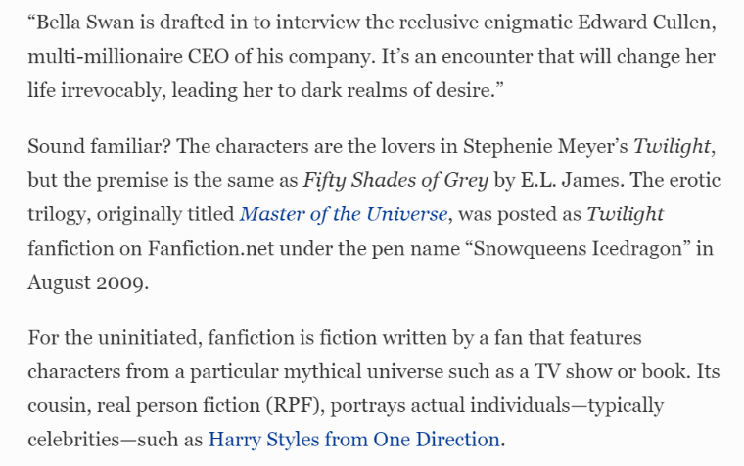
The Most Successful Fanfic?
Forbes (10 Feb 2017)
Notes:
https://www.forbes.com/sites/hayleycuccinello/2017/02/10/fifty-shades-of-green-how-fanfiction-went-from-dirty-little-secret-to-money-machine/?sh=f6e3b88264cf

Slide 4
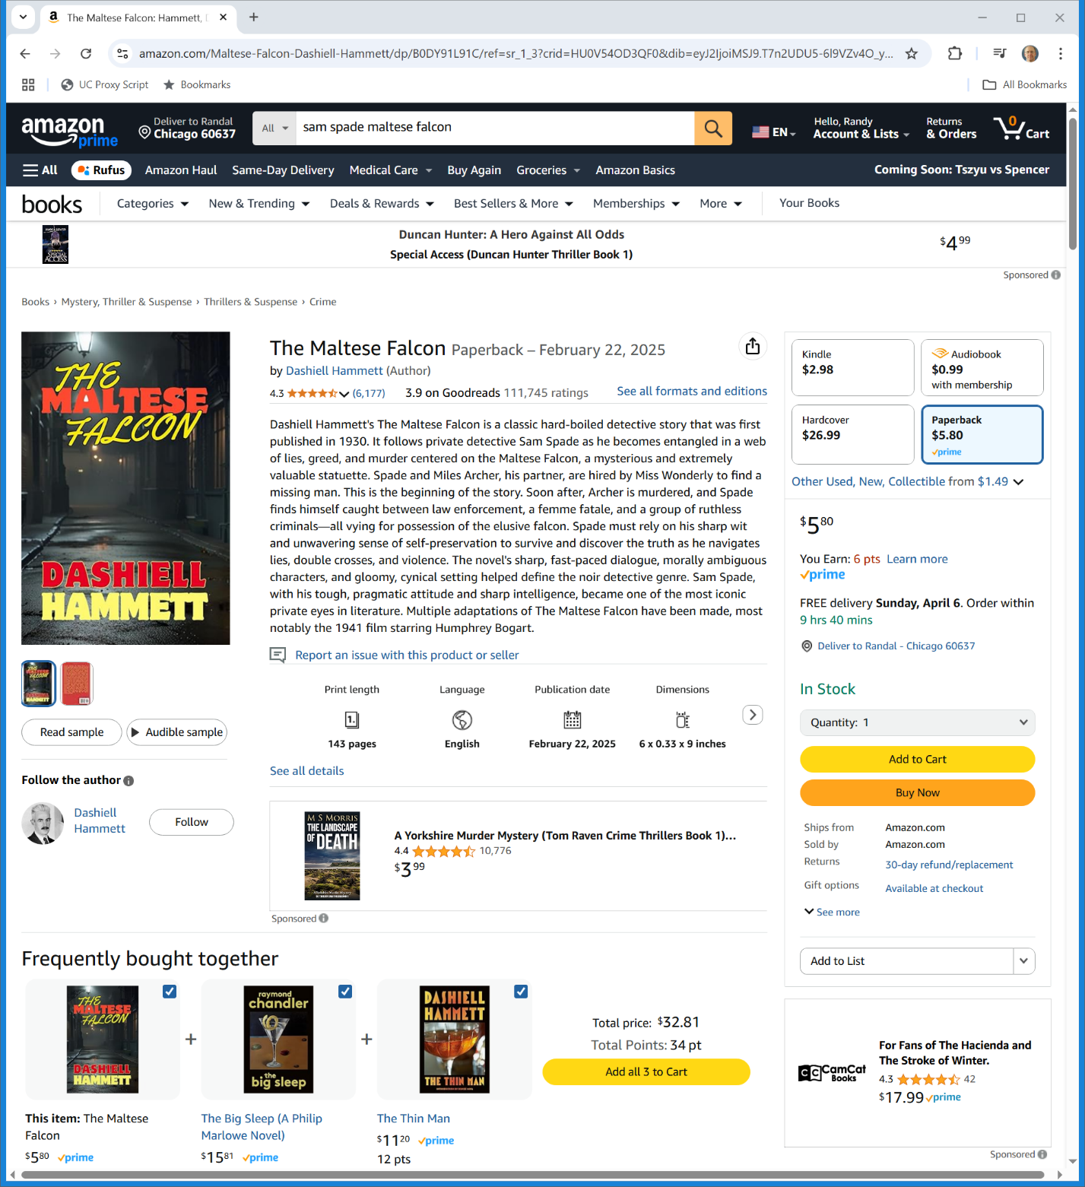

The Maltese Falcon
Amazon (Visited 3 Apr 2025)
Notes:
https://www.amazon.com/Maltese-Falcon-Dashiell-Hammett/dp/B0DY91L91C/ref=sr_1_3?crid=HU0V54OD3QF0&dib=eyJ2IjoiMSJ9.T7n2UDU5-6l9VZv4O_yeRG5_YrSLaxR-E06qoLDsyzNrpXt4ajV21bDuPKcB9aGLEM4-xeBbONijlNQGsYyHwa3E2cjE57bvdh5GfwRSoGKrYXRR5-IdV38gR2iP6ROXCkszxCVkxMVx41G8YIUwQU_9IjFxOWQ49n3XLMlC7GhC84G3ICLli95T_KuheiT_7EFvuhYxIMbKhI9gdIvdHQ.zLp0WQSqVUMdE3pSsCY3QokEvW90q0Af54fA59inL3o&dib_tag=se&keywords=sam+spade+maltese+falcon&qid=1743707986&sprefix=sam+spade+maltese+falcon%2Caps%2C91&sr=8-3

Slide 5
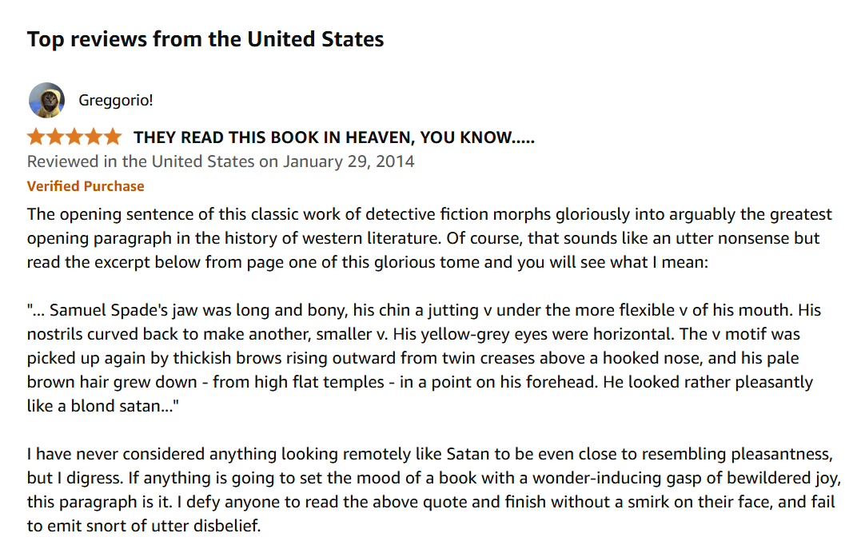
The Maltese Falcon
Amazon (Visited 3 Apr 2025)
Notes:
https://www.amazon.com/Maltese-Falcon-Dashiell-Hammett/dp/B0DY91L91C/ref=sr_1_3?crid=HU0V54OD3QF0&dib=eyJ2IjoiMSJ9.T7n2UDU5-6l9VZv4O_yeRG5_YrSLaxR-E06qoLDsyzNrpXt4ajV21bDuPKcB9aGLEM4-xeBbONijlNQGsYyHwa3E2cjE57bvdh5GfwRSoGKrYXRR5-IdV38gR2iP6ROXCkszxCVkxMVx41G8YIUwQU_9IjFxOWQ49n3XLMlC7GhC84G3ICLli95T_KuheiT_7EFvuhYxIMbKhI9gdIvdHQ.zLp0WQSqVUMdE3pSsCY3QokEvW90q0Af54fA59inL3o&dib_tag=se&keywords=sam+spade+maltese+falcon&qid=1743707986&sprefix=sam+spade+maltese+falcon%2Caps%2C91&sr=8-3

Slide 6
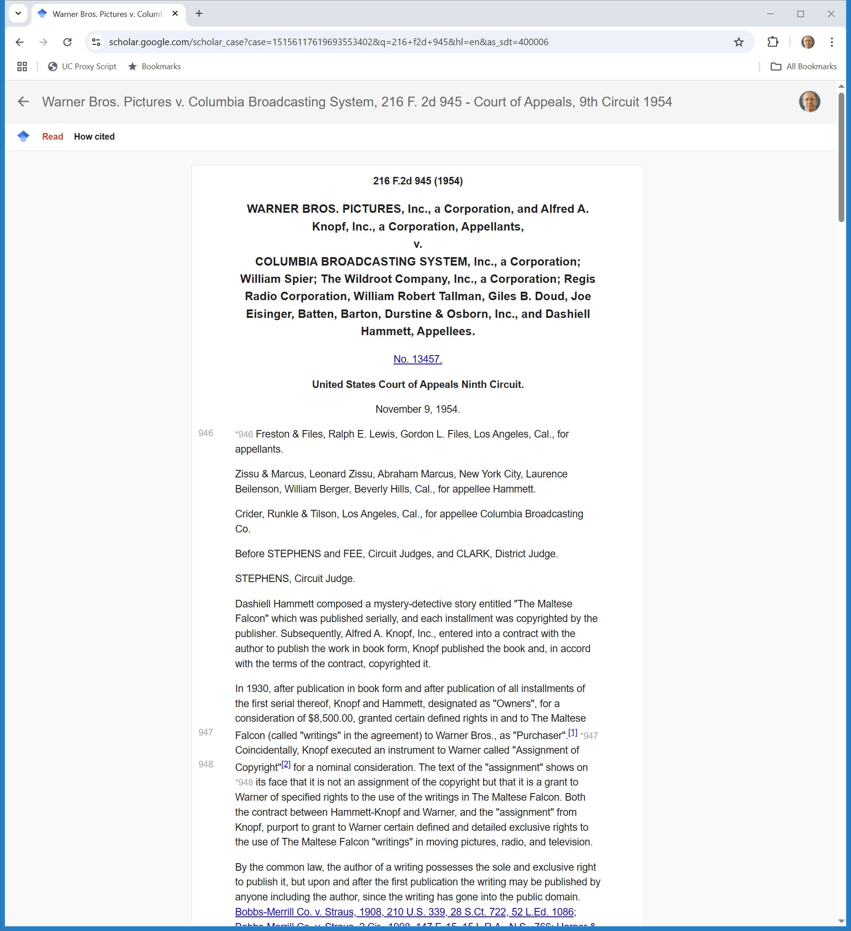
The Maltese Falcon Again
“It is conceivable that the character really constitutes the story being told, but if the character is only the chessman in the game of telling the story he is not within the area of the protection afforded by the copyright.”
Warner Brothers, 216 F.2d 945 (9th Cir. 1954)

Slide 7
Characters: Gaiman v. McFarlane
360 F.3d 655 (7th Cir. 2004)

Slide 8
Gaiman v. McFarlane: Text v. Pictures
Core Facts
  McFarlane invites four writers to help create scripts for issue of Spawn
  Not done as work made for hire
  Gaiman text creates three new “characters” illustrated by McFarlane
Are the characters copyrightable?

Slide 9
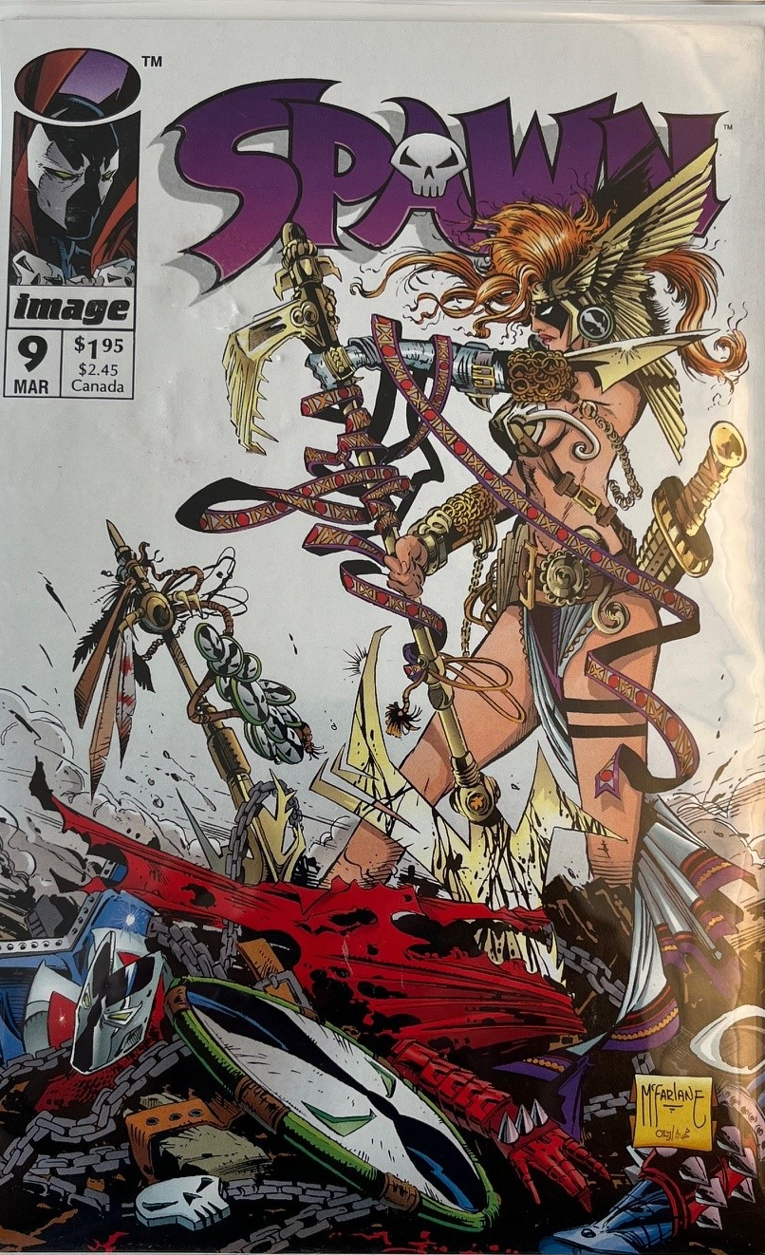
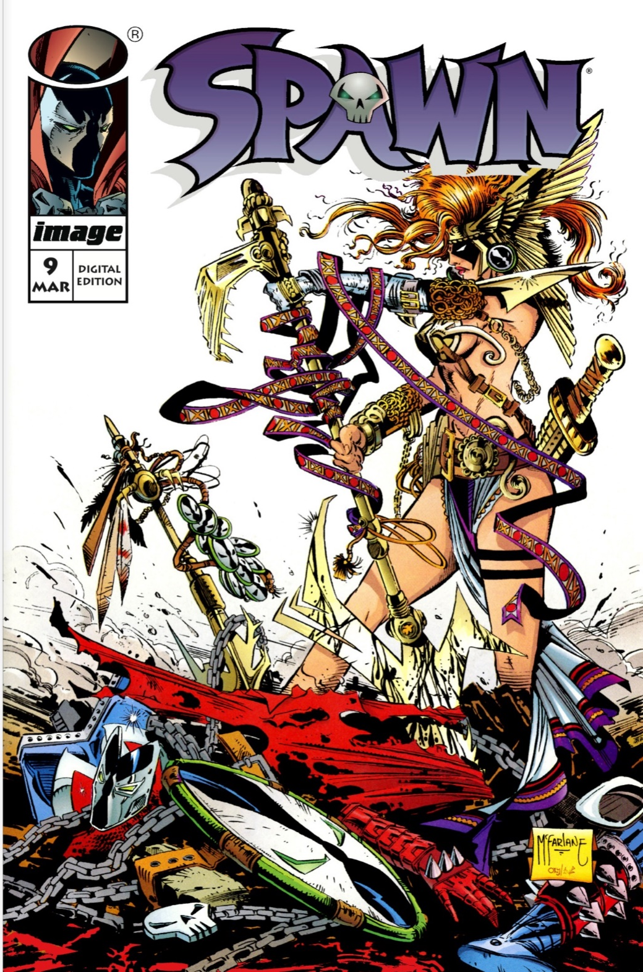

Spawn No. 9
Physical Cover/Digital Cover

Slide 10
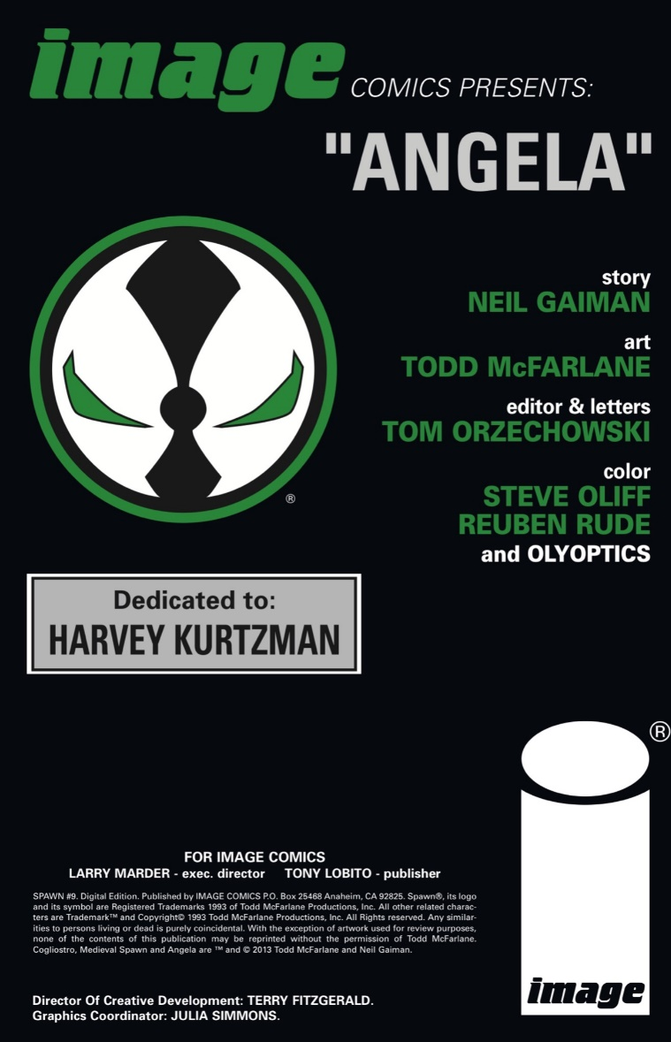

Spawn No. 9: Authors?
Credits

Slide 11
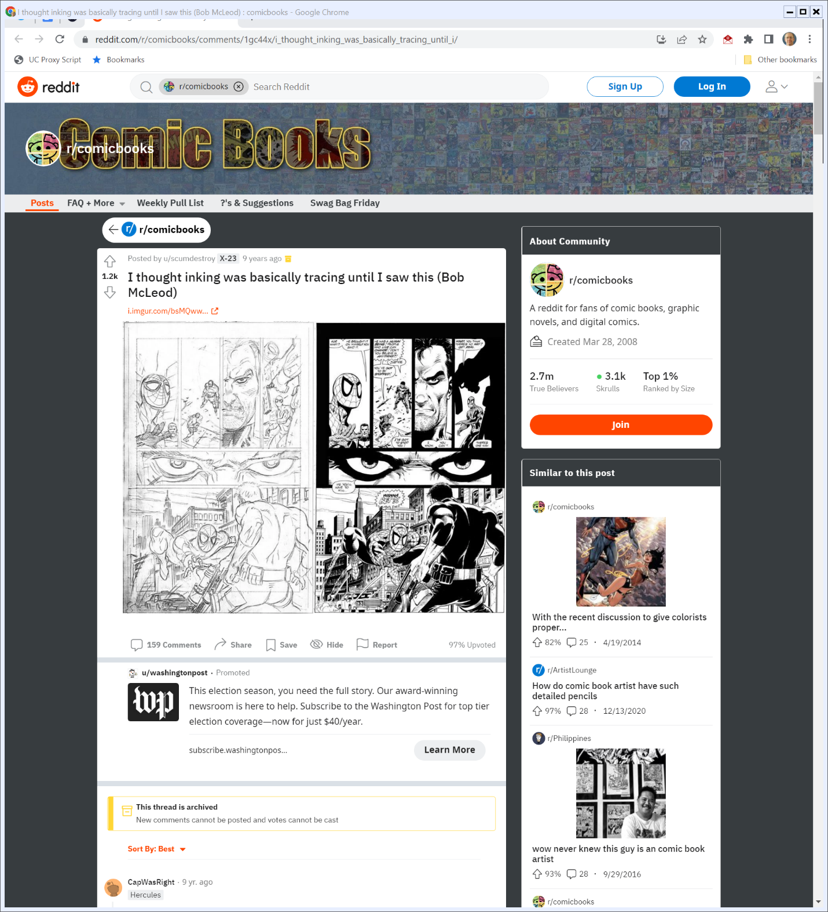

Penciler v. Inker
Reddit (Visited 12 Oct 2022)
Notes:
https://www.reddit.com/r/comicbooks/comments/1gc44x/i_thought_inking_was_basically_tracing_until_i/

Slide 12
Digital Edition Spawn No. 9: Copyrights and Trademark
Credits

Slide 13
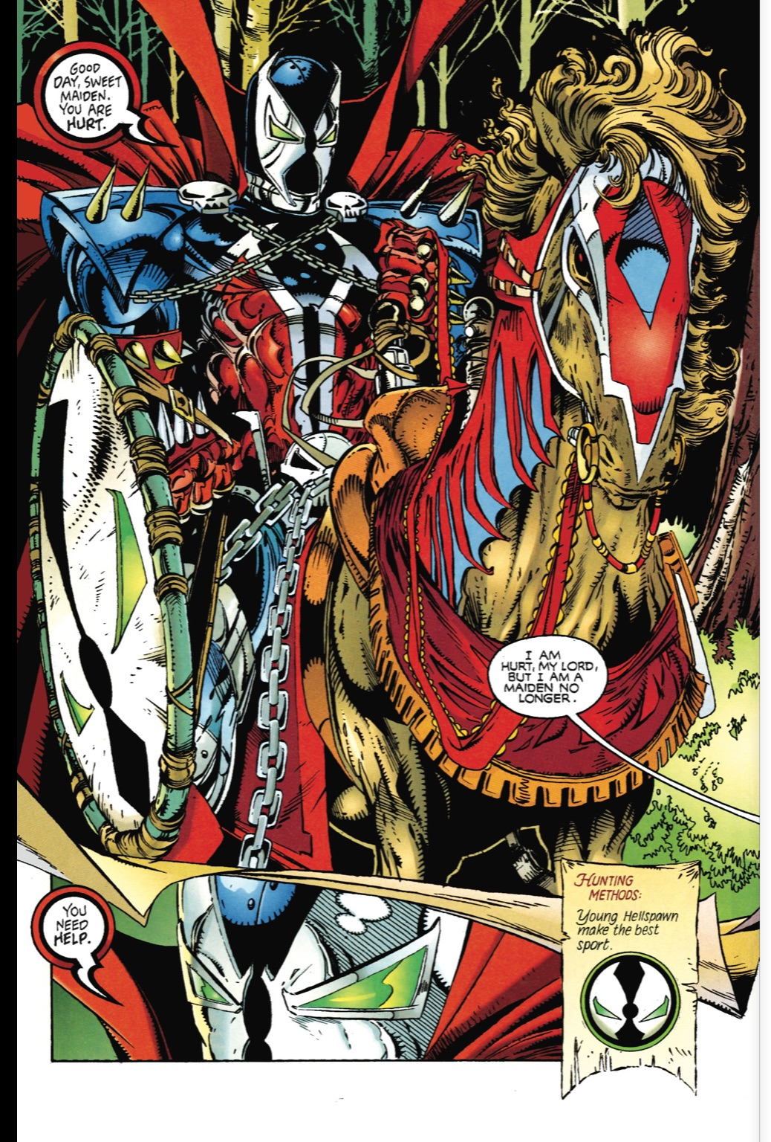
Olden Days Spawn (TTYN (1 of 4))
Spawn No. 9

Slide 14
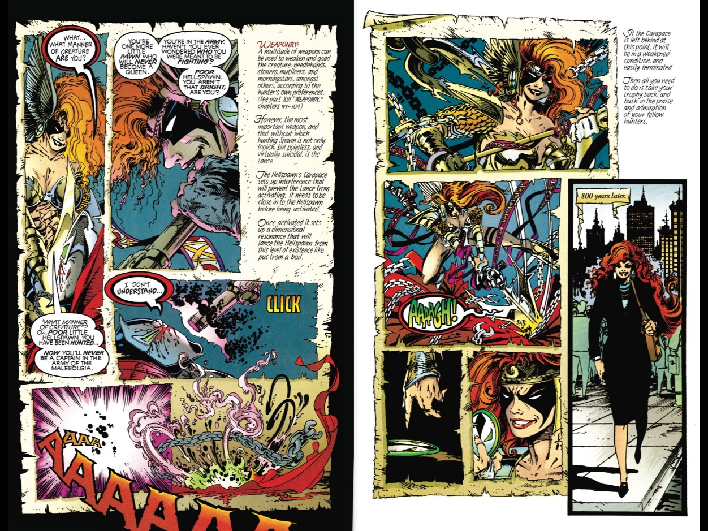

Angela 800 Years Later (TTYN (2 of 4))
Spawn No. 9

Slide 15
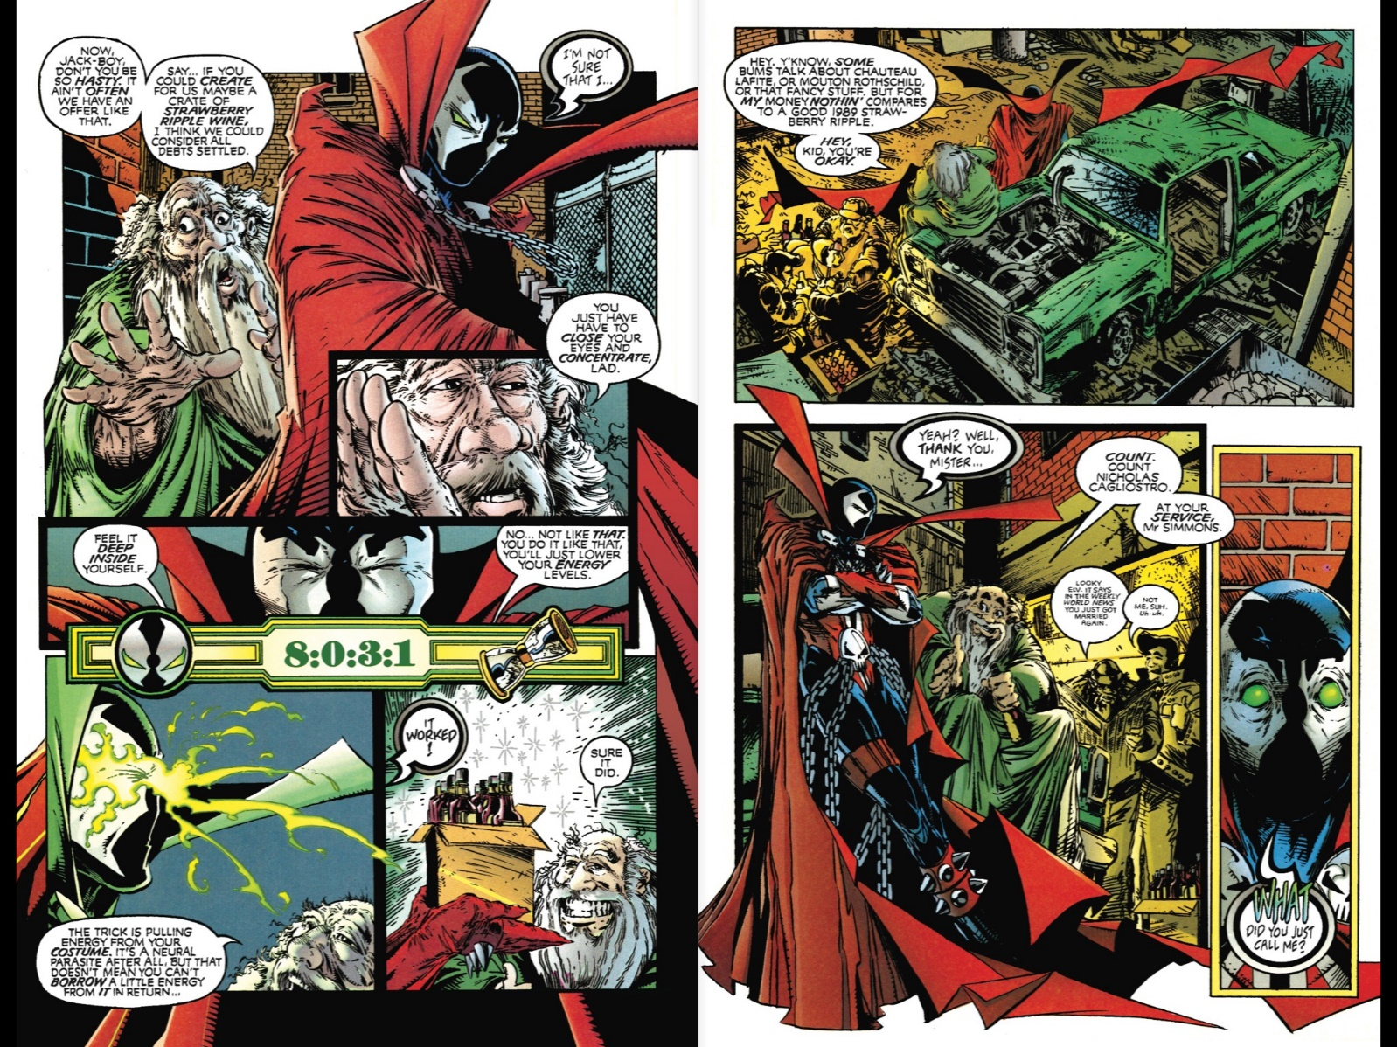

Count Nicholas Cagliostro (TTYN (3 of 4))
Spawn No. 9

Slide 16
Sorting Characters
TTYN (4 of 4)
Questions
  Which of these characters are within copyright? What separates those that are from those that are not?
  Who owns the copyright on these characters?

Slide 17
Joint Authorship Again
“It is true that people who contribute merely nonexpressive elements to a work are not copyright owners. … There has to be some original expression contributed by anyone who claims to be a co-author, and the rule (we’ll consider an exception momentarily) is that his contribution must be independently copyrightable.”
Gaiman (7th Cir. 2004)

Slide 18
One More Time
“But where two or more people set out to create a character jointly in such mixed media as comic books and motion pictures and succeed in creating a copyrightable character, it would be paradoxical if though the result of their joint labors had more than enough originality and creativity to be copyrightable, no one could claim copyright.”
Gaiman (7th Cir. 2004)

Slide 19
Scènes á faire
“Related to the fundamental idea-expression dichotomy that we’ve already mentioned, the doctrine teaches that ‘a copyright owner can’t prove infringement by pointing to features of his work that are found in the defendant’s work as well but that are so rudimentary, commonplace, standard, or unavoidable that they do not serve to distinguish one work within a class of works from another.’ Bucklew v. Hawkins, Ash, Baptie & Co., 329 F.3d 923, 929 (7th Cir. 2003) … .”
Gaiman (7th Cir. 2004)

Slide 20
Copyrighting the Count
“[Gaiman] claims to be the joint owner of the copyright on a character that has a specific name and a specific appearance. Cogliostro’s age, obviously phony title (‘Count’’), what he knows and says, his name, and his faintly Mosaic facial features combine to create a distinctive character. No more is required for a character copyright.”
Gaiman (7th Cir. 2004)

Slide 21
The Test Here
“Although Gaiman’s verbal description of Cogliostro may well have been of a stock character, once he was drawn and named and given speech he became sufficiently distinctive to be copyrightable.”
Gaiman (7th Cir. 2004)

Slide 22
DC Comics v. Towle
802 F.3d 1012 (9th Cir. 2015)

Slide 23
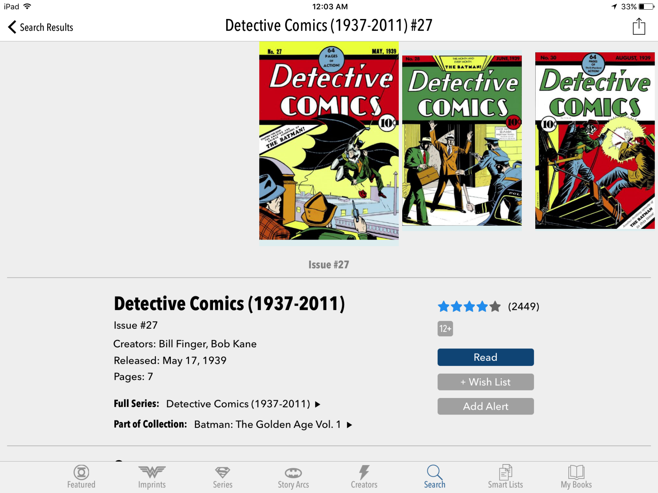
DC Comics Store

Slide 24
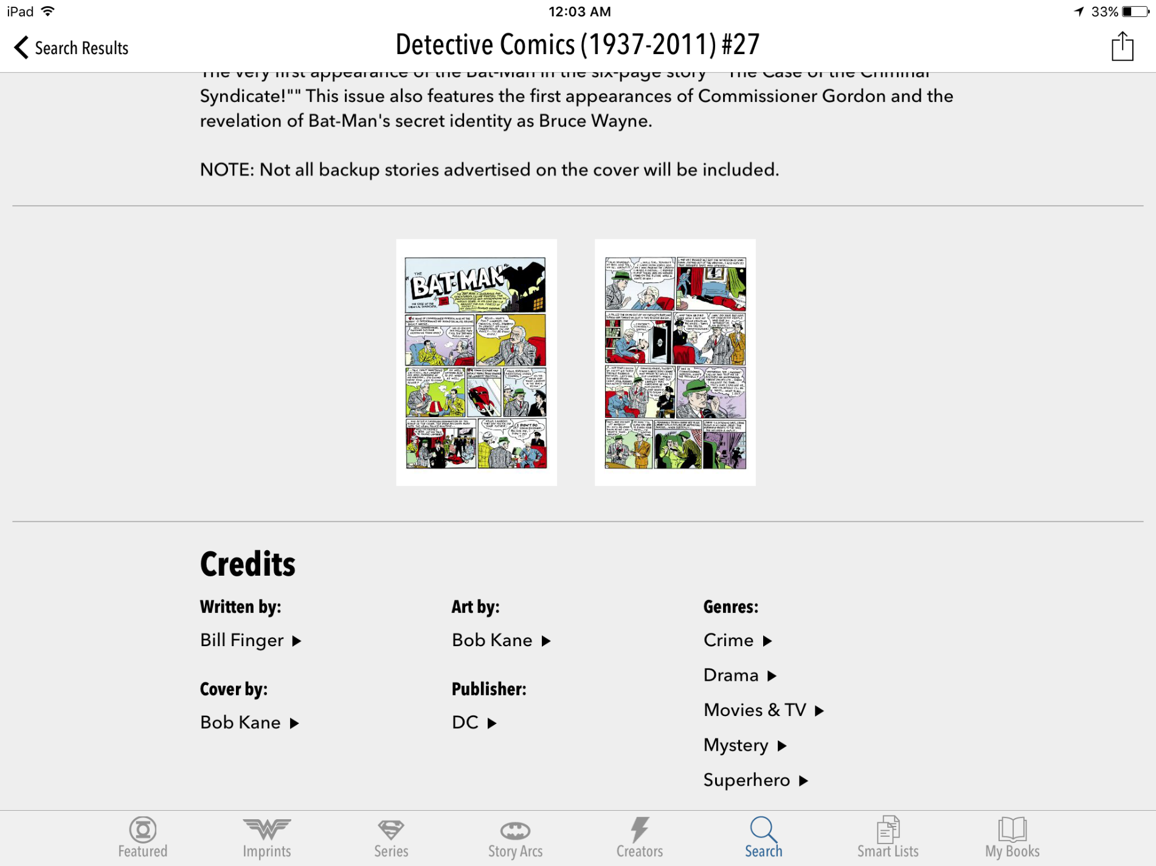
DC Comics Store

Slide 25
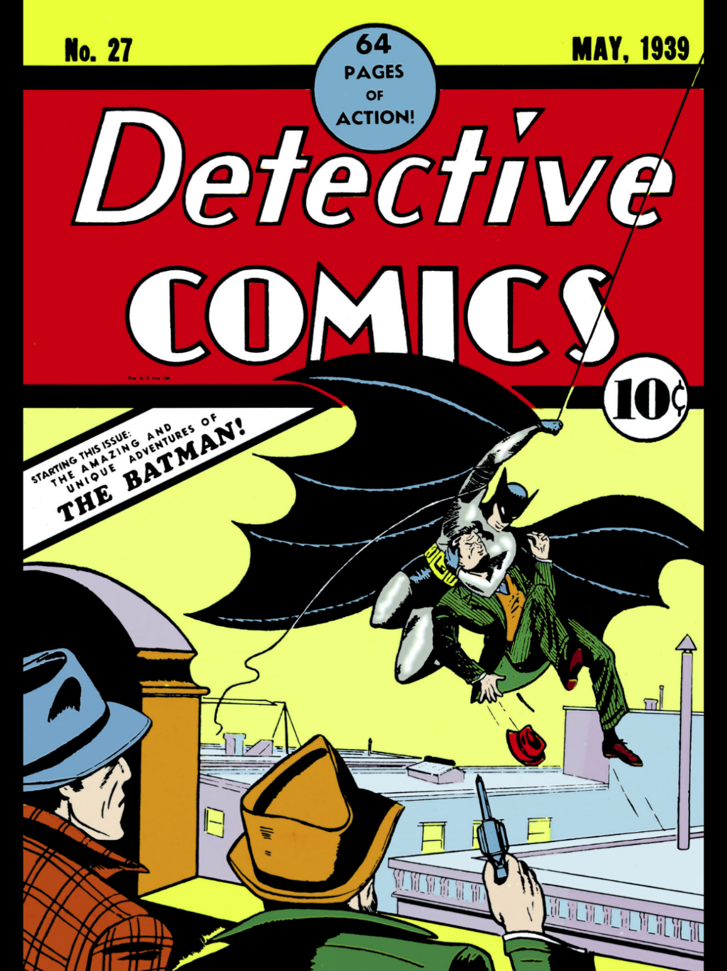
The Batman
Detective Comics No. 27 (May 1939)

Slide 26
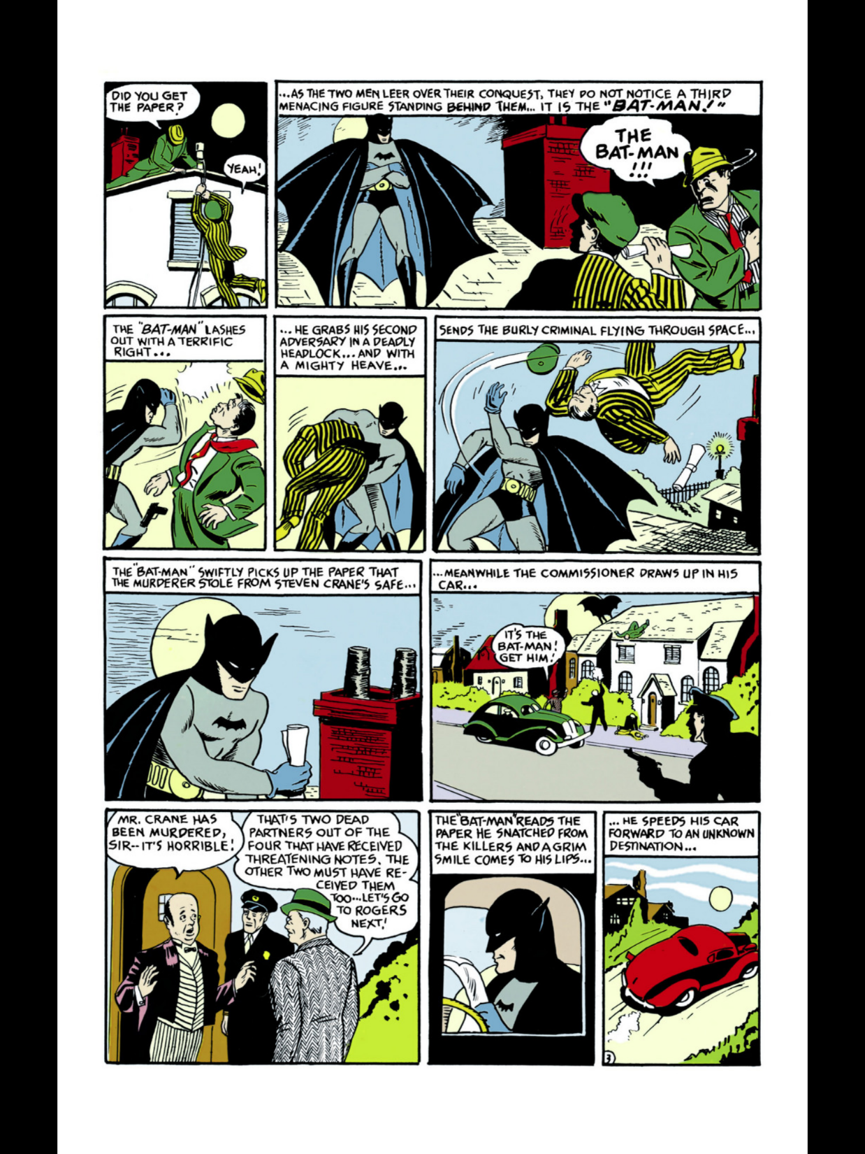
And His Car?
DC No. 27

Slide 27
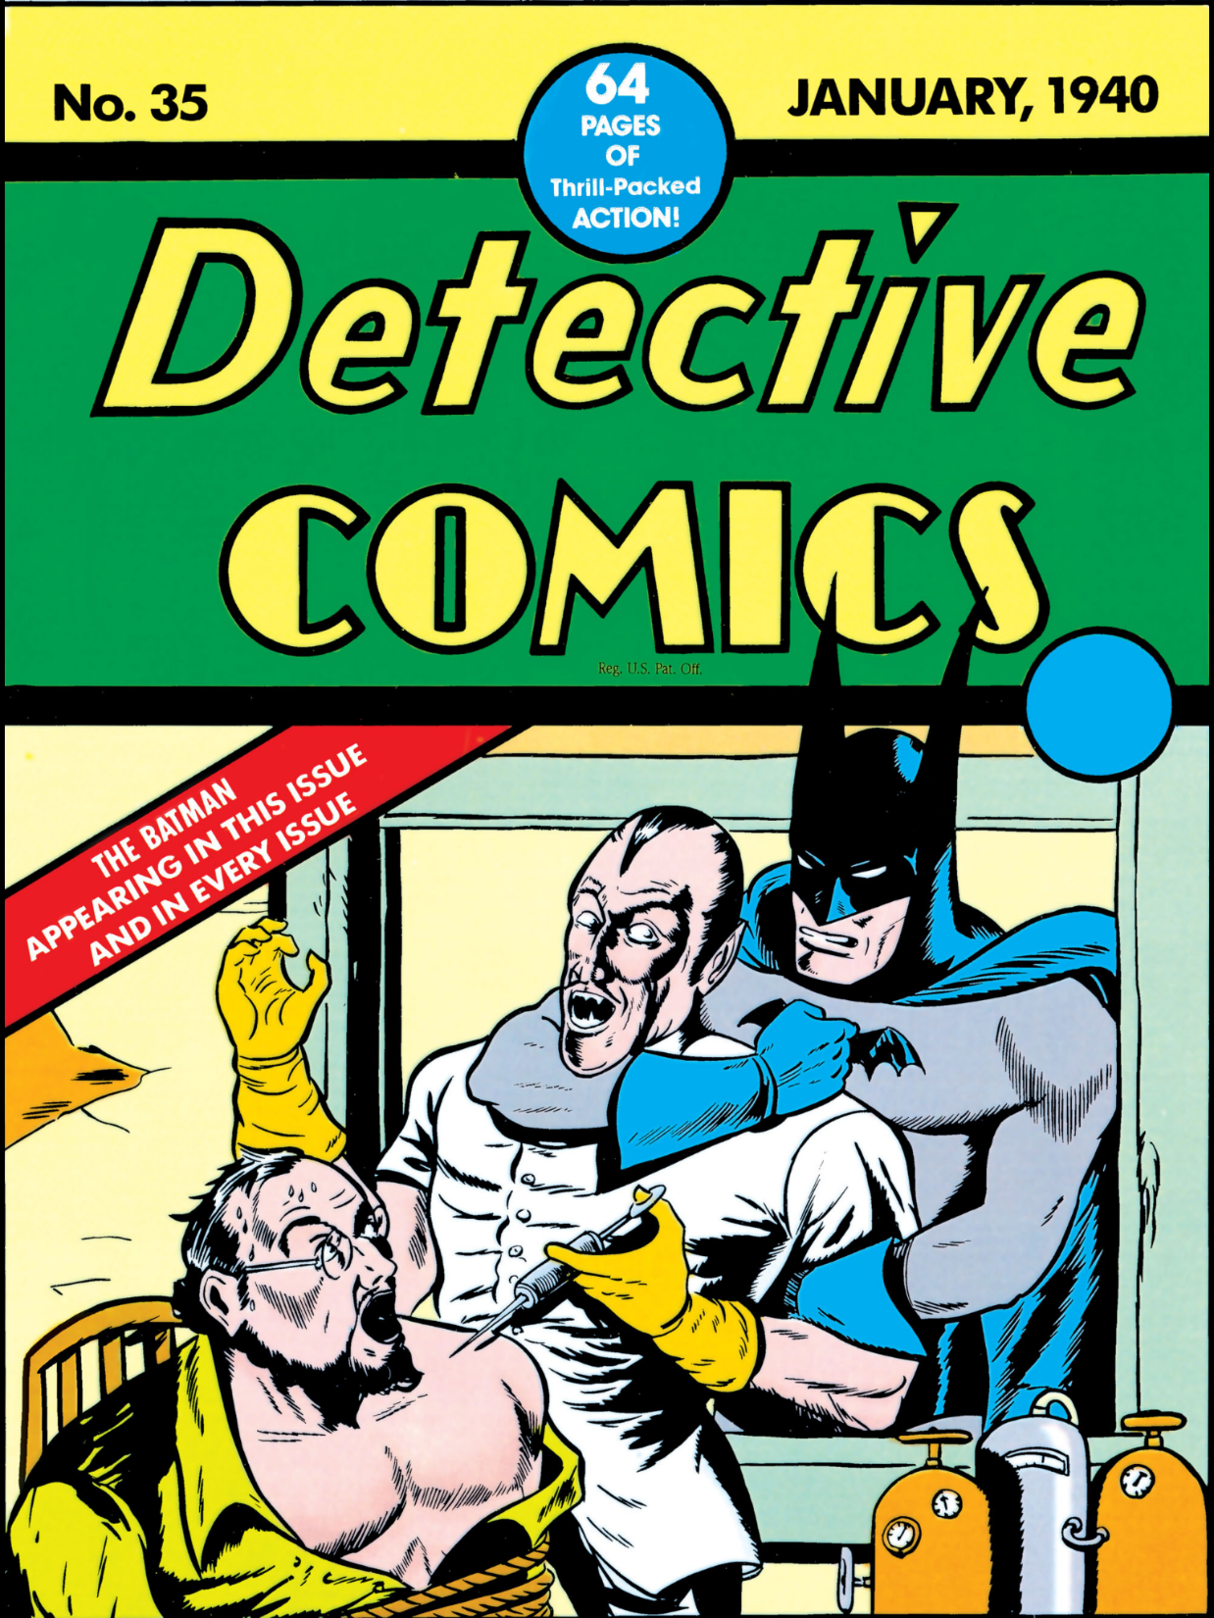
DC No. 35
Jan 1940

Slide 28
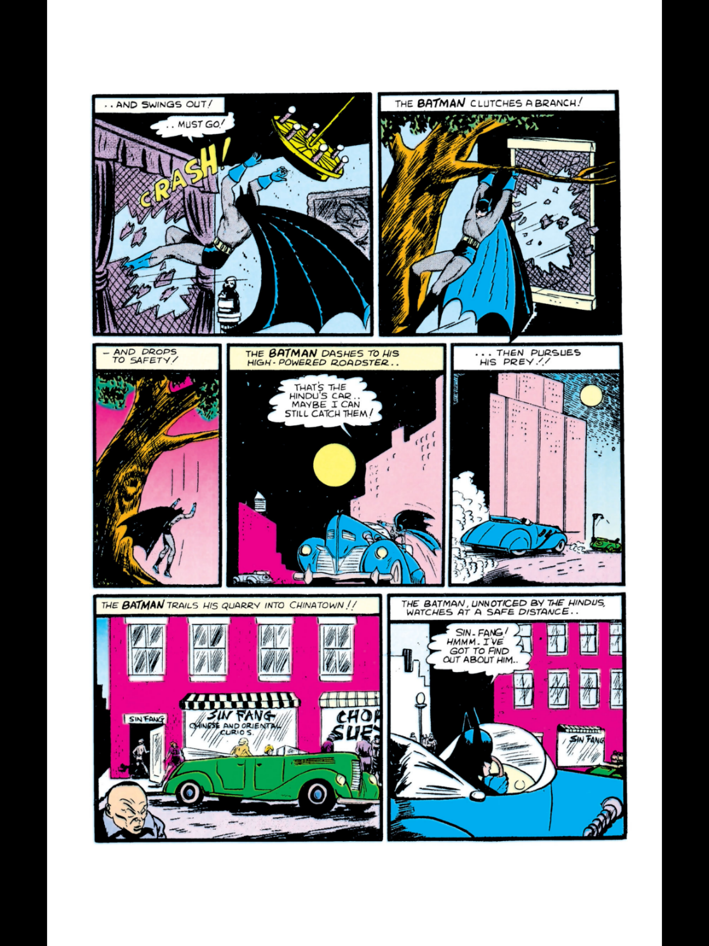

And His Car?
DC No. 35

Slide 29
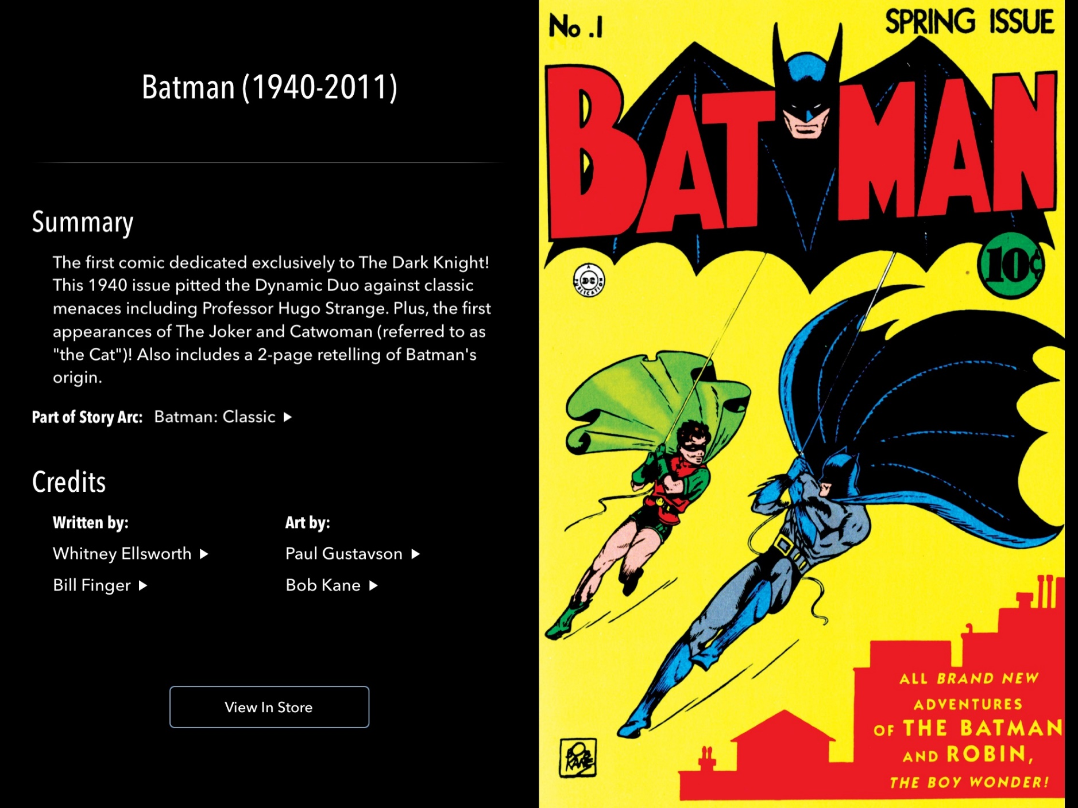
Batman No. 1
Spring 1940

Slide 30
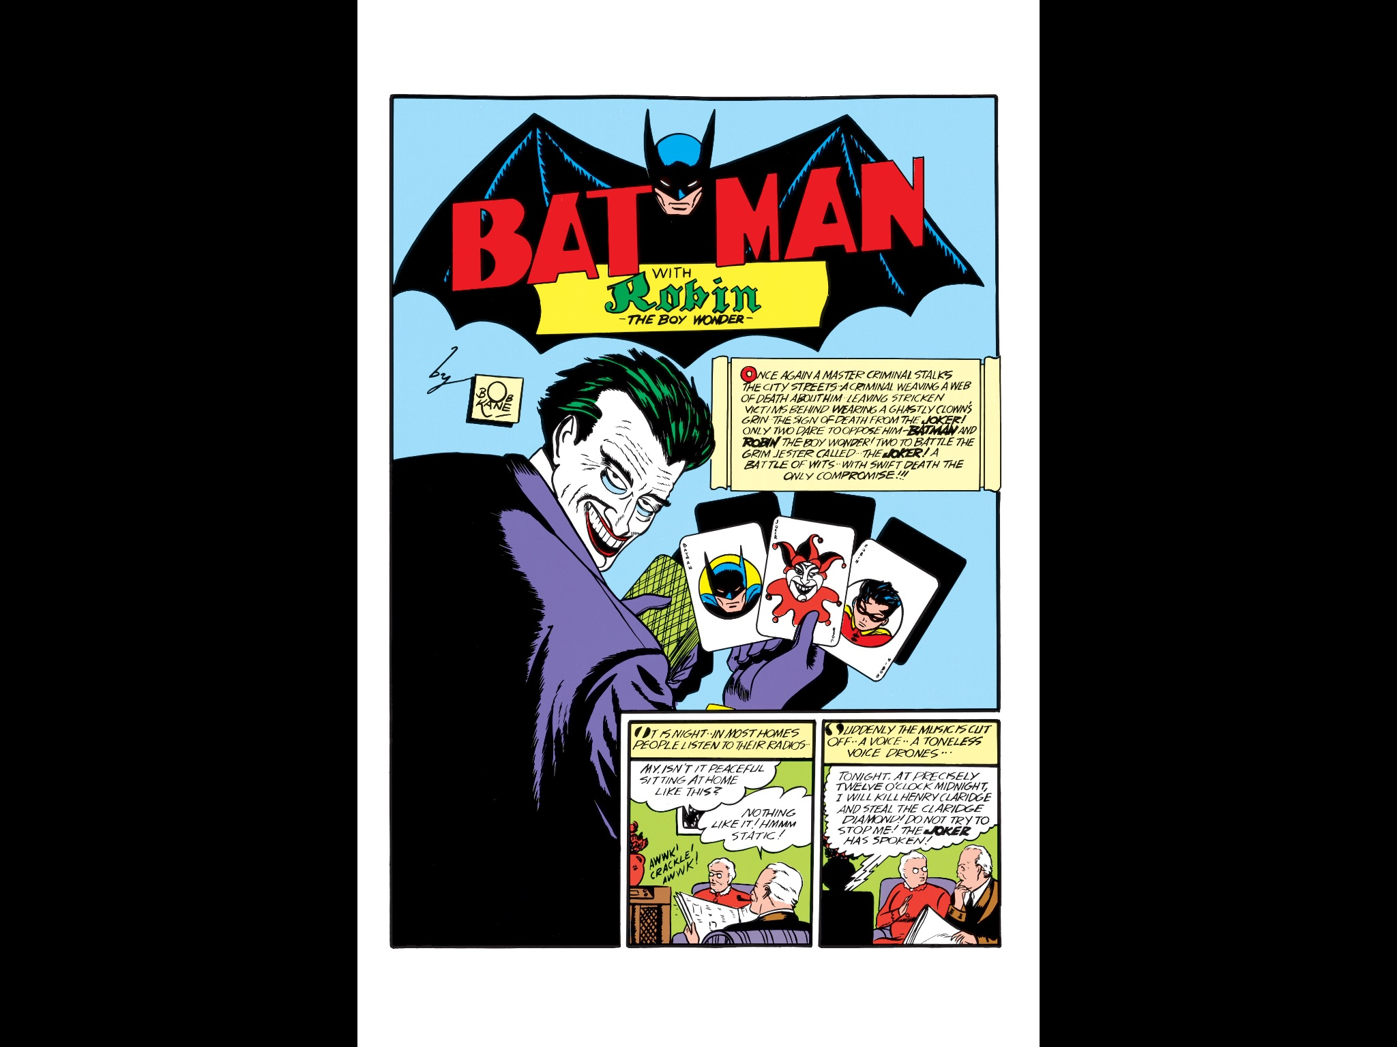
“By Bob Kane”
Batman No. 1

Slide 31
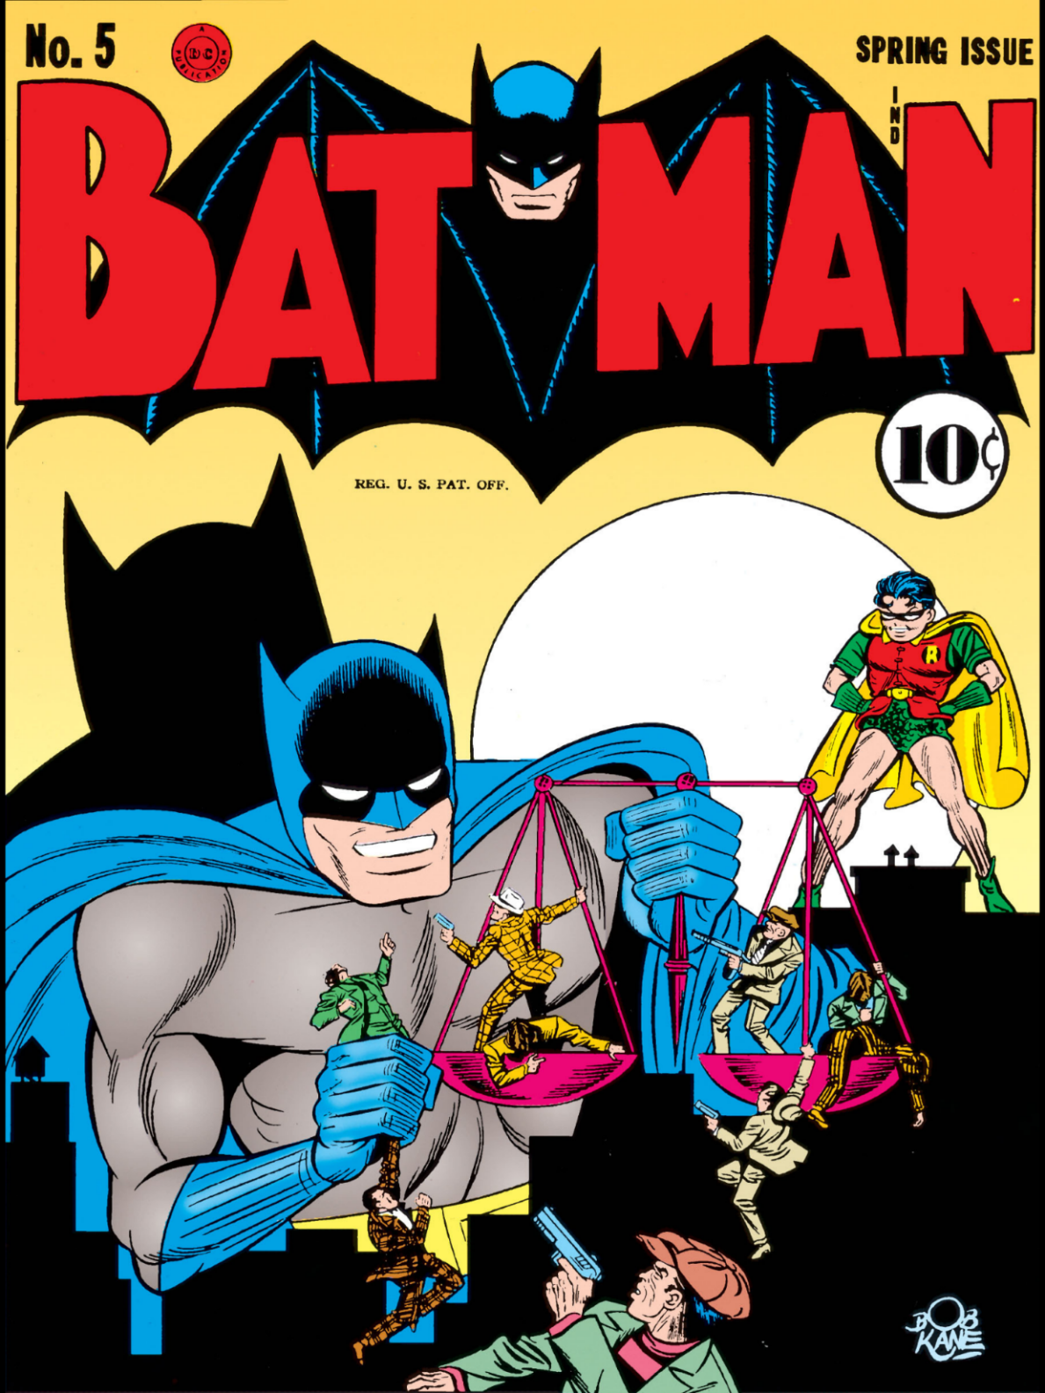
Batman No. 5 (Bob Kane)
Spring 1941

Slide 32
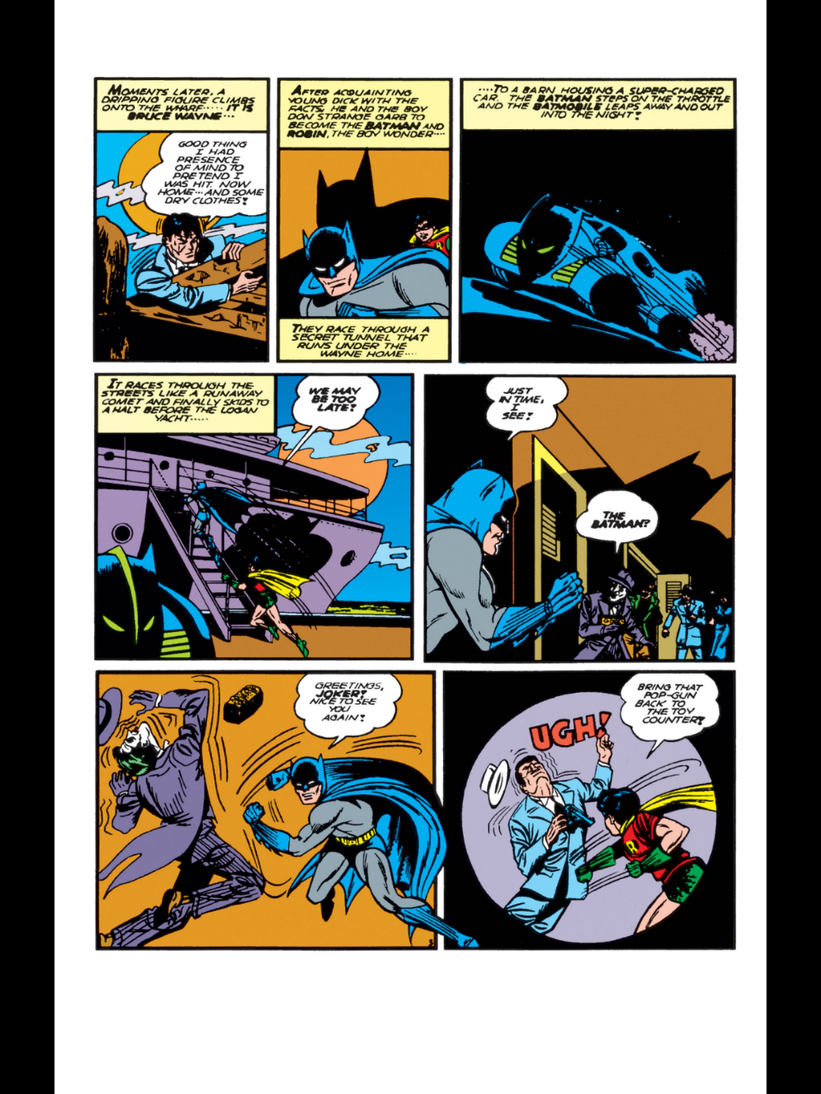
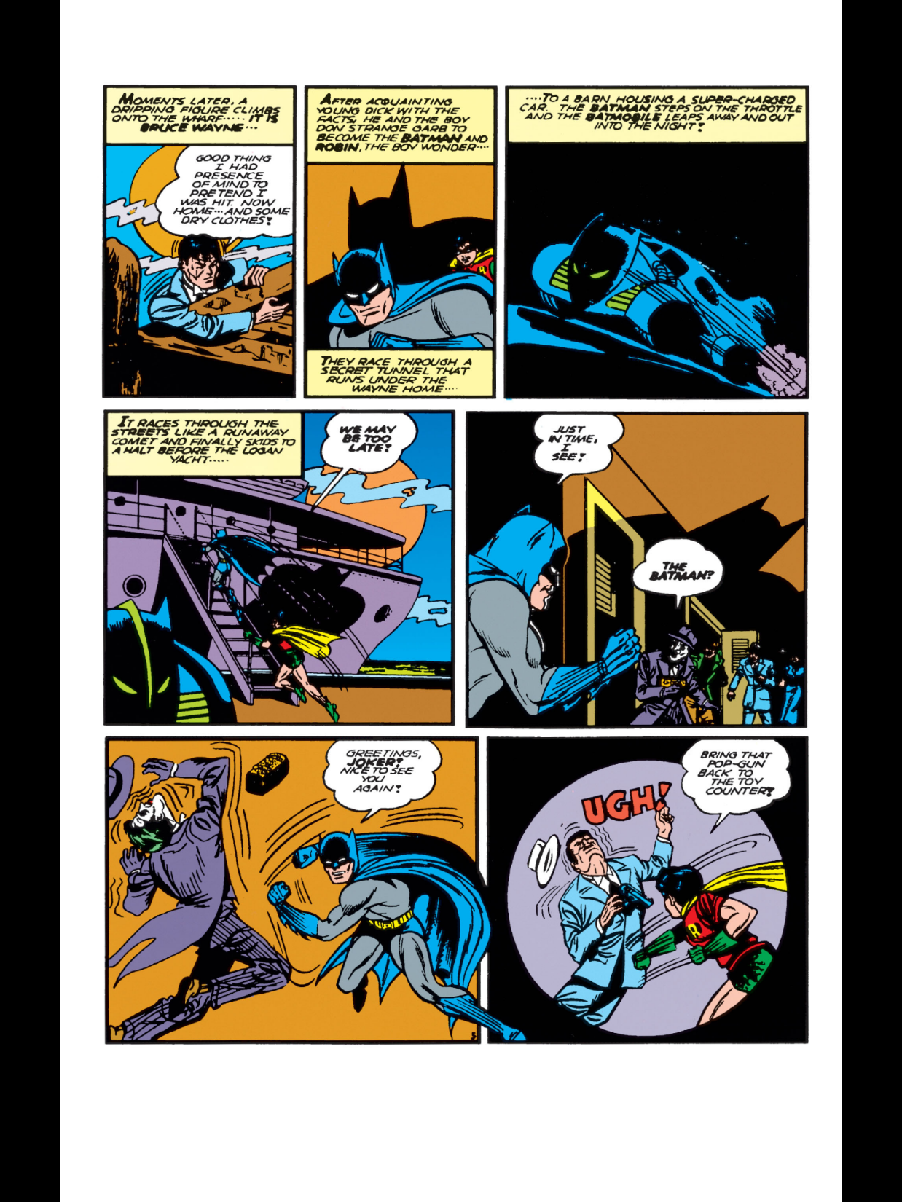
The Batmobile (TTYN (1 of 3))
Batman No. 5

Slide 33

Next Panel: The Logan Yacht (TTYN (2 of 3))
Batman No. 5

Slide 34
Sorting Characters
TTYN (3 of 3)
Questions
  Is the Batmobile a copyrighted character? When did it become such?
  Is the Logan Yacht a copyrighted character?
  Does anything distinguish the two under copyright?

Slide 35
CA9 Pictures
DC Comics v. Towle (CA9 2015)

Slide 36
CA9 Pictures
DC Comics v. Towle (CA9 2015)

Slide 37
Three-Part Test
“We read these precedents as establishing a three-part test for determining whether a character in a comic book, television program, or motion picture is entitled to copyright protection. First, the character must generally have ‘physical as well as conceptual qualities.’ Air Pirates, 581 F.2d at 755.”
DC Comics (9th Cir. 2015)

Slide 38
Three-Part Test
“Second, the character must be ‘sufficiently delineated’ to be recognizable as the same character whenever it appears. See Rice, 330 F.3d at 1175. Considering the character as it has appeared in different productions, it must display consistent, identifiable character traits and attributes, although the character need not have a consistent appearance. See Halicki, 547 F.3d at 1224.”
DC Comics (9th Cir. 2015)

Slide 39
Three-Part Test
“Third, the character must be ‘especially distinctive’ and ‘contain some unique elements of expression.’ Halicki, 547 F.3d at 1224. It cannot be a stock character such as a magician in standard magician garb. Rice, 330 F.3d at 1175. Even when a character lacks sentient attributes and does not speak (like a car), it can be a protectable character if it meets this standard. Halicki, 547 F.3d at 1224.”
DC Comics (9th Cir. 2015)

Slide 40
Accessing the Original via The Derivative Work
“Accordingly, the author of an underlying work is entitled to sue a third party who makes an unauthorized copy of an authorized derivative work to the extent that the material copied derived from the underlying work.”
DC Comics (9th Cir. 2015)

Slide 41
James Bond?
“In each instance, courts have deemed the persistence of a character’s traits and attributes to be key to determining whether the character qualifies for copyright protection. The character ‘James Bond’ qualifies for copyright protection because, no matter what the actor who portrays this character looks like, James Bond always maintains his ‘cold-bloodedness; his overt sexuality; his love of martinis ‘shaken, not stirred;’ his marksmanship; his ‘license to kill’ and use of guns; his physical strength; [and] his sophistication.’ Metro-Goldwyn-Mayer, 900 F. Supp. at 1296.”
DC Comics (9th Cir. 2015)

Slide 42
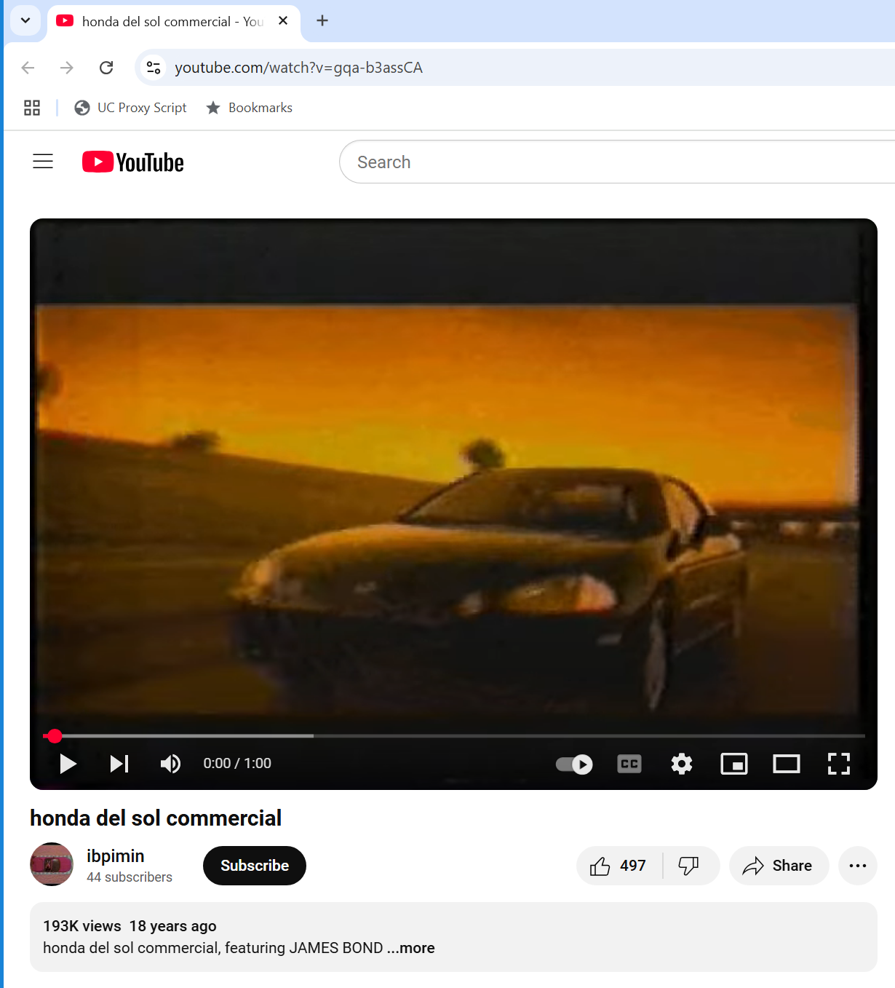
Finding Mr. Bond?
YouTube: gqa-b3assCA (Visited 3 Apr 2025)

Slide 43

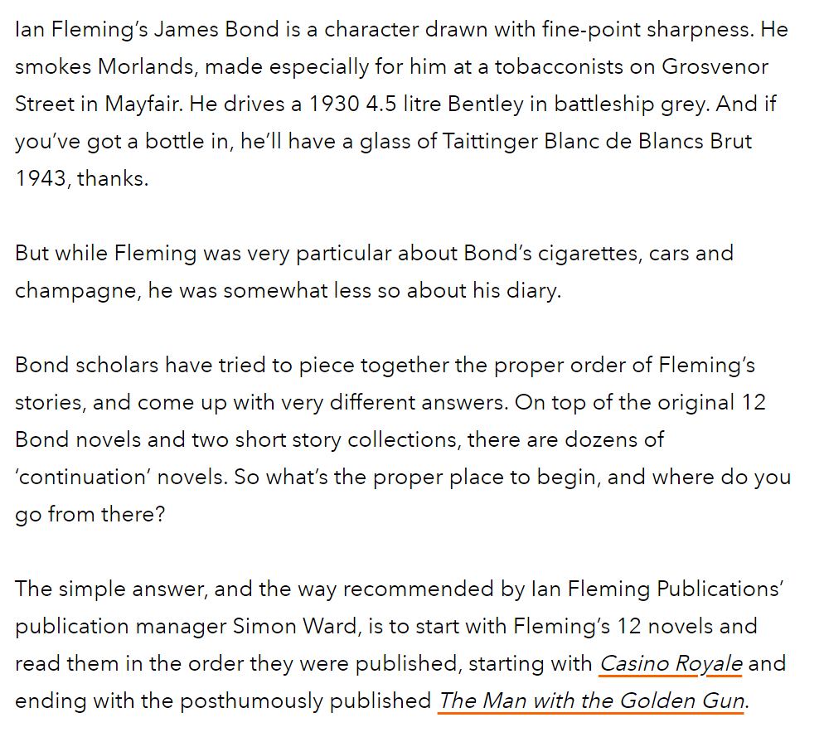
Reading James Bond
Penguin (27 Sept 2021)
Notes:
https://www.penguin.co.uk/articles/2021/09/james-bond-books-best-order-ian-fleming

Slide 44
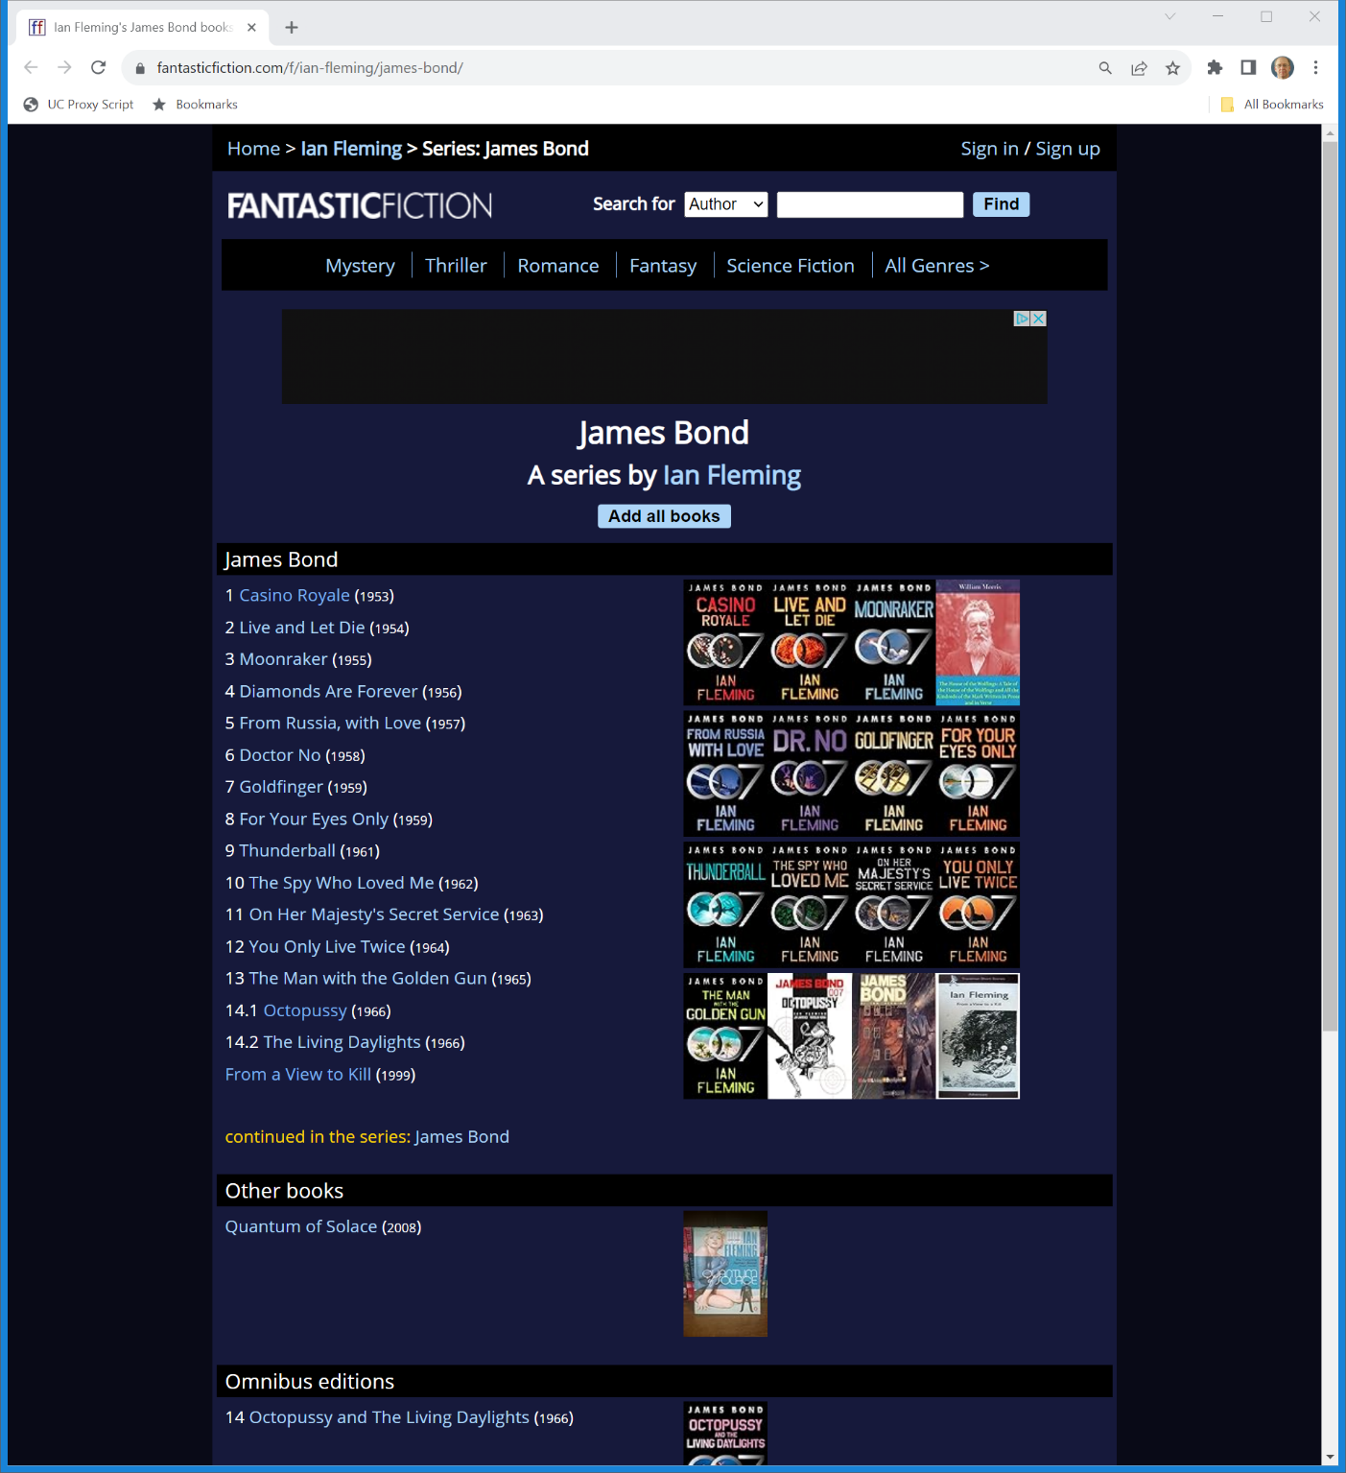

The Ian Fleming Bond Canon
Fantasticfiction.com

Slide 45
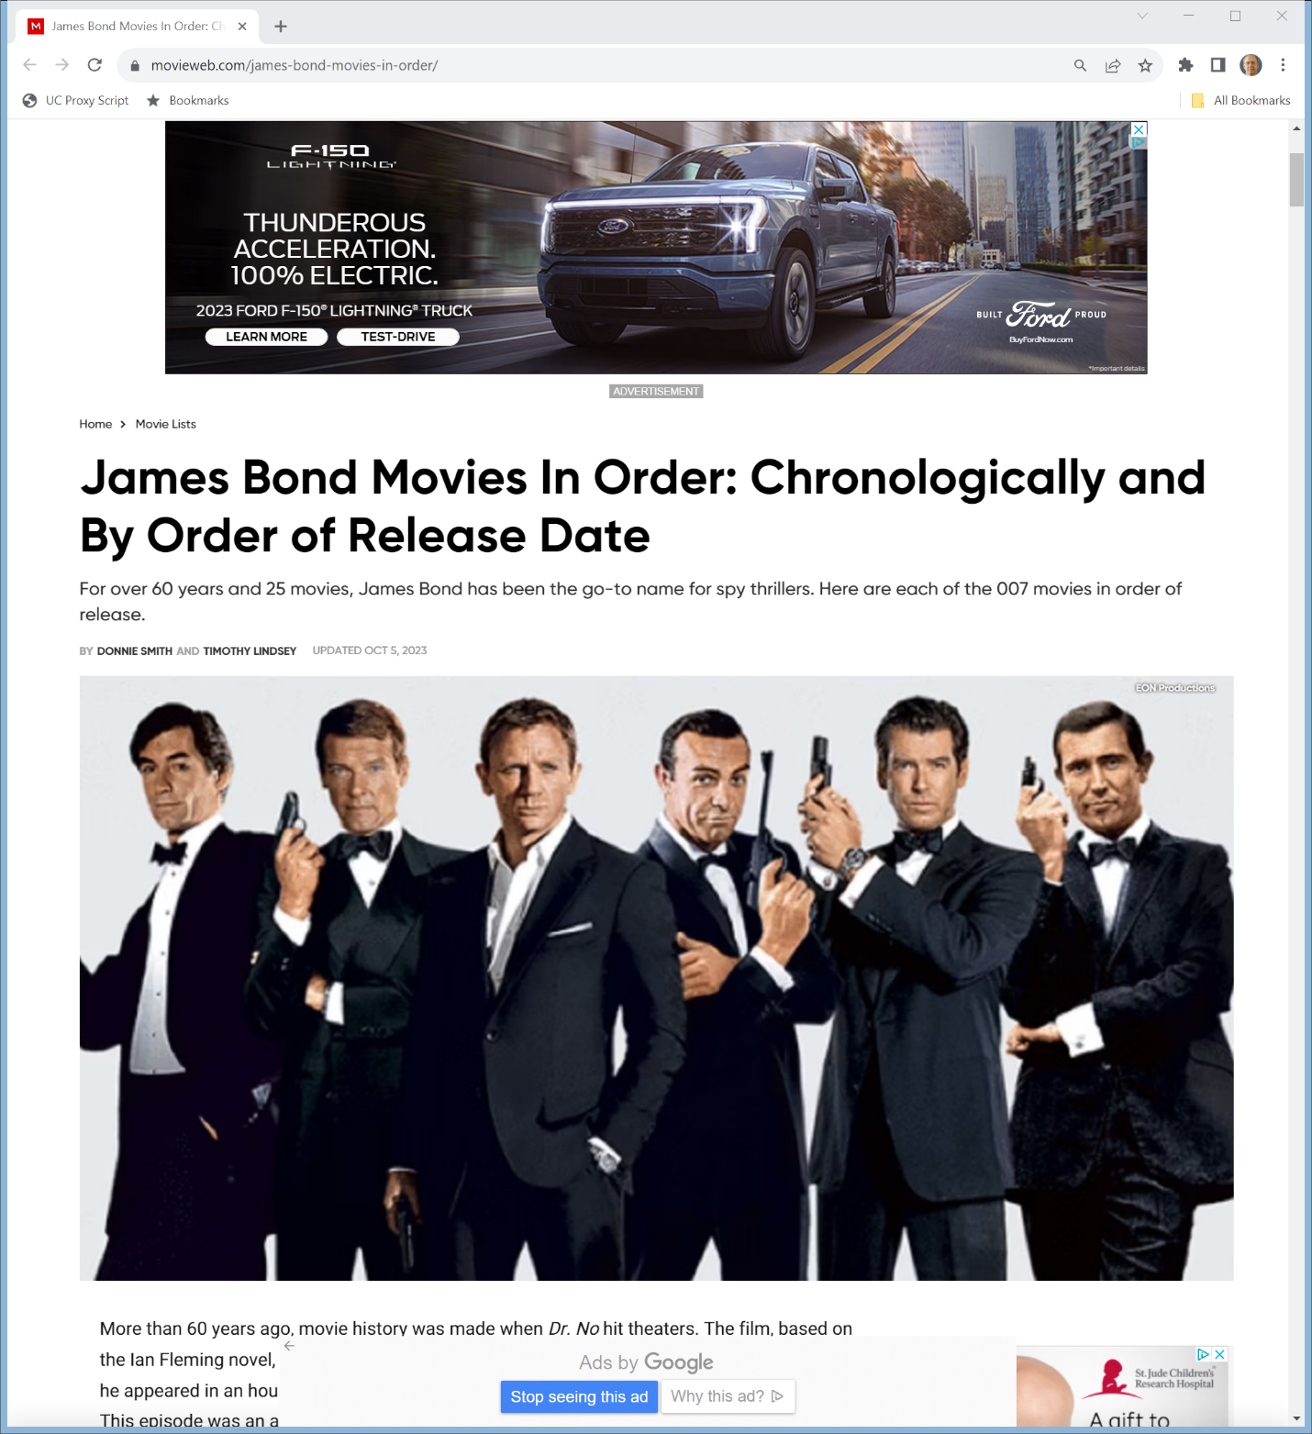
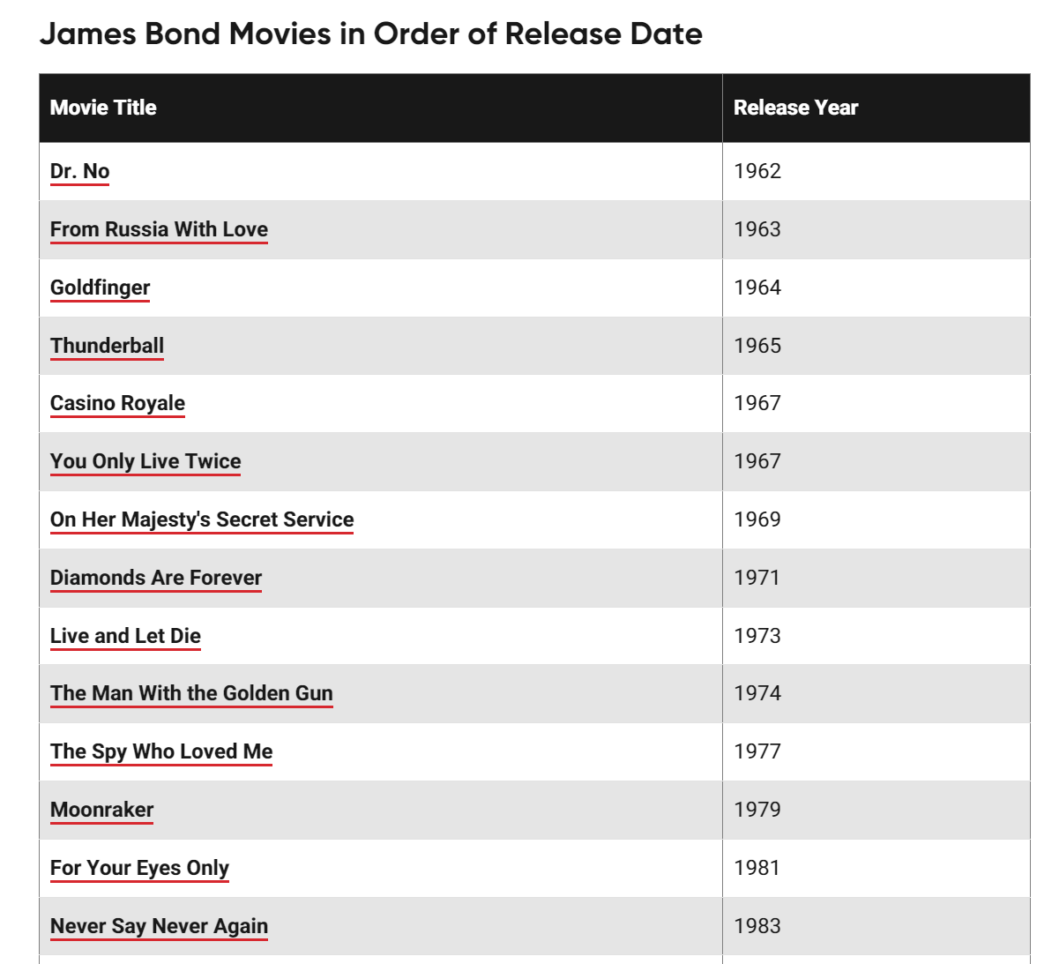
James Bond Movies
MovieWeb.com (5 Oct 2023)
Notes:
https://movieweb.com/james-bond-movies-in-order/

Slide 46
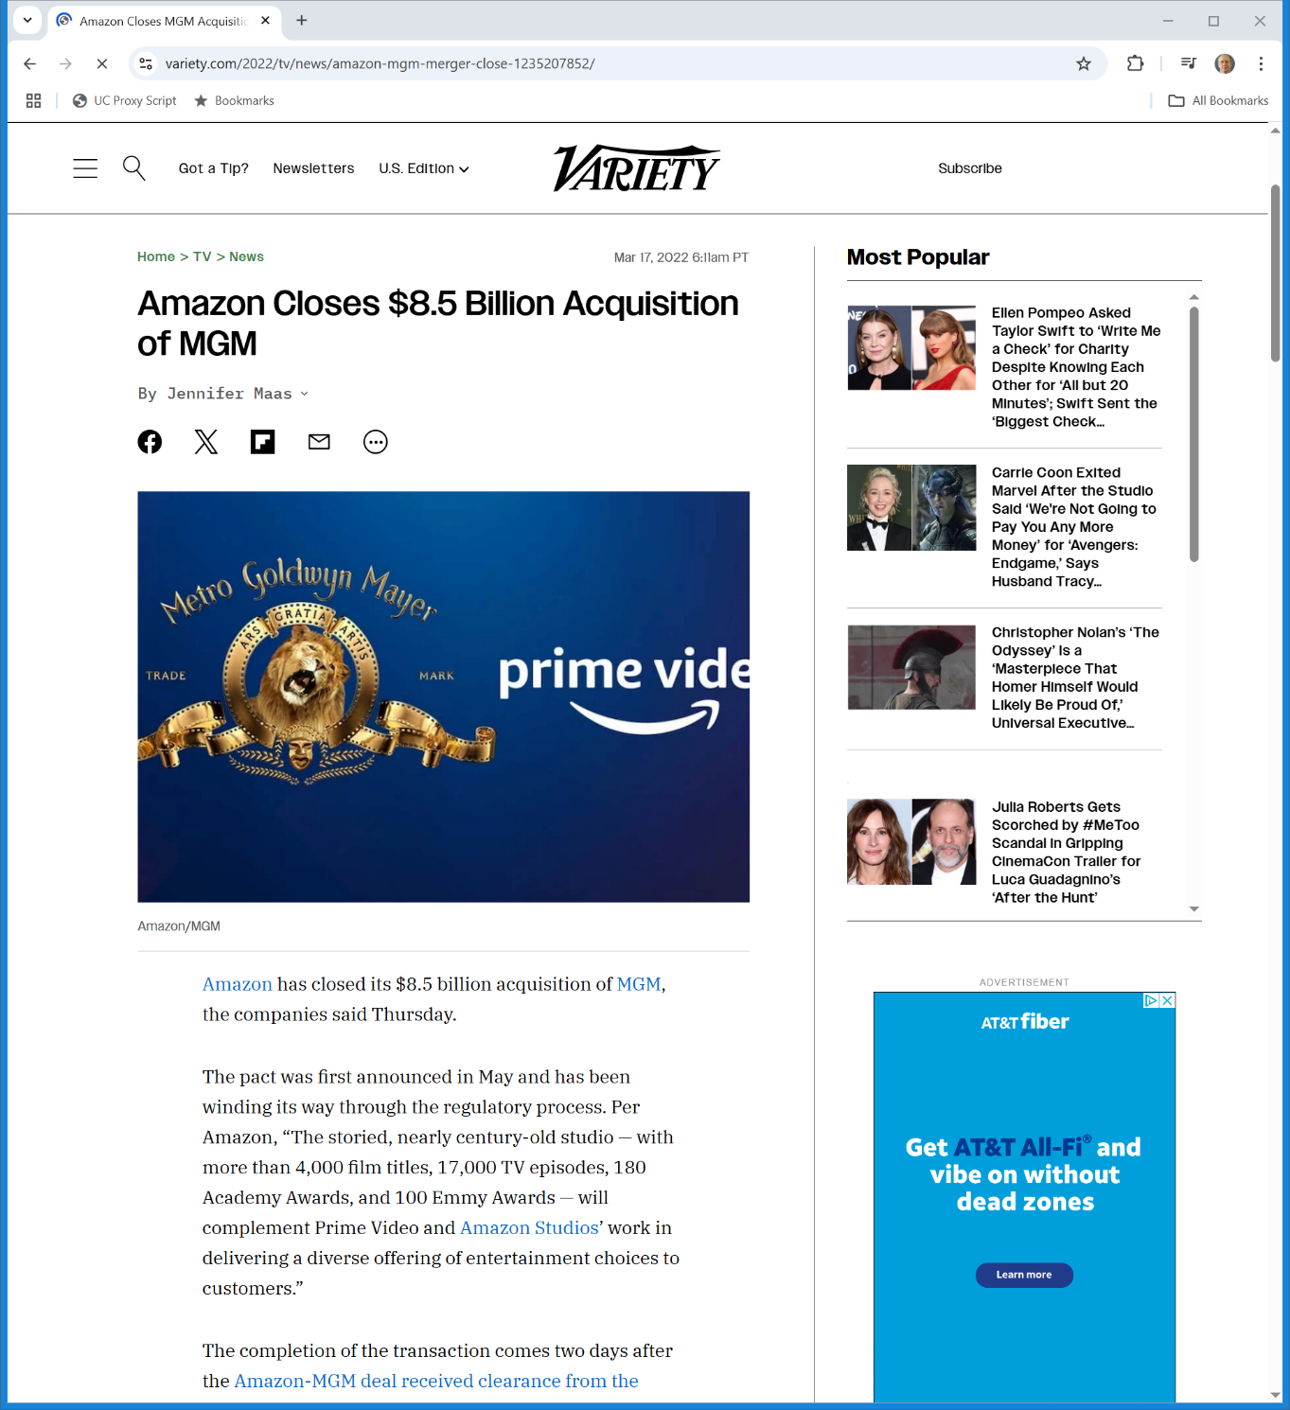
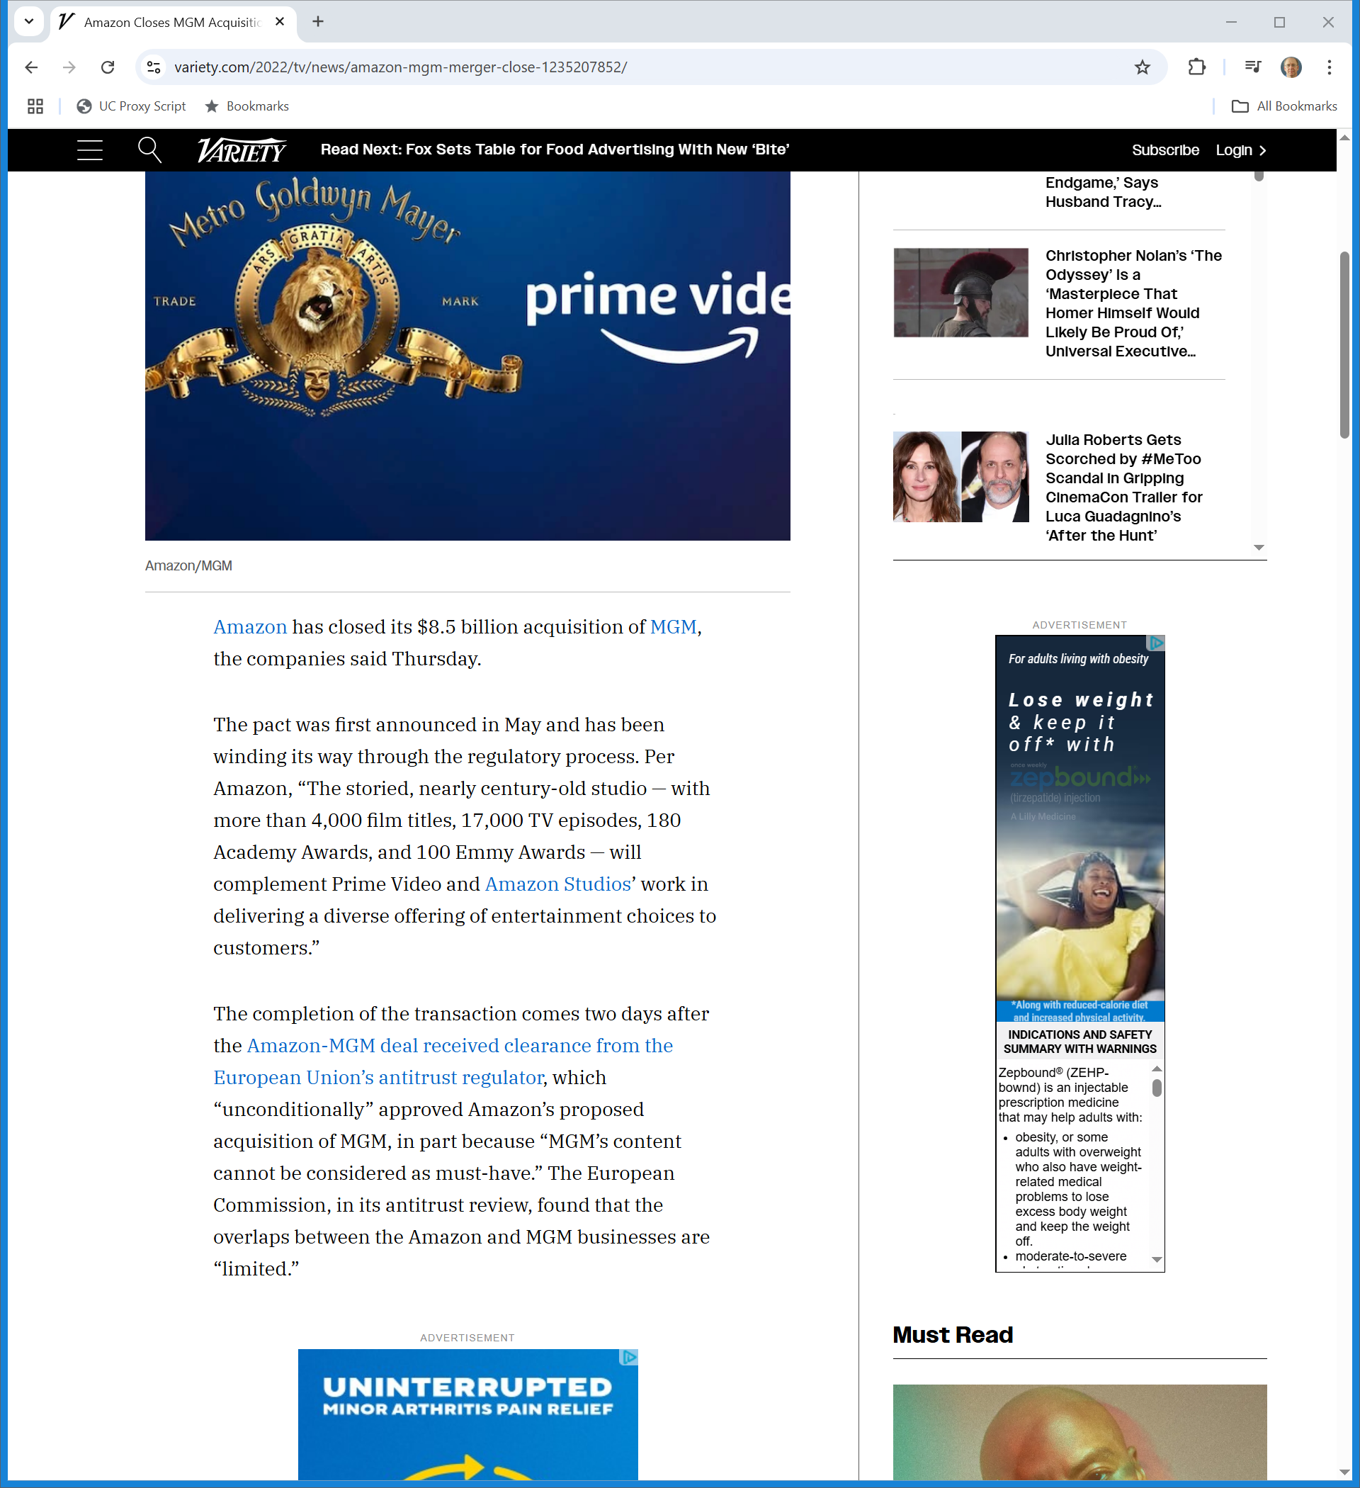
Mar 2022: Amazon Buys MGM
Variety (17 Mar 2022)
Notes:
https://variety.com/2022/tv/news/amazon-mgm-merger-close-1235207852/

Slide 47
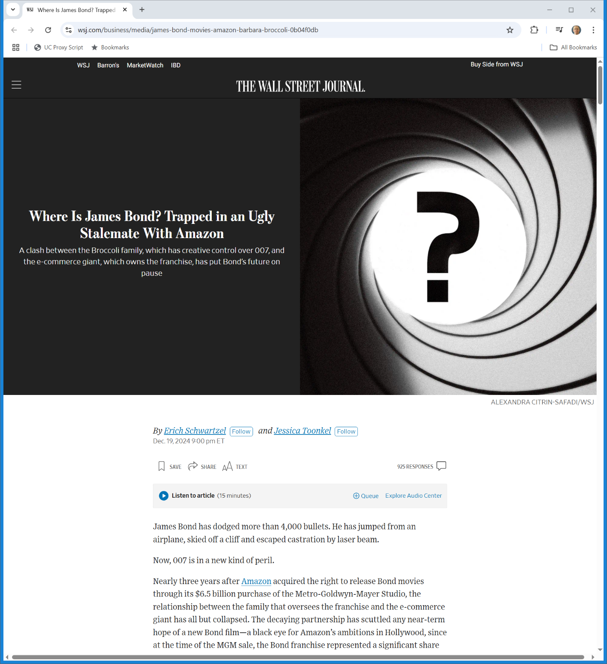
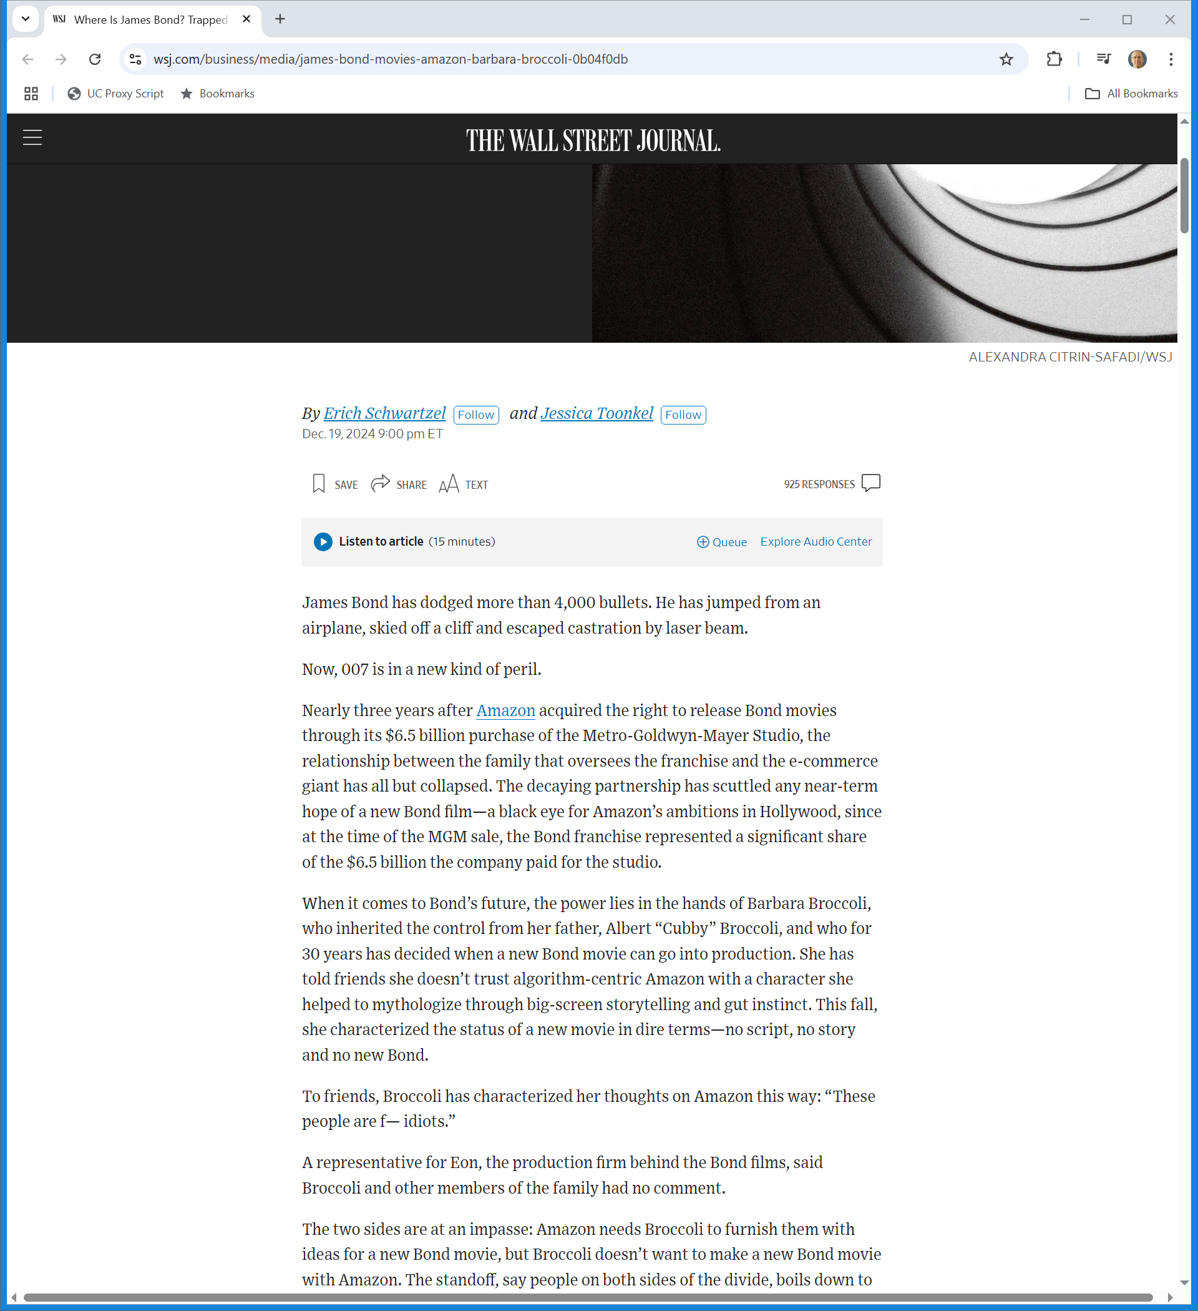
Bond Defeated?
WSJ (19 Dec 2024)
Notes:
https://www.wsj.com/business/media/james-bond-movies-amazon-barbara-broccoli-0b04f0db

Slide 48

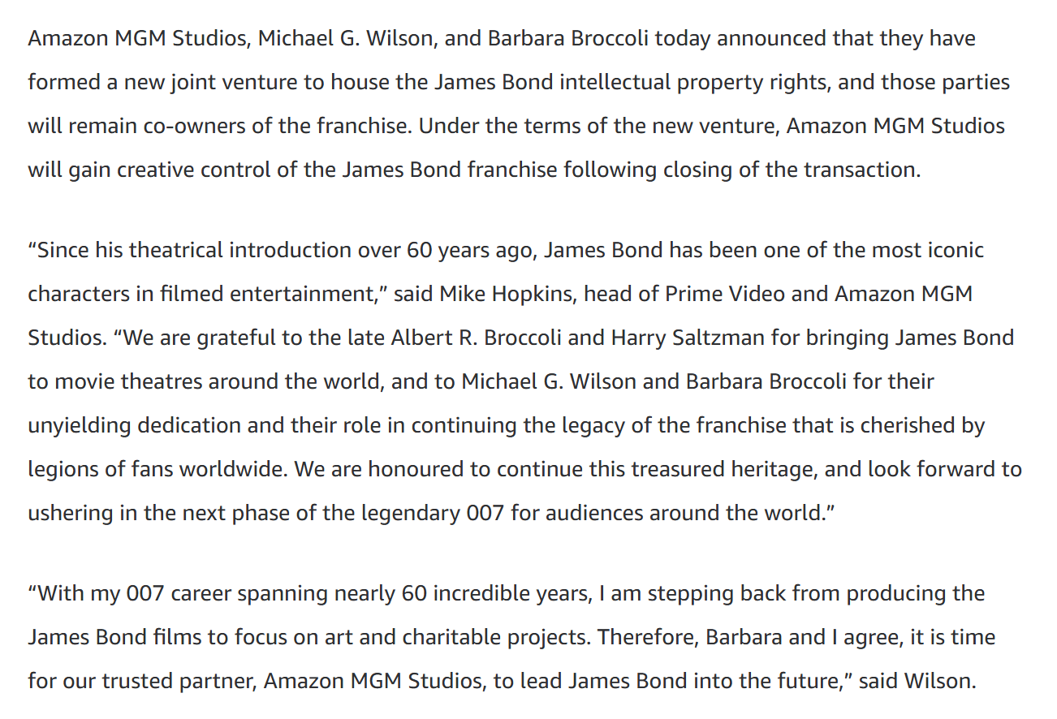
Bond Reborn?
Amazon (25 Mar 2025)
Notes:
https://www.aboutamazon.com/news/company-news/amazon-mgm-studios-james-bond

