Slide 1
Class 5: Wed 2 Apr 2025 Copyright Spring 2025 Authorship and Ownership
Randal C. Picker
James Parker Hall Distinguished Service Professor of Law
The Law School
The University of Chicago

Slide 2
Key Questions for Today
Questions
How should we organize the production of copyrighted works?
As we move away from a single author, how should copyright law shape the interactions among a team of people creating a copyrighted work? What turns on that?

Slide 3
101: Joint Work
A “joint work” is a work
prepared by two or more authors with the intention that their contributions be merged into inseparable or interdependent parts of a unitary whole.

Slide 4
201: Ownership of Copyright
(a) Initial Ownership.
Copyright in a work protected under this title vests initially in the author or authors of the work. The authors of a joint work are coowners of copyright in the work.

Slide 5
Understanding Joint Work
H.R. 94-1476 (3 Sept 1976)

Slide 6
Rights of Co-Authors
H.R. 94-1476 (3 Sept 1976)

Slide 7
101: Copyright Owner
“Copyright owner”,
with respect to any one of the exclusive rights comprised in a copyright, refers to the owner of that particular right.

Slide 8
202
Ownership of copyright as distinct from ownership of material object
Ownership of a copyright, or of any of the exclusive rights under a copyright, is distinct from ownership of any material object in which the work is embodied.

Slide 9
202 (Cont.)
Transfer of ownership of any material object, including the copy or phonorecord in which the work is first fixed, does not of itself convey any rights in the copyrighted work embodied in the object; nor, in the absence of an agreement, does transfer of ownership of a copyright or of any exclusive rights under a copyright convey property rights in any material object.

Slide 10
204
Execution of transfers of copyright ownership
(a) A transfer of copyright ownership, other than by operation of law, is not valid unless an instrument of conveyance, or a note or memorandum of the transfer, is in writing and signed by the owner of the rights conveyed or such owner’s duly authorized agent.

Slide 11
201: Ownership of Copyright
(b) Works Made for Hire.
In the case of a work made for hire, the employer or other person for whom the work was prepared is considered the author for purposes of this title, and, unless the parties have expressly agreed otherwise in a written instrument signed by them, owns all of the rights comprised in the copyright.

Slide 12
101: Work Made for Hire
A “work made for hire” is—
(1) a work prepared by an employee within the scope of his or her employment; or

Slide 13
101: Work Made for Hire
(2) a work specially ordered or commissioned for use
as a contribution to a collective work, as a part of a motion picture or other audiovisual work, as a translation, as a supplementary work,

Slide 14
101: Work Made for Hire
as a compilation, as an instructional text, as a test, as answer material for a test, or as an atlas,
if the parties expressly agree in a written instrument signed by them that the work shall be considered a work made for hire.

Slide 15
When Does It Matter Who the Author Is?
Duration of Copyright
Limitations on Assignment
Control over Copyright

Slide 16
When Does It Matter: Duration
302(a) In General.
Copyright in a work created on or after January 1, 1978, subsists from its creation and, except as provided by the following subsections, endures for a term consisting of the life of the author and 70 years after the author’s death.

Slide 17
When Does It Matter: Duration
302(c) Anonymous Works, Pseudonymous Works, and Works Made for Hire.
In the case of an anonymous work, a pseudonymous work, or a work made for hire, the copyright endures for a term of 95 years from the year of its first publication, or a term of 120 years from the year of its creation, whichever expires first.

Slide 18
203. Termination of transfers and licenses granted by the author
(a) Conditions for Termination.
In the case of any work other than a work made for hire, the exclusive or nonexclusive grant of a transfer or license of copyright or of any right under a copyright, executed by the author on or after January 1, 1978, otherwise than by will, is subject to termination under the following conditions:

Slide 19
Letter
TTYN (1 of 3)
Hypo 1
I write famous person, Ima Star, a fan letter
She writes back a letter telling me about her life
I want to publish her letter on my website
Who is the author of her letter? Who is the owner of the copyright in that letter? Can I publish her letter?

Slide 20
Structuring Book Copyrights
TTYN (2 of 3)
Hypo 2
X writes a book
As a condition of publishing the book, the U of Chicago Press requires that it obtain the copyright to the book
What happens and where does that put us?

Slide 21
Structuring Book Copyrights
TTYN (3 of 3)
Hypo 3
X is thinking about writing a book
The U of C press hires X as an employee
X writes the book
What happens and where does that put us?

Slide 22
Hypo 1 Answer
Authorship
Ima Star wrote the letter, she is the author
Copyright
Under 201(a), author is initial owner of copyright
Publication on Website?: No
Copyright owner controls the right to publish under 106(3)

Slide 23
Hypo 2 Answer
Authorship
X is the author
Copyright
Duration is life of the author + 70 years under 302(a)
X can transfer the copyright to the U of C Press under 204(a)

Slide 24
Hypo 2 Answer
Termination of Transfer
After 35 years under 203(a)(3)

Slide 25
Hypo 3 Answer
Authorship
Under work made for hire rules, U of C Press is the author and therefore the owner (201(b), 201(a))
Copyright
Duration of copyright is the lesser of 95 years from the date of publication or 120 years from the date of creation (302(c))

Slide 26
Hypo 3 Answer
No Termination Right
203(a) carves out works made for hire

Slide 27
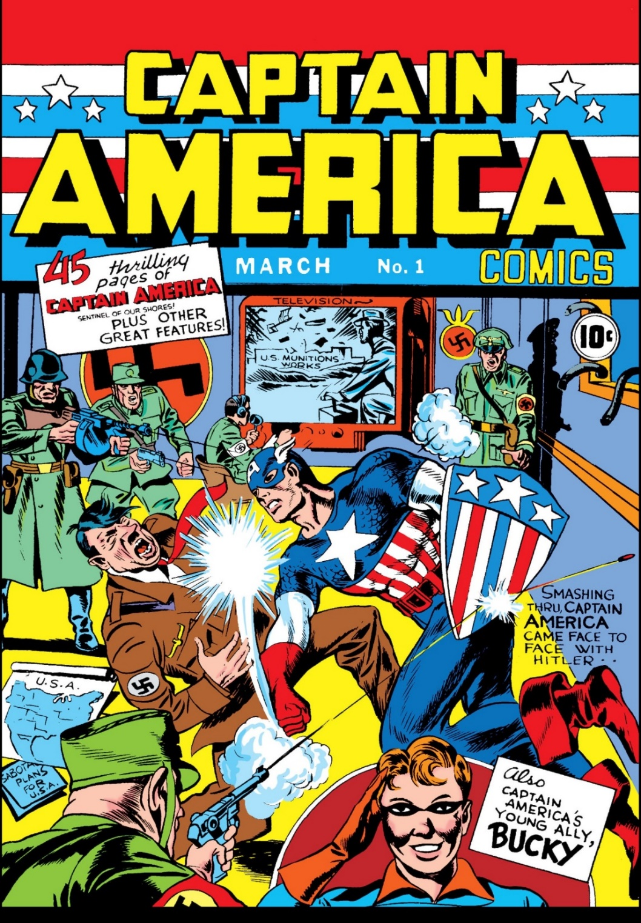
At the Beginning
March 1941

Slide 28
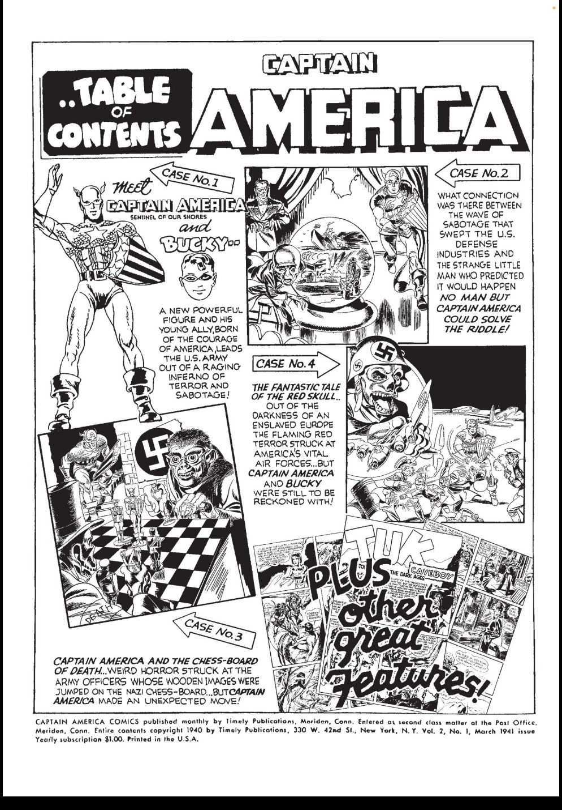

Copyright Notice
Captain America #1

Slide 29
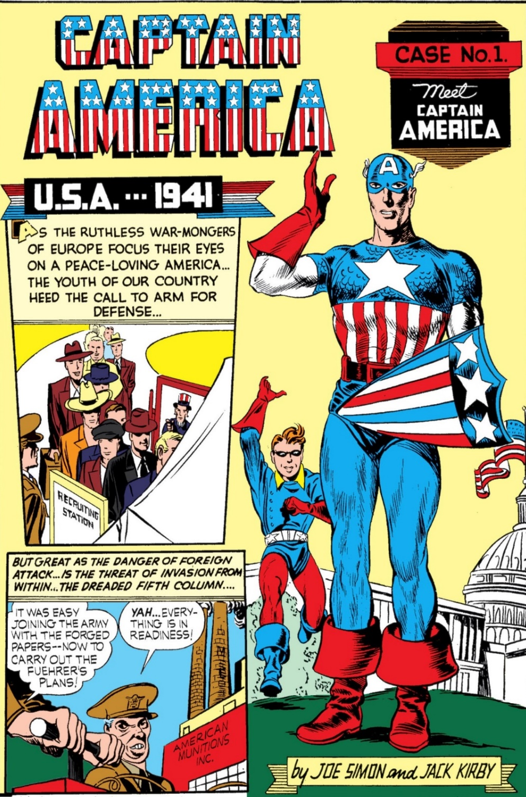
“By Joe Simon and Jack Kirby”
Captain America #1

Slide 30
Marvel v. Kirby
726 F.3d 119 (2nd Cir. 2013)

Slide 31
Termination and WMFH
“We also find … that the district court was correct in concluding that the works at issue are ‘works made for hire’ under section 304(c).”
Kirby (2nd Cir. 2013)

Slide 32
A Little Marvel History
“Marvel was founded as Timely Comics in 1939 by one Martin Goodman. In 1940, Marvel purchased the first ten issues of Captain America from Kirby and Joe Simon. But Kirby and Simon would soon move on to a competitor, DC Comics. To replace them, Goodman hired one Stanley Lieber. Lieber would come to be known by his pen name, Stan Lee.”
Kirby (2nd Cir. 2013)

Slide 33
Understanding Authorship: Thomson v. Larson
147 F.3d 195 (2nd Cir. 1998)

Slide 34
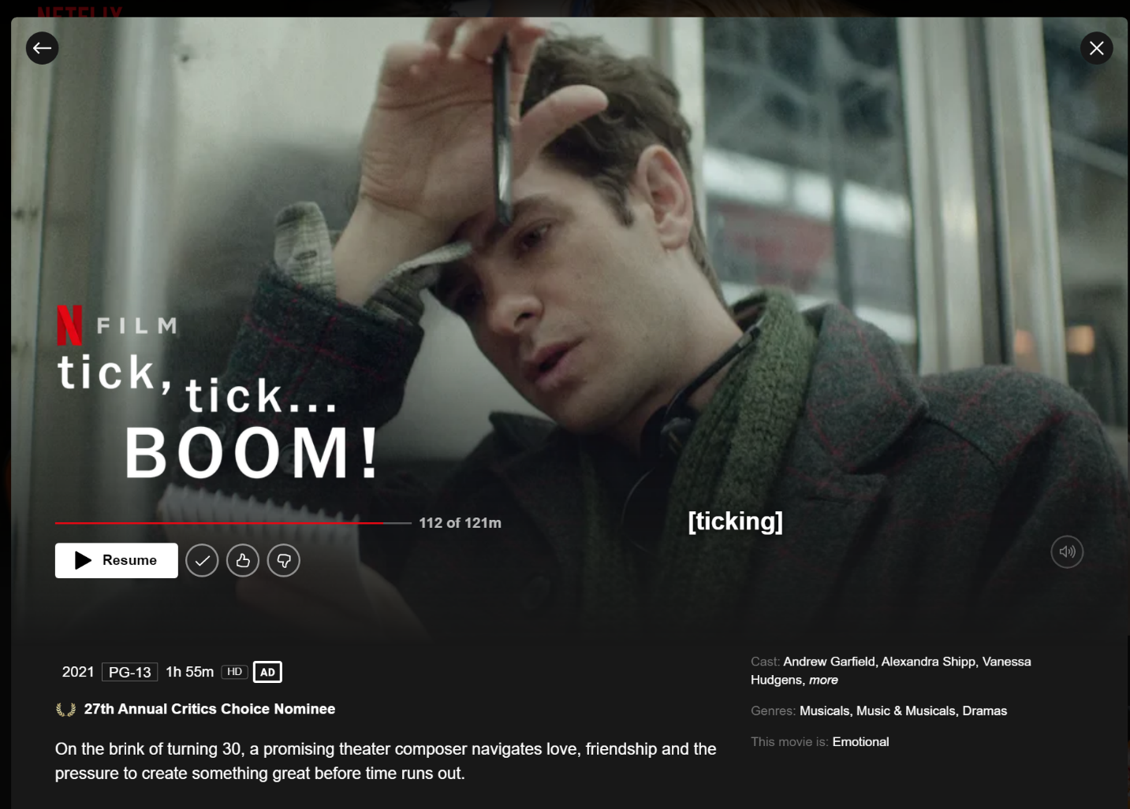
Pre-Rent Larson
Netflix

Slide 35
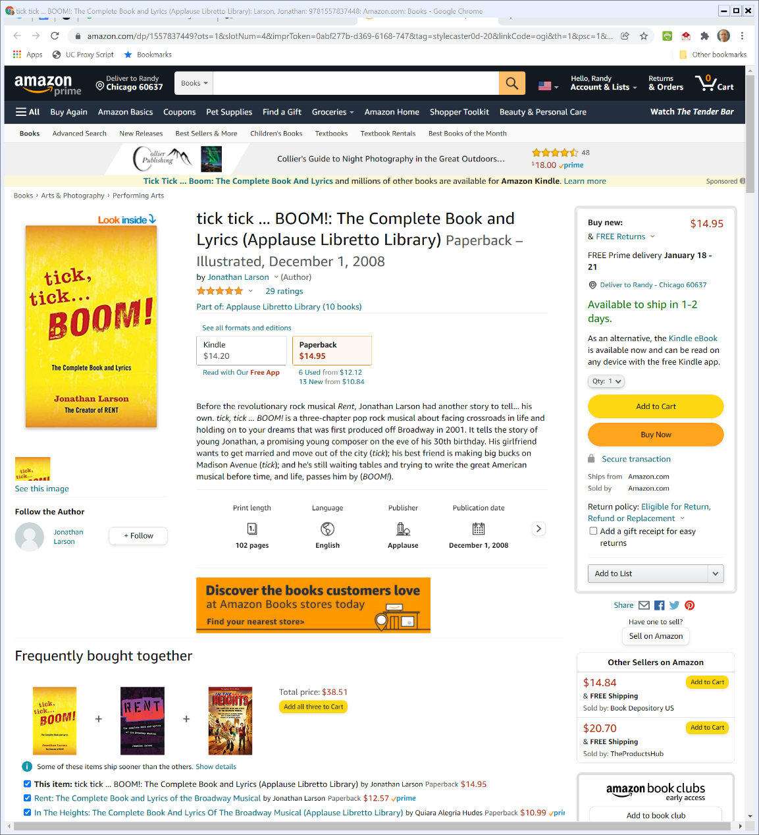

tick, tick … BOOM!
Amazon

Slide 36
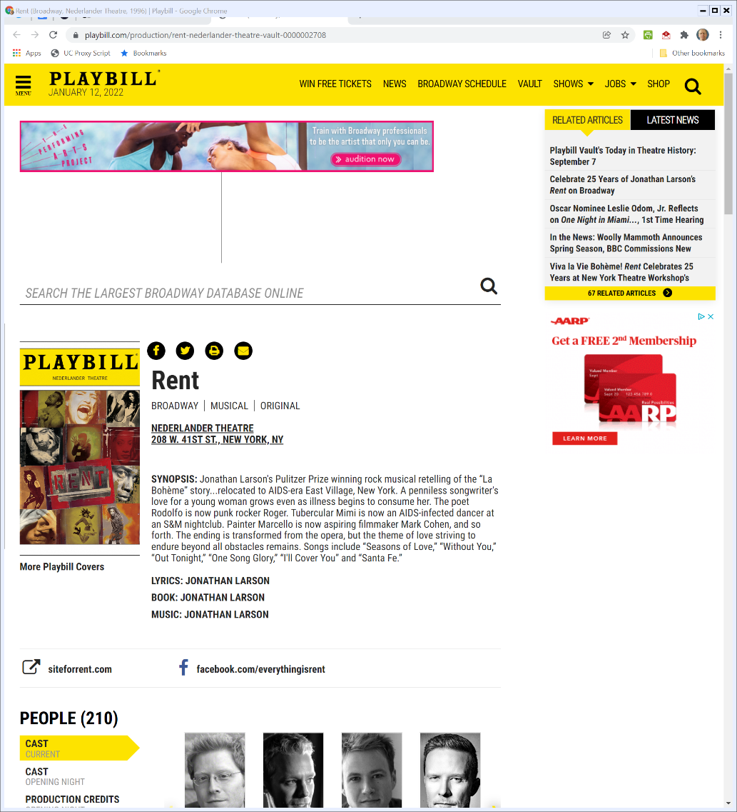

Rent Playbill
Playbill.com (Visited 12 Jan 2022)
Notes:
https://www.playbill.com/production/rent-nederlander-theatre-vault-0000002708

Slide 37
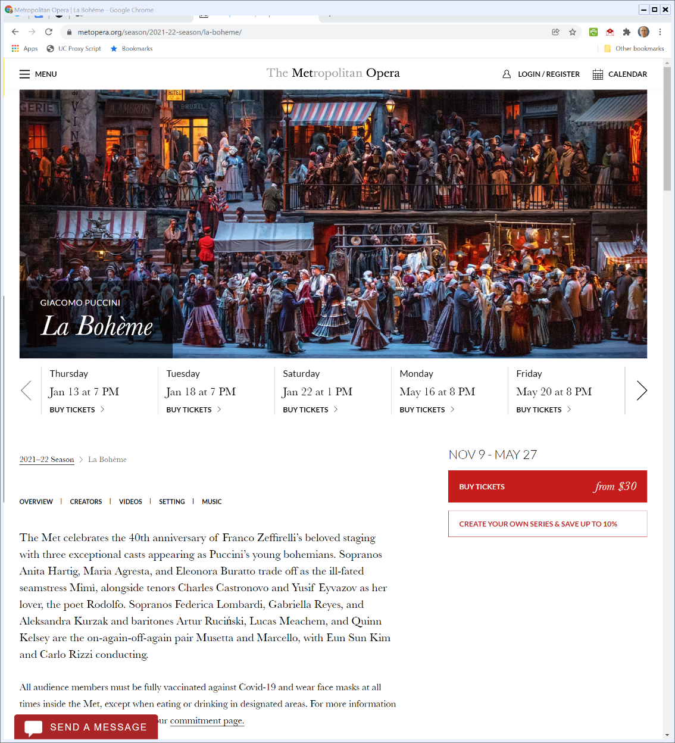

La Bohème at the Met
The Met Opera (Visited 12 Jan 2022)
Notes:
https://www.metopera.org/season/2021-22-season/la-boheme/

Slide 38
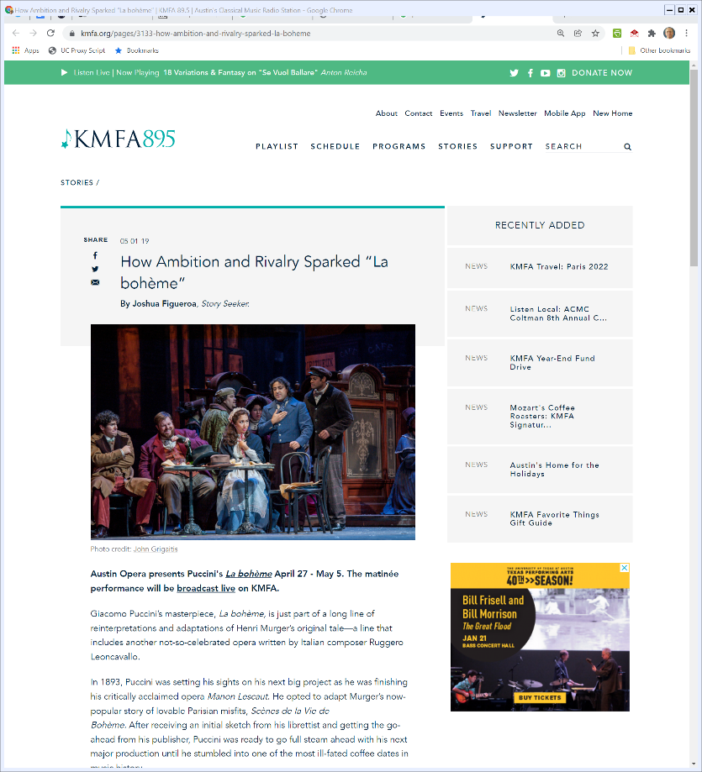
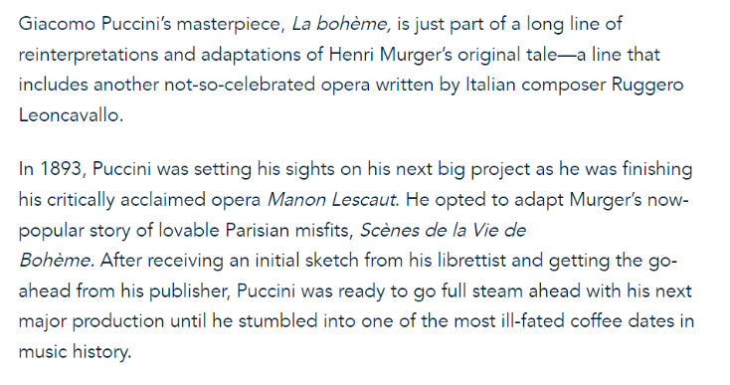
The Creation of Culture
KMFA.org (1 May 2019)
Notes:
https://kmfa.org/pages/3133-how-ambition-and-rivalry-sparked-la-boheme

Slide 39
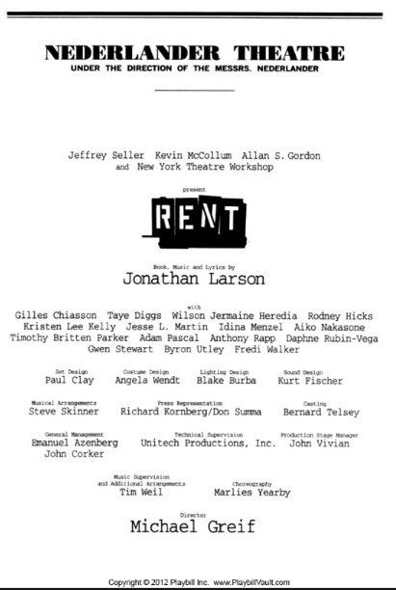
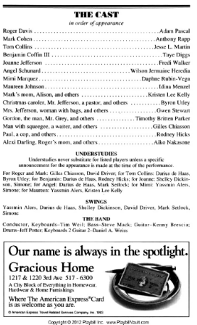
Credits
Rent Broadway Playbill

Slide 40
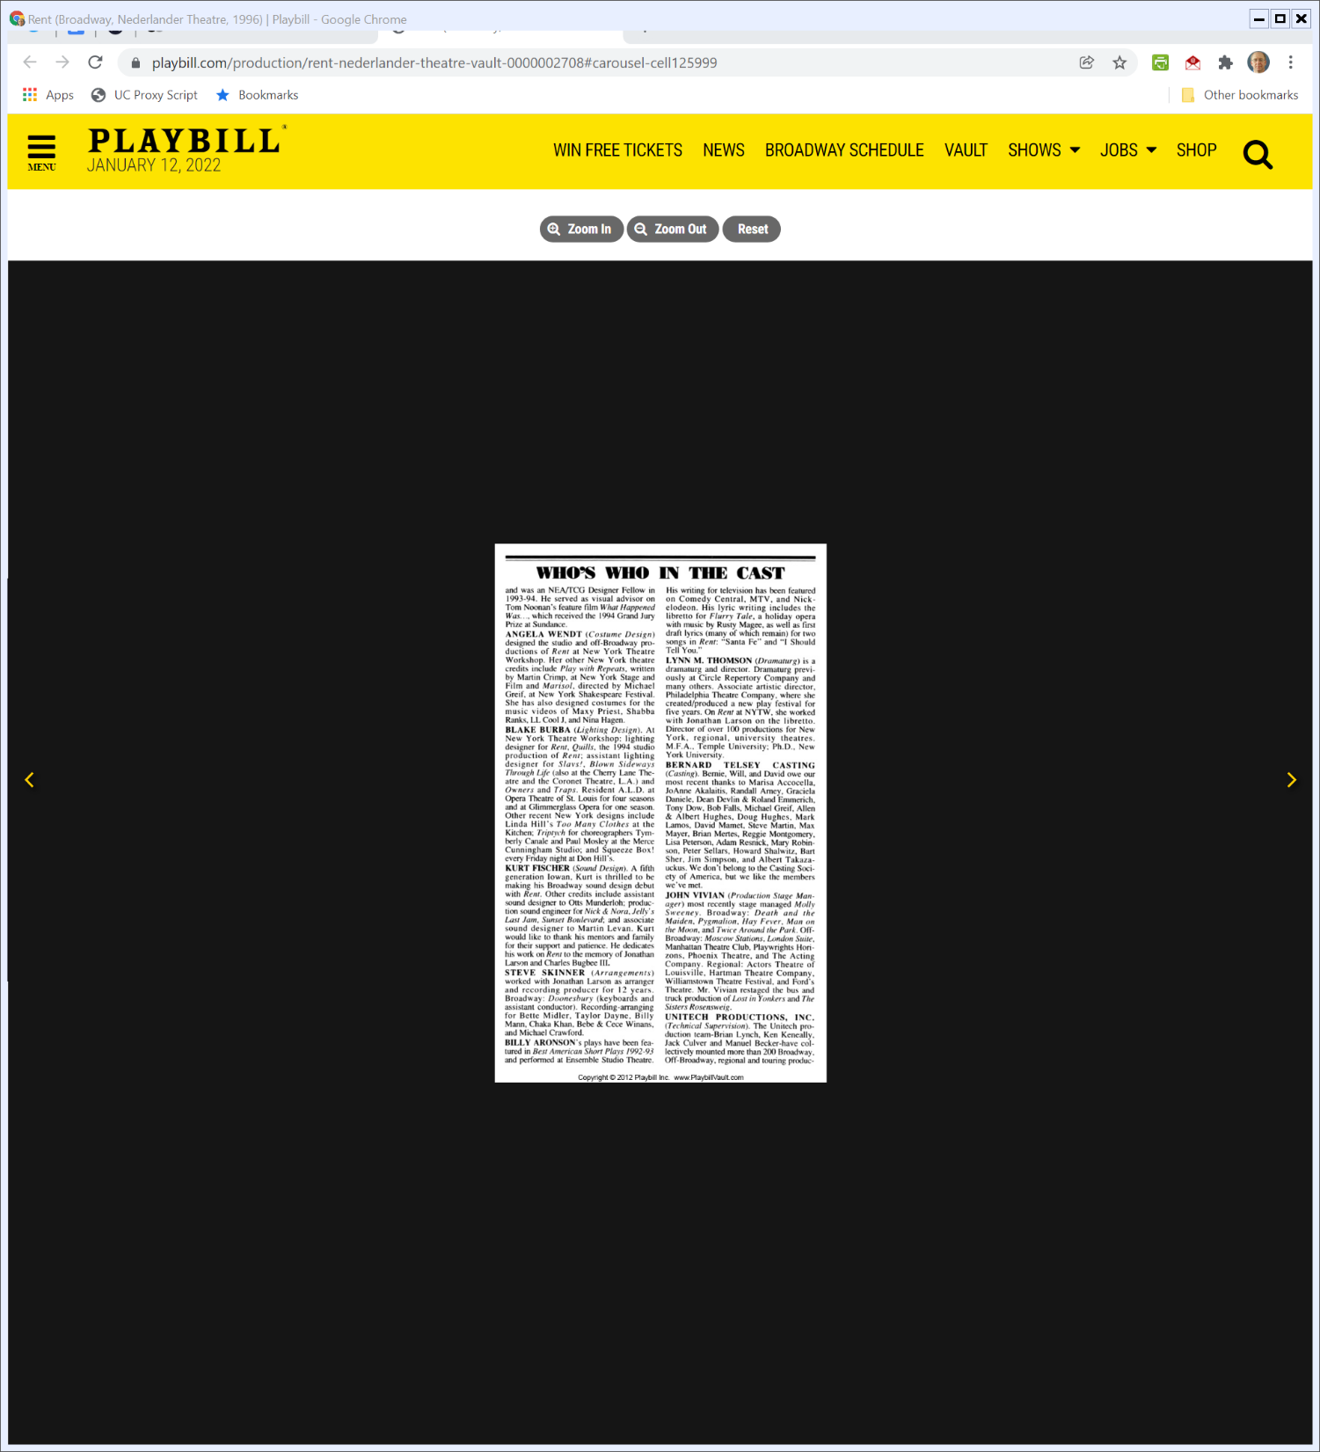
Aronson, Thomson
Rent Broadway Playbill

Slide 41
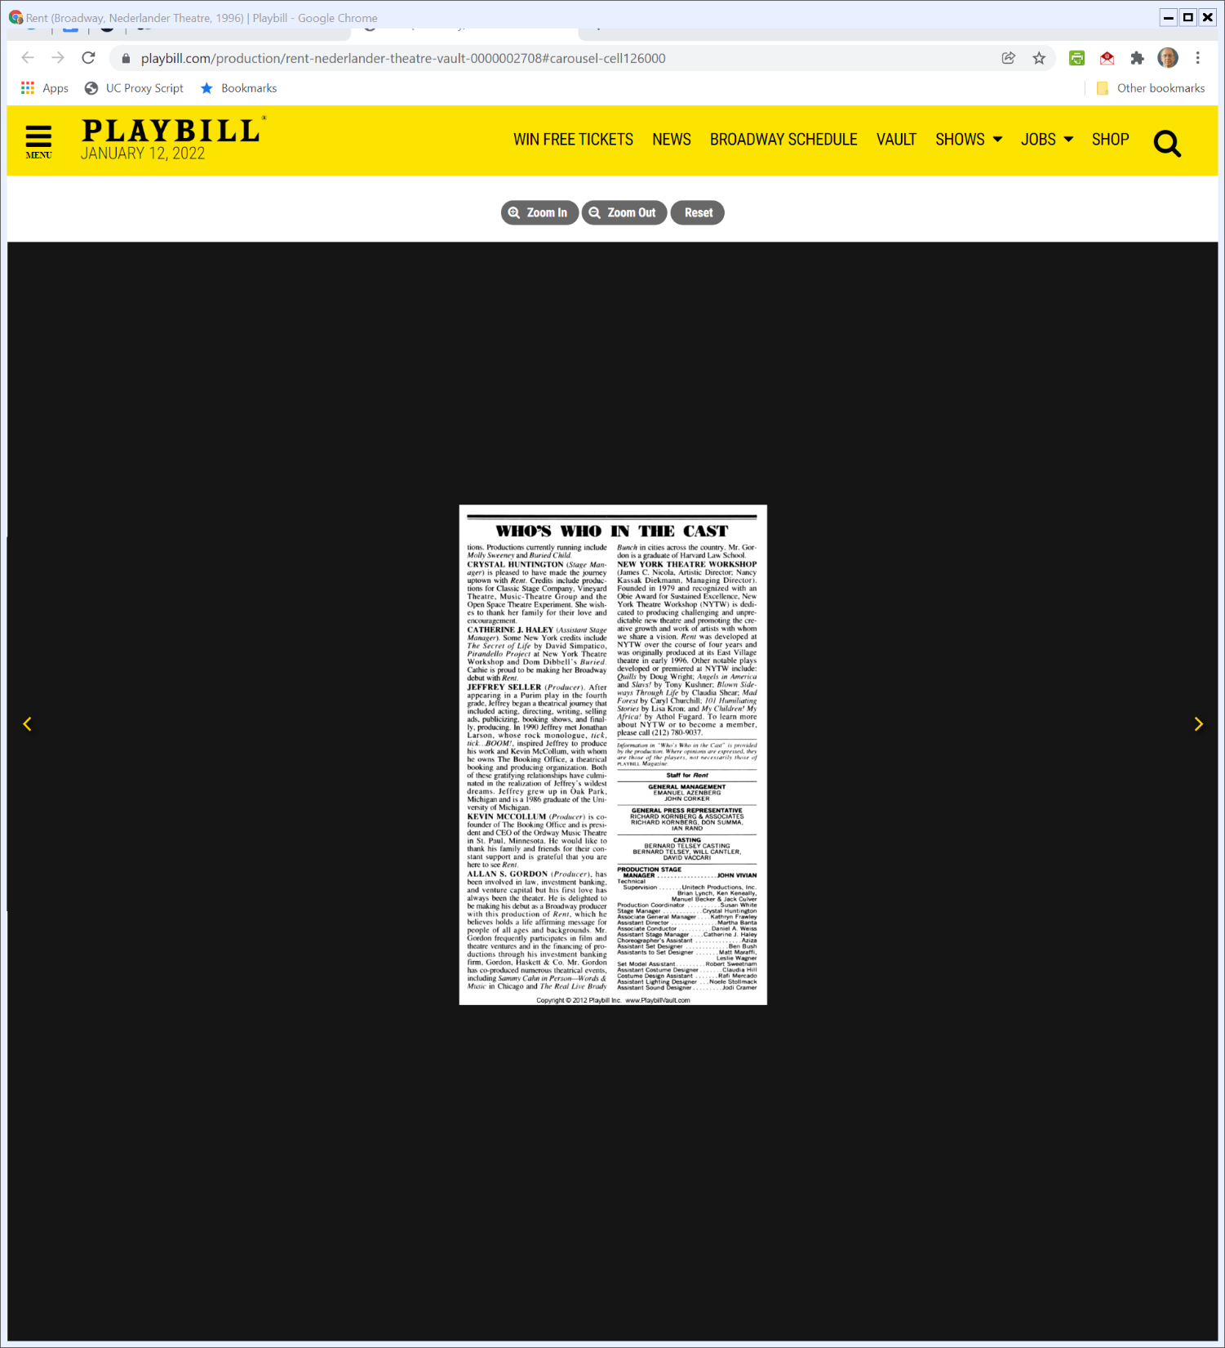
NYTW
Rent Broadway Playbill

Slide 42
“Shimmers With Hope”
The New York Times (14 Feb 1996)

Slide 43
The American Musical Lives
The New York Times (14 Feb 1996)

Slide 44
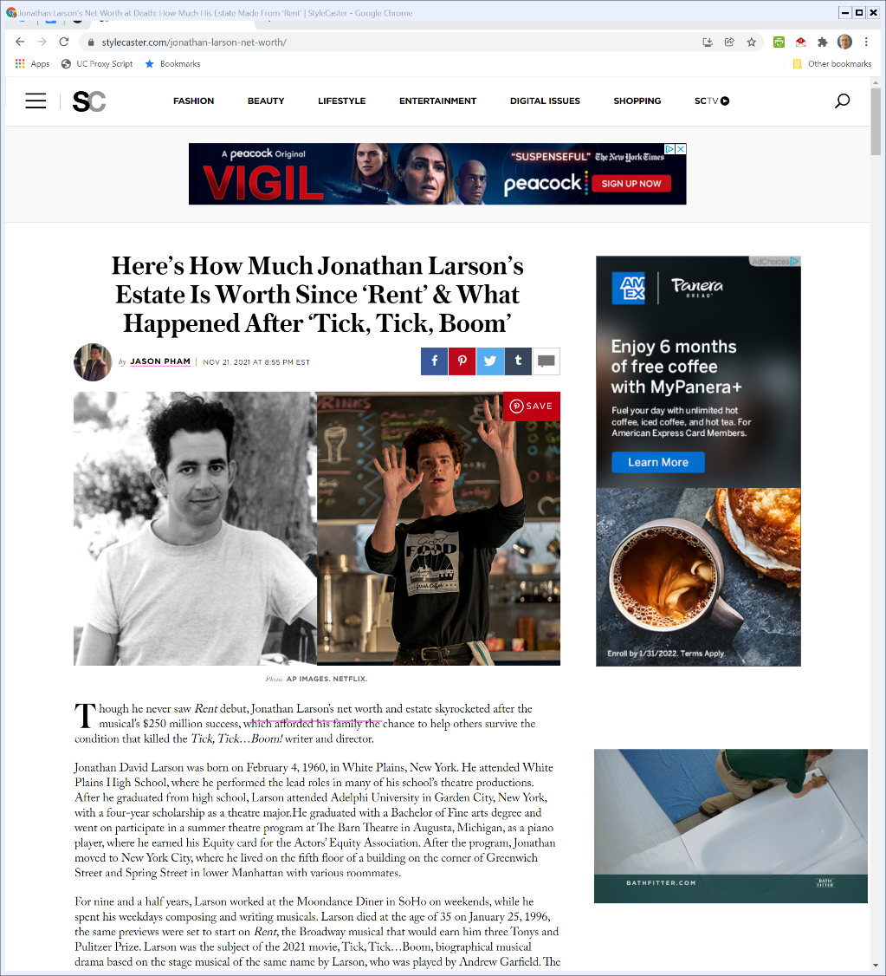
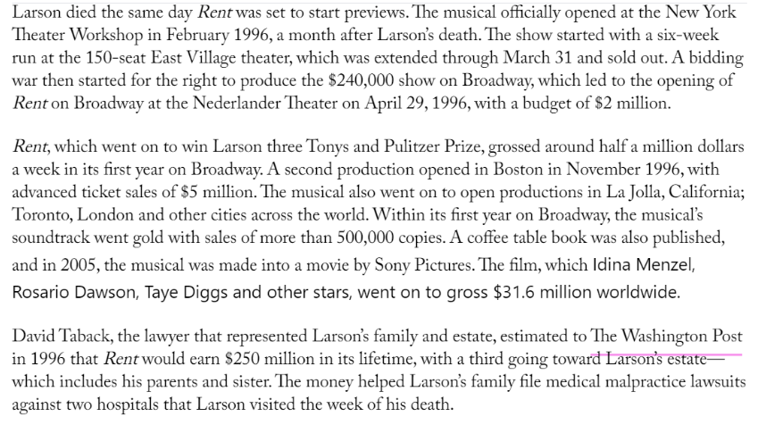
How Much Money Is at Stake?: $80+M
Stylecaster.com (21 Nov 2021)
Notes:
https://stylecaster.com/jonathan-larson-net-worth/

Slide 45
Broadway Musical
TTYN (1 of 4)
Hypo 4
A Broadway musical is being written by two individuals, A and L. They work together on a single text.
Eventually, they disagree on what should happen but agree that L can move forward with the musical.

Slide 46
Broadway Musical
TTYN (2 of 4)
Questions
What was their authorship status in the beginning?
What is the process by which they should dissolve that relationship?
What does that mean for authorship status and copyright regarding the work in place at the point of dissolution?

Slide 47
Poem
TTYN (3 of 4)
Hypo 5
You and I sit down and a poem is written
I write the first three stanzas, you write the fourth stanza
Who is/are the author(s) of the poem? What rights do we each have?

Slide 48
Broadway Musical Again
TTYN (4 of 4)
Hypo 6
A Broadway musical is being written.
I write all of it, but you write one song (music and lyrics)
Who is/are the author(s) of the musical? What rights do we each have?
Do any of these match Thomson v. Larson?

Slide 49
Thomson v. Larson
Core Facts
1989: Aronson and Larson start work on Rent
1991: Split via written agreement
1992: New York Theatre Workshop (NYTW) advises Larson to get a bookwriter to help with the musical; Larson says no.

Slide 50
Thomson v. Larson
1995: Larson agrees to let NYTW hire Thomson as dramaturg
Contract says $2000 fee as full consideration
Billing as dramaturg
No mention of copyright
1995: Larson and Thomson work together
One document, kept by Larson on Larson’s computer

Slide 51
Thomson v. Larson
Nov. 1995: Larson executes contract with NYTW
Specifies Larson as sole author and gives Larson approval, control and ownership rights
23 Jan 1996
Final dress rehearsal
Larson dies

Slide 52
Thomson v. Larson
Next Month
Four people, including Thomson, make final changes; three of four try to disclaim copyright; Thomson doesn’t do that.
April, 96: Thomson seeks more $ and recognition; Larson heirs offer 1% of author’s royalties

Slide 53
Thomson v. Larson
Thomson sues for co-authorship status and $
Wants 16% of author’s share of royalties
See footnote 11 for calculation: 50% of what she participated in creating
What does she get?

Slide 54
First Interaction in Thomson
Larson/Aronson
Working together followed by a split:
Title: “RENT a rock opera by Jonathan Larson. Original concept and additional lyrics by Billy Aronson.”
Aronson agrees he won’t be considered co-author of RENT

Slide 55
First Interaction in Thomson
How should we assess this? Can an “author” waive that status by contract?
If Aronson isn’t an author, are there other issues that we need to consider?

Slide 56
Second Set of Interactions in Thomson
The Larson/NYTW/Thomson Contract
What role do the contracts play?
What role does intent play
Larson’s intent easy here: Me and me alone
Does Thomson have a separate interest in her work? With what consequences?

Slide 57
The Approach in Childress
Single Text, Single Author, Multiple Participants
Editors and Authors
Focus on
1. both make independently copyrightable contributions
2. mutual intent to be co-authors

Slide 58
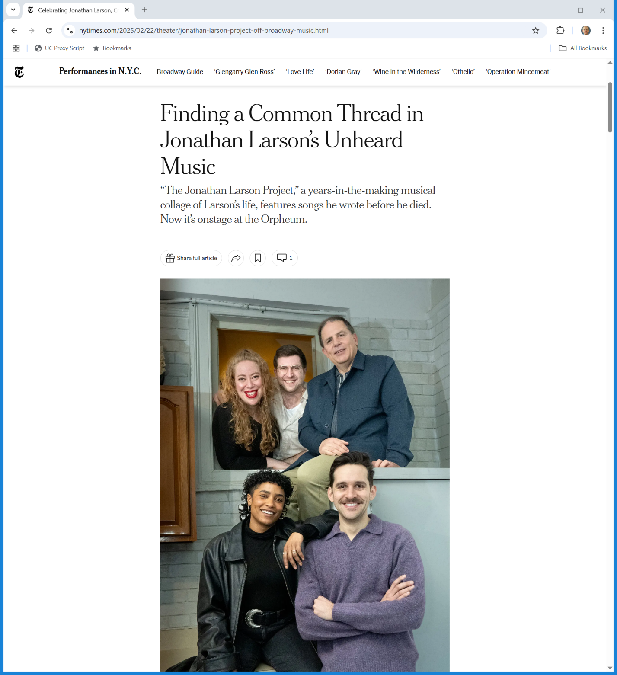
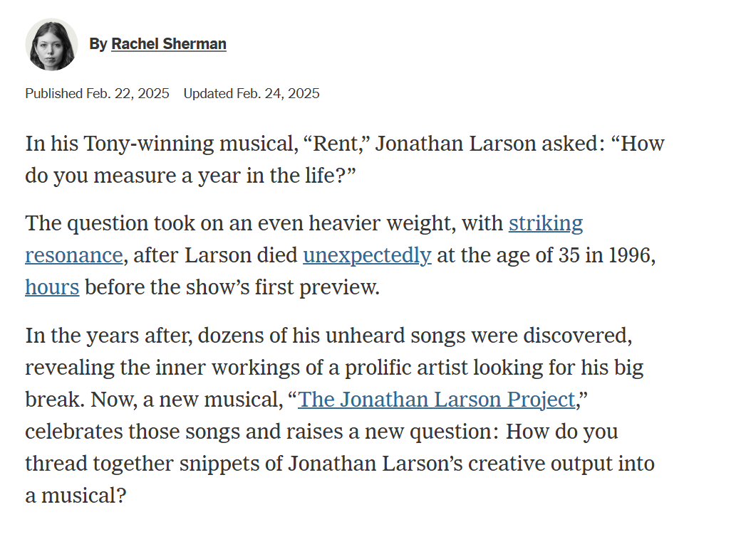
The Jonathan Larson Project
New York Times (22 Feb 2025)
Notes:
https://www.nytimes.com/2025/02/22/theater/jonathan-larson-project-off-broadway-music.html

Slide 59
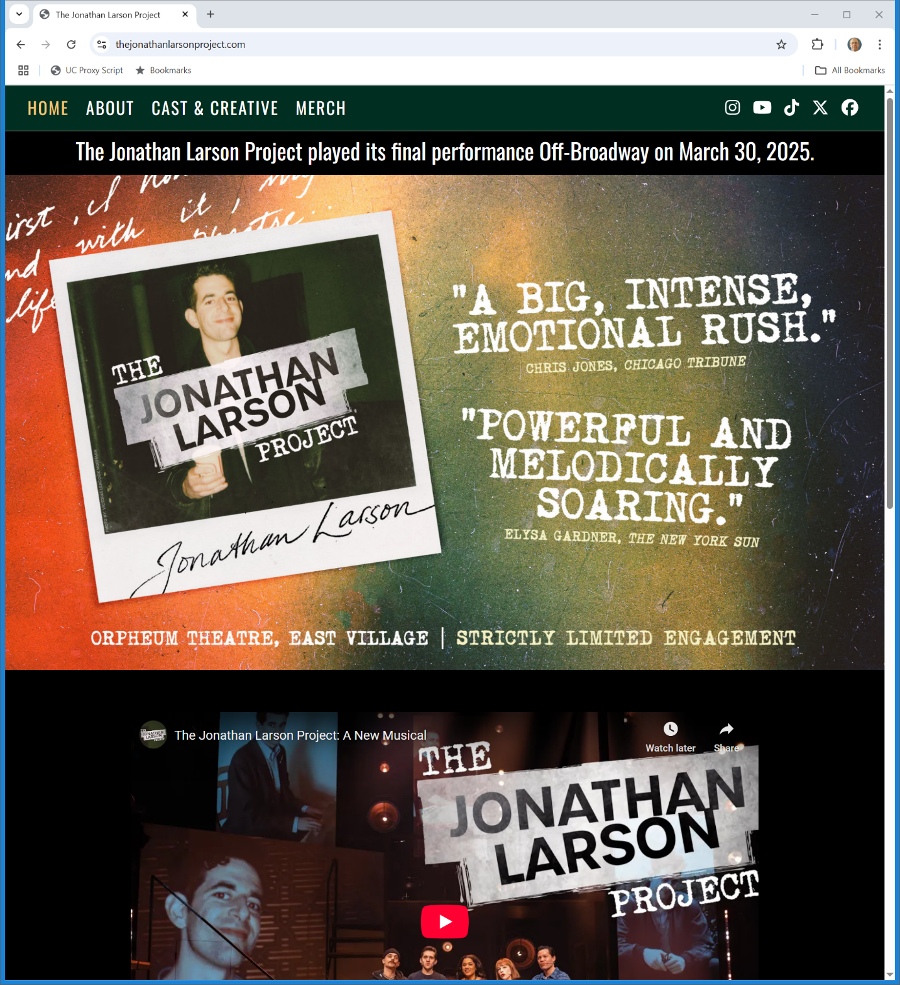
Just Closed
The Jonathan Larson Project
Notes:
https://thejonathanlarsonproject.com/

Slide 60
CCNV v. Reid: Work Made for Hire
490 U.S. 730 (1989)

Slide 61
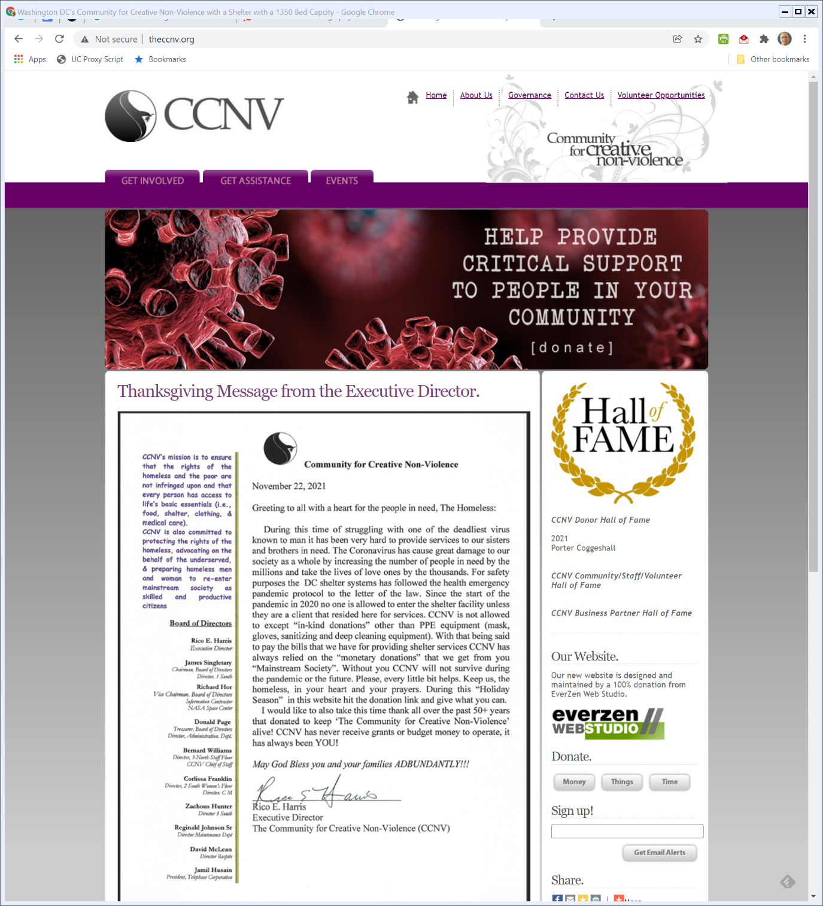
Who is CCNV?
Theccnv.org (Visited 12 Jan 2022)
Notes:
http://www.theccnv.org/

Slide 62
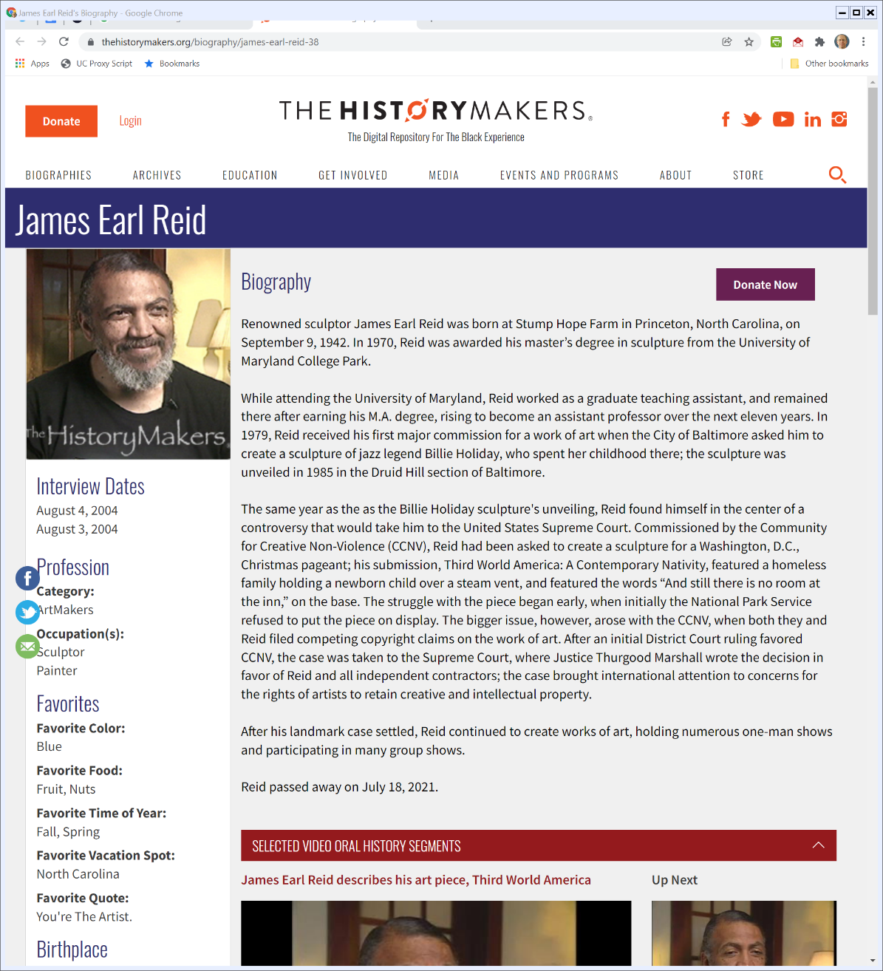
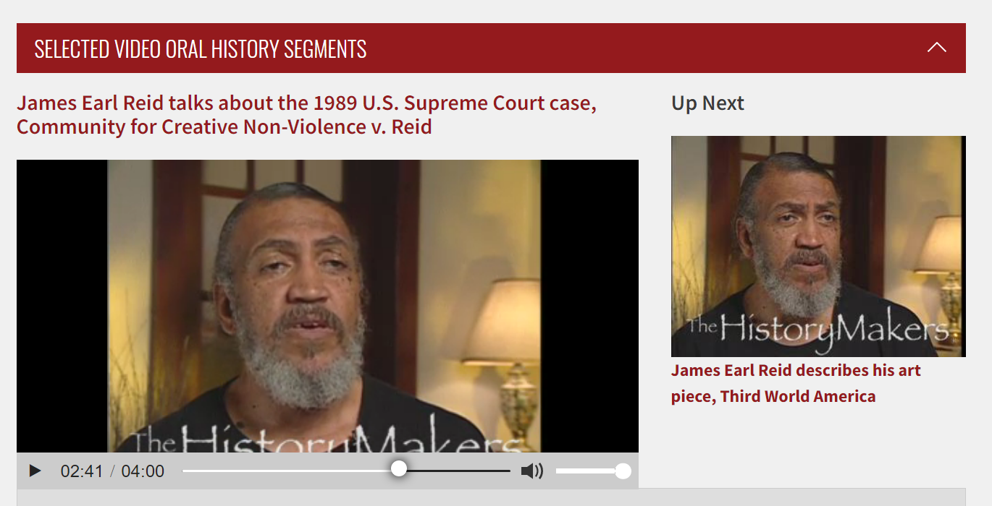
And James Earl Reid?
The History Makers (Visited 12 Jan 2022)
Notes:
https://www.thehistorymakers.org/biography/james-earl-reid-38

Slide 63
“I was sucked in by a saint and then the Devil came out.”
The Washington Post (27 Mar 1989)

Slide 64
CCNV v. Reid
Core Facts
Snyder and CCNV members conceive of a sculpture
Modern Nativity scene involving the homeless on a grate built into a pedestal
Agree on title
Engage local artist, Reid

Slide 65
CCNV v. Reid
Reid does sketches, modifies them after visit with Snyder
Reid wants to incorporate shopping bags; CCNV says no, wants shopping cart

Slide 66
Authoring Third World America?
TTYN (1 of 2)
Questions
Who is/are the author(s) of the sculpture? Snyder/CCNV? Reid? Both?
How does relate to our discussion of the ideas/expression dichotomy?
How does the analysis in Thomson apply here?

Slide 67
Authoring Third World America?
TTYN (2 of 2)
Questions
How does the creation process compare to what we saw in Rogers v. Koons?

Slide 68
Understanding Employees
Reid says four understandings in lower courts
1. Employee “whenever the hiring party retains the right to control the product”
2. Employee is hiring party who “actually wielded control”
3. Employee as common law agency idea
4. Formal salaried employee

Slide 69
Employee Status Determined Based on General Common Law of Agency
“To determine whether a work is for hire under the Act, a court first should ascertain, using principles of general common law of agency, whether the work was prepared by an employee or an independent contractor. After making this determination, the court can apply the appropriate subsection of § 101.”
CCNV v. Reid (U.S. 1989)

Slide 70
Factors to Consider
Multiple factors:
Hiring party’s right to control manner and means
Skill required
Location and duration of the work
Whether the hiring party has the right to assign other work
Tax treatment of the hired party

Slide 71
Consequences
Narrow Employee Definition Means
Much greater chance of coauthor/coowner situation
Hired party may be considered to be author
So might hiring party and that could easily result in joint work (or something else?)
Deal with this through contractual assignment?

Slide 72
The Remand
Three Subsequent District Court Opinions
Snyder dies, Carol Fennelly substituted as party in interest
Consent judgment filed Jan 7, 1991

Slide 73
The Remand
Consent Judgment Terms
ORDERED, that Reid shall be recognized as the sole author of Third World America; and it is
FURTHER ORDERED, that CCNV shall be the sole owner of the original copy of Third World America and of all rights under Section 109 of the Copyright Act, with respect to that copy;

Slide 74
The Remand
Consent Judgment Terms
FURTHER ORDERED, that Reid shall be the sole owner of all rights under Section 106 of the Copyright Act, with respect to three-dimensional reproductions of Third World America;

Slide 75
The Remand
Consent Judgment Terms
FURTHER ORDERED, that CCNV and Reid shall be co-owners of all rights under Section 106 of the Copyright Act, with respect to two-dimensional reproductions of Third World America, including the right to copy and to distribute to the public any such reproductions made prior to the date hereof

Slide 76
The Remand
2nd Opinion
“Despite the consent judgment, however, the matter remains in stalemate. CCNV possesses the sculpture. Reid wishes to make a mold of it to capitalize on his exclusive three-dimensional reproduction rights. CCNV refuses to give Reid access to it.”

