Slide 1
Class 4: Mon 31 Mar 2025
Copyright Spring 2025
Facts and Compilations
Randal C. Picker
James Parker Hall Distinguished Service Professor of Law
The Law School
The University of Chicago

Slide 2
Yesterday’s NYT Front Page
New York Times (30 Mar 2025)

Slide 3
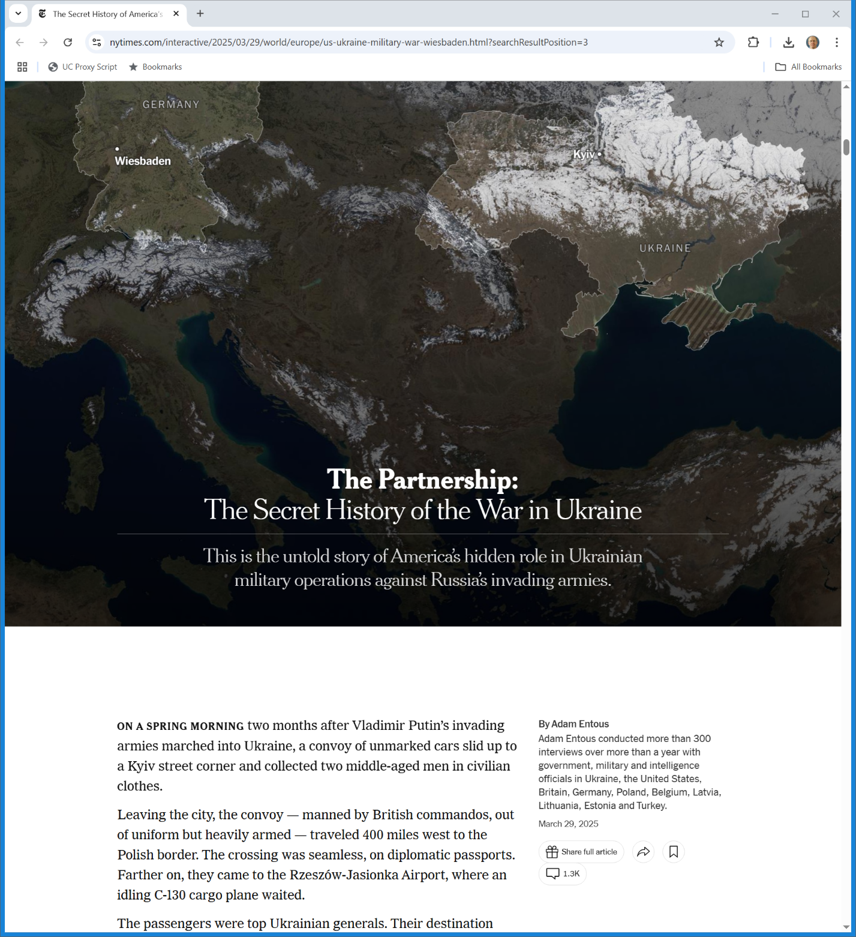
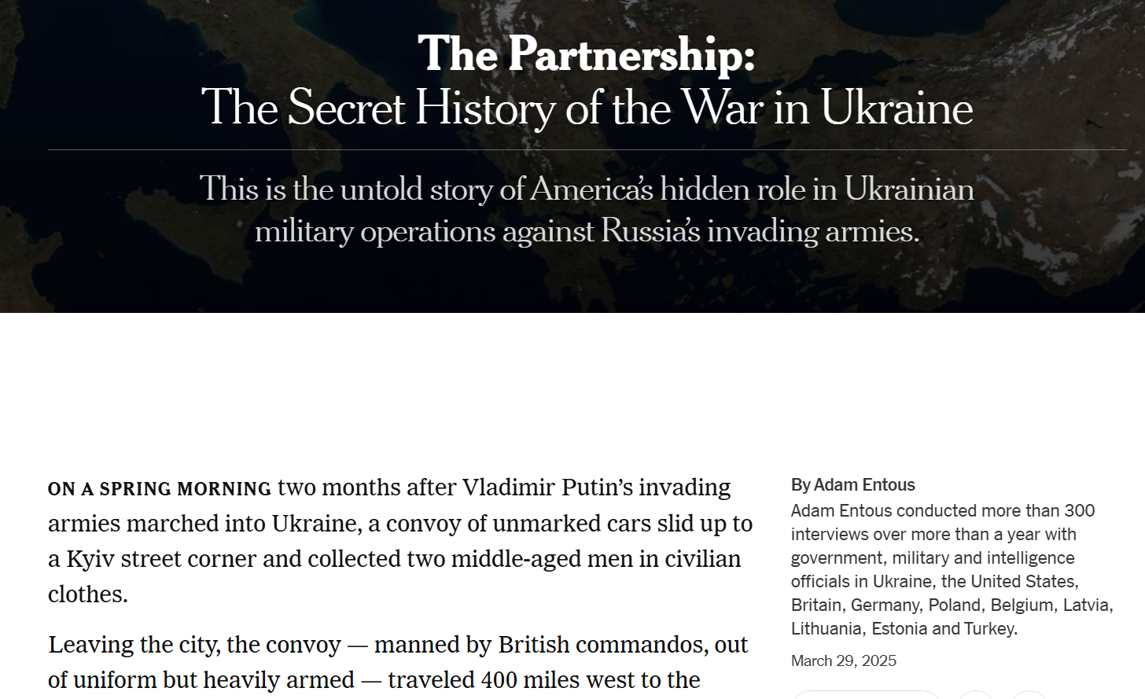
300+ Interviews
New York Times (29 Mar 2025)
Notes:
https://www.nytimes.com/interactive/2025/03/29/world/europe/us-ukraine-military-war-wiesbaden.html

Slide 4
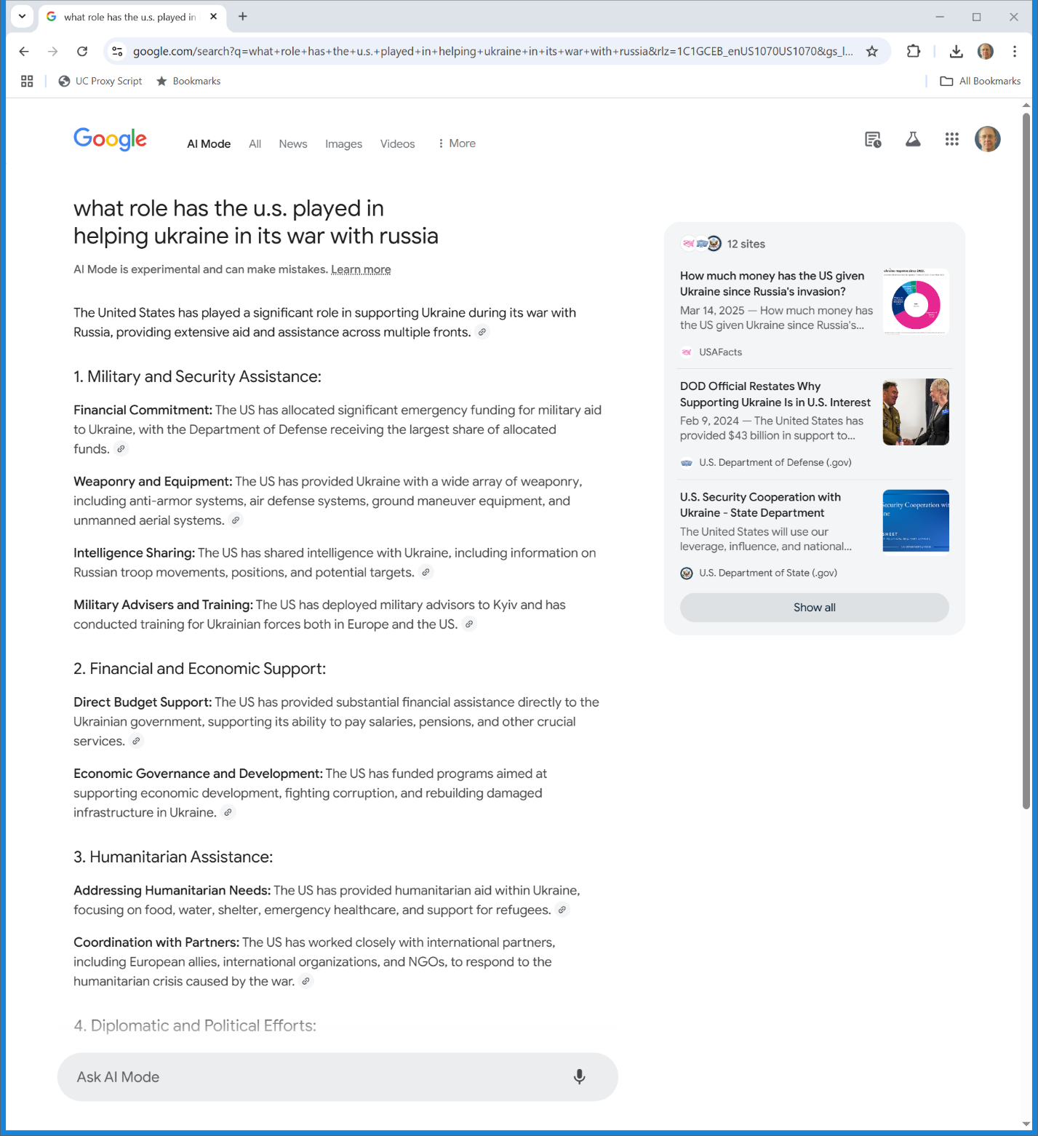
U.S. Role in Ukraine War?
Google AI Mode (31 Mar 2025)

Slide 5
Feist (U.S. 1991)
499 U.S. 340 (1991)

Slide 6
Feist
Rural Telephone Service
  the local phone company in northwest Kansas
  Provide service, assign phone numbers, get all of the info as a byproduct of those activities
  Required by law to issue phone book

Slide 7
Feist
  Distribute phone books: free to consumers, charge companies to be in Yellow Pages
Feist Publications
  Entrant into area-wide phone book market
  Struck deal with 10 of 11 to license listings; Rural refused
  Feist got names from phone book; sought to verify listings; did most not all

Slide 8
Legal “Facts” in Feist
“Two Well-Established Propositions”
  Facts are not copyrightable
  Compilations of facts are copyrightable

Slide 9
Copyright’s Incentives
Do we need to give Rural a copyright in the phone listings to incentive it to issue the phone book?

Slide 10
Facts and Copyright
Single Facts
  Start with Sec. 102(b):
    In no case does copyright protection for an original work of authorship extend to any idea, procedure, process, system, method of operation, concept, principle, or discovery, regardless of the form in which it is described, explained, illustrated, or embodied in such work.

Slide 11
Facts as Discoveries
Putting the language to one side
  Authors as discovering facts, not creating them
  Facts as existing independent of the author, hence no origination

Slide 12
Sec. 103
“(a) The subject matter of copyright as specified by section 102 includes compilations and derivative works, but protection for a work employing preexisting material in which copyright subsists does not extend to any part of the work in which such material has been used unlawfully.”
U.S. Copyright Statute

Slide 13
Sec. 103
“(b) The copyright in a compilation or derivative work extends only to the material contributed by the author of such work, as distinguished from the preexisting material employed in the work, and does not imply any exclusive right in the preexisting material. The copyright in such work is independent of, and does not affect or enlarge the scope, duration, ownership, or subsistence of, any copyright protection in the preexisting material.”
U.S. Copyright Statute

Slide 14
House Report
U.S. Copyright Statute

Slide 15
Covers All Uses of Preexisting Material or Data
U.S. Copyright Statute

Slide 16
Groups of Facts: Compilations
The definition of compilation in Sec. 101:
  A “compilation” is a work formed by the collection and assembling of preexisting materials or of data that are selected, coordinated, or arranged in such a way that the resulting work as a whole constitutes an original work of authorship.

Slide 17
What is Copyrightable in a Compilation?
S/C/A
  Selection
  Coordination
  Arrangement

Slide 18
The Heart of Copyright
Hard work (“sweat of the brow”) v. originality
Feist finds originality to be a constitutional requirement for copyright protection by Congress
  Raises difficult issues about the ability of Congress to protect merely hard work creations, even under, say, the Commerce Clause

Slide 19
Facts v. Compilations
“This, then, resolves the doctrinal tension: Copyright treats facts and factual compilations in a wholly consistent manner. Facts, whether alone or as part of a compilation, are not original and therefore may not be copyrighted. A factual compilation is eligible for copyright if it features an original selection or arrangement of facts, but the copyright is limited to the particular selection or arrangement. In no event may copyright extend to the facts themselves.”
Feist (U.S. 1991)

Slide 20
What Makes a Compilation Original?
“As discussed earlier, however, the originality requirement is not particularly stringent. A compiler may settle upon a selection or arrangement that others have used; novelty is not required. Originality requires only that the author make the selection or arrangement independently.”
Feist (U.S. 1991)

Slide 21
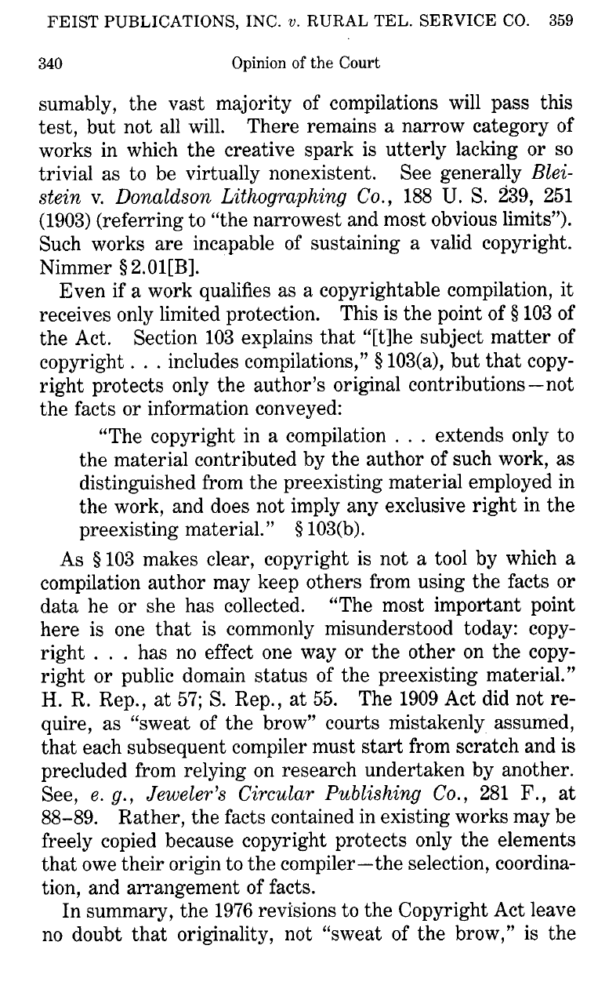
Expect Most Compilations to Be Copyrightable
“Presumably, the vast majority of compilations will pass this test, but not all will. There remains a narrow category of works in which the creative spark is utterly lacking or so trivial as to be virtually nonexistent.”
Feist (U.S. 1991)

Slide 22
Facts and Copyright
Two Paths to Pursue
  I want to copyright a “fact” or something fact-like. Can I do that?
  What compilations will suffice?

Slide 23
Understanding “Facts”
Two Situations
  Market Information
  The SAT

Slide 24
3.95
Is the number 3.95 copyrightable?

Slide 25
Price Determination on Exchanges
TTYN (1 of 6)
Hypo 1
  Company, call it the New York Mercantile Exchange, runs a market on which contracts are traded
  It is required pursuant to CFTC regulations (see 17 CFR 16.01) to determine daily settlement prices for contracts

Slide 26
Price Determination on Exchanges
TTYN (2 of 6)
  Depending on trading volume, this is not a purely mechanical exercise and so, at least in some circumstances, Company uses its independent judgment in recording the closing price
Are those prices copyrightable? Does Company author those prices or does it just discover prices?

Slide 27
Market Surveys
TTYN (3 of 6)
Hypo 2
  Bankco surveys banks across the country to calculate an average interest rate for particular terms
  Second firm, call it Costco, quotes one of those rates in its own ads
Copyright infringement?

Slide 28
Market Surveys
TTYN (4 of 6)
Does it matter how Bankco does the survey?
How it calculates the average?

Slide 29
Market Predictions
TTYN (5 of 6)
Hypo 3
  Corp publishes a guide to used car prices. Although Corp surveys actual market transactions, it doesn’t report mere averages but instead offers forecasts (predictions) of what prices will be like over the next six weeks

Slide 30
Market Predictions
TTYN (6 of 6)
  “We predict that a 2019 Red Honda Accord with 70,000 miles on it will sell for $19,500 over the 6 weeks.”
Copyrightable? Does it matter if the predictions match exactly the market averages calculated from market surveys?

Slide 31
Answers: Copyrightable?
1. Market Exchange Price
  No
2. Interest Rate Average
  No
3. Used Car Value Forecast
  Yes

Slide 32
Price Determination on Exchanges
“The question then, is one of characterization: does the Committee create the settlement prices, or is it more accurate to view the Committee’s task as like that of a census taker, copying the market’s valuation of futures contracts?”
New York Mercantile Exchange, 497 F.3d 109 (2nd Cir. 2007)

Slide 33
Creation v. Discovery
“While the line between creation and discovery is often clear-cut, we recognize that it is a difficult line to draw in this case. For reasons we explain below, we believe there is a strong argument that, like the census taker, NYMEX does not ‘author’ the settlement prices as the term is used in copyright law.”
New York Mercantile Exchange, 497 F.3d 109 (2nd Cir. 2007)

Slide 34
Market Surveys
“… [T]he Court determines that, even drawing all reasonable inferences from the evidence in Plaintiff’s favor, the averages are unprotectable because they are uncopyrightable facts, because they are too short to be copyrighted, and because the so-called merger doctrine … bars copyright protection.”
Costco, 978 F.Supp.2d 280 (SDNY 2013)

Slide 35
Market Predictions
“The district court was simply mistaken in its conclusion that the Red Book valuations were, like the telephone numbers in Feist, pre-existing facts that had merely been discovered by the Red Book editors. To the contrary, Maclean’s evidence demonstrated without rebuttal that its valuations were neither reports of historical prices nor mechanical derivations of historical prices or other data.”
CCC Information Services, 44 F.3d 61 (2nd Cir. 1994)

Slide 36
Market Predictions
“Rather, they represented predictions by the Red Book editors of future prices estimated to cover specified geographic regions. … The valuations themselves are original creations of Maclean. The balancing of interests … leads to the conclusion that we should reject CCC’s argument seeking the benefit of the merger doctrine.”
CCC Information Services, 44 F.3d 61 (2nd Cir. 1994)

Slide 37
Market Predictions
“Because the ideas contained in the Red Book are of the weaker, suggestion-opinion category, a withholding of the merger doctrine would not seriously impair the policy of the copyright law that seeks to preserve free public access to ideas.”
CCC Information Services, 44 F.3d 61 (2nd Cir. 1994)

Slide 38
Cultural Facts?
Question
  The scar on Harry Potter’s forehead is in the shape of:
    (a) a lightning bolt
    (b) a Nimbus 2000
    (c) an owl
    (d) the copyright symbol ©

Slide 39
Cultural Facts
“We conclude that The SAT unlawfully copies from Seinfeld and that its copying does not constitute fair use and thus is an actionable infringement.”
Castle Rock Entertainment, 150 F.3d 132 (2nd Cir. 1998)

Slide 40
Cultural Facts
“… [E]ach SAT trivia question is based directly upon original protectable expression in Seinfeld. … The SAT did not copy from Seinfeld unprotected facts, but, rather, creative expression.”
Castle Rock Entertainment, 150 F.3d 132 (2nd Cir. 1998)

Slide 41
What Is My Name and Address?
TTYN (1 of 4)
Is it …?
  Name?
    First: Randy, Randal, Randall?
    Middle: Nothing, C, C., Cluny?
    Last: Picker
  12 combinations

Slide 42
What Is My Name and Address?
TTYN (2 of 4)
Is it …?
  Address?
    5523
    S, S., South
    Kimbark
    Ave, Ave., Avenue
  9 combinations for 108 total

Slide 43
What Is My Name and Address?
TTYN (3 of 4)
Questions
  A firm is in the business of providing information to make it possible for its customers to get mail delivered successfully to particular targets
  It creates a database of names and addresses to do that. It makes choices of who is in and out and it also resolves the issues posed in the first two slides

Slide 44
What Is My Name and Address?
TTYN (4 of 4)
Questions
  What rights does it have in the database as such?
  In the individual entries in the database? Is it making an S/C/A when it decides to go with one particular version of my name and address?

Slide 45
Experian
893 F.3d 1176 (9th Cir. 2018)

Slide 46
Experian (CA9 2018)
Starting Points
  The database
    How should we classify it in copyright? What does Section 103 and Feist say about its copyrightability?

Slide 47
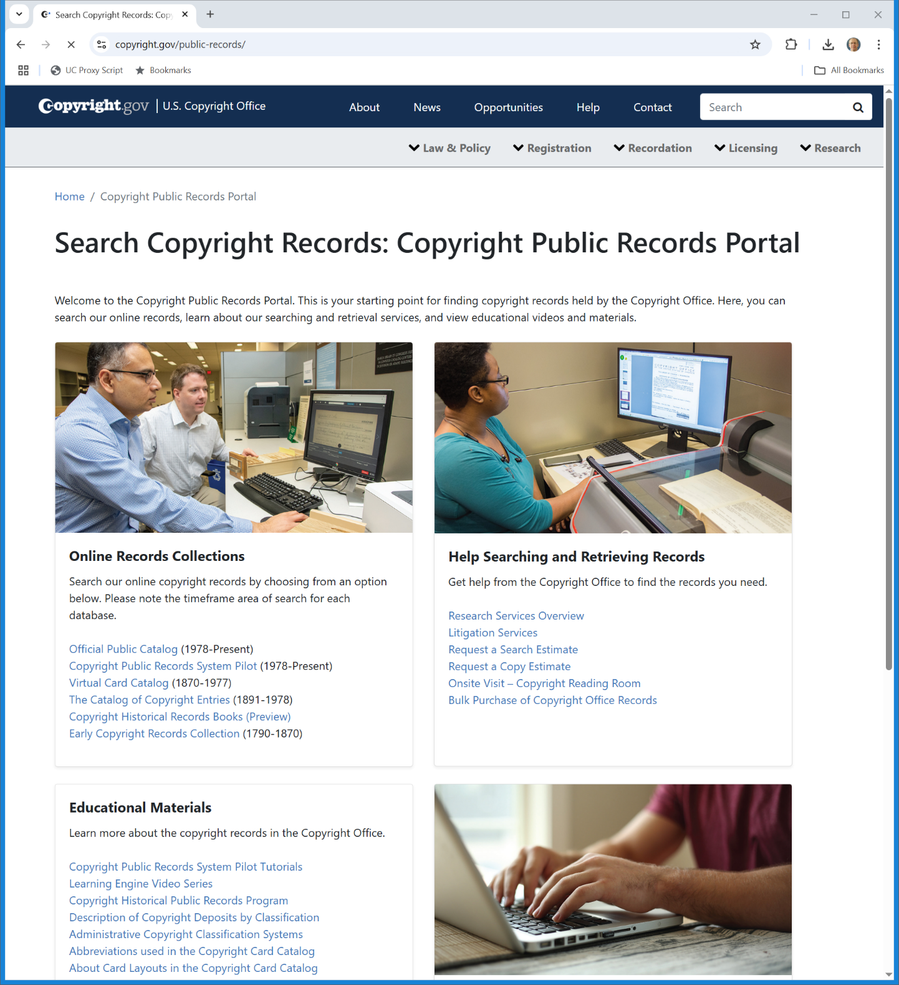
Searching Copyright Records
Copyright.gov (31 Mar 2025)
Notes:
https://www.copyright.gov/public-records/

Slide 48
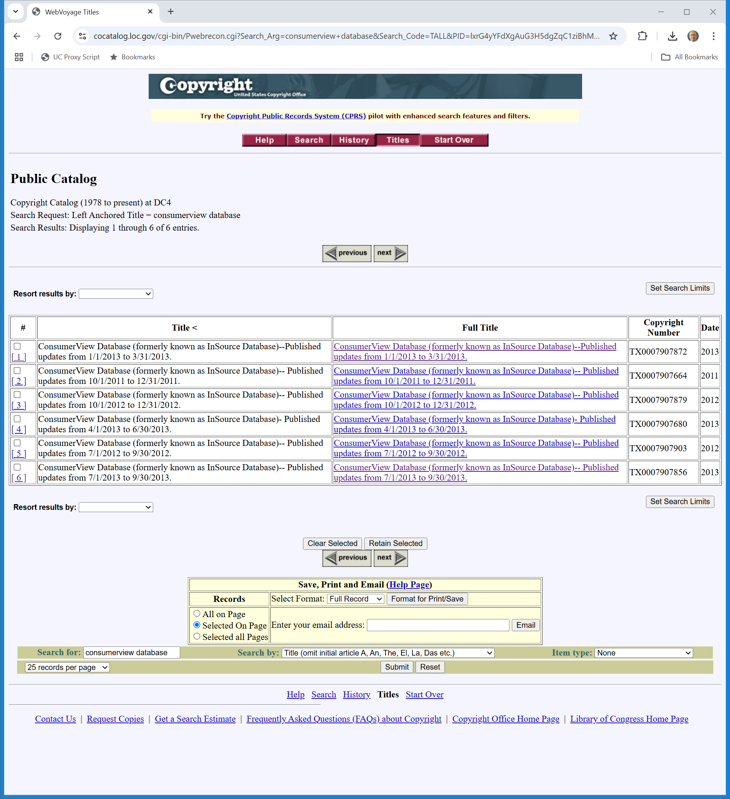
Search on “consumerview database”
Copyright.gov (31 Mar 2025)
Notes:
https://cocatalog.loc.gov/cgi-bin/Pwebrecon.cgi?Search_Arg=consumerview+database&Search_Code=TALL&PID=lxrG4yYFdXgAuG3H5dgZqC1ziBhMj&SEQ=20250331115805&CNT=25&HIST=1

Slide 49
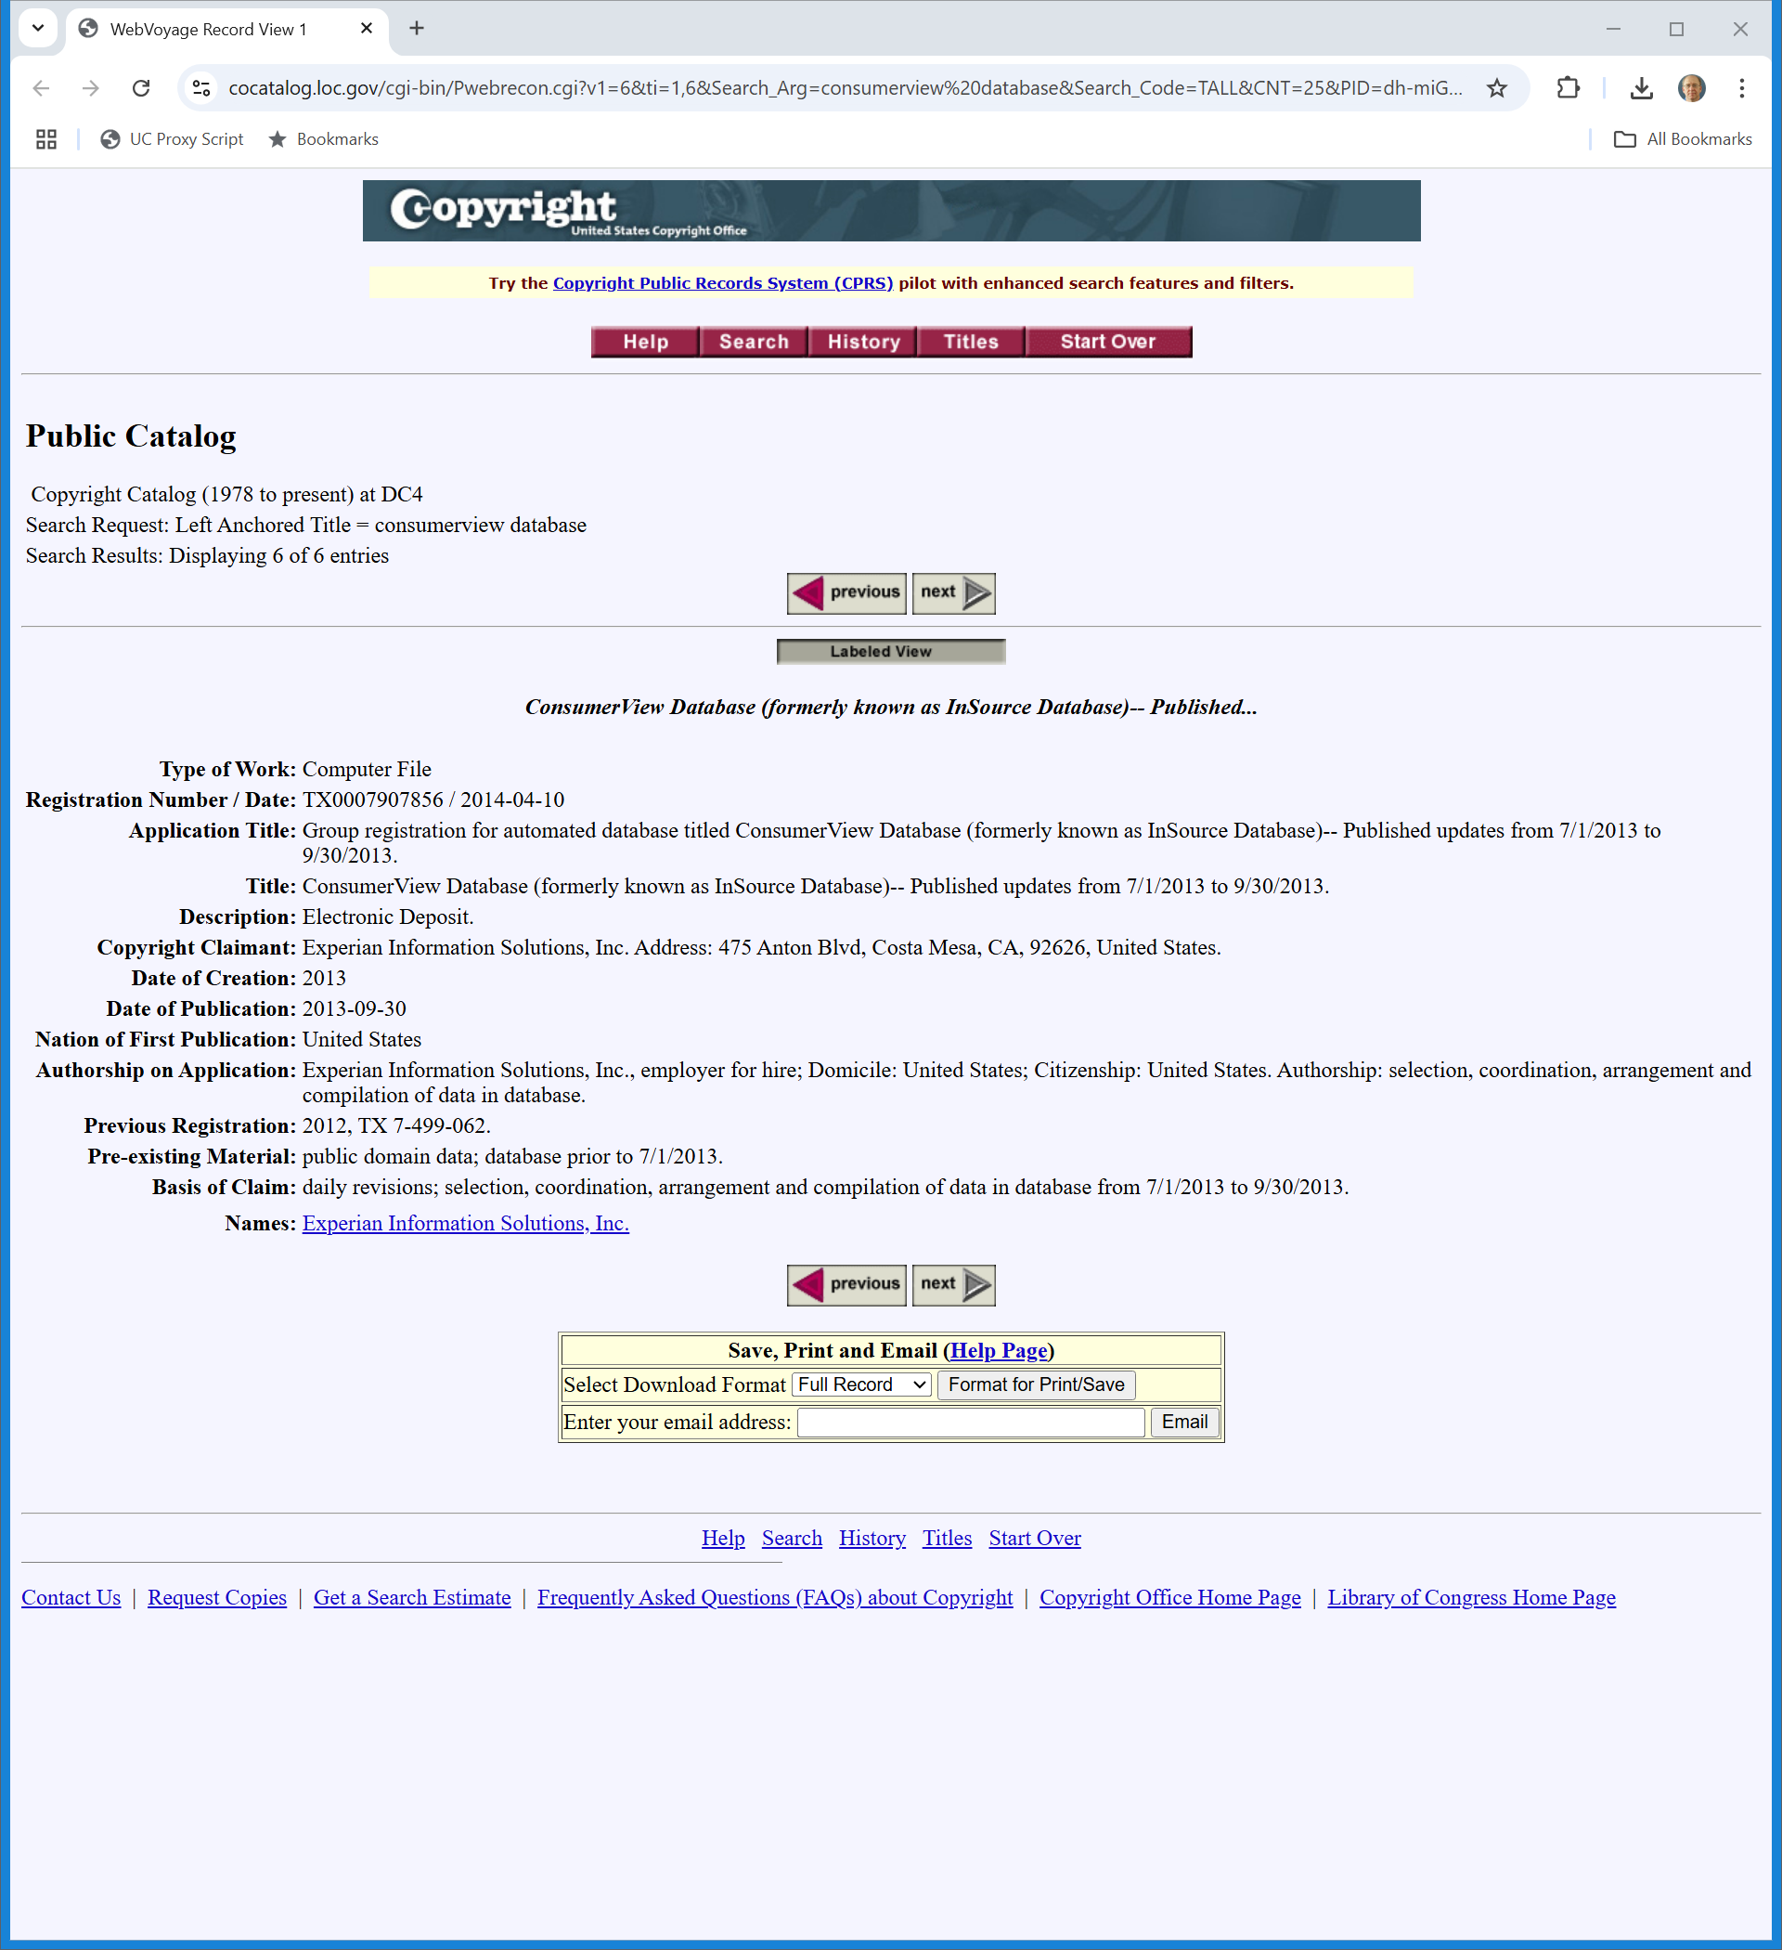
Result
Copyright.gov (31 Mar 2025)
Notes:
https://cocatalog.loc.gov/cgi-bin/Pwebrecon.cgi?v1=6&ti=1,6&Search%5FArg=consumerview%20database&Search%5FCode=TALL&CNT=25&PID=dh-miGFYNRzG7hmzAa1UPR7LbRSeY&SEQ=20250331115823&SID=1

Slide 50
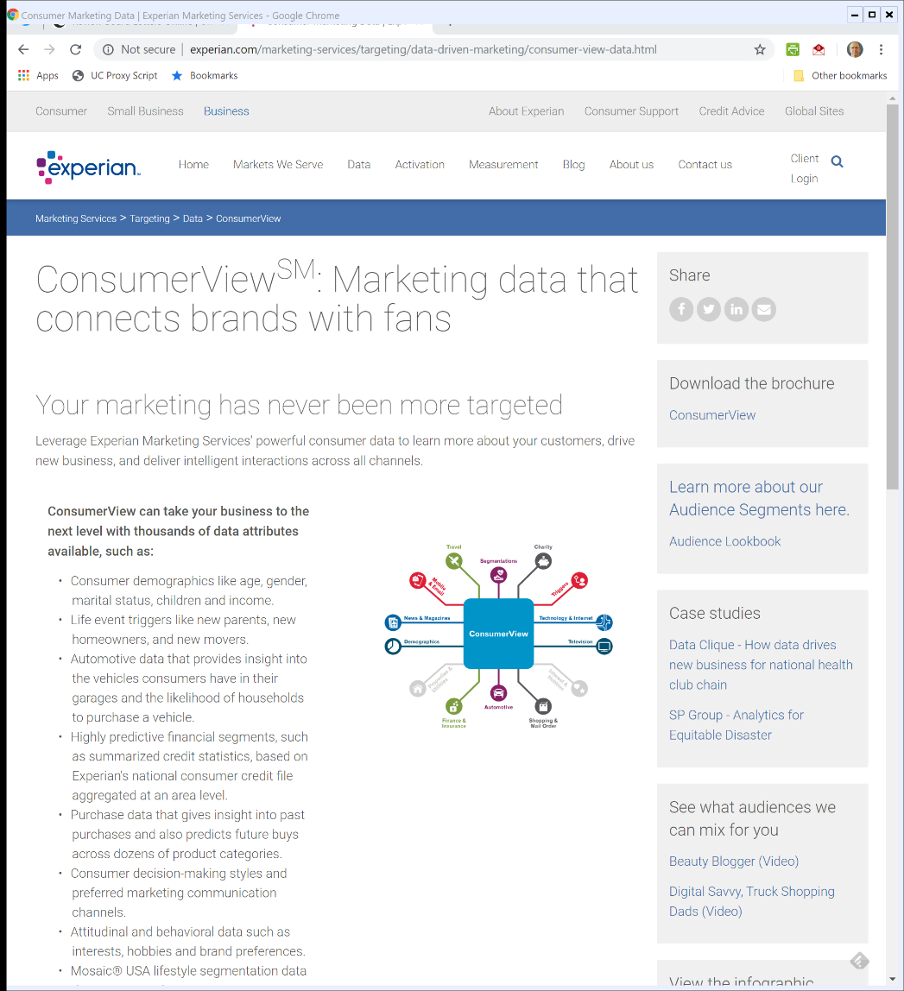

Experian Consumer View
Notes:
http://www.experian.com/marketing-services/targeting/data-driven-marketing/consumer-view-data.html

Slide 51
Finding the Compilation Here
What was …
  Selected
  Coordinated
  Arranged

Slide 52
Data Culling and Creativity
“Applying these principles to this case leads to the conclusion that Experian’s lists are entitled to limited protection. Experian’s selection process in culling data from multiple sources and selecting the appropriate pairing of addresses with names before entering them in the database involves a process of at least minimal creativity.”
Experian (9th Cir. 2018)

Slide 53
Numerous and Conflicting Sources?
“The listings are compiled by first collecting and comparing multiple sources, and then sorting conflicting information through the creation of business rules that Experian created to select from among the conflicts. As the Fifth Circuit said in Mason, selection is sufficiently creative when the compiler makes ‘choices . . . independently . . . to select information from numerous and sometimes conflicting sources.’ 967 F.2d at 141.”
Experian (9th Cir. 2018)

Slide 54
Judgment? Creativity?
“Experian’s process more than meets that standard. Much like the compilers in Mason and Key Publications, Experian’s employees choose from multiple and sometimes conflicting sources, and they use their judgment in selecting which names and addresses to include in the database.”
Experian (9th Cir. 2018)

Slide 55
What Does this Mean?
“On the basis of our review of the decisions in this and other circuits, we must conclude that the name and address pairings in this case are copyrightable as compilations under post-Feist standards.”
Experian (9th Cir. 2018)

Slide 56
And Again
“The District Court correctly granted Natimark summary judgment on Experian’s copyright claim. Experian’s name and address pairings are factual compilations entitled to only thin copyright protection. Experian failed to establish infringement.”
Experian (9th Cir. 2018)

Slide 57
Sorting Experian
Bottom Line
  Finding big compilation easy here; tons of selection being made re inclusion and exclusion
  None of that in Feist (and Feist says most compilations will qualify for copyrightability)
  That of course gives no control over individual facts as such, but the court seems to treat name/address pairings as separate compilations

Slide 58
Sorting Experian
Bottom Line
  Understanding the 80% analysis
    May be fine on question of whether it is a copy but takes us right into derivative work question
    Tricky line here will be between figuring out what is a derivative work and what is a legitimate use of individual facts

Slide 59
Sorting Experian
Bottom Line
    Derivative work issue was raised in complaint; not in opinions; don’t know why

