Slide 1
Class 3: Thurs 27 Mar 2025 Copyright Spring 2025 Ideas v. Expression
Randal C. Picker
James Parker Hall Distinguished Service Professor of Law
Ludwig & Hilde Wolf Teaching Scholar
The Law School
The University of Chicago

Slide 2
What Does Copyright Protect?
Key Question
You produce a copyrighted work. What is the scope of the rights that you receive?
Can Selden block Baker from using the bookkeeping system in Selden’s book?
What exactly does Rentmeester control regarding his Jordan photograph? Thin? Thick?

Slide 3
Section 102(b)
In no case does copyright protection for an original work of authorship extend to any idea, procedure, process, system, method of operation, concept, principle, or discovery, regardless of the form in which it is described, explained, illustrated, or embodied in such work.

Slide 4
Baker v. Selden
101 U.S. 99 (1879)

Slide 5
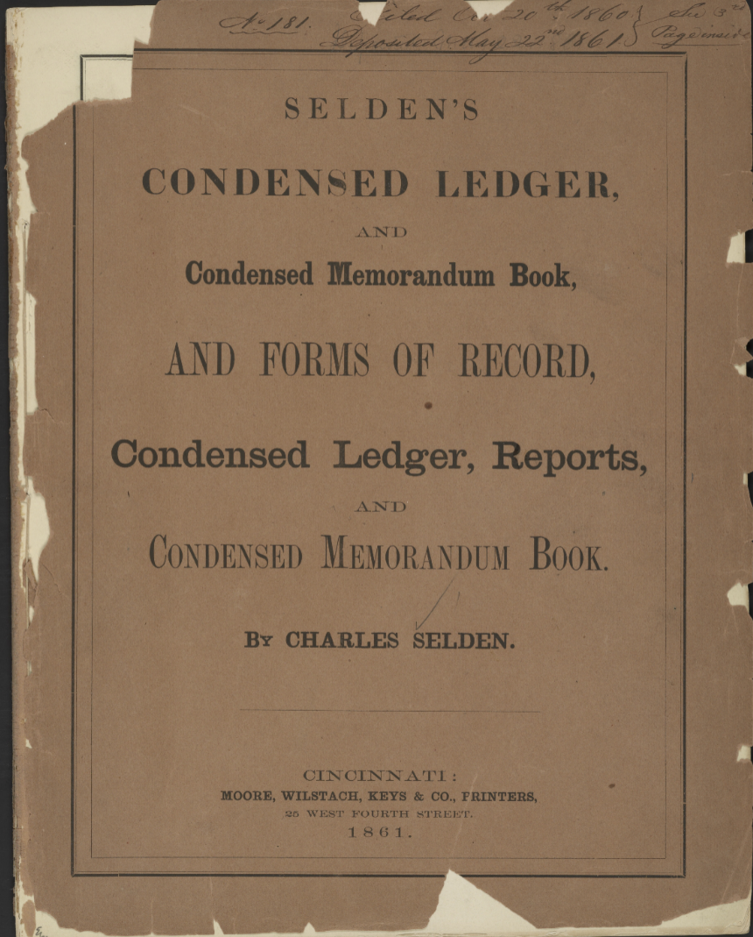
Selden’s Book
U.S. Library of Congress

Slide 6
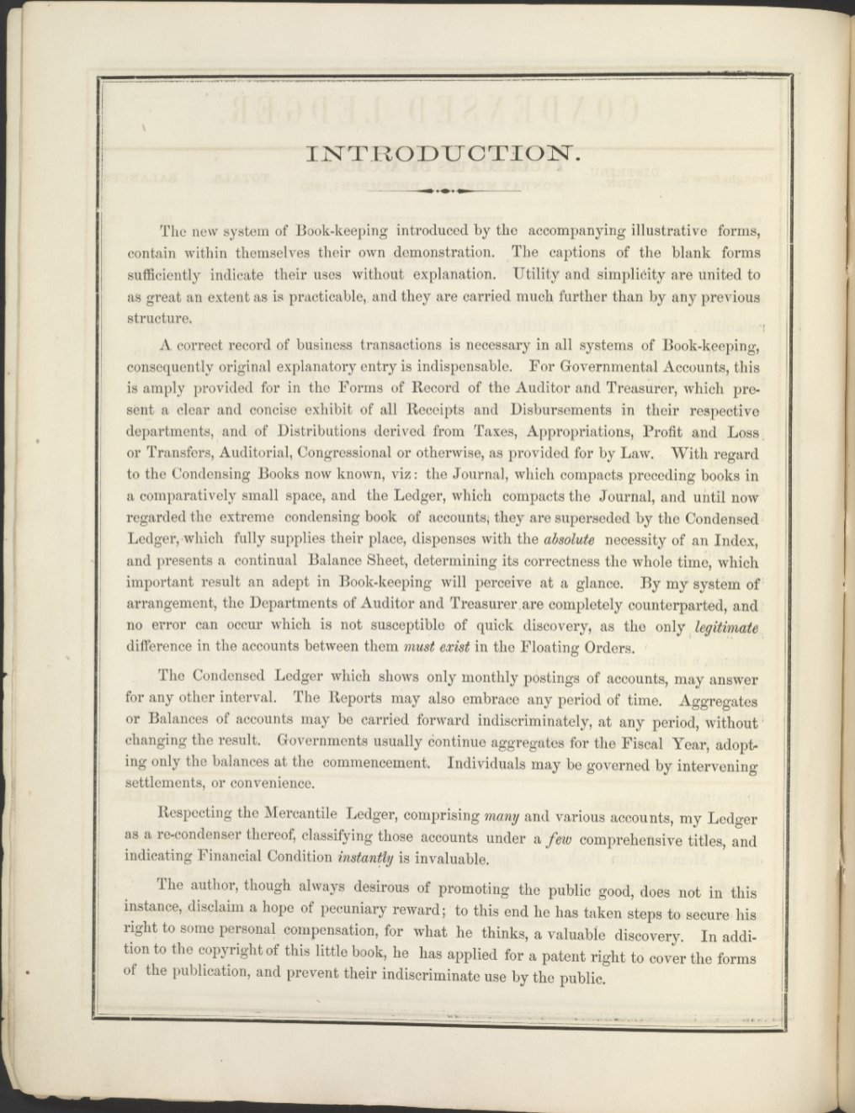

Selden’s Book
U.S. Library of Congress

Slide 7
“A Hope of Pecuniary Reward”
U.S. Library of Congress

Slide 8
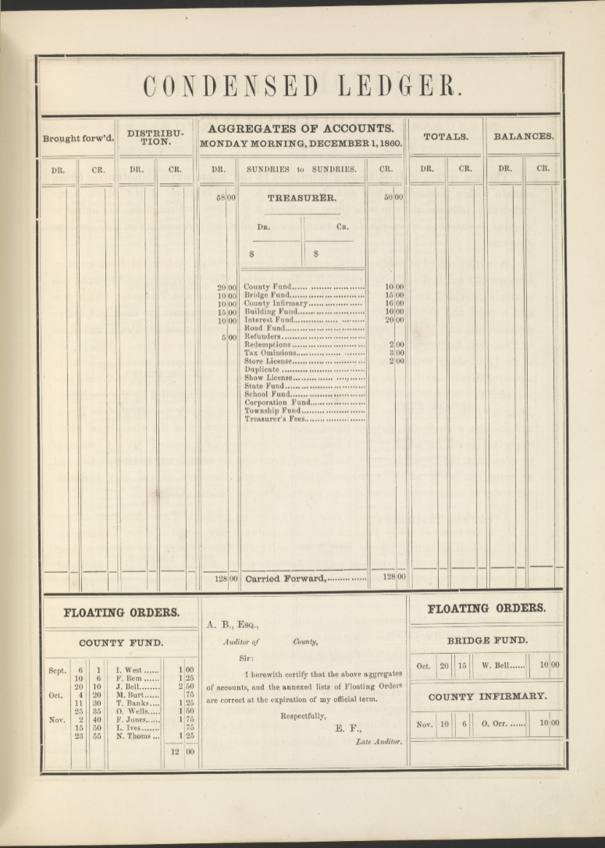
Selden’s Book
U.S. Library of Congress

Slide 9
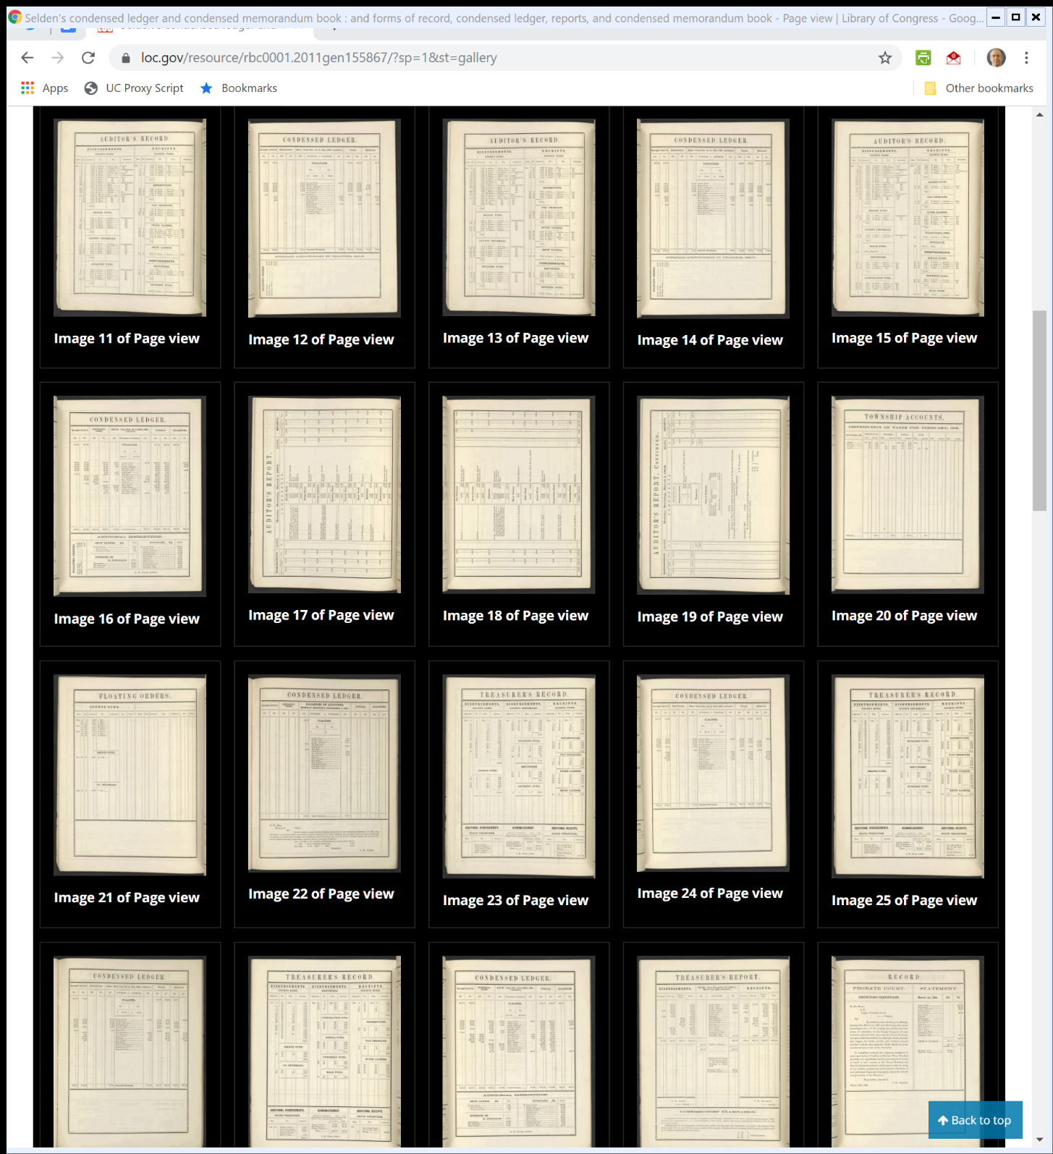
Selden’s Book
U.S. Library of Congress

Slide 10
Baker’s 1876 Book
HathiTrust

Slide 11
Patenting the System
Should Selden Have Received a Patent on the Bookkeeping System?
Is this eligible?
If so, what are the advantages of getting a patent (relative to copyright)?
Disadvantages?

Slide 12
Patenting the System
Issues
Patent system runs tougher filters for eligibility
Novelty/nonobviousness means leap relative to current knowledge must be meaningful
Patent office judges that initially
Business method patent history quirky

Slide 13
Patenting the System
If patented, can block other uses of the system
Shorter period of protection (20 years vs. life of the author + 70 years (302(a)))
Selden doesn’t seem to have received a patent

Slide 14
Is this a Copy?: Similar But Different
“The defendant uses a similar plan so far as results are concerned; but makes a different arrangement of the columns, and uses different headings. If the complainant’s testator had the exclusive right to the use of the system explained in his book, it would be difficult to contend that the defendant does not infringe it, notwithstanding the difference in his form of arrangement; …”
Baker v. Selden (US 1879)

Slide 15
You Can Get A Copyright on a Bookkeeping Book, But …
“There is no doubt that a work on the subject of book-keeping, though only explanatory of well-known systems, may be a subject of a copyright; but, then, it is claimed only as a book. … But there is a clear distinction between the book, as such, and the art which it is intended to illustrate.”
Baker v. Selden (US 1879)

Slide 16
Separating Copyright and Patent
“The novelty of the art or thing described or explained has nothing to do with the validity of the copyright. To give to the author of the book an exclusive property in the art described therein, when no examination of its novelty has ever been officially made, would be a surprise and a fraud upon the public. That is the province of letters-patent, not of copyright.”
Baker v. Selden (US 1879)

Slide 17
No Copyright in Blank Account Books
“The conclusion to which we have come is, that blank account-books are not the subject of copyright; and the mere copyright of Selden’s book does not confer upon him the exclusive right to make and use account-books ruled and arranged as designated by him and described and illustrated in said book.”
Baker v. Selden (US 1879)

Slide 18
“Practical Application”
“And where the art it teaches cannot be used without employing the methods and diagrams used to illustrate the book, or such as are similar to them, such methods and diagrams are to be considered as necessary incidents to the art, and given therewith to the public; not given for the purpose of publication in other works explanatory of the art, but for the purpose of practical application.”
Baker v. Selden (US 1879)

Slide 19
Idea/Expression Dichotomy
No Control over Ideas
You cannot use copyright to gain control over an idea (102(b))
Copyright Protects Expressions of Ideas
Usually, my expression of an idea doesn’t block you from creating your expression of the idea
Both of our expressions will be protected under 102(a)

Slide 20
In Baker v. Selden
The Idea
Selden’s system of bookkeeping
The Expression
Selden’s book describing the system
And the Forms?
Court seems to assume small number of possible expressions in creating forms and therefore not copyrightable (merger doctrine)

Slide 21
Current Status of Blank Forms
U.S. Copyright Office Circular 33
Notes:
https://www.copyright.gov/circs/circ33.pdf

Slide 22
Current Status of Blank Forms
U.S. Copyright Office Circular 33

Slide 23
Current Status of Blank Forms
U.S. Copyright Office Circular 33

Slide 24
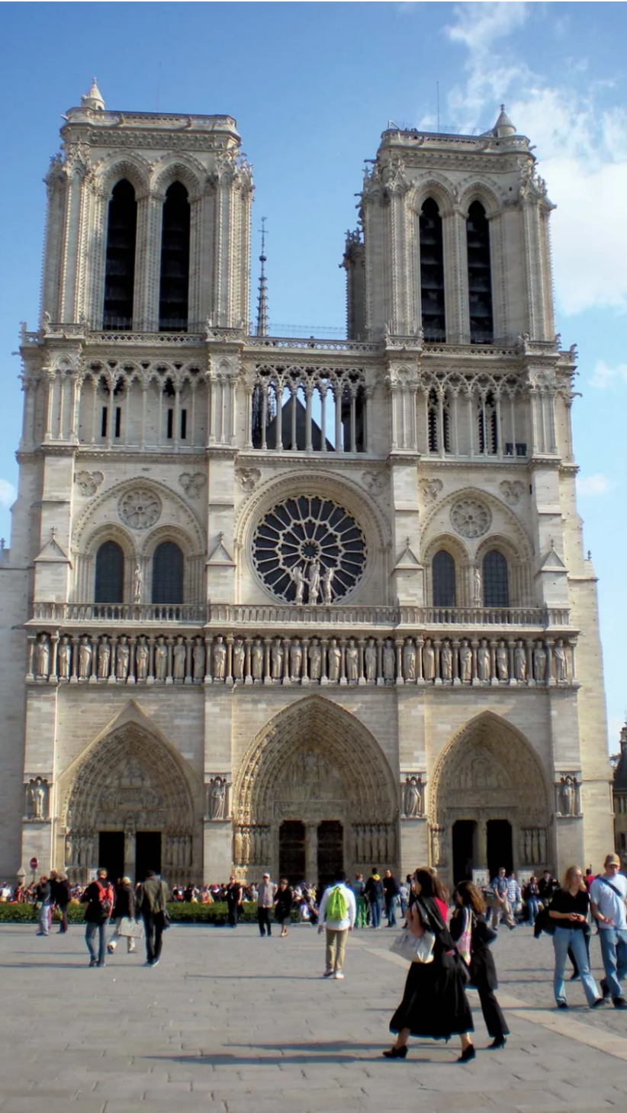
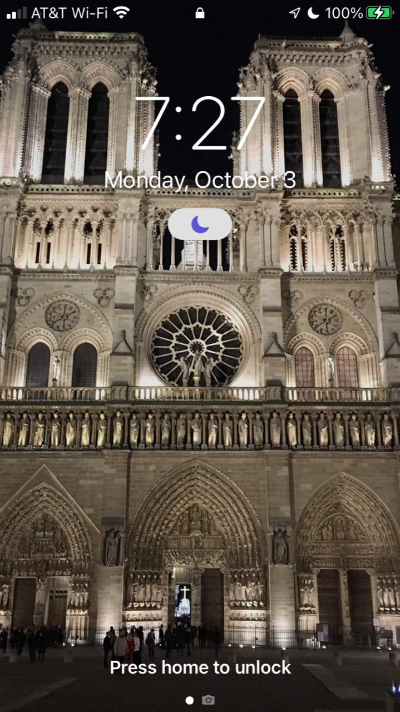
Two Pictures (TTYN (1 of 4))
Notes:
https://www.britannica.com/topic/Notre-Dame-de-Paris

Slide 25
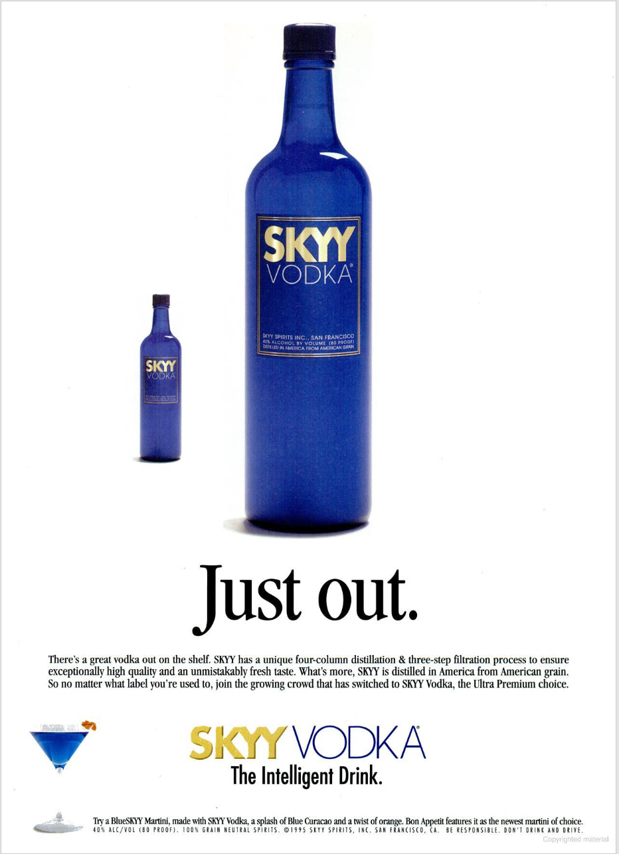
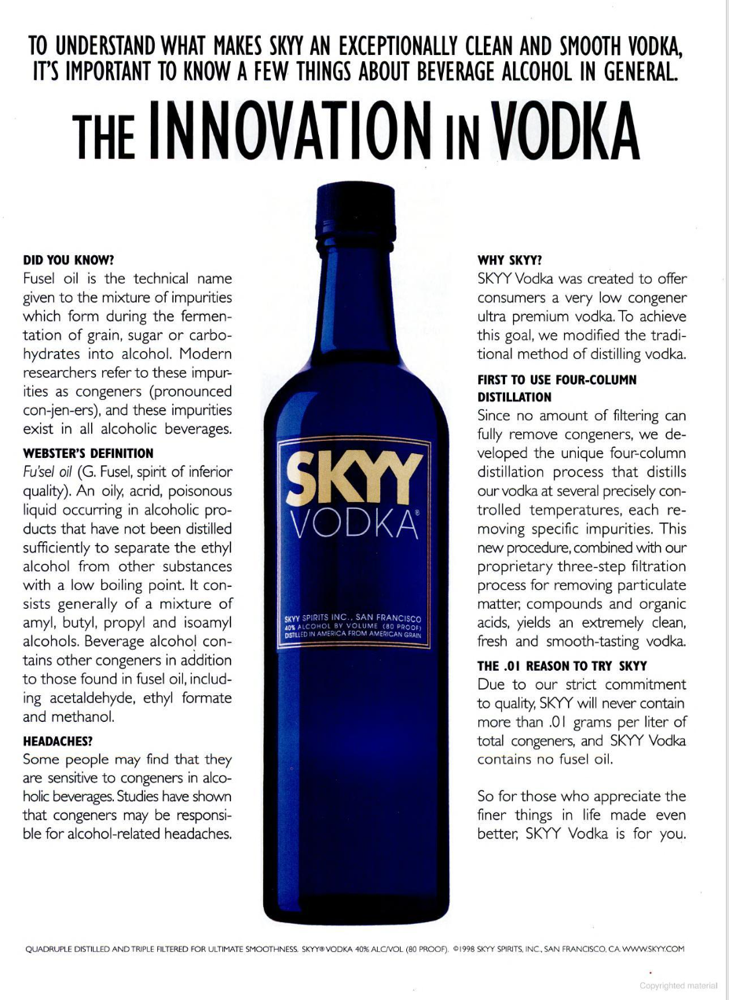
Two Pictures (TTYN (2 of 4))
The Advocate (13 June 1995)/Popular Science (Dec 1998)
Notes:
https://books.google.com/books?id=n2QEAAAAMBAJ&pg=PT10&dq=skyy+vodka&hl=en&sa=X&ved=2ahUKEwjq9_ehzsT6AhXOrokEHVmJDT84ChC7BXoECAMQBg#v=onepage&q&f=false
https://books.google.com/books?id=Xe4prmt78TcC&pg=PA81&dq=skyy+fusel+oil&hl=en&sa=X&ved=2ahUKEwigqszJ2qqMAxVxmYkEHYeeAlUQuwV6BAgFEAc#v=onepage&q&f=false

Slide 26

Two Pictures (TTYN (3 of 4))
Henderson Email (26 Mar 2025)

Slide 27
Sorting the Pictures
TTYN (4 of 4)
Questions
How should we understand the relationships among the two pictures in each set?
Is one image derived from the other image? Independent of that image?
What facts would we need to know?
What path would lead to copyright infringement? Which would avoid that result?

Slide 28
Ets-Hokin v. Skyy (Skyy I)
225 F.3d 1068 (9th Cir. 2000)

Slide 29
The Infringement Claim
“Skyy claims that it found Ets-Hokin’s photographs unsatisfactory and thus hired other photographers to photograph the bottle. *** Ets-Hokin brought suit against Skyy and three other defendants for copyright infringement, fraud, and negligent misrepresentation. *** He also alleged that Skyy used photographs taken by the other photographers that mimicked his own photos; specifically, he claimed that these photographers improperly used his photographs to produce virtually identical photos of the vodka bottle.”
Ets-Hokin (9th Cir. 2000)

Slide 30
Copyright Here
“In view of the low threshold for the creativity element, and given that the types of decisions Ets-Hokin made about lighting, shading, angle, background, and so forth have been recognized as sufficient to convey copyright protection, we have no difficulty in concluding that the defendants have not met their burden of showing the invalidity of Ets-Hokin’s copyright, and that Ets-Hokin’s product shots are sufficiently creative, and thus sufficiently original, to merit copyright protection.”
Ets-Hokin (9th Cir. 2000)

Slide 31
Ets-Hokin v. Skyy (Skyy II)
323 F.3d 763 (9th Cir. 2003)

Slide 32
No Infringement Here
“Though the Ets–Hokin and Skyy photographs are indeed similar, their similarity is inevitable, given the shared concept, or idea, of photographing the Skyy bottle. When we apply the limiting doctrines, subtracting the unoriginal elements, Ets–Hokin is left with only a ‘‘thin’’ copyright, which protects against only virtually identical copying. See Apple, 35 F.3d at 1442 (9th Cir. 1994). ***.”
Ets-Hokin (9th Cir. 2003)

Slide 33
No Infringement Here
“The same is true here, where the range of protectable expression is constrained by both the subject-matter idea of the photograph and the conventions of the commercial product shot. Skyy’s photographs are not virtually identical to those of Ets–Hokin. Indeed, they differ in as many ways as possible within the constraints of the commercial product shot. The lighting differs; the angles differ; the shadows and highlighting differ, as do the reflections and background. The only constant is the bottle itself. The photographs are therefore not infringing.”
Ets-Hokin (9th Cir. 2003)

Slide 34
Rentmeester v. Nike
883 F.3d 1111 (9th Cir. 2018)

Slide 35
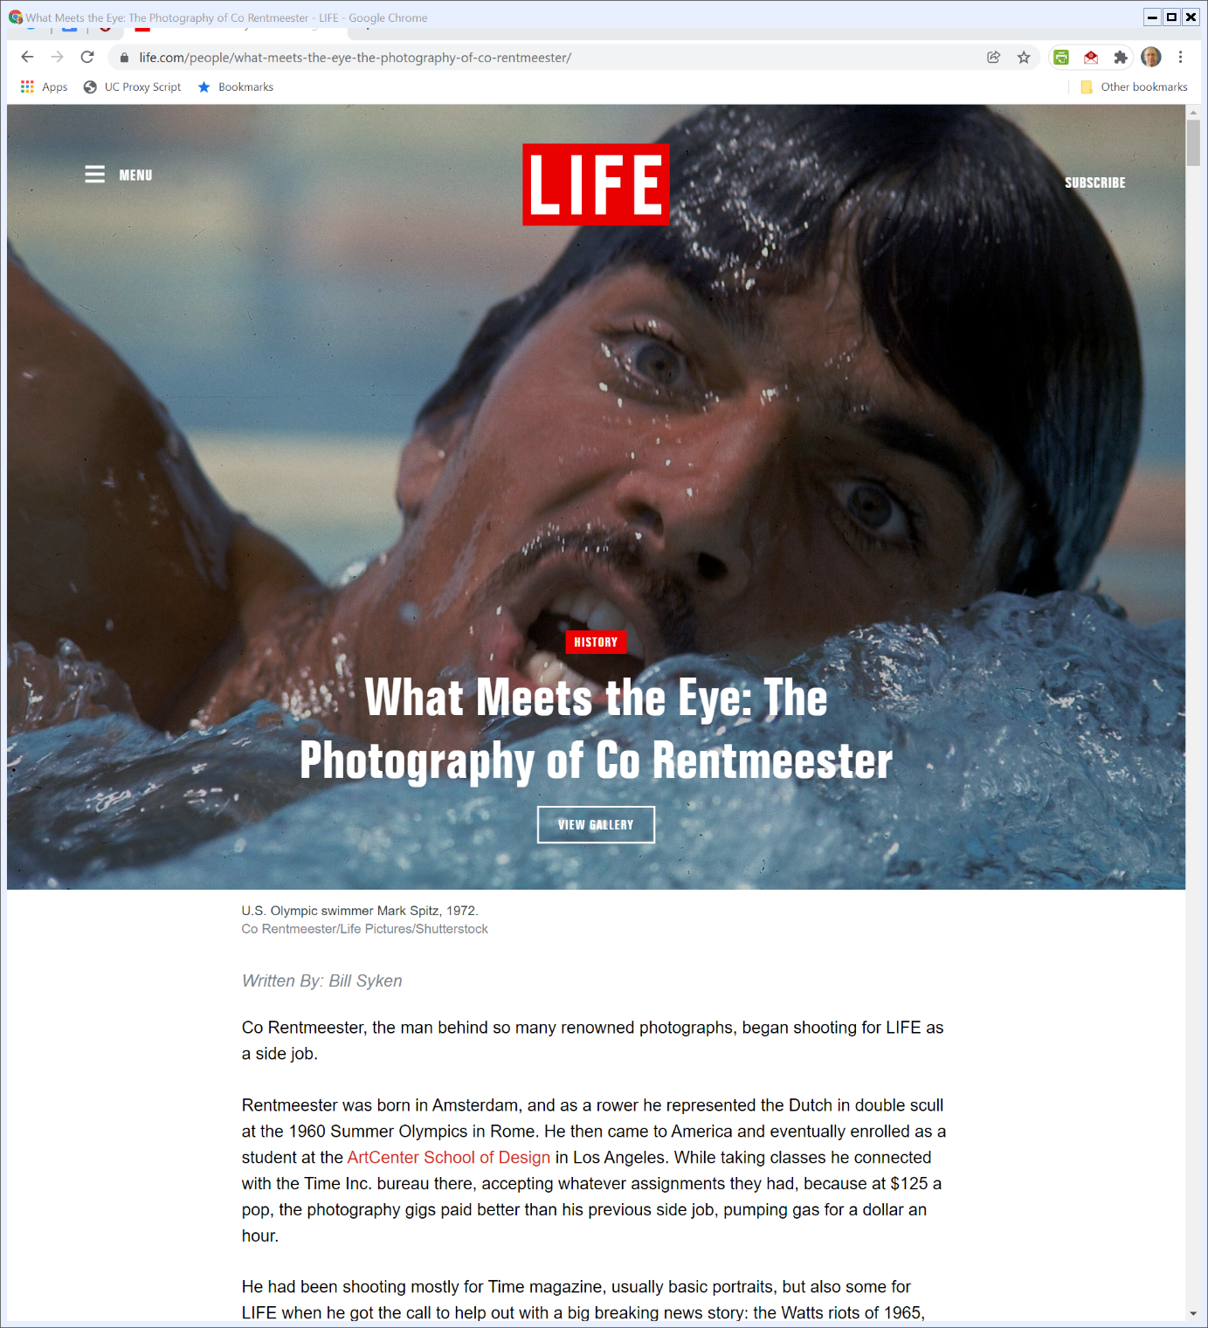
Who is Co Rentmeester?
Life.com (Visited 6 Jan 2022)
Notes:
https://www.life.com/people/what-meets-the-eye-the-photography-of-co-rentmeester/

Slide 36
First Cause of Action
Rentmeester Complaint

Slide 37
First Cause of Action: Derivative Works
Rentmeester Complaint

Slide 38
Evidence of Copying and Substantial Similarity
Says the Second Circuit in Rogers re The Ordinary Observer Test
“Substantial similarity does not require literally identical copying of every detail. Such similarity is determined by the ordinary observer test: the inquiry is ‘whether an average lay observer would recognize the alleged copy as having been appropriated from the copyrighted work.’”

Slide 39
Rentmeester Photo (TTYN (1 of 5))
Rentmeester v. Nike (CA9 2018)

Slide 40
Nike Photo (TTYN (2 of 5))
Rentmeester v. Nike (CA9 2018)

Slide 41
Together (TTYN (3 of 5))
Rentmeester v. Nike (CA9 2018)

Slide 42
A Preliminary Conversation
TTYN (4 of 5)
Discuss the relationship between these two images
Is there copying here? Does it differ from what went on in Rogers, Burrow-Giles, Bleistein or Ets-Hokin?

Slide 43
The Rentmeester Photo: Thin or Thick? (TTYN (5 of 5))
“Rentmeester’s selection and arrangement of those elements produced an image entitled to the broadest protection a photograph can receive.”
Rentmeester (9th Cir. 2018)

Slide 44
Two-Part Test: Extrinsic/Intrinsic
“In our circuit, determining whether works are substantially similar involves a two-part analysis consisting of the ‘extrinsic test’ and the ‘intrinsic test.’ The extrinsic test assesses the objective similarities of the two works, focusing only on the protectable elements of the plaintiff’s expression. Cavalier v. Random House, Inc., 297 F.3d 815, 822 (9th Cir. 2002).”
Rentmeester (9th Cir. 2018)

Slide 45
Filter Out Unprotectable and then Compare
“Before that comparison can be made, the court must ‘filter out’ the unprotectable elements of the plaintiff’s work—primarily ideas and concepts, material in the public domain, and scènes à faire (stock or standard features that are commonly associated with the treatment of a given subject). Id. at 822–23. The protectable elements that remain are then compared to corresponding elements of the defendant’s work to assess similarities in the objective details of the works.”
Rentmeester (9th Cir. 2018)

Slide 46
Intrinsic Test: Total Concept and Feel/Plaintiff Must Meet Both Tests
“The intrinsic test requires a more holistic, subjective comparison of the works to determine whether they are substantially similar in ‘total concept and feel.’ Id. at 822 (internal quotation marks omitted). To prevail, a plaintiff must prove substantial similarity under both tests. Funky Films, Inc. v. Time Warner Entertainment Co., 462 F.3d 1072, 1077 (9th Cir. 2006).”
Rentmeester (9th Cir. 2018)

Slide 47
Extrinsic Can Be a Matter of Law/Intrinsic for Jury
“Only the extrinsic test’s application may be decided by the court as a matter of law, McCulloch v. Albert E. Price, Inc., 823 F.2d 316, 319 (9th Cir. 1987), so that is the only test relevant in reviewing the district court’s ruling on a motion to dismiss.”
Rentmeester (9th Cir. 2018)

Slide 48
Mechanics of Substantial Similarity
Meaning
If defendant can show that no reasonable jury would find the two images substantially similar when focusing only on the protected elements embodied in those pictures, plaintiff loses without more

Slide 49
Mechanics of Substantial Similarity
Considering the Tests
What are the virtues/vices of this approach?
How should we apply them here?

Slide 50
A Different Conversation
Incentives for Creation
Do we think Rentmeester would have taken the original photo even if he had known of the subsequent use that Nike would make of it?
Does that matter? Should that matter?

Slide 51
Third Image: Nike Jumpman Logo (TTYN (1 of 2))
Rentmeester v. Nike (CA9 2018)

Slide 52
Situating the Logo (TTYN (2 of 2))
Rentmeester Complaint

