Slide 1
Class 2: Wed 26 Mar 2025
Copyright Spring 2025
Copying and Use
Randal C. Picker
James Parker Hall Distinguished Service Professor of Law
The Law School
The University of Chicago

Slide 2
Objects within Copyright
“That any citizen of the United States, or resident therein, who shall be the author, inventor, designer, or proprietor of any book, map, chart, dramatic or musical composition, engraving, cut, print, or photographs or negative thereof, or of a painting, drawing, chromo, statue, statuary, and of models or designs intended to be perfected as works of the fine arts, and his executors, administrators, or assigns,”
1870 Copyright Act: 2nd General Revision

Slide 3
Uses of Works
“shall, upon complying with the provisions of this act, have the full liberty of printing, reprinting, publishing, completing, copying, executing, finishing, and vending the same; and in the case of a dramatic composition, of publicly performing or representing it, or causing it to be performed or represented by others; and authors may reserve the right to dramatize or to translate their own works.”
1870 Copyright Act: 2nd General Revision

Slide 4
1878: Edison Phonograph
U.S. Patent No. 200,521 (19 Feb 1878)

Slide 5
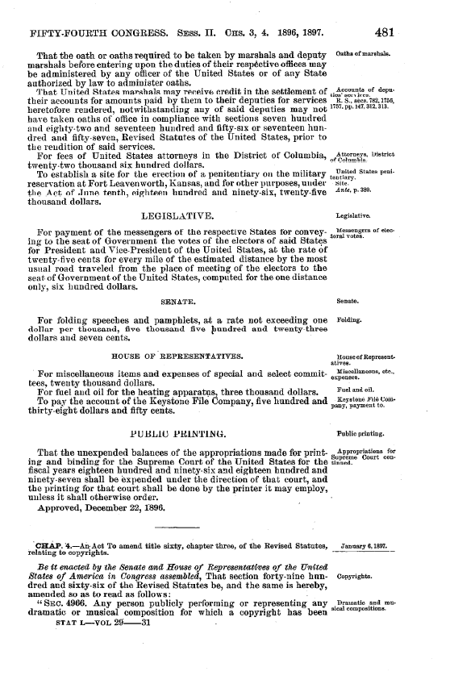
1897: Musical Public Performances Added
“Any person publicly performing or representing any dramatic or musical composition for which a copyright has been obtained, without the consent of the proprietor of said dramatic or musical composition, or his heirs or assigns, shall be liable for damages therefor …”
1897 Act Amendments

Slide 6
1899: Perforating Machine
U.S. Patent No. 630,598 (8 Aug 1899)

Slide 7
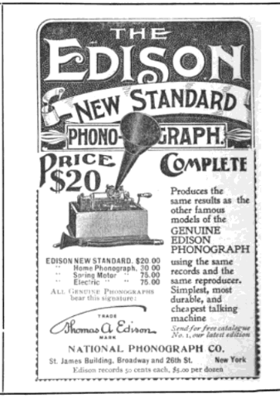
1898 Phonograph
Public Opinion Magazine (8 Nov 1898, p576)
Notes:
https://books.google.com/books?id=RKVAAAAAMAAJ&pg=PA576&dq=edison+standard+phonograph&hl=en&newbks=1&newbks_redir=0&sa=X&ved=2ahUKEwiHivWfg5v1AhVLHM0KHaKGDdQ4ChDoAXoECAoQAg#v=onepage&q&f=false

Slide 8
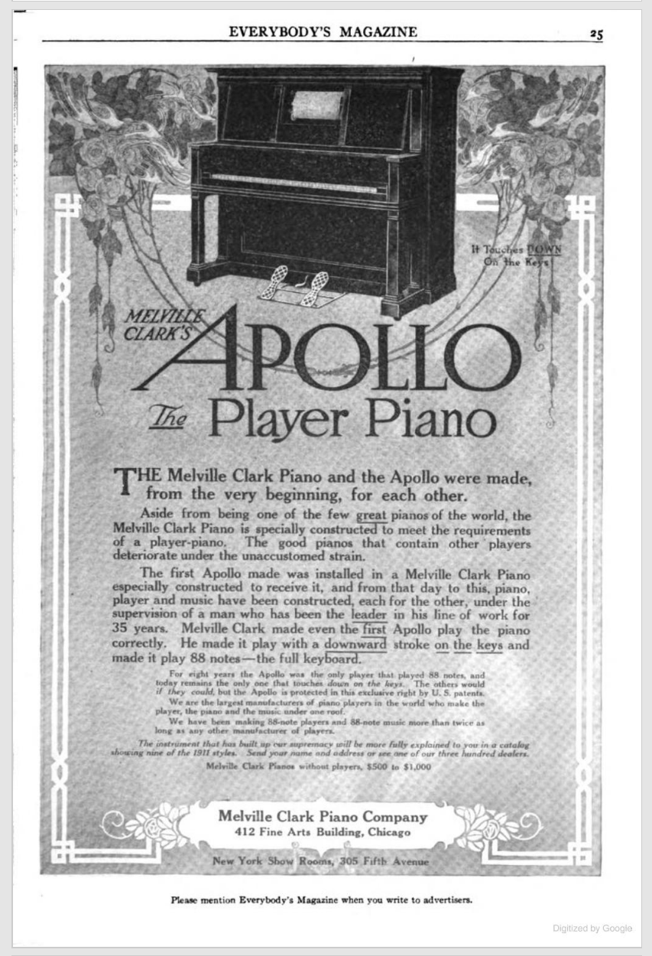
Apollo Player Piano
Everybody’s Magazine (June 1911, p25)
Notes:
https://books.google.com/books?id=ZqHNAAAAMAAJ&pg=RA1-PA25&dq=apollo+piano+player+clark&hl=en&newbks=1&newbks_redir=0&sa=X&ved=2ahUKEwimiLjxipv1AhWSW80KHThFCQ8QuwV6BAgCEAY#v=onepage&q&f=false

Slide 9
White-Smith (U.S. 1908)
209 U.S. 1 (1908)

Slide 10
Framing 1: “The Intellectual Conception”
“On behalf of the appellant it is insisted that it is the intention of the copyright act to protect the intellectual conception which has resulted in the compilation of notes which, when properly played, produces the melody which is the real invention of the composer. It is insisted that this is the thing which Congress intended to protect, and that the protection covers all means of expression of the order of notes which produce the air or melody which the composer has invented.”
White-Smith (U.S. 1908)

Slide 11
Framing 2: Read the Statute
“On the other hand, it is contended that while it is true that copyright statutes are intended to reward mental creations or conceptions, that the extent of this protection is a matter of statutory law, and that it has been extended only to the tangible results of mental conception, and that only the tangible thing is dealt with by the law, and its multiplication or reproduction is all that is protected by the statute.”
White-Smith (U.S. 1908)

Slide 12
What is a Copy?
“What is meant by a copy? We have already referred to the common understanding of it as a reproduction or duplication of a thing. A definition vas given by Bailey, J., in West v. Francis, 5 B. & A. 743, quoted with approval in Boosey v. Whight, supra. He said: ‘A copy is that which comes so near to the original as to give to every person seeing it the idea created by the original.’”
White-Smith (U.S. 1908)

Slide 13
Eyes v. Ears?
“These musical tones are not a copy which appeals to the eye. In no sense can musical sounds which reach us through the sense of hearing be said to be copies, as that term is generally understood, and as we believe it was intended to be understood in the statutes under consideration. …,”
White-Smith (U.S. 1908)

Slide 14
Statute Protects the Object, Not the Work
“The statute has not provided for the protection of the intellectual conception apart from the thing produced, however meritorious such conception may be, but has provided for the making and filing of a tangible thing, against the publication and duplication of which it is the purpose of the statute to protect the composer.”
White-Smith (U.S. 1908)

Slide 15
How Should We Approach Copies and Copying?
1870 Statute Doesn’t Separate Work and Physical Object (Maybe)
  This is the Court’s point about not offering protection for the “intellectual conception apart from the thing produced.”

Slide 16
Is Copying About
Literal reproduction?
  The copy must look like the original?
Functional reproduction?
  Music compositions were played on pianos, and so are piano rolls
  Piano rolls therefore substitute for music sheets and therefore are copies?

Slide 17
1909: “The Copyrighted Work”
“§1 Exclusive Rights as to Copyrighted Works. Any person entitled thereto, upon complying with the provisions of this title, shall have the exclusive right: (a) To print, reprint, publish, copy, and vend the copyrighted work;”
1909 Copyright Act

Slide 18
1976 Act Legislative History
H. Rep. 94-1476 (3 Sept 1476)

Slide 19
The Work is the Point, Not The Form (So Long as It is Fixed))
H. Rep. 94-1476 (3 Sept 1476)

Slide 20
Bright Tunes v. Harrisongs
420 F.Supp. 177 (SDNY 1976)

Slide 21
Bright Tunes v. Harrissongs
Play the Music
  Mack: He’s So Fine
  Harrison: My Sweet Lord
  https://blogs.law.gwu.edu/mcir/case/bright-tunes-music-v-harrisongs-music/

Slide 22



The Songs
Component Motifs
  A: B:
  B (with grace note):
Notes:
Source: http://ccnmtl.columbia.edu/projects/law/library/cases/case_brightharrisongs.html

Slide 23
The Songs
He’s So Fine
  AAAABBwgBB
My Sweet Lord
  AAAABBwgB

Slide 24
The Songs
Accessing He’s So Fine
  At or near the top of the charts in the US and the UK in 1963
My Sweet Lord
  Recorded in 1970

Slide 25
Understanding Copying
Should we have a …
  Bad person theory of copying?
    This would require something like intent or recklessness; presumably knowing copying
  A substitution theory of copying?
    If thing doesn’t compete with original, not a copy
  Or a replication theory of copying?

Slide 26
Understanding Copying
  A use theory of copying?
    Any use, whether knowing or not, suffices to make a copy

Slide 27
The Creative Process at Work and Copying
“What happened? I conclude that the composer, in seeking musical materials to clothe his thoughts, was working with various possibilities. As he tried this possibility and that, there came to the surface of his mind a particular combination that pleased him as being one he felt would be appealing to a prospective listener; in other words, that this combination of sounds would work. Why? Because his subconscious knew it already had worked in a song his conscious mind did not remember.”
Bright Tunes (1976)

Slide 28
The Creative Process at Work and Copying
“Having arrived at this pleasing combination of sounds, the recording was made, the lead sheet prepared for copyright and the song became an enormous success. Did Harrison deliberately use the music of He’s So Fine? I do not believe he did so deliberately. Nevertheless, it is clear that My Sweet Lord is the very same song as He’s So Fine with different words, and Harrison had access to He’s So Fine. This is, under the law, infringement of copyright, and is no less so even though subconsciously accomplished.”
Bright Tunes (1976)

Slide 29
106. Exclusive rights in copyrighted works
Subject to sections 107 through 121, the owner of copyright under this title has the exclusive rights to do and to authorize any of the following:
  (1) to reproduce the copyrighted work in copies or phonorecords;
  (2) to prepare derivative works based upon the copyrighted work;

Slide 30
101: Derivative Work
A “derivative work” is a work based upon one or more preexisting works,
  such as a translation, musical arrangement, dramatization, fictionalization, motion picture version, sound recording, art reproduction, abridgment, condensation, or any other form in which a work may be recast, transformed, or adapted.

Slide 31
101: Derivative Work
  A work consisting of editorial revisions, annotations, elaborations, or other modifications which, as a whole, represent an original work of authorship, is a “derivative work”.

Slide 32
What Counts as a Copy?
TTYN (1 of 4)
Hypo 1
  I take a picture of Stonehenge
    Ignore fact is in UK
  You see my picture and are inspired by it
  You fly to Stonehenge and take another picture of it
I sue you for copyright infringement: who wins?

Slide 33
What Counts as a Copy?
TTYN (2 of 4)
Hypo 2
  Again, I take a picture and again, you see it
  You say: “I could fly to Stonehenge to take a picture or I could Xerox this one.”
  You copy it
I sue you for copyright infringement: who wins?

Slide 34
What Counts as a Copy?
TTYN (3 of 4)
Hypo 3
  I take a picture of Stonehenge
  You see my picture and are inspired by it
  You fly to Stonehenge and make a miniature model of it out of clay
I sue you for copyright infringement: who wins?

Slide 35
What Counts as a Copy?
TTYN (4 of 4)
Hypo 4
  I take picture of Stonehenge, you see it.
  You decide to make a miniature model of Stonehenge out of clay
  Working from my picture, you build your model of Stonehenge
I sue you for copyright infringement: who wins?

Slide 36
Hypo 1 Answer
We both get copyrights in our photographs
There is no copyright infringement

Slide 37
Hypo 2 Answer
Simple copyright infringement

Slide 38
Hypo 3 Answer
No infringement

Slide 39
Hypo 4 Answer
Tricky?
  No infringement?
    Sculpted work won’t preserve lighting, camera angles
    Should just re-create the original object built by the Druids

Slide 40
Hypo 4 Answer
Tricky
  Infringement?: Holmes’s Statement in Bleistein
    “Others are free to copy the original. They are not free to copy the copy.”
  Implementing Holmes
    Does the mini-Stonehenge made from looking at my photo copy the copy or copy the original?

Slide 41
Rogers v. Koons
960 F.2d 301 (2nd Cir. 1992)

Slide 42
Rogers’s Puppies
Scanlon Hires Rogers to Photograph Puppies
  Rogers is paid $200 for prints by the Scanlons
  Rogers did the creative work in figuring out how to do the picture
  Rogers retained the copyright to the work

Slide 43
Rogers’s Puppies
Rogers Licenses Work to Museum Graphics
  5,000 notecards printed initially
  Subsequent printings

Slide 44
Creating “String of Puppies”
1988 Banality Exhibition at Sonnabend Gallery
  Koons looking create a group of art works
  Selects studios to do physical work of creating pieces
  Buys notecard of Puppies
  Tears off copyright notice and gives it executing artisans

Slide 45
Authorship?
Not discussed here but note …
  Koons as animating creative force vs. artisans who actually build the thing in question
One author? Koons or the artisans? Joint authors?

Slide 46
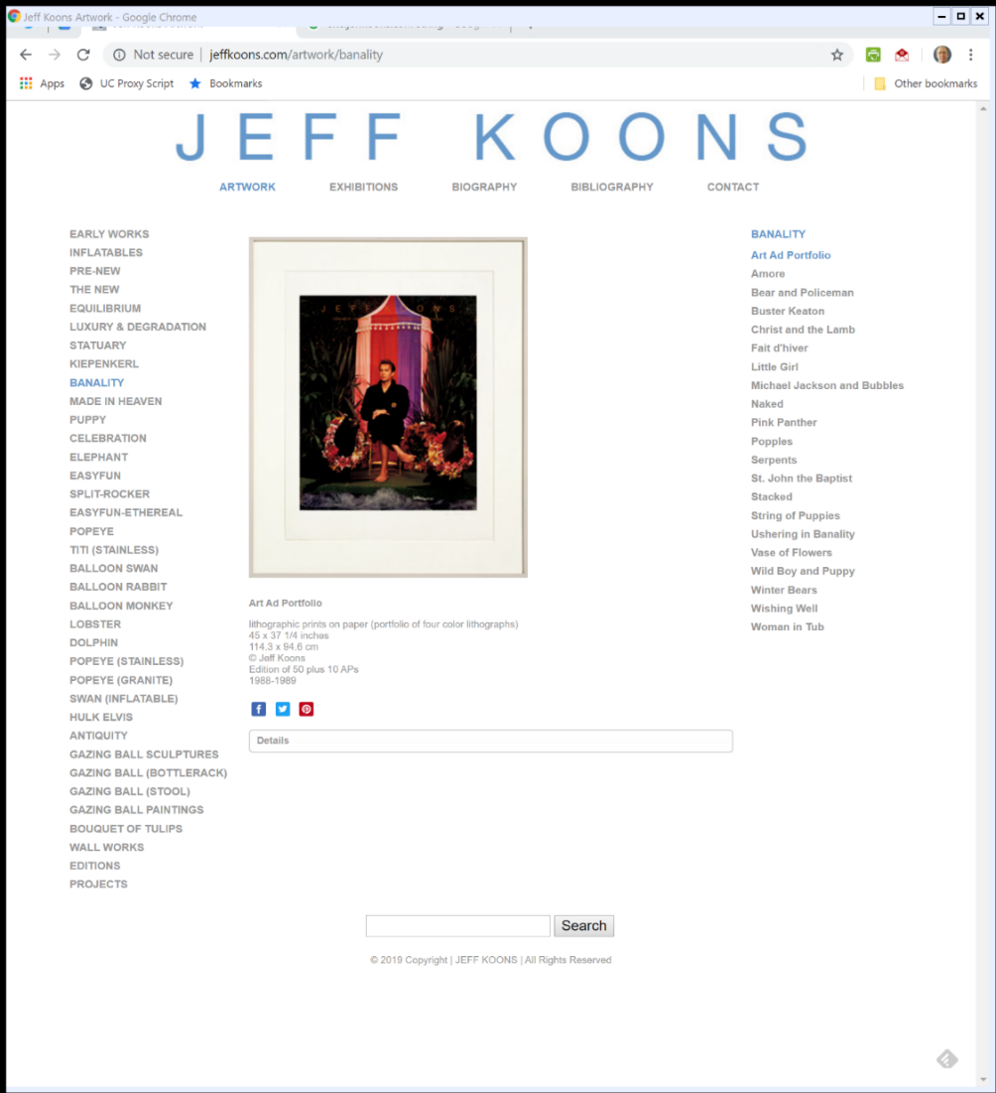

Banality Show (TTYN (1 of 3))
JeffKoons.com (2 Oct 2019)

Slide 47
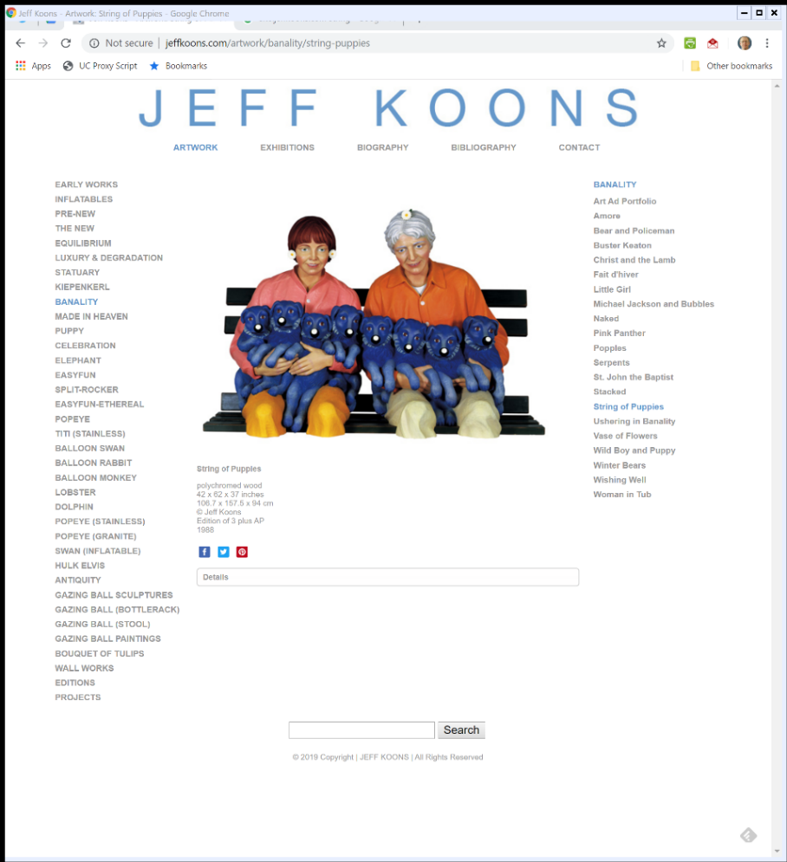

String of Puppies (TTYN (2 of 3))
JeffKoons.com (2 Oct 2019)

Slide 48
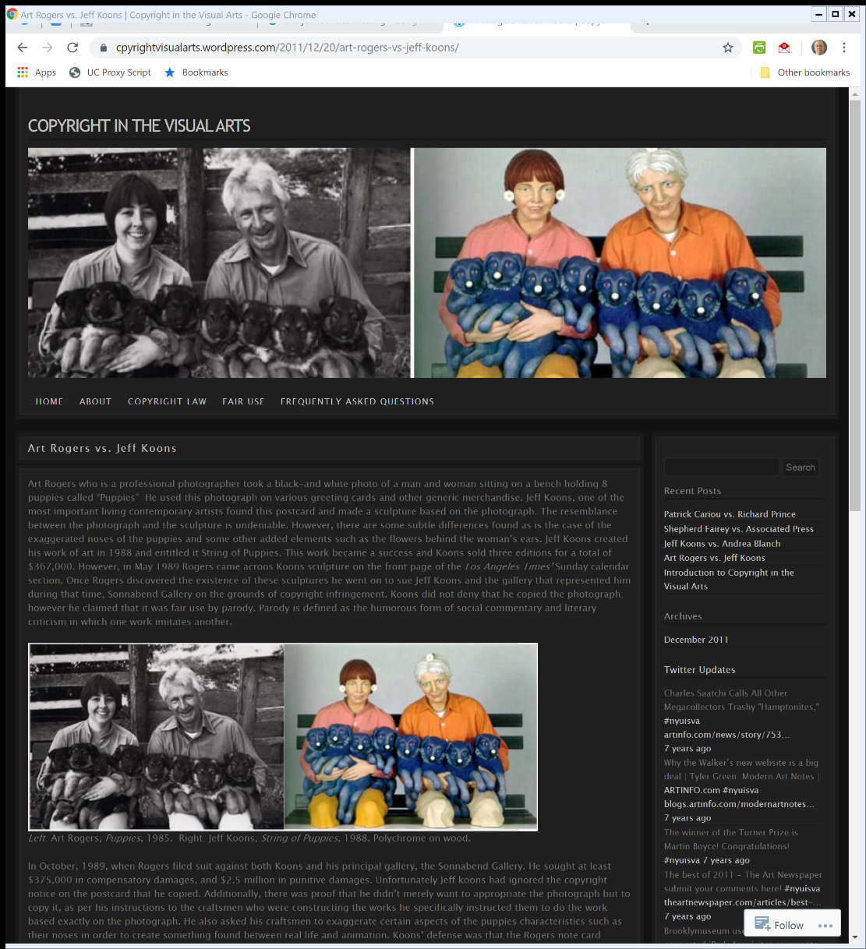

Comparing The Two (TTYN (3 of 3))
cpyrightvisualarts.wordpress.com (2 Oct 2019)
Notes:
https://cpyrightvisualarts.wordpress.com/2011/12/20/art-rogers-vs-jeff-koons/

Slide 49
The Lawsuit
Facts
  Koons sells three copies of String of Puppies for $367,000
  Keeps fourth copy for himself
  Friend of Scanlon sees picture of Koon’s work in LA Times, who in turn tells Rogers
  Rogers sues for infringement

Slide 50
Copying the Work v. Accessing the Original
What limits how a subsequent user can access the original?
  Do I have to go directly to the original or can I access the original through someone else’s work?

Slide 51
Why Not This?
Mini-Stonehenge obviously not a copy because
  Photo was just two-dimensional image of Stonehenge
  Mini-Stonehenge is 3D form
  Change in dimensionality precludes copying?

Slide 52
Now Rogers v. Koons
Should we say …
  Koons was just accessing original through the photograph ala the mini-Stonehenge example
  Koons also switched the dimensonality
Ergo no copying of copy, just 3D implementation of original accessed through the photo?

Slide 53
No Independent Original Here
Stonehenge Exists Separately
  I didn’t create Stonehenge when I took a picture of it; it existed already

Slide 54
Understanding Copying: Substantial Similarity
“Substantial similarity does not require literally identical copying of every detail. … Such similarity is determined by the ordinary observer test: the inquiry is “whether an average lay observer would recognize the alleged copy as having been appropriated from the copyrighted work.” Ideal Toy Corp. v. Fab-Lu Ltd., 360 F.2d 1021, 1022 (2d Cir. 1966).”
Rogers v. Koons (2nd Cir. 1992)

Slide 55
Sneering at the Court
“Thus, Koons’ allegation that a trial judge uneducated in art is not an appropriate decision-maker misses the mark; the decision-maker, whether it be a judge or a jury, need not have any special skills other than to be a reasonable and average lay person.”
Rogers v. Koons (2nd Cir. 1992)

Slide 56
What Did Rogers Do?
“It is not therefore the idea of a couple with eight small puppies seated on a bench that is protected, but rather Roger’s expression of this idea—as caught in the placement, in the particular light, and in the expressions of the subjects—that gives the photograph its charming and unique character, that is to say, makes it original and copyrightable.”
Rogers v. Koons (2nd Cir. 1992)

Slide 57
Fair Use
Treat This as A Starting Point
  We will do two days on fair use
  This is a good example of what fair use looked like before it started to change with Sup Ct’s 1994 decision in Campbell
  Interesting parallels to Warhol

Slide 58
Satire v. Parody
“The problem in the instant case is that even given that ‘String of Puppies’ is a satirical critique of our materialistic society, it is difficult to discern any parody of the photograph ‘Puppies’ itself. We conclude therefore that this first factor of the fair use doctrine cuts against a finding of fair use. The circumstances of this case indicate that Koons’ copying of the photograph ‘Puppies’ was done in bad faith, primarily for profit-making motives, and did not constitute a parody of the original work.”
Rogers v. Koons (2nd Cir. 1992)

Slide 59
Understanding Fourth Factor Market Harm
“Hence the inquiry considers not only harm to the market for the original photograph, but also harm to the market for derivative works. It is obviously not implausible that another artist, who would be willing to purchase the rights from Rogers, would want to produce a sculpture like Rogers’ photo and, with Koons’ work extant, such market is reduced. Similarly, defendants could take and sell photos of ‘String of Puppies,’ which would prejudice Rogers’ potential market for the sale of the ‘Puppies’ notecards, in addition to any other derivative use he might plan.”
Rogers v. Koons (2nd Cir. 1992)

