Slide 1
Class 1: Mon 24 Mar 2025 Copyright Spring 2025 Introduction
Randal C. Picker
James Parker Hall Distinguished Service Professor of Law
The Law School
The University of Chicago

Slide 2
Constitution
The Congress shall have the Power . . .
To promote the progress of science and the useful arts, by securing for limited times to authors and inventors the exclusive right to their respective writings and discoveries;
(Art. I, § 8, cl. 8)

Slide 3
Piece of Paper No. 1
Copyright Magic: The Blank Paper and the Pen

Slide 4
Blank Piece of Paper Laws
Starting Questions
What are the laws that apply to blank pieces of paper?
What happens if a copyrighted work is created on a blank piece of paper?
How does that change the applicable laws?

Slide 5
102. Subject matter of copyright: In general
(a)
Copyright protection subsists, in accordance with this title, in original works of authorship fixed in any tangible medium of expression, now known or later developed, from which they can be perceived, reproduced, or otherwise communicated, either directly or with the aid of a machine or device.

Slide 6
101: “Fixed”
A work is “fixed” in a tangible medium of expression
when its embodiment in a copy or phonorecord, by or under the authority of the author, is sufficiently permanent or stable to permit it to be perceived, reproduced, or otherwise communicated for a period of more than transitory duration.

Slide 7
Use v. Access
Copyright is
mainly about use rules, assuming legitimate access
Copyright isn’t
a regime for creating access rights

Slide 8
Use v. Access
Key Use v. Access Point
The fact that copyright now applies to the poem on the piece of formerly-blank paper doesn’t alter usually the underlying physical property rules that apply to the piece of paper (or, more generally, any other physical object in which a copyrighted work is embodied)

Slide 9
Do I Have a Copyright in the Poem?
Yes
Copyright protection subsists, in accordance with this title, in original works of authorship fixed in any tangible medium of expression
Poem should qualify as OWA
But how do we know it is original?
Paper should quality as TME
Writing will fix the OWA in a TME

Slide 10
Copyright “Originality”
Original to me and not copied from preexisting work
Copyright doesn’t ask how good the work is
And it doesn’t ask whether someone else has created the same work before so long as I didn’t copy my work from them
Copyright quite different from patents in that way

Slide 11
Copyright “Originality”
Copyright as source rule
Key to copyrightability of my poem is that it is original to me and not copied from somewhere else and that it has some minimum level of creativity

Slide 12
Don’t Need ©
No Formalities Required
Don’t need © or something like that
But can (see 401-407) and has advantages (see, for example, 401(d))
This came into effect in the U.S. with our entry into the Berne Convention as of March 1, 1989

Slide 13
Don’t Need to Register
Don’t need to register the work with the government
But can (see 408-410) and necessary to sue for copyright infringement (see 411); also matters for availability of statutory damages
Very different from patents

Slide 14
Getting the Terms Right
Physical Objects v. Works
Is the piece of paper with the poem on it the work?
If not, what is the work?
Copies vs. Originals
Is the single piece of paper on which the poem is written a copy?

Slide 15
106. Exclusive rights in copyrighted works
Subject to sections 107 through 121, the owner of copyright under this title has the exclusive rights to do and to authorize any of the following:
(1) to reproduce the copyrighted work in copies or phonorecords;
(2) to prepare derivative works based upon the copyrighted work;

Slide 16
106 (Cont.)
(3) to distribute copies or phonorecords of the copyrighted work to the public by sale or other transfer of ownership, or by rental, lease, or lending;
(4) in the case of literary, musical, dramatic, and choreographic works, pantomimes, and motion pictures and other audiovisual works, to perform the copyrighted work publicly;

Slide 17
106 (Cont.)
(5) in the case of literary, musical, dramatic, and choreographic works, pantomimes, and pictorial, graphic, or sculptural works, including the individual images of a motion picture or other audiovisual work, to display the copyrighted work publicly; and
(6) in the case of sound recordings, to perform the copyrighted work publicly by means of a digital audio transmission.

Slide 18
201: Ownership of copyright
(a) Initial Ownership.
Copyright in a work protected under this title vests initially in the author or authors of the work. The authors of a joint work are coowners of copyright in the work.

Slide 19
Piece of Paper No. 2
TTYN (1 of 5)
A Second Writing

Slide 20
Piece of Paper No. 3
TTYN (2 of 5)

Slide 21
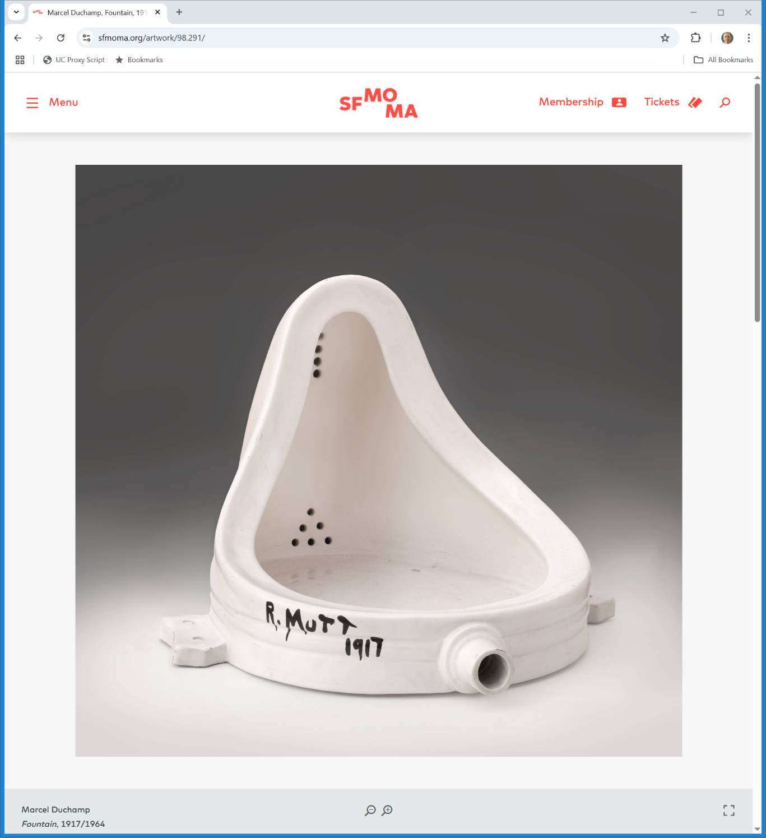
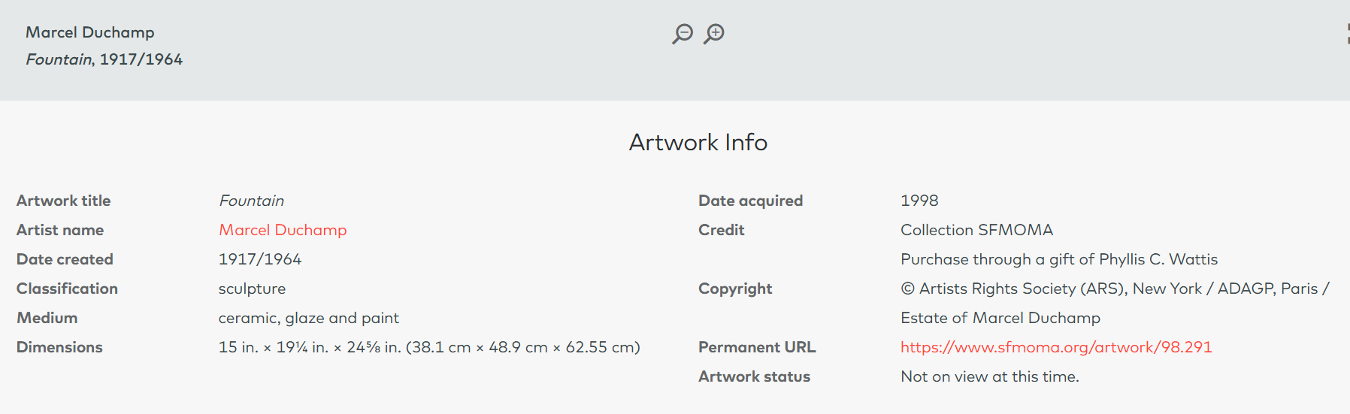
Marcel Duchamp, Fountain, 1917? (TTYN (3 of 5))
SFMOMA (Visited 24 Mar 2025)
Notes:
https://www.sfmoma.org/artwork/98.291/

Slide 22
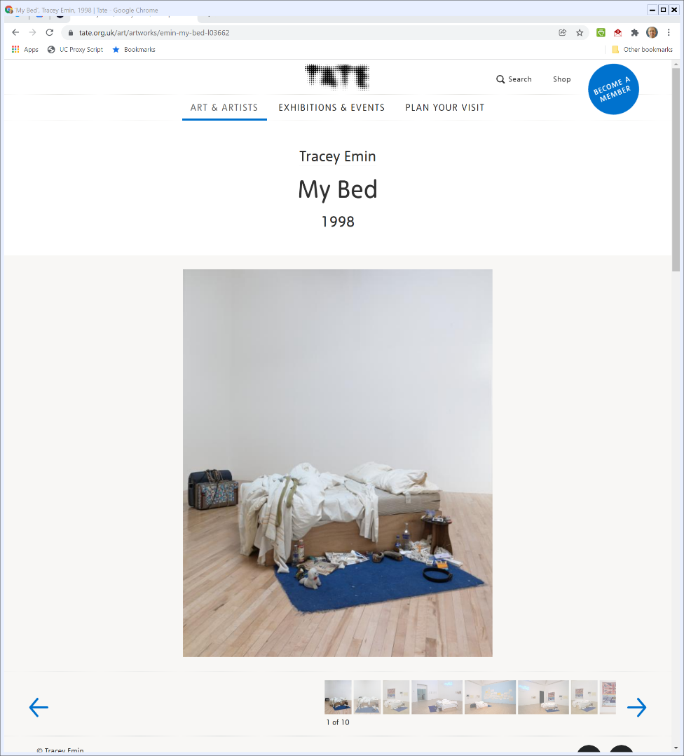
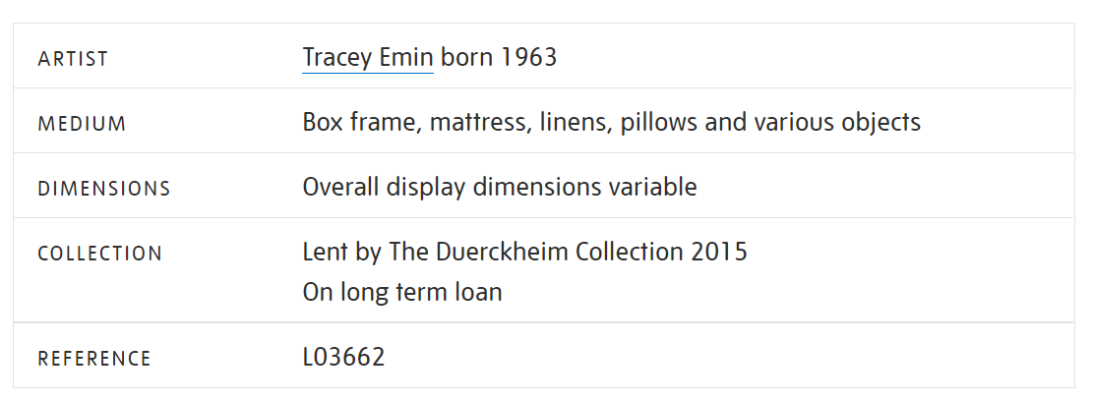

Tracey Emin, My Bed (1998) (TTYN (4 of 5))
The Tate
Notes:
https://www.tate.org.uk/art/artworks/emin-my-bed-l03662

Slide 23
Sec. 101: “Pictorial, graphic and sculptural works” (TTYN (5 of 5))
Title 17

Slide 24
One Balloon
???

Slide 25
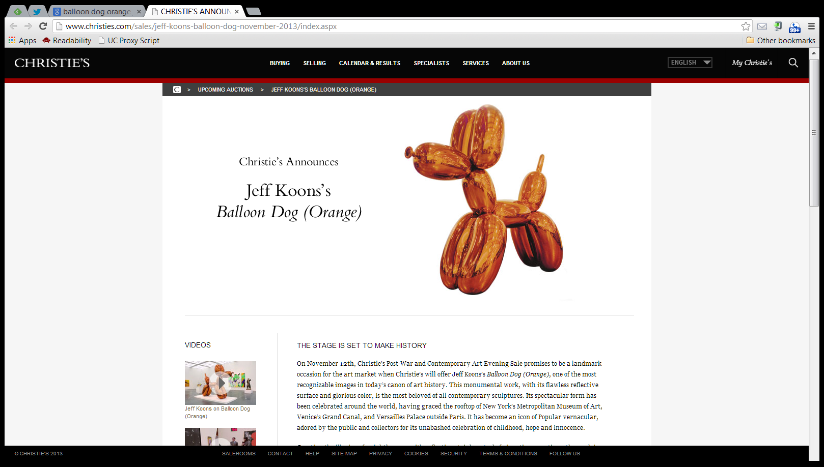
Nov 2013: Christie’s Auction Announcement
Christies.com
Notes:
Source: http://www.christies.com/sales/jeff-koons-balloon-dog-november-2013/index.aspx

Slide 26
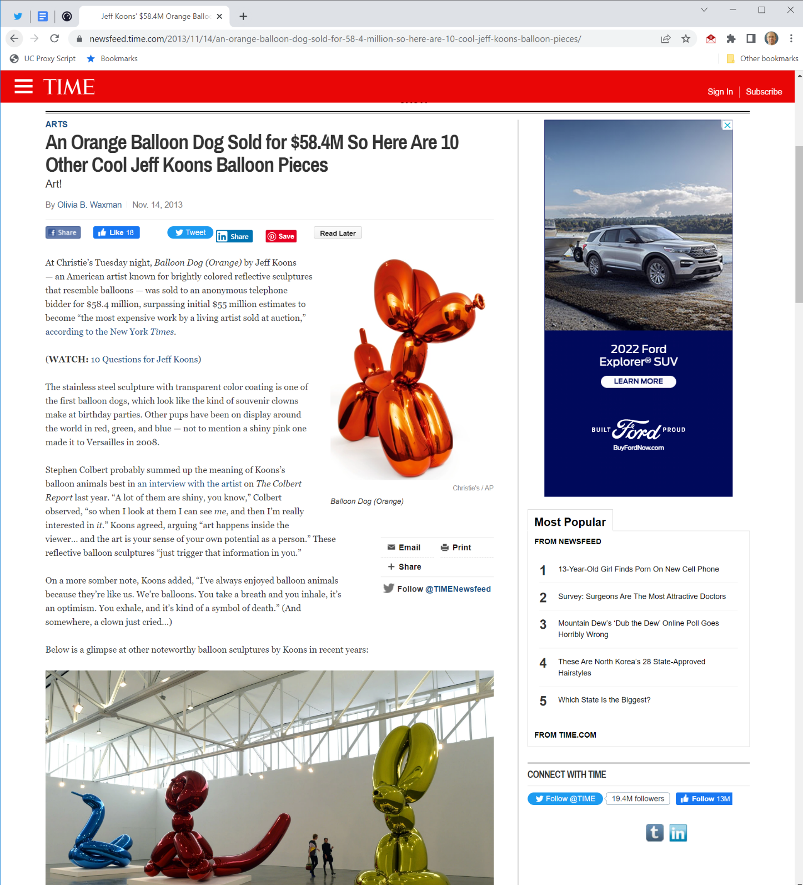

$58.4M
Time Magazine (14 Nov 2013)
Notes:
Source: http://newsfeed.time.com/2013/11/14/an-orange-balloon-dog-sold-for-58-4-million-so-here-are-10-cool-jeff-koons-balloon-pieces/

Slide 27
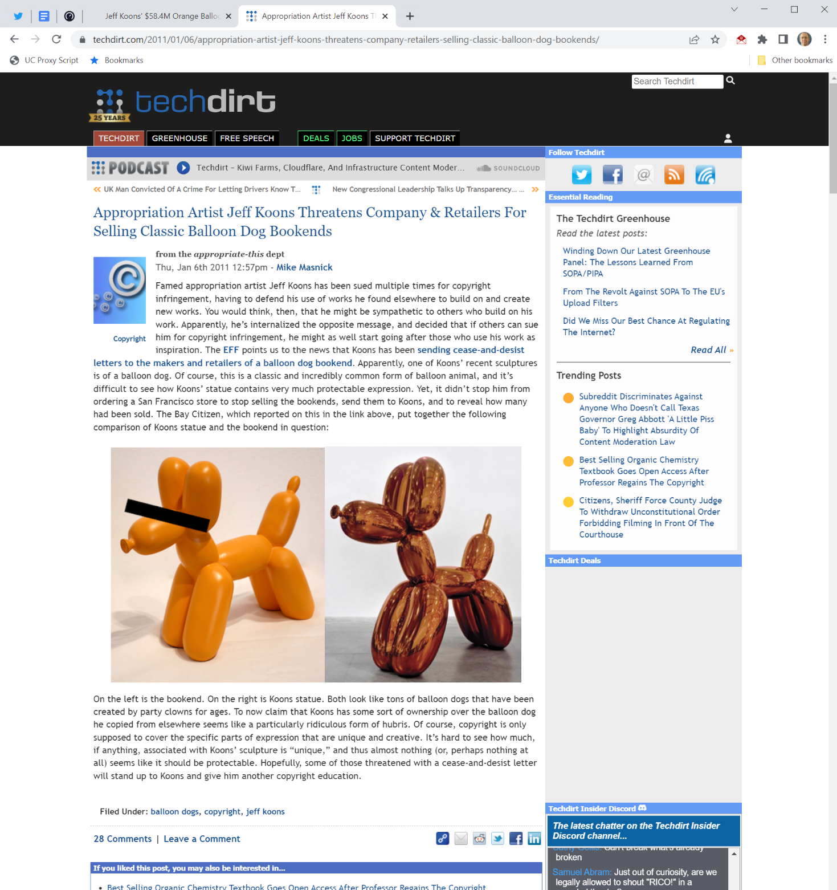

Bookends?
Techdirt (6 Jan 2011)
Notes:
Source: http://www.techdirt.com/articles/20110106/03183912549/appropriation-artist-jeff-koons-threatens-company-retailers-selling-classic-balloon-dog-bookends.shtml

Slide 28
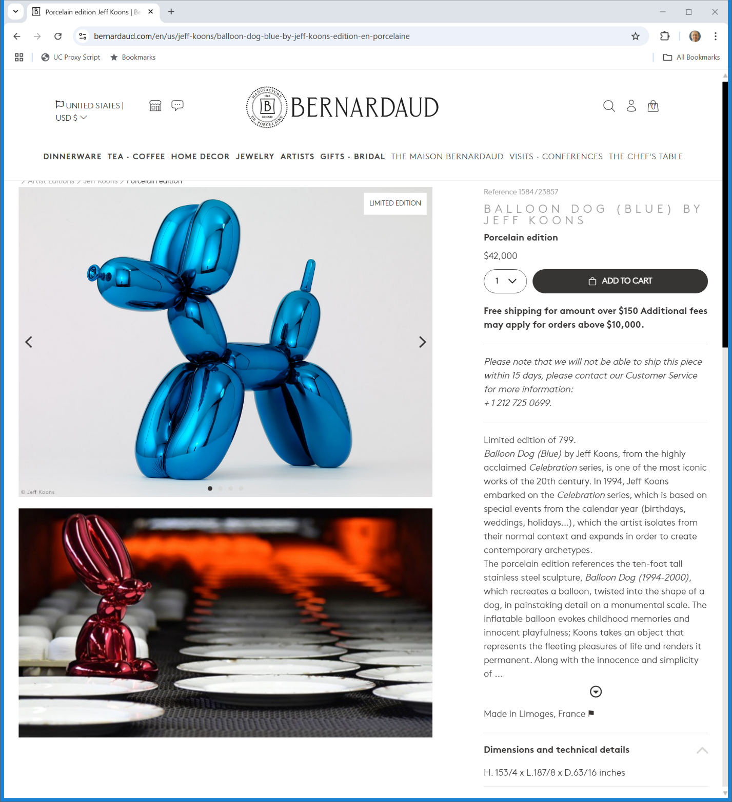

Need Ome?
Bernardaud (Visited 24 Mar 2025)
Notes:
https://www.bernardaud.com/en/us/jeff-koons/balloon-dog-blue-by-jeff-koons-edition-en-porcelaine

Slide 29
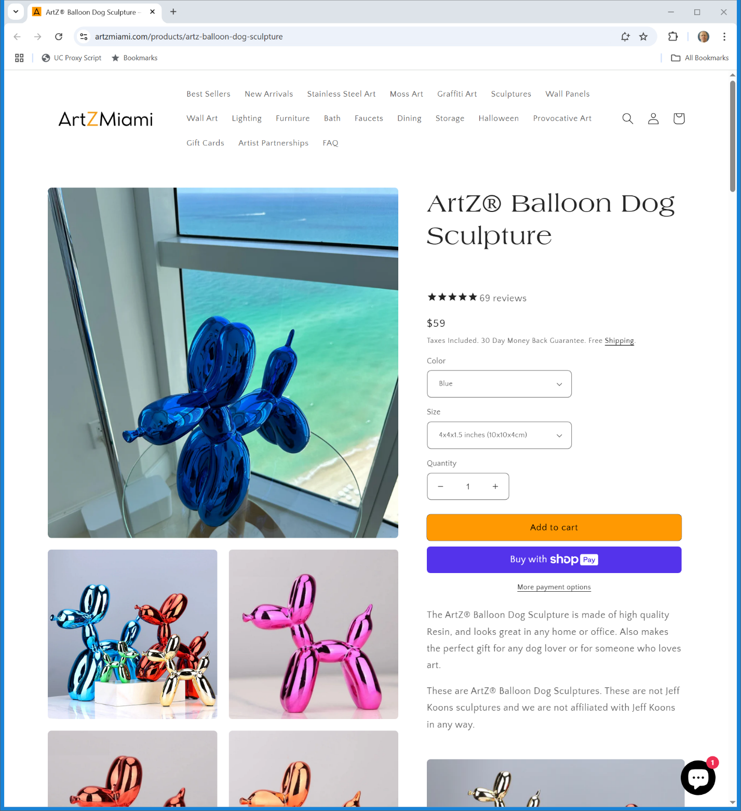

$59
ArtZMiami(Visited 24 Mar 2025)

Slide 30
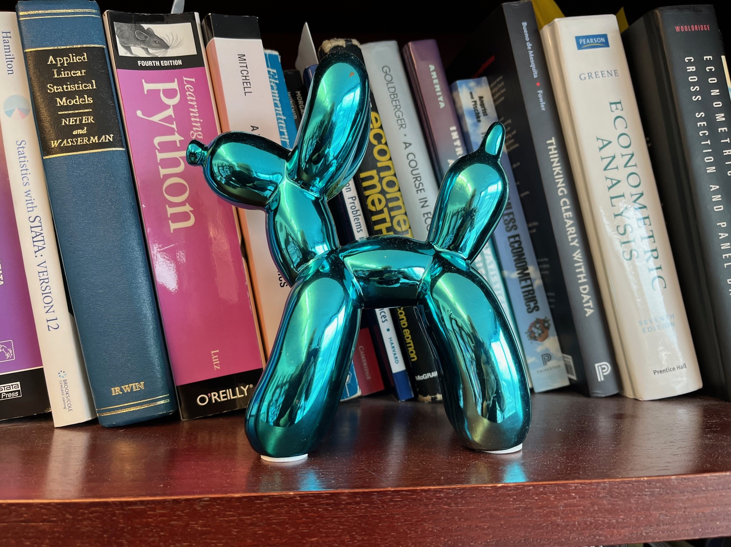
$10?
My Office

Slide 31
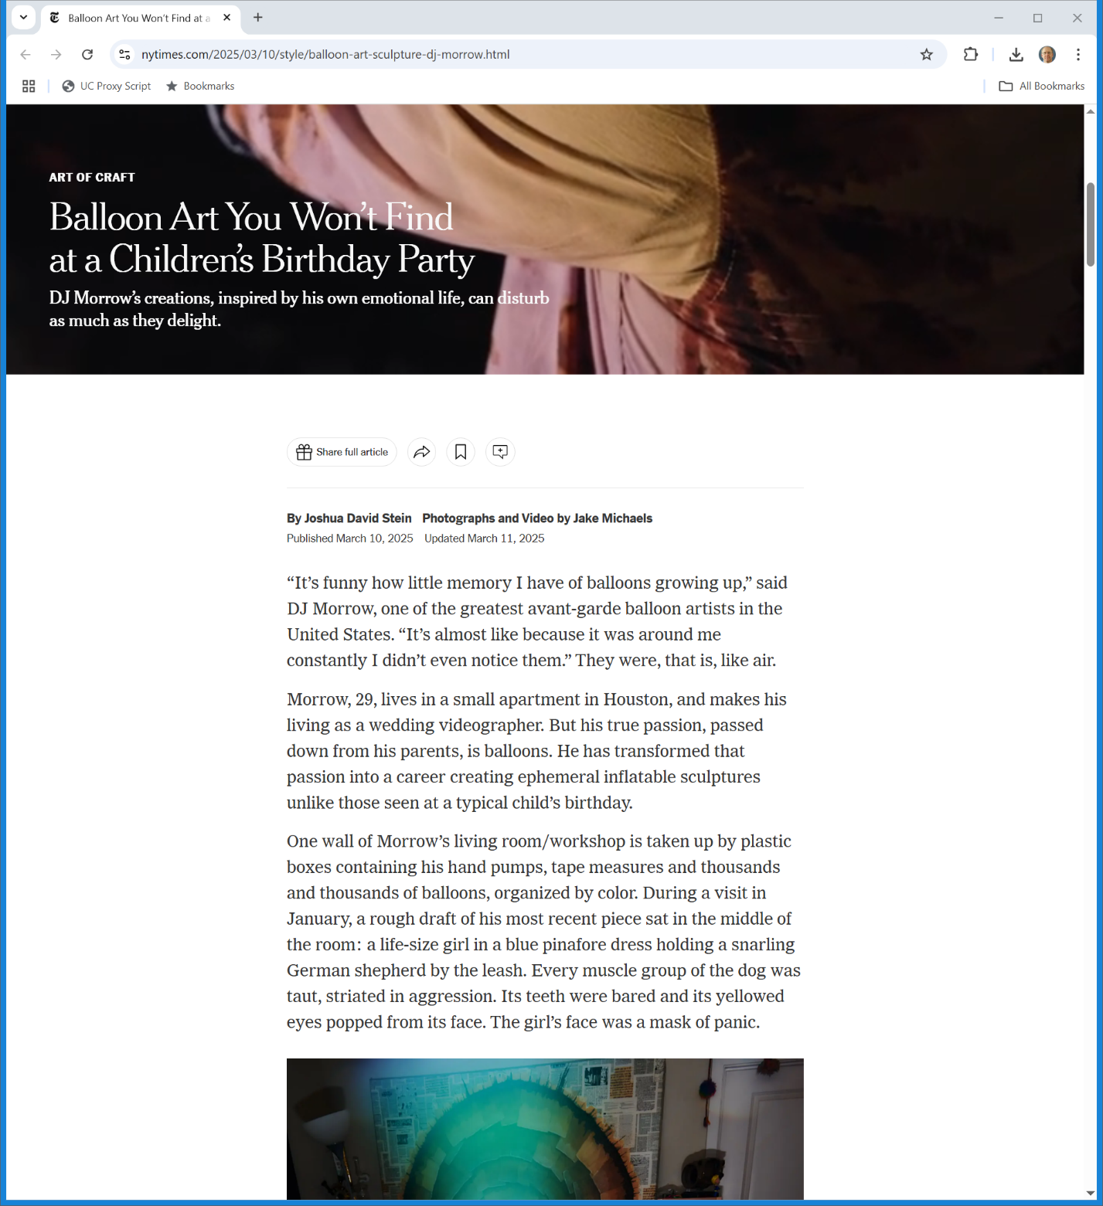

Balloons as TME
New York Times (10 Mar 2025)
Notes:
https://www.nytimes.com/2025/03/10/style/balloon-art-sculpture-dj-morrow.html

Slide 32
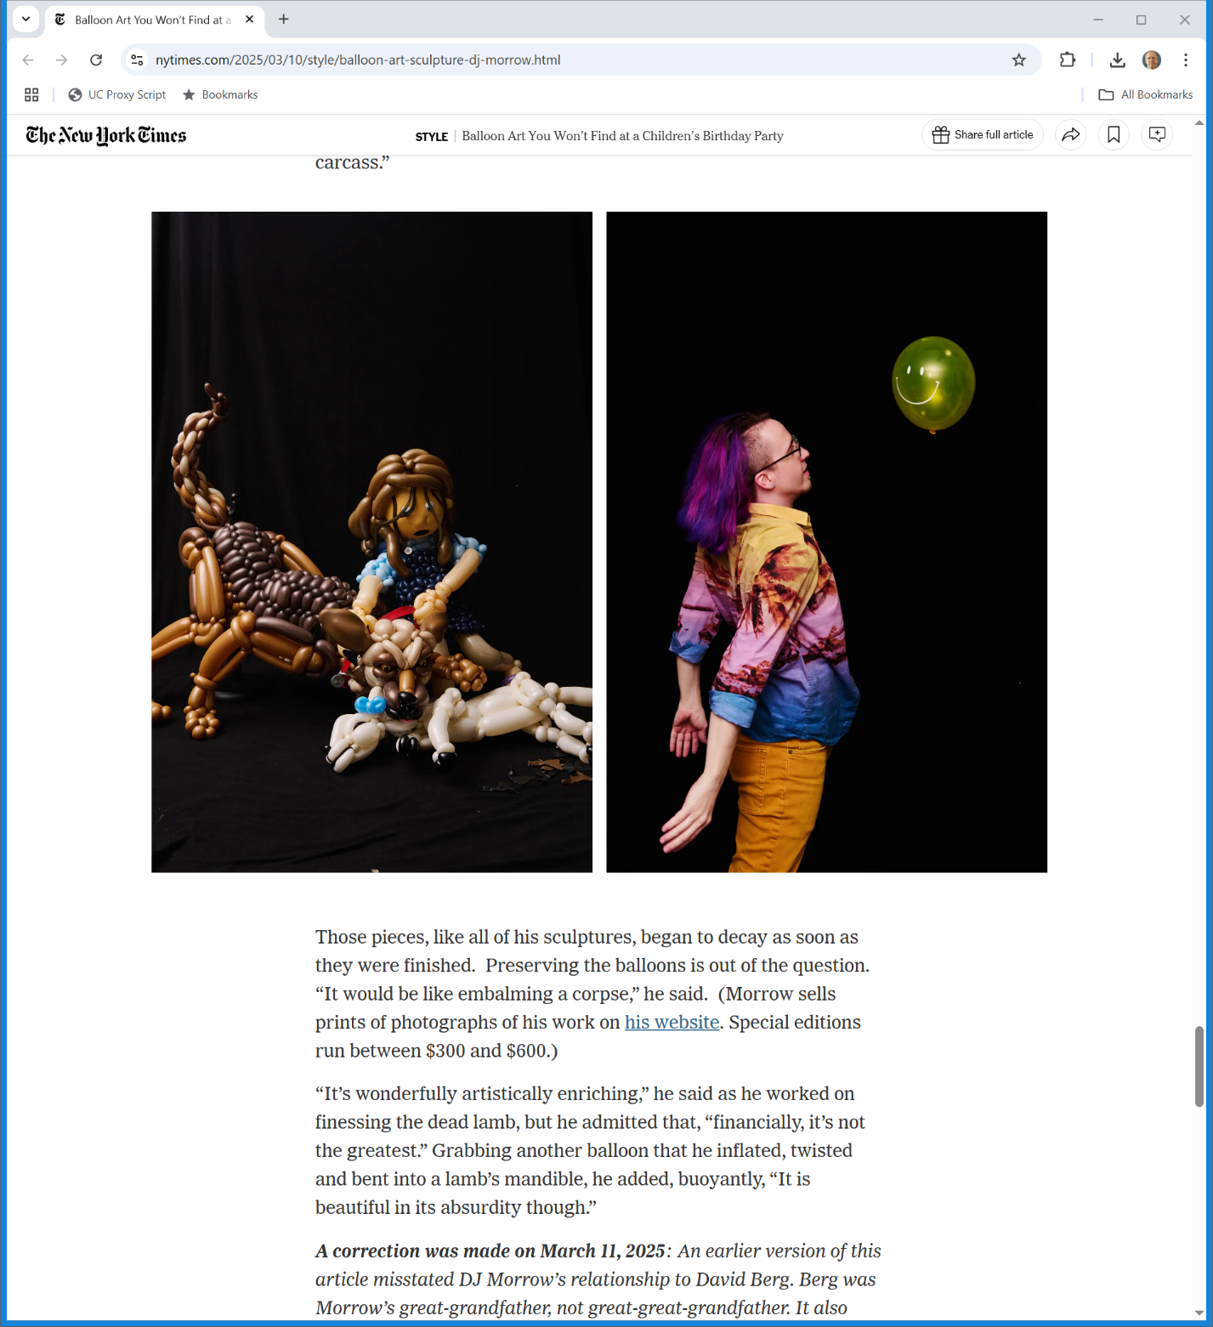

Fixed?
New York Times (10 Mar 2025)
Notes:
https://www.nytimes.com/2025/03/10/style/balloon-art-sculpture-dj-morrow.html

Slide 33
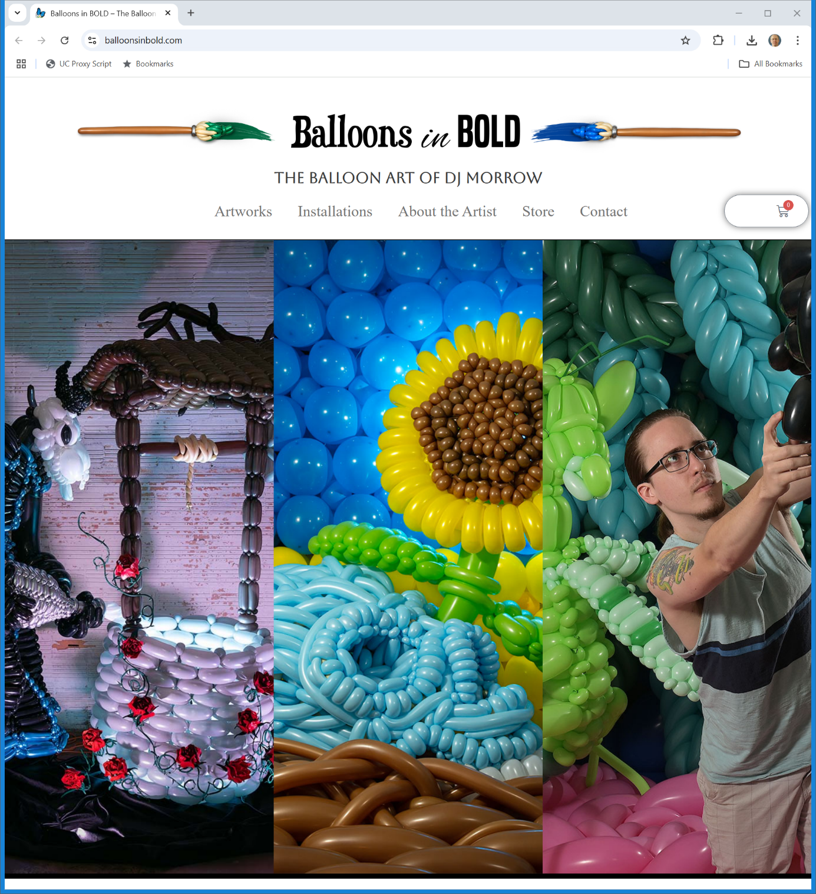
More?
Balloons in Bold (Visited 19 Mar 2025)
Notes:
https://balloonsinbold.com/

Slide 34
Burrow-Giles (U.S. 1884)
111 U.S. 53 (1884)

Slide 35
Fathoming Oscar Wilde
New York Times (2 Feb 1882)

Slide 36
Burrow-Giles Lithographic Co. v. Sarony
Searching for Oscar Wilde No. 18
Photo taken in the U.S. in 1882
Napoleon Sarony, photographer, died on Nov. 9, 1896

Slide 37
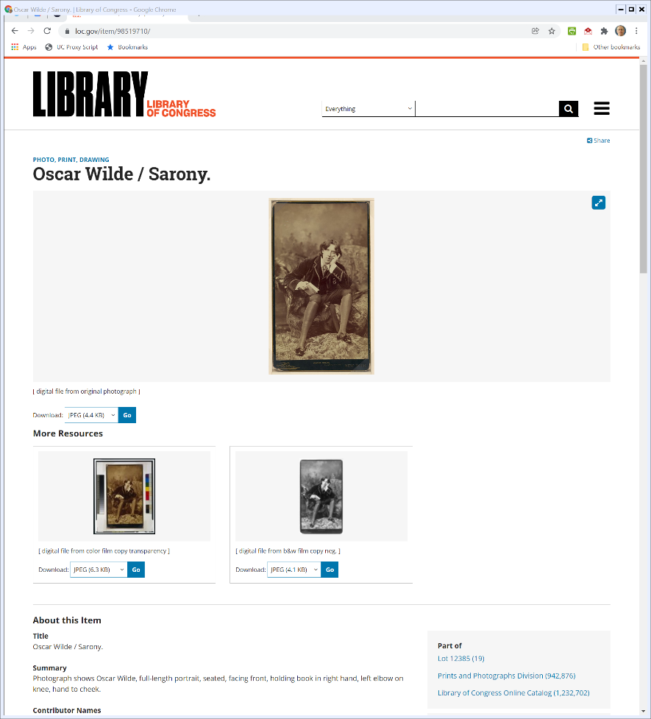
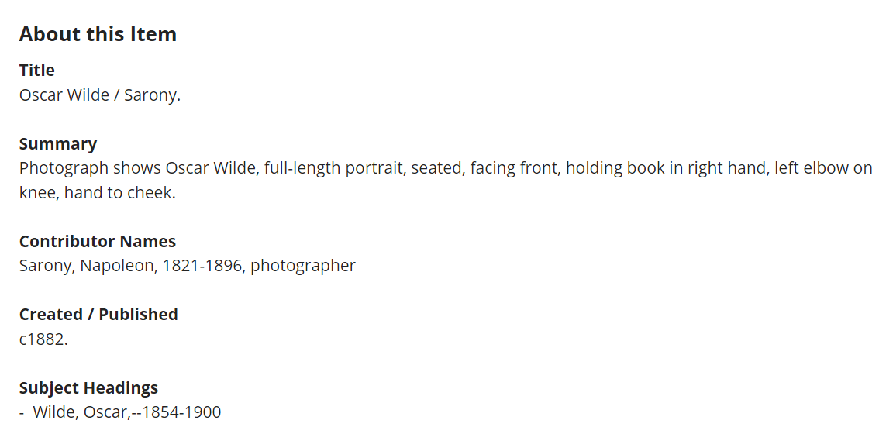
Sarony Photograph of Oscar Wilde
Library of Congress
Notes:
https://www.loc.gov/item/98519710/

Slide 38
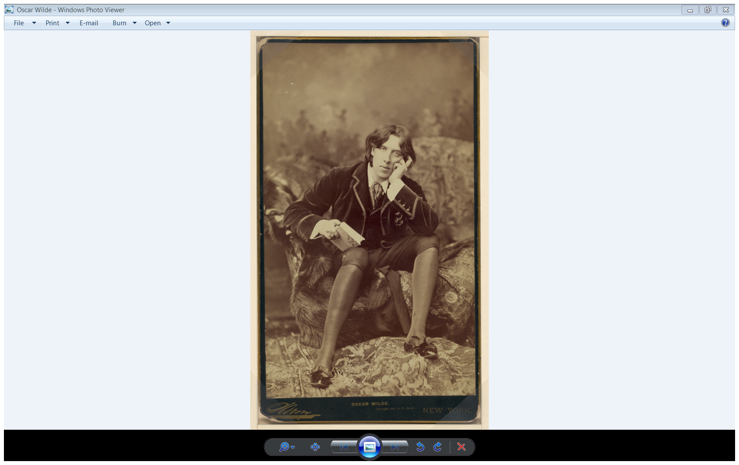
The Wilde Photo

Slide 39
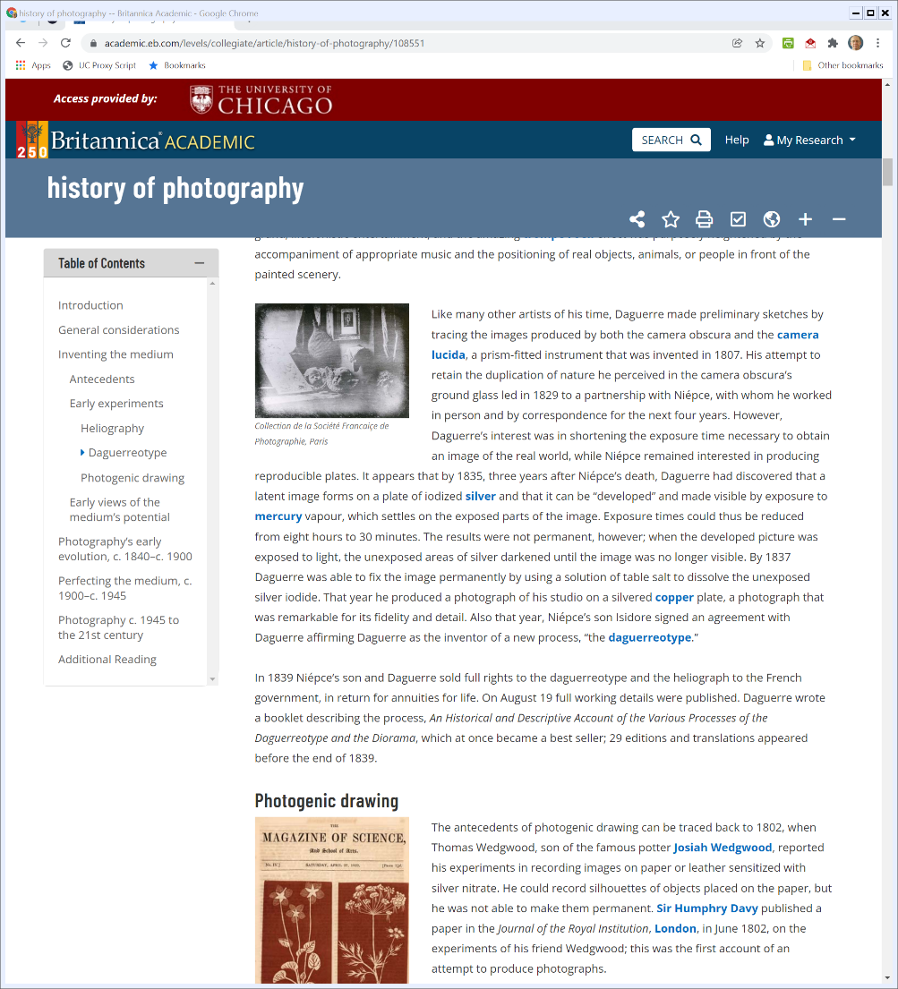

1830s: Invention of Photography?
Britannica (Visited: 3 Jan 2022)
Notes:
https://academic.eb.com/levels/collegiate/article/history-of-photography/108551

Slide 40
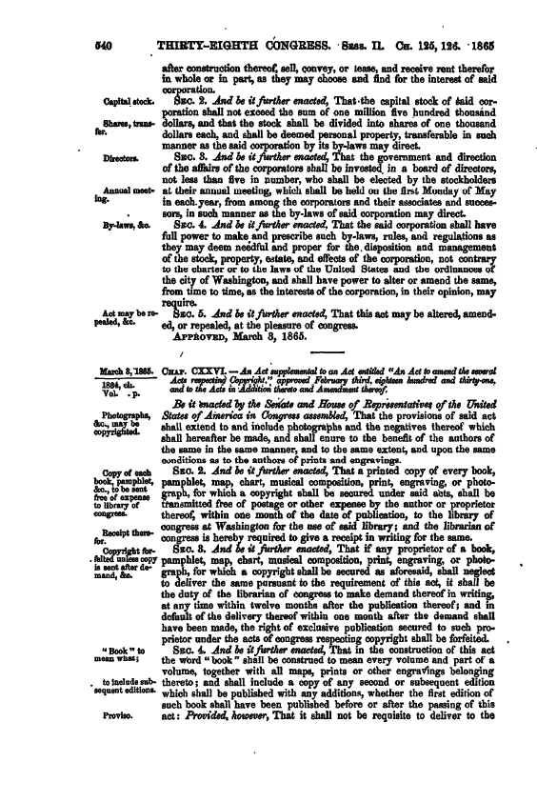
1865 Copyright Act: Photography
“That the provisions of said act shall extend to and include photographs and the negatives thereof which shall hereafter be made, and shall enure to the benefit of the authors of the same in the same manner, and to the same extent, and upon the same conditions as to the authors of prints and engravings.”
1865 Copyright Act

Slide 41
The Key Questions in Burrow-Giles
How does a new device—the camera producing photographs—match with the Constitution’s focus on Authors and Writings?
What conception of authorship will make possible a copyrighted work from such a device?

Slide 42
What is our focus?
The mechanical device?
The quill pen and the ink?
The printing press?
The paint brush and the canvas?
The camera?
Are some mechanical devices within the Constitution and others outside it?

Slide 43
What is our focus?
The role of the author in creating the work?
For manuscripts, the direct link between the brain and the hand doing the writing?
For the printing press, the movement from the manuscript authored as above to the books produced by the press?
For the camera, pushing a button?

Slide 44
What Counts as an Original Photograph?
OW No. 18 is a “useful, new, harmonious, characteristic, and graceful picture, and that plaintiff made the same … entirely from his own original conception, to which he gave visible form by posing the said Oscar Wilde in front of the camera, selecting and arranging the costume, draperies, and other various accessories in said”
Burrow-Giles (U.S. 1884)

Slide 45
What Counts as an Original Photograph?
“photograph, arranging the subject so as to present graceful outlines, arranging and disposing the light and shade, suggesting and evoking the desired expression, and from such disposition, arrangement, or representation, made entirely by plaintiff, he produced the picture in suit.”
Burrow-Giles (U.S. 1884)

Slide 46
Intellectual Invention
“These findings, we think, show this photograph to be an original work of art, the product of plaintiff’s intellectual invention, of which plaintiff is the author, and of a class of inventions for which the Constitution intended that Congress should secure to him the exclusive right to use, publish and sell … .”
Burrow-Giles (U.S. 1884)

Slide 47
Bleistein (U.S. 1903)
188 U.S. 239 (1903)

Slide 48
Bleistein v. Donaldson Lithographing Co.
Circus Advertising
Circus advertising key early form of advertising
Circuses advertised by “billers” who could cover 7,000 square feet a day with ads
Notes:
Source: Zimmerman in Intellectual Property Stories

Slide 49
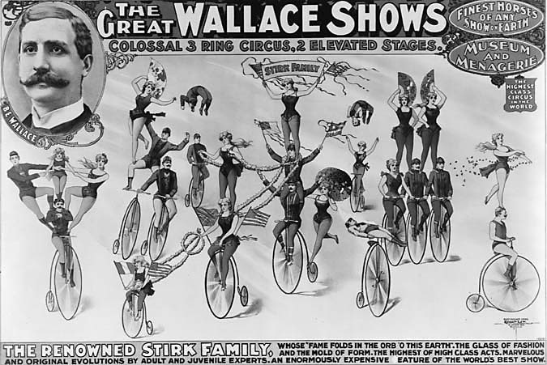
The Posters in Bleistein
Source: Edward Samuels, The Illustrated Story of Copyright
Notes:
Source: http://www.edwardsamuels.com/illustratedstory/chapter%206/wallace.jpg

Slide 50
The Creation of the Posters
Originals or Copies?
6th Circuit concludes the Donaldson versions were substantially identical to the Courier versions
And the Setup to the Supreme Court
Donaldson claims that the Bleistein posters were outside of the protection of copyright law and 6th Circuit agreed

Slide 51
Can’t Copy The Copy
“But even if they had been drawn from the life, that fact would not deprive them of protection. The opposite proposition would mean that a portrait by Velasquez or Whistler was common property because others might try their hand on the same face. Others are free to copy the original. They are not free to copy the copy.”
Bleistein (U.S. 1903)

Slide 52
Why Shouldn’t We Reject Copyright in Advertising?
Don’t focus on quality, focus on need for creation?
We should use copyright to incentivize the creation of works that wouldn’t otherwise be produced
Given the importance of advertising to the circus, circuses would produce posters with or without copyright protection

Slide 53
Why Shouldn’t We Reject Copyright in Advertising?
Given that copyright frustrates subsequent uses, we shouldn’t propertize except when we need to do so to cause creation
Bleistein loses
Is this Justice Harlan?

Slide 54
Harlan: Ads aren’t Fine Art
“... [The work] must have some connection with the fine arts to give intrinsic value. ... We are unable to discover anything useful or meritorious in the design copyrighted by the plaintiffs in error other than as an advertisement of the acts to be done or exhibited to the public in Wallace’s show.”
Bleistein (U.S. 1903)

Slide 55
Holmes: Judges Shouldn’t Judge Art
“It would be a dangerous undertaking for persons trained only to the law to constitute themselves final judges of the worth of pictorial illustrations, outside of the narrowest and most obvious limits.”
Bleistein (U.S. 1903)

