Slide 1
Class 23: Thurs 22 Feb 2024
Antitrust Winter 2024
App Stores: Google
Randal C. Picker
James Parker Hall Distinguished Service Professor of Law
The Law School
The University of Chicago
Copyright © 2000-24 Randal C. Picker. All Rights Reserved.

Slide 2
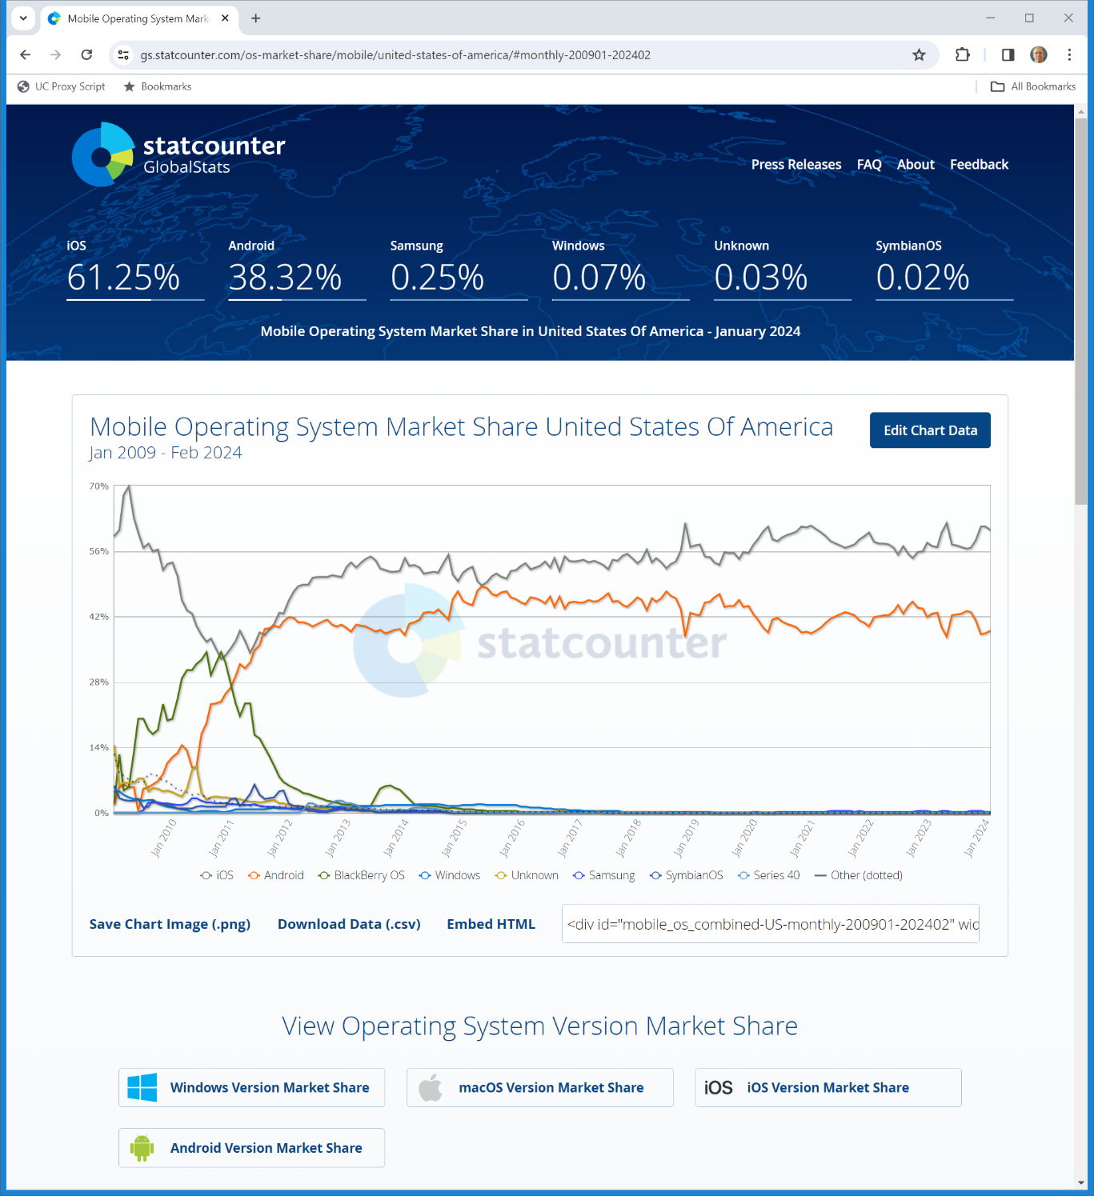
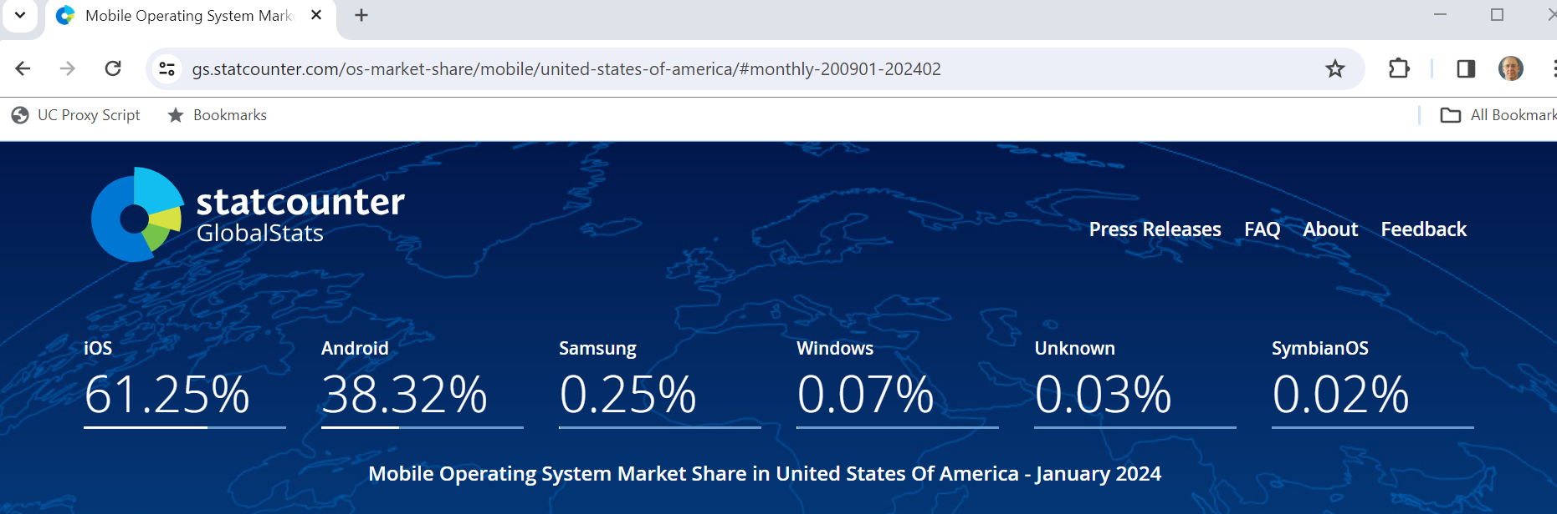
U.S. Mobile Operating System Market Shares
Statcounter (Visited 18 Feb 2024)
Notes:
https://gs.statcounter.com/os-market-share/mobile/united-states-of-america/#monthly-200901-202402

Slide 3
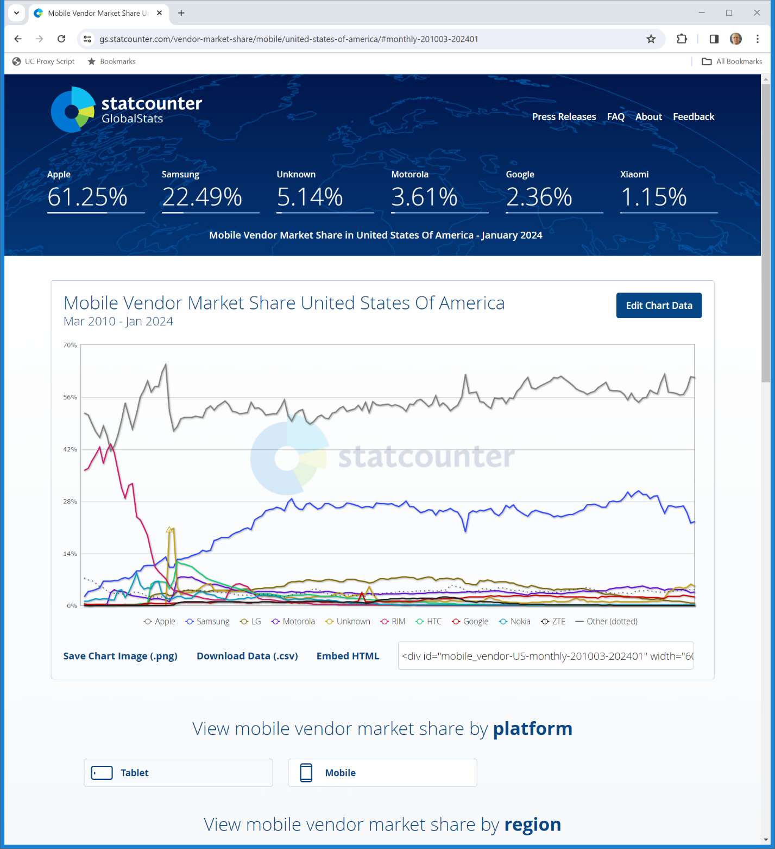

Mobile Vendor Market Share in the U.S.
Statcounter (Visited 22 Feb 2024)
Notes:
https://gs.statcounter.com/vendor-market-share/mobile/united-states-of-america/#monthly-201003-202401

Slide 4
Mobile Vendor Market Share in the U.S.
Statcounter (Visited 22 Feb 2024)
Notes:
https://gs.statcounter.com/vendor-market-share/mobile/united-states-of-america/#monthly-201003-202401

Slide 5
Sellling Android
TTYN (1 of 2)
Hypo 1
  Google creates Android and sells it for cash to OEMs (cell phone handset makers). It competes with other firms doing the same (Microsoft among others)
Antitrust issues?

Slide 6
Sellling Android
TTYN (2 of 2)
Hypo 2
  Some firms such as Microsoft sell smartphone OSs for cash
  Google creates Android but doesn’t sell it for cash but instead “charges” that OEMs have to preinstall Google apps and defaults
Antitrust issues? Would it matter if Google insisted on exclusivity?

Slide 7
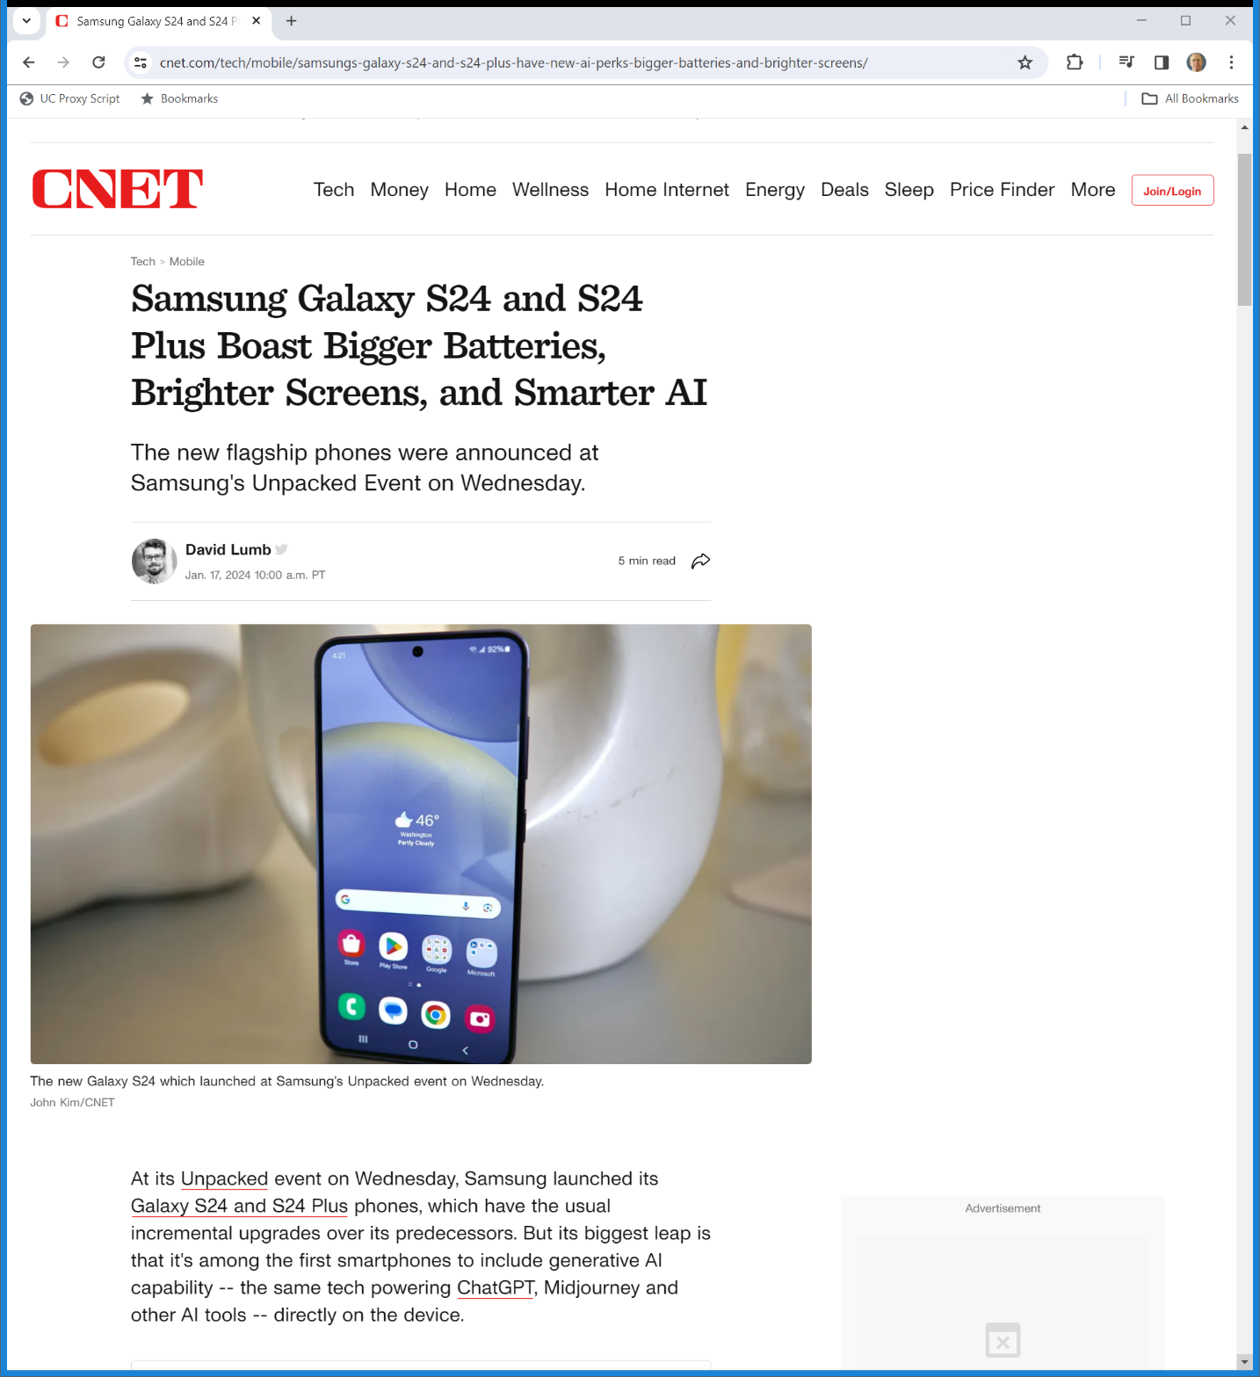
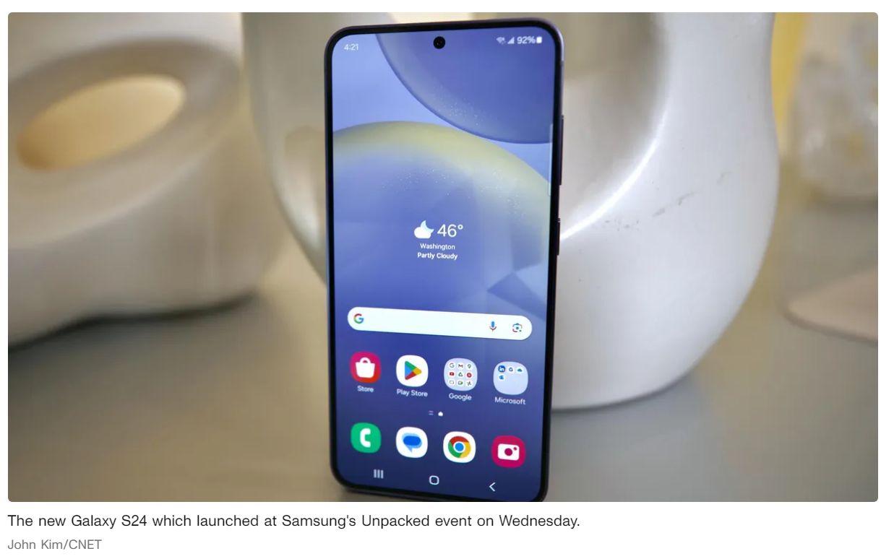
New Galaxy S24
CNET (17 Jan 2024)
Notes:
https://www.cnet.com/tech/mobile/samsungs-galaxy-s24-and-s24-plus-have-new-ai-perks-bigger-batteries-and-brighter-screens/

Slide 8
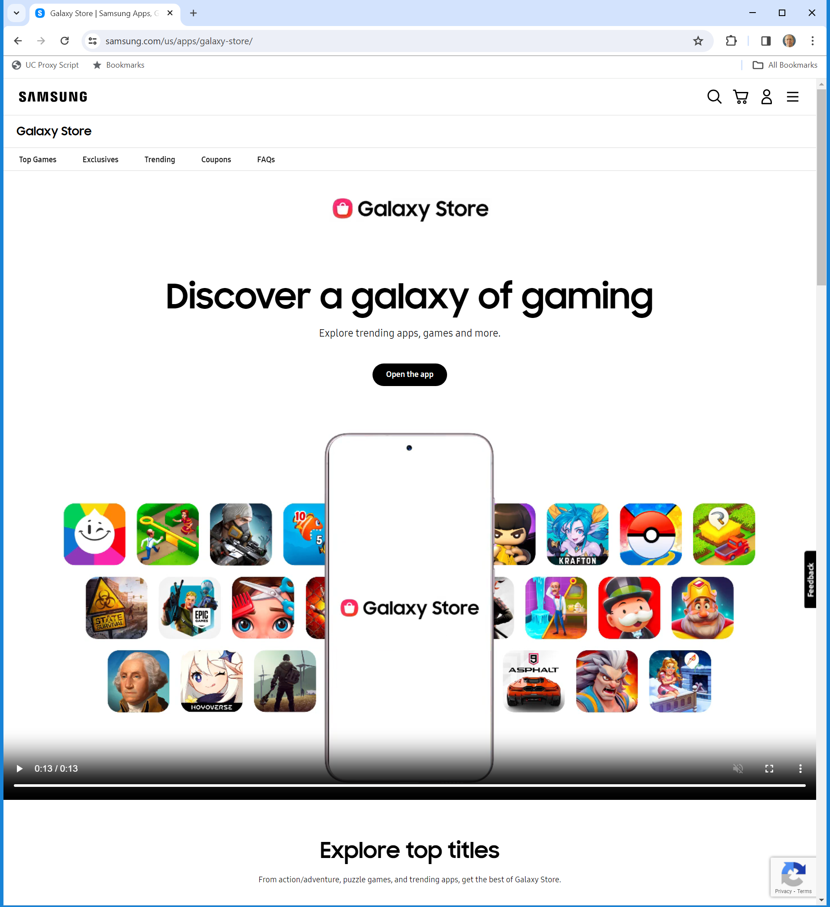
Galaxy Store
Samsung (Visited 22 Feb 2024)

Slide 9
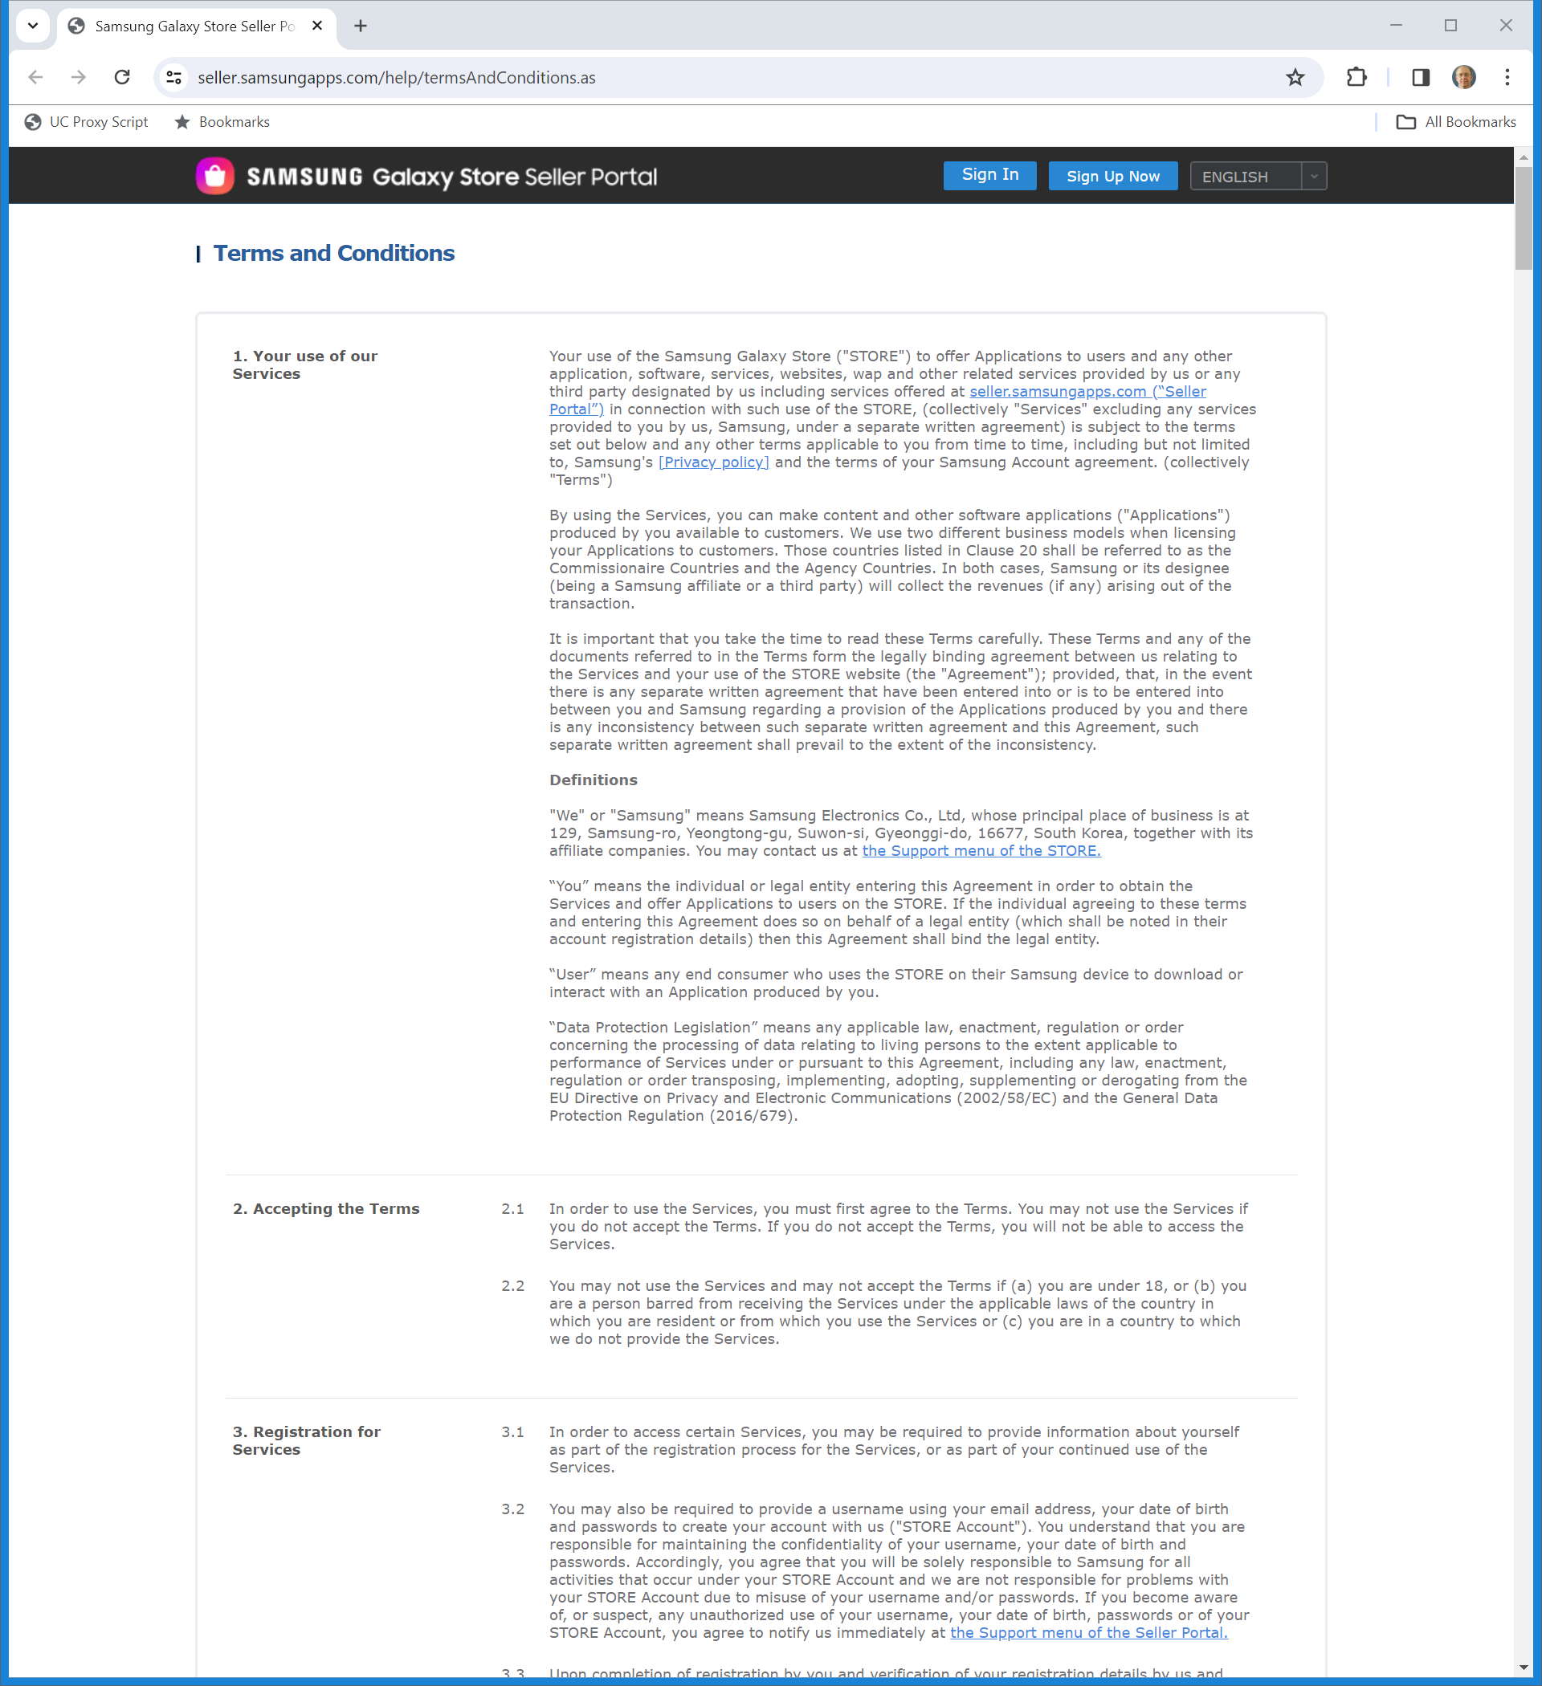
Samsung Store Terms and Conditions
Samsung Seller Portal (Visited 22 Feb 2024)
Notes:
https://seller.samsungapps.com/help/termsAndConditions.as

Slide 10
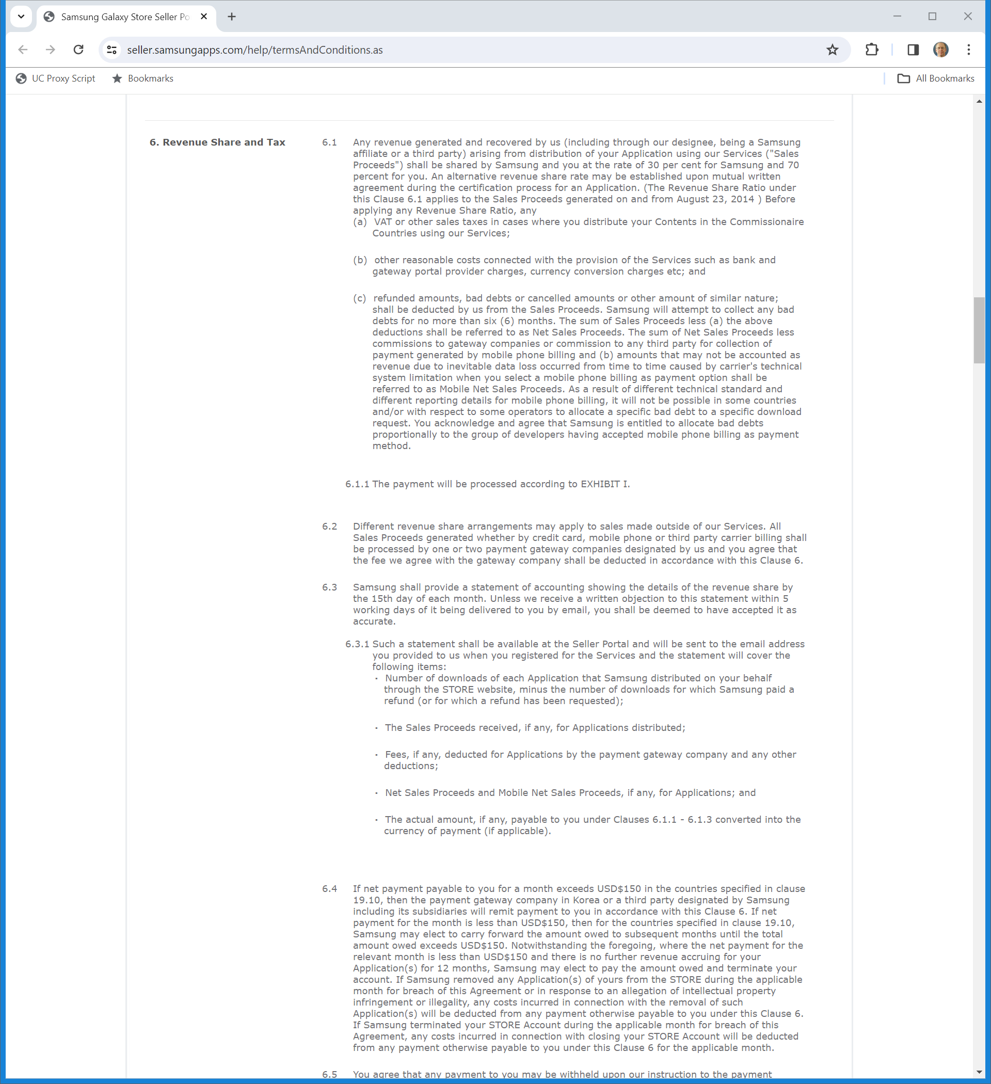
30% Royalty Rate
Samsung Seller Portal (Visited 22 Feb 2024)
Notes:
https://seller.samsungapps.com/help/termsAndConditions.as

Slide 11
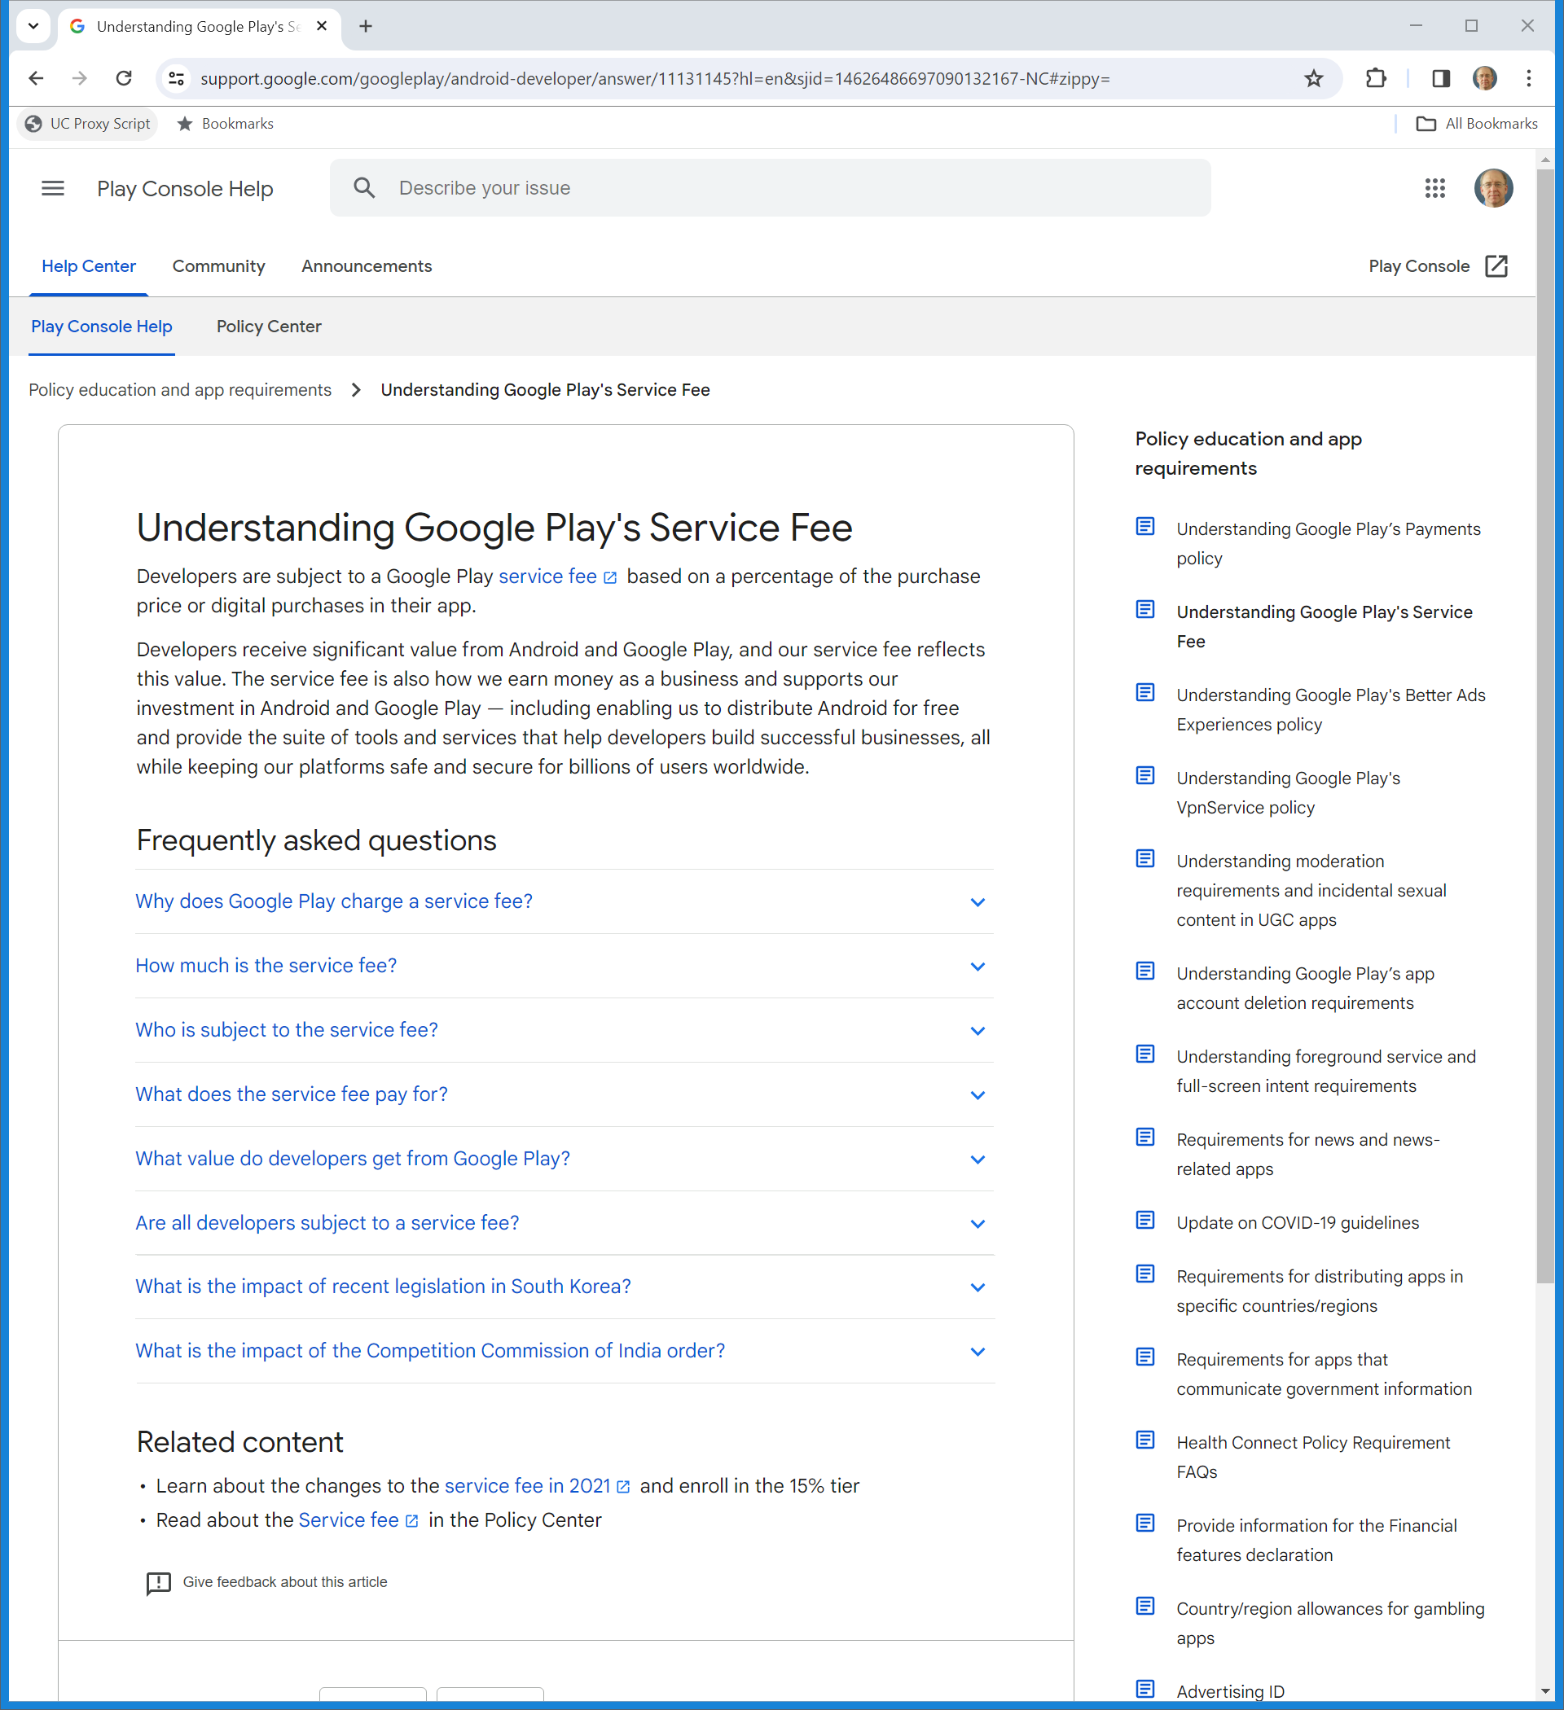
Google Play Service Fee
Google Play Support (Visited 22 Feb 2024)
Notes:
https://support.google.com/googleplay/android-developer/answer/11131145?hl=en&sjid=14626486697090132167-NC#zippy=

Slide 12
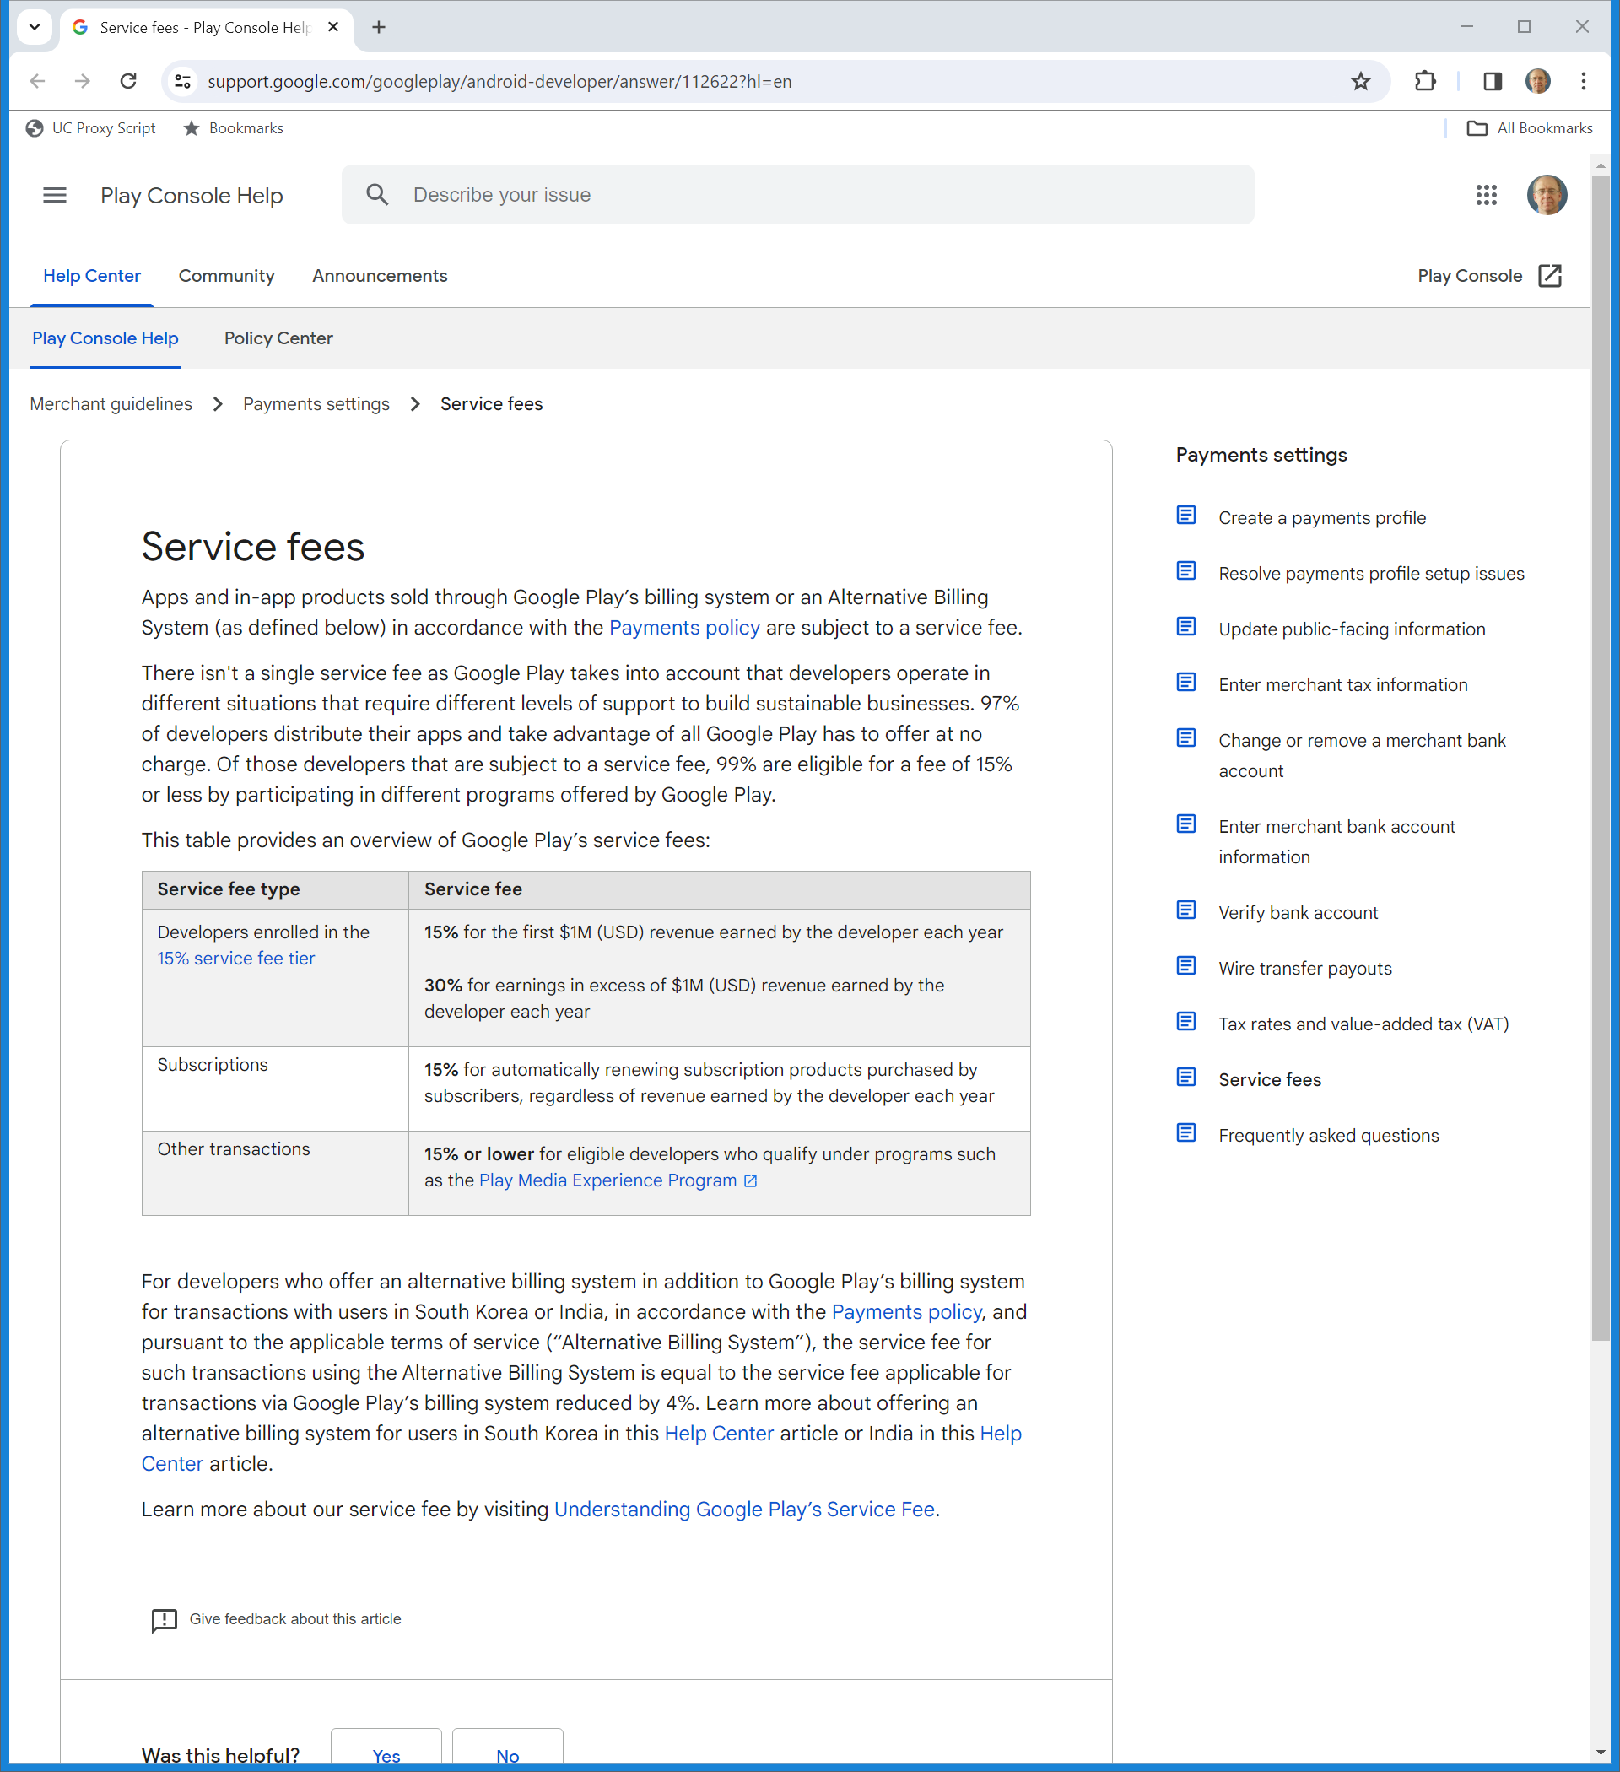
15%/30% Royalties
Google Play Support (Visited 22 Feb 2024)
Notes:
https://support.google.com/googleplay/android-developer/answer/112622?hl=en

Slide 13
South Korea/India
Google Play Support (Visited 22 Feb 2024)
Notes:
https://support.google.com/googleplay/android-developer/answer/112622?hl=en

Slide 14
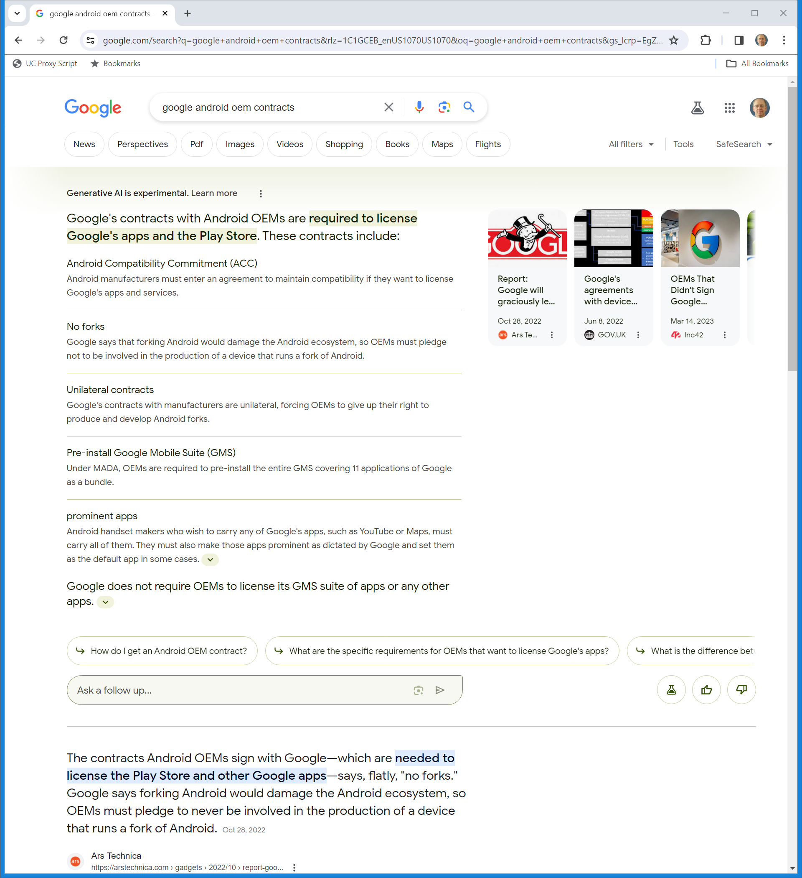
Google Contracts with OEMs
Google Gen AI (Visited 22 Feb 2024)
Notes:
https://www.google.com/search?q=google+android+oem+contracts&rlz=1C1GCEB_enUS1070US1070&oq=google+android+oem+contracts&gs_lcrp=EgZjaHJvbWUyBggAEEUYOTIGCAEQRRhAMgYIAhBFGEAyBggDEEUYQNIBCDcxNzVqMGo3qAIAsAIA&sourceid=chrome&ie=UTF-8

Slide 15
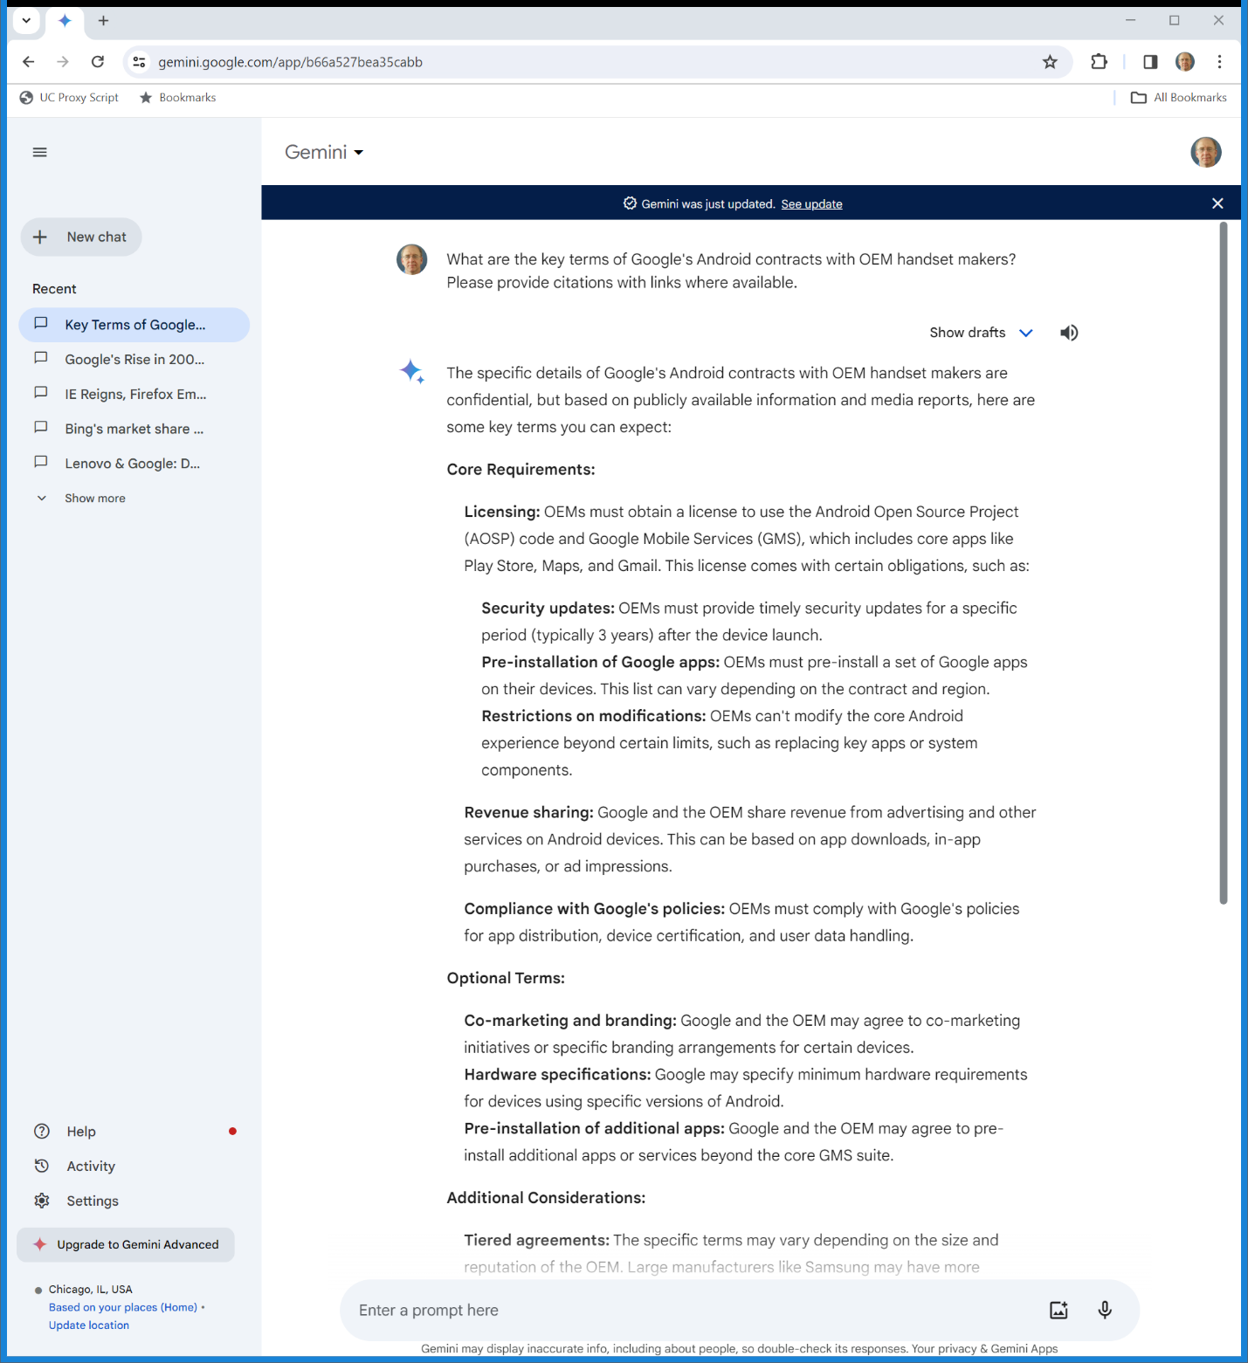
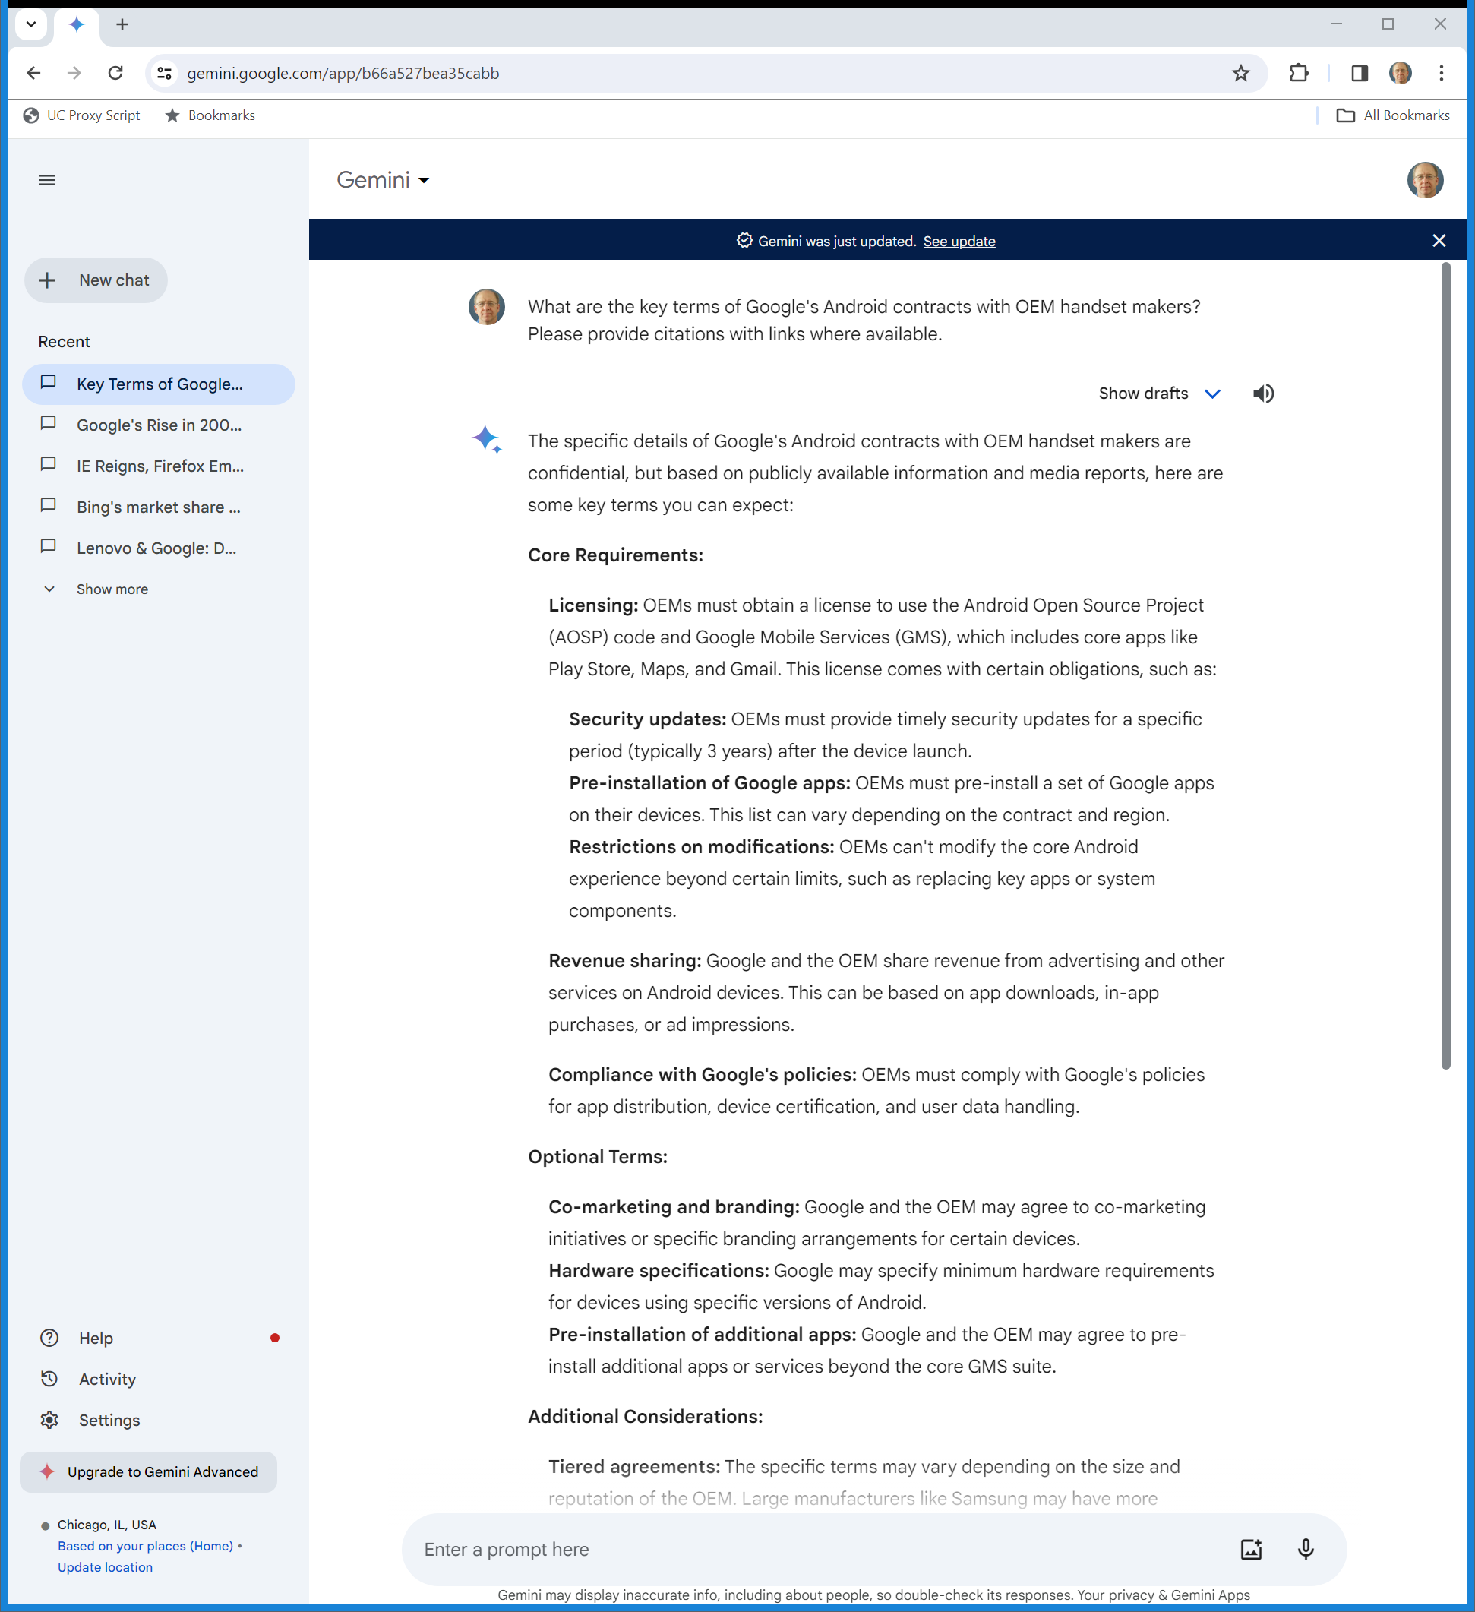
Gemini: Google Contracts with OEMs
Google Gen AI (Visited 22 Feb 2024)
Notes:
https://gemini.google.com/app/b66a527bea35cabb

Slide 16
Gemini: Google Contracts with OEMs
Google Gen AI (Visited 22 Feb 2024)
Notes:
https://gemini.google.com/app/b66a527bea35cabb

Slide 17
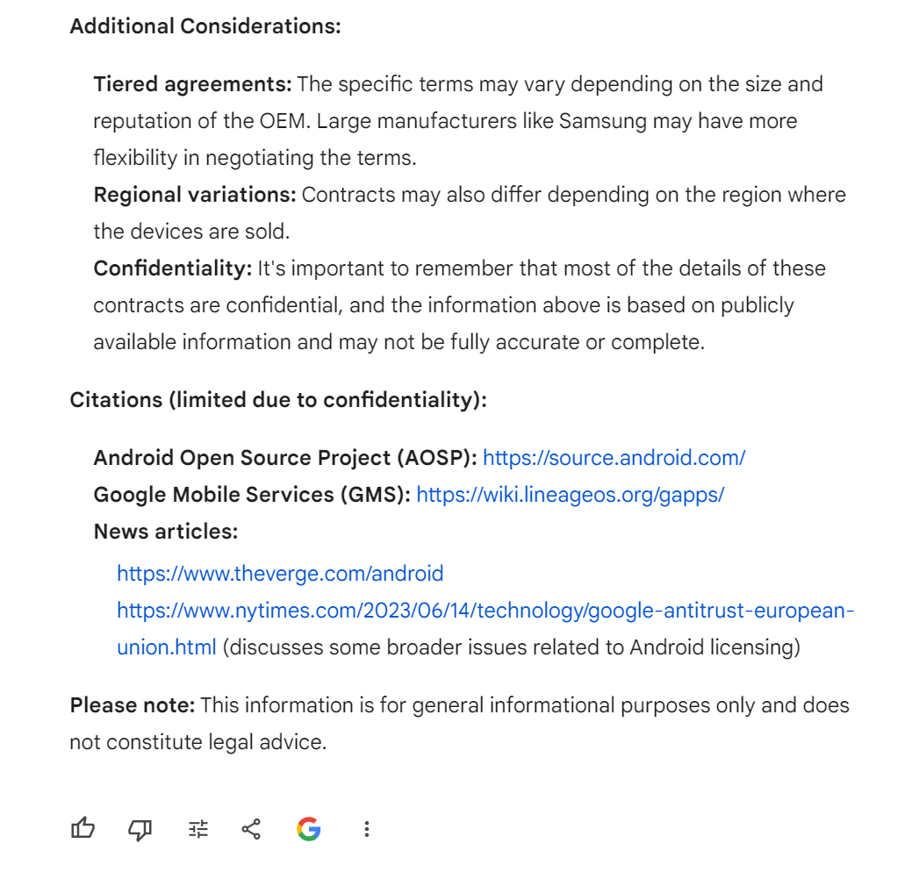
Gemini: Google Contracts with OEMs
Google Gen AI (Visited 22 Feb 2024)
Notes:
https://gemini.google.com/app/b66a527bea35cabb

Slide 18
Preinstallation
TTYN (1 of 4)
Hypo
  Apple/Samsung builds the iPhone/Galaxy. It adds software:
    An operating system: iOS/Android under a contract with Google
    The App Store/The Galaxy Store/The Google Play store pursuant to contract with Google

Slide 19
Preinstallation
TTYN (2 of 4)
Hypo
    Various apps (on an iPhone, Safari, a calculator, email, calendar, messaging software, FaceTime, Maps, Wallet and more; on the Galaxy, the apps in the icons above)

Slide 20
Preinstallation
TTYN (3 of 4)
Questions
  Does this raise antitrust issues? Does it matter whether the apps can or cannot be deleted?
  Do we think that these activities should otherwise be regulated?

Slide 21
Preinstallation
TTYN (4 of 4)
Questions
  Could Apple/Samsung auction off the right to be the default App Store, browser, search engine etc.?
  Should Apple/Samsung be required to offer an EU-style MS browser ballot or search engine choice screen for each of the apps that it currently preinstalls? For an alternative OS?

Slide 22
Aug 2020: Epic Sues Google
Epic v. Google Complaint (13 Aug 2020)

Slide 23
Theory of the Case
Epic v. Google Complaint (13 Aug 2020)

Slide 24
May 2022: Match Sues Google
Match Complaint (9 May 2022)

Slide 25
May 2022: Match Sues Google
Match Complaint (9 May 2022)

Slide 26
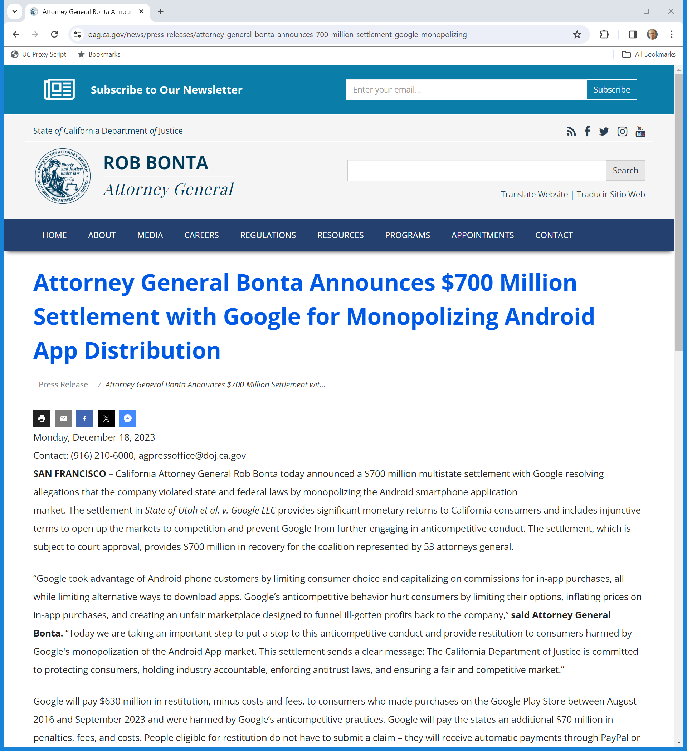
Sept/Dec 2023: State/Google Settlement
California AG (18 Dec 2023)
Notes:
https://oag.ca.gov/news/press-releases/attorney-general-bonta-announces-700-million-settlement-google-monopolizing

Slide 27
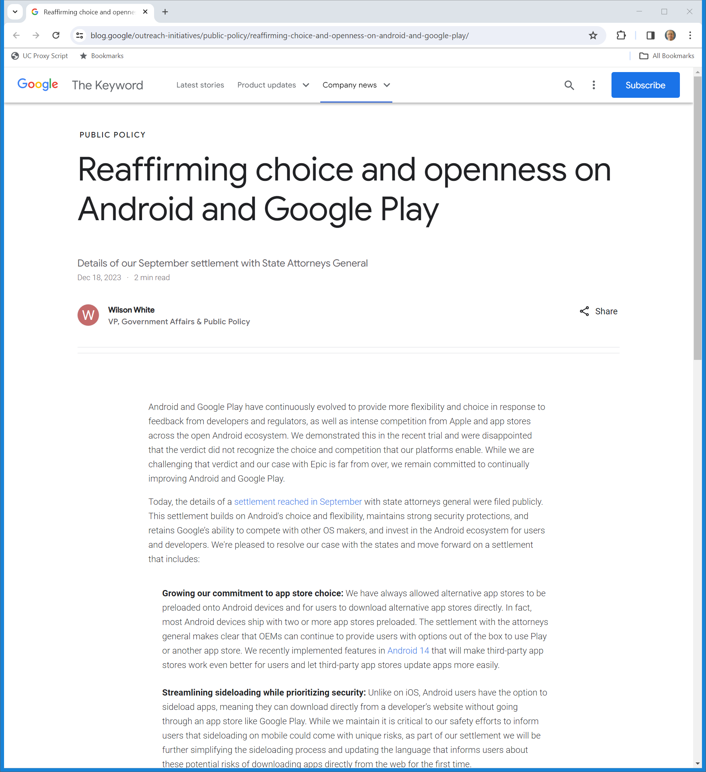
Sept/Dec 2023: Google/State Settlement
Google (18 Dec 2023)
Notes:
https://blog.google/outreach-initiatives/public-policy/reaffirming-choice-and-openness-on-android-and-google-play/

Slide 28
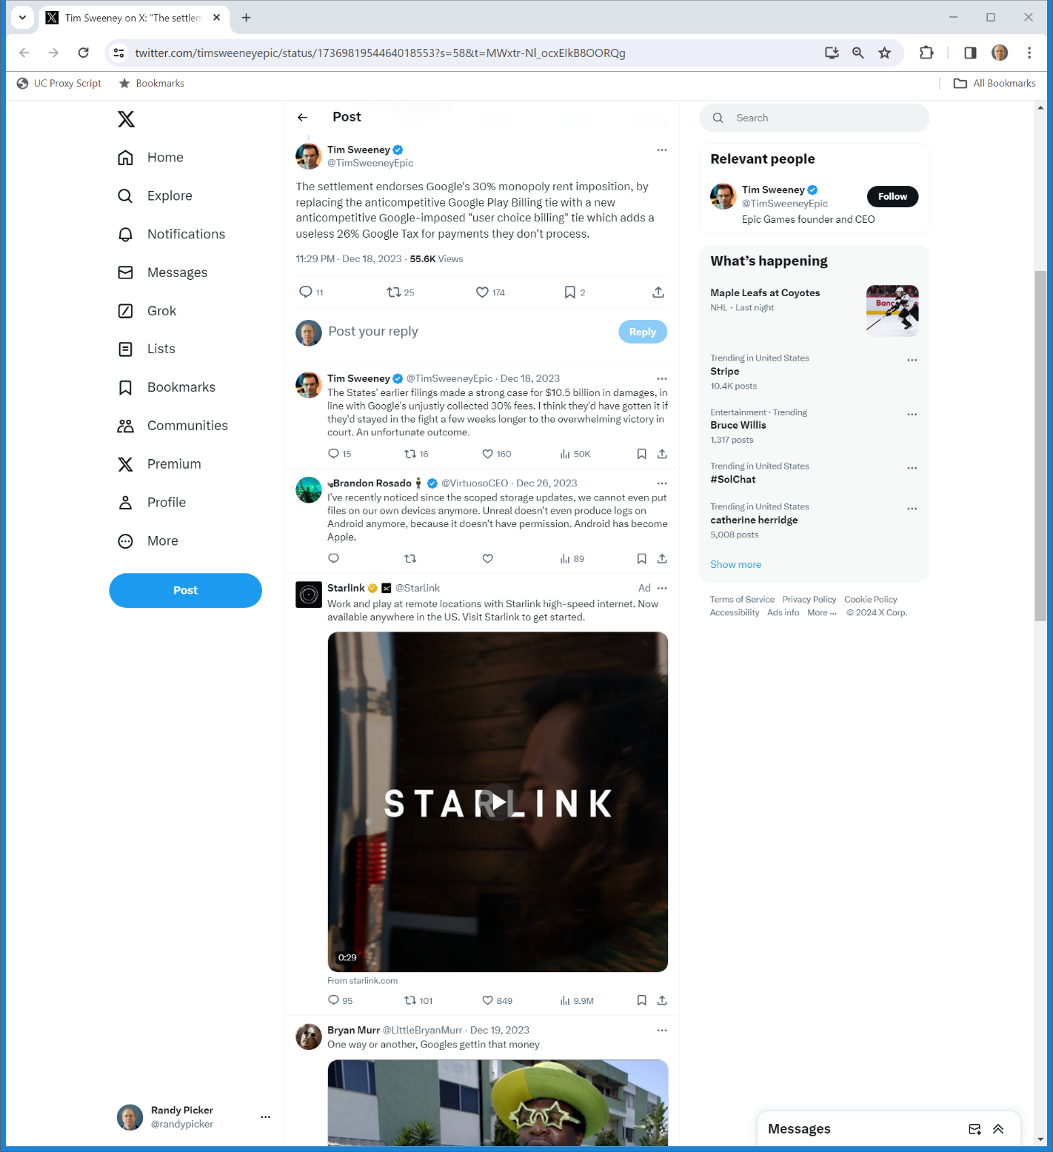

“Useless 26% Google Tax”
Sweeney (18 Dec 2023)
Notes:
https://twitter.com/timsweeneyepic/status/1736981954464018553?s=58&t=MWxtr-Nl_ocxEIkB8OORQg

Slide 29
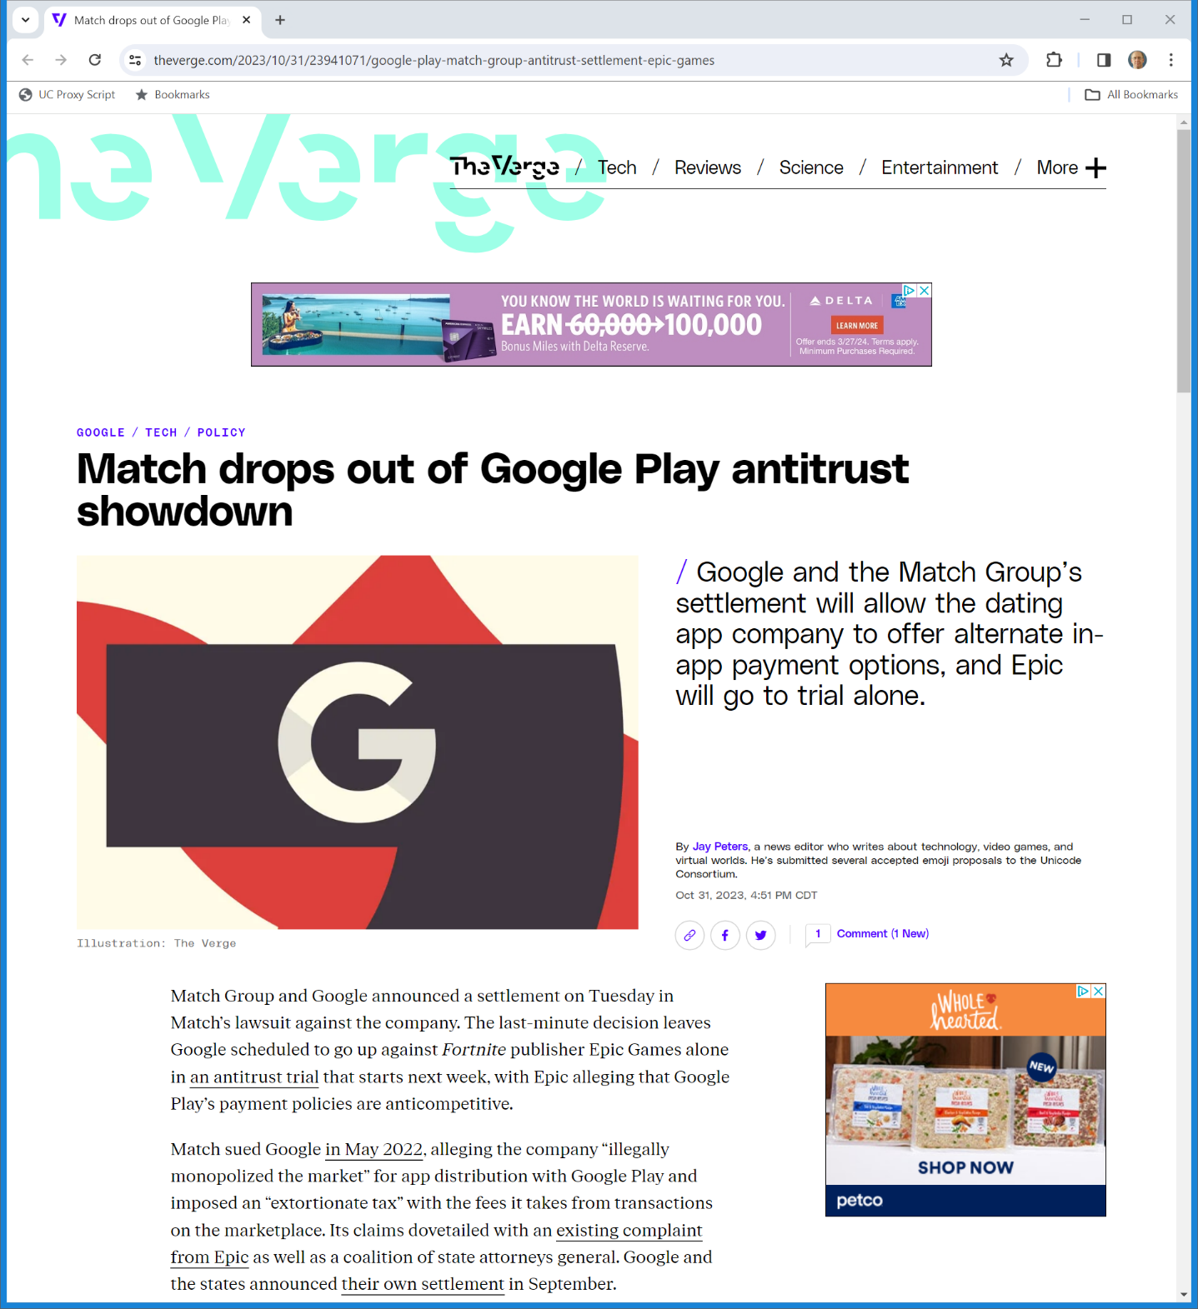
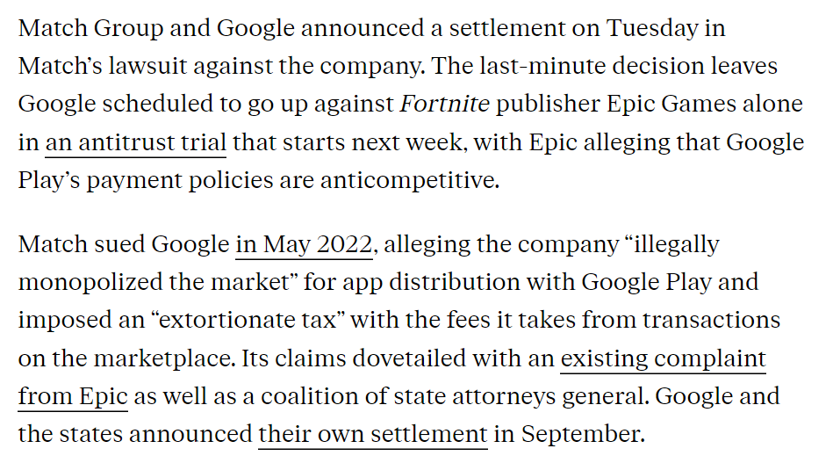
Google/Match Settle on Eve of Trial
The Verge (31 Oct 2023)
Notes:
https://www.theverge.com/2023/10/31/23941071/google-play-match-group-antitrust-settlement-epic-games

Slide 30
Is There A Relevant Antitrust Market?
Epic v. Google Jury Verdict Form (11 Dec 2023)

Slide 31
Two Markets: App Distribution/In-App Billing
Epic v. Google Jury Verdict Form (11 Dec 2023)

Slide 32
Monopolization?: Yes
Epic v. Google Jury Verdict Form (11 Dec 2023)

Slide 33
Discussion
TTYN
Questions
  Why did Epic win in front of the jury?
  What do we think will happen on the appeal to the Ninth Circuit given the result in Epic v. Apple?

Slide 34
The Digital Markets Act: Contestable and Fair Markets
DMA (14 Sept 2022)

Slide 35
Going Beyond Competition Law (But Why?)
DMA (14 Sept 2022)

Slide 36
Contestability and Fairness
DMA (14 Sept 2022)

Slide 37
Understanding Contestability
DMA (14 Sept 2022)

Slide 38
Understanding Unfairness
DMA (14 Sept 2022)

Slide 39
Core Platform Services
DMA (14 Sept 2022)

Slide 40
Choice Screens: Search, Browser, Virtual Assistant
DMA (14 Sept 2022)

Slide 41
Third-Party App Stores
DMA (14 Sept 2022)

Slide 42
Free Access to Device Features
DMA (14 Sept 2022)

Slide 43
Why?
DMA (14 Sept 2022)

Slide 44
FRAND Access to Search Engine Data
DMA (14 Sept 2022)

Slide 45
FRAND for App Stores?
DMA (14 Sept 2022)

Slide 46
FRAND for App Stores?
DMA (14 Sept 2022)

Slide 47
Applying These Rules
[TTYN (1 of 2)]
Try Apple
  Can Apple charge say Spotify an IP/ecosystem fee as a condition of access to iOS? Can that fee be equal to whatever sales Spotify makes through the iOS app and whatever Spotify sells outside the iOS app and that will be consumed through an iOS device?

Slide 48
Applying These Rules
[TTYN (2 of 2)]
Try Apple
  Can Apple charge any search engine a per search fee for each search done on an iOS device?
  Can Apple charge end-users different handset device prices depending on whether or not they use the Apple App Store?

Slide 49
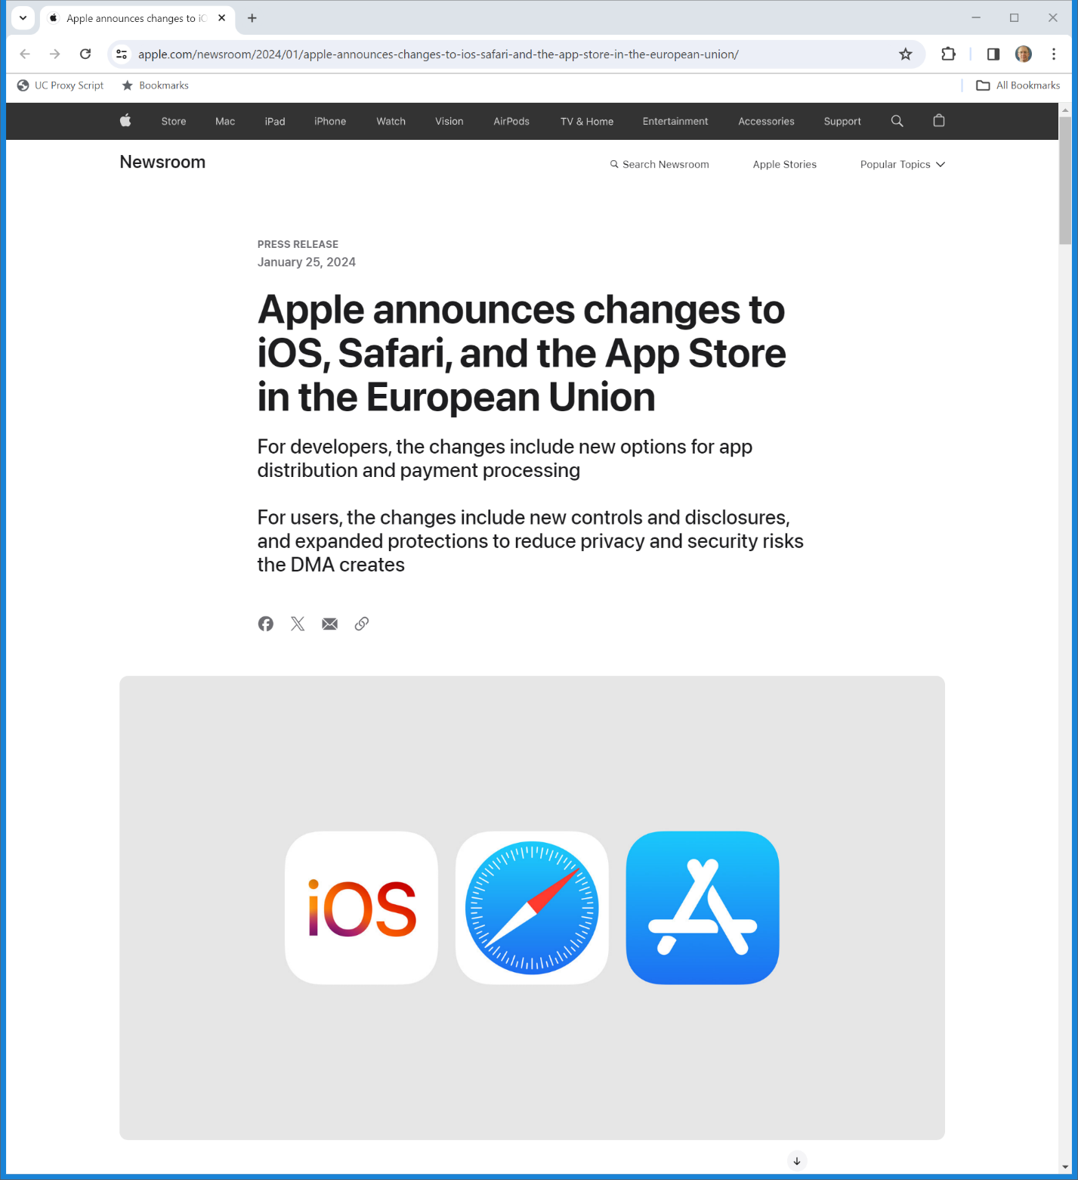
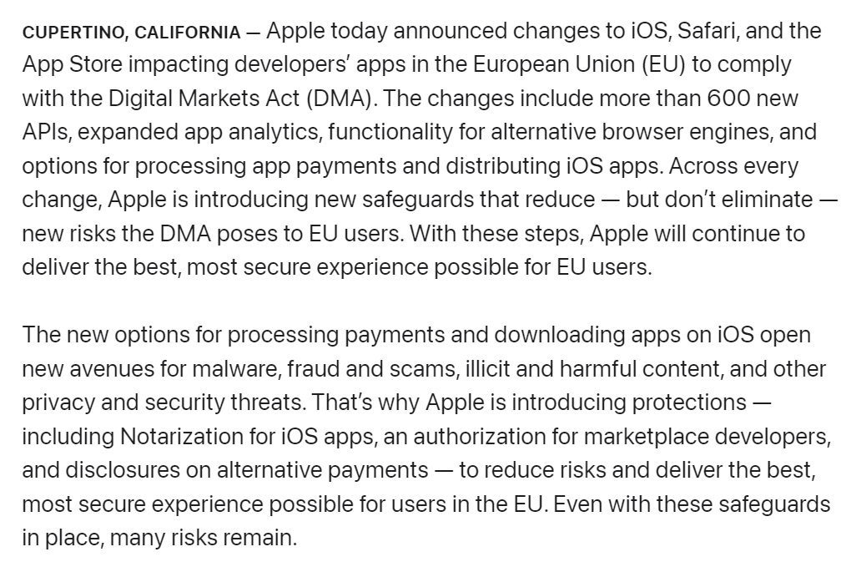
Apple DMA Response
Apple (25 Jan 2024)
Notes:
https://www.apple.com/newsroom/2024/01/apple-announces-changes-to-ios-safari-and-the-app-store-in-the-european-union/

Slide 50
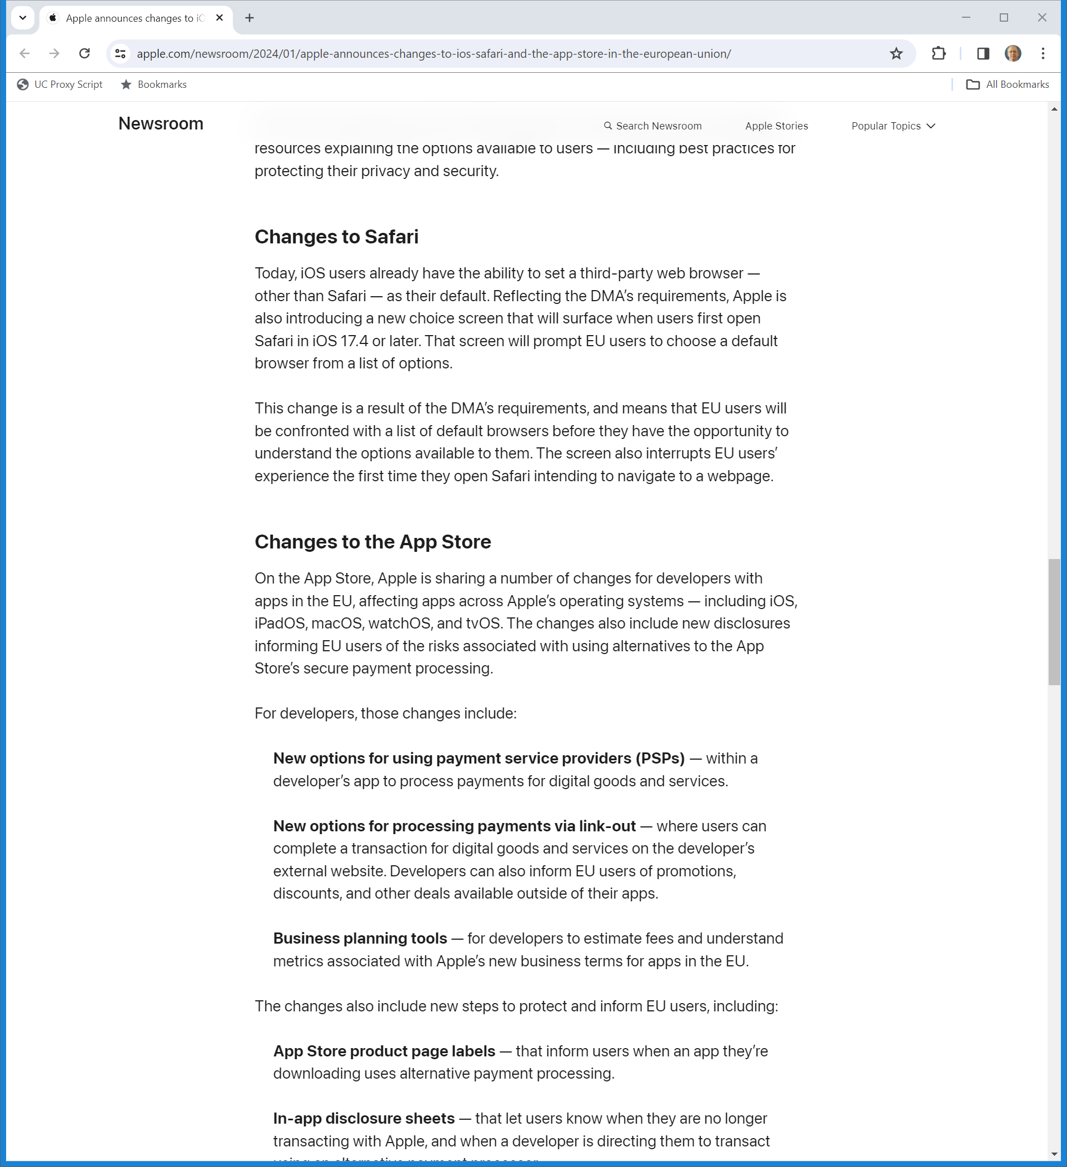
New Browser Choice Screen
Apple (25 Jan 2024)
Notes:
https://www.apple.com/newsroom/2024/01/apple-announces-changes-to-ios-safari-and-the-app-store-in-the-european-union/

Slide 51
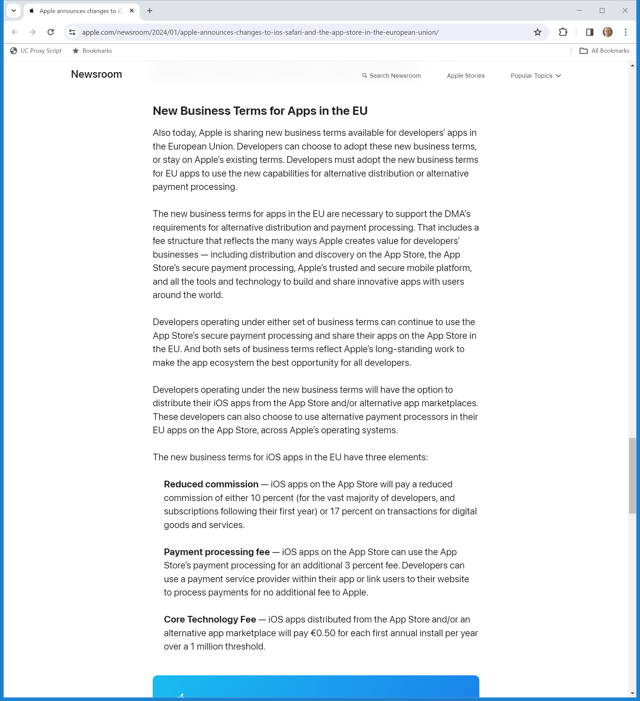
New Fee Structure (If Dev Wants It)
Apple (25 Jan 2024)
Notes:
https://www.apple.com/newsroom/2024/01/apple-announces-changes-to-ios-safari-and-the-app-store-in-the-european-union/

Slide 52
Three Pieces
Apple (25 Jan 2024)
Notes:
https://www.apple.com/newsroom/2024/01/apple-announces-changes-to-ios-safari-and-the-app-store-in-the-european-union/

Slide 53
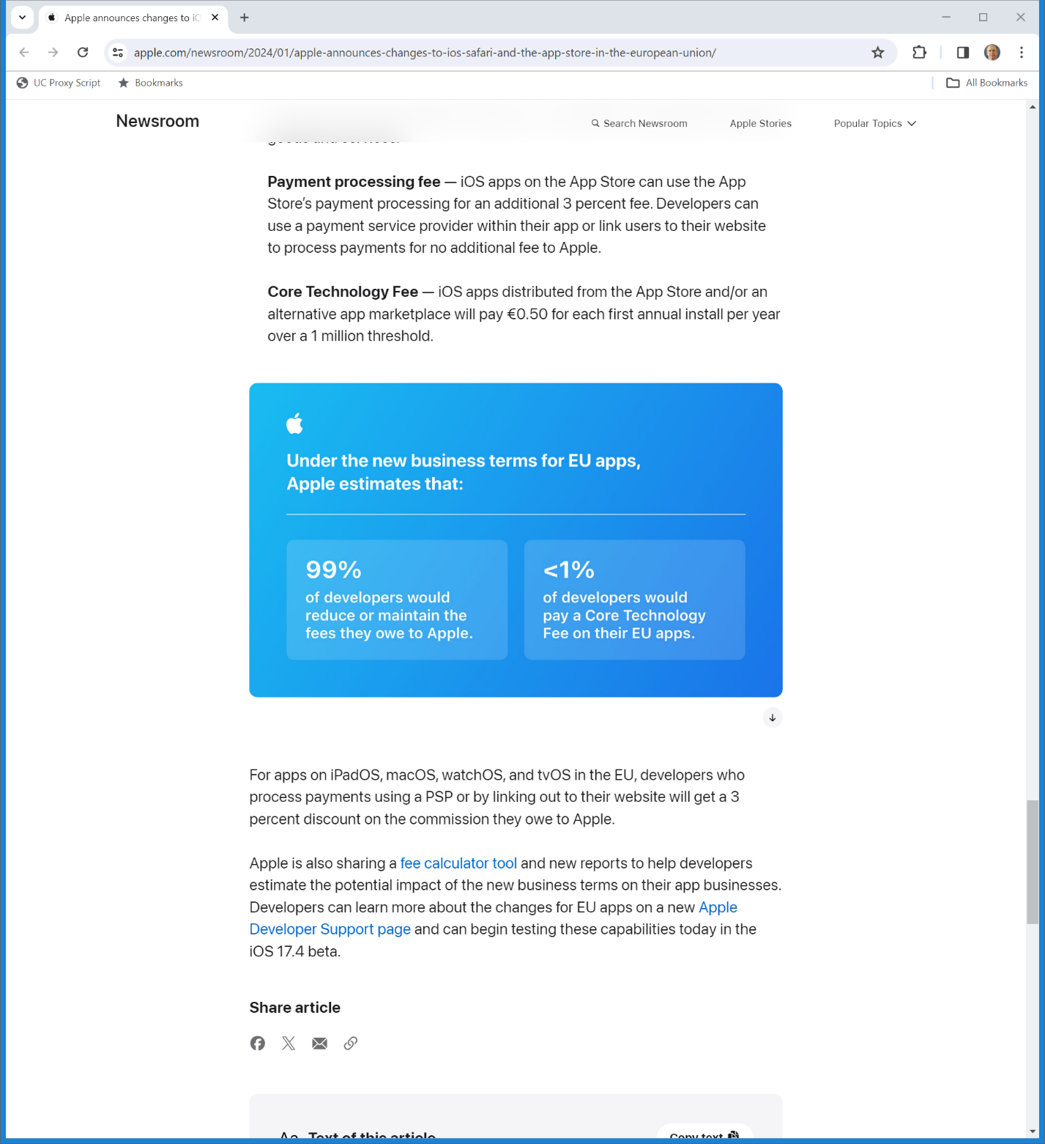

How Will This Matter For Developers?
Apple (25 Jan 2024)
Notes:
https://www.apple.com/newsroom/2024/01/apple-announces-changes-to-ios-safari-and-the-app-store-in-the-european-union/

Slide 54
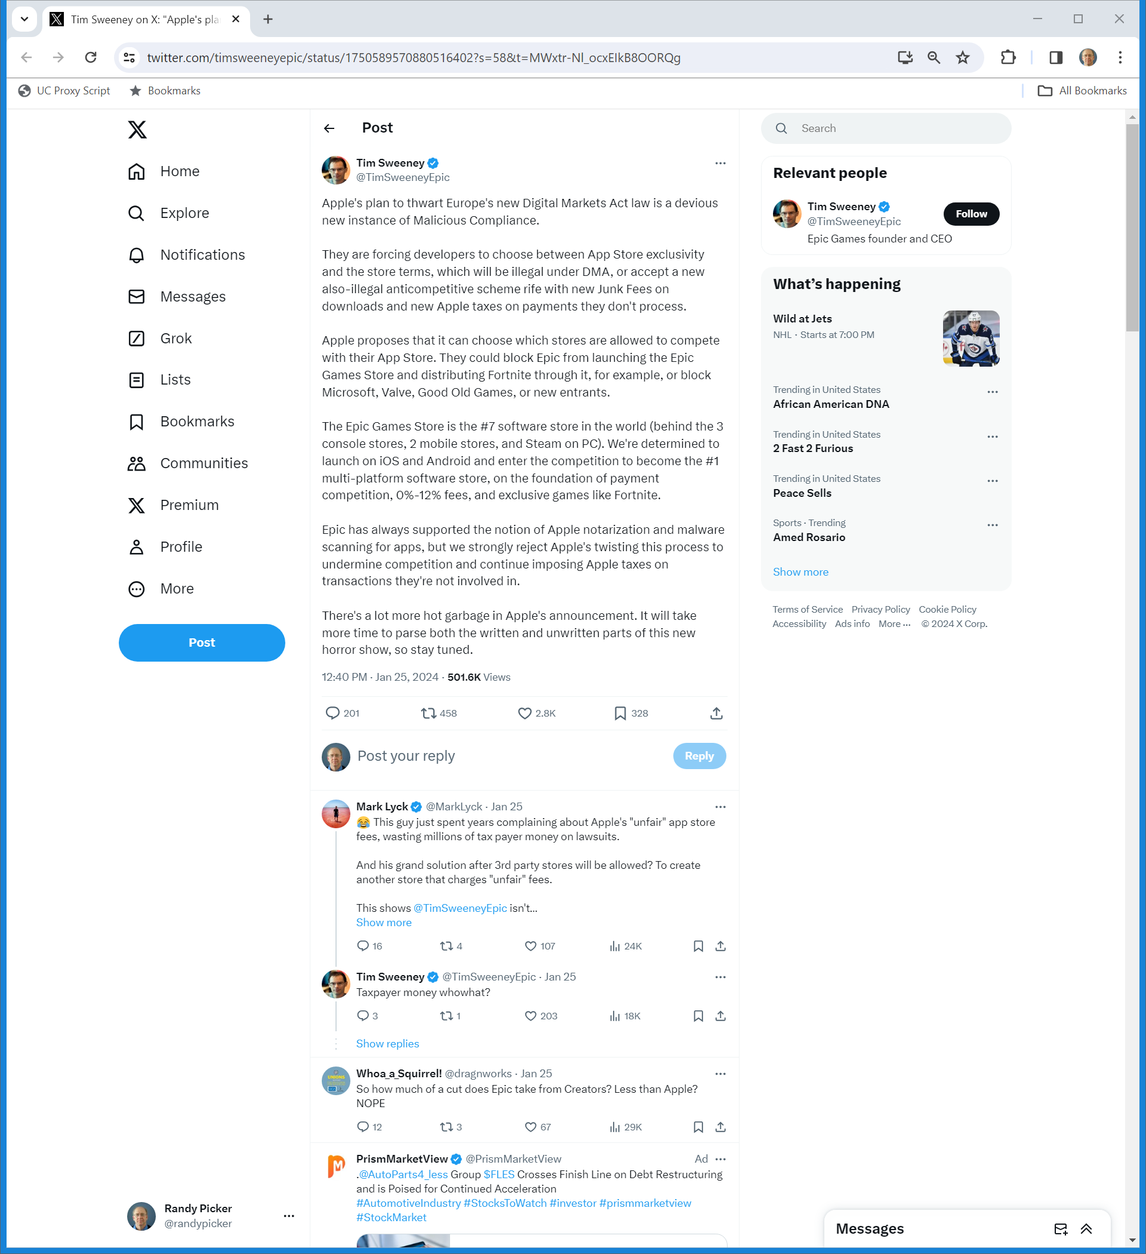
Malicious Compliance/Hot Garbage
Sweeney (25 Jan 2024)
Notes:
https://twitter.com/timsweeneyepic/status/1750589570880516402?s=58&t=MWxtr-Nl_ocxEIkB8OORQg

Slide 55
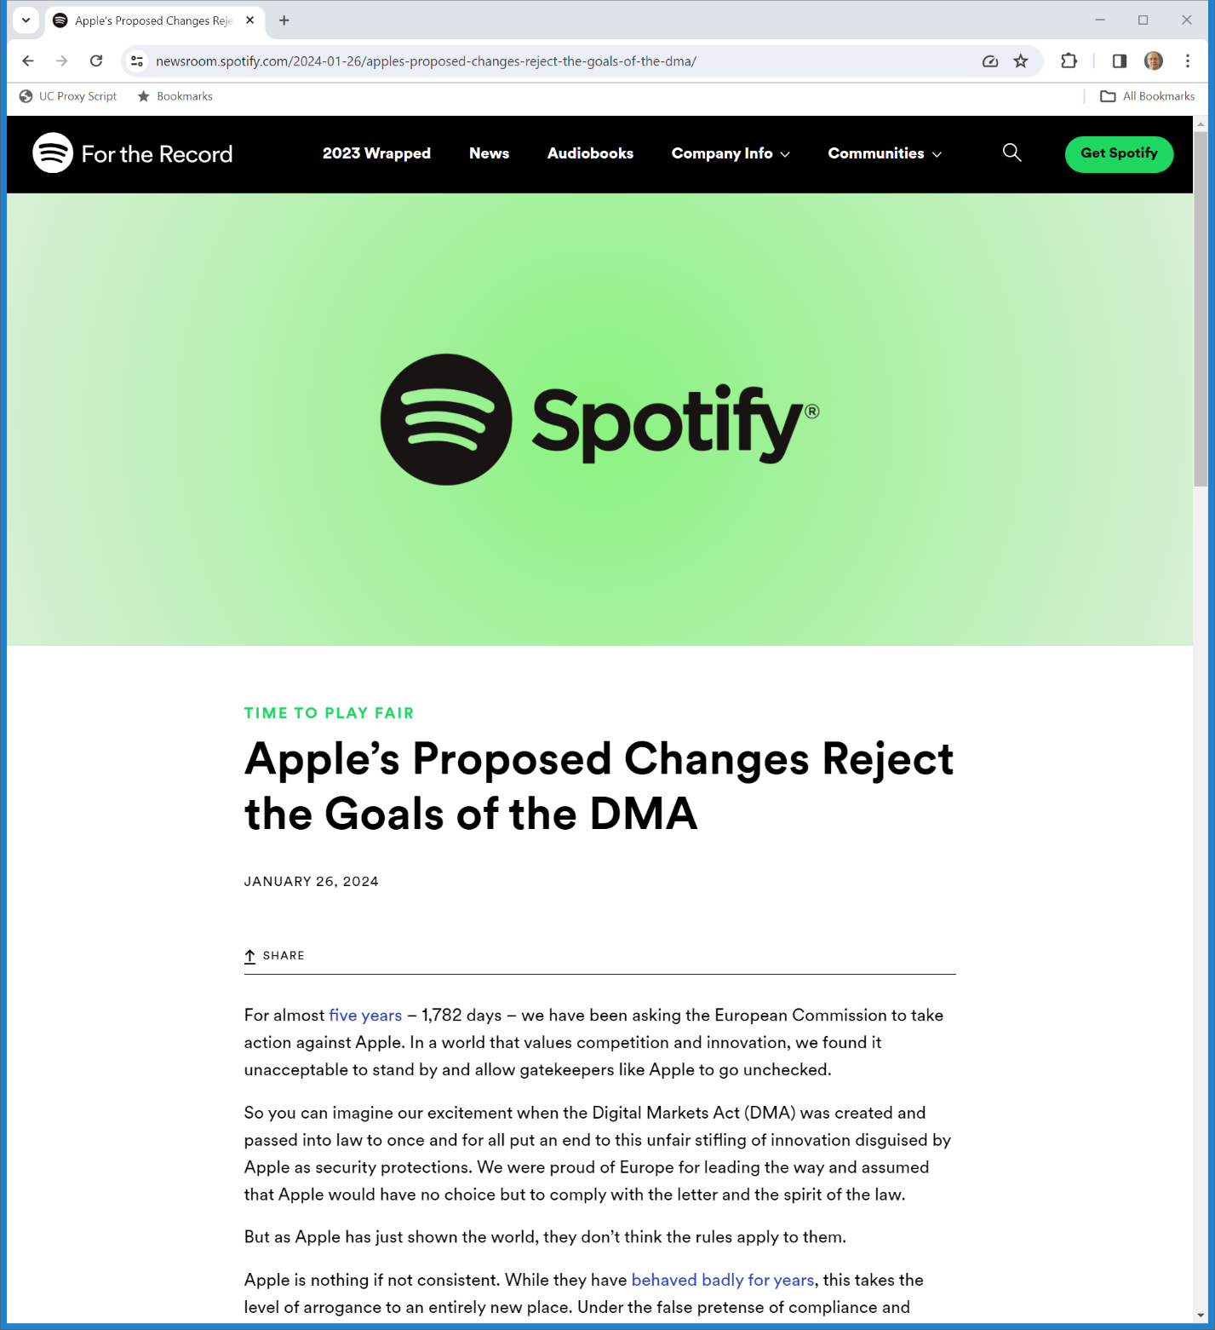
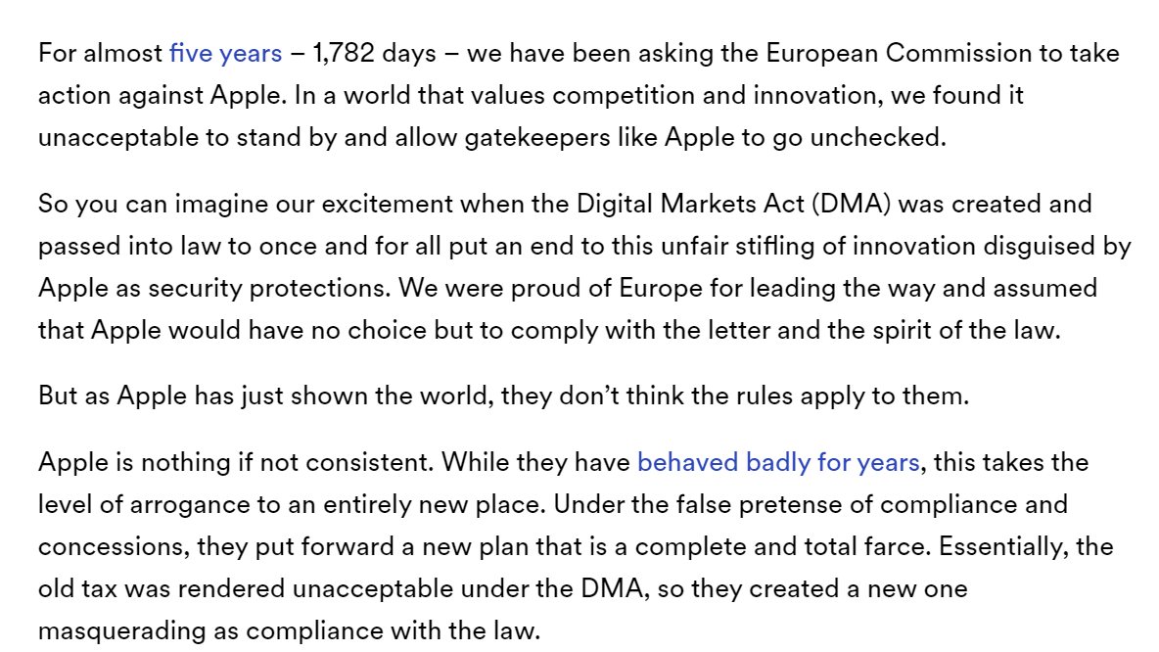
“A Complete and Total Farce”
Spotify (26 Jan 2024)
Notes:
https://newsroom.spotify.com/2024-01-26/apples-proposed-changes-reject-the-goals-of-the-dma/

Slide 56
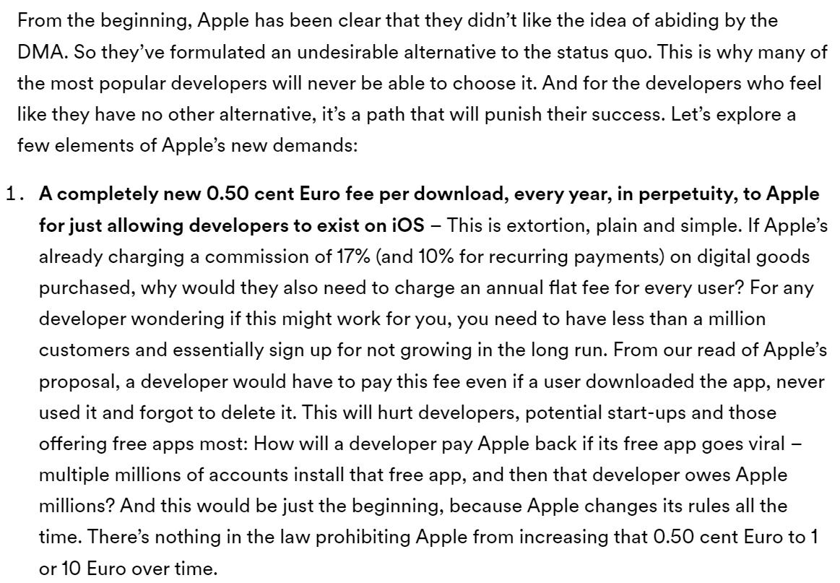
“Extortion, Plain and Simple”
Spotify (26 Jan 2024)
Notes:
https://newsroom.spotify.com/2024-01-26/apples-proposed-changes-reject-the-goals-of-the-dma/

Slide 57
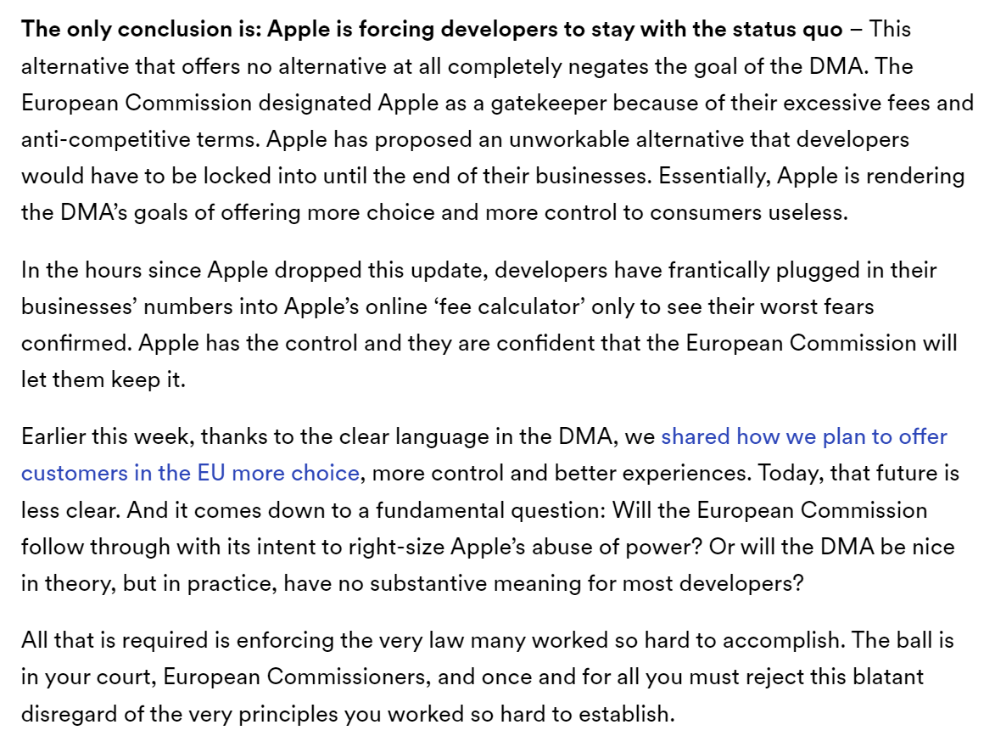
Spotify’s Response
Spotify (26 Jan 2024)
Notes:
https://newsroom.spotify.com/2024-01-26/apples-proposed-changes-reject-the-goals-of-the-dma/

Slide 58
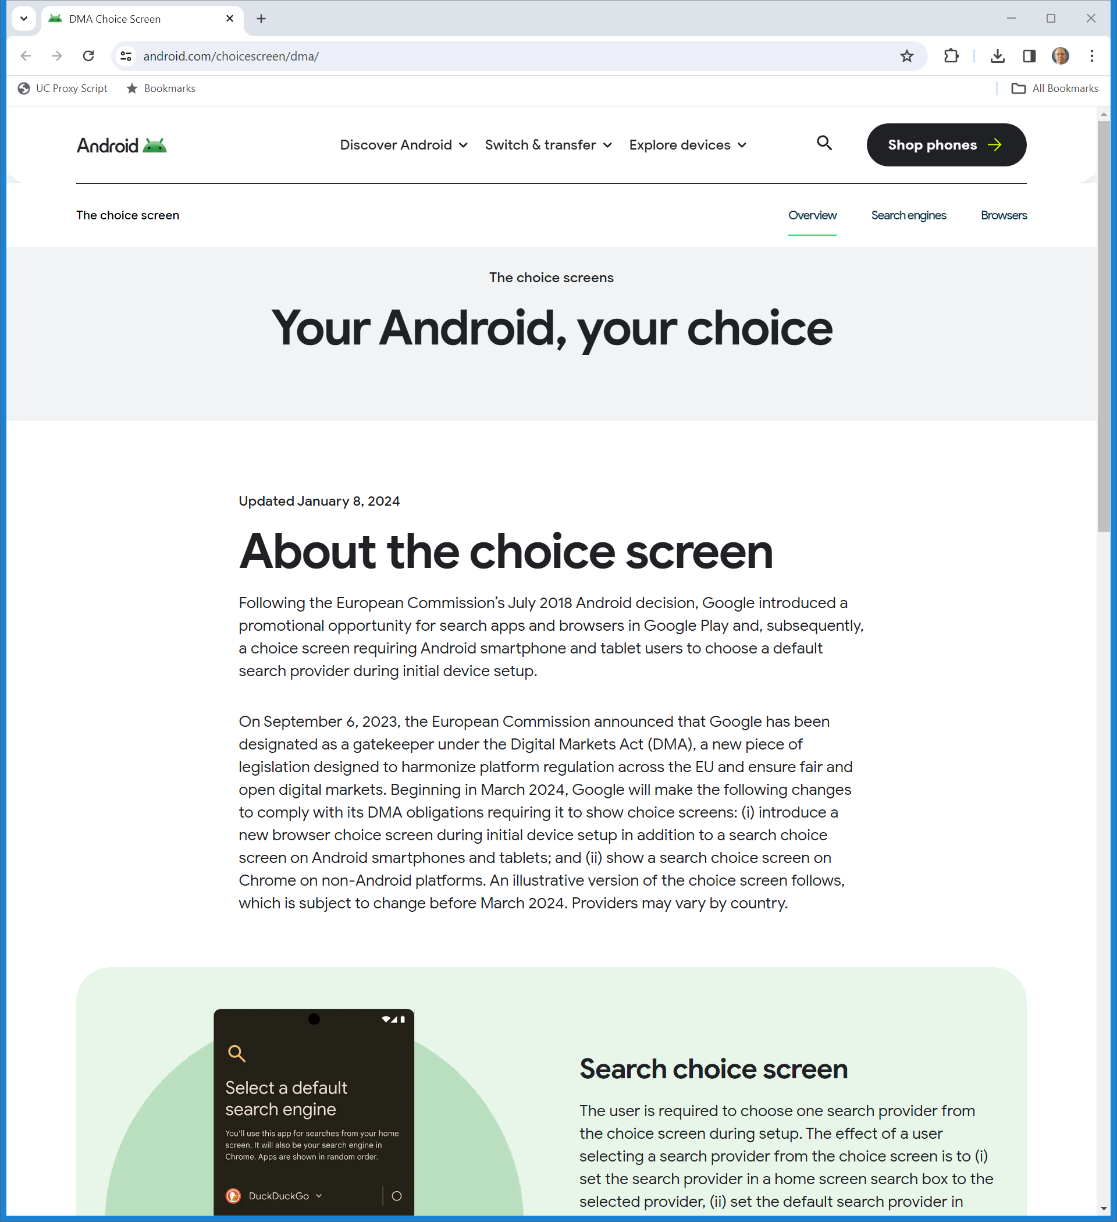
Google DMA Response
Android (8 Jan 2024)
Notes:
https://www.android.com/choicescreen/dma/

Slide 59
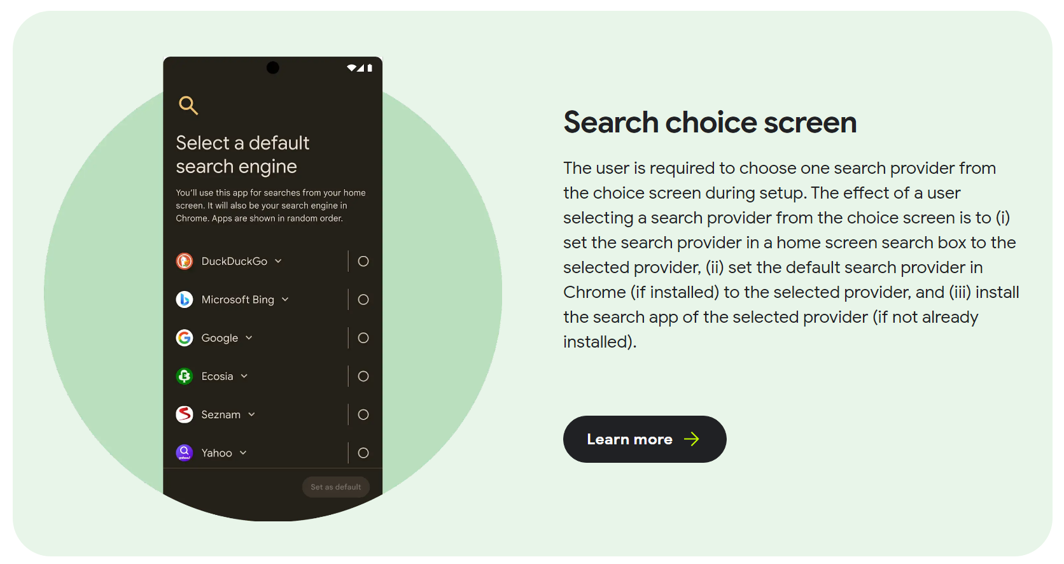
DMA Search Choice Screen
Android (8 Jan 2024)
Notes:
https://www.android.com/choicescreen/dma/

Slide 60
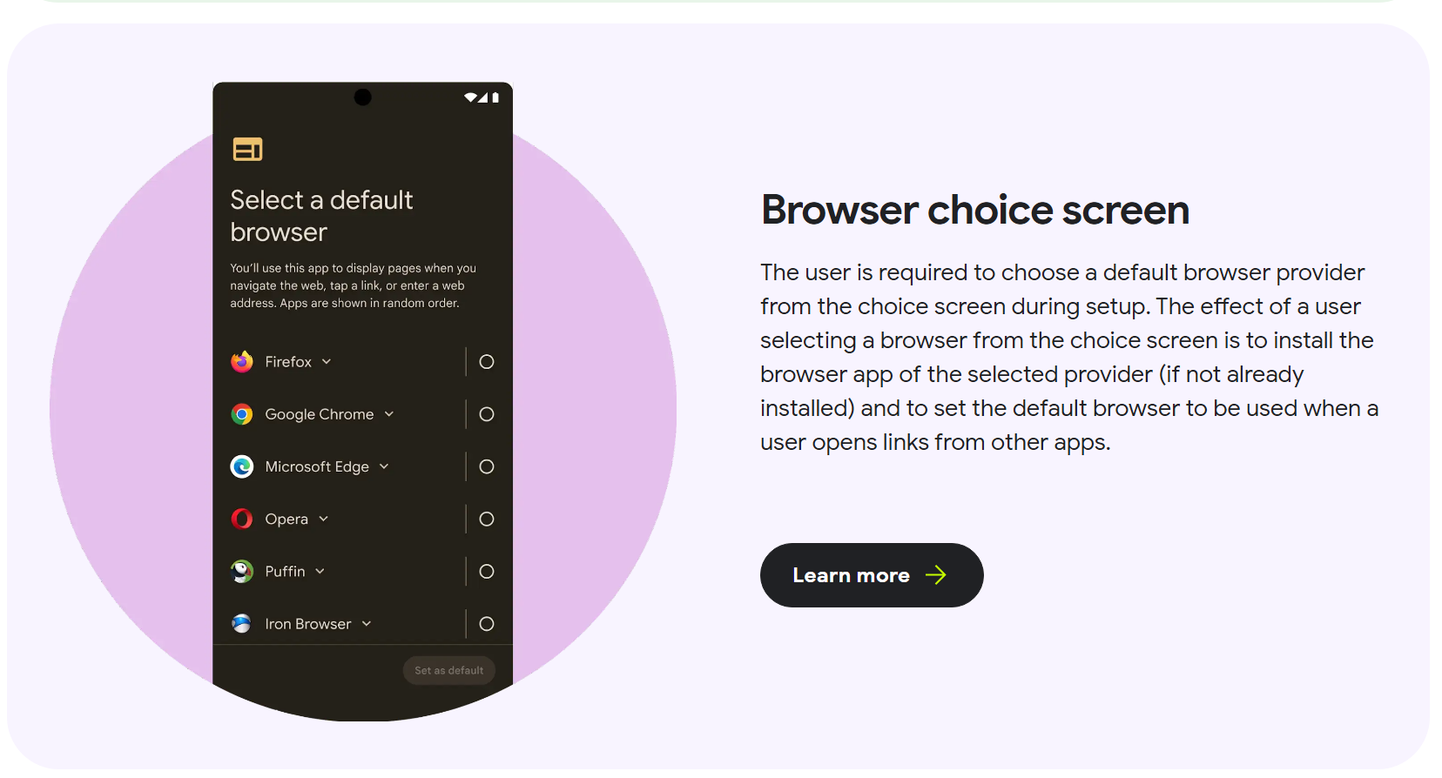
DMA Browser Choice Screen
Android (8 Jan 2024)
Notes:
https://www.android.com/choicescreen/dma/

Slide 61
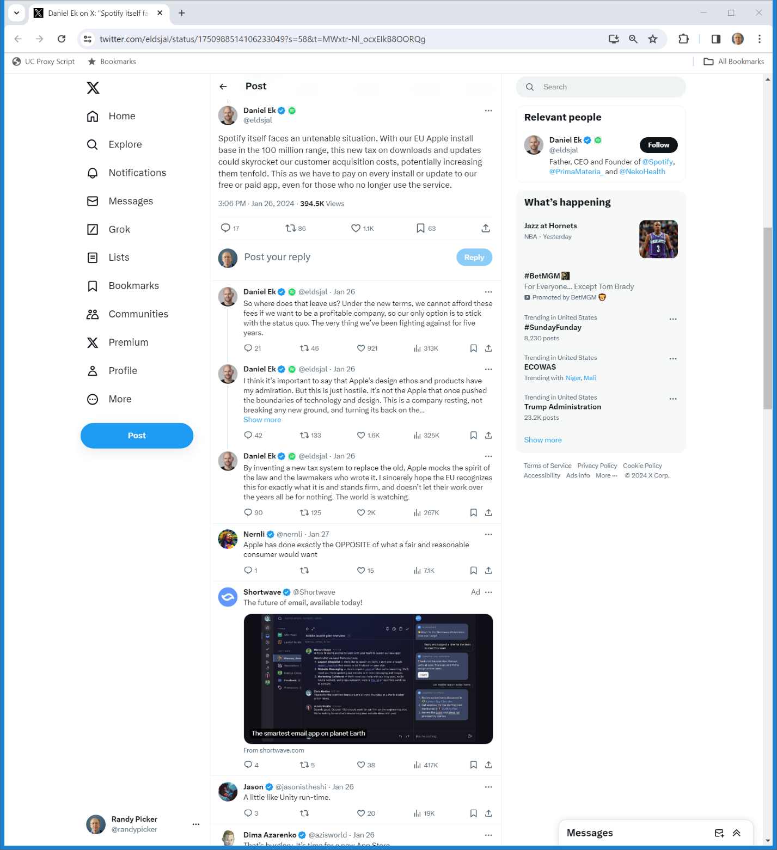
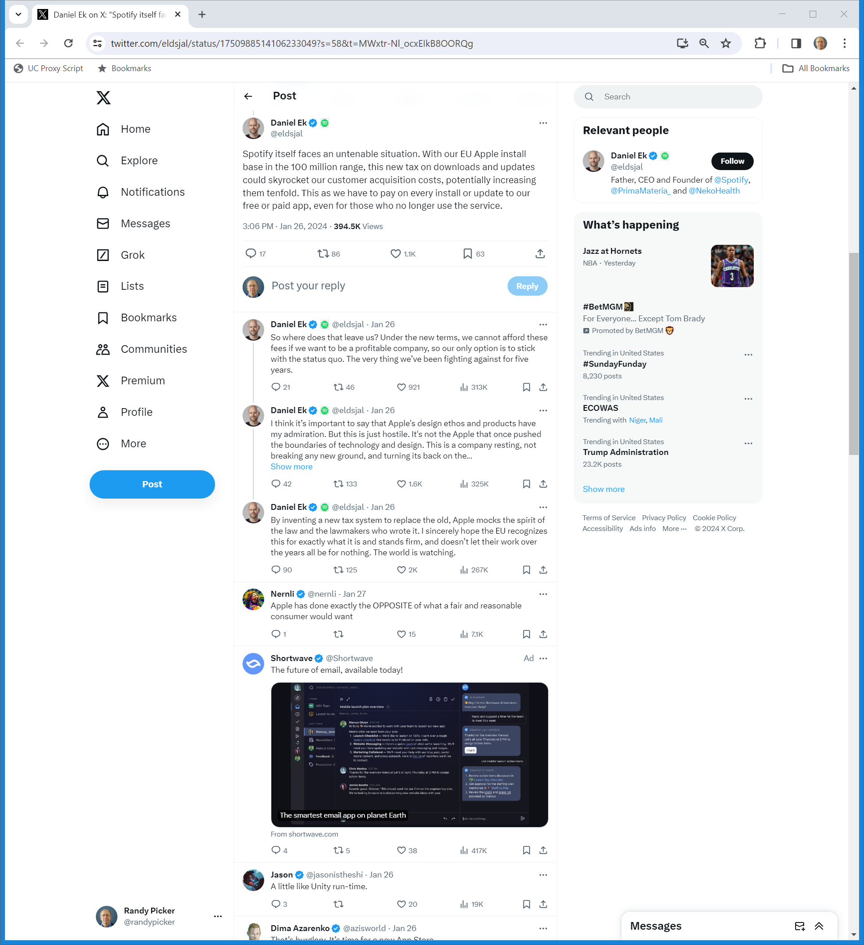
An Untenable Situation?
Spotify CEO (26 Jan 2024)
Notes:
https://twitter.com/eldsjal/status/1750988514106233049?s=58&t=MWxtr-Nl_ocxEIkB8OORQg

Slide 62
Mocking the Spirit of the DMA?
Spotify CEO (26 Jan 2024)
Notes:
https://twitter.com/eldsjal/status/1750988514106233049?s=58&t=MWxtr-Nl_ocxEIkB8OORQg

Slide 63
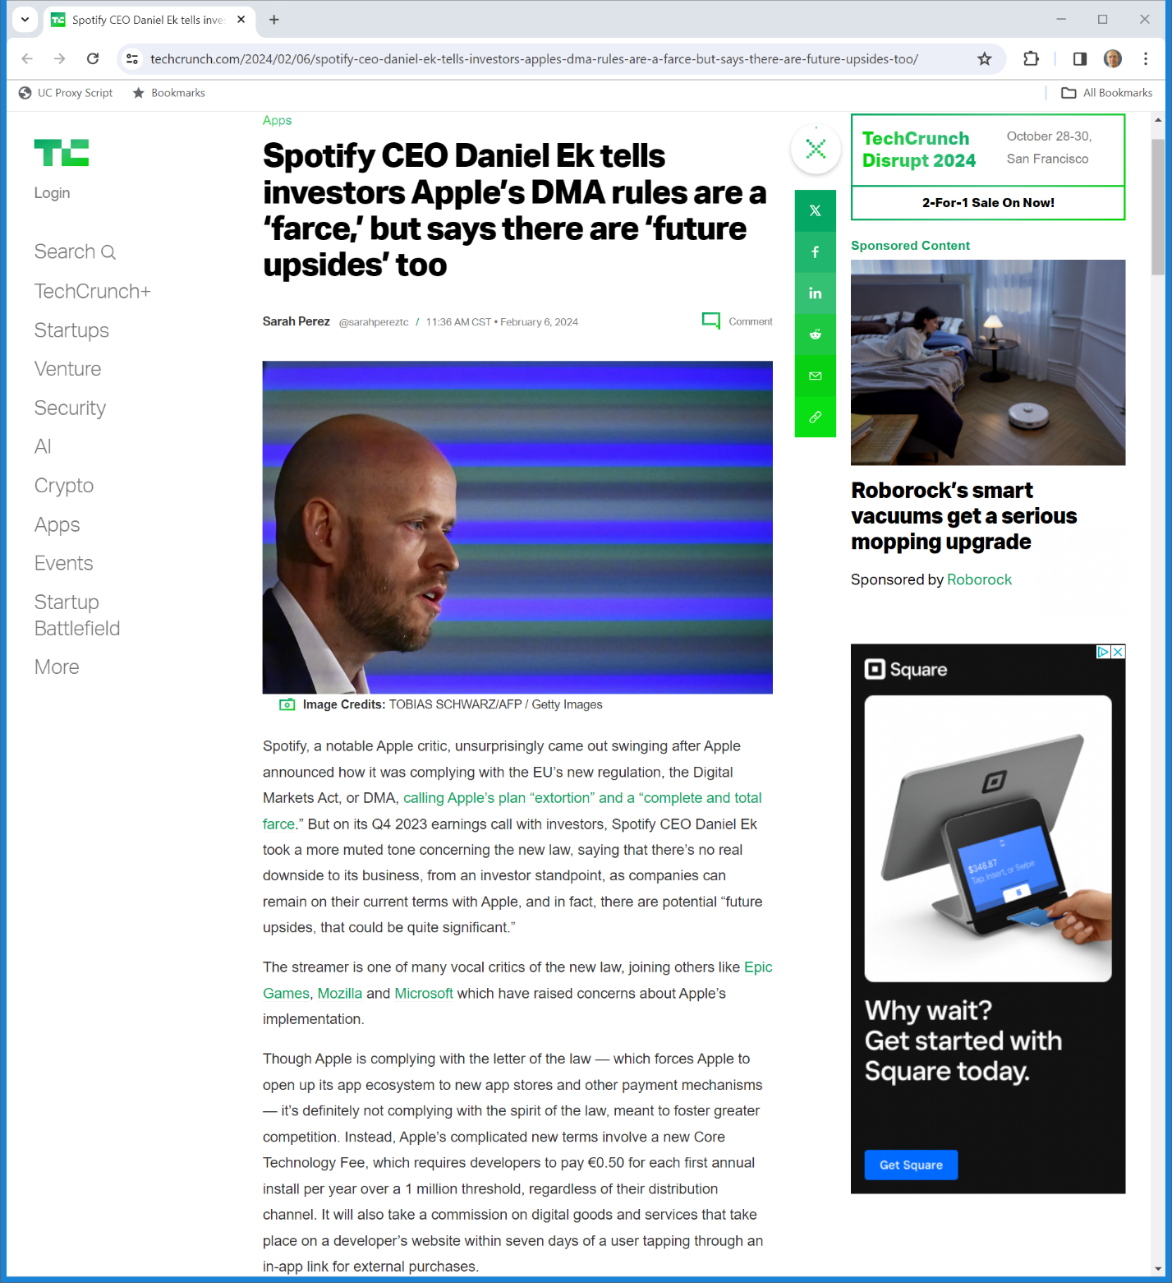

A Different Tune to Investors
TechCrunch (6 Feb 2024)
Notes:
https://techcrunch.com/2024/02/06/spotify-ceo-daniel-ek-tells-investors-apples-dma-rules-are-a-farce-but-says-there-are-future-upsides-too/

Slide 64
Regulating the App Store?
TTYN (1 of 5)
Hypo
  You are a member of Congress considering possible legislation to deal with platforms
  Four possible regulatory tools are on the table: (1) common carrier status; (2) nondiscrimination; (3) rate regulation; and (4) required open competition

Slide 65
Regulating the App Store?
TTYN (2 of 5)
1. Common Carrier
  The app store should be treated like a common carrier, meaning that Apple cannot refuse to carry any applications and must have uniform pricing
    Can’t block apps with malware, can’t block porn, can’t block misinformation and more

Slide 66
Regulating the App Store?
TTYN (3 of 5)
2. Nondiscrimination
  A nondiscrimination obligations as to all apps:
    Apple might be allowed to filter (blocking certain types of apps) but it would need to do this without regard to ownership
    No preinstallation of Apple apps or paid preinstallation from others
    No app ranking

Slide 67
Regulating the App Store?
TTYN (4 of 5)
3. Price Regulation
  Apple currently charges a 30% commission on fee-based apps
  Apple instead should be required to have “just and reasonable” rates and a federal agency should regulate those rates

Slide 68
Regulating the App Store?
TTYN (5 of 5)
4. Competing App Stores
  Apple should be barred from limiting iOS devices from operating with competing app stores as per the DMA
  App store competition would push agency fees to competitive levels and the market could sort the right balance of curation and openness for apps?

