Slide 1
Class 16: Mon 3 Nov 2025 Antitrust Fall 2025 Robinson-Patman Act
Randal C. Picker
James Parker Hall Distinguished Service Professor of Law
The Law School
The University of Chicago
Copyright © 2000-25 Randal C. Picker. All Rights Reserved.

Slide 2
Volvo Trucks
546 U.S. 164 (2006)

Slide 3
Importance of Interbrand Competition
“Interbrand competition, our opinions affirm, is the ‘primary concern of antitrust law.’ Continental T.V., Inc. v. GTE Sylvania Inc., 433 U.S. 36, 51-52 (1977). The Robinson-Patman Act signals no large departure from that main concern.”
Volvo Trucks (US 2006)

Slide 4
Importance of Interbrand Competition
“Even if the Act’s text could be construed in the manner urged by Reeder and embraced by the Court of Appeals, we would resist interpretation geared more to the protection of existing competitors than to the stimulation of competition.”
Volvo Trucks (US 2006)

Slide 5
Declining to Extend Robinson-Patman
“By declining to extend Robinson–Patman’s governance to such cases, we continue to construe the Act ‘consistently with broader policies of the antitrust laws.’ Brooke Group, 509 U.S., at 220 (quoting Great Atlantic & Pacific Tea Co. v. FTC, 440 U.S. 69, 80, n. 13 (1979)) …”
Volvo Trucks (US 2006)

Slide 6
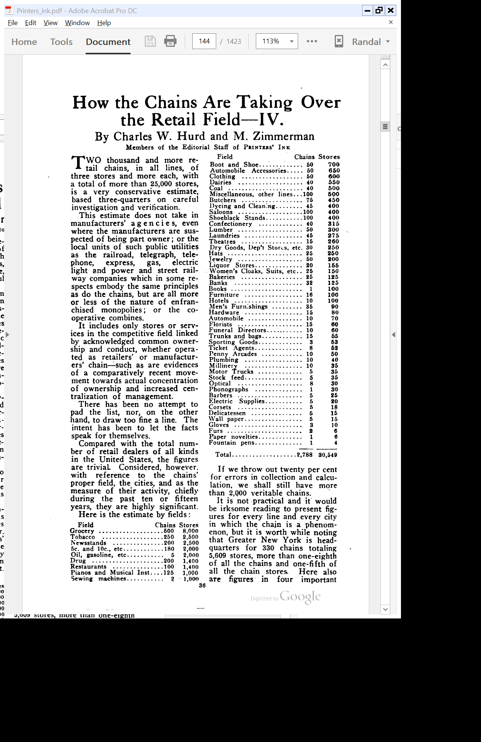
Leading Chains in 1914
Printers’ Ink (8 Oct 1914)

Slide 7
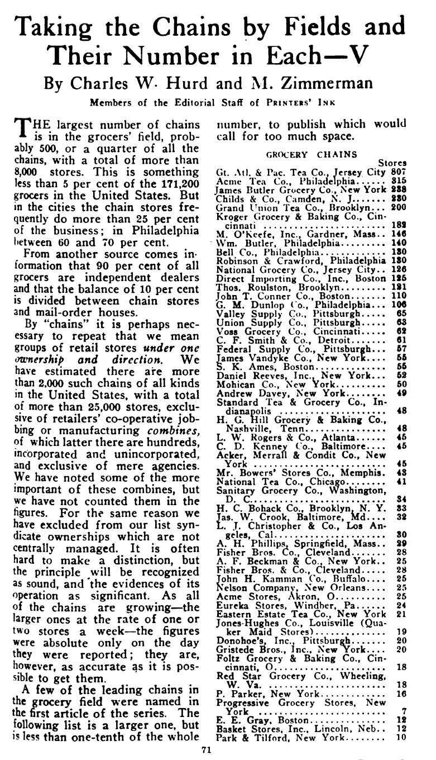
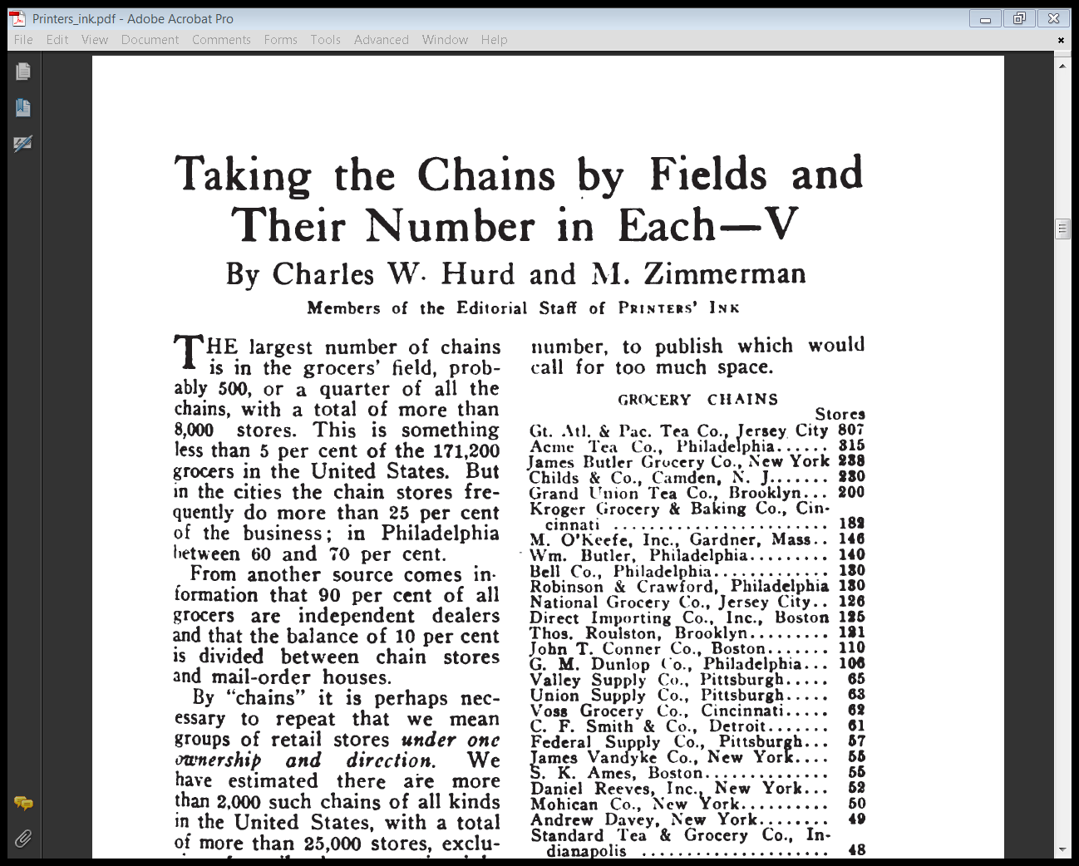
Leading Grocery Chains in 1914
Printers’ Ink (15 Oct 1914)

Slide 8
Price Discrim in Clayton Act
Clayton Act (15 Oct 1914)

Slide 9
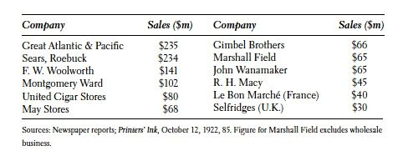
World’s Largest Retailers (1920s)
The Great A&P

Slide 10
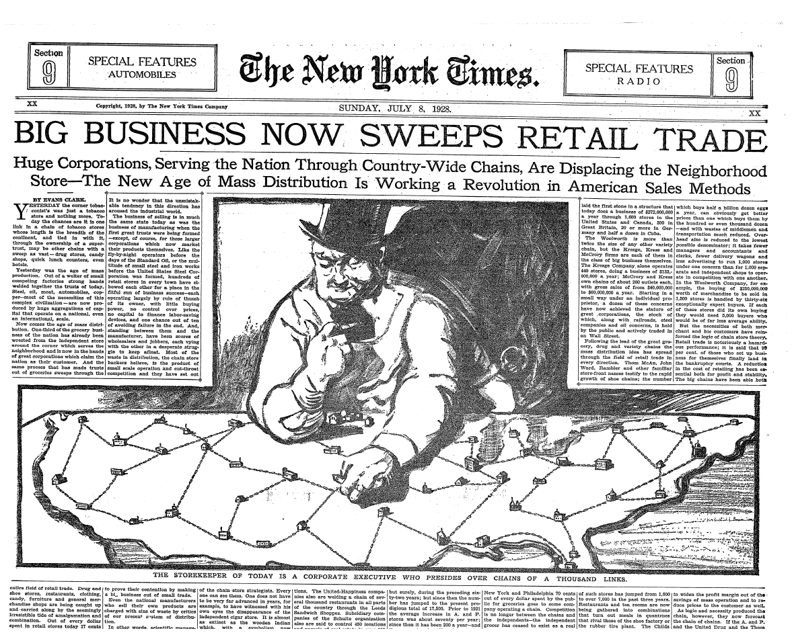
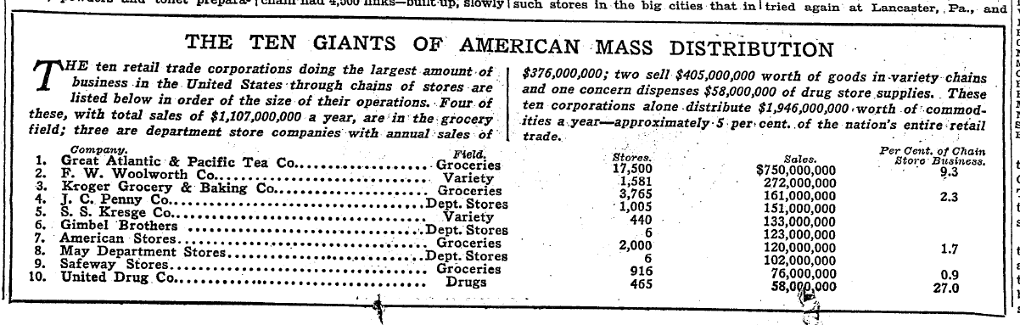
The Rise of Chain Stores
NYT (8 July 1928)

Slide 11
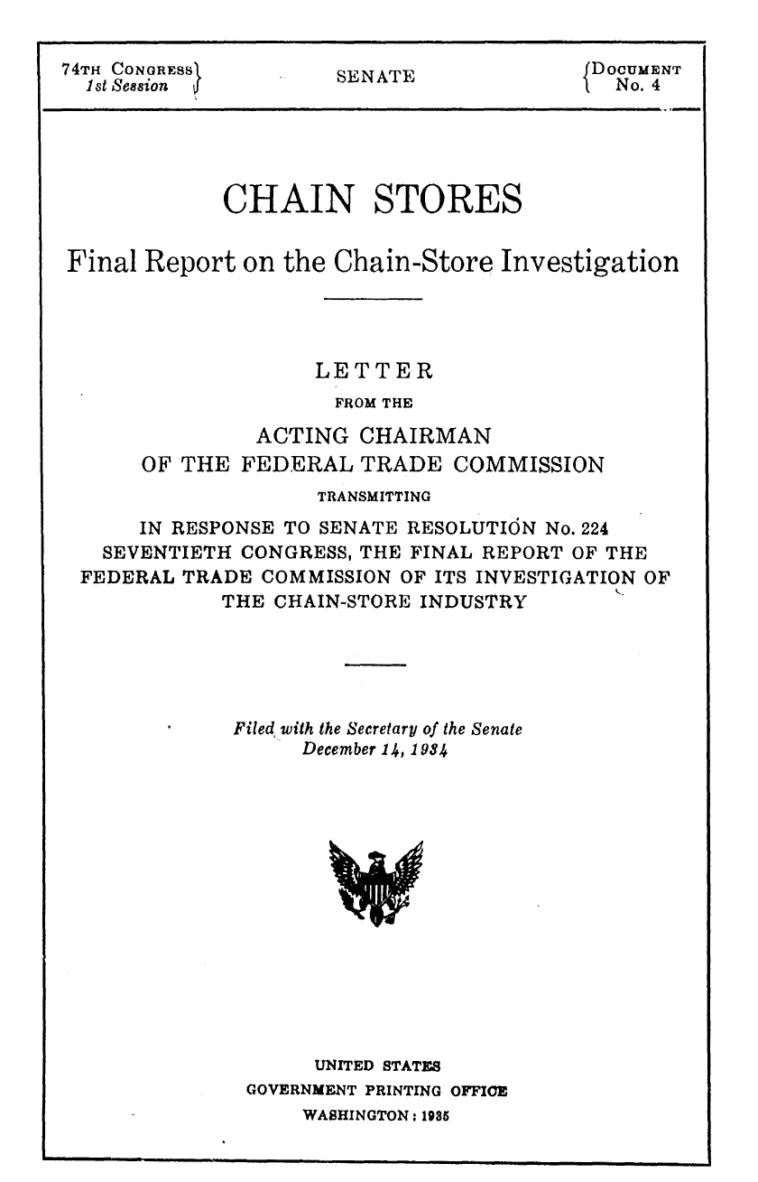
FTC Report on Chain Stores
FTC Chain Store Report (14 Dec 1934)

Slide 12
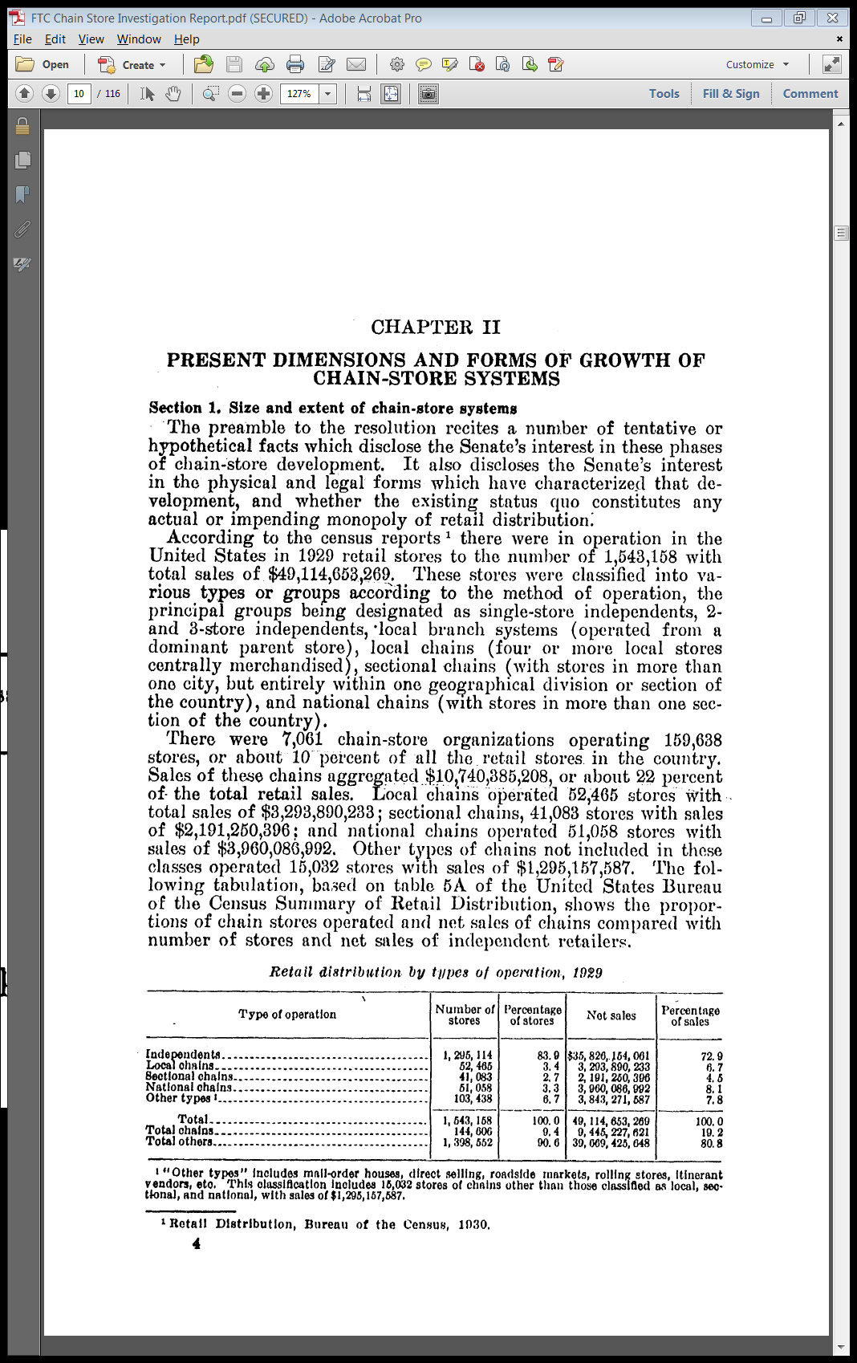
The State of Retail in 1929
FTC Chain Store Report (14 Dec 1934)

Slide 13
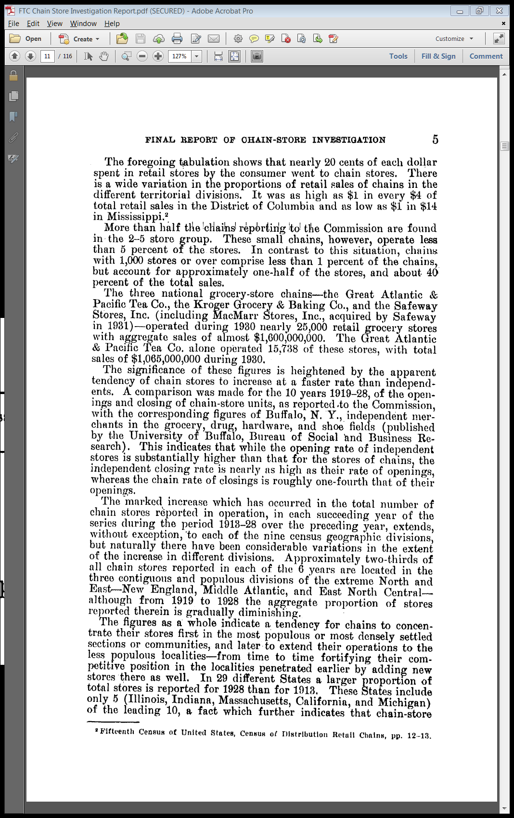
Growth of Grocery Chain Stores
FTC Chain Store Report (14 Dec 1934)

Slide 14
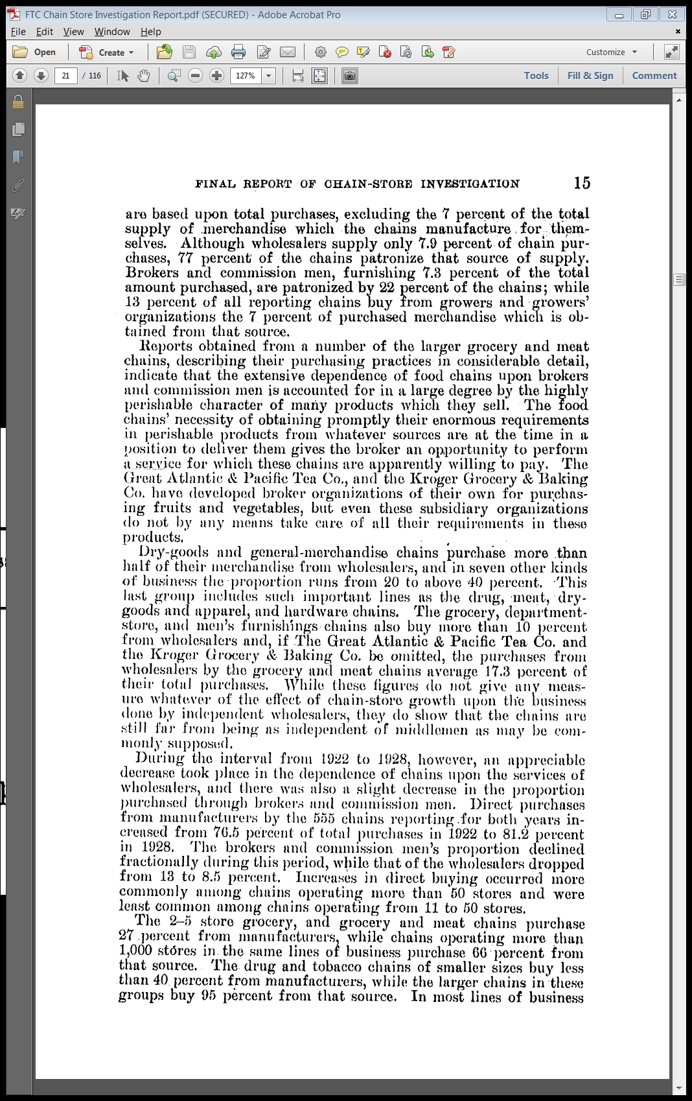
Change in Vertical Distribution for Chains
FTC Chain Store Report (14 Dec 1934)

Slide 15
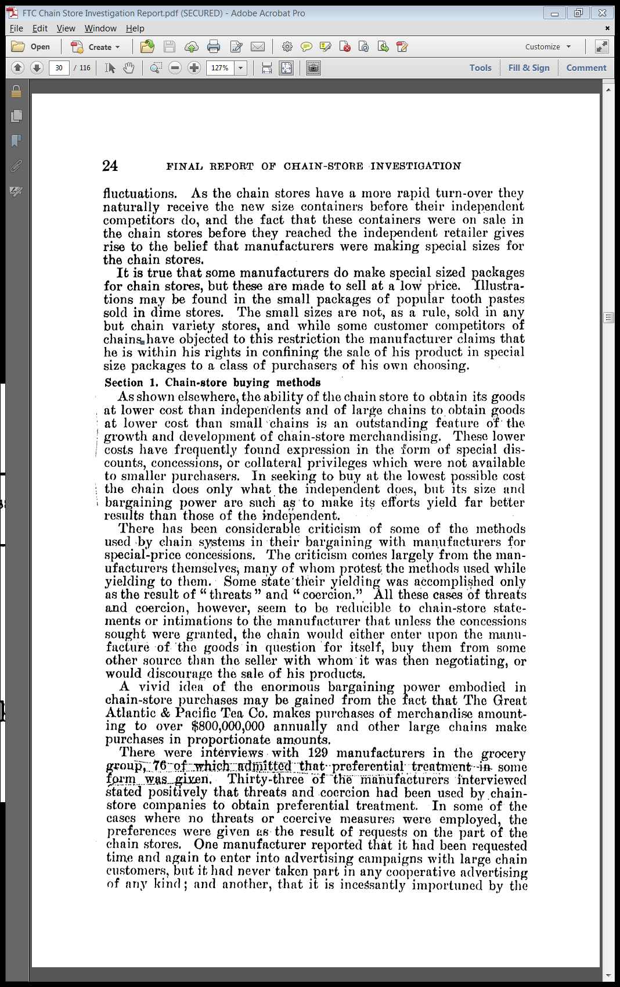
Chain Store Bargaining Over Prices
FTC Chain Store Report (14 Dec 1934)

Slide 16
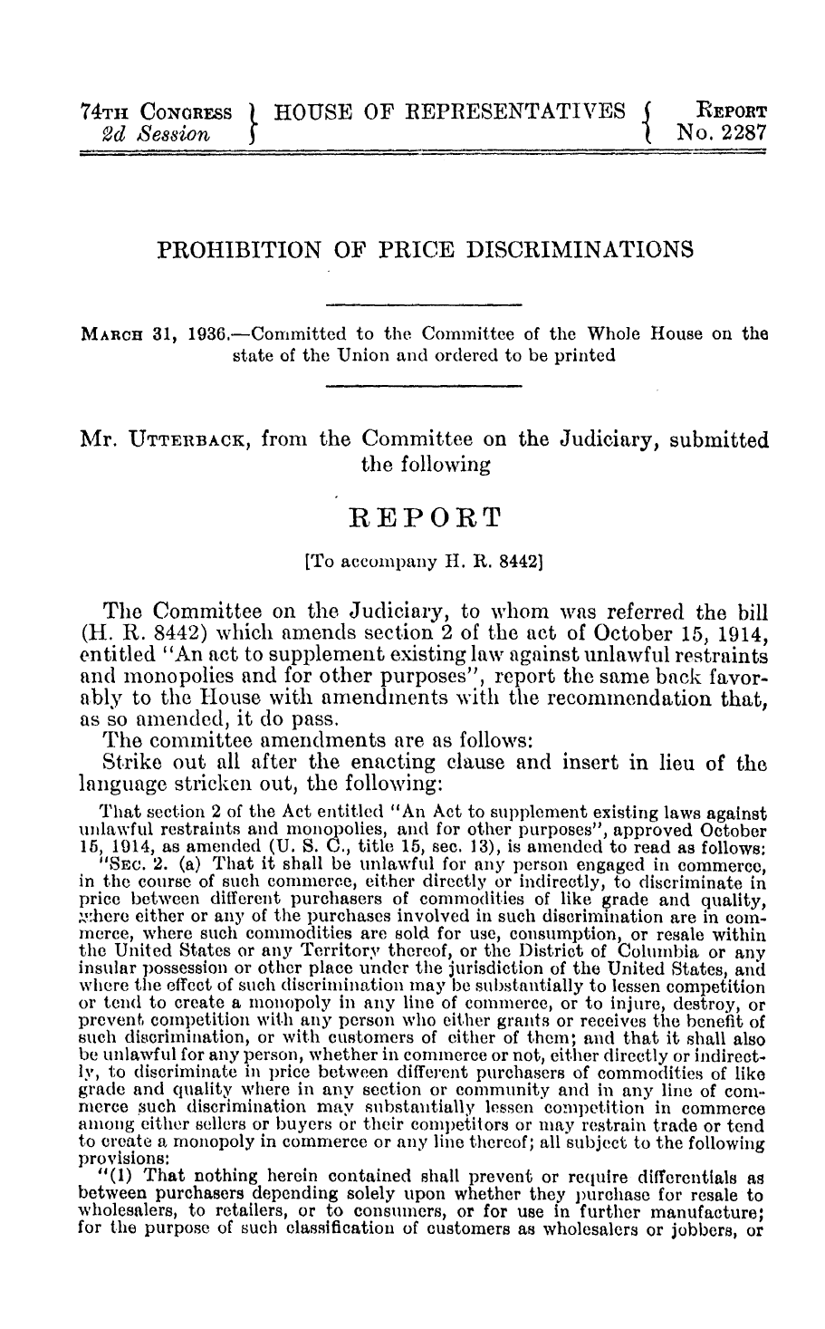
Robinson-Patman Legislative History
House Report (31 Mar 1936)

Slide 17
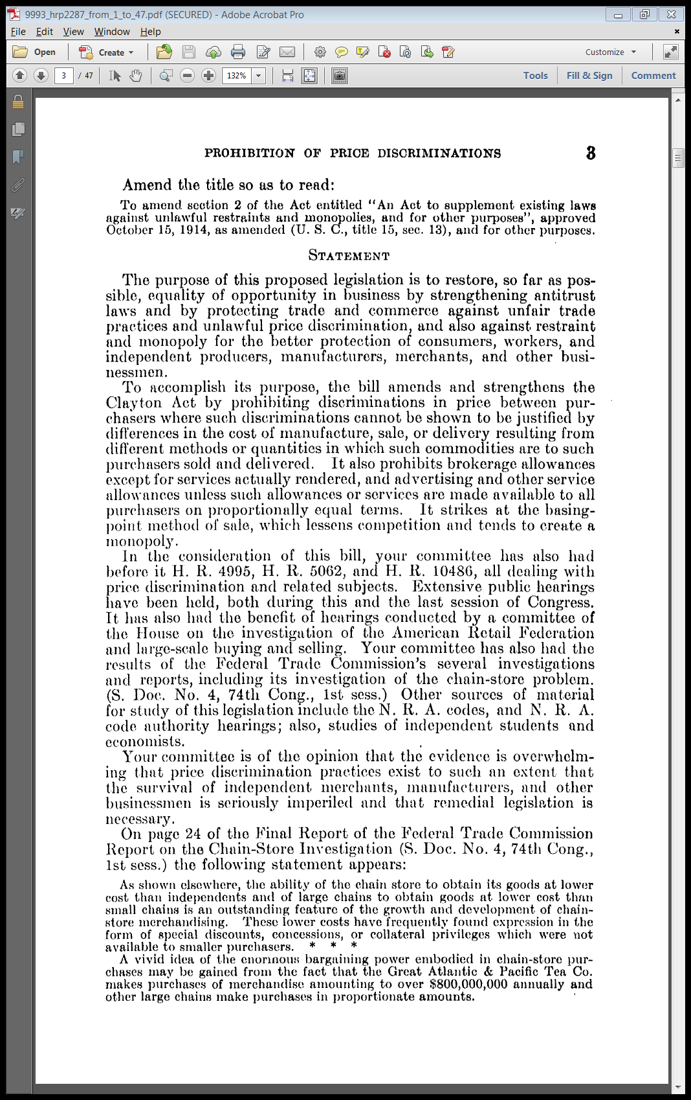
“Equality of Opportunity”
House Report (31 Mar 1936)

Slide 18
Strengthen Clayton Act Rules
House Report (31 Mar 1936)

Slide 19
CA2(a): Unlawful Price Discrimination
“(a) It shall be unlawful for any person engaged in commerce, in the course of such commerce, either directly or indirectly, to discriminate in price between different purchasers of commodities of like grade and quality, where either or any of the purchases involved in such discrimination are in commerce, where such commodities are sold for use, consumption, or resale …”
15 USC 13

Slide 20
Effects of Discrimination: Normal Incipiency Or Injury to Competition
“and where the effect of such discrimination may be substantially to lessen competition or tend to create a monopoly in any line of commerce, or to injure, destroy, or prevent competition with any person who either grants or knowingly receives the benefit of such discrimination, or with customers of either of them … ”
15 USC 13

Slide 21
Four Provisos: Different Costs
“Provided, That nothing herein contained shall prevent differentials which make only due allowance for differences in the cost of manufacture, sale, or delivery resulting from the differing methods or quantities in which such commodities are to such purchasers sold or delivered … .”
15 USC 13

Slide 22
CA2(b): Rebuttal of Price-Facie Case
“(b) Upon proof being made, at any hearing on a complaint under this section, that there has been discrimination in price or services or facilities furnished, the burden of rebutting the prima-facie case thus made by showing justification shall be upon the person charged with a violation of this section, and unless justification shall be affirmatively shown, the Commission is authorized to issue an order terminating the discrimination:.”
15 USC 13

Slide 23
Matching Competitive Prices
“Provided, however, That nothing herein contained shall prevent a seller rebutting the prima-facie case thus made by showing that his lower price or the furnishing of services or facilities to any purchaser or purchasers was made in good faith to meet an equally low price of a competitor, or the services or facilities furnished by a competitor.”
15 USC 13

Slide 24
CA2(d): Contracting for Sales Services
“(d) It shall be unlawful for any person engaged in commerce to pay or contact for the payment of anything of value to or for the benefit of a customer of such person in the course of such commerce as compensation or in consideration for any services or facilities furnished by or through such customer in connection with the processing, handling, sale, or offering for sale of any products or commodities manufactured, sold, or offered for sale by such person, unless such payment or consideration is available on proportionally equal terms to all other customers competing in the distribution of such products or commodities.”
15 USC 13

Slide 25
CA2(e): Proportionate Treatment of Purchasers
“(e) It shall be unlawful for any person to discriminate in favor of one purchaser against another purchaser or purchasers of a commodity bought for resale, with or without processing, by contracting to furnish or furnishing, or by contributing to the furnishing of, any services or facilities connected with the processing, handling, sale, or offering for sale of such commodity so purchased upon terms not accorded to all purchasers on proportionally equal terms.”
15 USC 13

Slide 26
CA2(f): Inducing or Receiving Discrim
“(f) It shall be unlawful for any person engaged in commerce, in the course of such commerce, knowingly to induce or receive a discrimination in price which is prohibited by this section.”
15 USC 13

Slide 27
Primary-Line Discrimination
Firm Discriminating Competes with Victim
The alleged price discrimination is done by a firm competing with the harmed firm.
Utah Pie (US 1967)
The allegation there was that national pie firms set lower prices in the local Utah market than they did elsewhere in an attempt to hurt the local firm.

Slide 28
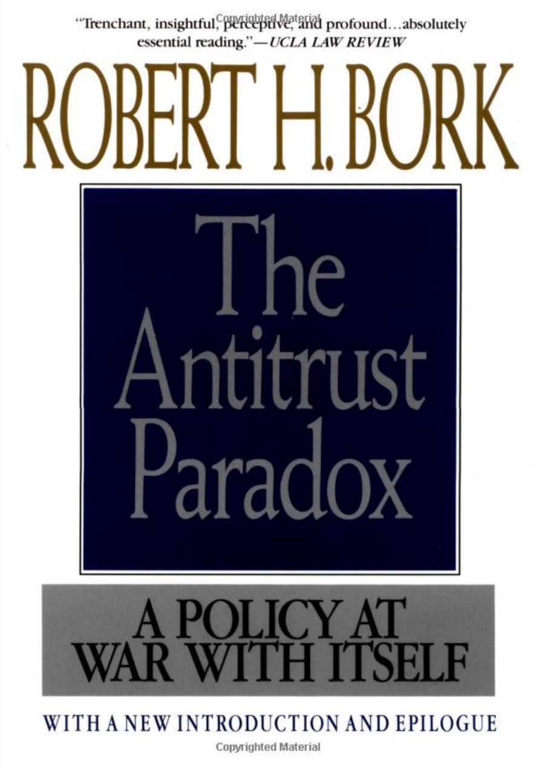
Bork on Robinson-Patman and Utah Pie
“There could be no clearer demonstration than the Utah Pie decision that the statute is essentially anticompetitive and anticonsumer.”
Bork, The Antitrust Paradox p387 (1978, 1993)

Slide 29
Utah Pie
386 U.S. 685 (1967)

Slide 30
Evolution of Pie Market in Utah (TTYN (1 of 5))
Utah Pie (US 1967)

Slide 31
Evolution of Pie Market in Utah (TTYN (2 of 5))
Utah Pie (US 1967)

Slide 32
Analyzing the Pie Market
TTYN (3 of 5)
Questions
How do you assess competition in the pie market in Utah?
Do you need to know something about the price of pies in Chicago to assess that?

Slide 33
Analyzing the Pie Market
TTYN (4 of 5)
Hypo
LocalFirm
NatFirm
Salt Lake
Chicago

Slide 34
Analyzing the Pie Market
TTYN (5 of 5)
Chicago Prices
Absent RP, National Firm will set monopoly price in Chicago. What with RP?
Utah Prices
How does the presence of the Robinson-Patman Act implicate how national firms will price their pies in Utah?

Slide 35
Primary-Line Discrimination
Absent RP
Oligopoly in Salt Lake City, and uncertain pricing but probably lower prices in SLC than Chicago
With RP
National Firm will face price discrimination charge if it charges less than the Chicago price in Salt Lake City.

Slide 36
Primary-Line Discrimination
Two possibilities
Good News Possibility: Drop Chicago price to compete in Salt Lake City
Bad News Possibility: Chicago monopoly price supports oligopoly pricing in Salt Lake City

Slide 37
Lessening of Competition
Utah Pie (US 1967)

Slide 38
Secondary-Line Discrimination
Firm Discriminating Alters Competition Among Its Customers
The secondary-line case occurs where the alleged price discrimination alters competition among customers of the firm.

Slide 39
Morton Salt
334 U.S. 37 (1948)

Slide 40
Salt Prices
Morton Salt (US 1948)

Slide 41
Chain Stores v. Independent Stores
Morton Salt (US 1948)

Slide 42
Form v. Substance on Prices
Morton Salt (US 1948)

Slide 43
Reasonable Possibility of Harm to Competition
Morton Salt (US 1948)

Slide 44
NY Great A&P Tea Co.
173 F.2d 79 (7th Cir. 1949)

Slide 45
Competing in Local Markets
TTYN (1 of 5)
Hypo
A&P has a monopoly in market X. It faces a competitor in market Y.
It would like to get rid of the competitor in Y.
What prices should it set in market X? In Y? What are the connections, if any, between those two decisions?

Slide 46
Setting Up A&P
TTYN (2 of 5)
Two People, One Pie: How should it be divided?
$1000

Slide 47
Setting Up A&P
TTYN (3 of 5)
Production Technology for Good
TC(Q) = F + cQ
Let F = 1000 (fixed costs for manufacturing plant)
c =2 (marginal cost of production for each unit of the good)
Assume
Q_{A&P} = 800, Q_{M&P} = 200

Slide 48
Setting Up A&P
TTYN (4 of 5)
What happens?
Will A&P produce on its own? Will M&P?
Will they share a producer? How will the costs of F get split if they do so? Is that likely to be influenced by their costs of self-production (vertical integration)?
Does it matter if the numbers are uncertain?

Slide 49
Setting Up A&P
TTYN (5 of 5)
Is this A&P?

Slide 50
Doing the Numbers
Costs if Done Together
1000 units at MC of $2 + 1000 fixed costs = $3000
Cost of $3 per unit

Slide 51
Doing the Numbers
Costs if Done Separately
A&P
800 units at MC of $2 + 1000 fixed costs = $2600
Cost of $3.25 per unit

Slide 52
Doing the Numbers
Costs if Done Separately
M&P
200 units at MC of $2 + 1000 fixed costs = $1400
Cost of $7 per unit
What prices can A&P negotiate for relative to M&P?

Slide 53
Enriching the Example
Possibilities
Efficiencies?
A&P is more efficient than smaller firms through vertical integration and more
Bargaining?
A&P is bigger than smaller firms and is able to better negotiate prices (“we want a price 5¢ under our competitors”)

Slide 54
Enriching the Example
Monopsony?
A&P has purchasing power and is reducing output to lower its marginal cost of purchasing goods
RPA End Run?
A&P is just looking for tools to evade the application of the Robinson-Patman Act

Slide 55
A&P Cost Strategy: Blacklist/Vertical Integration
“The buying policy of A&P was to so use its power as to get a lower price on its merchandise than that obtained by its competitors. … It used its large buying power to coerce suppliers to sell to it at a lower price than, to its competitors on the threat that it would place such suppliers on its private blacklist if they did not conform, or that A&P would go into the manufacturing business in competition with the recalcitrant suppliers.”
NY Great A&P Tea Co. (7th Cir. 1949)

Slide 56
Who Was Blessed?
“This price advantage given A&P by the suppliers was, it is fairly inferable, not ‘twice blessed’ like the quality of mercy that ‘droppeth as the gentle rain from heaven.’ It did not bless ‘him that gives and him that takes.’ Only A&P was blessed, and the supplier had to make his profit out of his other customers at higher prices, which were passed on to the competition A&P met in the retail field.”
NY Great A&P Tea Co. (7th Cir. 1949)

Slide 57
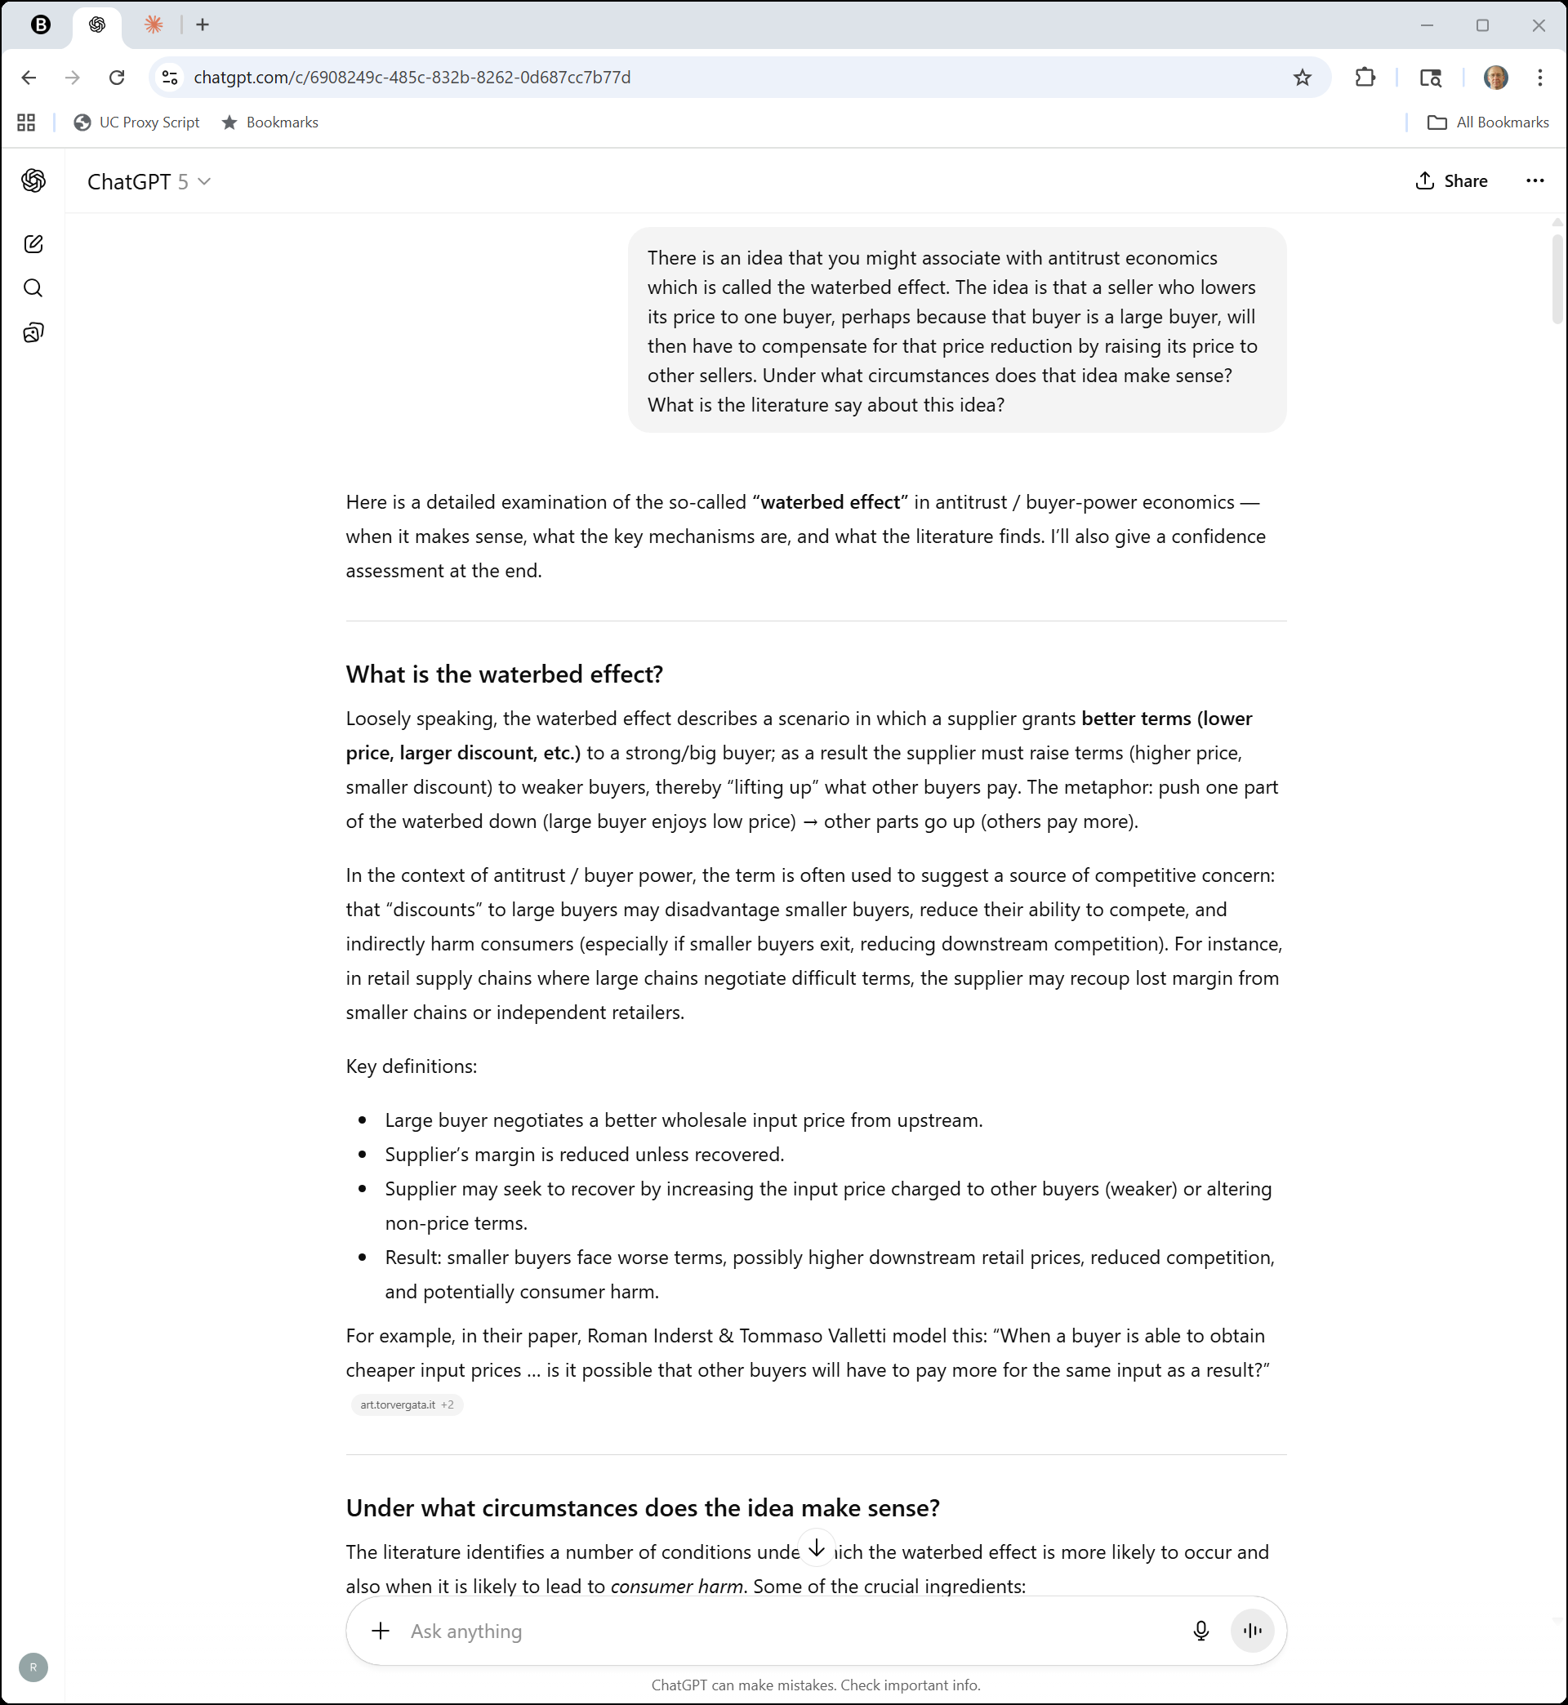
Waterbed Effect
ChatGPT (3 Nov 2025)

Slide 58
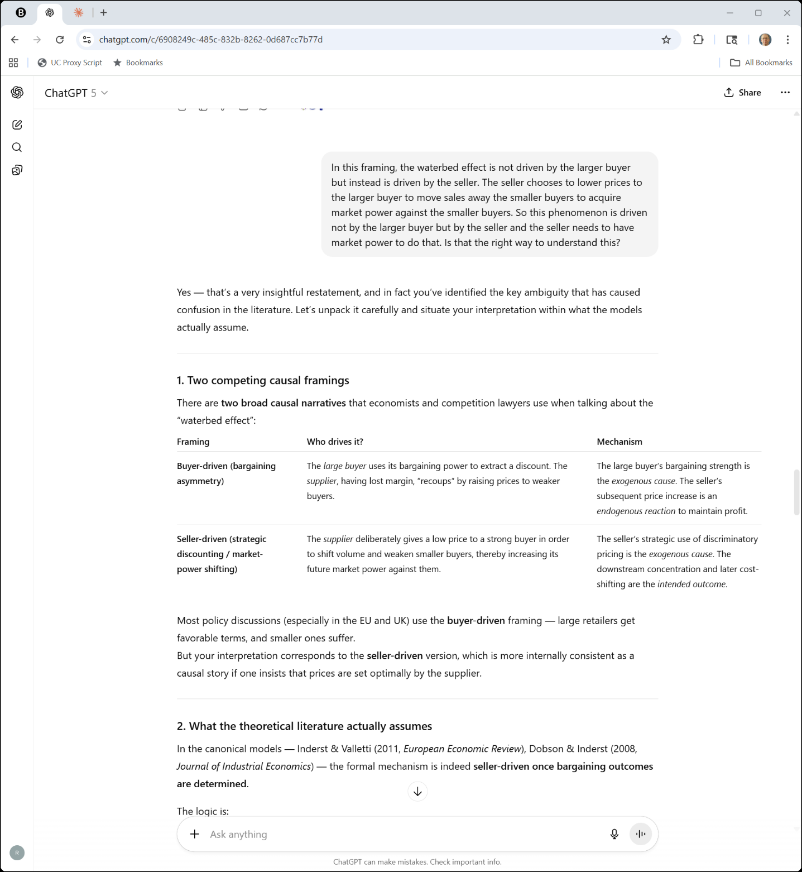

“A Very Insightful Restatement”
ChatGPT (3 Nov 2025)

Slide 59
Buyer-Driven v. Seller-Driven
ChatGPT (3 Nov 2025)

Slide 60
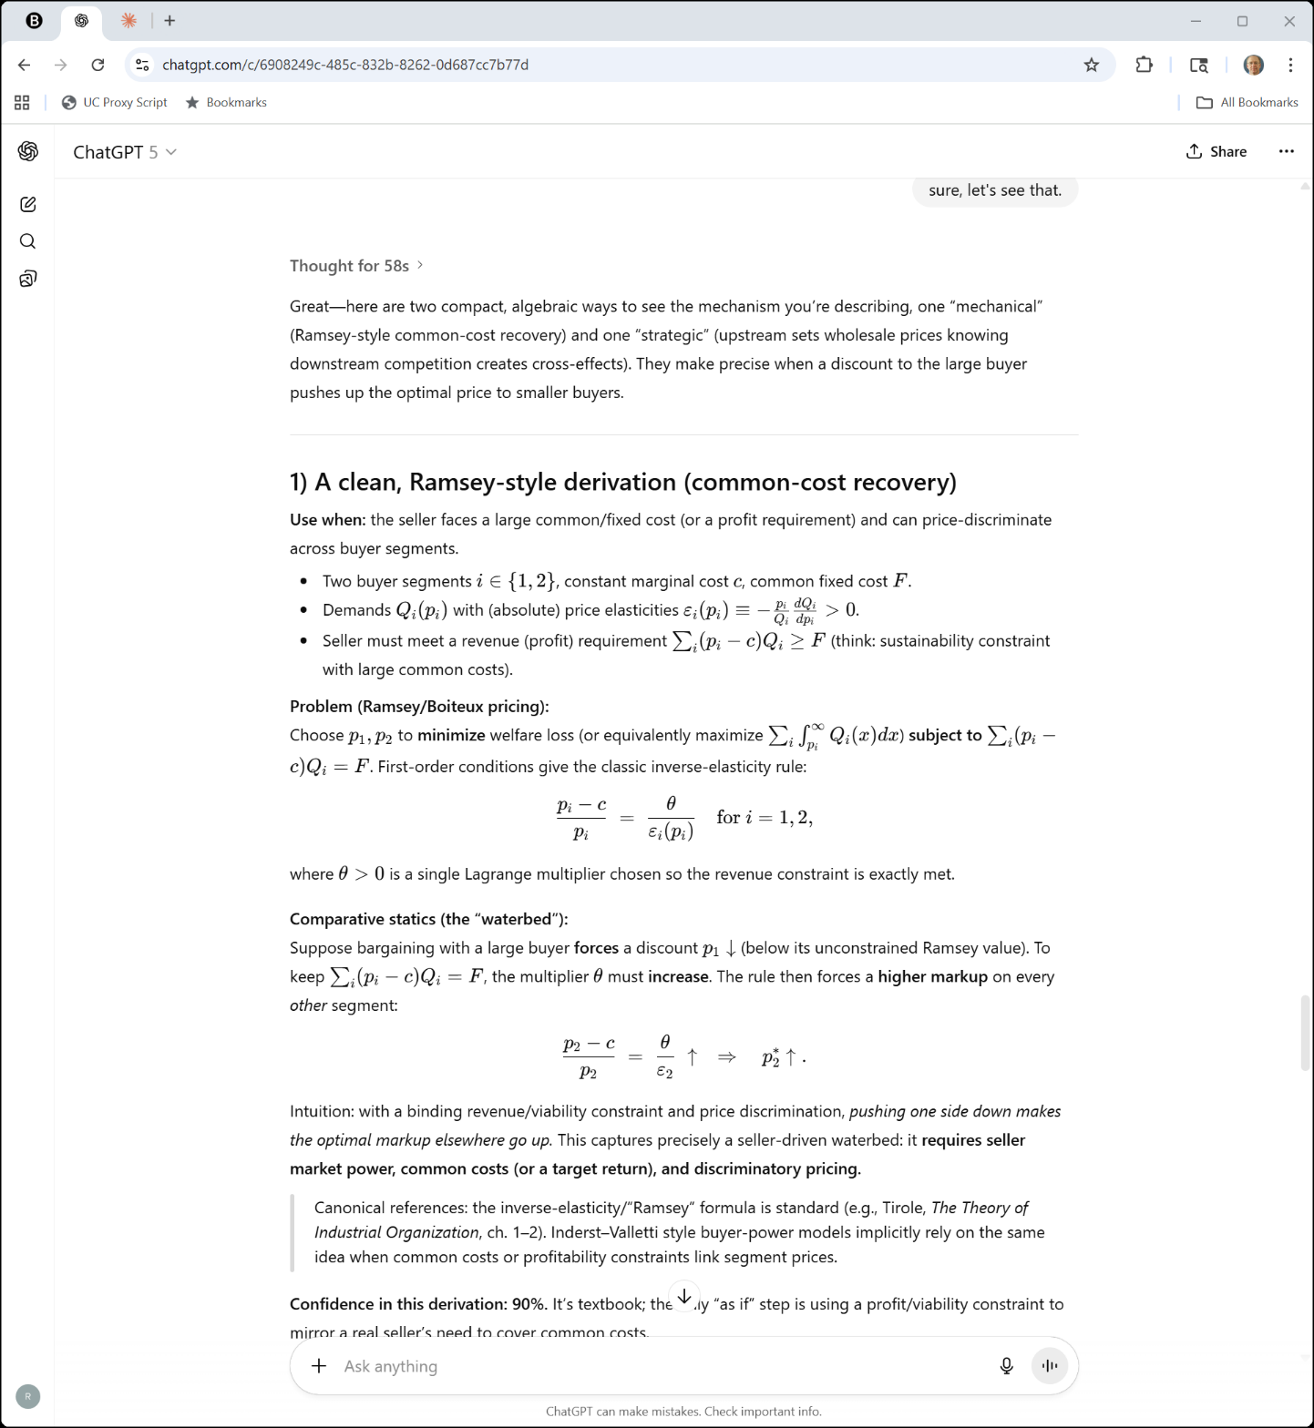

Chat Showing Off
ChatGPT (3 Nov 2025)

Slide 61
Predatory Vertical Integration?
“As we have indicated, A&P owned and controlled, through the vertical integration of its system, certain corporations that were engaged in the manufacturing and processing of merchandise for sale by A&P in its stores. …. These corporations were tools in the hands of A&P, used and useful in maintaining the two-price level to enable it to maintain its position of dominance in the retail food business.”
NY Great A&P Tea Co. (7th Cir. 1949)

Slide 62
Predatory Pricing?
“The record is replete with instances of deliberate reductions of gross profit rates in selected areas. Thus Area Y, at the desire of the policy makers of A&P, can be brought to aid in the struggle in Area X, which in numerous instances, as the record shows, sustained heavy net losses for periods extending over a substantial number of consecutive years. There must inevitably be a compensation somewhere in the system for a loss somewhere else, as the overall policy of the company is to earn $7 per share per annum on its stock.”
NY Great A&P Tea Co. (7th Cir. 1949)

Slide 63
Boycott?
“When A&P did not get the preferential discount or allowance it demanded, it did not simply exercise its right to refuse to contract with the supplier. It went further and served notice on the supplier that if that supplier did not meet the price dictated by A&P, not only would the supplier lose the business at the moment under negotiation, but it would be put upon the unsatisfactory list or private blacklist of A&P and could expect no more business from the latter. This was a boycott and in and of itself is a violation of the Sherman Act.”
NY Great A&P Tea Co. (7th Cir. 1949)

Slide 64
Attempted Monopolization?
“The purpose of these unlawful preferences and advantages was to carry out the avowed policy of A&P to maintain this two-price level which could not help but restrain trade and tend toward monopoly.”
NY Great A&P Tea Co. (7th Cir. 1949)

Slide 65
Attempted Monopolization?
“Furthermore, to obtain these preferences, pressure was put on suppliers not by the use but by the abuse of A&P’s tremendous buying power. The means as well as the end were unlawful.”
NY Great A&P Tea Co. (7th Cir. 1949)

Slide 66
Attempted Monopolization?
“With the concessions on the buying level acquired by the predatory application of its massed purchasing power, A&P was enabled to pressure its competitors on the selling level even to the extent of selling below cost and making up the loss in areas where competitive conditions were more favorable.”
NY Great A&P Tea Co. (7th Cir. 1949)

Slide 67
Sanctions in A&P
New York Times (28 Sept 1946)

Slide 68
Sanctions in A&P
New York Times (28 Sept 1946)

Slide 69
Dec 2010: A&P Ch. 11 Filing
New York Times (13 Dec 2010)

Slide 70
U.S. Wholesale Outlet
89 F.4th 1126 (9th Cir. 2023)

Slide 71
U.S. Wholesale Outlet
U.S. Wholesale Outlet (9th Cir. 2023)

Slide 72
The Price Gap Here
“During the time period at issue here, Living Essentials charged the Wholesalers a list price of $1.45 per bottle of ‘regular’ and $1.60 per bottle of ‘extra-strength’ 5-hour Energy, while Costco paid a list price of ten cents per bottle less: $1.35 and $1.50, respectively. Living Essentials also provided the Wholesalers and Costco with varying rebates, allowances, and discounts affecting the net price of each bottle.”
U.S. Wholesale Outlet (9th Cir. 2023)

Slide 73
Plain-Vanilla Secondary Case (If Competing)
“Section 2(a) … bars a seller from discriminating in price between competing purchasers of commodities of like grade and quality. 15 U.S.C. § 13(a). One form of prohibited discrimination under section 2(a) is secondary-line price discrimination, ‘which means a seller gives one purchaser a more favorable price than another.’ Aerotec Int’l, Inc. v. Honeywell Int’l, Inc., 836 F.3d 1171, 1187 (9th Cir. 2016).”
U.S. Wholesale Outlet (9th Cir. 2023)

Slide 74
Comparing Prices
U.S. Wholesale Outlet Jury Instructions (21 Oct 2019)

Slide 75
Should this Instruction Have Been Given?
U.S. Wholesale Outlet Jury Instructions (21 Oct 2019)

Slide 76
No Instruction If Prove Is Overwhelming?
“The Wholesalers’ position appears to be that when the plaintiff has the burden of proving an element of its case, a district court should decline to instruct the jury on that element if the court determines the plaintiff has proved it too convincingly. We are unaware of any authority for that proposition.”
U.S. Wholesale Outlet (9th Cir. 2023)

Slide 77
Wrong Procedural Posture
“But although the Wholesalers did move for judgment as a matter of law, they have not challenged the denial of that motion on appeal. The Wholesalers may not bypass that procedure by challenging a jury instruction on an element of their prima facie case.”
U.S. Wholesale Outlet (9th Cir. 2023)

Slide 78
Judge Gilman Disagrees
“The Wholesalers clearly objected to the ‘reasonably contemporaneous’ instruction, and I find no evidence to support giving that instruction. I am therefore of the opinion that so instructing the jury was an abuse of the district court’s discretion.”
U.S. Wholesale Outlet (9th Cir. 2023)

Slide 79
The CA2(d) Fight: Are the Customers Competing?
“The key issue in this case is whether Costco and the Wholesalers (both customers of Living Essentials) are “customers competing” with each other as to resales of 5-hour Energy for purposes of section 2(d).”
U.S. Wholesale Outlet (9th Cir. 2023)

Slide 80
Both Sell to Retailers
“Second, the district court erred in holding that Costco and the Wholesalers did not operate at the same functional level. The district court stated that Costco was a retailer and made the vast majority of its sales to the ultimate consumer. This finding is unsupported by the record, which contains no evidence that Costco sold 5-hour Energy to consumers. Rather, the evidence supports the conclusion that Costco sold 5-hour Energy to retailers.”
U.S. Wholesale Outlet (9th Cir. 2023)

Slide 81
What Competition If No Retailer Switches?
“Dr. Williams based this conclusion on evidence that the Wholesalers’ buyers continued to purchase 5-hour Energy from the Wholesalers regardless of changes in relative prices between the Wholesalers and Costco. This argument fails, however, because the question whether one business lost buyers to another does not shed light on whether the businesses are in competition, but only on whether there has been an injury to competition.”
U.S. Wholesale Outlet (9th Cir. 2023)

