Slide 1
UChicago Law: New Frontiers in Law & Economics
Randal C. Picker
Summer 2017
Google Search and the Desktop Internet

Slide 2
A (Very) Short Internet History

Slide 3
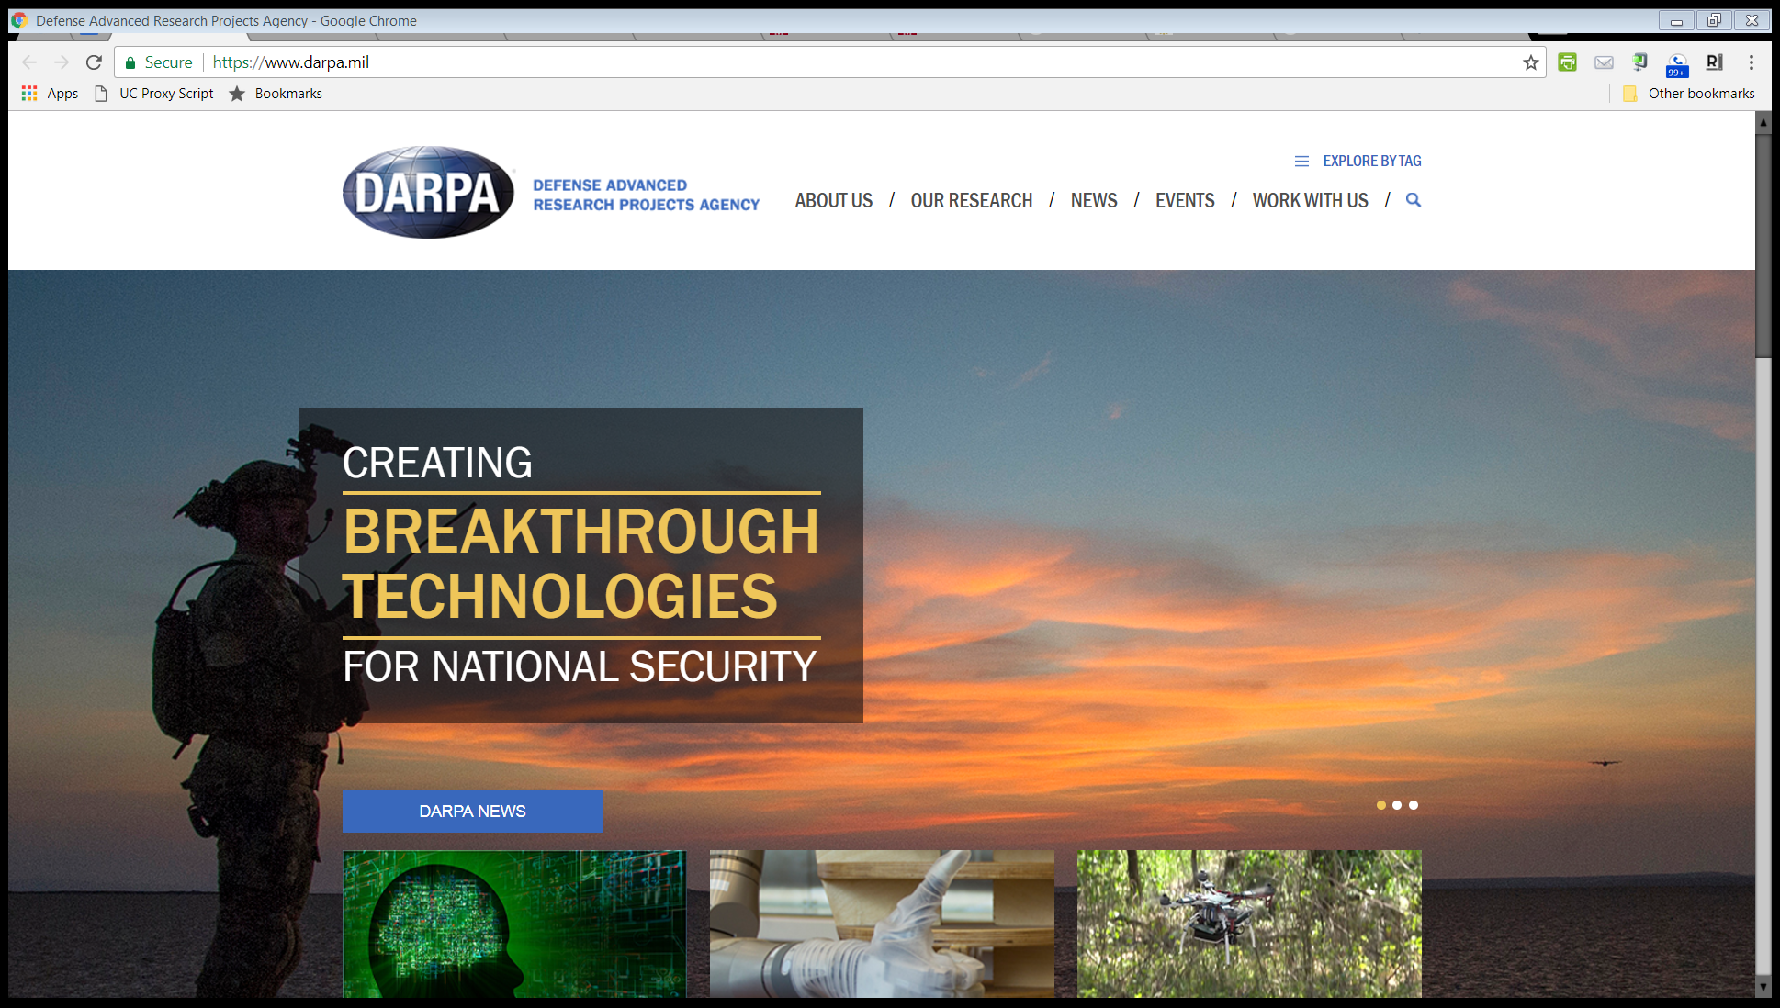
DARPA

Slide 4
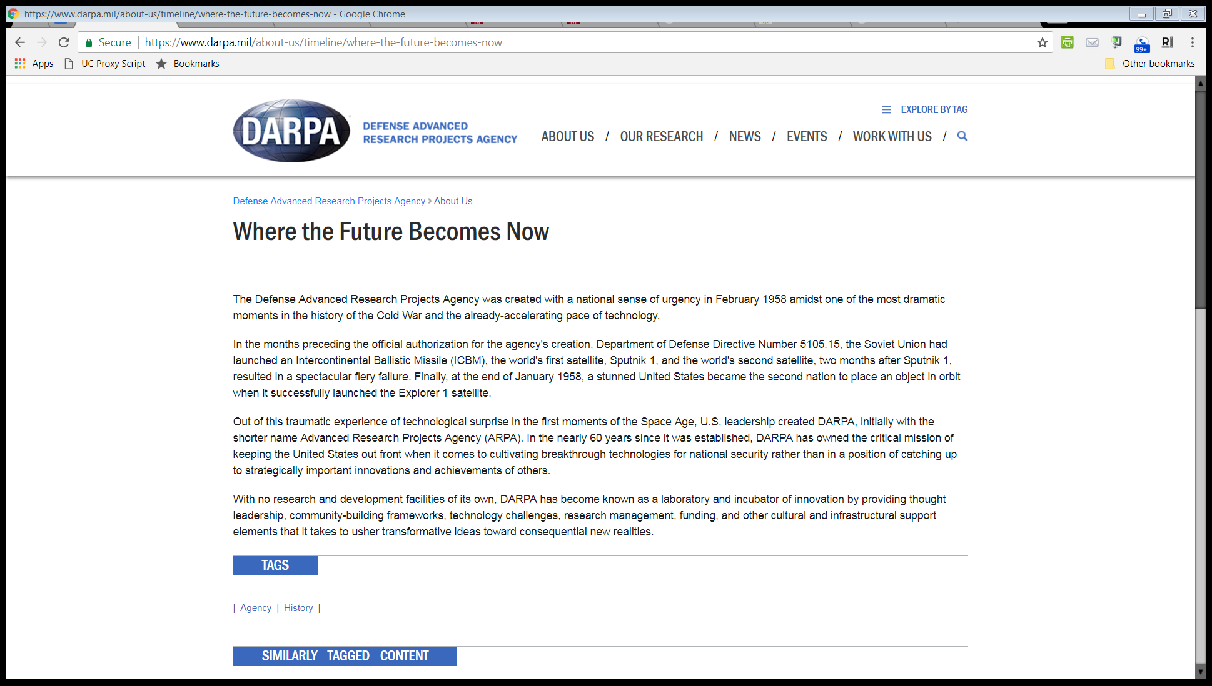
DARPA History
“The Defense Advanced Research Projects Agency was created with a national sense of urgency in February 1958 amidst one of the most dramatic moments in the history of the Cold War and the already-accelerating pace of technology.”

Slide 5
Sputnik and Soviet Missiles
New York Times (Oct 13, 1957)

Slide 6
Sputnik and Soviet Missiles
New York Times (Oct 13, 1957)

Slide 7
Sen. John F. Kennedy on Sputnik
New York Times (Dec 8, 1957)

Slide 8
DARPA History
“In the months preceding the official authorization for the agency’s creation, Department of Defense Directive Number 5105.15, the Soviet Union had launched an Intercontinental Ballistic Missile (ICBM), the world’s first satellite, Sputnik 1, and the world’s second satellite, two months after Sputnik 1, resulted in a spectacular fiery failure.”

Slide 9
DARPA History
“Out of this traumatic experience of technological surprise in the first moments of the Space Age, U.S. leadership created DARPA, initially with the shorter name Advanced Research Projects Agency (ARPA).”

Slide 10
DARPA History
“In the nearly 60 years since it was established, DARPA has owned the critical mission of keeping the United States out front when it comes to cultivating breakthrough technologies for national security rather than in a position of catching up to strategically important innovations and achievements of others.”

Slide 11
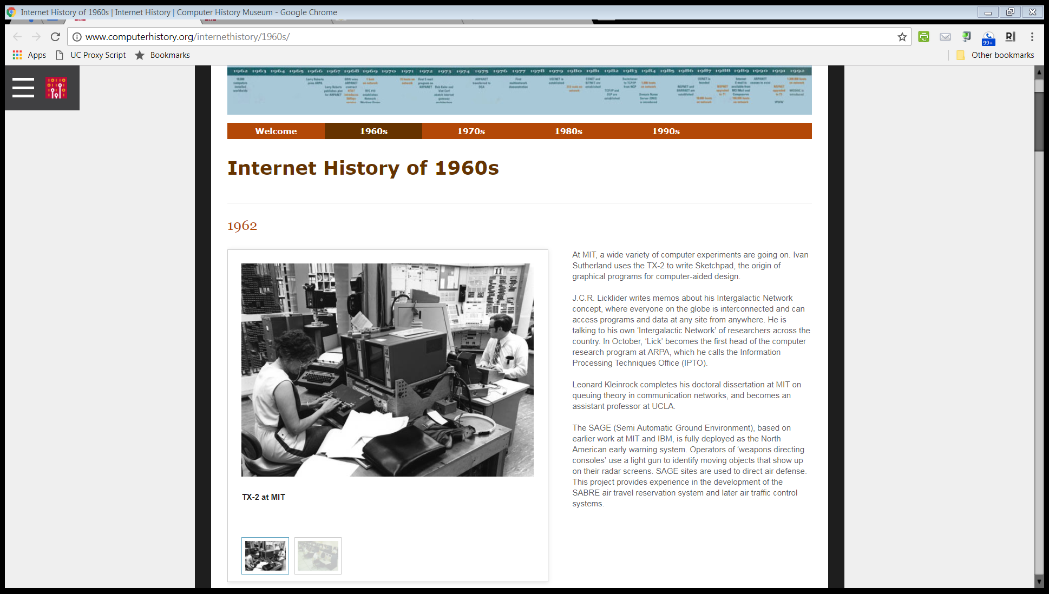
JCR Licklider at ARPA
Source: Computer History Museum

Slide 12
Licklider Intergalactic Computer Memo

Slide 13
How to Control a Network of Computers
Licklider Intergalactic Computer Memo (1963)

Slide 14
Baran, On Distributed Communication Networks
IEEE Publication, March, 1964

Slide 15
Baran, On Distributed Communication Networks
IEEE Publication, March, 1964

Slide 16
ARPANET December 1969
Source: BBN Report No. 4799, April, 1981

Slide 17
Cerf & Kahn, Protocol for Packet Networks
IEEE Publication, May, 1974

Slide 18
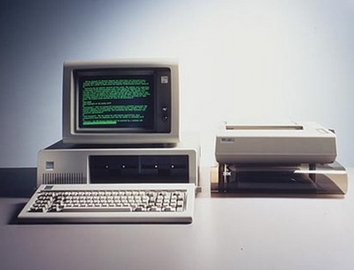
IBM Personal Computer, Aug 12, 1981

Slide 19
1985 Comdex: Windows 1.0 Release
The New York Times, Nov 26, 1985

Slide 20
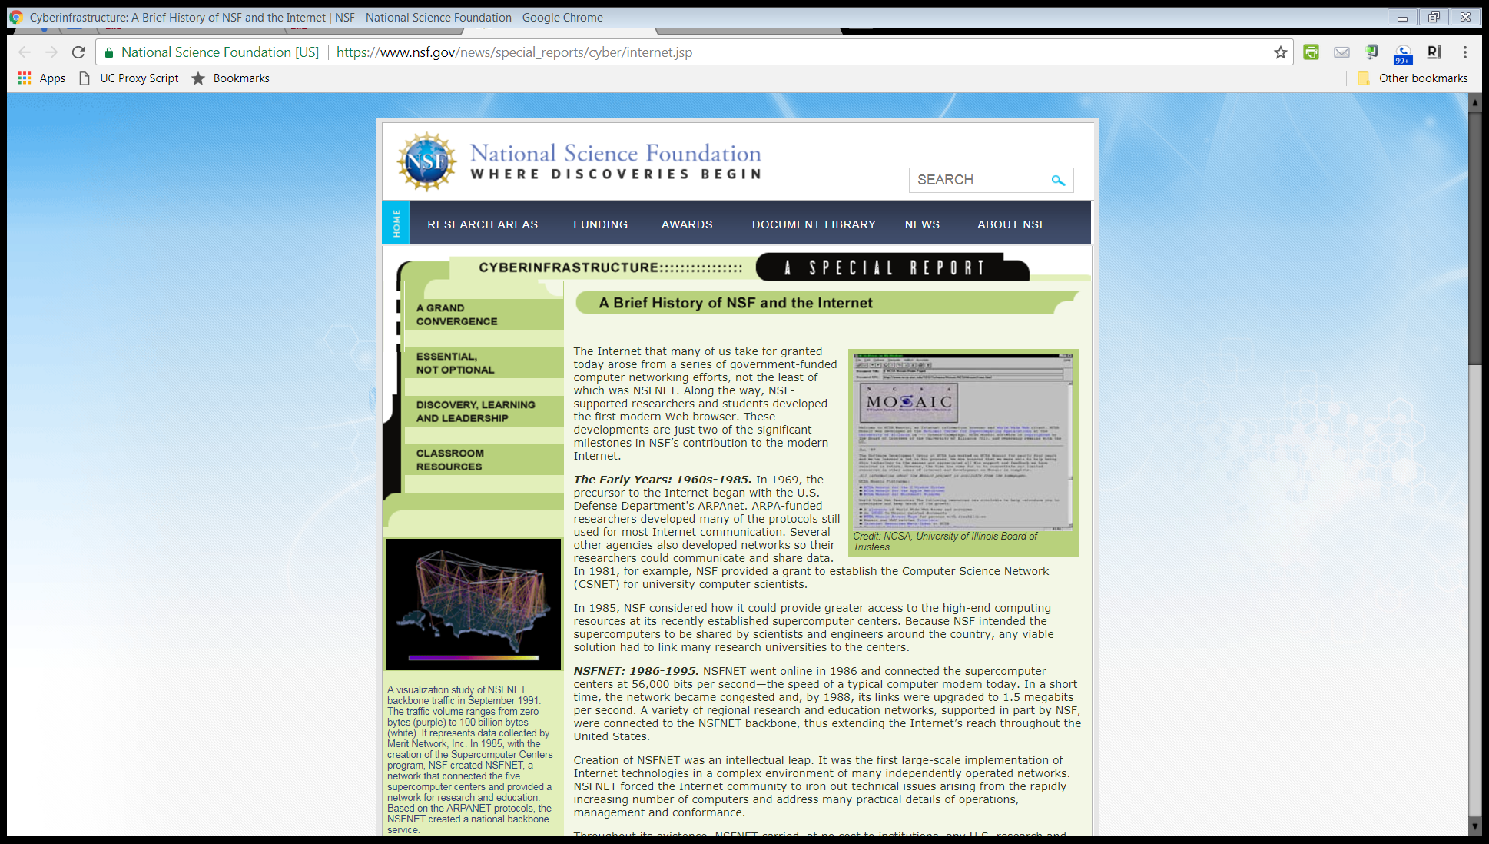
NSFNET and Network Proliferation

Slide 21
NSFNET and Network Proliferation

Slide 22
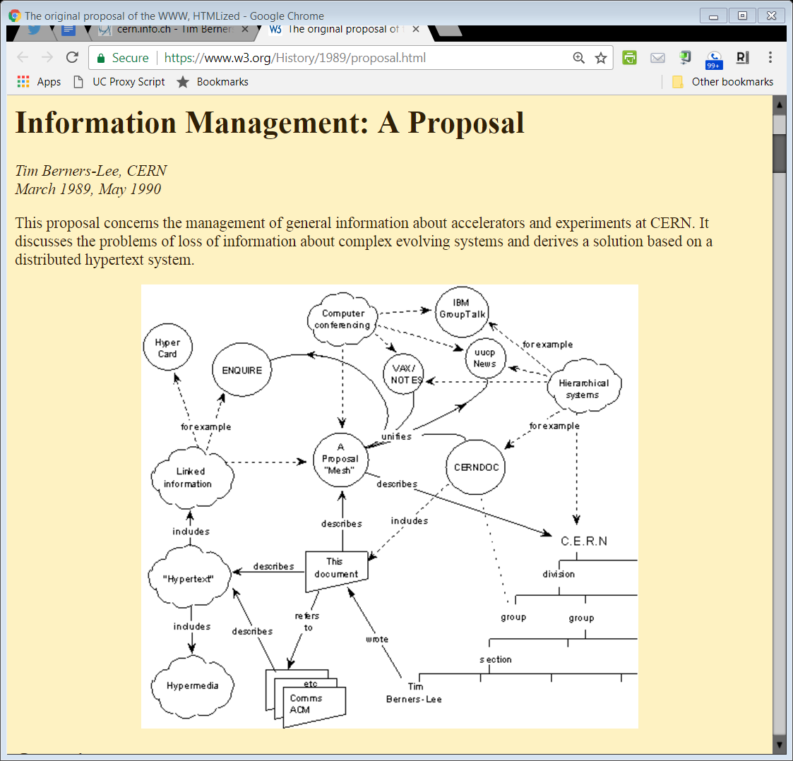
Berners-Lee Mesh Proposal, March, 1989
Source: www.w3.org
Notes:
https://www.w3.org/History/1989/proposal.html

Slide 23
Berners-Lee Mesh Proposal, March, 1989
Source: www.w3.org
Notes:
https://www.w3.org/History/1989/proposal.html

Slide 24
Mosaic
New York Times, 8 Dec 1993

Slide 25
Mosaic
New York Times, 8 Dec 1993

Slide 26
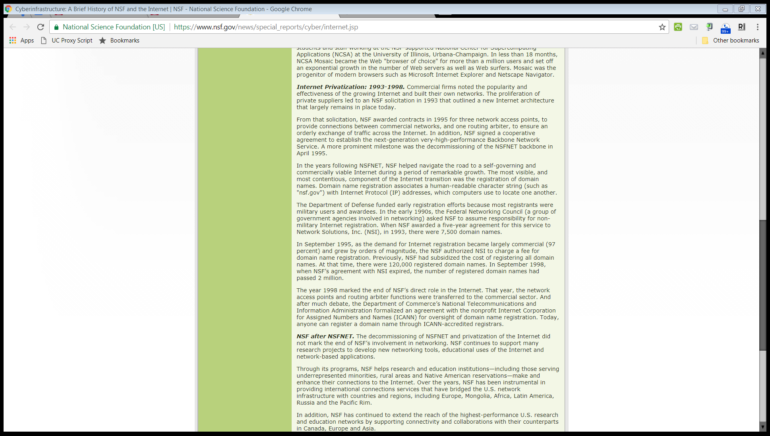
Privatization of NSFNET

Slide 27
Search Before Google

Slide 28
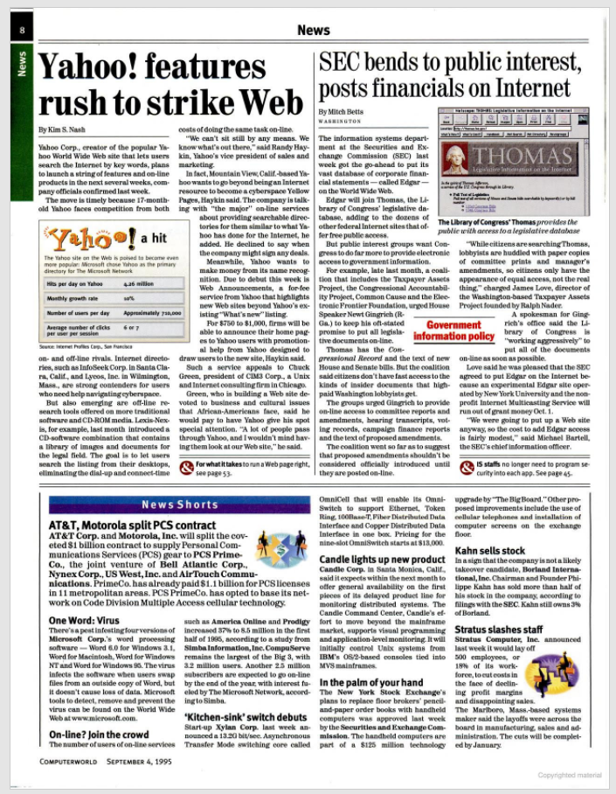
Yahoo!
Computerworld, 4 Sept 1995

Slide 29
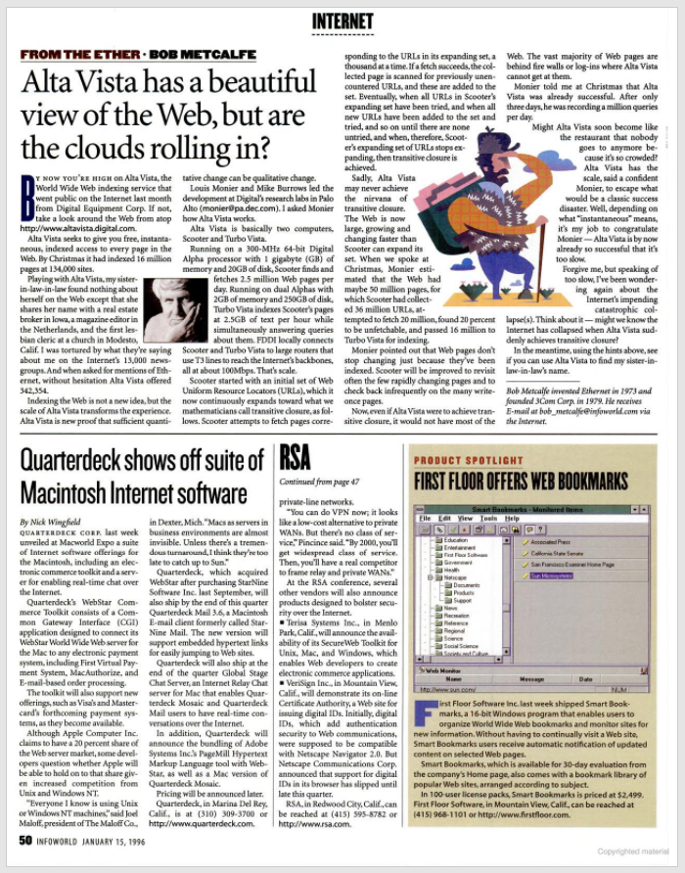
Alta Vista
InfoWorld, 15 Jan 1996

Slide 30
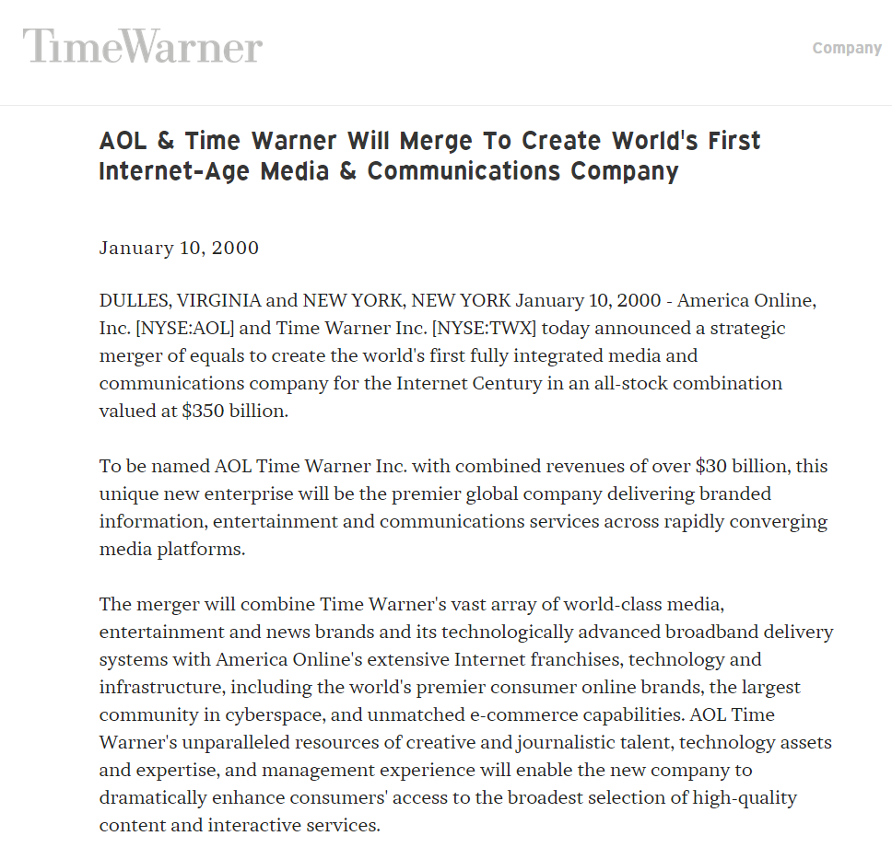
AOL/Time Warner Merger
“America Online, Inc. [NYSE:AOL] and Time Warner Inc. [NYSE:TWX] today announced a strategic merger of equals to create the world’s first fully integrated media and communications company for the Internet Century in an all-stock combination valued at $350 billion.”
Time Warner Press Release, Jan 10, 2000

Slide 31
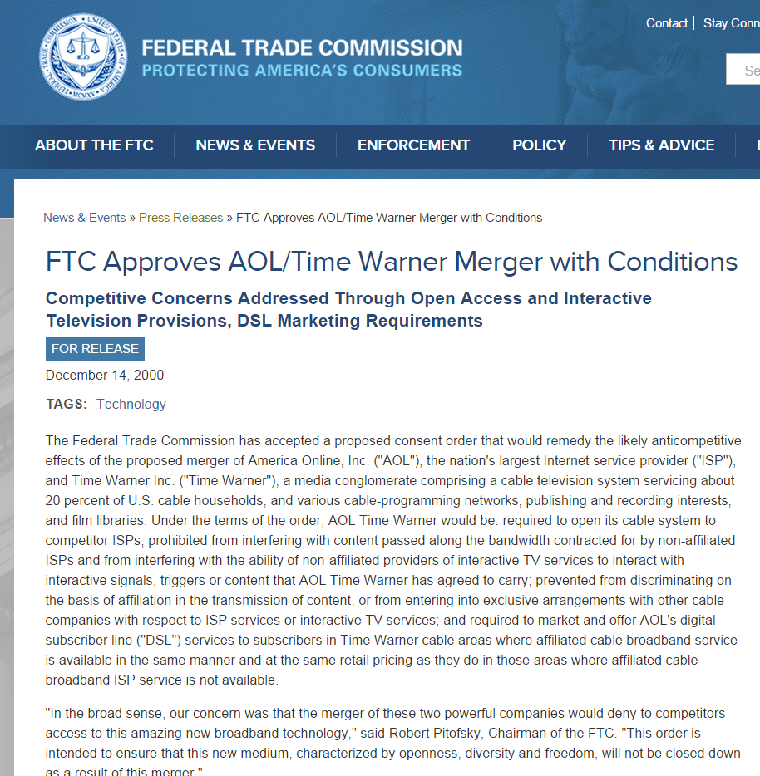
FTC Approval: “Yes, but …”
“Under the terms of the order, AOL Time Warner would be: required to open its cable system to competitor ISPs; prohibited from interfering with content passed along the bandwidth contracted for by non-affiliated ISPs and from interfering with the ability of non-affiliated providers of interactive TV”
Federal Trade Commission Press Release, Dec 14, 2000

Slide 32
AOL/TW Internet Site Visitors
New York Times, Nov 13, 2000
Notes:
Ways of delivering information: directory or search
Search engines: Alta Vista, Lycos
Sherlock Holmes, silver blaze, pay attention to what is missing
No Google

Slide 33
Commercial Alert Complaint
“This letter responds to the July 16, 2001 complaint filed by Commercial Alert requesting that the Federal Trade Commission (‘FTC’ or ‘Commission’) investigate whether Alta Vista Co., AOL Time Warner, Inc., Direct Hit Technologies, iWon, Inc., Looksmart, Ltd., Microsoft Corp., and Terra Lycos S.A. (hereinafter, ‘named search engine companies’)”
FTC Search Engine Letter, June 27, 2002
Notes:
More info on firms?

Slide 34
Commercial Alert Complaint
“are violating Section 5 of the Federal Trade Commission Act (‘FTC Act’), 15 U.S.C. § 45(a)(1), (1) by failing to disclose that advertisements are inserted into search engine results lists.”
FTC Search Engine Letter, June 27, 2002

Slide 35
No Formal FTC Action, But …
“Although the staff is not recommending Commission action at this time, we are sending letters to search engine companies outlining the need for clear and conspicuous disclosures of paid placement, and in some instances paid inclusion, so that businesses may avoid possible future Commission action.”
FTC Search Engine Letter, June 27, 2002

Slide 36
Inventing Google

Slide 37
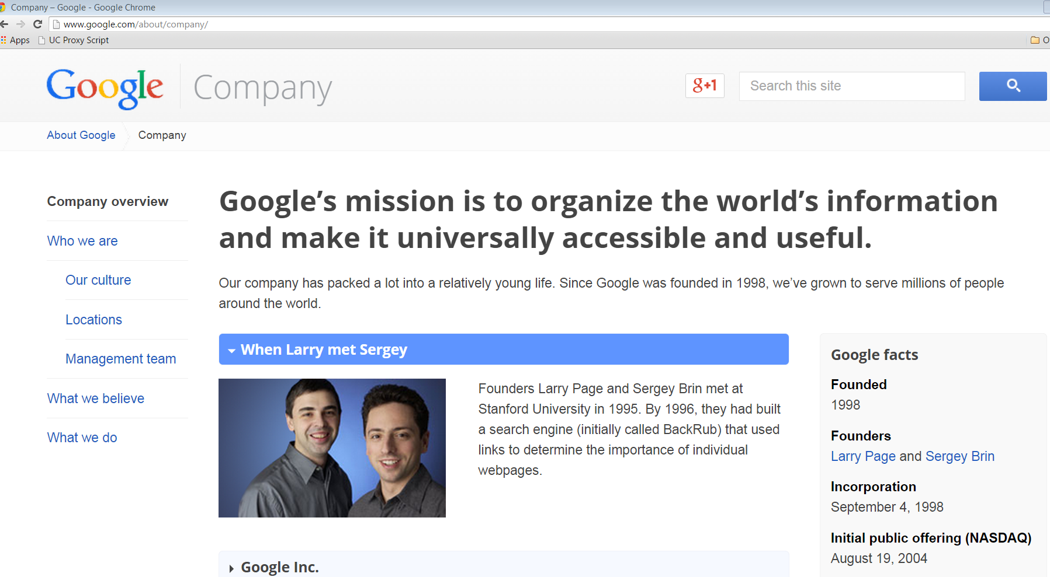
Google Mission Statement

Slide 38
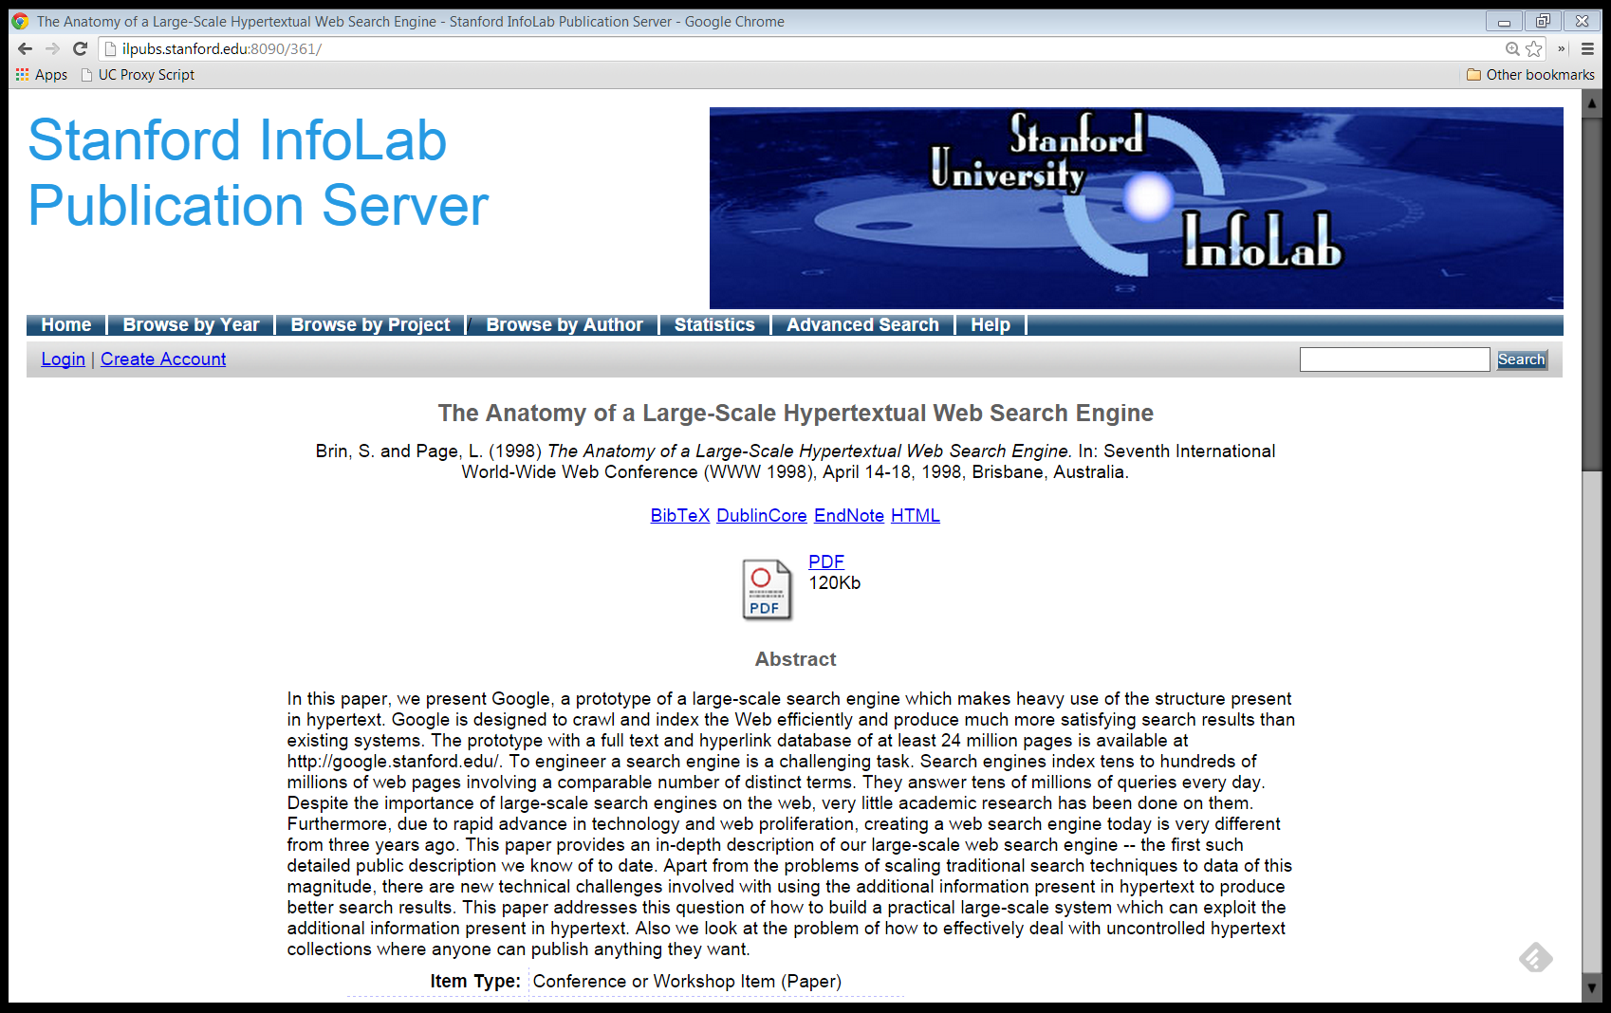
Brin & Page (1998)

Slide 39
A Prototype Search Engine
Brin & Page (1998)

Slide 40
A Prototype Search Engine
“In this paper, we present Google, a prototype of a large-scale search engine which makes heavy use of the structure present in hypertext.”
Brin & Page (1998)

Slide 41
A Prototype Search Engine
“Google is designed to crawl and index the Web efficiently and produce much more satisfying search results than existing systems.”
Brin & Page (1998)

Slide 42
A Prototype Search Engine
“The prototype with a full text and hyperlink database of at least 24 million pages is available at http://google.stanford.edu/”
Brin & Page (1998)

Slide 43
Exploiting Data in Hyperlinks
“Apart from the problems of scaling traditional search techniques to data of this magnitude, there are new technical challenges involved with using the additional information present in hypertext to produce better search results.”
Brin & Page (1998)

Slide 44
PageRank Patent
U.S. Patent No. 7,058,628 (June 6, 2006)

Slide 45
Brin & Page (1998)

Slide 46
Advertising and Mixed Motives
“Currently, the predominant business model for commercial search engines is advertising. The goals of the advertising business model do not always correspond to providing quality search to users.”
Brin & Page (1998)

Slide 47
Advertising and Mixed Motives
“For example, in our prototype search engine one of the top results for cellular phone is ‘The Effect of Cellular Phone Use Upon Driver Attention’, a study which explains in great detail the distractions and risk associated with conversing on a cell phone while driving.”
Brin & Page (1998)

Slide 48
Advertising and Mixed Motives
“… It is clear that a search engine which was taking money for showing cellular phone ads would have difficulty justifying the page that our system returned to its paying advertisers.”
Brin & Page (1998)

Slide 49
Advertising and Mixed Motives
“For this type of reason …, we expect that advertising funded search engines will be inherently biased towards the advertisers and away from the needs of the consumers.”
Brin & Page (1998)
Notes:
OUTRO: As they say on late night TV, but there is more and turn to that in next segment.
TAGLINE: I’m Randy Picker at the University of Chicago. This is Internet Giants: The Law and Economics of Media Platforms.

Slide 50
Bias is Difficult to Evaluate
“Since it is very difficult even for experts to evaluate search engines, search engine bias is particularly insidious. A good example was OpenText, which was reported to be selling companies the right to be listed at the top of the search results for particular queries … .”
Brin & Page (1998)

Slide 51
Bias is Difficult to Evaluate
“… . This type of bias is much more insidious than advertising, because it is not clear who ‘deserves’ to be there, and who is willing to pay money to be listed.”
Brin & Page (1998)

Slide 52
Easy to Favor, Hard to Detect
“But less blatant bias are likely to be tolerated by the market. For example, a search engine could add a small factor to search results from ‘friendly’ companies, and subtract a factor from results from competitors.”
Brin & Page (1998)

Slide 53
Easy to Favor, Hard to Detect
“This type of bias is very difficult to detect but could still have a significant effect on the market.”
Brin & Page (1998)

Slide 54
Good, but Not Too Good
“Furthermore, advertising income often provides an incentive to provide poor quality search results. … .”
Brin & Page (1998)

Slide 55
Good, but Not Too Good
“In general, it could be argued from the consumer point of view that the better the search engine is, the fewer advertisements will be needed for the consumer to find what they want.”
Brin & Page (1998)

Slide 56
Good, but Not Too Good
“This of course erodes the advertising supported business model of the existing search engines.”
Brin & Page (1998)

Slide 57
Conclusion?
“But we believe the issue of advertising causes enough mixed incentives that it is crucial to have a competitive search engine that is transparent and in the academic realm.”
Brin & Page (1998)
Notes:
OUTRO: But Google wouldn’t stay in the academic realm too long and we turn to turning Google into a product in our next segment.
TAGLINE: I’m Randy Picker at the University of Chicago. This is Internet Giants: The Law and Economics of Media Platforms.

Slide 58
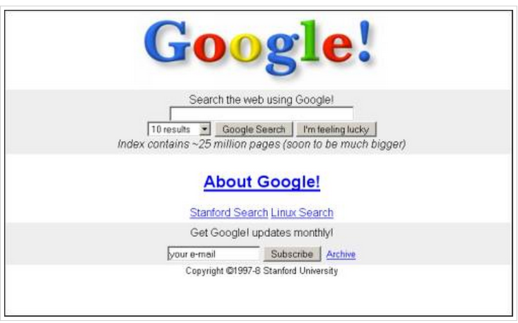
Data Model: Crawl, index, rank
Goal: Build a great product
Hoped for Result: Market power (and no apologies for that)
Original Google Homepage, Nov 11, 1998

Slide 59
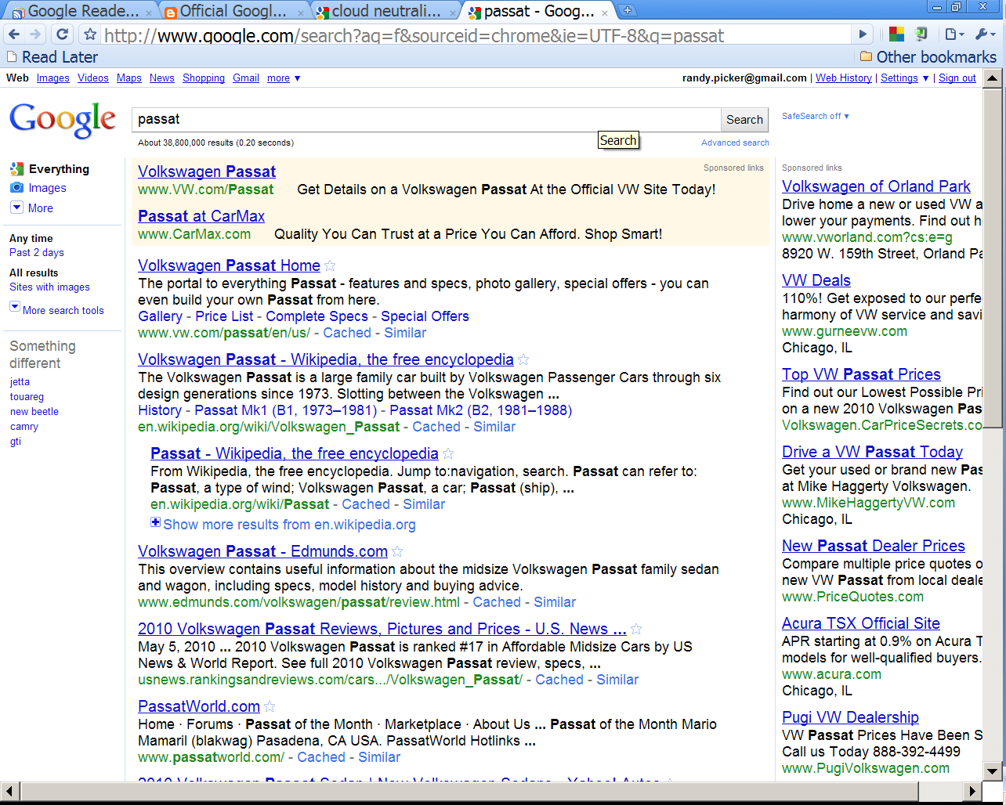
SCS
Ten Blue Links

Slide 60
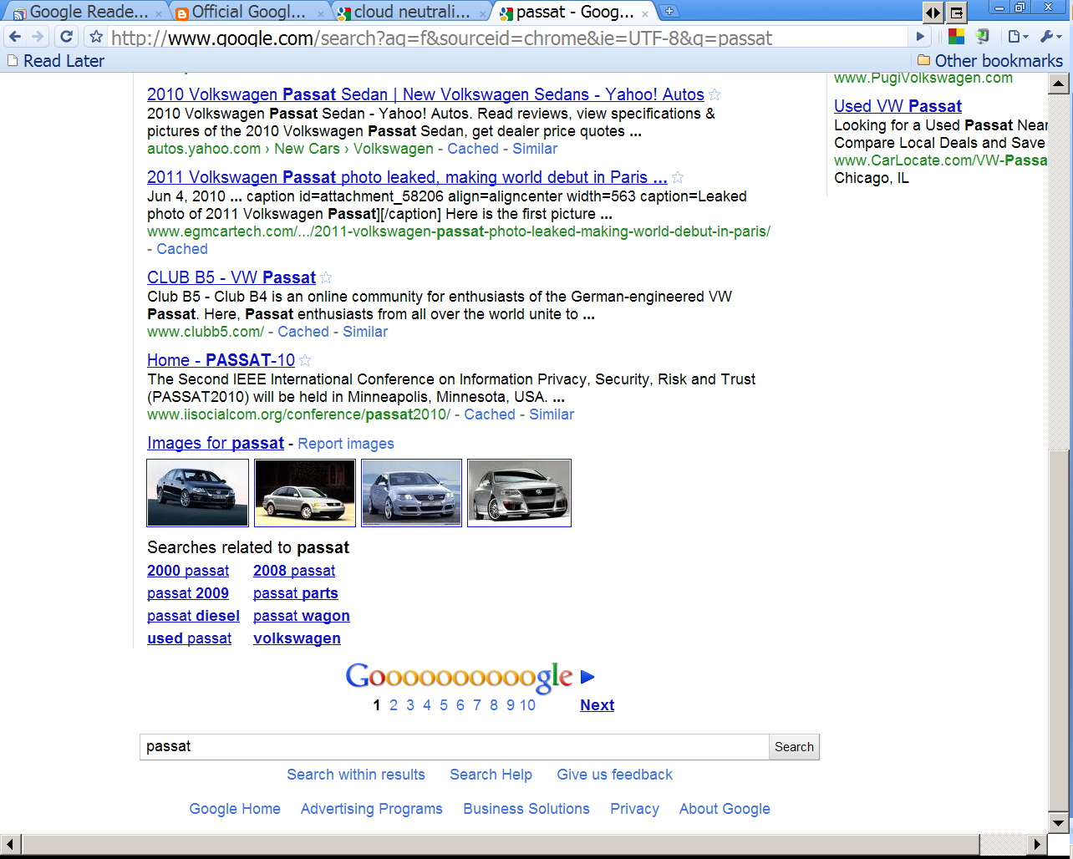
SCS

Slide 61
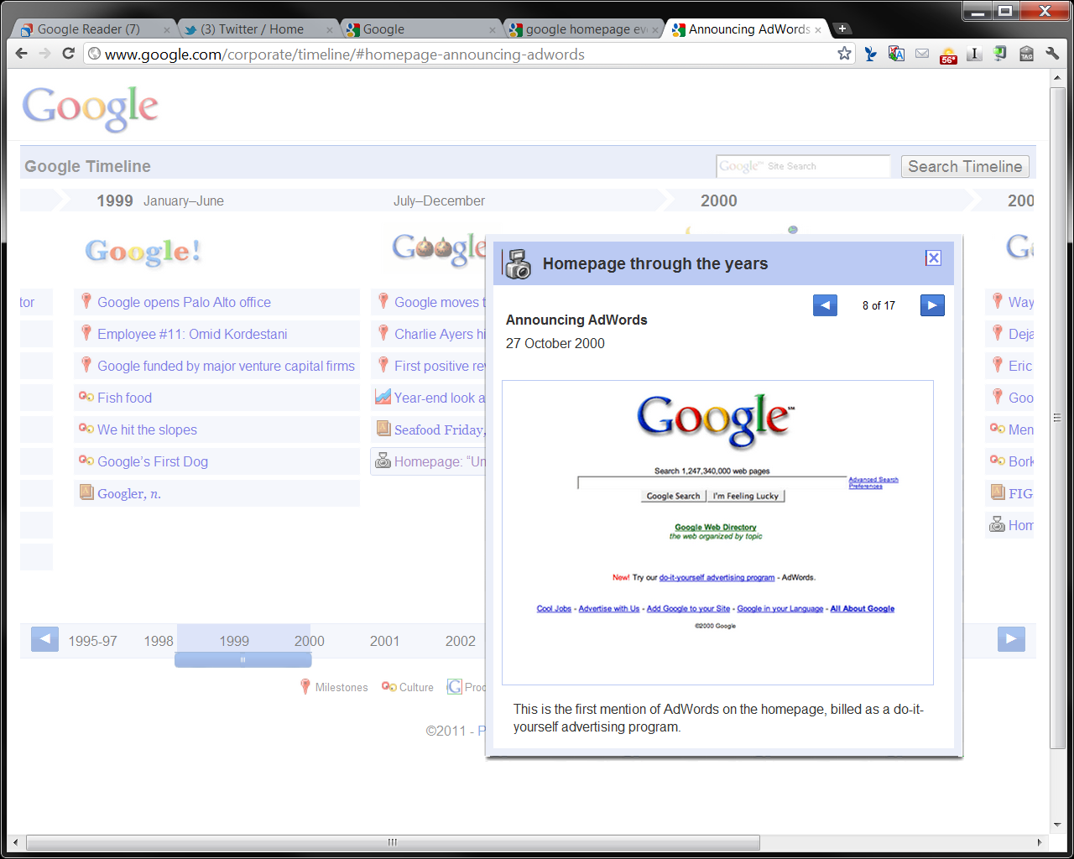
Google Homepage, Oct 27, 2000

Slide 62
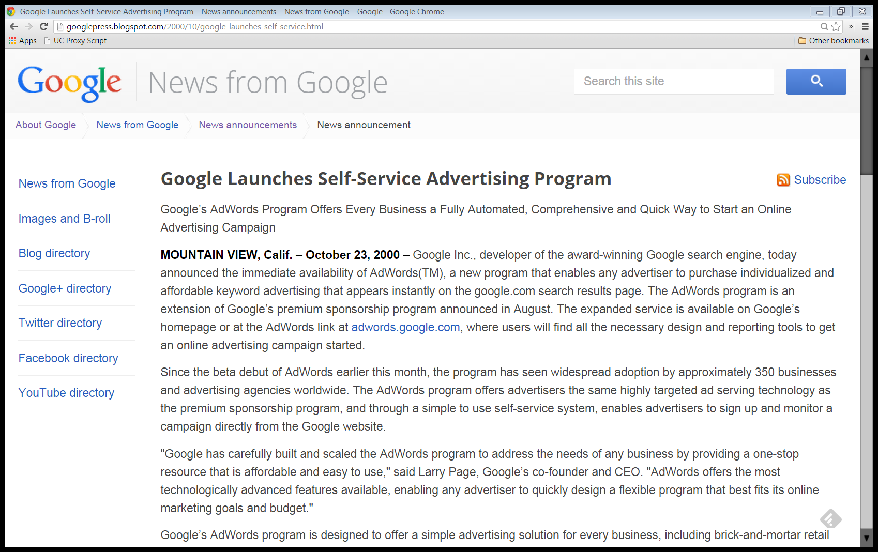
AdWords
“Google Inc., developer of the award-winning Google search engine, today announced the immediate availability of AdWords(TM), a new program that enables any advertiser to purchase individualized and affordable keyword advertising that appears instantly on the google.com search results page.”
Google AdWords Announcement, Oct 23, 2000

Slide 63
Buying Keywords
“… Google’s AdWords program enables advertisers to purchase carefully selected keywords that target potential customers by serving an ad that matches a user’s search query.”
Google AdWords Announcement, Oct 23, 2000

Slide 64
Rapid Search Growth
“Google’s superior effectiveness as a search resource is gaining widespread acclaim from its growing number of loyal users, who currently conduct more than 20 million searches per day on google.com. Google’s overall web traffic continues to increase by 3 million queries per day each month.”
Google AdWords Announcement, Oct 23, 2000

Slide 65
Ad Pricing
“The AdWords program provides low-cost exposure on one of the industry’s leading search engines with CPMs from $15 or 1.5 cents an impression, $12 or 1.2 cents an impression, and $10 or 1 cent an impression, for the top, middle, and bottom ad unit positions, respectively.”
Google AdWords Announcement, Oct 23, 2000

Slide 66
Google Classic and Privacy
Identity Revelation and Google Search
Advertising Use of Identity
Anon Search
Anon Ads (Contextual Only)
Organic Search Results Use of Identity
Notes:
OUTRO: That was a overview of simple Google: ten blue links and CPM (per impression ads). Head into tech and econ in next segments and then come to how Google has evolved into the entity of today.
TAGLINE: I’m Randy Picker at the University of Chicago. This is Internet Giants: The Law and Economics of Media Platforms.

Slide 67
The Infrastructure Behind Google: Economics

Slide 68
Two-Sided Markets

Slide 69
Platforms as Two-Sided Markets
P$
The Platform Room
P$

Slide 70
Platforms as Two-Sided Markets
Content (TV program, organic search, etc.)
Advertisers
Consumer

Slide 71
Price
v.
Marginal Cost
In a two-sided market, it can be the best outcome for one side of the market to face prices less than marginal cost.

Slide 72
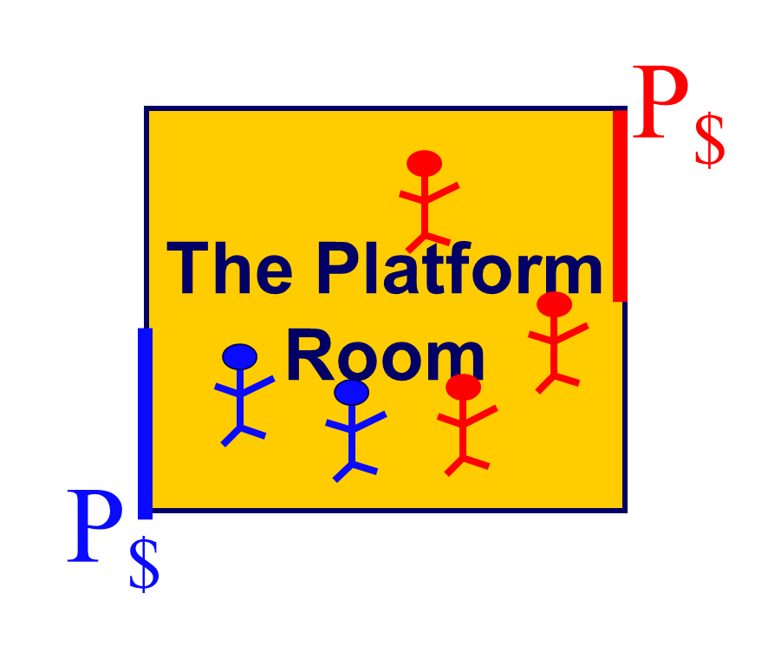
Two-Sided Markets Hypo
Blue Side
Two types of blue customers: low value and high value
N_{BL} = Number of possible low-value blue customers = 2
N_{BH} = Number of possible high-value blue customers = 2
V_{BL} = Value to low-value blue customer of being in the room = $2
V_{BH} = Value to high-value blue customer of being in the room = $4
MC_{B} = Marginal Cost of serving a blue customer = $3

Slide 73
Two-Sided Markets Hypo
Red Side
N_{R} = Number of possible red customers = 4
V_{R} = Value to each red customer of being in the room = 2*N_{B}
MC_{R} = Marginal Cost of serving a red customer = $3

Slide 74
Two-Sided Markets Hypo
Assume for now that Price = Marginal Cost (P_{B} = MC = 3 and P_{R} = MC =3)
What will happen?

Slide 75
Two-Sided Markets Hypo
Outcome So Far
Low-value blue types stays home (2 < 3)
High-value blue types joins the platform (4 > 3)
Usually, that would be a good outcome: only users with value in excess of marginal cost are participating
What about the red side?

Slide 76
Two-Sided Markets Hypo
Outcome So Far
With two blues in the room, reds value joining the platform at 4 (2 x 2)
With a price to reds of 3, all four will join, as they value it for more than price
And we should like that since they value it for more than marginal cost (3)

Slide 77
Two-Sided Markets Hypo
Outcome So Far
Calculating Social Welfare
SWF = Number of Reds on Platform x (Value to Reds – Cost of Serving them) + Number of Blues on Platform x (Value to Blues – Cost of Serving them)
SWF = 4*(4-3) + 2*(4-3) = 6
Notes:
OUTRO: Can we do better than 6? We can if we set prices below marginal cost to the blue side; turn to that next.
TAGLINE: I’m Randy Picker at the University of Chicago. This is Internet Giants: The Law and Economics of Media Platforms.

Slide 78
Two-Sided Markets Hypo
Outcome So Far
6
Can we do better?
Notes:
INTRO: Price = MC, SWF = 6

Slide 79
Two-Sided Markets Hypo
Outcome So Far
Set P_{B} = 2 and P_{R} =4
Price below marginal cost to blue side and above marginal cost to red side
Have to raise prices to reds to maintain solvency given below-cost pricing to blues
What will happen?

Slide 80
Two-Sided Markets Hypo
Outcome So Far
Both blue types will join the platform (for high-value blues, 4 > 2 and for low-value blue types, 2 = 2 (and set price at $1.99 if you’d like)
Marginal cost is still 3 so we have low-value types who value the platform for less than the cost of serving them; problem?
What about the red side?

Slide 81
Two-Sided Markets Hypo
Outcome So Far
With four blues in the room, reds value joining the platform at 8 (4 x 2)
With a price to reds of 4, all four will join, as they value it for more than price
And we should like that since they value it for more than marginal cost (3)

Slide 82
Two-Sided Markets Hypo
Outcome So Far
Calculating Social Welfare
SWF = Number of Reds on Platform x (Value to Reds – Cost of Serving them) + Number of Blues on Platform x (Value to Blues – Cost of Serving them)
SWF = 4*(8-3) + 2*(4-3) + 2*(2-3) = 20

Slide 83
Two-Sided Markets Hypo
Outcome So Far
The reds value having the blues on the platform sufficiently that adding the low-value blue types to the platform is useful.
But they will stay home if they are actually charged the marginal cost of serving them

Slide 84
Two-Sided Markets Hypo
Outcome So Far
They don’t internalize the benefits they are conferring on the red side.
Reducing prices to them below marginal cost helps to solve that.
Pricing below marginal cost to one side of two-sided platform market can be socially useful

Slide 85
Two-Sided Markets Hypo
Outcomes and Take Aways
When either side of the platform cares about the presence of the other side, our usual competitive pricing rules may go out the window.
In this example, it is socially useful to price below marginal cost to get the low-value blue types to participate

Slide 86
Two-Sided Markets Hypo
Outcomes and Take Aways
3. Blue types ignore the benefits that their participation confers on red types and so we need to subsidize low-value blue types to get the extra social benefits for the red types

Slide 87
Two-Sided Markets Hypo
Outcomes and Take Aways
4. If we can’t separate the different blue types—if we have a pooling outcome—then the high-value blue types will benefit from the need to subsidize the low-value blue types
Notes:
OUTRO: that suggest might want to give away the product to one side, and Google seems to do just that. Want to switch to new idea, exercising monopoly power in auction markets.
TAGLINE: I’m Randy Picker at the University of Chicago. This is Internet Giants: The Law and Economics of Media Platforms.

Slide 88
Auctions and Monopoly Power

Slide 89
Exercising Market Power in Auctions
Variant of Varian (2006)
  Auction Set Up: 3 ad slots
      1st slot gets 100 clicks per day
      2nd slot gets 80 clicks per day
      3rd slot gets 60 clicks per day
    3 advertisers, each values click at 50 cents
  Min bid requirement: 5 cents per click

Slide 90
Market Power in Auctions
Equilibrium Outcome
  Advertisers need to receive same net value
    Person in slot three will pay minimum, 5 cents per click, and will get 60 clicks valued at 50 cents each
    Net is (.50-.05)*60 = $27
    Pays total of .05*60 = $3

Slide 91
Market Power in Auctions
  2nd slot advertiser will net
    (.50-price)*80
    For equilibrium, that needs to equal 27
    Means p =.1625
    Pays total revenues of 80*.1625 = $13

Slide 92
Market Power in Auctions
  1st slot advertiser will net
    (.50-price)*100
    Again, needs to net $27 in equilibrium
    p = .23
    Total paid by 1st slot advertiser is $23
Total Revenues for Search Engine
  3+13+23 = 39

Slide 93
Market Power in Auctions
Results
  All three advertisers net $27, so auction is stable and pricing is driven off of reservation price for 3rd slot and incremental value for being in above slot
  This is Vickrey-Clarke-Groves Mechanism
  Total Revs of $39

Slide 94
Market Power in Auctions
What happens if the search engine reduces the number of slots from 3 to 2?
  One bidder will be left out and competition to be included will exhaust net value
  Equilibrium bid is 50 cents per click—full value—for 180 clicks
  Revenues jump from $39 to $90

Slide 95
Market Power in Auctions
Reducing slots—output—boosts profits to search engine.
Key Point
  Exercise market power in auction markets by controlling the number of things sold
  Here that is the number of advertising slots

Slide 96
Google Evolves

Slide 97
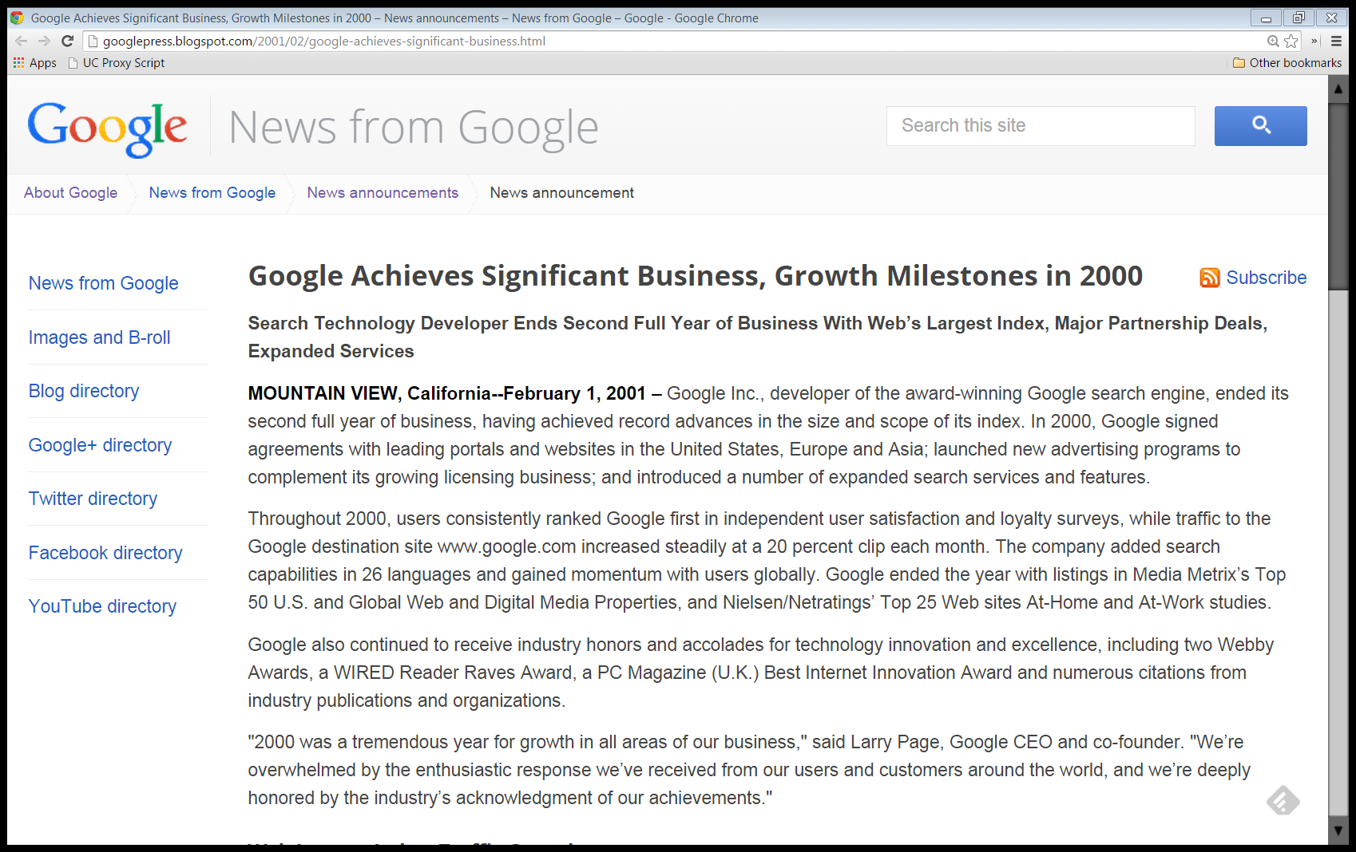
Indexing Growth
“In 2000, Google surpassed all other search engines in delivering the largest index available on the World Wide Web. Supported by an infrastructure of more than 6,000 Linux-based computer servers in multiple data centers by the end of the year, Google’s index comprised more than 1.3 billion indexed web pages.”
Google Announcement, Feb 1, 2001

Slide 98
Traffic Growth
“Traffic to the company’s destination site continually broke new records, and by the end of the year, increased to more than 27 million searches per day. Combined with traffic from its customers’ sites, Google provided more than 60 million searches per day in 2000, achieving a 3,180 percent increase from the start of the year.”
Google Announcement, Feb 1, 2001

Slide 99
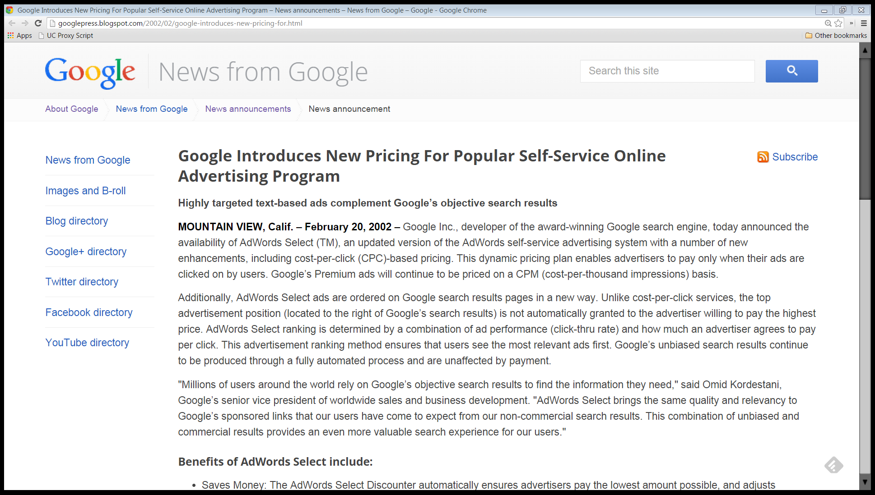
Cost Per Click Pricing
“Google Inc., developer of the award-winning Google search engine, today announced the availability of AdWords Select(TM), an updated version of the AdWords self-service advertising system with a number of new enhancements, including cost-per-click (CPC)-based pricing. This dynamic pricing plan enables advertisers to pay only when their ads are clicked on by users.”
Google Announcement, Feb 20, 2002

Slide 100
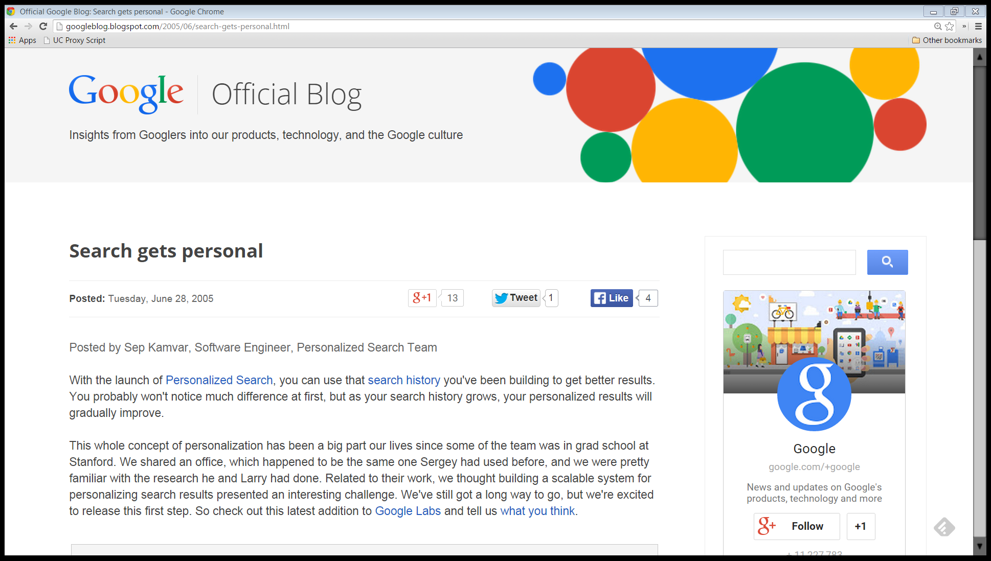
Personalized Search
“With the launch of Personalized Search, you can use that search history you’ve been building to get better results. You probably won’t notice much difference at first, but as your search history grows, your personalized results will gradually improve.”
Google Announcement, June 28, 2005

Slide 101
Personalized Search and Privacy
Identity Revelation and Google Search
Advertising Use of Identity
Anon Search
Anon Ads (Contextual Only)
Personalized Search (Bundled Opt In)
Anon Ads (Contextual Only)
Organic Search Results Use of Identity

Slide 102
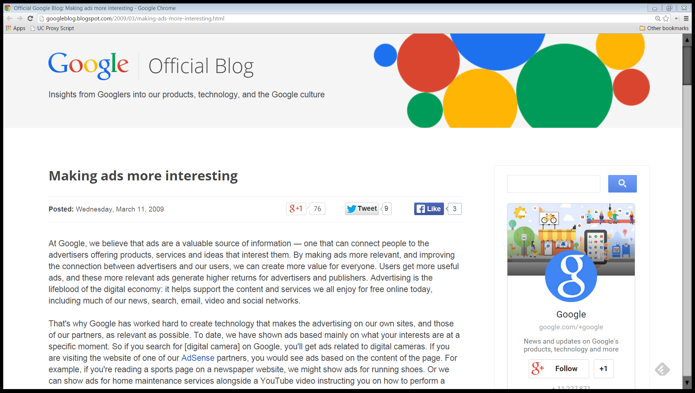
Personalized Ads
“At Google, we believe that ads are a valuable source of information — one that can connect people to the advertisers offering products, services and ideas that interest them. By making ads more relevant, and improving the connection between advertisers and our users, we can create more value for everyone.”
Google Announcement, Mar 11, 2009

Slide 103
Google and Privacy
Identity Revelation and Google Search
Anon Search
Browser-Me Ads (Opt Out)
Personalized Search (Bundled Opt In)
Browser-Me Ads (Opt Out)
Advertising Use of Identity
Anon Search
Anon Ads (Contextual Only)
Personalized Search (Bundled Opt In)
Anon Ads (Contextual Only)
Organic Search Results Use of Identity
Google Announcement, Mar 11, 2009

Slide 104
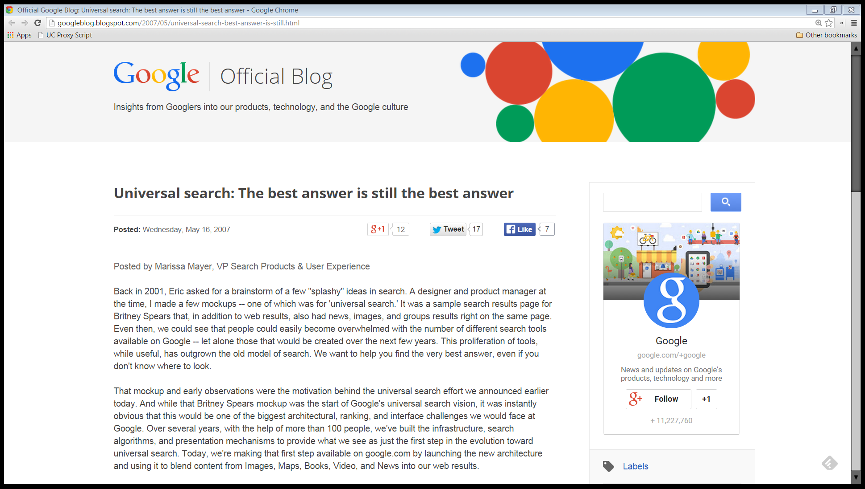
Universal Search
“Back in 2001, Eric asked for a brainstorm of a few ‘splashy’ ideas in search. A designer and product manager at the time, I made a few mockups -- one of which was for ‘universal search.’ It was a sample search results page for Britney Spears that, in addition to web results, also had news, images, and groups results right on the same page.”
Google Announcement, May 16, 2007
Notes:
OUTRO:
TAGLINE:

Slide 105
Google as Media Company
Media markets such as radio and TV
Competition always a click away and (historically) zero cash price to viewers
Exercise market power (raise prices to consumers) through advertising volume and intensity
Original Google Homepage, Nov 11, 1998

Slide 106
Media Companies and Market Power
Ad-supported media companies degrade content
For a media company with market power with viewers: have lots of ads a legitimate exercise of market power
Antitrust will bar media company with market power from using that power to maintain power or increase it
Original Google Homepage, Nov 11, 1998

Slide 107
Google as a Media Company

Slide 108
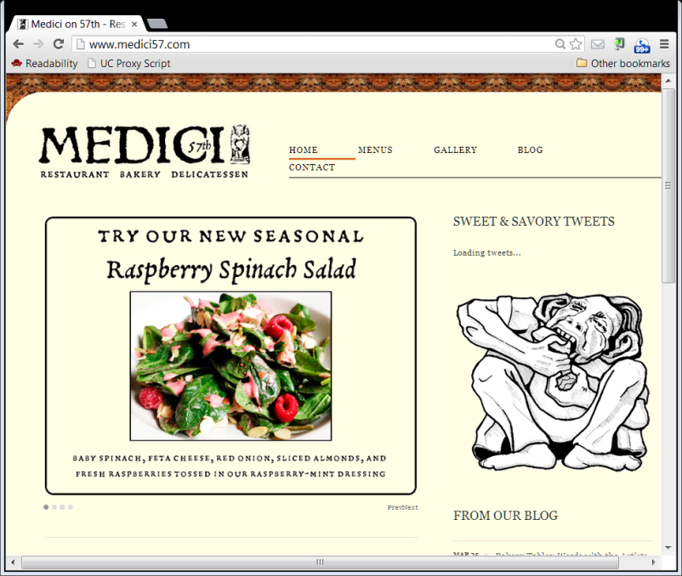
Google’s Search Model: 1st Party Content
What the restaurant says about itself
Advertisers
Non-Local
Google
Local
Consumers

Slide 109
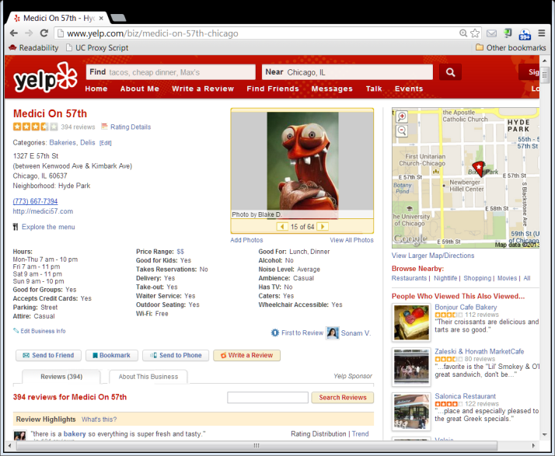
Evolution of Local: 3d Party Review Sites
Consumers as Producers
What consumers say about the restaurant
Yelp
How should we let an incumbent with a large market share (a dominant firm?) respond to entry?
Consumers as Users

Slide 110
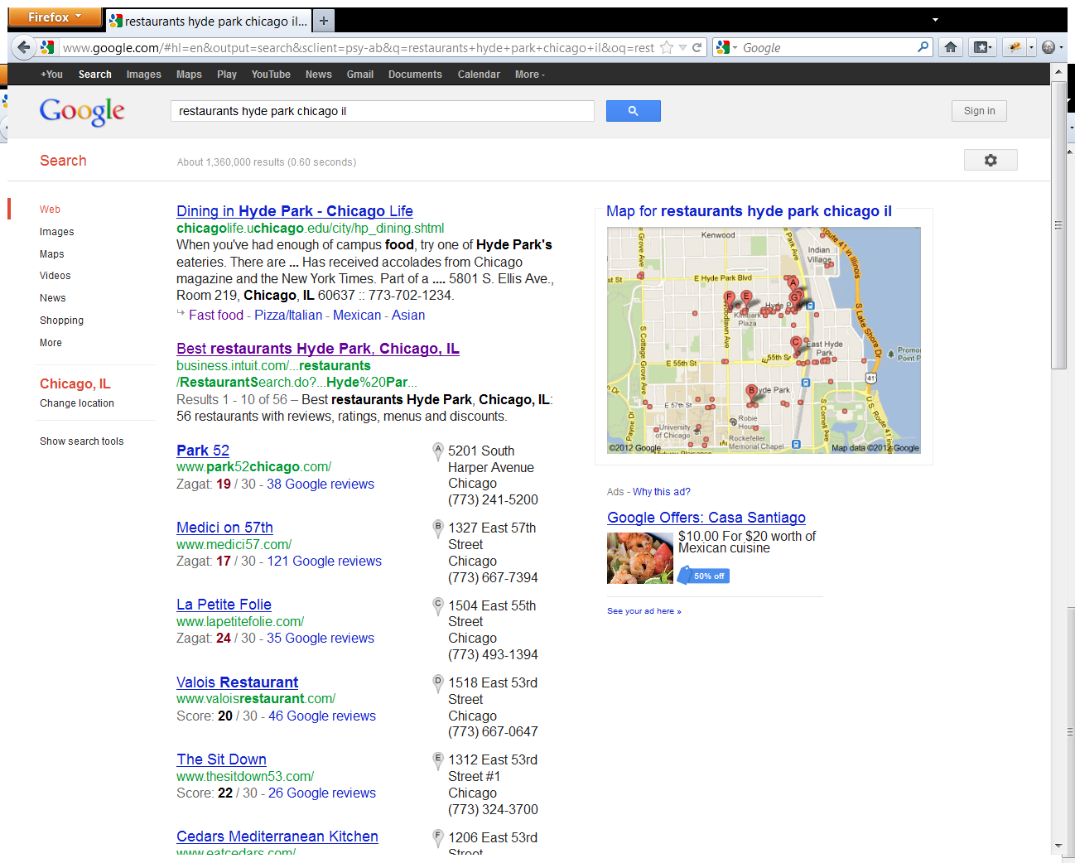
3. No Competition: Hardwired in favor of Google
1. Organic Search Competition (no $)
4. Onebox result: hardwired Google reviews; organic competition?
2. Auctions (all $)
Google Hyde Park Restaurants Search, June 25, 2012
Notes:
OUTRO: Now ready to look at how competition authorities see all of this; we start with Europe in our next segment.
TAGLINE: I’m Randy Picker at the University of Chicago. This is Internet Giants: The Law and Economics of Media Platforms.

Slide 111
1. Is scraping an act of monopoly maintenance?
2. Is Google’s hard-wiring of its results in universal search results an act of tying, monopoly maintenance or EU-style leveraging?
3. Question 2 is quite different from asking whether universal search itself is anti-competitive
Google Hyde Park Restaurants Search, June 25, 2012

Slide 112
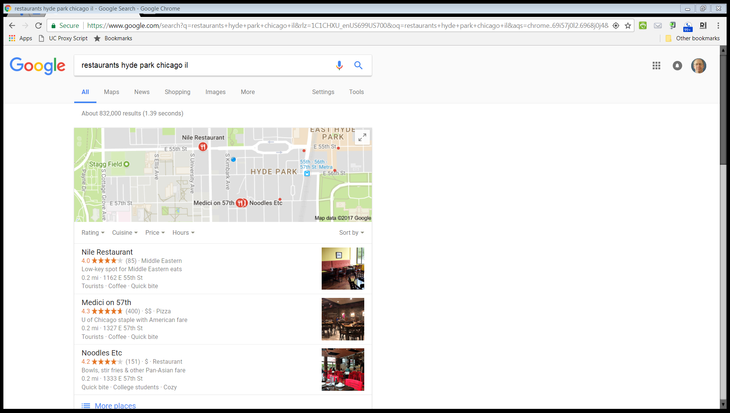
Google Hyde Park Restaurants Search, July 6, 2017

Slide 113
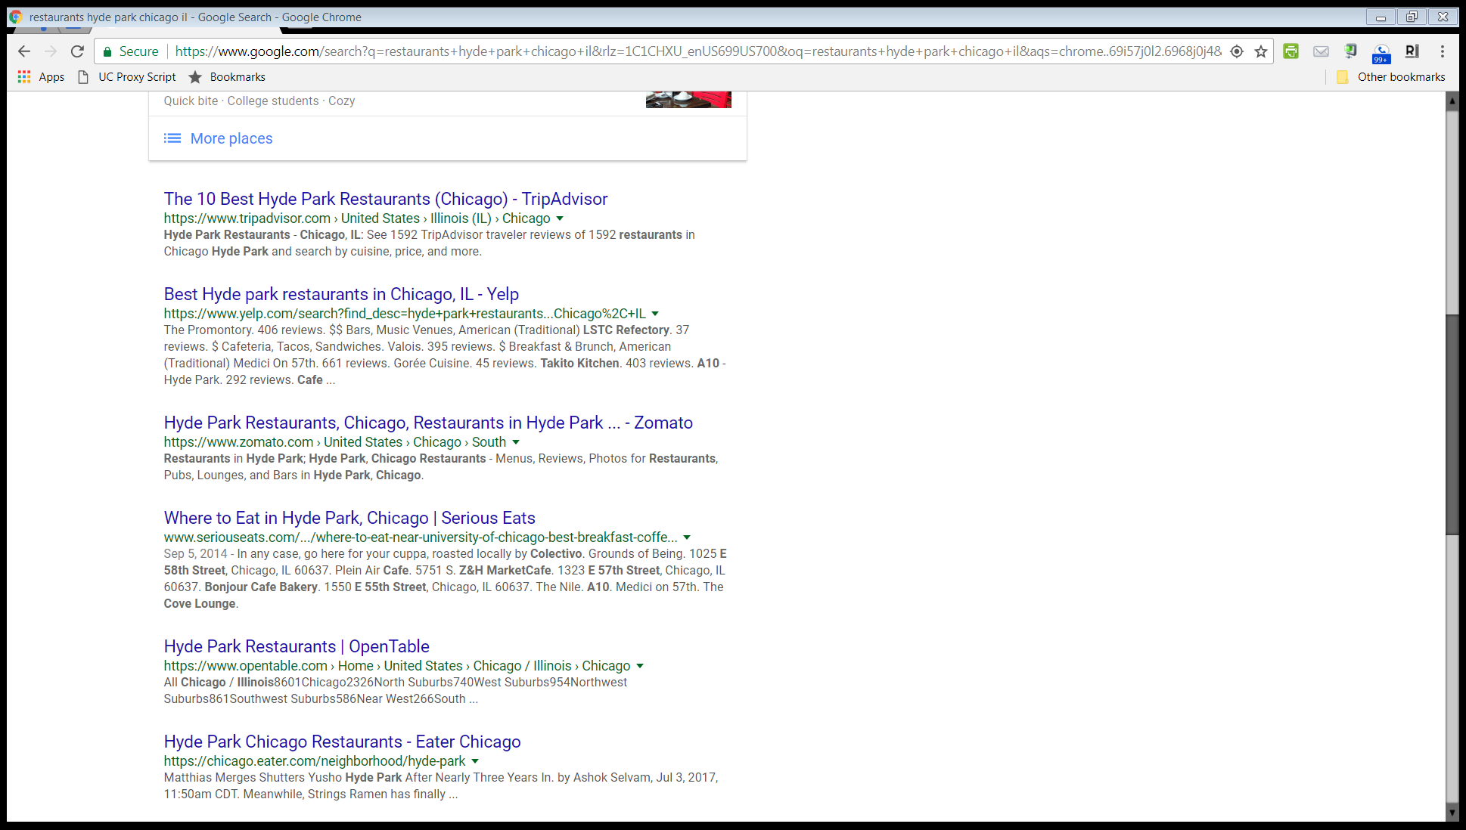
Google Hyde Park Restaurants Search, July 6, 2017

Slide 114
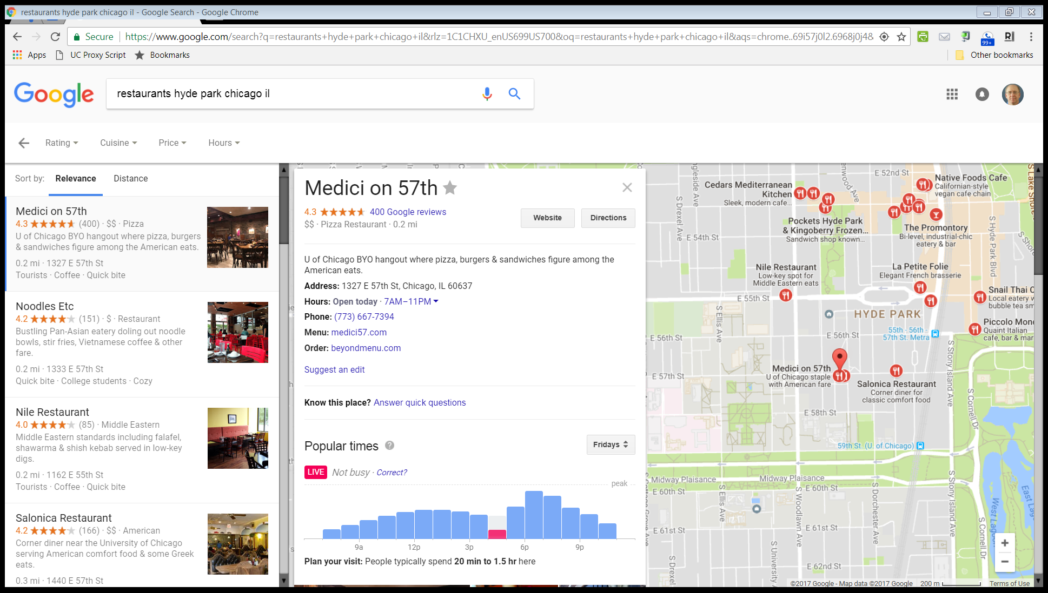
Google Hyde Park Restaurants Search, July 6, 2017

Slide 115
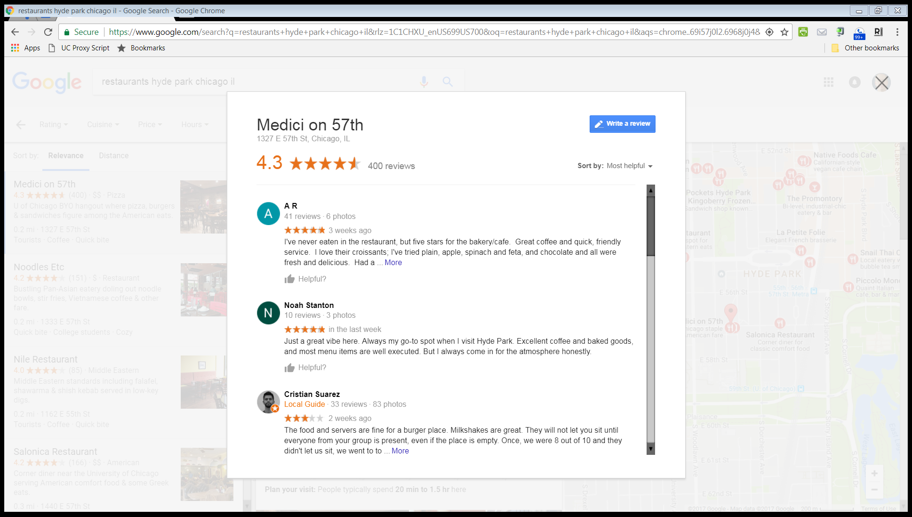
Google Hyde Park Restaurants Search, July 6, 2017

Slide 116
Competition Issues 2010-14

Slide 117
The European Competition Investigation of Google

Slide 118
Vertical Search
“The Commission will investigate whether Google has abused a dominant market position in online search by allegedly lowering the ranking of unpaid search results of competing services which are specialised in providing users with specific online content such as price comparisons (so-called vertical search services)”
EU Announcement, 30 May 2010

Slide 119
Vertical Search
“and by according preferential placement to the results of its own vertical search services in order to shut out competing services.”
EU Announcement, 30 May 2010

Slide 120
Advertising Exclusivity
“The Commission’s probe will additionally focus on allegations that Google imposes exclusivity obligations on advertising partners, preventing them from placing certain types of competing ads on their web sites, as well as on computer and software vendors, with the aim of shutting out competing search tools.”
EU Announcement, 30 May 2010

Slide 121
Advertising Portability
“Finally, it will investigate suspected restrictions on the portability of online advertising campaign data to competing online advertising platforms.”
EU Announcement, 30 May 2010

Slide 122
The FTC and Google

Slide 123
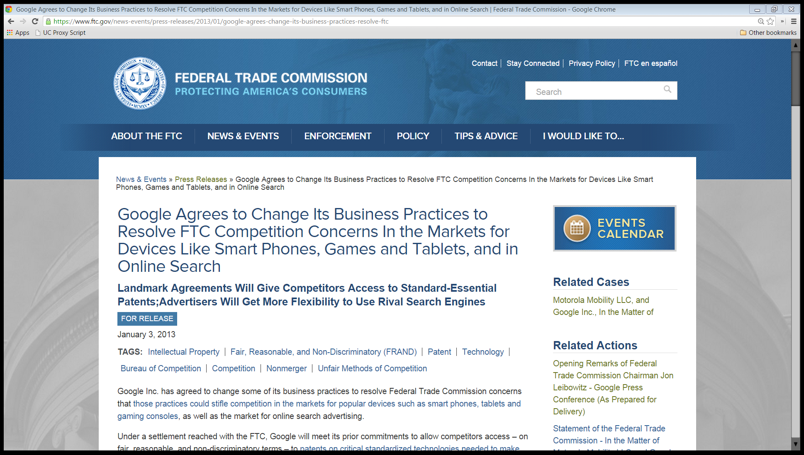
U.S. FTC, Jan 3, 2013

Slide 124
Closing of Search Bias Investigation
“We issue this Statement to explain the Commission’s unanimous decision to close the portion of its investigation relating to allegations that Google unfairly preferences its own content on the Google search results page and selectively demotes its competitors’ content from those results. Some parties refer to this alleged practice as ‘search bias.’”
U.S. FTC, Jan 3, 2013

Slide 125
Horizontal v. Vertical Search
“Google is a ‘horizontal,’ or general purpose, search engine because it seeks to cover the Internet as completely as possible, delivering a comprehensive list of results to any query.”
U.S. FTC, Jan 3, 2013

Slide 126
Horizontal v. Vertical Search
“General purpose search engines are distinct from ‘vertical’ search engines, which focus on narrowly defined categories of content such as shopping or travel.”
U.S. FTC, Jan 3, 2013

Slide 127
Horizontal v. Vertical Search
“Although vertical search engines are not wholesale substitutes for general purpose search engines, they present consumers with an alternative to Google for specific categories of searches.”
U.S. FTC, Jan 3, 2013

Slide 128
Switch from Ten Blue Links to Universal Search
“Some vertical websites alleged that Google unfairly promoted its own vertical properties through changes in its search results page, such as the introduction of the “Universal Search” box, which prominently displayed Google vertical search results in response to certain types of queries, including shopping and local.”
U.S. FTC, Jan 3, 2013

Slide 129
Switch from Ten Blue Links to Universal Search
“Prominent display of Google’s proprietary content had the collateral effect of pushing the “ten blue links” of organic search results that Google had traditionally displayed farther down the search results page.”
U.S. FTC, Jan 3, 2013

Slide 130
Better Answers Aren’t a Violation of Sec 5
“While Google’s prominent display of its own vertical search results on its search results page had the effect in some cases of pushing other results ‘below the fold,’ the evidence suggests that Google’s primary goal in introducing this content was to quickly answer, and better satisfy, its users’ search queries by providing directly relevant information.”
U.S. FTC, Jan 3, 2013

Slide 131
No Sec 5 Violation
“Based on this evidence, we do not find Google’s business practices with respect to the claimed search bias to be, on balance, demonstrably anticompetitive, and do not at this time have reason to believe that these practices violate Section 5.”
U.S. FTC, Jan 3, 2013
Notes:
OUTRO: So Google emerged unscathed. Not quite. Things got more interesting in footnote 2 of the FTC statement and we turn to that in the next segment.
TAGLINE: I’m Randy Picker at the University of Chicago. This is Internet Giants: The Law and Economics of Media Platforms.

Slide 132
The issue here wasn’t universal search or the onebox.
The issue was the hard-wired linking of the Google review sites.
Google Hyde Park Restaurants Search, June 25, 2012

Slide 133
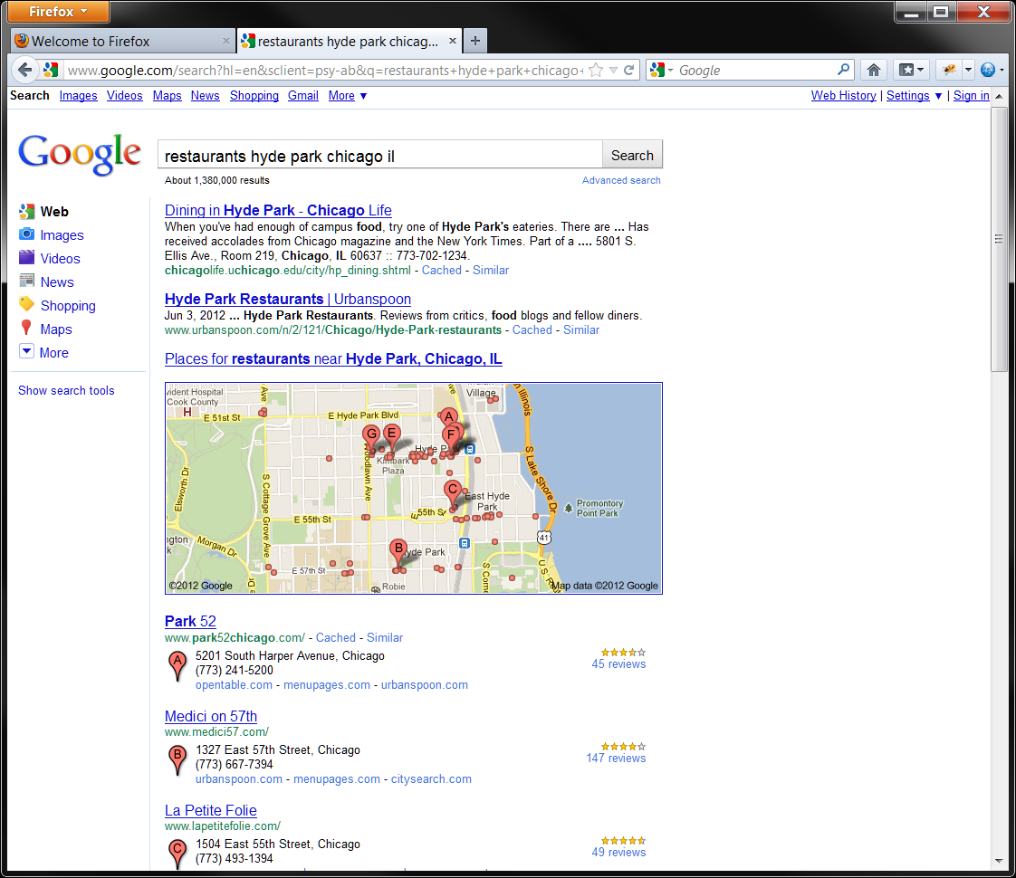
Visiting as IE6 shows design possibilities: alternate third-party homepage sites presented on first page of search results.
Google Hyde Park Restaurants Search, June 25, 2012

Slide 134
FN2: Scraping as Violation of Sec 5?
“The Commission also investigated allegations that Google had unfairly ‘scraped,’ or misappropriated, the content of certain competing websites, passed this content off as its own, and then threatened to delist these rivals entirely from Google’s search results when they protested the misappropriation of their content.”
U.S. FTC, Jan 3, 2013

Slide 135
FN2: Scraping as Violation of Sec 5?
“The Commission considered whether this conduct could have diminished the incentive of Google’s rivals to invest in bringing new and innovative content and services to the Internet in the future or reduced Google’s own incentive to innovate in the relevant markets, and if so whether this conduct was actionable as an unfair method of competition within the meaning of Section 5 of the FTC Act, 15 U.S.C. § 45.”
U.S. FTC, Jan 3, 2013

Slide 136
FN2: 3 Votes Say Violation But …
“Chairman Leibowitz, Commissioner Brill and Commissioner Ramirez found the record evidence to support strong concerns about Google’s conduct in this regard, and Google has committed to refrain from this conduct in the future. … While Commissioner Ramirez is pleased that Google has decided to change certain of its practices, she objects to the form of the commitments made by Google.”
U.S. FTC, Jan 3, 2013

Slide 137
FN2: 3 Votes Say Violation But …
Important to understand that scraping is a type of portability and portability can be critical to competition
Scraping solves coordination problem faced by users of sites like Yelp
U.S. FTC, Jan 3, 2013

Slide 138
Back to Europe

Slide 139
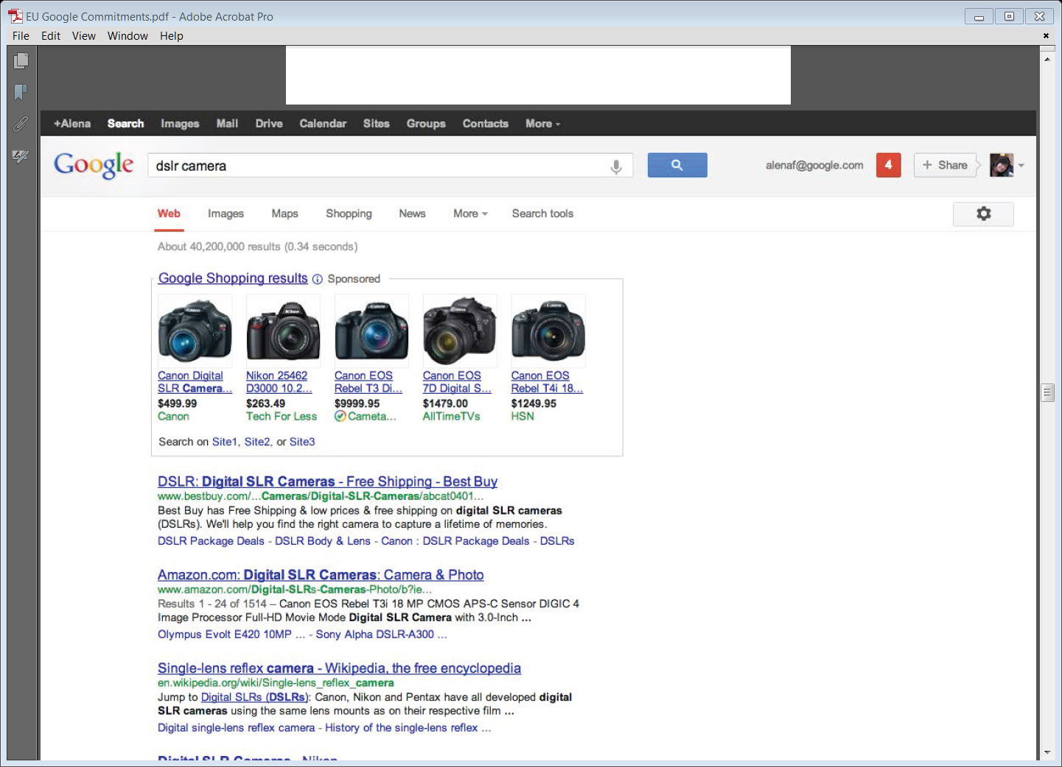
Google’s Proposed Commitment to EU, Apr 3, 2013

Slide 140
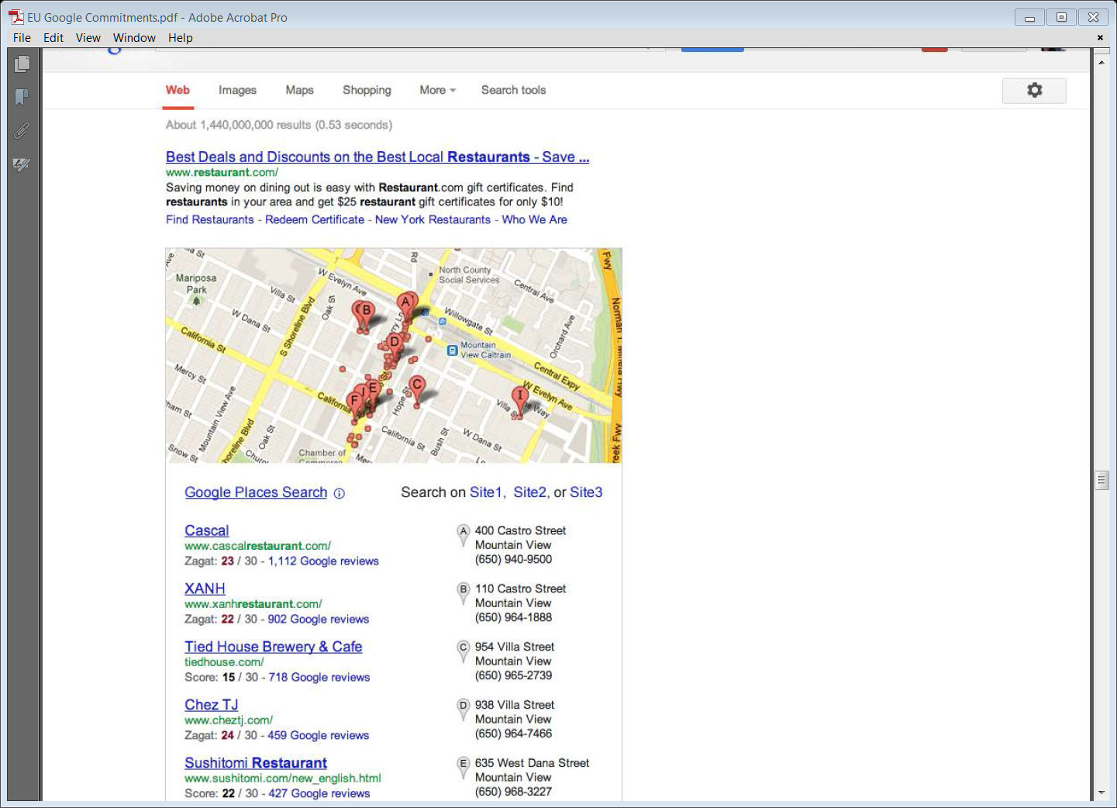
Google’s Proposed Commitment to EU, Apr 3, 2013

Slide 141
Google’s Proposed Commitment to EU, Oct 21, 2013

Slide 142
Google’s Proposed Commitment to EU, Oct 21, 2013

Slide 143
Google’s Proposed Commitment to EU, Oct 21, 2013

Slide 144
The EC and Google Shopping

Slide 145
Shopping on Google
Notes:
INTRO: Let’s go shopping.

Slide 146
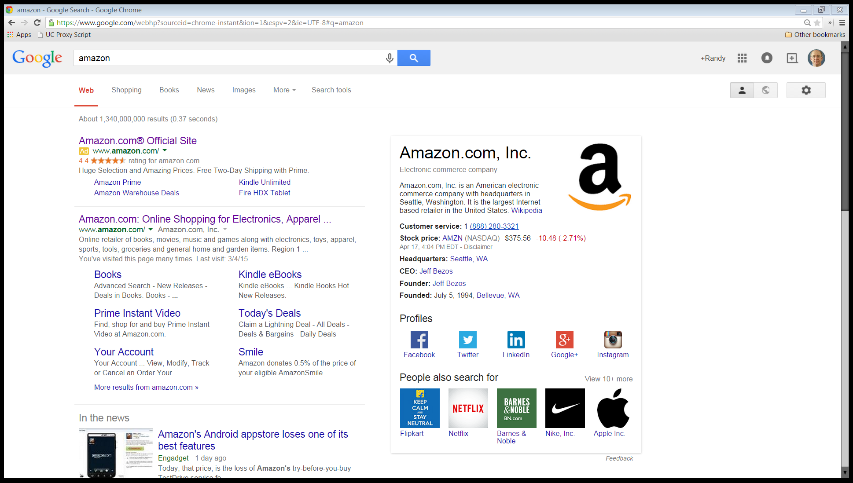
Google search: “amazon”: on Apr 18, 2015

Slide 147
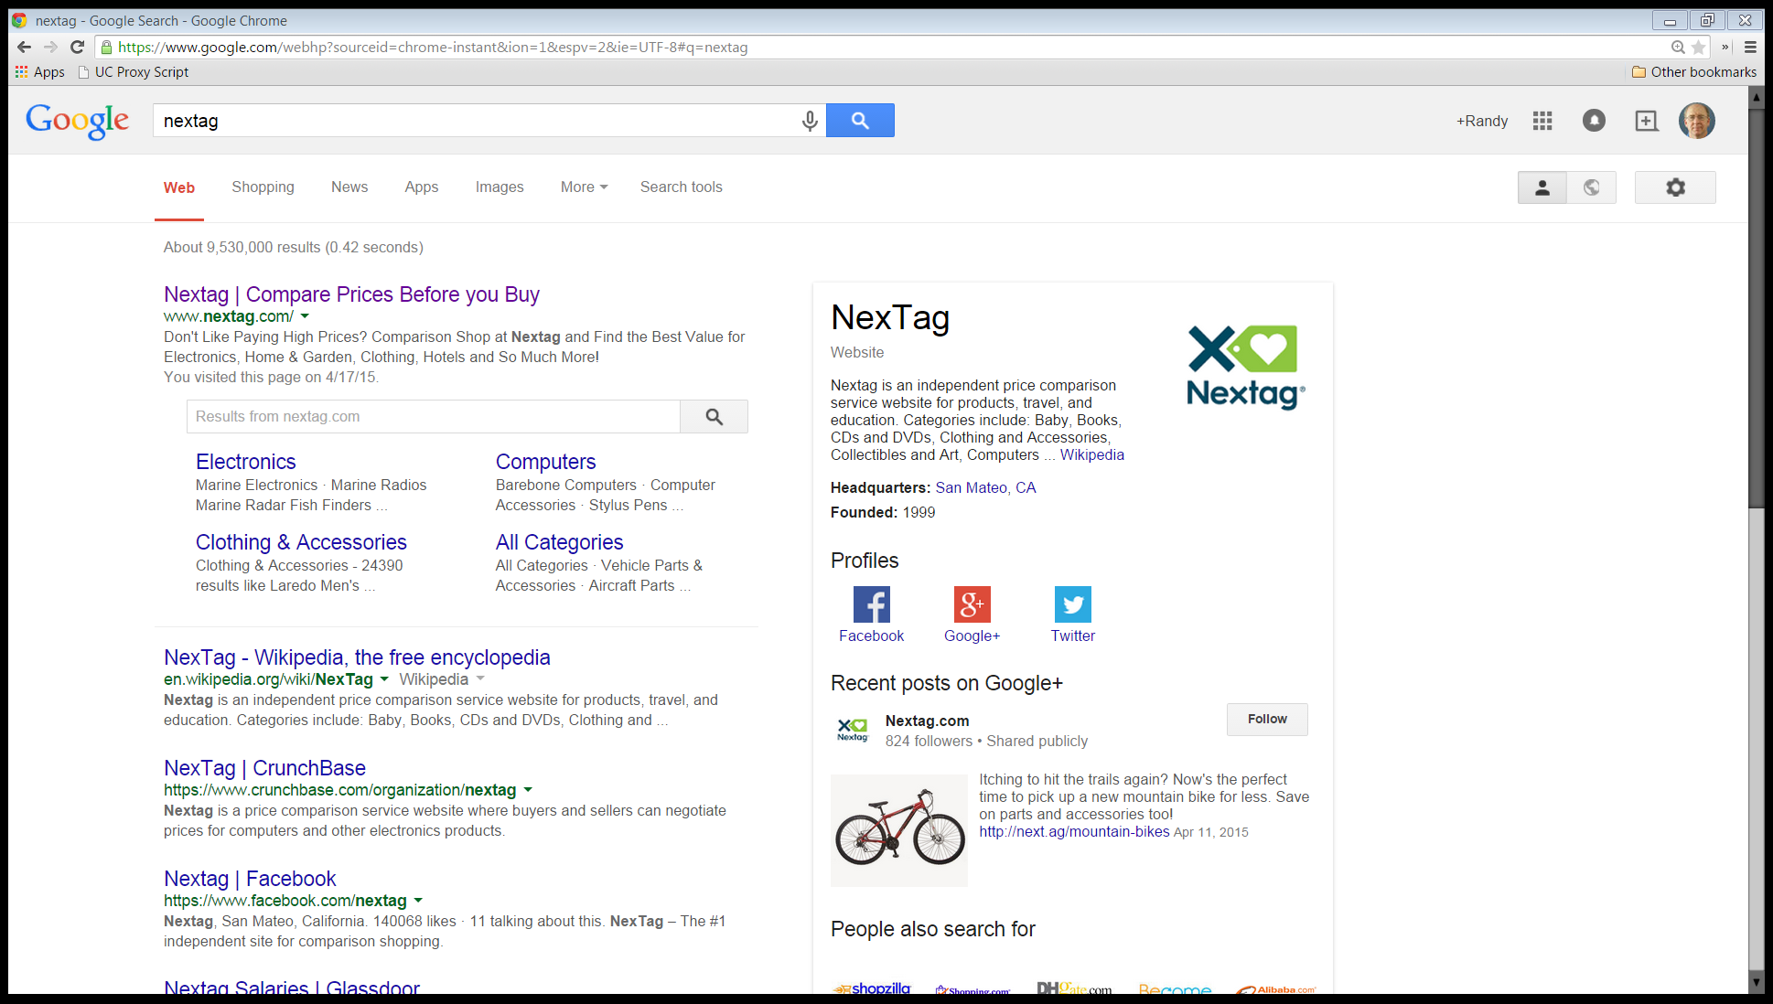
Google search: “nextag”: on Apr 18, 2015

Slide 148
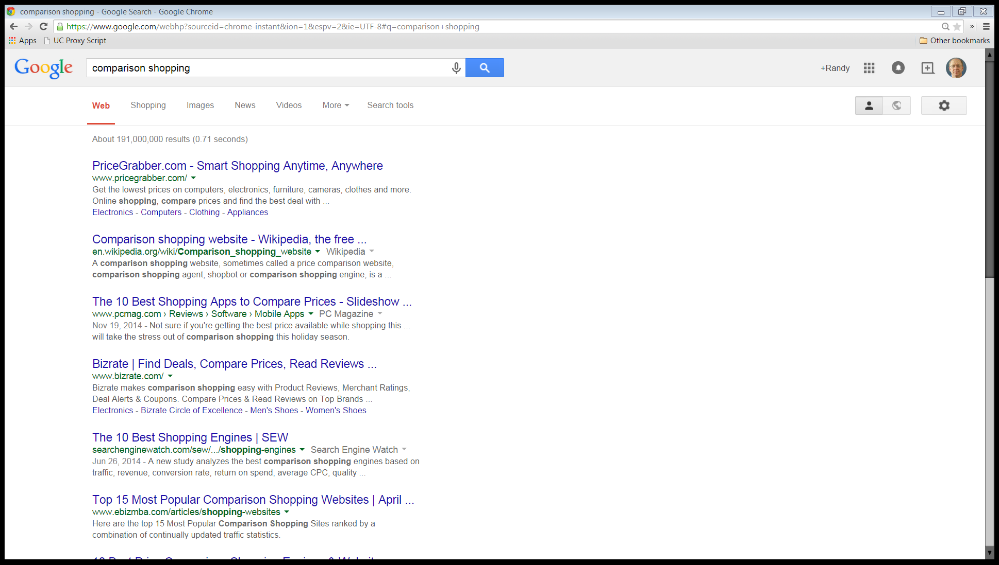
Google search: “comparison shopping”: on Apr 18, 2015

Slide 149
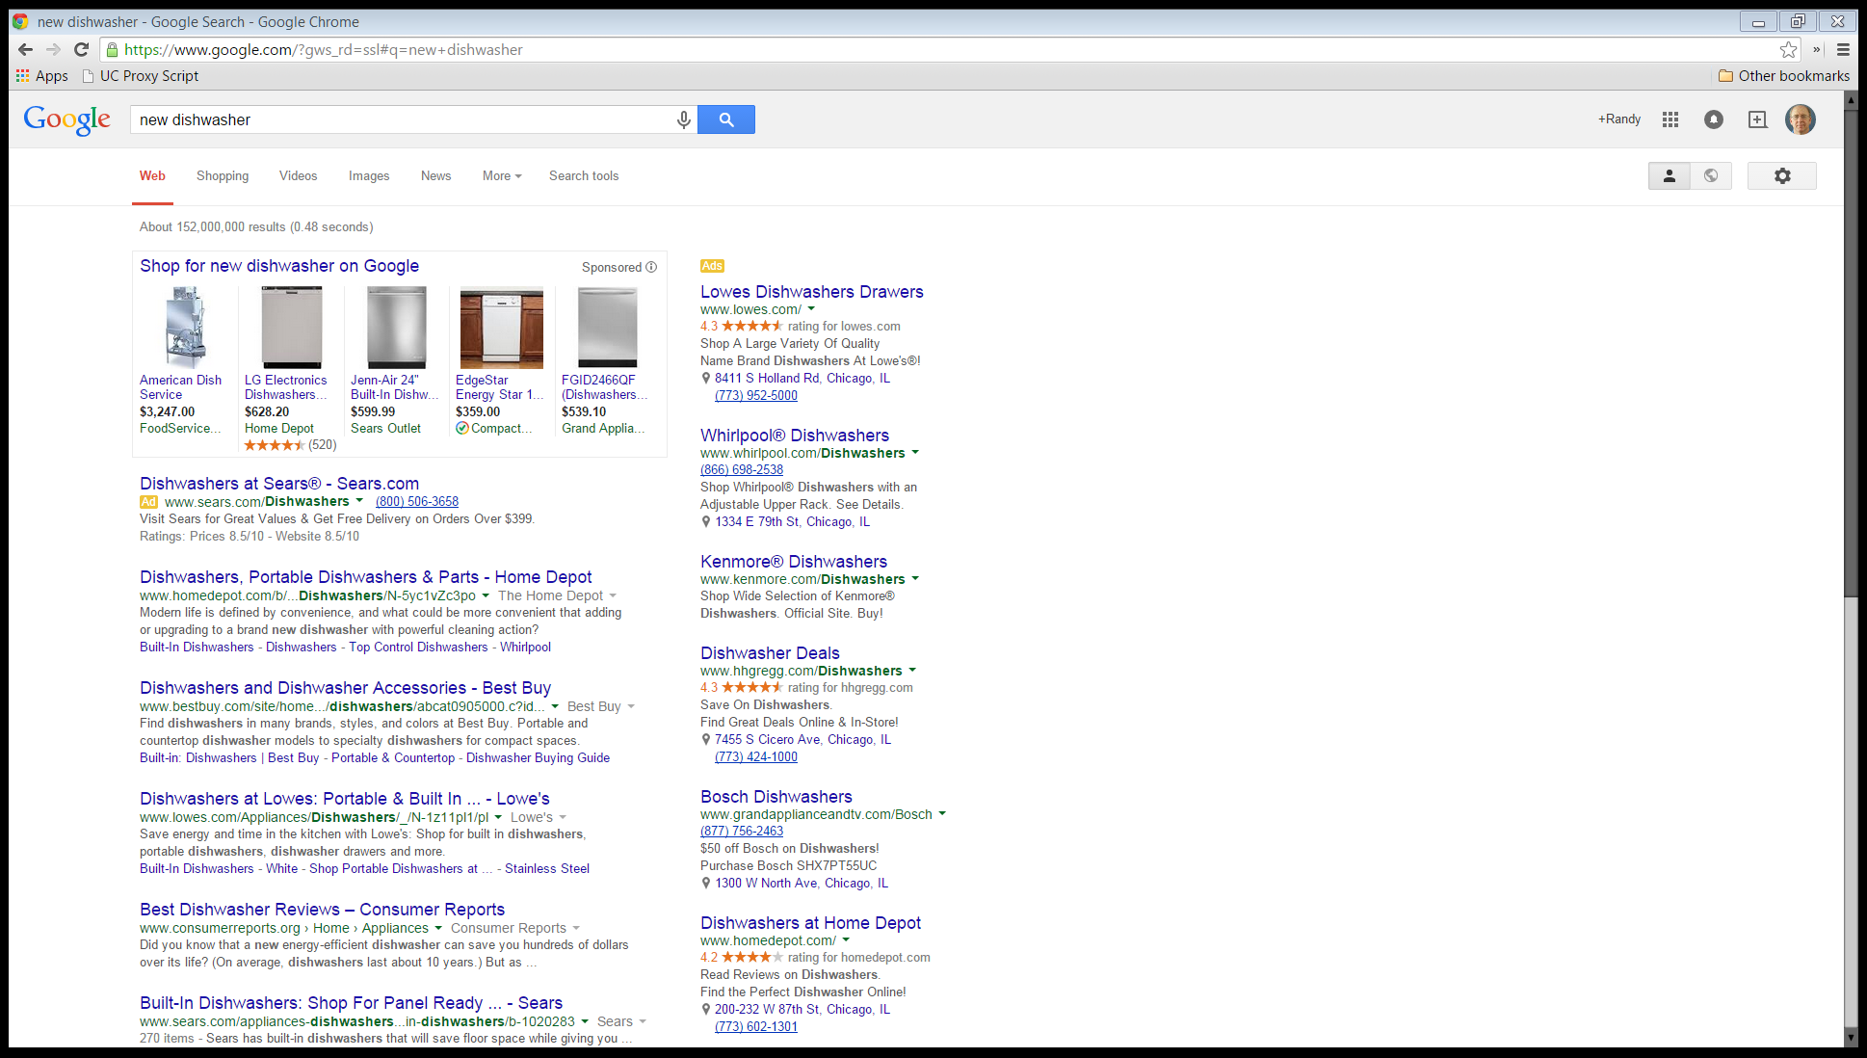
Search on Google: “new dishwasher”: Apr 16, 2015

Slide 150
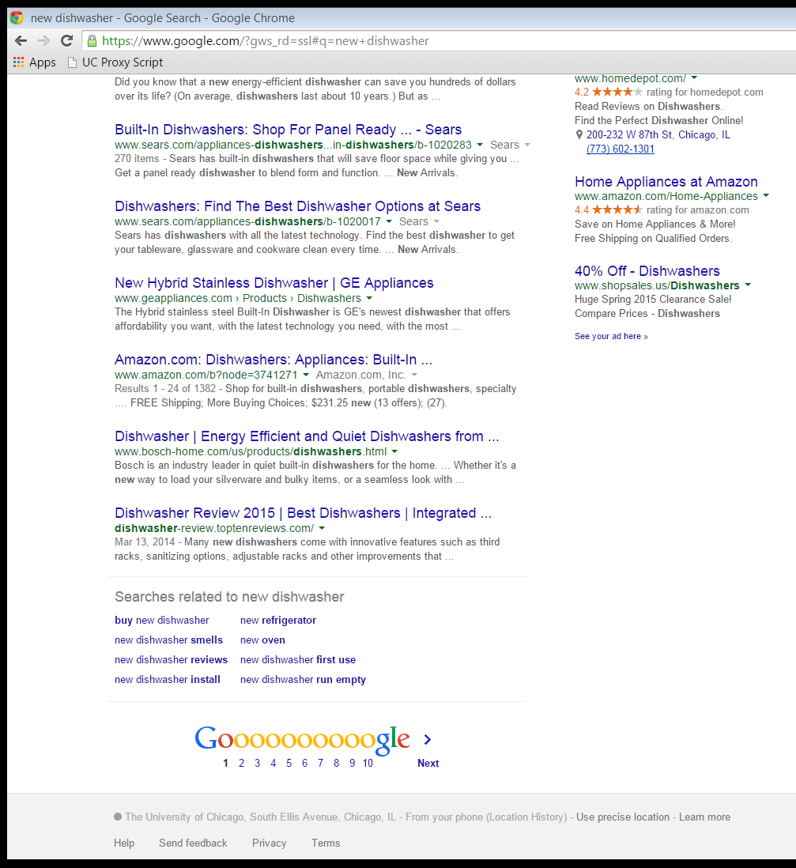
Search on Google: “new dishwasher”: Apr 16, 2015

Slide 151
Google Shopping: A New Data Model
Notes:
INTRO: What exactly is Google shopping and why does it matter?

Slide 152
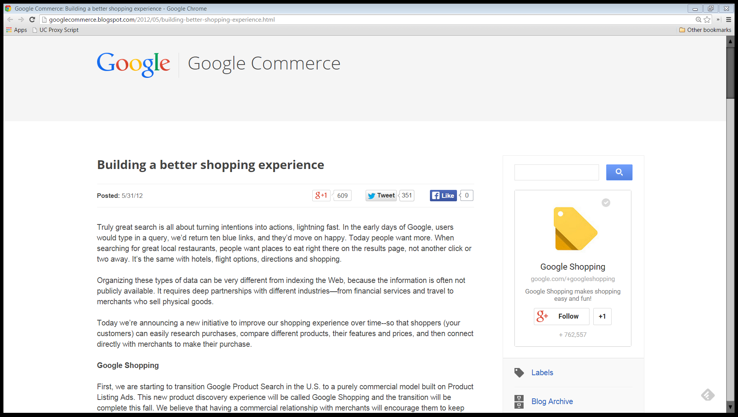
Answers, Not Links
“Truly great search is all about turning intentions into actions, lightning fast. In the early days of Google, users would type in a query, we’d return ten blue links, and they’d move on happy. Today people want more.”
Google Commerce Blog, May 31, 2012

Slide 153
Answers, Not Links
“When searching for great local restaurants, people want places to eat right there on the results page, not another click or two away. It’s the same with hotels, flight options, directions and shopping.”
Google Commerce Blog, May 31, 2012

Slide 154
A Different Data Model
“Organizing these types of data can be very different from indexing the Web, because the information is often not publicly available. It requires deep partnerships with different industries—from financial services and travel to merchants who sell physical goods.”
Google Commerce Blog, May 31, 2012

Slide 155
Ranking Based on Relevance and Bid Price
“First, we are starting to transition Google Product Search in the U.S. to a purely commercial model built on Product Listing Ads. … Ranking in Google Shopping, when the full transition is complete this fall, will be based on a combination of relevance and bid price--just like Product Listing Ads today.”
Google Commerce Blog, May 31, 2012

Slide 156
Sponsored Results
Search on Google: “new dishwasher”: Apr 16, 2015

Slide 157
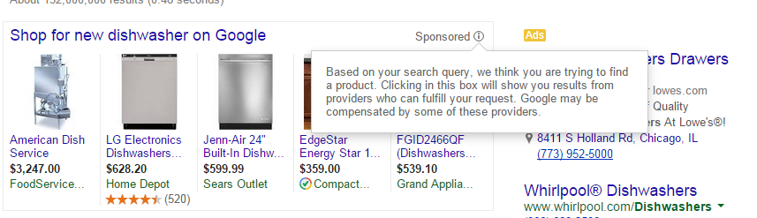
Sponsored Results
Search on Google: “new dishwasher”: Apr 16, 2015

Slide 158
15 April 2015: The EU Statement of Objections

Slide 159
“The Commission is concerned that users do not necessarily see the most relevant results in response to queries – to the detriment of consumers and rival comparison shopping services, as well as stifling innovation.”
European Commission Fact Sheet, 15 Apr 2015

Slide 160
Google Market Share in Europe
“Google has a dominant position in providing general online search services throughout the EEA, with market shares above 90% in most EEA countries.”
European Commission Fact Sheet, 15 Apr 2015

Slide 161
Five Preliminary Conclusions: Google Shopping Favored
“Google systematically positions and prominently displays its comparison shopping service in its general search results pages, irrespective of its merits. This conduct started in 2008.”
European Commission Fact Sheet, 15 Apr 2015

Slide 162
Five Preliminary Conclusions: Google Shopping Favored
“Google does not apply to its own comparison shopping service the system of penalties, which it applies to other comparison shopping services on the basis of defined parameters, and which can lead to the lowering of the rank in which they appear in Google’s general search results pages.”
European Commission Fact Sheet, 15 Apr 2015

Slide 163
Five Preliminary Conclusions: Preference Matters
“Froogle, Google’s first comparison shopping service, did not benefit from any favourable treatment, and performed poorly.”
European Commission Fact Sheet, 15 Apr 2015

Slide 164
Five Preliminary Conclusions: Preference Matters
“As a result of Google’s systematic favouring of its subsequent comparison shopping services ‘Google Product Search’ and ‘Google Shopping’, both experienced higher rates of growth, to the detriment of rival comparison shopping services.”
European Commission Fact Sheet, 15 Apr 2015

Slide 165
Five Preliminary Conclusions: Harms Consumers
“Google’s conduct has a negative impact on consumers and innovation. It means that users do not necessarily see the most relevant comparison shopping results in response to their queries, and that incentives to innovate from rivals are lowered as they know that however good their product, they will not benefit from the same prominence as Google’s product.”
European Commission Fact Sheet, 15 Apr 2015

Slide 166
Remedy?
“The Statement of Objections takes the preliminary view that in order to remedy the conduct, Google should treat its own comparison shopping service and those of rivals in the same way. This would not interfere with either the algorithms Google applies or how it designs its search results pages.”
European Commission Fact Sheet, 15 Apr 2015

Slide 167
Remedy?
“It would, however, mean that when Google shows comparison shopping services in response to a user’s query, the most relevant service or services would be selected to appear in Google’s search results pages.”
European Commission Fact Sheet, 15 Apr 2015

Slide 168
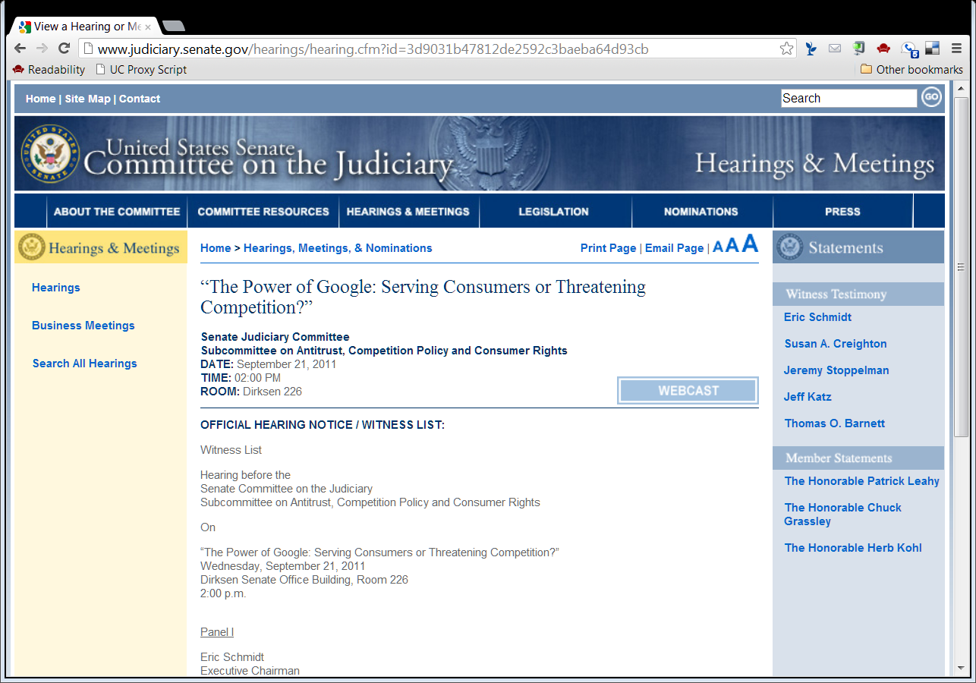
Google’s Own Model of Neutrality
Schmidt Testimony Response: “With respect to a page on a Google-owned site such as YouTube that is crawled and ranked within our search results, such a page is not placed higher because it is on a site owned by Google than an identical page would be if it were owned by another business.”
Senate Judiciary Hearing, Sept 21, 2011

Slide 169
27 June 2017: EC Google Shopping Fine

Slide 170
€2.42 Billion Fine
European Commission Press Release, 27 June 2017

Slide 171
Froogle Entry in Comparison Shopping Market
“In 2004 Google entered the separate market of comparison shopping in Europe, with a product that was initially called ‘Froogle’, re-named ‘Google Product Search’ in 2008 and since 2013 has been called ‘Google Shopping’.”
European Commission Press Release, 27 June 2017

Slide 172
Froogle as a Product
“It allows consumers to compare products and prices online and find deals from online retailers of all types, including online shops of manufacturers, platforms (such as Amazon and eBay), and other re-sellers.”
European Commission Press Release, 27 June 2017

Slide 173
Froogle Failure
“When Google entered comparison shopping markets with Froogle, there were already a number of established players. Contemporary evidence from Google shows that the company was aware that Froogle’s market performance was relatively poor (one internal document from 2006 stated ‘Froogle simply doesn’t work’).”
European Commission Press Release, 27 June 2017

Slide 174
Self-Preferencing
“From 2008, Google began to implement in European markets a fundamental change in strategy to push its comparison shopping service. This strategy relied on Google’s dominance in general internet search, instead of competition on the merits in comparison shopping markets:”
European Commission Press Release, 27 June 2017

Slide 175
Self-Preferencing
“Google has systematically given prominent placement to its own comparison shopping service: when a consumer enters a query into the Google search engine in relation to which Google’s comparison shopping service wants to show results, these are displayed at or near the top of the search results.”
European Commission Press Release, 27 June 2017

Slide 176
Demoted Other Products
“Google has demoted rival comparison shopping services in its search results: rival comparison shopping services appear in Google’s search results on the basis of Google’s generic search algorithms.”
European Commission Press Release, 27 June 2017

Slide 177
Google’s Algorithms Do This
“Google has included a number of criteria in these algorithms, as a result of which rival comparison shopping services are demoted.”
European Commission Press Release, 27 June 2017

Slide 178
Demoted Other Products
“Evidence shows that even the most highly ranked rival service appears on average only on page four of Google’s search results, and others appear even further down. Google’s own comparison shopping service is not subject to Google’s generic search algorithms, including such demotions.”
European Commission Press Release, 27 June 2017

Slide 179
And In Pictures
European Commission Press Release, 27 June 2017

Slide 180
Impact of Practices
“Given Google’s dominance in general internet search, its search engine is an important source of traffic. As a result of Google’s illegal practices, traffic to Google’s comparison shopping service increased significantly, whilst rivals have suffered very substantial losses of traffic on a lasting basis.”
European Commission Press Release, 27 June 2017

Slide 181
Impact of Practices
“Since the beginning of each abuse, Google’s comparison shopping service has increased its traffic 45-fold in the United Kingdom, 35-fold in Germany, 19-fold in France, 29-fold in the Netherlands, 17-fold in Spain and 14-fold in Italy.”
European Commission Press Release, 27 June 2017

Slide 182
Impact of Practices
“Following the demotions applied by Google, traffic to rival comparison shopping services on the other hand dropped significantly. For example, the Commission found specific evidence of sudden drops of traffic to certain rival websites of 85% in the United Kingdom, up to 92% in Germany and 80% in France. …”
European Commission Press Release, 27 June 2017

Slide 183
Impact of Practices
“In combination with the Commission’s other findings, this shows that Google’s practices have stifled competition on the merits in comparison shopping markets, depriving European consumers of genuine choice and innovation.”
European Commission Press Release, 27 June 2017

Slide 184
Equal Treatment Remedy
“The Commission Decision requires Google to stop its illegal conduct within 90 days of the Decision and refrain from any measure that has the same or an equivalent object or effect. In particular, the Decision orders Google to comply with the simple principle of giving equal treatment to rival comparison shopping services and its own service:”
European Commission Press Release, 27 June 2017

Slide 185
Equal Treatment Remedy
“Google has to apply the same processes and methods to position and display rival comparison shopping services in Google’s search results pages as it gives to its own comparison shopping service.”
European Commission Press Release, 27 June 2017

Slide 186
EC Monitoring
“It is Google’s sole responsibility to ensure compliance and it is for Google to explain how it intends to do so. Regardless of which option Google chooses, the Commission will monitor Google’s compliance closely and Google is under an obligation to keep the Commission informed of its actions (initially within 60 days of the Decision, followed by periodic reports).”
European Commission Press Release, 27 June 2017

Slide 187
Other Pending Cases
“The Commission has already come to the preliminary conclusion that Google has abused a dominant position in two other cases, which are still being investigated.”
European Commission Press Release, 27 June 2017

Slide 188
Other Pending Cases
“These concern: 1) the Android operating system, where the Commission is concerned that Google has stifled choice and innovation in a range of mobile apps and services by pursuing an overall strategy on mobile devices to protect and expand its dominant position in general internet search; and”
European Commission Press Release, 27 June 2017

Slide 189
Other Pending Cases
“2) AdSense, where the Commission is concerned that Google has reduced choice by preventing third-party websites from sourcing search ads from Google's competitors.”
European Commission Press Release, 27 June 2017

Slide 190
Other Pending Cases
“The Commission also continues to examine Google’s treatment in its search results of other specialised Google search services. Today’s Decision is a precedent which establishes the framework for the assessment of the legality of this type of conduct. At the same time, it does not replace the need for a case-specific analysis to account for the specific characteristics of each market.”
European Commission Press Release, 27 June 2017

Slide 191
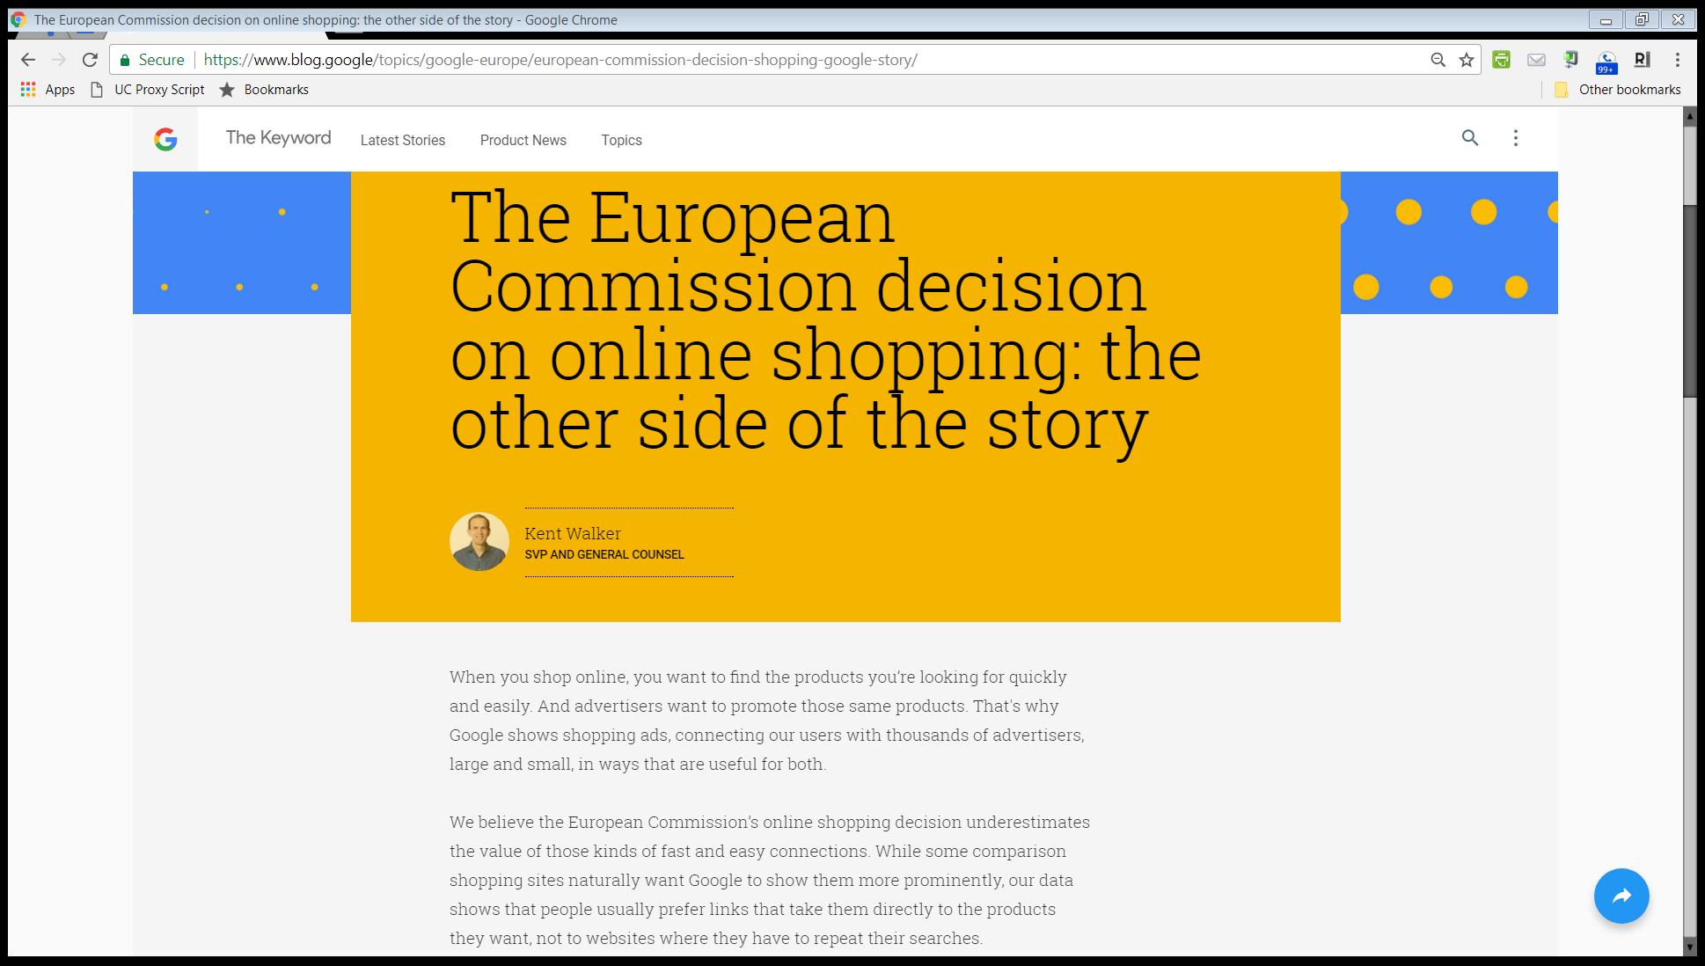
Answers Not Links
“When you shop online, you want to find the products you’re looking for quickly and easily. And advertisers want to promote those same products. That’s why Google shows shopping ads, connecting our users with thousands of advertisers, large and small, in ways that are useful for both.”
Google Response, 27 June 2017

Slide 192
Answers Not Links
“We believe the European Commission’s online shopping decision underestimates the value of those kinds of fast and easy connections. While some comparison shopping sites naturally want Google to show them more prominently, our data shows that people usually prefer links that take them directly to the products they want, not to websites where they have to repeat their searches.”
Google Response, 27 June 2017

Slide 193
Amazon!
“When the Commission asks why some comparison websites have not done as well as others, we think it should consider the many sites that have grown in this period—including platforms like Amazon and eBay. With its comparison tools, reviews, millions of retailers, and vast range of products from sneakers to groceries, Amazon is a formidable competitor and has become the first port of call for product searches.”
Google Response, 27 June 2017

Slide 194
Amazon!
“And as Amazon has grown, it’s natural that some comparison services have proven less popular than others. We compete with Amazon and other sites for shopping-related searches by showing ever more useful product information.”
Google Response, 27 June 2017

Slide 195
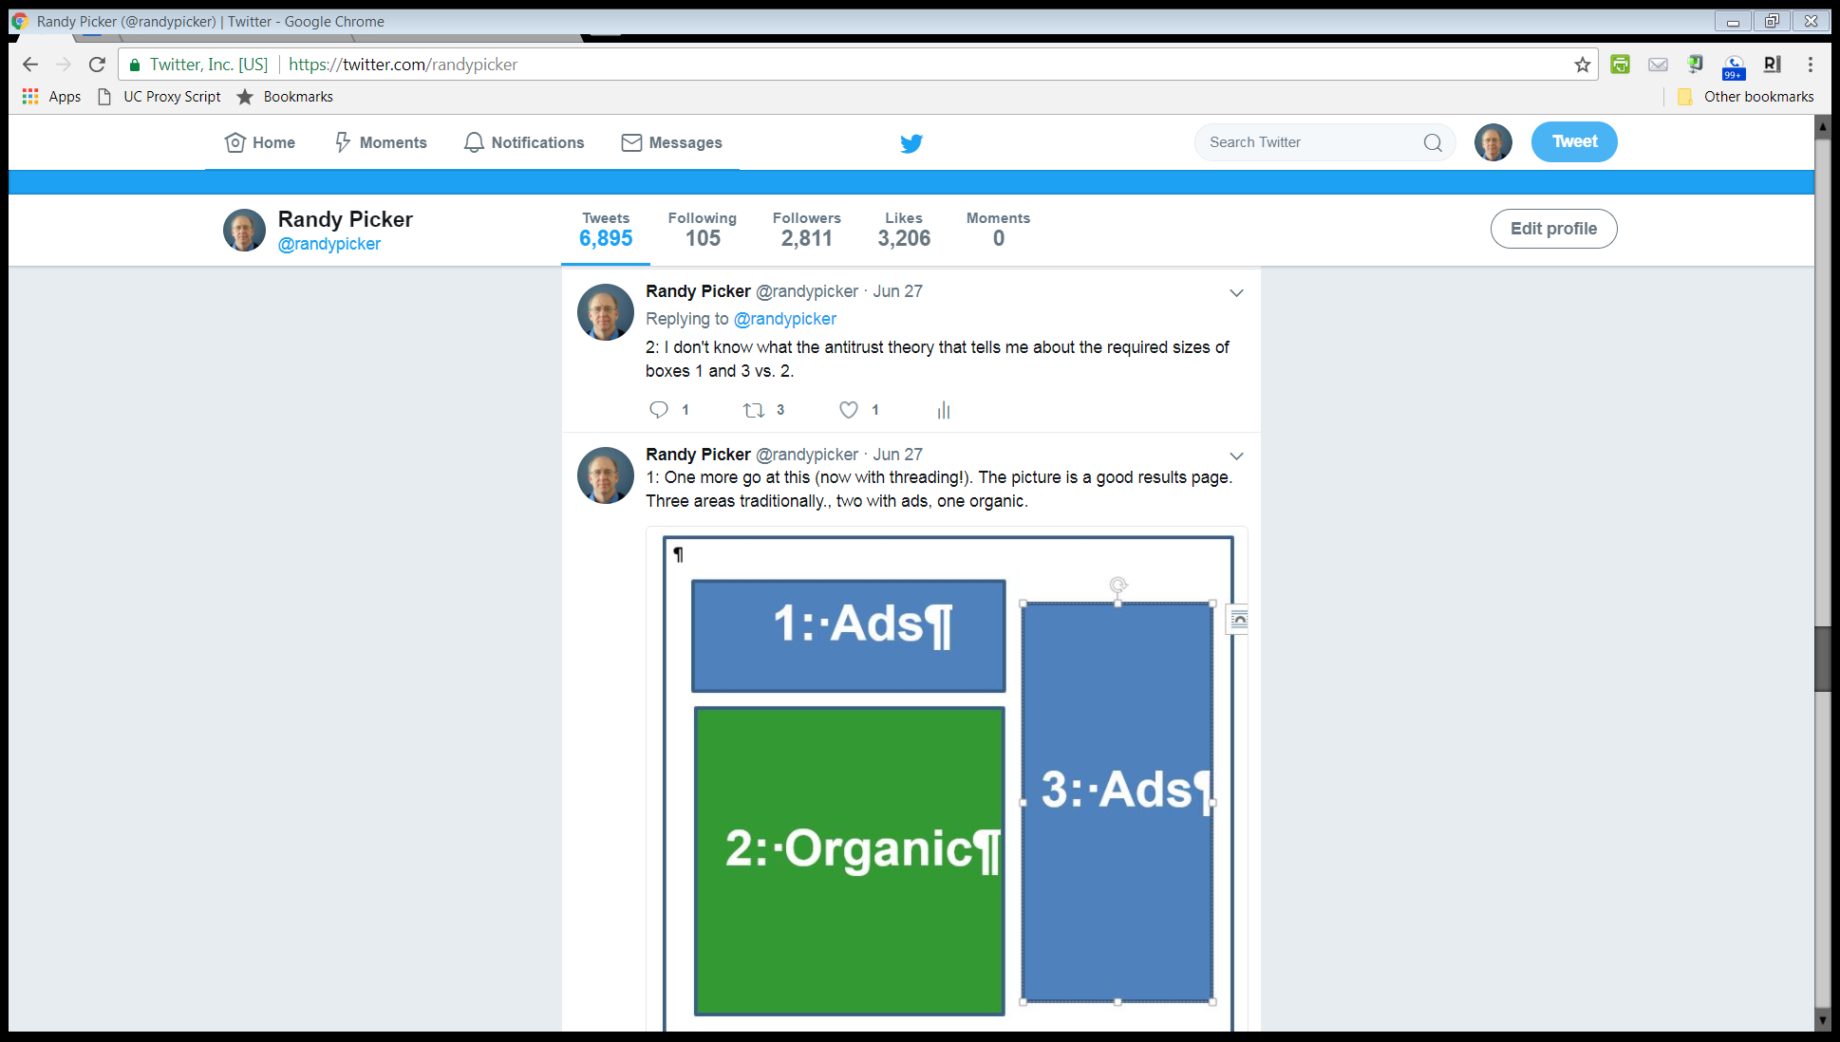
Twitter: @randypicker, 27 June 2017

Slide 196
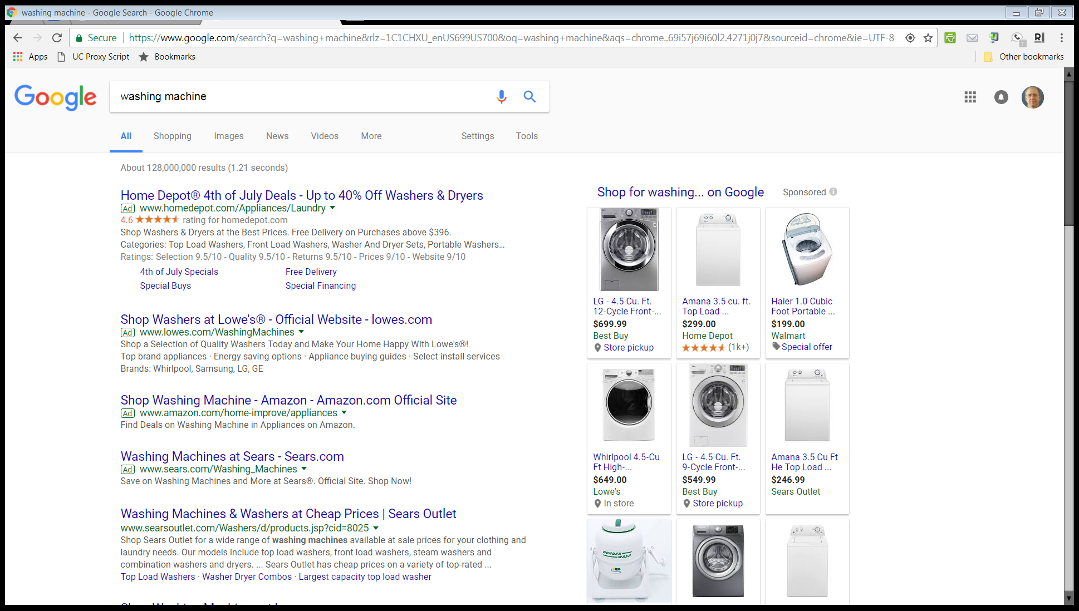
Google Search: “washing machine”: 7 July 2017

Slide 197
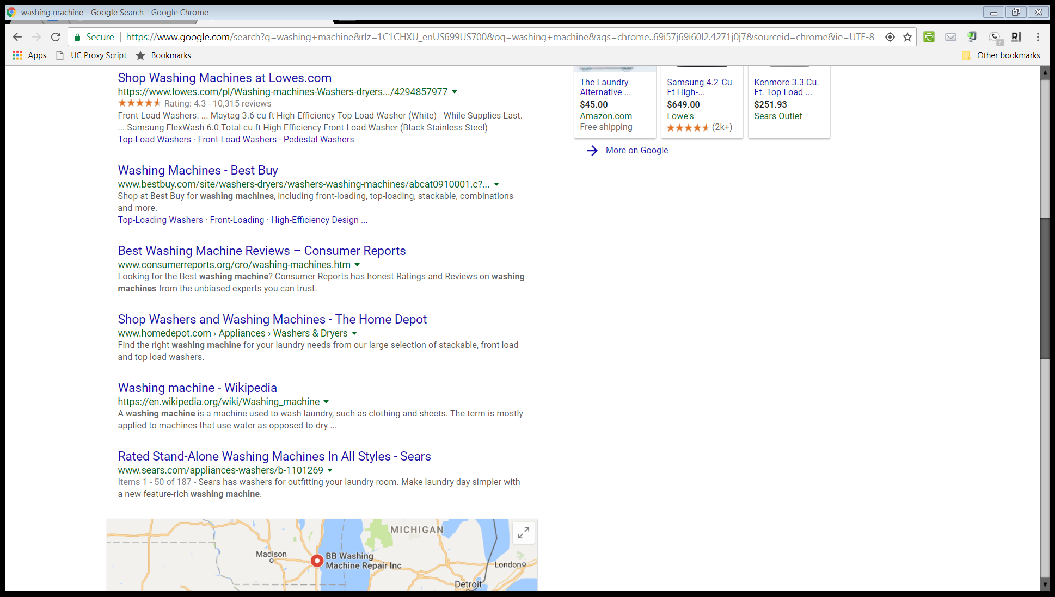
Google Search: “washing machine”: 7 July 2017

Slide 198
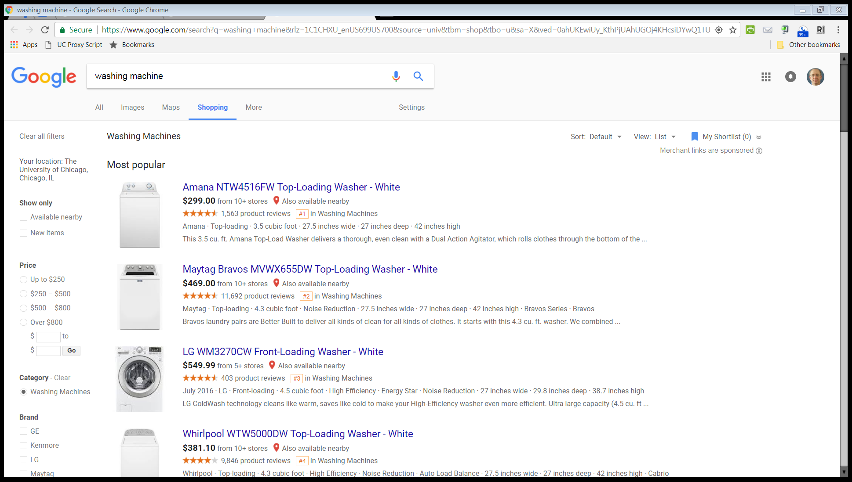
Google Search: “washing machine”: 7 July 2017

Slide 199
Single slot can be shared in a rich statistical fashion; not a technical problem.
But the antitrust question is what is the basis for forcing that sharing?
Google Search: “washing machine”: 7 July 2017

Slide 200
EC fine was €2.42 billion. Need to see decision to assess that, but …
Fine should only be based on incremental revenues meaning sponsored block here on right relative to revenues of running traditional Google ads as on left here.
Google Search: “washing machine”: 7 July 2017

